Slide 1
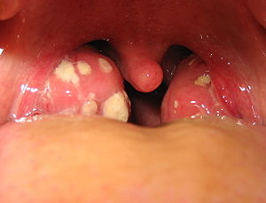
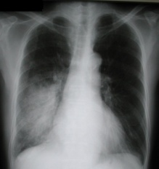
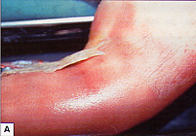
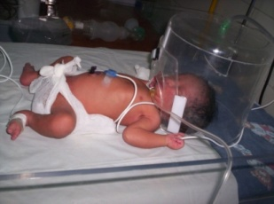
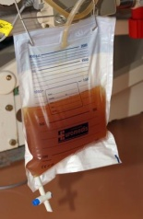
Bacterial diseases
Professor Shiranee Sriskandan
Course code (MBBS) : Microbiology 2
Course code (BMS) : IIP-L10

Slide 2
Learning objectives
List the potential sources and possible routes of infection by bacteria
Explain the concepts of infectivity and virulence and define the term infective dose
Give examples of bacterial pathogens transmitted by different routes and outline the ways in which they cause disease

Slide 3
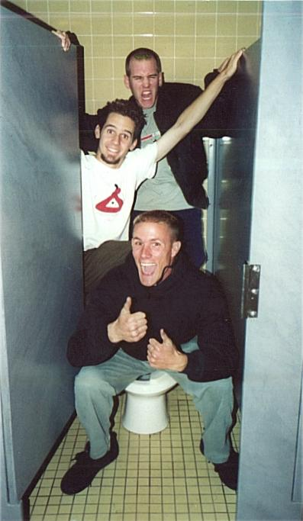
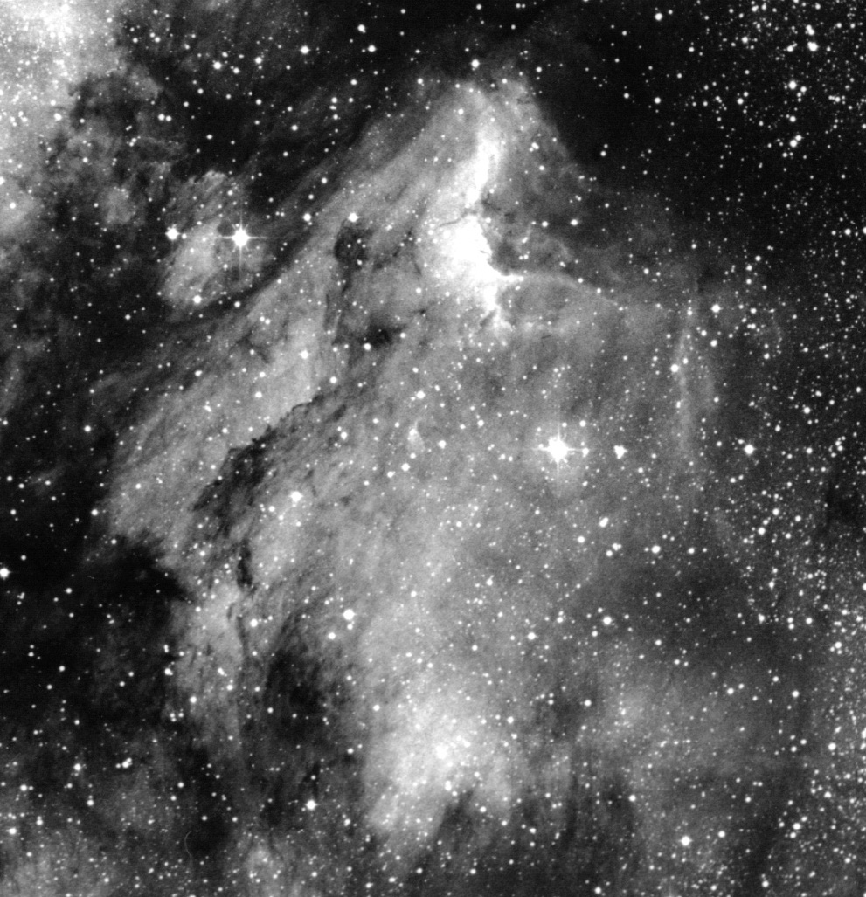

Sources and Routes of bacterial infection
Intrinsic
Extrinsic
Mythical

Slide 4
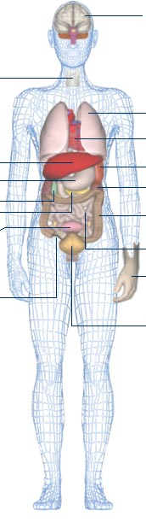
Intrinsic sources
Brain
Streptococcus spp
Lactobacilli
Actinomyces
Fusobacterium
Nasal cavity & sinuses
Upper Respiratory tract
Mouth
Staphylococcus spp.
Streptococcus pneumoniae
Haemophilus influenzae
Branhamella catarrhalis
Trachea
Lungs
Heart
Spleen
Kidneys
Escherichia coli
Bacteroides ap.
Proteus spp
Klebsiella
Enterobacter spp.
Clostridium spp
Peptostreptococcus spp
Lactobacillus
Enterococci
Streptococcus group B
Candida/yeast
Anaerobes
Liver
Lactobacilli
Candida/yeast
Helicobacter pylori
Stomach
Gall bladder
Pancreas
Large
intestine
Bladder
Small
intestine
Large-Small bowel junction
Appendix
Staphylococcus epidermidis
Staphylococcus aureus
Propionobacterium acnes
Corynaebacterium spp.
Lower genital tract (vagina)
Lactobacillus
Enterococci
Streptococcus group B
Candida/yeast
Anaerobes
Skin

Slide 5
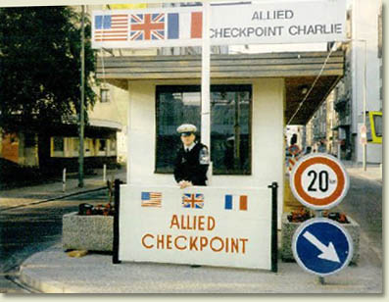

Portals of entry
Expected
Un-expected

Slide 6
Portal of entry: upper respiratory tract
Mouth and nose
Nasal cavity & sinuses
Upper Respiratory tract

Slide 7
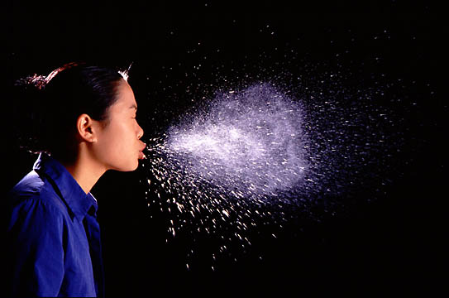


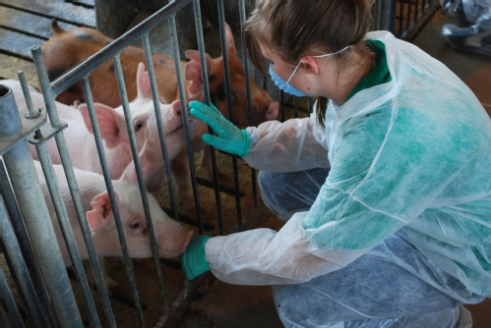
Infections targeting the upper respiratory tract
Usually extrinsically-acquired from respiratory tract droplets or airborne
Hand transmission can act as intermediate
Viruses
Influenza
Parainfluenza
RSV
Rhinoviruses
Measles
Varicella (Chicken pox)=VZV
Other herpes viruses (HSV, EBV)
Bacteria
Streptococcus spp (dental bacteria)
Streptococcus pneumoniae
Streptococcus pyogenes
Neisseria meningitidis
Staphylococcus aureus (MSSA and MRSA)

Slide 8

Consequences of bacterial infection acquired via the upper respiratory tract
Upper respiratory tract infection
Lower respiratory tract infection
Pharyngitis
Tonsillitis
Sinusitis
Pneumonia
Pneumonitis
Spread to adjacent structures
Spread to bloodstream
Brain abscess
Meningitis
Empyema (pleural space)
Pericarditis
Bacteraemia
  eg pneumococcal bacteremia; meningococcal bacteremia or meningitis
Viraemia
  eg varicella, measles

Slide 9
Portal of entry: urogenital tract
Extrinisic sources
Intrinisic Sources
Large
intestine

Slide 10
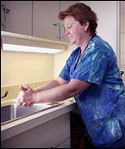
Infections targeting urogenital tract
Intrinsic infections that infect the urogenital tract
Extrinisic infections that infect the urogenital tract
Nosocomial infection
  Urinary catheters
Sexually transmitted pathogens
  HIV, Herpes simplex (viruses)
  Neisseria gonorrhoeae (bacteria)
  Chlamydia trachomatis
  Syphilis
Escherichia coli
Bacteroides ap.
Proteus spp
Klebsiella
Enterobacter spp.
Enterococci
Streptococcus group B
Candida/yeast
(Group A strep- from throat)
Large
intestine

Slide 11
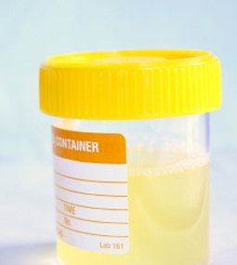
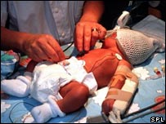
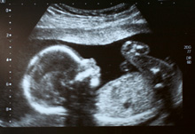
Consequences of urogenital tract infection
Urinary tract infection
Pelvic infection/STD
Cystitis
Pyelonephritis
Gonococcal urethritis
Pelvic inflammatory disease
Tubo-ovarian abscess
Puerperal infection
Neonatal group B strep infection
Neonatal gonococcal conjunctivitis
Maternal endometritis (group A strep)

Slide 12
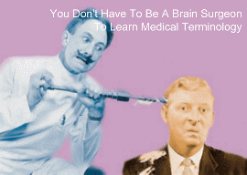
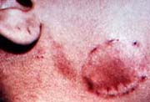
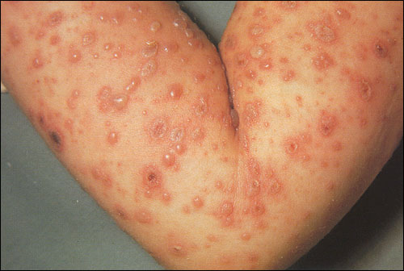
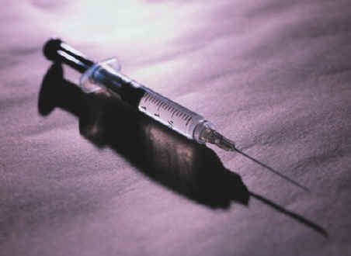
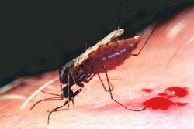
Portals of entry: broken skin
Surgery
Pre-existing skin breaches incl. burns etc
IVDA
Bites-human and animal
Insects
Intravenous cannulae
(the intravenous portal of entry)

Slide 13
Infections that target broken skin
Skin & mouth bacteria:
Staphylococcus aureus,
  altered by antibiotics or hosp exposure eg MRSA, Pseudomonas
Bacteria in droplets that contaminate wounds from mouth eg
Streptococcus pyogenes
Unusual pathogens
Pasteurella multocida from dog bites
Aeromonas hydrophilia from medicinal leeches
Clostridium perfringens from soil
Wounds that are close to bowel flora
  Gram negatives!

Slide 14
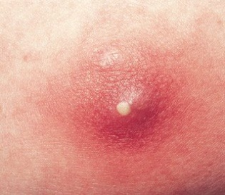
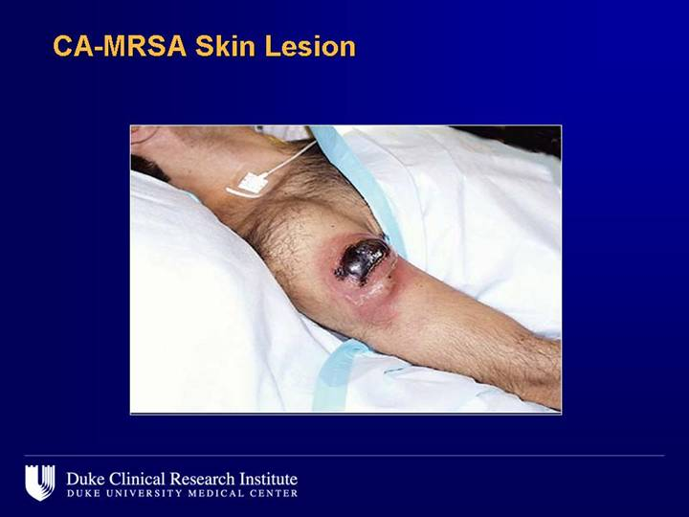
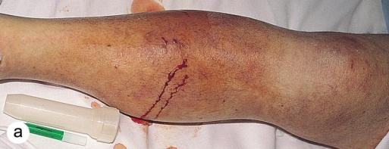
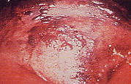
Consequences of infection via broken skin
Superficial infection
Cellulitis
Abscess
Fasciitis
Myositis
Gangrene/necrotic infection
Bacteremia

Slide 15
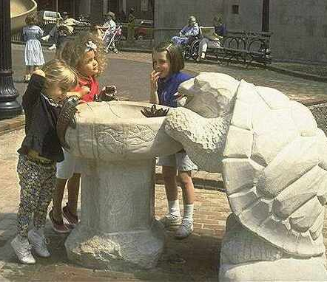

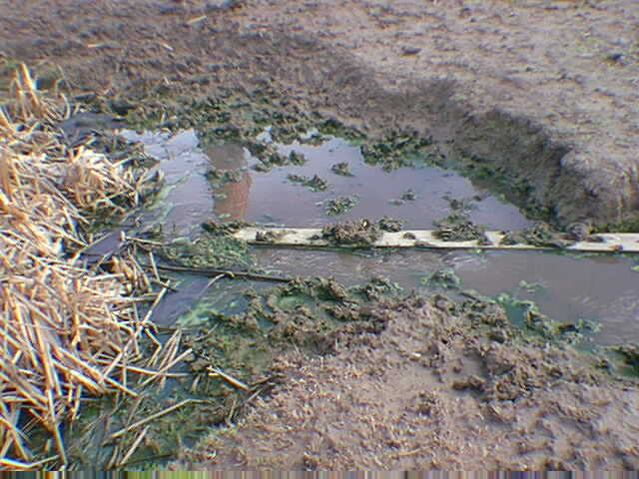
Portal of entry: the gastro-intestinal tract
‘faeco-oral route’
Infections that target the GI tract:
Viruses
Hepatitis A
Norovirus
Hepatitis E
Bacteria
Escherichia coli(travellers diarrhoea/HUS)
Campylobacter jejuni
Salmonella spp.
Listeria
Shigella spp(dysentery)
Salmonella paratyphi (paratyphoid)
Salmonella typhae (typhoid)
Vibrio cholerae (cholera)
Toxins
Staphylococcal enterotoxins
Botulinum toxin
Shellfish and jellyfiosh toxins

Slide 16
Consequences of infection acquired via the GI tract
Diarrhoeal illnesses
“D&V” (V or D)
Travellers diarrhoea
Dysentery
Bacteremic/systemic infections
Typhoid (S. typhi)
Listeriosis (L. monocytogenes)
Toxin-mediated disease
D & V (eg S. aureus enterotoxin)
Neurological (eg botulism)

Slide 17
Pathogenicity of bacteria
Eg Staphylococcus aureus from skin causing abscess
Pathogens
  Cause disease
Commensals
  Don’t cause disease
True
Opportunistic
Eg Staphylococcus epidermidis in skin causing hip joint infection
Eg Lactobacillus in vagina and GI tact
‘Pathogenicity’= ability to cause DISEASE

Slide 18
Factors affecting pathogenicity
‘Infectivity’ General features favoring infection
Transmission to host
Ability to colonise host
Tropism– Find unique niche (in or outside cells)
Replicate
Immune Evasion at site of colonisation or niche
‘infectious dose’
‘Virulence’ Features that enhance disease causation
Toxin production
Enzymes that degrade host molecules
Complete immune evasion

Slide 19
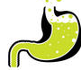
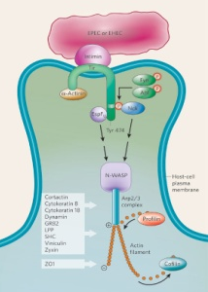
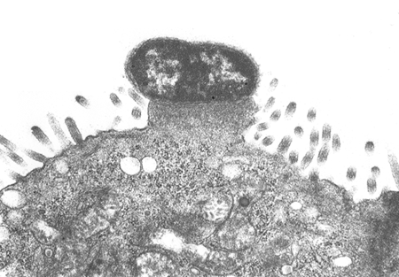
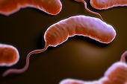
Infectivity and infectious dose
The infectious dose is the number of bacteria required to initiate an infection and can be affected by…
Route of transmission
Ability to colonise host-
Tropism and motility
Replication speed
Immune Evasion at site
Stomach acid means high doses often req. Use of antacid lowers inf dose
Enteropathogenic E. coli “EPEC” type 3 secretion for adherence (pedestals)
Vibrio cholerae.
high infective dose
Short replication time (0.2h)
?cause or effect
Notes:
During infection with the extracellular bacterium EPEC, the intimin receptor (Tir) translocates from the bacterium into the host cell and inserts itself into the host-cell plasma membrane (a process mediated by the T3SS). This receptor interacts with intimin on the bacterial surface, thereby firmly anchoring the bacterium to the host cell. N-WASP and the Arp2/3 complex (which consists of seven host proteins) are recruited downstream of the Tir-interacting protein (Nck or EspF_{u}), leading to the generation of actin filaments beneath the attached bacteria and the formation of the pedestal structure. Numerous proteins are found in EPEC pedestals (some of which are listed in the shaded box); however, the precise organization of these proteins in EPEC- and EHEC-induced pedestal generation has not been clearly shown

Slide 20
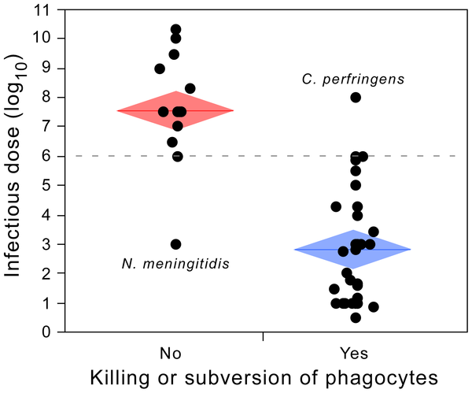
Association between infectious dose and the capacity of pathogens of killing professional phagocytes or surviving inside professional phagocytes.
Gama JA, Abby SS, Vieira-Silva S, Dionisio F, et al. (2012) Immune Subversion and Quorum-Sensing Shape the Variation in Infectious Dose among Bacterial Pathogens. PLoS Pathog 8(2): e1002503. doi:10.1371/journal.ppat.1002503
http://www.plospathogens.org/article/info:doi/10.1371/journal.ppat.1002503

Slide 21
Examples of infectious dose
Low to high infective doses (ie High to Low infectivity)
Mycobacterium tuberculosis 10 CFU
Shigella dysenteriae 10 CFU
E. coli enterohaemorrhagic (EHEC) 10 CFU
Neisseria meningitidis 1000 CFU
Streptococcus pyogenes 1000 CFU
Listeria monocytogenes 1000 CFU
Legionella pneumophila 100,000 CFU
E. coli enteropathogenic (EPEC) 10,000, 000 CFU
Vibrio cholerae 10, 000, 000 CFU

Slide 22
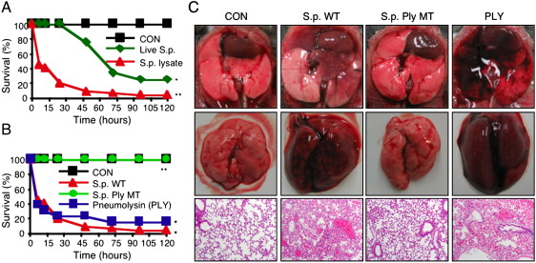
Virulence
Features that enhance disease causation: S. pneumoniae
control
Infected
(PLN+)
Infected
(PLN-)
Toxin production eg Pneumolysin: cholesterol-dependent pore-forming toxin affecting lung architecture
Degradation of host molecules eg Hyaluronan lyase- degrades host hyaluronic acid matrix for nutrition and ? spread

Slide 23
Virulence cont’d
Features that enhance disease causation: S. aureus
APC
Interference with host cell function eg Superantigens made by S. aureus interfering with normal T cell function
Immune evasion eg S. aueus leukocidins leading to neutrophil death
T
Shock
Organ failure
neutrophil

Slide 24
Infectious disease examples by portal of entry

Slide 25
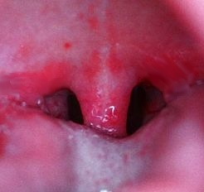
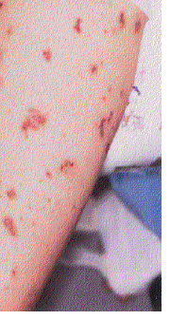
Mouth: droplet transmission
Tonsillitis.
Streptococcus pyogenes
Meningococcal septicaemia
Neisseria meningitidis colonises nasopharynx asymptomatically before invading epithelial then endothelial cells

Slide 26
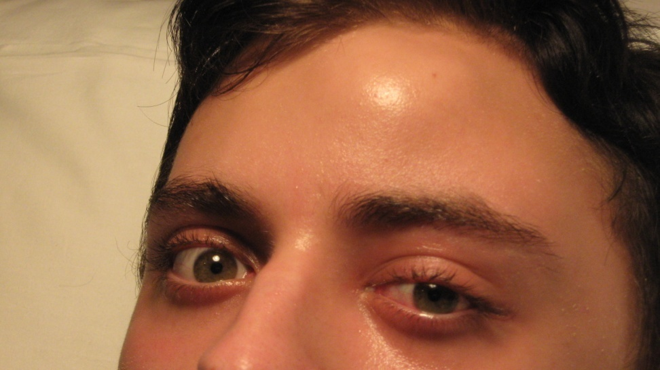
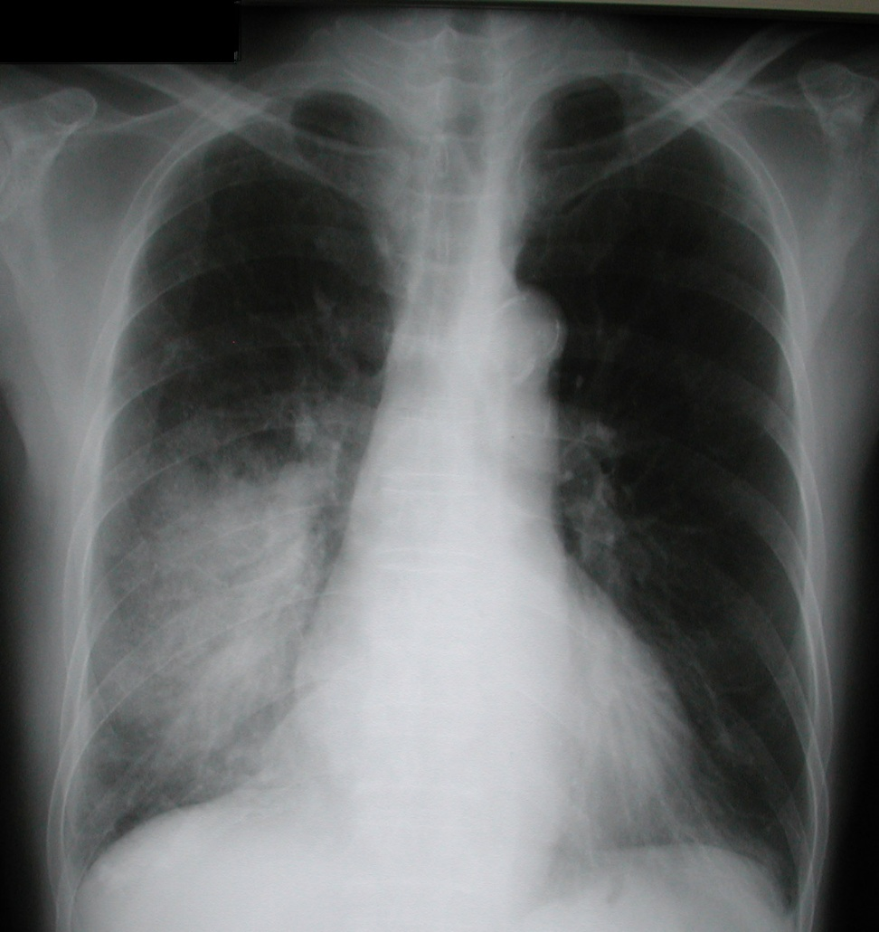
Upper to lower respiratory tract
Nasal sinuses: bacterial infections with
Streptococcus pneumoniae
Streptococcus milleri
Haemophilus influenzae
Pneumonia: Strep pneumoniae

Slide 27
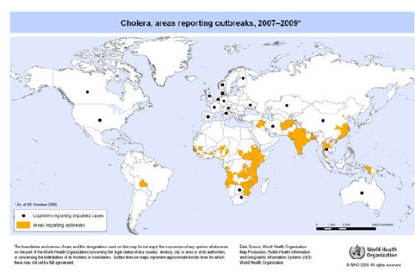
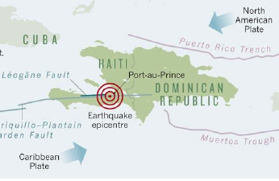
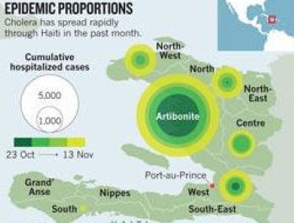
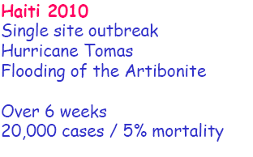
Faeco-oral transmission
Previous Cholera Epidemiology
Haiti Earthquake

Slide 28
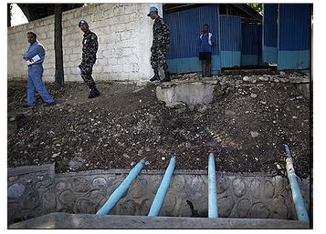
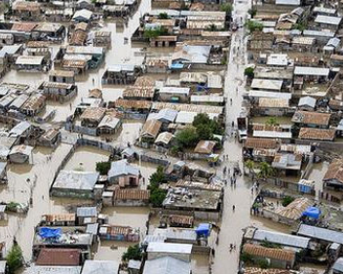
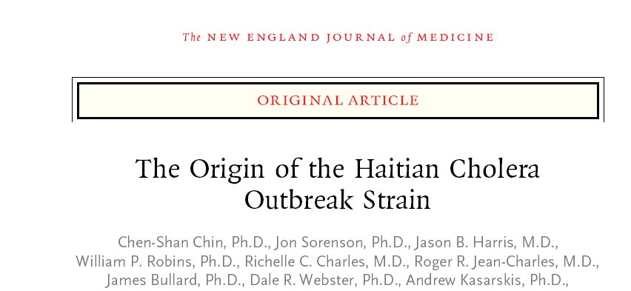
Faeco-oral transmission: cholera cont’d
Autumn 2010; UN base upstream of outbreak

Slide 29
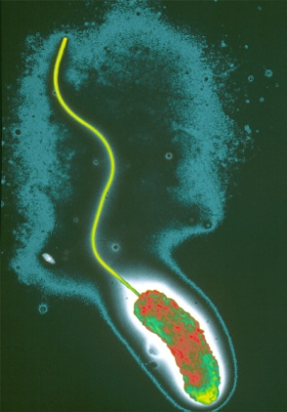
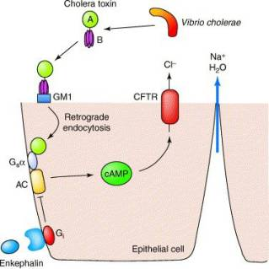

Vibrio cholerae pathogenicity
Enormous infective dose 10⁶- 10¹⁰ !
Flagella used to penetrate mucus
Then makes 2 component toxin
A + B
Binds to GM gangliosides on gut
Triggers cAMP
Chloride efflux
Na and water follow
Profuse diarrhoea
Rice water stools

Slide 30
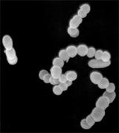
Gastro-intestinal to Urogenital tract.. to neonates
Genital tract colonisation with group B strep (from GI tract)- Harmless 30-40% of women
....leading to invasive group B strep infection in neonates: meningitis, septicaemia, death

Slide 31
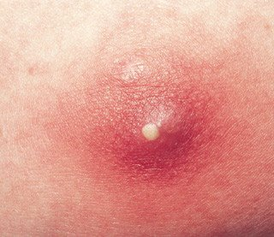
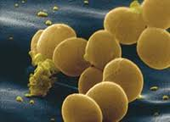
Portal of entry inoculation through skin:
Staphylococcus aureus
S. aureus produces a family of Leukocidins
=toxins which destroy neutrophils, producing characteristic pus

Slide 32
Pathogens to know....
Gram negative
Gram positive
Staphylococcus aureus
Streptococcus
  Group A= S. pyogenes
  Group B=S. agalactiae
  Viridans strep=dental bacteria
  Pneumococcus=S. pneumoniae
Clostridium (difficile, tetani, botulinum, pergringens)
Listeria spp.
Neisseria (meningitidis and gonorrhoeae)
Haemophilus influenzae
Escherichia coli (EPEC, EHEC, ETEC, uropathogenic)
Salmonella spp.,
Vibrio cholerae
Shigella

Slide 33
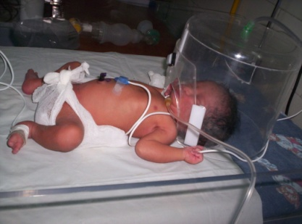
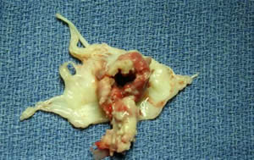


Opportunistic bacterial pathogens
Gram positives
Gram negatives
Pseudomonas aeruginosa
eg indwelling long-term urinary catheters and multiple UTI’s previously treated with antibiotic
Acinetobacter baumanii
eg open battlefield trauma heavy prophylaxis with broad spectrum antibiotics followed by ICU stay and nosocomial transmission
Staphylococcus epidermidis
eg prosthetic joint and valve infections, metalwork, central line infections
Enterococcus faecalis
eg abnormal heart valves

Slide 34
Learning objectives
Explain the concepts of infectivity and virulence and define the term infective dose
Give examples of bacterial pathogens transmitted by different routes and outline the ways in which they cause disease

Slide 35
Learning objectives
List the possible routes of infection
  UPPER RESPIRATORY TRACT
  FAECO-ORAL (ENTERIC)
  UROGENITAL TRACT
  SKIN
  INTRAVENOUS
List the possible sources of infection by bacteria:
  UPPER RESP TRACT
  LOWER GI TRACT
  SEXUAL/UROGENITAL TRACT
  SKIN
  FOOD + WATER
  Animals
  SELF

