Slide 1



Analysis of nucleic acids
Dr Charlotte Dean
Course code (MBBS) : Nucleic acids 6
Course code (BMS) : NAGE-L11

Slide 2
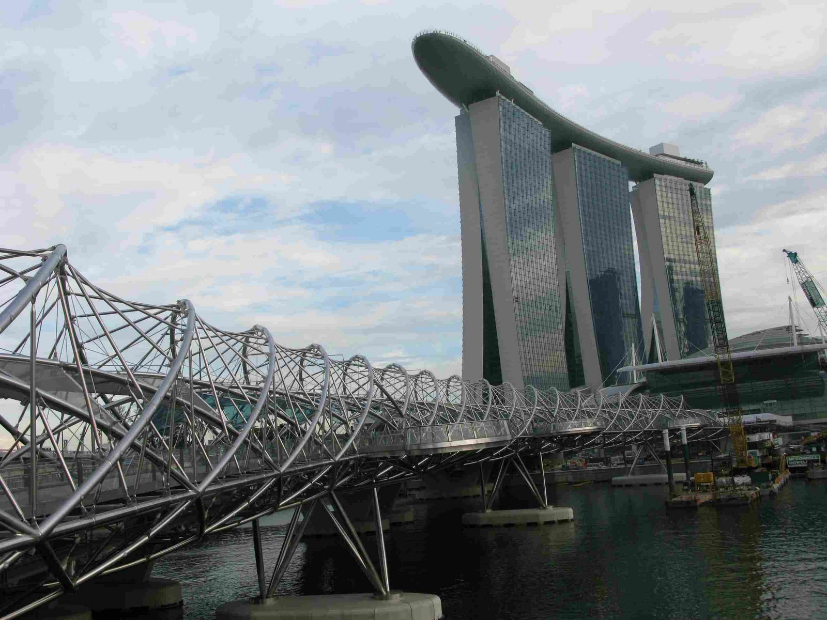

Slide 3
Outline
Why is this important-an example
DNA Cloning
Restriction endonuclease digestion
Separation of DNA fragments
Nucleic Acid Hybridisation
Polymerase Chain Reaction (PCR)
Microarrays
Notes:
2

Slide 4
Personalised medicine-HER2 and breast cancer
Overexpression of HER2 leads to more aggressive breast cancer
(involved in cell growth and proliferation)
20% of breast cancer is Her2 positive- more aggressive
Drugs (biologic therapy) have been developed specifically for
cancer where individuals have a Her2 mutation
e.g. Trastuzumab (Herceptin)

Slide 5
Next generation sequencing-the personalised genome
Identify if a cancer is Her2 positive or not
Tailor treatment (e.g. Herceptin)
Hand held genome sequencers
Ion Torrent technology

Slide 6
DNA cloning
A method of selectively amplifying DNA sequences of interest to generate homogenous DNA populations
  Cell-based DNA cloning (in vivo)
  Cell-free DNA cloning (in vitro) - PCR
Notes:
3

Slide 7
Cell-based DNA cloning
(1) Construction of recombinant DNA molecules in vitro by:
  cutting a target DNA and a replicon (sequence capable of independent replication – e.g. plasmid, bacteriophage, Yeast Artificial Chromosome) with specific enzymes, restriction endonucleases, so that the ends of the two DNA sequences are compatible
Purify and mix
Notes:
4

Slide 8
Cell-based DNA cloning
(1) Construction of recombinant DNA molecules in vitro by:
  cutting a target DNA and a replicon (sequence capable of independent replication – e.g. plasmid, lambda phage, YAC) with specific enzymes, restriction endonucleases, so that the ends of the two DNA sequences are compatible
  mixing and joining the DNA fragments by using the enzyme DNA ligase
Notes:
5

Slide 9
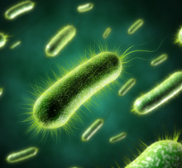
Cell-based DNA cloning
(2) Transformation of the recombinant DNA molecules into host cells (bacteria, yeast)
Notes:
6

Slide 10
Cell-based DNA cloning
(2) Transformation of the recombinant DNA molecules into host cells (bacteria, yeast)
(3) Selective propagation of individual cell colonies on agar plate
(selectable antibiotic resistance marker in the replicon; only cells with replicon survive)
antibiotic
Notes:
7

Slide 11
Cell-based DNA cloning
(2) Transformation of the recombinant DNA molecules into host cells (bacteria, yeast)
(3) Selective propagation of individual cell colonies on agar plate
(4) Expansion of the cell culture and isolation of recombinant
DNA
antibiotic
Notes:
8

Slide 12
Restriction endonucleases
Type II restriction endonucleases are enzymes that cleave DNA at specific recognition sequences
  Recognition sites are usually 4-8bp palindromic sequences
5’
…GATC…
…CTAG…
3’
3’
5’
Restriction endonucleases are one half of bacterial restriction-modification systems, a kind of primitive immune system. Host DNA is protected by methylation of a base in the RE site by a specific methylase - RE will only cleave unmethylated DNA from invading organisms, not host DNA
Notes:
9

Slide 13
Restriction endonucleases
Type II restriction endonucleases are enzymes (usually dimers) that cleave DNA at specific recognition sequences
  Recognition sites are usually 4-8bp palindromic sequences
Produce “blunt” or “sticky” DNA ends..
        …with an overhang
…GATC…
…CTAG…
5’
3’
3’
5’
5’
…GA TC…
…CT AG…
5’
…G ATC…
…CTA G…
3’
3’
3’
5’
Notes:
10

Slide 14
Restriction endonucleases
The longer the recognition site, the less frequently it occurs in DNA
Notes:
11

Slide 15
Separation of DNA fragments
Electrophoresis
DNA is negatively charged due to its phosphate backbone and it moves towards the anode (+ve electrode) when an electrical force is applied to a DNA solution
- - - - - - -
- - - - - - -
Notes:
12

Slide 16
Separation of DNA fragments
_
DNA size resolution
When DNA is forced to travel through a porous gel matrix (agarose / polyacrylamide gel) small fragments are retarded less than large fragments and hence travel faster
_
3kb
2kb
_
1kb
Notes:
13

Slide 17
Separation of DNA fragments
_
DNA size resolution
When DNA is forced to travel through a porous gel matrix (agarose / polyacrylamide gel) small fragments travel faster than large fragments
After resolution, DNA can be isolated from the gel or transferred to a membrane to form a replica for hybridisation
_
3kb
2kb
_
1kb
Notes:
14

Slide 18
Nucleic Acid Hybridisation
A method for detecting specific nucleic acid sequences in which homologous single-stranded DNA or RNA molecules combine to form double-stranded molecules
Standard assay involves a labeled ( * ) nucleic acid probe to identify homologous related target molecules in a mixture of unlabeled nucleic acids
5’ 3’
3’ 5’
5’ 3’
3’ 5’
*
Notes:
15

Slide 19
Hybridisation assays
Target DNA (e.g. from an agar plate or gel) is immobilised on a solid support - nylon or nitrocellulose membrane - which readily binds single-stranded nucleic acid (e.g. denatured DNA or mRNA) and then hybridised with a solution of (radioactively or fluorescently) labeled (*) probe
1. Target DNA
2. Probe DNA
*
*
*
*
*
*
Denature
and hybridise
Denature
and bind
*
*
Solid support (membrane)
Notes:
18

Slide 20
Hybridisation (“Blotting”) of DNA fragments after Separation
_
_
3kb
2kb
*
_
After resolution, DNA can be isolated from the gel or transferred to a membrane to form a replica for hybridisation with a labelled probe ( * ) detected by exposure of photographic film
1kb
Notes:
14

Slide 21
Southern Blot Animation
http://www.dnatube.com/video/1512/Southern-blot

Slide 22
Hybridisation assays – immensely important and versatile in nucleic acid analysis
Examples:
  Southern blot hybridisation (DNA target and DNA probe)
  (after Ed Southern)
  Northern blot hybridisation (RNA target and DNA probe)
  Colony blot hybridisation (bacterial DNA target, DNA probe)
  Tissue in situ hybridisation (RNA target and RNA probe)
  Chromosome in situ hybridisation (Chromosome target and DNA probe)
  Reverse hybridisation – Microarrays (immobilised DNA or oligonucleotide probe, target DNA solution)
Notes:
19

Slide 23
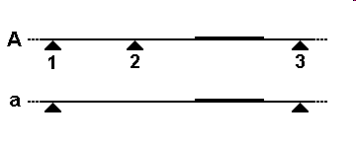
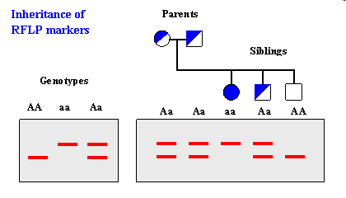
Detection of Restriction Fragment Length Polymorphism in human genomic DNA by restriction digestion, gel electrophoresis and hybridisation with a gene-specific probe
probe

Slide 24
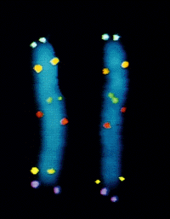
In situ hybridisation to locate specific genes on chromosomes
Probes for 6 genes labelled with different fluorescent dyes showing paired copies on metaphase chromosomes during mitosis
From “Molecular Biology of the Cell”, Alberts et al, 4th ed.

Slide 25
Melting temperature and hybridisation stringency
Denaturation of a probe DNA is achieved by heating until the hydrogen bonds between the bases holding the two strands together are disrupted
The energy needed to do this depends on:
  Strand length: longer strand = more hydrogen bonds to break
  Base composition: G-C pair has one more hydrogen bond than A-T, so harder to break
  Chemical environment:
    Monovalent cations (Na⁺) stabilise the DNA duplex by neutralising charge on phosphate backbone
    denaturants (formamide / urea) destabilise the DNA duplex
Notes:
20

Slide 26
Melting temperature and hybridisation stringency
Melting temperature (T_{m}) - measure of nucleic acid duplex stability
  Midpoint temp. of transition from double stranded (DS) to single stranded (SS) forms of nucleic acid
  For mammalian genomic DNA (40% GC) this is ~87ºC
Hybridisation is carried out at temperatures <25ºC below T_{m}
Hybridisation stringency (i.e. the power to distinguish between related sequences) increases with:
  Increase in temperature
  Decrease in Na⁺ concentration
SS/DS
T_{m}
T (ºC)
Notes:
21

Slide 27
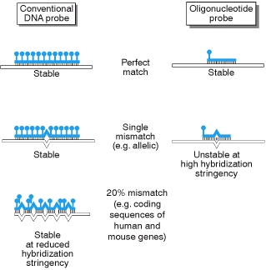
Hybridisation Stringency
reaction conditions, notably temperature and salt, that dictate the annealing of single-stranded DNA/DNA, DNA/RNA, and RNA/RNA hybrids
at high stringency, duplexes form only between strands with perfect one-to-one complementarity
lower stringency allows annealing between strands with some degree of mismatch between bases

Slide 28
Cell-free DNA cloning – PCR
(Kary Mullis, Nobel Laureate 1993)
Polymerase Chain Reaction (PCR)
In vitro method to allow selective amplification of a specific target DNA within a heterogeneous collection of DNA sequences (e.g. total genomic DNA or complex cDNA population)
Notes:
22

Slide 29
PCR methodology
Some sequence information of the target (e.g. gene of interest) is needed to design 2 primers (15 - 25 nucleotides in length), one complimentary to each strand of the DNA to be copied (“forward” and “reverse”)
Notes:
23

Slide 30
PCR methodology
Some sequence information of the target is needed to design 2 primers (15 - 25 nucleotides in length), one complimentary to each strand of the DNA to be copied (“forward” and “reverse”)
Primers are specifically annealed to heat-denatured DNA by lowering temperature
5’
3’
3’
5’
Heat denature DNA
5’
3’
3’
5’
Notes:
24

Slide 31
PCR methodology
Some sequence information is needed to design 2 primers (15 - 25 nucleotides in length), one complimentary to each strand of the DNA to be copied
Primers are specifically annealed to heat denatured DNA by lowering temperature
Thermostable Thermophilus aquaticus DNA polymerase + dNTPs extend 5’->3’ from the primers and generate new strands
Heat denature DNA
Taq polymerase
dNTPs
Notes:
25

Slide 32
PCR methodology
Denature and repeat the cycle many times (PCR machine)
  For example:
Denature 94ºC
Anneal 50-60ºC
Extend 72ºC
Heat denature DNA
30 cycles
Geometric increase in amount of specific target sequence
Notes:
26

Slide 33
PCR animation
http://www.youtube.com/watch?v=2KoLnIwoZKU

Slide 34
PCR - primer design
Length
  Usually about 20 nucleotides for a complex genomic DNA target – gives required specificity for target sequence
Base composition
  Avoid tandem repeats of nucleotides that can form hairpins
  %GC and length should give an ~equal T_{m} for each primer
3’ end
  Avoid complementarity of the bases at the 3’ ends
  Primer dimers may result
5’
3’
5’
3’
5’
3’
3’
5’
3’
5’
Notes:
27

Slide 35
PCR - Applications
Typing genetic markers (Restriction Fragment Length Polymorphisms)
Detecting point mutations
  restriction site changes, Allele-specific amplification
cDNA cloning
Genome walking
Gene expression – Reverse Transcription-PCR (reverse transcribe mRNA to DNA using oligo-dT [binds to polyA tail], then amplify)
Introducing mutations experimentally (base mismatches)
DNA sequencing
DNA microarrays
Notes:
28

Slide 36
DNA (oligonucleotide) microarrays
A DNA (or oligonucleotide) microarray is a collection of microscopic DNA (or oligonucleotide) spots, commonly representing single genes, robotically arrayed on a solid surface, e.g. a glass slide
Qualitative or quantitative measurements with DNA microarrays utilize the selective nature of DNA-DNA or DNA-RNA hybridisation under high-stringency conditions, with fluorophore-based detection
DNA arrays are commonly used for expression profiling, i.e. monitoring expression levels of thousands of genes simultaneously, or for comparative genomic hybridization

Slide 37
Example applications of microarrays
mRNA or gene expression profiling
- monitoring expression levels for thousands of genes simultaneously is relevant to many areas of biology and medicine, such as studying treatments, disease, and developmental stages. For example, microarrays can be used to identify disease genes by comparing gene expression in diseased and normal cells
SNP detection arrays - looking for Single Nucleotide Polymorphisms in the genome of populations

Slide 38
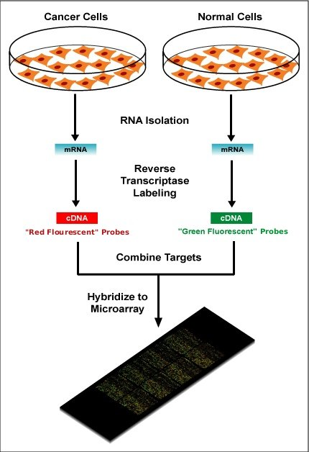
Microscope slide with arrayed DNA probes for all human genes (~30,000)

Slide 39
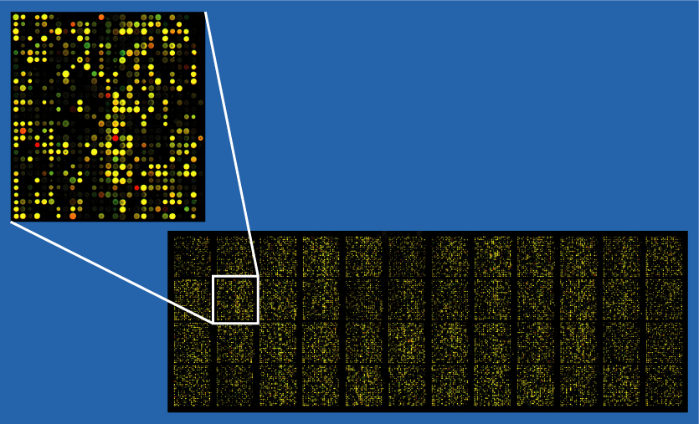
Gene expression analysis by microarray
Green – gene more highly expressed in normal cells
Red - gene more highly expressed in cancer cells
Yellow – gene equally expressed

Slide 40
Microarray animation
http://www.youtube.com/watch?v=3mAIN85GL-k

Slide 41
References
“Molecular Biology of the Cell” - Alberts et al.
“Human Molecular Genetics” - Strachan and Read
“Genes” - Lewin
Notes:
32

Slide 42
Thank you!

