Slide 1
DNA replication, the cell cycle and mitosis
Birgit Leitinger b.leitinger@imperial.ac.uk
Course code (MBBS) : Nucleic Acids 2
Course code (BMS) : NAGE-L2

Slide 2
Nucleic acids and gene expression
Nucleic acids and chromosomes
DNA replication, the cell cycle and mitosis
Gene organisation and transcription I
Gene organisation and transcription II
Protein translation and translational modification
Analysis of nucleic acids
Birgit Leitinger (b.leitinger@imperial.ac.uk)

Slide 3
Summary of 1st lecture
DNA and RNA bases - purines and pyrimidines, the four bases of DNA (A, T, G, C) and of RNA (A, U, G, C)
Sugars in DNA and RNA - deoxyribose and ribose
Nucleotides and nucleosides
DNA: polymer of deoxyribonucleotide units
Primary sequence of DNA specfies genetic information
DNA double helix - antiparallel complementary strands
Melting and annealing of complementary strands
Watson-Crick base pairing: G-C and A-T
Genomes of E.coli (a single circular DNA molecule) and Homo Sapiens (46 chromosomes contain linear DNA)
The human karyotype
Packaging of eukaryotic DNA - chromatin and chromosomes

Slide 4
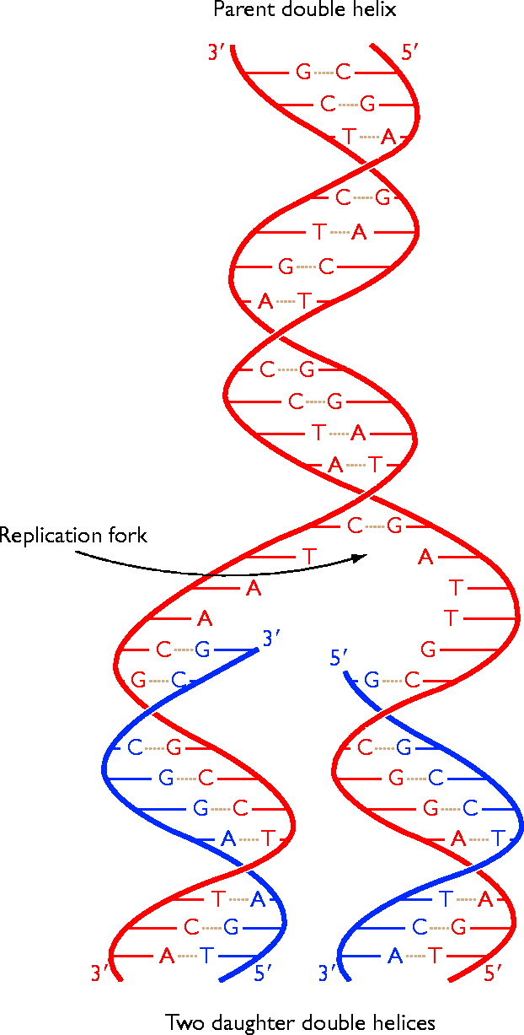
DNA replication, the cell cycle and mitosis
Overview
How cells duplicate DNA
Cell division cycle
How chromosomes segregate as cell divides
Chromatid separation at anaphase

Slide 5
Flow of genetic information
DNA replication
DNA
Transcription
mRNA
Translation
protein

Slide 6
DNA replication
Before each cell division, a faithful copy of the DNA needs to be made to ensure genetic continuity in the daughter cell.
Cell division
Identical copies of the DNA code

Slide 7
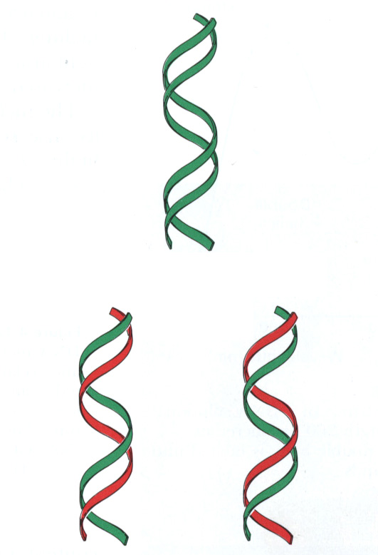
Semi-conservative replication
Parental DNA
DNA replication is semi-conservative. Each daughter cell inherits one old and one new strand.
new
old
old
new
Daughter molecules

Slide 8
DNA replication
5’
3’
C
G
A
T
G
C
G
C
The two strands are complementary to each other so each strand serves as a template for the synthesis of the other strand. This generates two identical copies.
T
A
3’
5’
5’
3’
5’
3’
C
G
C
G
A
T
A
T
G
C
G
C
G
C
G
C
T
A
T
A
3’
5’
3’
5’
old
new
new
old

Slide 9
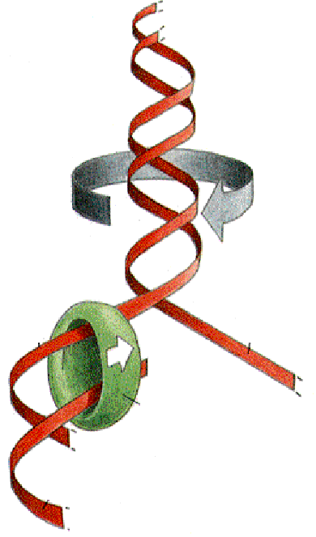
Opening of DNA helix
The DNA helix is very stable and has to be unwound before replication can occur. This is done by a DNA helicase, an enzyme that uses ATP as source of energy to break hydrogen bonds between base pairs.
DNA helix is unwound
New DNA is synthesised by
enzymes called DNA polymerases. DNA polymerases add nucleotides to the 3’ end of a growing chain.
template
DNA polymerase
new
chain

Slide 10
DNA Synthesis
DNA polymerases require:
a template strand
an oligonucleotide primer
a supply of deoxynucleotide triphosphates (dNTPs)
DNA polymerases cannot start a new chain from scratch!
primer
A
G
C
C
incoming dNTP
5'
G
C
A
T
T
G
T
A
A
C
G
G
T
C
A
3'
5'
template strand

Slide 11
Enzyme reaction
N
H
2
5'
N
N
O
DNA polymerases add dNTPs to the 3’ end of a DNA molecule.
DNA (and RNA) synthesis occurs in 5’ to 3’ direction.
Energy is released by hydrolysis of the triphosphate. This drives the reaction.
N
O
P
O
N
O
5'
O
N
H
2
3'
N
O
H
O
P
O
N
O
O
5'
O
O
3'
H
H
O
N
N
H
O
O
O
N
N
H
N
2
-
3'
A free 3’ hydoxyl group is required.
O
P
O
P
O
P
O
5'
O
O
-
O
-
O
-
3'
O
H
H

Slide 12
Drugs used as chain terminators I
Nucleoside analogs
N
H
O
2
H
3
C
N
N
H
N
O
N
O
H
O
H
O
O
O
H
H
N
3
H
dideoxycytidine (ddC)
azidothymidine (AZT)
Drug for HIV (zalcitabine)
Drug for HIV (Zidovudine)

Slide 13
Drugs used as chain terminators II
Nucleoside analogs
guanine base
O
N
H
2
N
N
H
N
N
N
N
H
OH
H
O
2
H
N
O
H
C
O
Drawn to show relationship to ribose
O
O
H
H
H
H
H
O
H
Acyclovir
Cytosine arabinose
Used in Chemotherapy
Drug for Herpes

Slide 14
The replication fork
Replication
proceeds
in this
direction:
movement
of the fork
Replication begins at discrete
points on the DNA molecule
called origin of replication.
The site of DNA synthesis is called a replication fork: the fork moves along during the
process.
replication fork
template
strand
The two daughter molecules
are identical, each containing an old and a new strand.
new strand

Slide 15
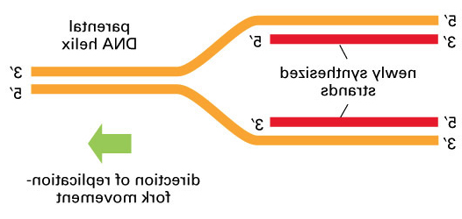
Asymmetry of replication fork
Parental DNA helix
3’
3’
5’
5’
Newly synthesised strands
3’
5’
3’
5’
Direction of replication fork movement
The templates for the two new daughter strands have opposite orientations: 3’ to 5’ and 5’ to 3’

Slide 16
Leading and lagging strands
3’
5’
Replication fork
movement
Leading strand
5’
3’
5’
3’
Okazaki fragments
Lagging strand
3’
5’
The replication fork is asymmetric. Both strands are synthesised in a 5’-3’ direction. The leading strand is synthesised continuously, whereas the lagging strand is synthesised in short pieces termed Okazaki fragments.

Slide 17
RNA primer starts new chain
RNA primes the synthesis of new DNA. A specialised RNA polymerase called DNA primase synthesises a short RNA fragment (~ 5 nucleotides). The RNA primer is only transient and removed at a later stage of replication.
DNA template
3’
5’
Primase
3’
5’
5’
3’
RNA primer
DNA polymerase
3’
5’
5’
3’
new DNA
For the synthesis pf the leading strand, an RNA primer is needed only to start replication at a replication origin.

Slide 18
Synthesis of lagging strand
Okazaki fragment
RNA primer
New RNA primer made by primase
3’
5’
3’
5’
5’
3’
Lagging strand template
DNA polymerase adds to RNA primer, starting new Okazaki fragment
3’
5’
3’
5’
5’
3’
DNA polymerase finishes DNA fragment
3’
5’
5’
3’
old RNA primer erased and replaced by DNA
3’
5’
5’
3’
DNA ligase joins new Okazaki fragment to growing chain
3’
5’
5’
3’

Slide 19
Joining of Okazaki fragments
5’ A A T C G A A C A C C G T A C C G T 3’
| | | | | | | | | | | | | | | | | |
3’ T T A G C U U G U G G C A T G G C A 5’
A special ribonuclease removes RNA primer using a 5’ to 3’ exonuclease activity.
A repair DNA polymerase then replaces RNA with DNA.
RNA primer
Okazaki fragment
5’ A A T C G A A C A C C G T A C C G T 3’
| | | | | | | | | | | | | | | | | |
3’ T T A G C T T G T G G C A T G G C A 5’
P
OH
DNA ligase joins the two fragments together using ATP. This makes the DNA strand continuous.
5’ A A T C G A A C A C C G T A C C G T 3’
| | | | | | | | | | | | | | | | | |
3’ T T A G C T T G T G G C A T G G C A 5’

Slide 20
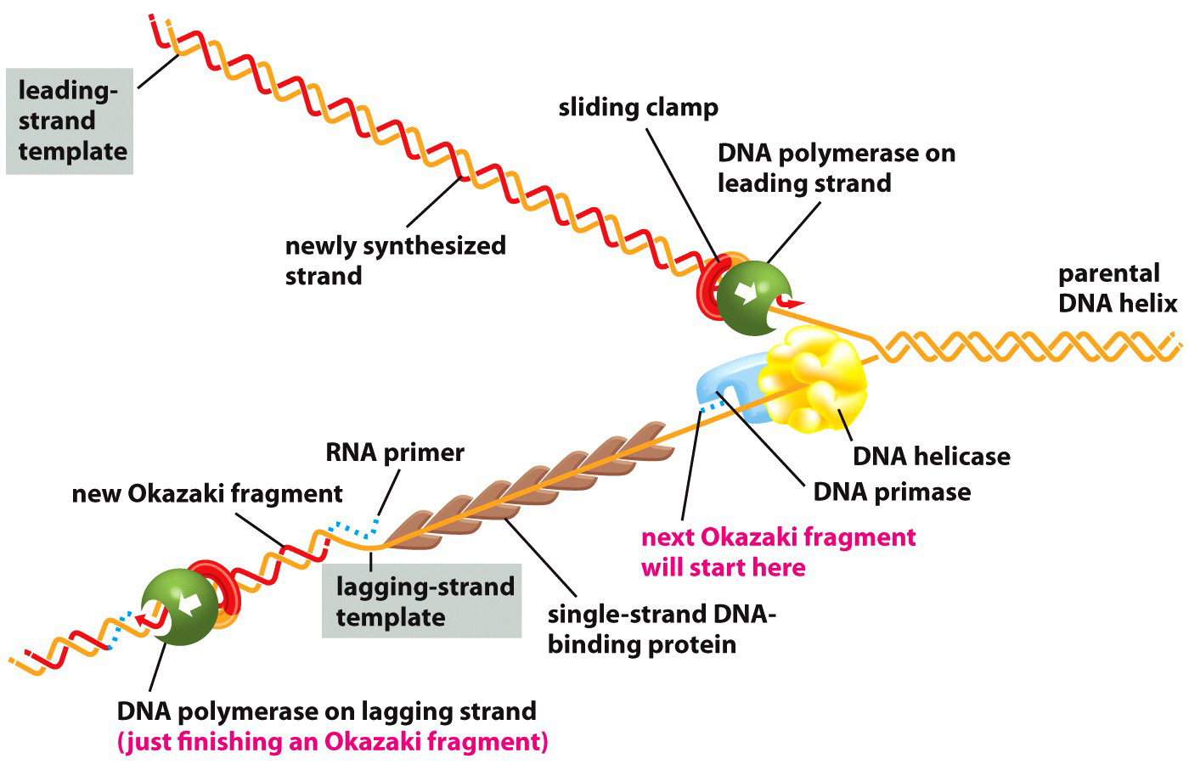
Replication fork proteins
DNA replication is performed by a group proteins that work together with DNA polymerase and primase, forming a multi-enzyme protein machine.

Slide 21
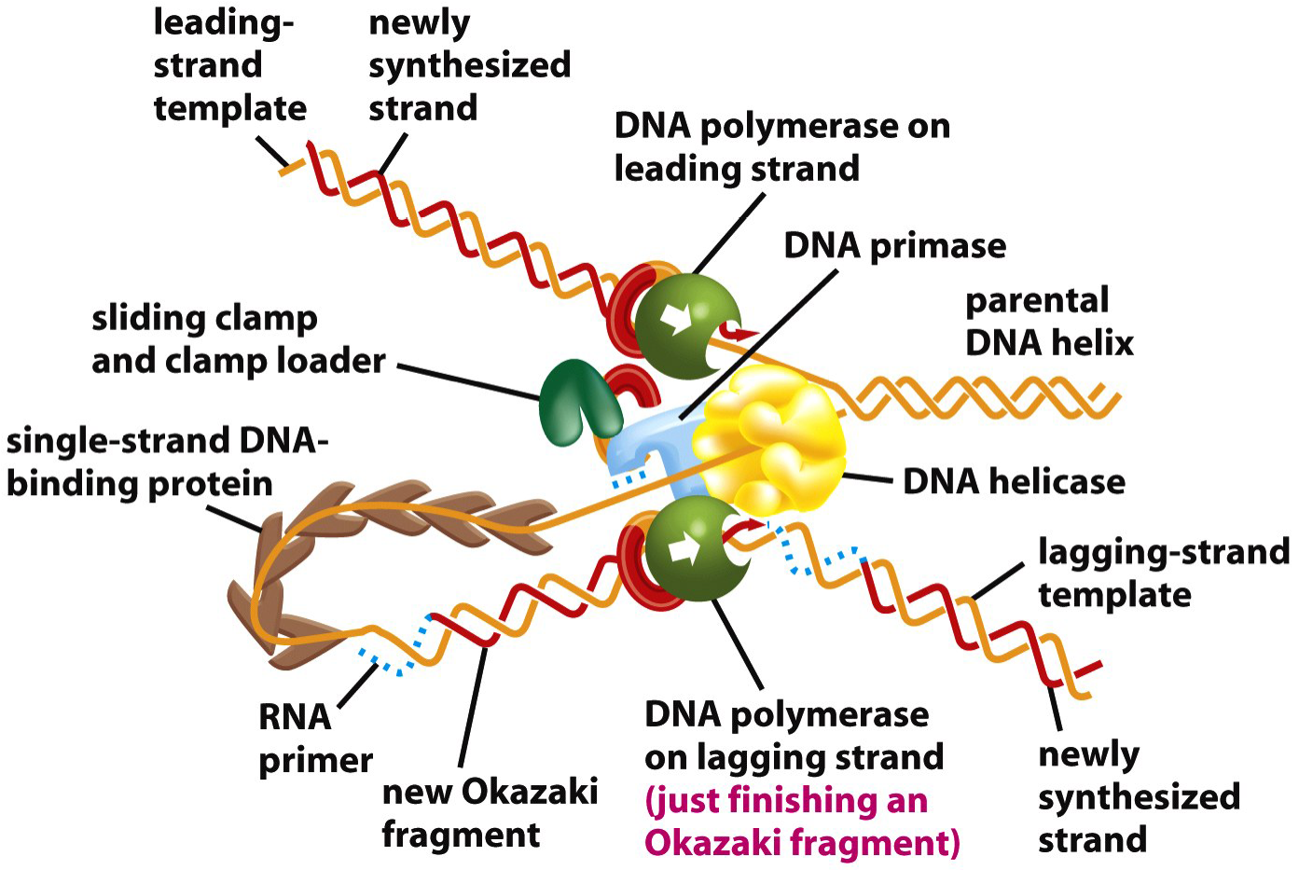
The replication complex
Coordination between leading and lagging strands. Most of the proteins involved in DNA replication are held together as a large multi-enzyme complex. The looping of the template for the lagging strand enables a both daughter strands to be synthesised in a coordinated manner.

Slide 22
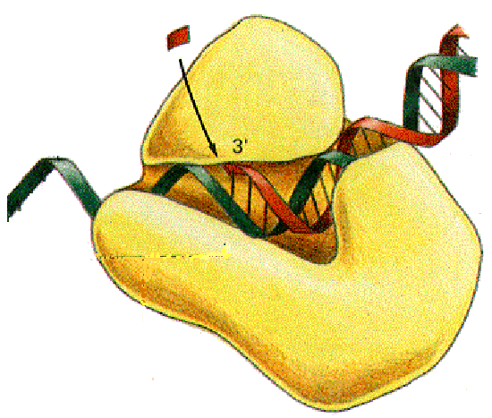
Proofreading mechanism
The high fidelity of DNA replication requires a proof-reading mechanism to ensure no mistakes are made. Mutations (changes in DNA sequence) are very dangerous to the organism. Any errors in replication cannot be repaired.
DNA replication has an error frequency of about 1 change per 10⁹ base pairs.
Before a new nucleotide is added, the previous nucleotide is checked for correct base-pairing.
Any incorrect bases are removed by 3’ to 5’ exonuclease activity of DNA polymerase. A new, correct nucleotide is then added.
proof-reading: check that
this base pair is correct,
before adding the new
nucleotide
incoming
NTP
primer
template
strand
DNA polymerase

Slide 23
Replication of the E.coli chromosome
In E.coli, replication starts at a unique origin, OriC. Two replication forks proceed simultaneously in opposite directions. The two forks meet at the other side of the circular chromosome.
Ori C
New DNA
Parental DNA
E.coli chromosome
Inititiation of replication at OriC
Replication fork
Replication fork
Bi-directional replication

Slide 24
Replication of eukaryotic genome
Eukaryotic chromosomes are linear and very long. Multiple replication origins are distributed at intervals of about 100 kilobase pairs. Each replication origin gives bi-directional replication forks. Replication is finished when all the forks have met.
+

Slide 25
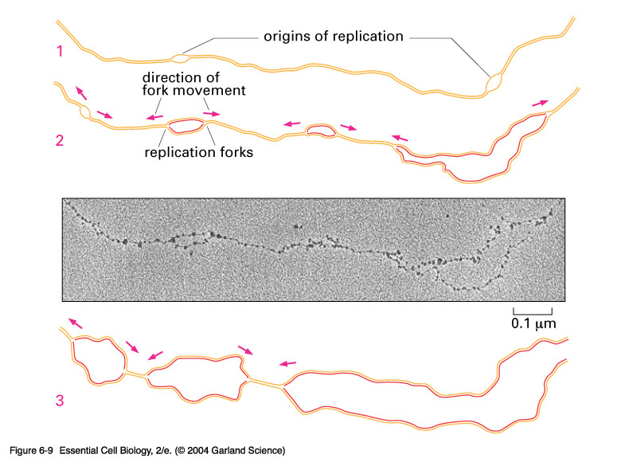
Eukaryotic replication forks
DNA replication in fly embryo

Slide 26
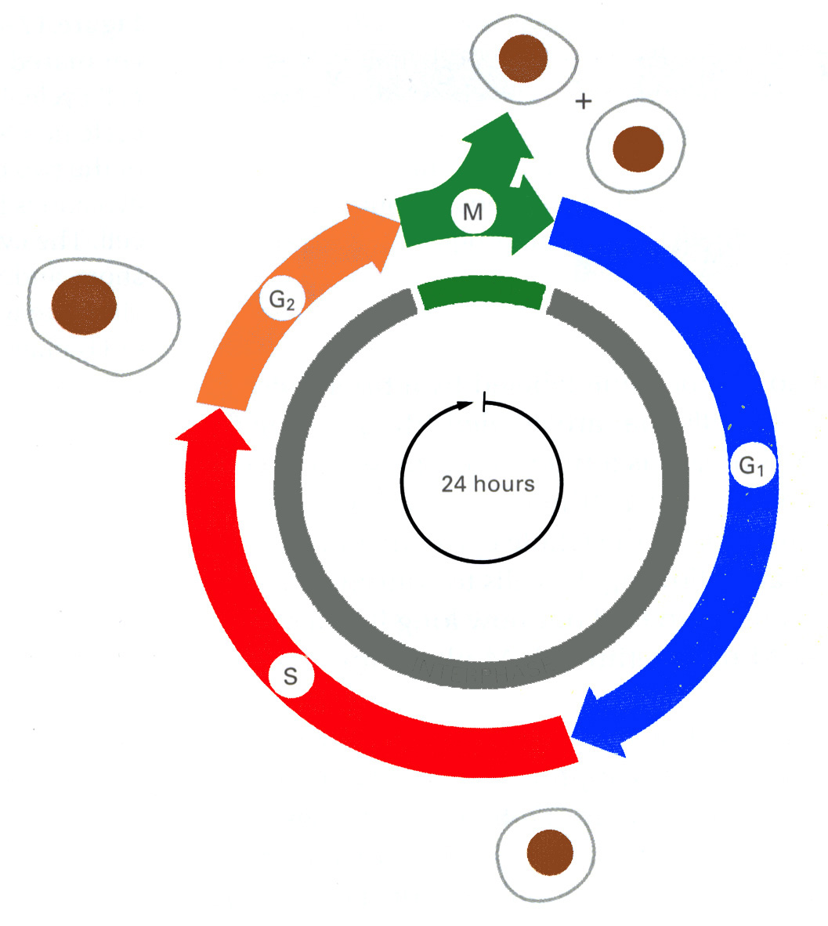
The cell cycle
G1, G0, S, and G2 are Interphase
M phase: Mitosis; cell division; 1hr
G1 phase: Gap phase 1 (prior to DNA syntesis); 10 hrs
S phase: period of DNA synthesis (replication); 9hrs
G2 phase: Gap phase 2 (between DNA synthesis and mitosis); 4 hrs
G0: cells which have stopped dividing
M
G2
Division
24 hrs
G1
S
Interphase
G0

Slide 27
Chromosomes during cell cycle
G1: DNA of each chromosome present as a single linear double helix of DNA
S phase: the DNA is replicated
G2: each chromosome has two identical sister chromatids
Mitosis: the two chromatids separate to the daughter cells

Slide 28
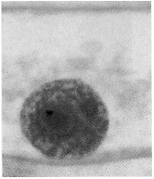
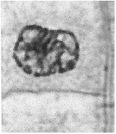
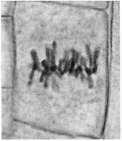
Stages of mitosis I
Interphase (G2)
Late prophase
Metaphase
Microtubule spindle
Chromosomes not visible
Condensed chromosomes,
each contains two sister chromatids
Condensed chromosomes,
aligned on central plane of spindle

Slide 29
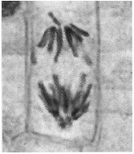
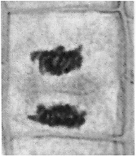
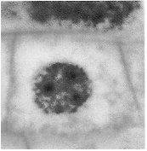
Stages of mitosis II
Anaphase
Telophase
Interphase (G1)
+
Condensation process reversed
Sister chromatids move to opposite poles of spindle
Two daughter cells

Slide 30
Summary
DNA replication is semi-conservative
DNA synthesis is mediated by DNA polymerases
DNA polymerases require a template and a primer
DNA synthesis occurs in the 5’ to 3’ direction
Nucleoside analogs lacking a 3’-OH terminate the chain
The replication fork, leading and lagging strands
Proof reading mechanism
Replication of E.coli and mammalian chromosomes
Phases of the life cycle of a eukaryotic cell
Stages of mitosis

