Slide 1
Nucleic acids and chromosomes
Birgit Leitinger b.leitinger@imperial.ac.uk
Course code (MBBS) : Nucleic Acids 1
Course code (BMS) : NAGE-L1

Slide 2
Nucleic acids and gene expression
Nucleic acids and chromosomes
DNA replication, the cell cycle and mitosis
Gene organisation and transcription I
Gene organisation and transcription II
Protein translation and translational modification
Analysis of nucleic acids

Slide 3
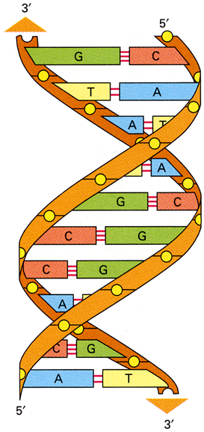
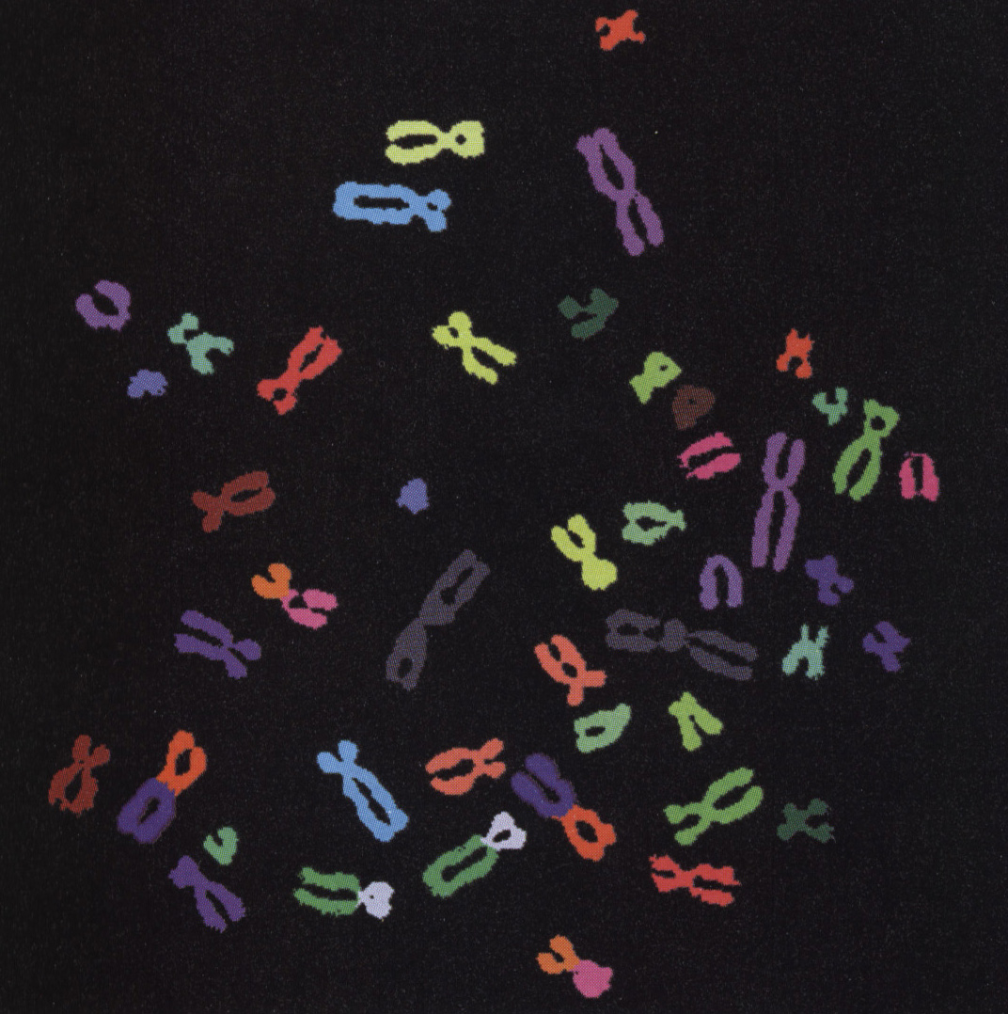
Nucleic acids and chromosomes
Overview
Chemical composition of DNA
Structure of DNA
How cells package DNA

Slide 4
Nucleic acids
DNA and RNA: molecules of heredity
DNA carries genetic information. The genes of all cells are made of DNA.
Chromosomes (DNA + proteins) segregate as cells divide.

Slide 5
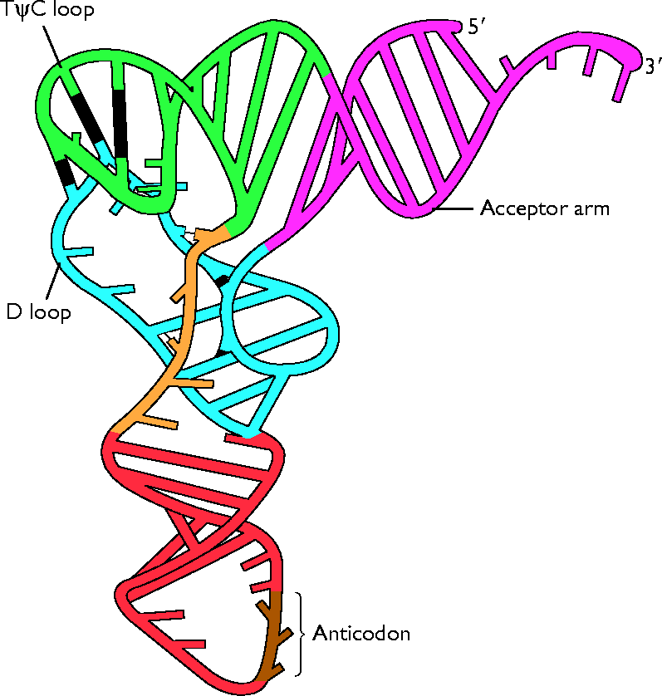
Nucleic acids
Nucleic acids are linear polymers of nucleotides.
DNA and RNA each contain 4 different types of nucleotides that are arranged in different sequences.
DNA
A C G T
RNA
A C G U
3D structure of DNA: double helix made up of two chains wrapping around each other.
RNA can assume a variety of shapes.
tRNA
DNA

Slide 6
DNA -deoxyribonucleotide acid
DNA is is a linear polymer of deoxyribonucleotide units
A nucleotide consists of a nitrogenous base, a sugar and one or more phosphate groups
N
H
2
N
N
H
H
N
N
O
O
O
H
_
5’
O
P
O
P
O
P
O
C
H
O
_
_
_
4’
1’
O
O
O
H
3’
2’
H
A nucleotide: deoxyadenosine 5’triphosphate
dATP
HO
H

Slide 7
Sugars - deoxyribose or ribose
DNA: deoxyribose, lacks an oxygen atom that is present in ribose, the parent compound.
RNA: Ribose.
Primes (’) are used in numbering the carbon atoms in the ribose: 1’ to 5’. The 1’ C is linked to the base; the 5’ C is linked to the phosphate.
H
H
H
H
5’
C
O
5’
C
O
HO
4’
1’
HO
4’
1’
H
3’
2’
H
H
3’
2’
H
HO
H
HO
OH
Deoxyribose
Ribose

Slide 8
DNA and RNA bases
H
There are 5 different bases; but each type of nucleic acid (DNA or RNA) contains only 4 bases
6
N
N
5
7
1
2
4
8
H
3
9
H
N
N
2 big ones (purines):
adenine (A), guanine (G)
2 small ones (pyrimidines):
cytosine (C), thymine (T)
OR: cytosine (C), uracil (U)
H
Purine ring
H
4
H
N
5
3
2
6
DNA contains A, C, G, T
RNA contains A, C, G, U
1
H
N
H
Pyrimidine ring

Slide 9
Purines
amino group
carbonyl group
H
N
H
2
O
6
N
N
H
N
N
5
7
N
1
8
N
2
H
H
H
3
4
9
H
N
N
H
N
N
N
H
2
N
N
H
amino group
Purine
Adenine
(A)
Guanine
(G)

Slide 10
Pyrimidines
amino group
carbonyl group
methyl group absent in uracil
H
N
H
2
O
O
H
H
H
C
H
3
H
H
N
4
5
N
N
N
3
2
6
1
O
N
H
O
N
H
O
N
H
H
N
H
Pyrimidine
Cytosine
(C)
Thymine
(T)
DNA only
Uracil
(U)
RNA only

Slide 11
Nucleosides
Base + (deoxy)ribose = nucleoside
Base Nucleoside
adenine (deoxy)adenosine
guanine (deoxy)guanosine
cytosine (deoxy)cytidine
uracil (deoxy)uridine
thymine (deoxy)thymidine
N
H
2
base (adenine)
N
N
9
N
N
H
O
5'
O
4'
1'
β-Glycosidic linkage
3'
2'
ribose
O
H
O
H
Adenosine

Slide 12
Nucleotides
Base + ribose + phosphate = nucleotide
Examples:
N
H
N
H
2
2
N
N
N
N
N
O
O
O
N
O
O
-
O
P
O
-
O
P
O
P
O
P
O
O
O
3'
2'
O
-
3'
2'
O
-
O
-
O
-
O
H
O
H
O
H
H
adenosine monophosphate
(AMP)
deoxycytidine triphosphate
(dCTP)

Slide 13
DNA - polymer of deoxyribonucleotide units
N
H
2
A long chain of deoxyribonucleotide units linked by phosphodiester links.
The 3’-OH of sugar of one nucleotide is linked to phosphate group, which in turn is joined to 5’-OH of adjacent sugar.
On each deoxyribose there is a base.
The chain has two ends, the 5’ end and the 3’ end. It is not symmetrical.
5' end
N
N
O
O
P
O
-
N
N
O
5'
N
H
O
2
3'
N
O
H
O
P
O
-
N
O
O
5'
O
O
3'
N
N
H
O
H
O
P
O
-
N
N
N
H
2
O
5'
O
3'
3' end
O
H
H

Slide 14
DNA primary sequence
The primary structure of a nucleic acid chain is the sugar-phosphate backbone with the bases, defined by the linear sequence of the bases. The bases carry genetic information, the sugar and phosphates perform a structural role.
By convention, the nucleotide sequence is specified from the 5’ to the 3’ end. The first nucleotide in a sequence has a free 5’ phosphate, and the last one a free 3’ OH.
Here: ACG (or 5’ACG3’)
N
H
2
A
N
N
5'
O
O
P
O
-
N
N
O
5'
N
H
O
2
3'
C
N
O
H
O
P
O
-
N
O
O
5'
O
G
O
3'
N
N
H
O
H
O
P
O
-
N
N
N
H
2
O
5'
O
3'
3'
O
H
H

Slide 15
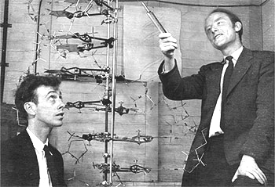
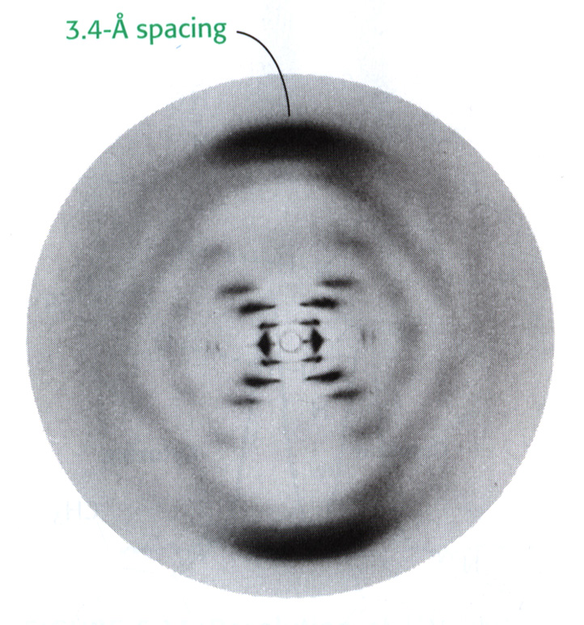
DNA secondary structure
1953: Watson and Crick determine double helical DNA structure through analysis of diffraction patterns from DNA fibers taken by R Franklin and M Wilkins.
3.4 Å spacing
X-ray diffraction pattern

Slide 16
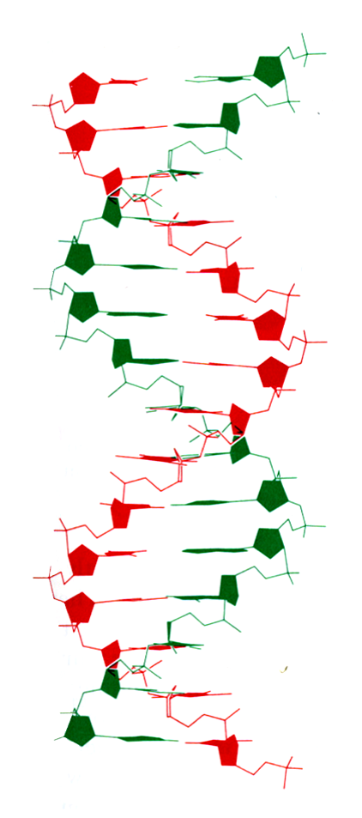
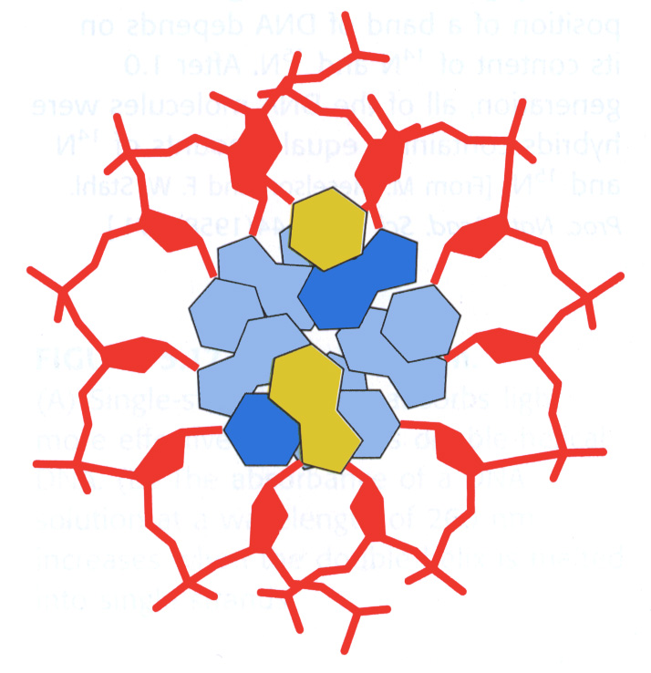
The double helix
5’
3’
Two strands of DNA run alongside each other forming a right-handed double helix.
The chains are antiparallel - they run in opposite directions.
The deoxyribose and phosphate groups run along the outside with the negative charges outside.
The bases point inwards and the flat planes are perpendicular to the helix.
The two chains are held together by hydrogen bonds between the bases.
10 bp per helical turn
3’
5’
Top view
2 nm wide

Slide 17
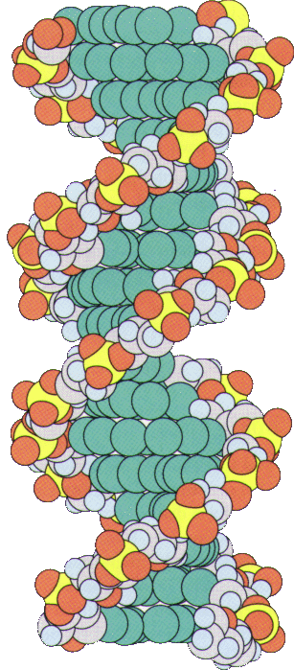
The double helix
phosphate backbone on the outside
minor groove
DNA bases buried on the inside
Hydrogen bonds between the bases stabilise the structure. Pairing of specific bases (Watson - Crick base pairs).
major groove

Slide 18
Hydrogen bonding
Watson-Crick base pairs
H
H
O
H
N
N
N
N
H
O
C
H
3
N
N
H
N
N
N
H
N
N
N
N
N
N
H
O
O
H
Adenine
(A)
Thymine
(T)
Guanine
(G)
Cytosine
(C)
2 hydrogen bonds
→ less stable
3 hydrogen bonds
→ more stable

Slide 19
Sequence complementarity of DNA strands
Most important aspect of DNA double helix: Specificity of pairing of bases. Adenine always pairs with Thymine. Guanine always pairs with Cytosine.
The two strands are complementary in their sequence. If the sequence of one strand is known, the sequence of the other strand follows.
Hydrogen bonds
5’
3’
C
G
A
T
G
C
G
C
T
A
3’
5’

Slide 20
Melting and re-annealing
5’ AATCGAACACCGTACCGT 3’
||||||||||||||||||
3’ TTAGCTTGTGGCATGGCA 5’
Heat or low salt
Melt or denature
T
A
C
G
C
C
G
T
3’
5’
A
A
C
T
C
G
A
A
C
A
+
T
T
A
G
C
T
G
T
T
G
3’
G
C
A
A
5’
T
G
C
G
Cool or high salt
Re-anneal or hybridise
5’ AATCGAACACCGTACCGT 3’
||||||||||||||||||
3’ TTAGCTTGTGGCATGGCA 5’

Slide 21
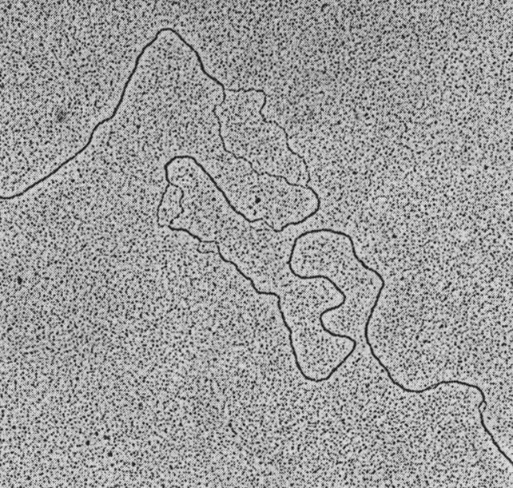
Partially unwound E.coli DNA
Electron micrograph of DNA molecule partly unwound by alkali

Slide 22
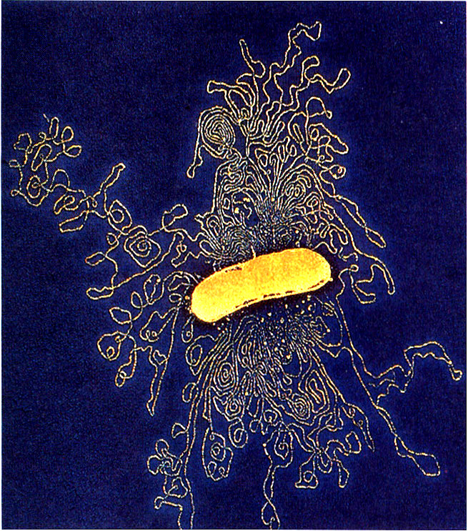
The E.coli genome
The entire DNA coding for an organism constitutes its genome. E.coli has 4.6 x 10⁶ base pairs in a single circular double-stranded molecule. The length of E.coli DNA is 1.4 mm.
Electron micrograph of part of the E.coli genome

Slide 23
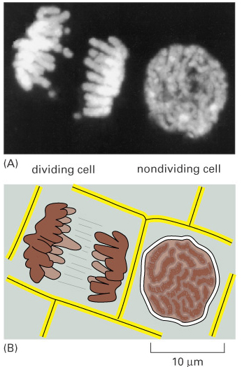
The human genome
~ 3 x 10⁹ base pairs of DNA divided into chromosomes that each contain a single, linear double-helical DNA molecule of ~ 200 x 10⁶ base pairs.
The sequence of the human genome is now completed
Chromosomes are visible only just before cells divide but not in non-dividing cells
Mitotic chromosomes: highly condensed form of chromosomes
Interphase chromosomes: extended form
.
dividing
non-dividing
Human chromosomes stained with fluorescent dyes
dividing
non-dividing

Slide 24
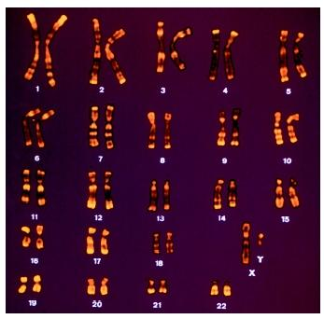
The karyotype
A karyotype is an organised profile of someone’s chromosomes.
A diploid human cell has 46 chromosomes
22 pairs of ‘normal’ chromosomes (autosomes) and
2 sex chromosomes (X and Y)
Sex chromosomes: XX for female; XY for male
Two homologues of each chromosome
G-banded karyotype of a normal male cell

Slide 25
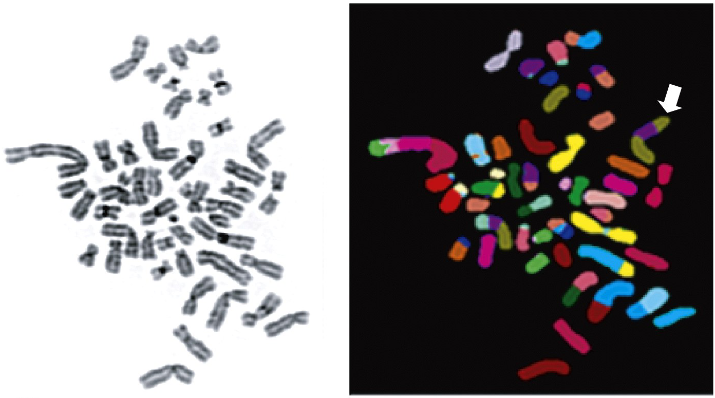
Abnormal karyotype
General DNA stain
Fluorescently labelled chromosomes
Abnormalities in breast tumour: 48 chromosomes instead of 46, multiple translocations, eg two pieces of chromosome 8 (green) plus piece of chromosome 17 (purple).

Slide 26
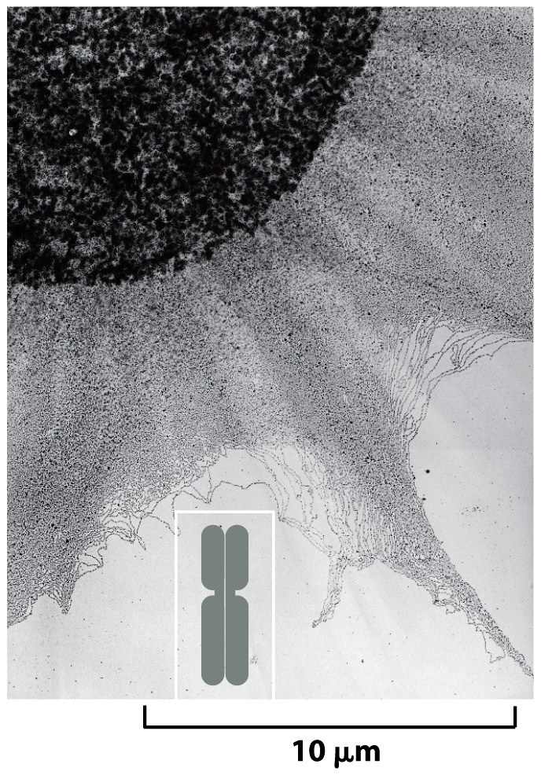
DNA in interphase chromosomes
DNA in interphase chromosomes is less compact than that in mitotic chromosomes.
Electron micrograph showing chromosomal DNA spilling out of lysed interphase nucleus.
Outline of condensed, mitotic chromosome shown at the same scale.

Slide 27
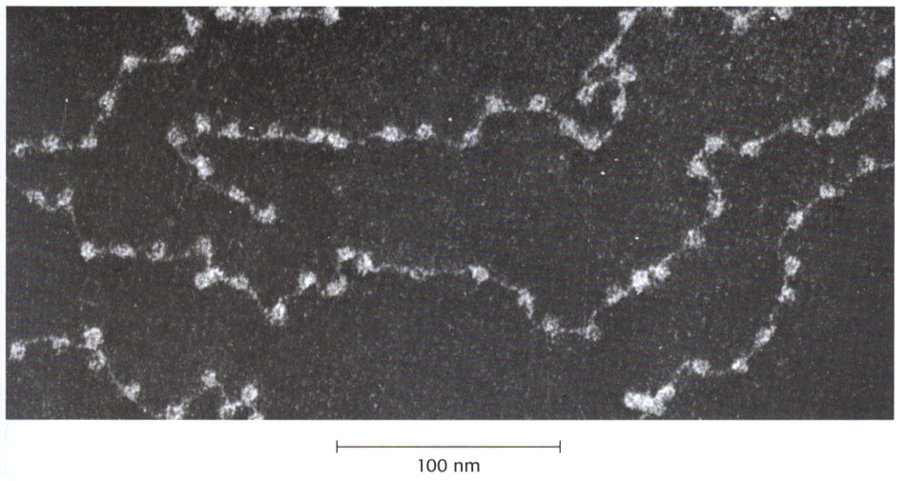
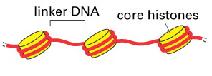
Packaging of eukaryotic DNA
The DNA in a diploid human cell: nearly 2 m long; yet the nucleus is only 5 - 8 μm in diameter!
Eukaryotic DNA is tightly packaged, forming a complex with proteins. This complex is called chromatin. During interphase, when cells are not dividing, chromatin is more extended. Further condensation during mitosis produces chromosomes.
The lowest level of packaging is the nucleosome, which consists of DNA wrapped around histone proteins.
Core DNA
100 nm
Nucleosome includes ~ 200 bp DNA
(linker DNA plus core DNA)
Electron micrograph of chromatin showing
nucleosomes as bead-like particles

Slide 28
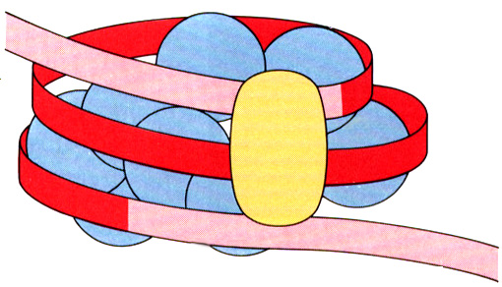
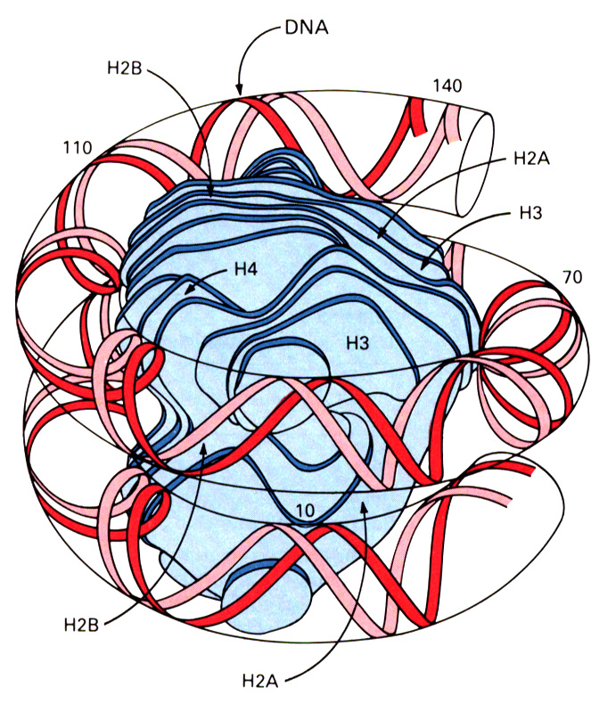
Structure of the nucleosome
8 histones; 2 each of 2A, 2B, 3 and 4
Histones: positively charged; interact with negatively charged sugar-phosphate backbone of DNA
About 150 base pairs of DNA wrapped around the histones (core DNA)
Histone 1 between the nucleosomes
Linker DNA
Model of nucelosome core showing DNA wound in left-handed superhelix around the histone octamer

Slide 29
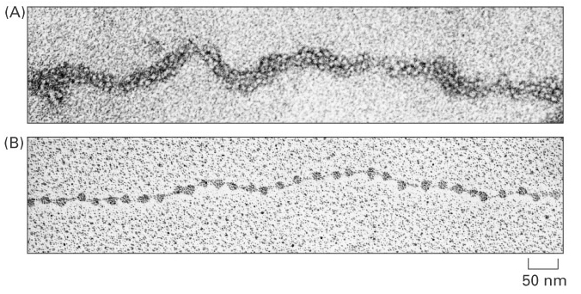
Packaging of the nucleosomes
The nucleosome causes an approximately 7-fold condensation of DNA. (200 bp ~68nm; wrapping around histone octamer ~10 nm)
The chain of nucleosomes is further packed to generate a more compact structure: the 30 nm fiber, giving ~40-fold condensation.
30 nm fiber
30 nm
Beads on a string unpacked chromatin
50 nm
In the interphase nucleus the DNA is further condensed about 100-1000 fold.

Slide 30
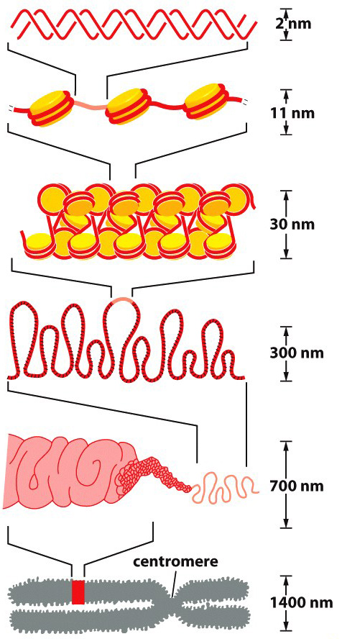
Chromosomes
DNA double helix
Beads on a string form of chromatin
Net result: each DNA molecule has been packaged into a mitotic chromosome that is 10 000 fold shorter than its extended length.
30 nm chromatin fiber of packed nucleosomes
Section of chromosome in extended scaffold (interphase chromosome)
Condensed section of chromosome
Entire mitotic chromosome

Slide 31
Summary
DNA and RNA bases - purines and pyrimidines, the four bases of DNA (A, T, G, C) and of RNA (A, U, G, C)
Sugars in DNA and RNA - deoxyribose and ribose
Nucleotides and nucleosides
DNA: polymer of deoxyribonucleotide units
Primary sequence of DNA specifies genetic information
DNA double helix - antiparallel complementary strands
Melting and annealing of complementary strands
Watson-Crick base pairing: G-C and A-T
Genomes of E.coli (a single circular DNA molecule) and Homo Sapiens (46 chromosomes contain linear DNA)
The human karyotype
Packaging of eukaryotic DNA - chromatin and chromosomes

