Slide 1
Introduction to thoracic anatomy: the thoracic wall
Dr Paul Strutton
Department of Surgery & Cancer
Faculty of Medicine
Thursday 14 February 2013

Slide 2
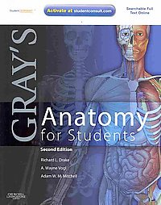
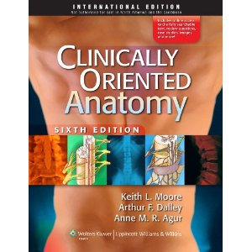
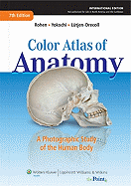
Textbooks

Slide 3
Working with cadavers
Always remember that the cadavers were donated by generous people to help you become a good doctor
Feelings of unease or apprehension are common, but seldom persist beyond the first session
There is no shame in feeling faint or wobbly – the important thing is to avoid hurting yourself by falling against something hard or sharp
If you feel faint, tell your neighbour, get clear of tables etc and sit on the floor – someone will then help you out of the room

Slide 4
Effective study in the DR
Time is limited – don’t disrupt things by coming in late
Read the course guide before coming to the session
If you don’t understand something, ask your demonstrator to explain
Use the DR time to study specimen pots and dry bones as well as the cadaver

Slide 5
How to help us!
In the 13th floor lab
Note the number of your half-skeleton box
Put the bones to be used in the lid
Put them back in their correct box when you have finished
This will save hours of wasted time for our technical staff

Slide 6
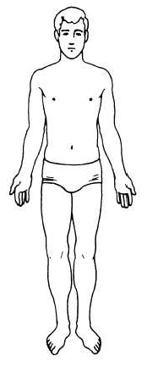
The anatomical position
Anterior (ventral)
Posterior (dorsal)
Superior
Inferior
Midline (median) means the mid-sagittal
Medial
Lateral
Proximal
Distal
Planes:
Sagittal:
Frontal (coronal)
Horizontal (transverse or axial)
Doctors need to describe body positions and relations with complete clarity.
The system of terminology used is based on the Anatomical Position.
The body is always described as if it were in this position regardless of its actual position.
Anterior (ventral)
Posterior (dorsal)
Superior (cranial, rostral)
Inferior (caudal)
Midline (median) means the mid-sagittal
Medial
Lateral
Proximal
Distal
Superficial
Deep
Sagittal
Frontal (coronal)
Horizontal (transverse or axial)

Slide 7
The thoracic skeleton and boundaries
Knowledge crucial for chest examination:
12 thoracic vertebrae
12 pairs of ribs and costal cartilages
Sternum

Slide 8
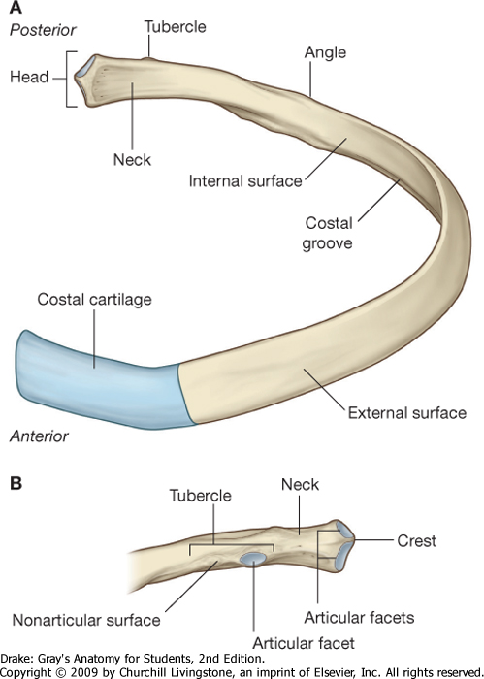
The Ribs
12 pairs
1-7 reach sternum (true)
Ribs 8-10 reach costal cartilage above (false)
11 and 12 lack anterior attachment (floating)
Articulations (= joints)
with vertebral column – heads
with costal cartilages – tubercles

Slide 9
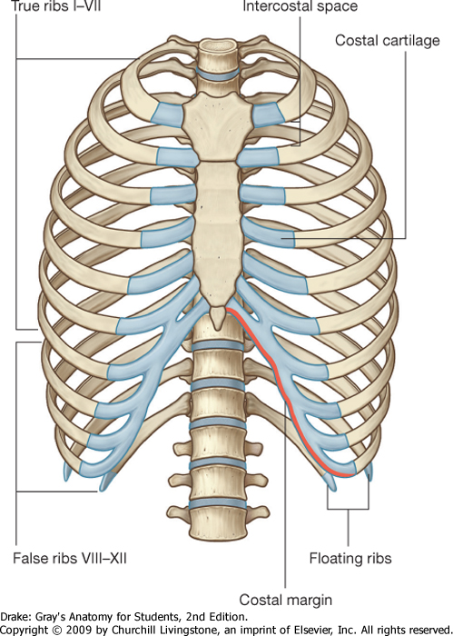
1st thoracic vertebra
Sternal angle
2nd rib
12th thoracic vertebra

Slide 10
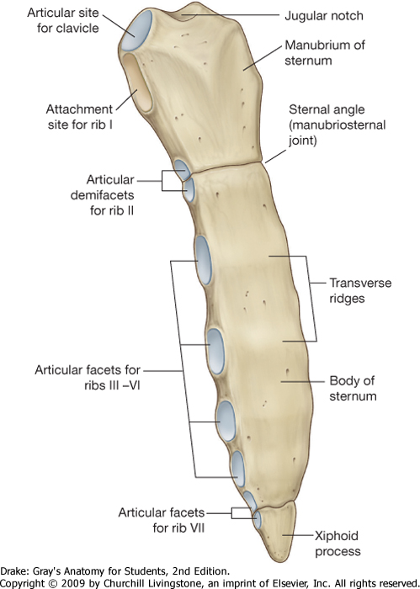
Sternum has 3 parts: manubrium, body & xiphoid
1st costal cartilages attach to manubrium
2nd to M-S joint
3rd – 7th to sternum
8th – 10th to cartilage above
11th & 12th - floating

Slide 11
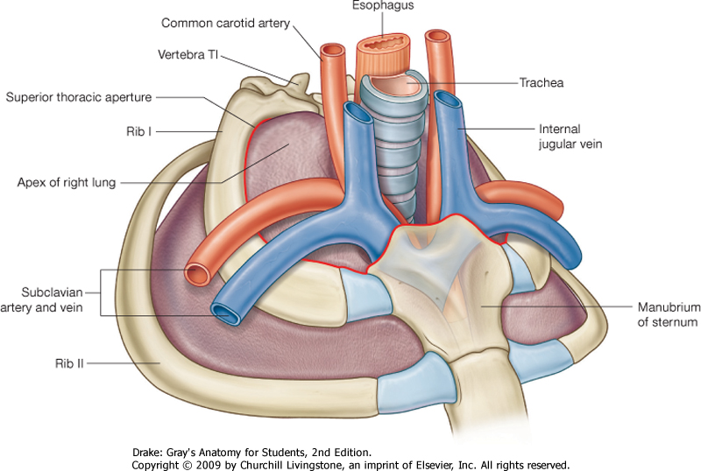
Thoracic inlet:
(superior thoracic aperture)
Ring formed of:
1st thoracic vertebra (T1)
1st ribs
Manubrium
Contents of thoracic inlet:
Great vessels heading for neck and upper limb, oesophagus, trachea, nerves and lymphatics

Slide 12
Most lung tissue and most capacity for lung expansion is in the lower parts of the thorax

Slide 13
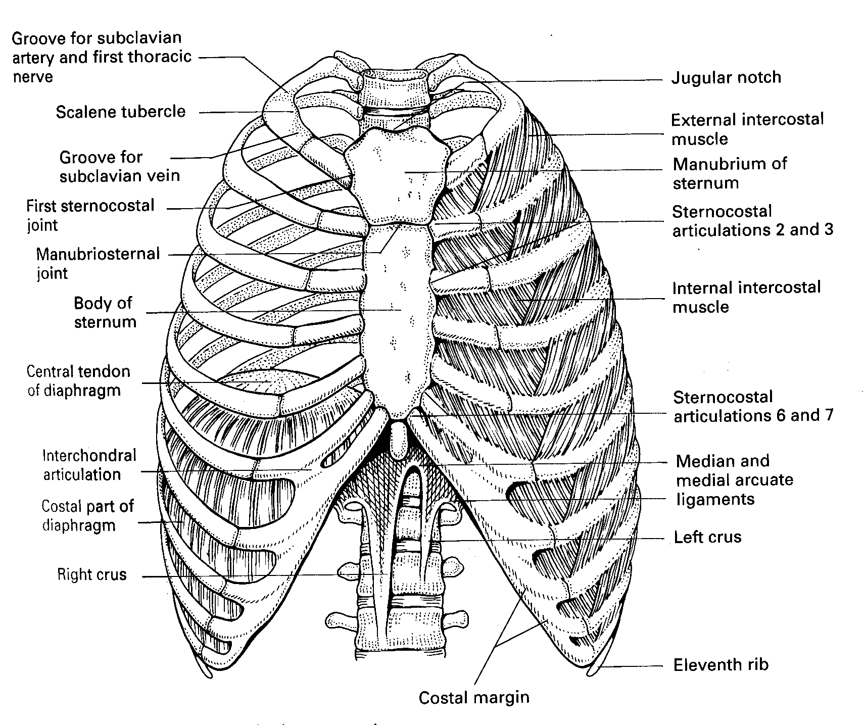
Muscles expanding chest and lung volume
Diaphragm: Has a flat central tendon with muscle radiating to costal margin and vertebrae. 1st – dome flattens to increase vertical diameter of chest. 2nd – pulls costal margin up to increase transverse and antero-posterior diameters

Slide 14
Muscles expanding chest and lung volume
Intercostals – have a secondary role – stiffen chest wall to improve efficiency of breathing movements

Slide 15
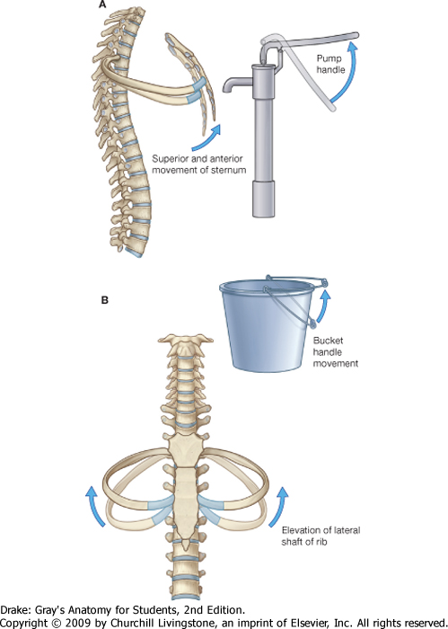
Movement of ribs to increase chest volume

Slide 16
The intercostal muscles
Three layers of muscles – organised like plywood
External intercostals – downwards and laterally from lower border of rib above to rib below.
Replaced by anterior intercostal membrane at costo-chondral (rib-cartilage) junction
2. Internal intercostals – attachments begin anteriorly at the sternum- from lower border of rib above to rib below - fibres directed at right angles to external intercostals.
Replaced by membrane posteriorly
3. Innermost intercostals – relatively trivial

Slide 17
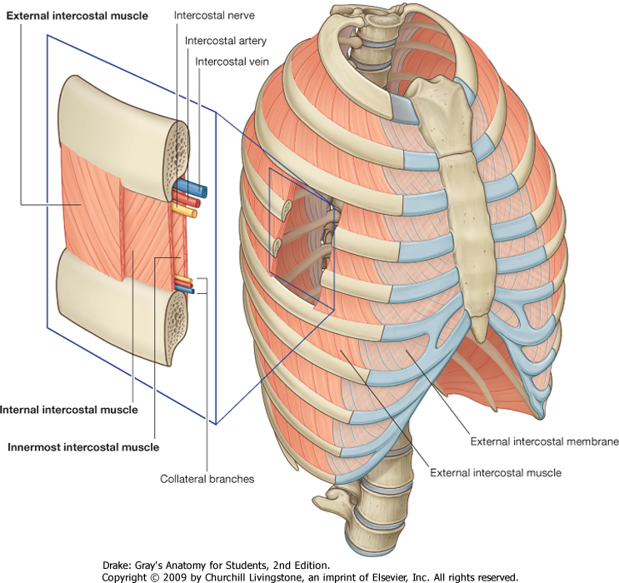
The intercostal muscles

Slide 18
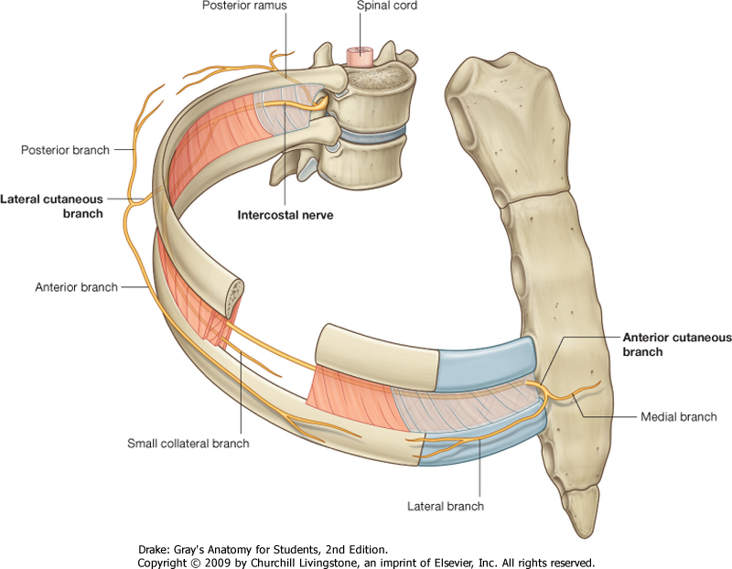
Intercostal nerves
11 pairs T1-T11 (+ 1 subcostal – T12)
Mixed (= motor + sensory)
Supply the intercostal spaces
Lateral cutaneous branch - anterior and posterior
Anterior cutaneous branch - medial and lateral

Slide 19
Intercostal neurovascular bundles
Vein, artery & nerve run just below rib deep to internal intercostal – closer together than shown
What are the implications for putting a needle or chest drain through the chest wall?

Slide 20
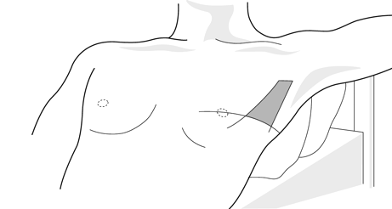
Area for inserting a chest drain
The safe area or triangle
Anterior border of the latissimus dorsi, the lateral border of the pectoralis major muscle, a line superior to the horizontal level of the nipple, and an apex below the axilla. 5th intercostal space anterior to mid axillary line

Slide 21
Intercostal neurovascular bundles
Each intercostal artery joins (anastomoses) with a major artery at each end of the intercostal space

Slide 22
The internal thoracic arteries:
branches of the subclavian arteries
Posterior (internal) view of anterior chest wall

Slide 23
Contents of the thoracic cavity
Filled laterally by the lungs - each lying in its pleural cavity
Space between the pleural cavities = mediastinum
Heart (lying in its pericardial sac)
Great vessels
Oesophagus
Trachea
Thymus
Thoracic duct and other major lymph trunks
Lymph nodes
Phrenic and vagus nerves

Slide 24
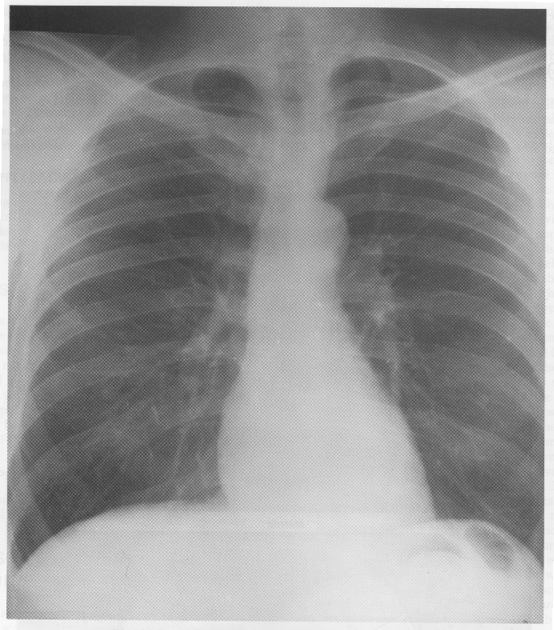
Main Areas of Chest
As seen on a PA radiograph of an adult
Blue line marks the diaphragm
Lung
Mediastinum

Slide 25
Safety and conduct in the DR Make sure you read the health and safety documentation on the intranet https://education.med.imperial.ac.uk/Years/1-1112/LSS/index.htm

