Slide 1
The Superior Mediastinum
Dr Paul Strutton
Department of Surgery & Cancer
Faculty of Medicine
Monday 25th February 2013

Slide 2
The Mediastinum
Is a thick midline partition that separates the two pleural cavities.
It extends from the superior thoracic aperture (inlet) to the inferior thoracic aperture and between the sternum anteriorly and the thoracic vertebrae posteriorly
It acts as a conduit for structures that pass through the thorax from one body region to another and for structures that connect thoracic organs to other body regions

Slide 3
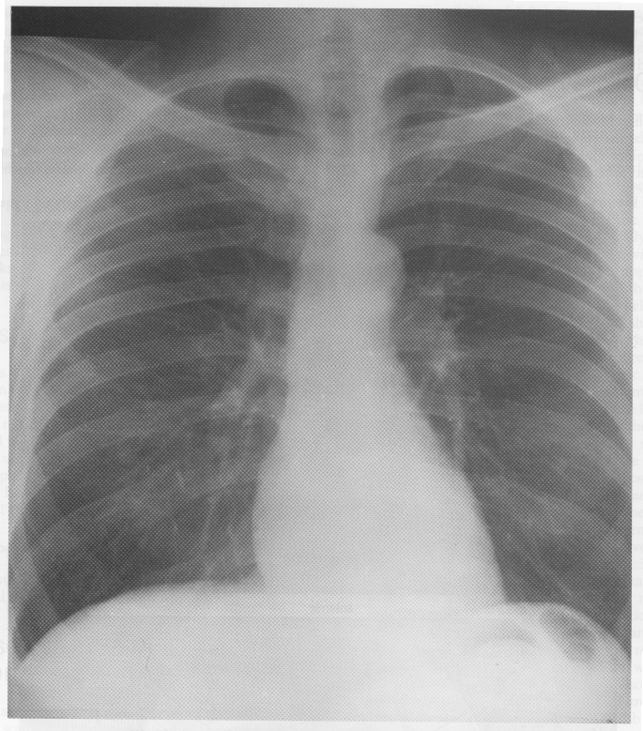
Lung
Mediastinum

Slide 4
Principal contents of the mediastinum
trachea - from larynx to bifurcation into principal (right and left main) bronchi
oesophagus- from pharynx - muscular tube – pierces diaphragm at level of T10
heart and pericardium
thoracic duct - lymphatic drainage
nerves
great vessels

Slide 5
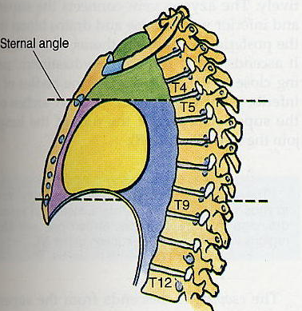
Divisions of the Mediastinum
Superior: above sternal angle
Inferior: below sternal angle
Anterior: anterior to heart in pericardial sac
Middle: pericardial sac & heart
Posterior: posterior to pericardial sac and diaphragm
Superior
Ant
Middle
Inferior
Post

Slide 6
Contents of the Superior Mediastinum
From anterior to posterior:
Thymus
Phrenic Nerves
Great veins
Main lymphatic trunks
Vagus nerves
Great arteries
Trachea and main bronchi
Upper oesophagus

Slide 7
The great veins
Superior Vena Cava (SVC) enters right atrium from above
Inferior Vena Cava (IVC) enters right atrium from below, through central tendon of diaphragm

Slide 8
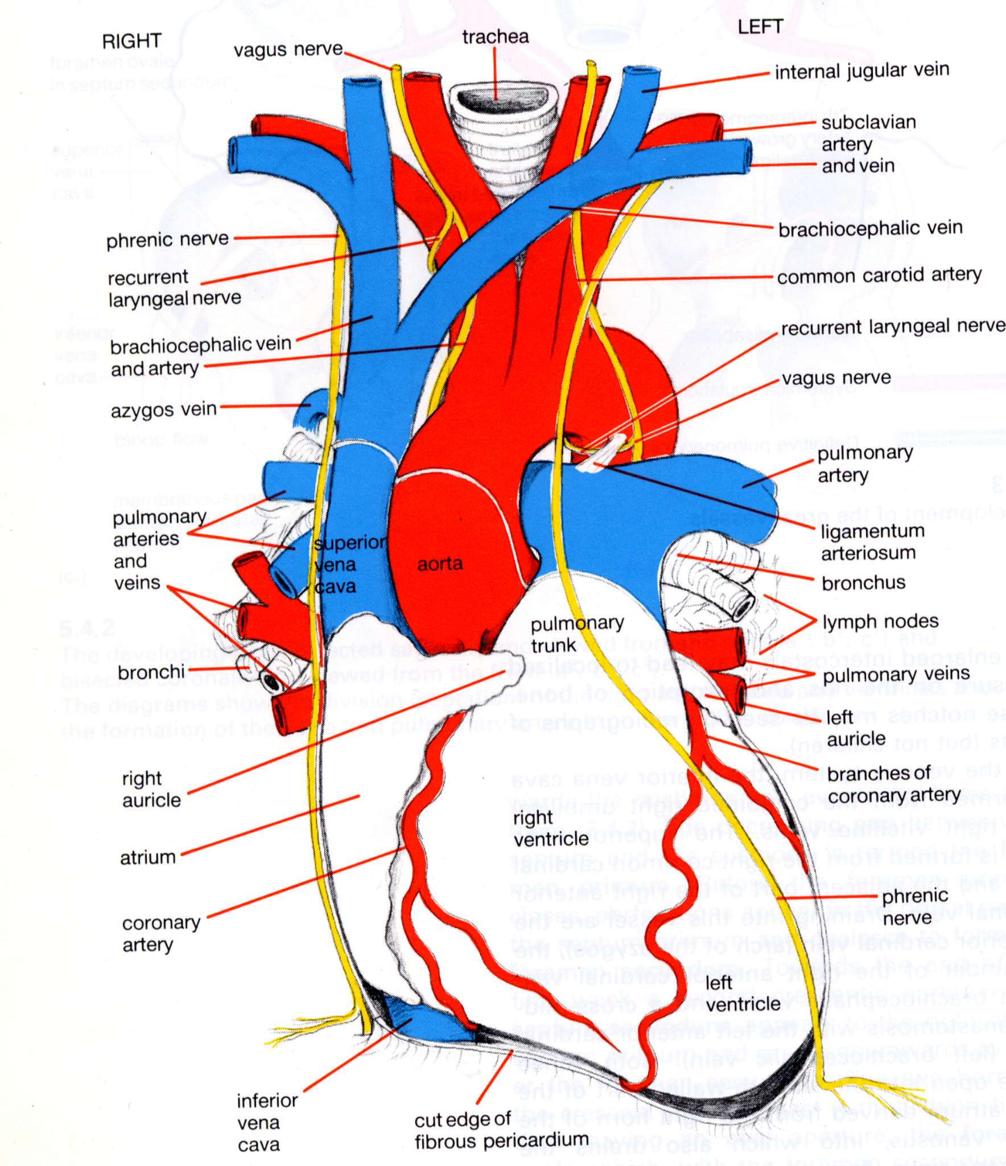
Superior Vena Cava:
Formed by asymmetric union of right and left brachiocephalic veins
Each brachiocephalic vein forms from an internal jugular vein and a subclavian vein

Slide 9
Tributaries of the Superior Vena Cava
Internal jugular veins from head & subclavian veins from upper limbs join to form left and right brachiocephalic veins
Left brachiocephalic vein crosses posterior to manubrium to join the right brachiocephalic vein to form the SVC

Slide 10
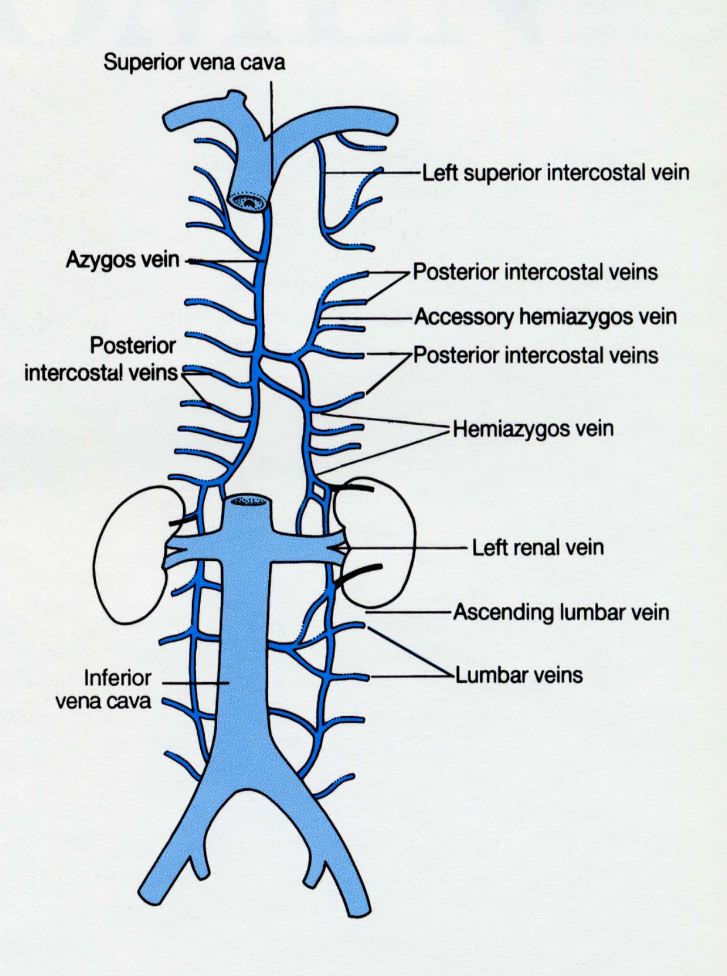
The Azygos Vein
(azygos = asymmetric)
Drains the posterior wall of the thorax and abdomen
Arches over the right lung root
Drains into the SVC

Slide 11
Arteries of the Superior Mediastinum
Ascending aorta
Arch of aorta
Descending aorta

Slide 12
Branches of ascending aorta and aortic arch
Ascending aorta:
Right and left coronary arteries (end arteries supplying heart muscle)
Aortic arch:
Brachiocephalic trunk – divides into right common carotid and right subclavian arteries
Left common carotid artery
Left subclavian artery

Slide 13
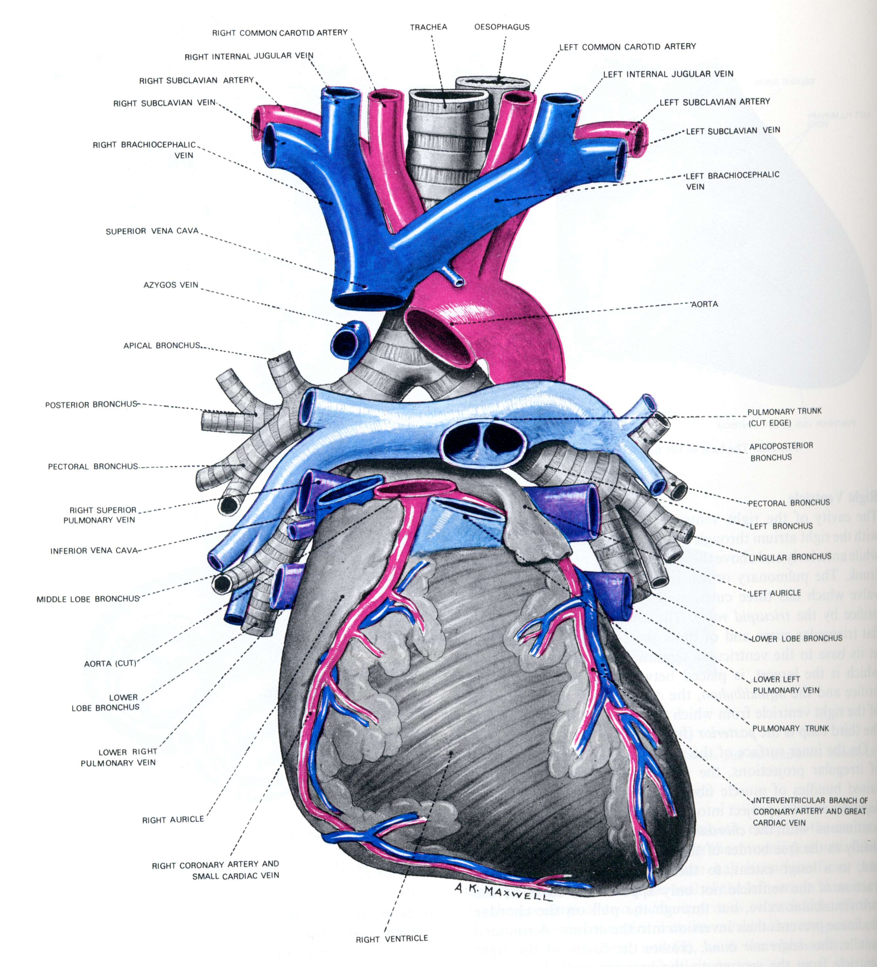
Brachiocephalic trunk
Left common carotid artery
Left subclavian artery
3 branches of aortic arch

Slide 14
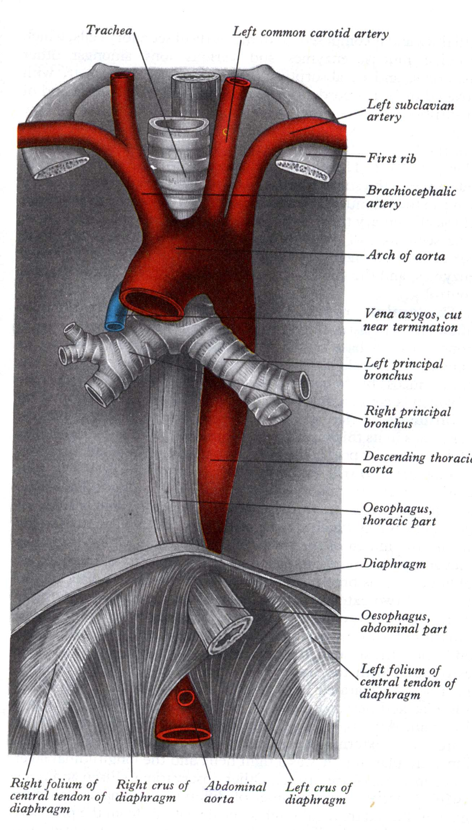
Relations of aorta and great arteries to the airway:
Aortic arch arises anterior to trachea
Arches over the left main bronchus at the lung root
Trachea lies behind & between brachiocephalic and left common carotid arteries

Slide 15
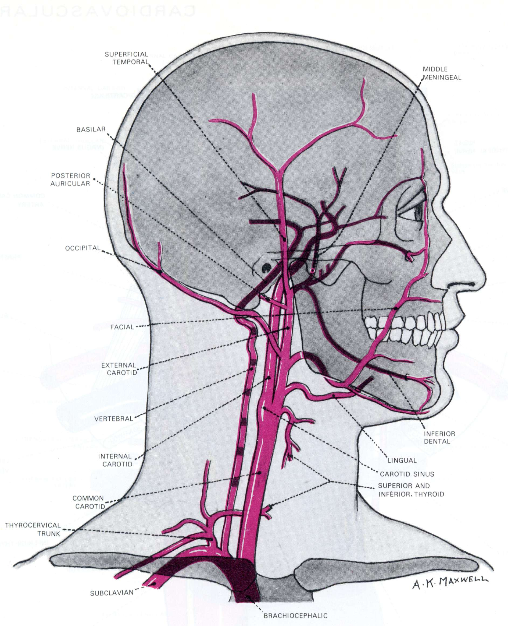
Distribution of common carotid arteries:
Divide into external and internal carotids high in neck
Main arteries of head and neck (with the vertebral arteries from the subclavian arteries)

Slide 16
Pulmonary trunk:
Outflow of right ventricle
Carries deoxygenated blood via left and right pulmonary arteries to lungs

Slide 17
The Pulmonary Trunk
Arises from the right ventricle
Carries deoxygenated blood to lungs
Divides into right & left Pulmonary Arteries
Ligamentum arteriosum connects PT to aortic arch. Is remnant of the ductus arteriosus – bypasses lungs in foetal life.

Slide 18
Phrenic Nerves
Formed in the cervical plexus from C3, 4, 5
Motor to the diaphragm
Sensory to:
central tendon of the diaphragm
mediastinal pleura
pericardium
peritoneum of central diaphragm
Right phrenic nerve reaches diaphragm lying on surface of:
right brachiocephalic vein
superior vena cava
right side of heart and pericardium - in front of lung root

Slide 19
Relations of great arteries to main nerves:
Vagus nerves lateral to common carotids
Left vagus passes anterior to aortic arch
Left phrenic crosses vagus to cross aortic arch more anteriorly

Slide 20
Left phrenic and vagus nerves:
Cross arch of aorta
Left phrenic descends in front of root lung
Left vagus crosses behind root lung gives off left recurrent laryngeal nerve – recurs (=turns back) around ligamentum arteriosum and aortic arch
Breaks up into many branches round oesophagus

Slide 21
Right vagus nerve:
Lies on the trachea
Crosses behind the root lung
Recurrent laryngeal branch – recurs (turns back) around right subclavian artery
Breaks up into branches on oesophagus

