Slide 1
Posterior mediastinum
Dr Paul Strutton
Department of Surgery & Cancer
Faculty of Medicine
Monday 4th March 2013

Slide 2
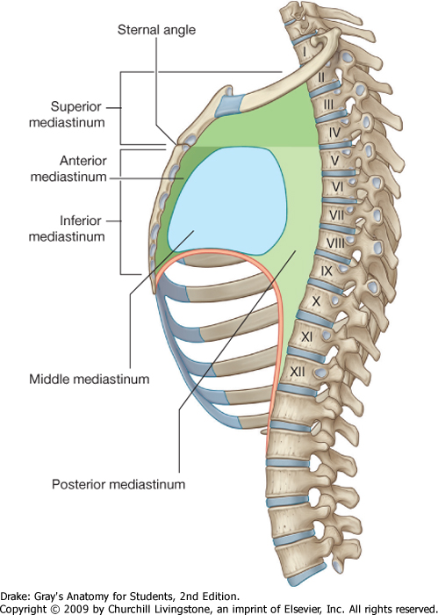
Post

Slide 3
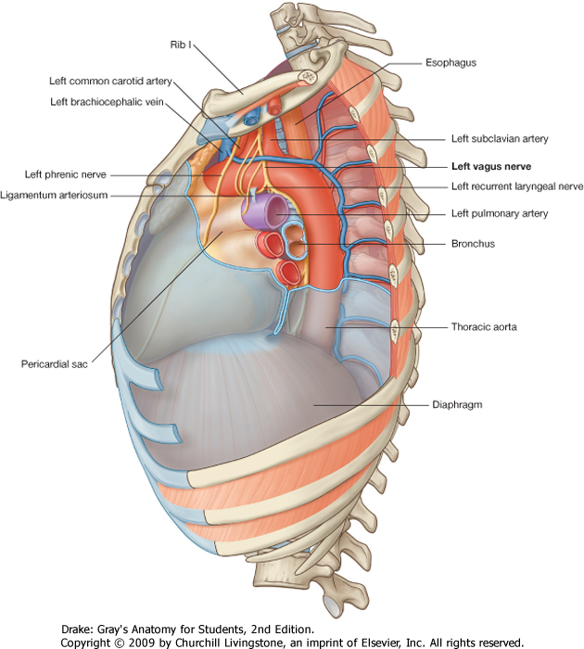
Mediastinum left lateral view

Slide 4
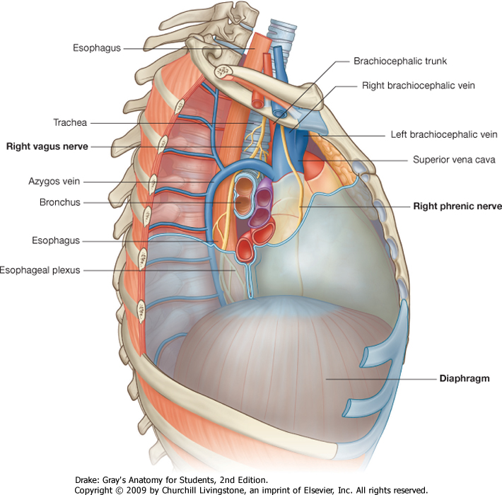
Mediastinum right lateral view

Slide 5
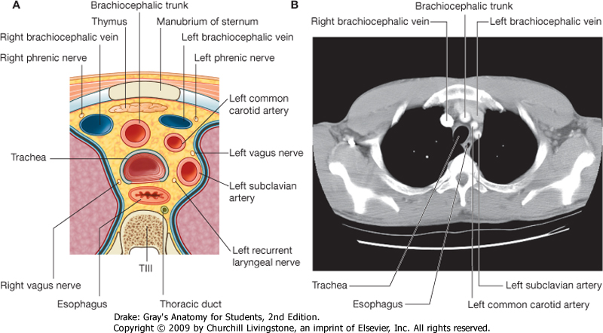

Slide 6
Contents of Posterior Mediastinum
Oesophagus
Descending aorta
Thoracic duct
Azygos venous system
Posterior mediastinal lymph nodes
Thoracic sympathetic trunks
Splanchnic nerves

Slide 7
Oesophagus
Begins at level of C7 vertebra
Ends at stomach, level of T11 vertebra
Bends more anteriorly at T7
Is right of aorta above T7
Deviates to left at T7
Progressively anterior to aorta below T7
Passes through diaphragm at T10
Has constrictions at four locations

Slide 8
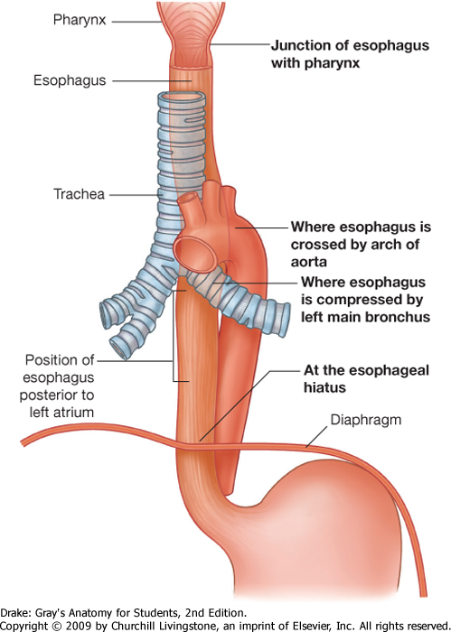
Constrictions of the oesophagus

Slide 9
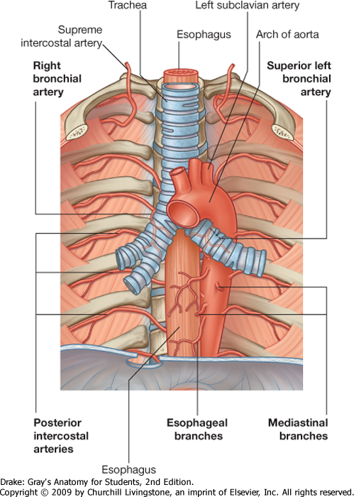
Arteries of the oesophagus

Slide 10
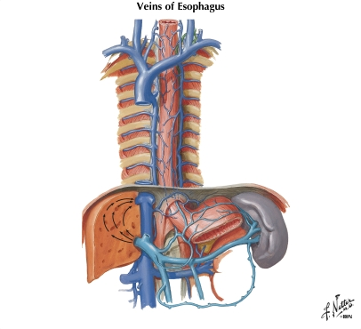
SVC
Hemiazygos V
Azygos
Veins of the oesophagus

Slide 11
Azygos Venous System
Drains posterior wall of chest and upper abdomen + posterior mediastinal organs
Usually accessory hemiazygos (upper) and hemiazygos (lower) veins on left cross thoracic vertebral bodies to join single axygos vein on right
Azygos vein arches over right lung root to enter SVC just above right atrium
Variable!

Slide 12
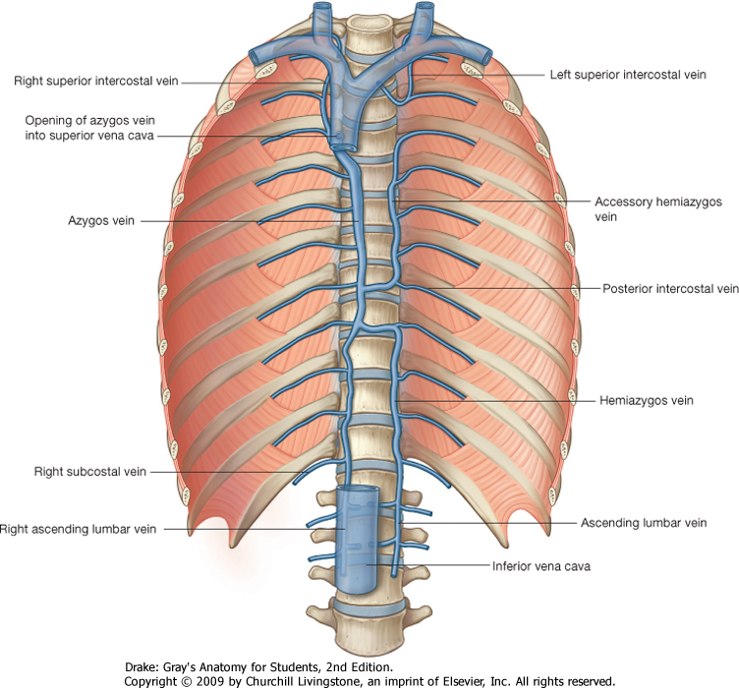

Slide 13
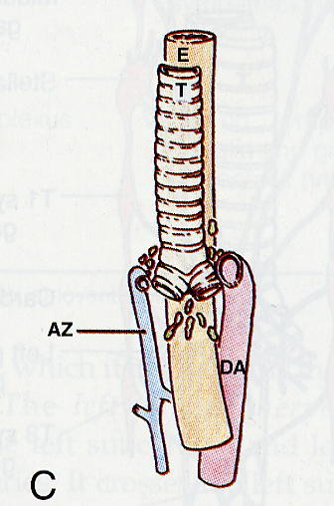
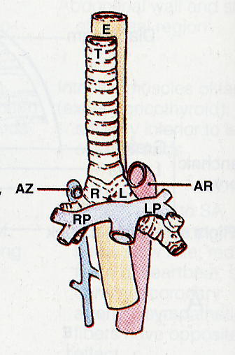
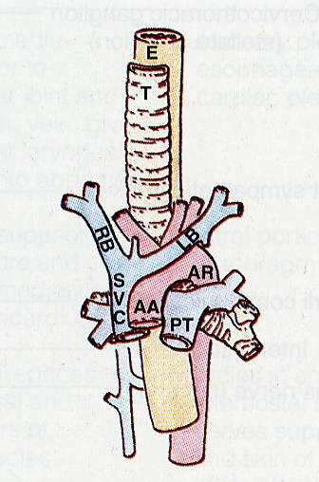
Relations of the Azygos Vein

Slide 14
Nerves within Inferior Mediastinum
Phrenics (C3, 4, 5) pass anterior to lung roots and cross pericardium to diaphragm
Vagi (Cranial nerve X) pass posterior to lung roots and form plexus following oesophagus into abdomen, giving branches to heart and lungs on the way
Sympathetic trunks lie on each side of the posterior mediastinum

Slide 15
Vagus nerves and their branches
Branches to chest and abdomen are parasympathetic (control smooth and cardiac muscle + glands of gut and airways)
Also large sensory from gut and lungs
Recurrent laryngeal nerve not parasympathetic – run back up neck to supply most skeletal muscles of larynx

Slide 16
Phrenic and vagus nerves

Slide 17
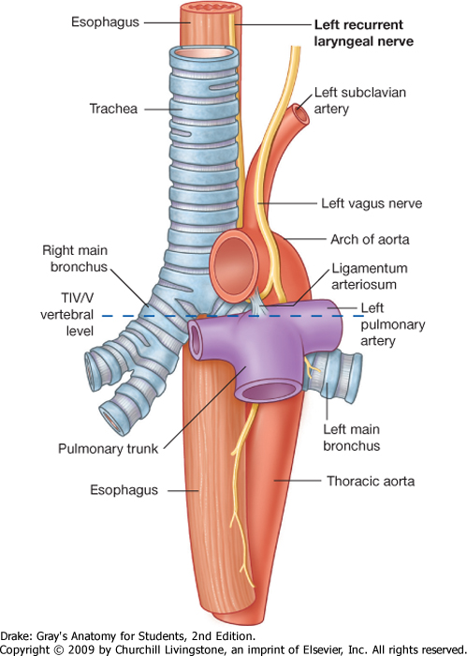
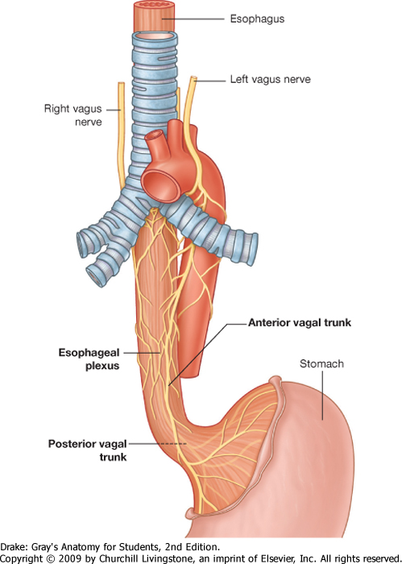
Vagus nerves

Slide 18
Sympathetic Trunks
Receive branches from spinal nerves T1 - L2
Distribute sympathetic nerves to smooth muscle and glands throughout body
Nerves to body wall synapse in ganglia of trunks
Nerves to internal organs (viscera) synapse in local ganglia
Also bring pain fibres back to CNS from viscera
Fibres from lower T5 - T12 reach abdomen in bundles called splanchnic nerves

Slide 19
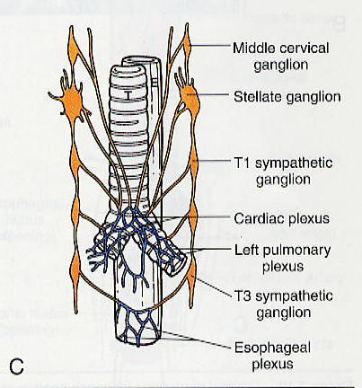
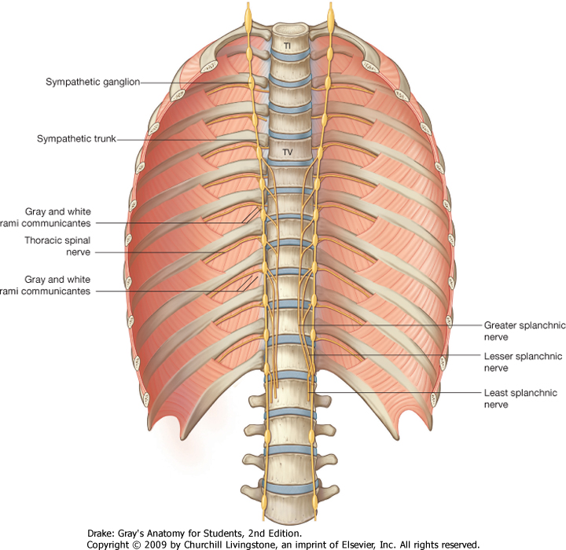

Slide 20
Thoracic Duct
Lymph duct returning lymph from lower limbs, pelvis, abdomen & left thoracic wall to blood
Begins below diaphragm at cisterna chyli
Starts between oesophagus and aorta on right
Crosses behind oesophagus to left side between T7 and T4
Drains into left brachiocephalic vein

Slide 21
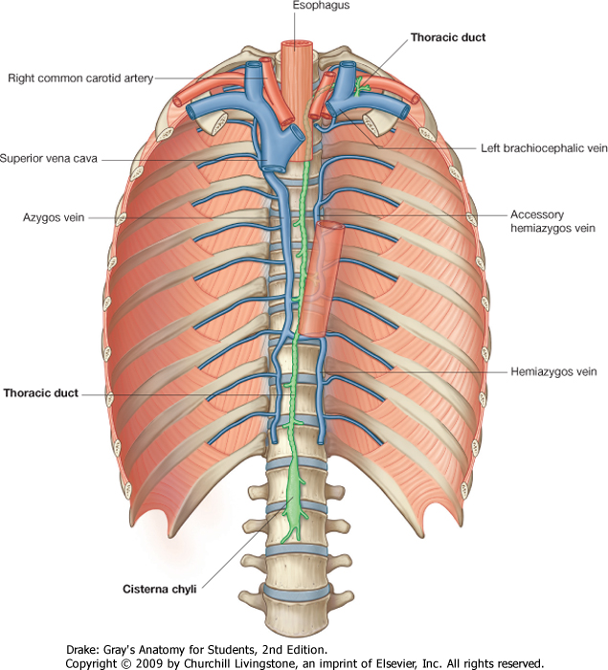

Slide 22
Review: Contents of Posterior Mediastinum
Oesophagus
Descending aorta
Thoracic duct
Azygos venous system
Posterior mediastinal lymph nodes
Thoracic sympathetic trunks
Splanchnic nerves

