Slide 1
Organisation of nerves in the thorax
Dr Paul Strutton
Department of Surgery & Cancer
Faculty of Medicine
Thursday 28th February 2013

Slide 2
Functional divisions of the CNS
Somatic (from Greek for body)
Skin and skeletal muscles
Autonomic or visceral (from Greek for guts)
Organs and parts of organs such as smooth muscle and glands

Slide 3
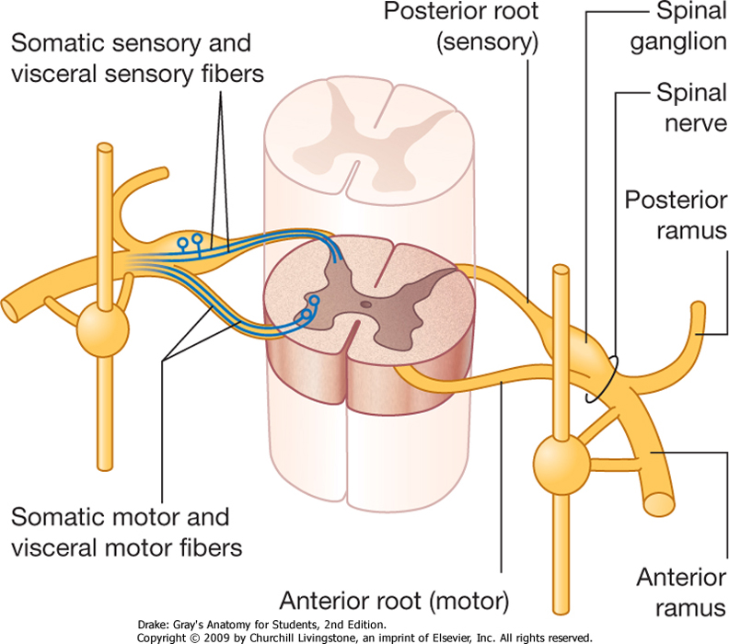
Somatic spinal nerves
Motor to skeletal muscle only
Skeletal muscle cannot function without them
Sensory to body wall but not to viscera
Segmental nerves may combine to form plexi supplying specialised areas (cervical, brachial, lumbosacral)

Slide 4
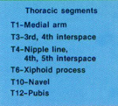
Dermatome
An area of skin which is supplied by a single spinal nerve on one side or from a single spinal cord
Myotome
Part of a skeletal muscle supplied by a single spinal nerve on one side or from a single spinal cord level

Slide 5
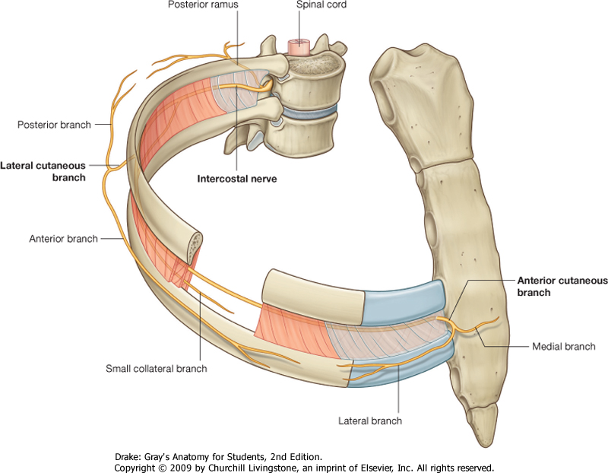
Intercostal nerves:
11 pairs (+ 1 subcostal)
Mixed (= motor + sensory)
Spinal or segmental nerves
(anterior primary rami)
Supply the intercostal spaces
Lateral cutaneous branch - anterior and posterior
Anterior cutaneous branch - medial and lateral

Slide 6
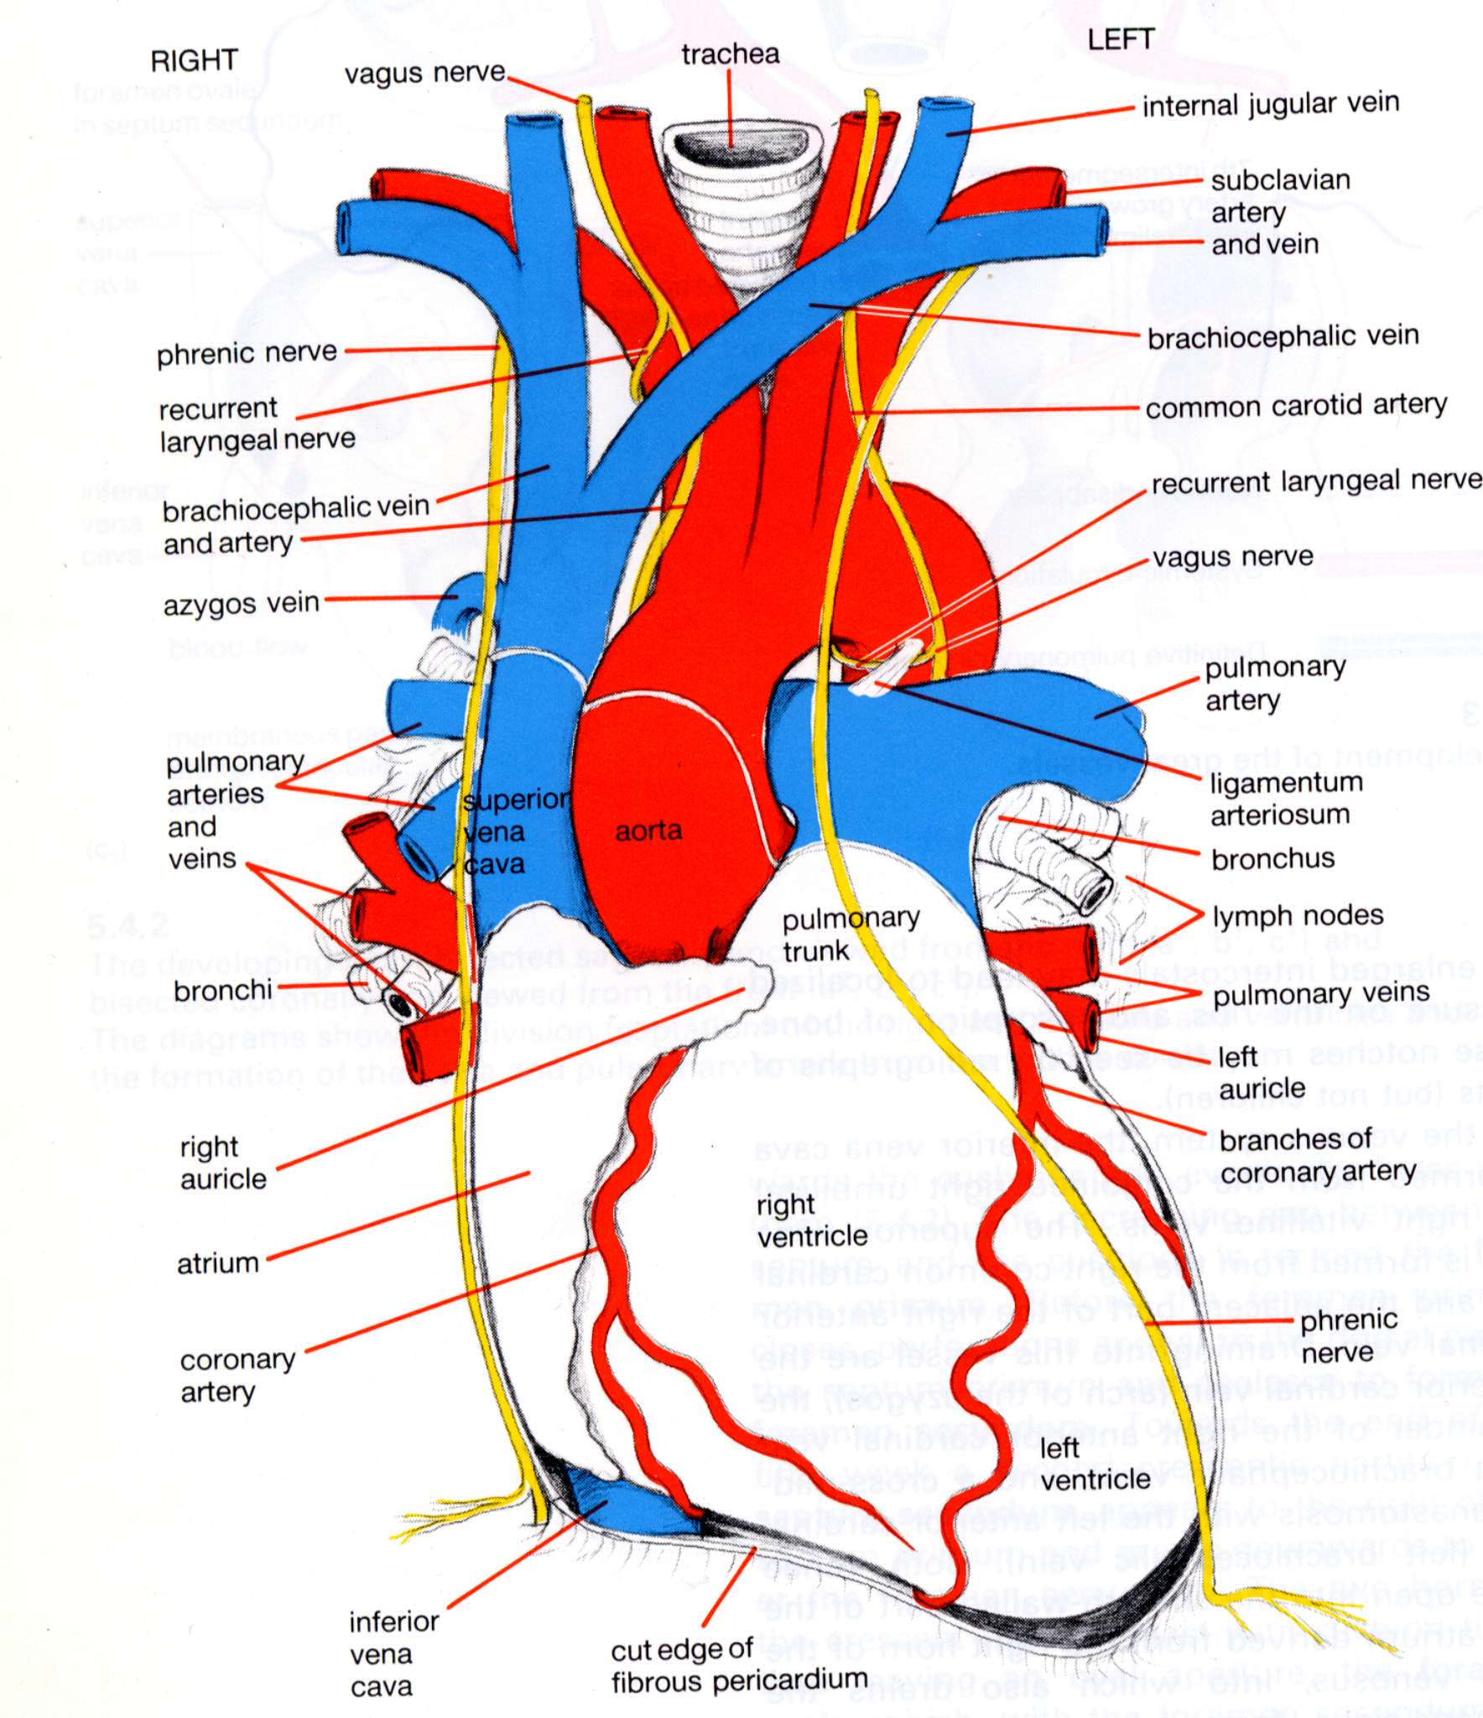
The Phrenic Nerves
Derived from anterior rami of spinal nerves C3 – C5
Somatic nerves – no autonomic function or visceral distribution
Motor fibres supply skeletal muscle of the diaphragm
“C3,4 and 5 keep the diaphragm alive”
Sensory fibres supply central diaphragm, its pleural covering, mediastinal pleura and pericardium
Also supply peritoneum on inferior surface of central diaphragm

Slide 7
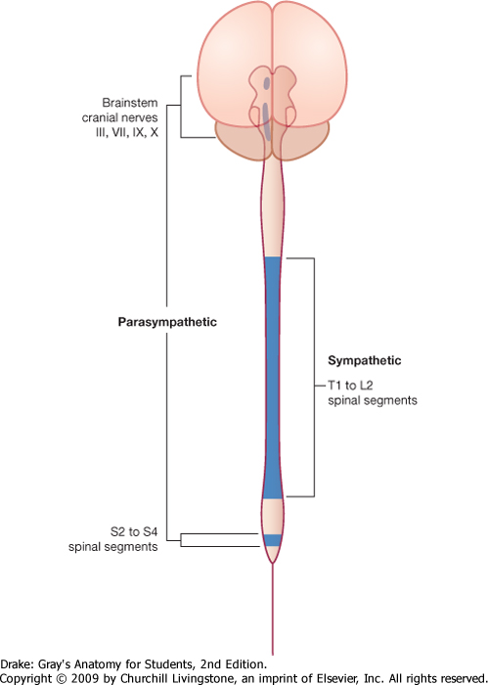
Autonomic nerves
Motor to cardiac muscle, smooth muscle and glands
Sensory to visceral organs
Divided into parasympathetic and sympathetic divisions
Different origins and distributions
Often but not always opposite in motor actions

Slide 8
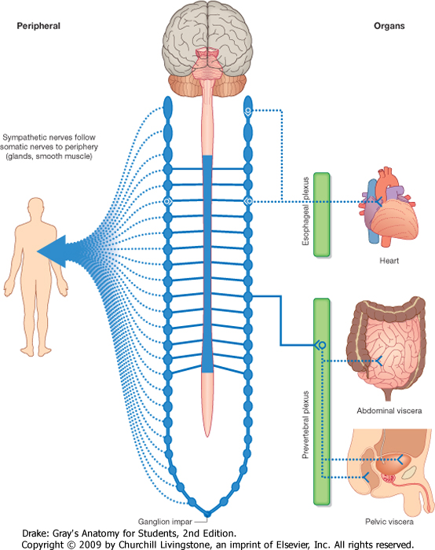
Sympathetic outflow from the spinal cord

Slide 9
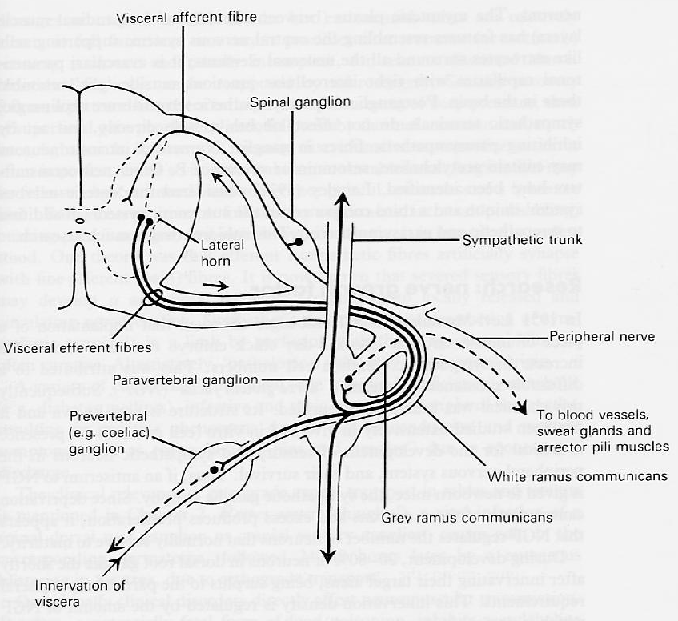
Sympathetic outflow from the spinal cord
All autonomic motor pathways involve preganglionic and postganglionic neurones
Pathways to body wall synapse in ganglia of sympathetic trunk
Visceral pathways synapse in unpaired ganglia
Trunks take fibres up or down

Slide 10
Sympathetic Trunks
Receive branches from spinal nerve T1 to L2
Distribute sympathetic nerves to smooth muscle and glands throughout body
Nerves to body wall synapse in ganglia of trunks
Nerves to viscera synapse in unpaired ganglia
Also bring pain fibres back to CNS from viscera
Fibres from lower T5-T12 reach abdomen in bundles called splanchnic nerves

Slide 11
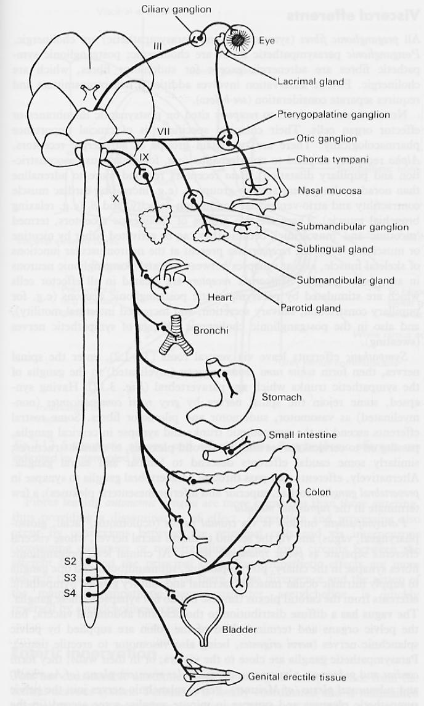
Parasympathetic Nerves
Five sets of nerves contain parasympathetic fibres:
Oculomotor (III) cranial nerves
Facial (VII) cranial nerves
Glossopharyngeal (IX) cranial nerves
Vagus (X) cranial nerves
Sacral (S2 – S4) spinal nerves
The first three will be considered with the head and neck. The most important now is the vagus, supplying the viscera of the thorax & most of the abdomen

Slide 12
Sympathetic nerves to the lungs and heart
Mainly from spinal nerves T2 – T4, passing through cervical and upper thoracic ganglia of sympathetic trunk
Many of their synapses are in micro-ganglia in the pulmonary and cardiac plexuses rather than in trunk ganglia

Slide 13
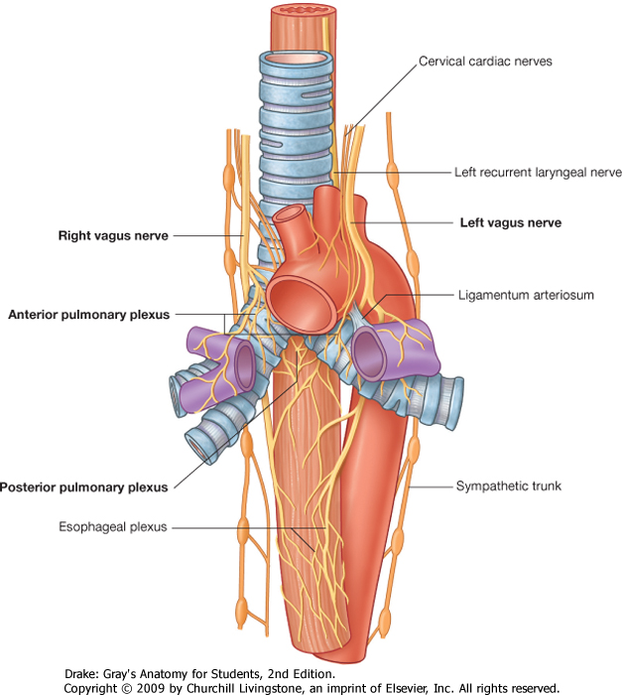
The pulmonary plexuses
Sympathetic nerves dilate the bronchioles
Parasympathetic (vagus) nerves constrict the bronchioles

Slide 14
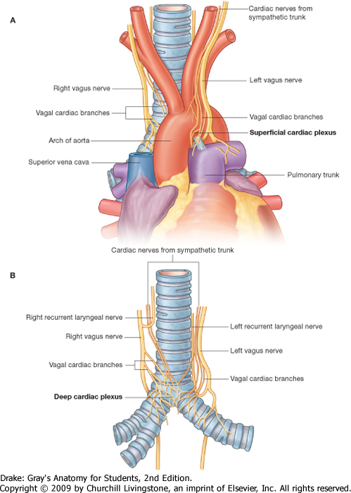
The cardiac plexuses
Sympathetic efferents increase heart rate and force of contraction
Parasympathetic efferents (vagus) decrease heart rate via the pacemaker tissue and constrict coronary arteries

Slide 15
The cardiac plexuses
Sympathetic afferents relay pain sensations from the heart
Parasympathetic afferents (vagus) relay blood pressure and chemistry information from the heart

Slide 16
Course of the Vagus Nerves
Cranial nerve X – arise from medulla and leave skull through jugular foramina
Descend neck posterolateral to common carotid artery
Left vagus crosses anterior to aortic arch then posterior to left lung root
Right vagus passes posterior to right lung root
Both vagi form a plexus round the oesophagus
Separate to form anterior and posterior oesophageal/gastric nerves

Slide 17
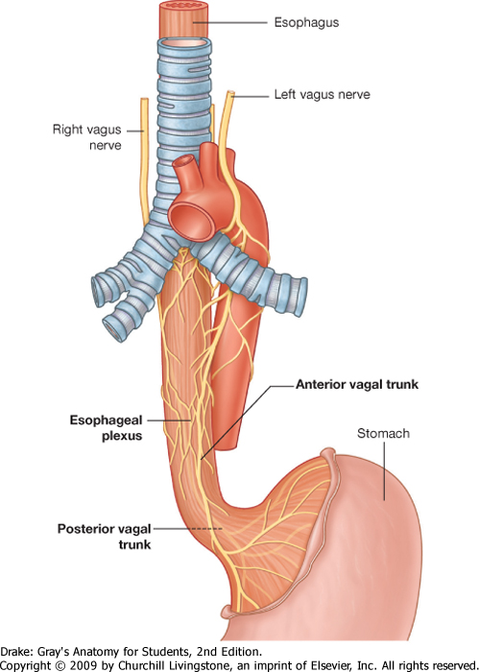
The oesophageal plexus
Sympathetic afferents relay pain sensations from the oesophagus
Parasympathetic afferents (vagus) senses normal physiological information from the oesophagus

Slide 18
Vagus nerves and their branches
Branches to chest and abdomen are parasympathetic (control smooth and cardiac muscle + glands of gut and airways)
Also large sensory (enteroceptor) content from gut and lungs
Unlike the sympathetic they provide no autonomic supply to the body wall (eg arterioles & sweat glands)
Recurrent laryngeal branch of vagus nerve is not parasympathetic – runs back up neck to supply most skeletal muscles of larynx

Slide 19
The Vagi in the Posterior Mediastinum
This posterior view of the oesophagus shows mainly the right vagus contributing to the oesophageal plexus
Remember that these nerves also acquire many sympathetic fibres
The inferior continuation of this nerve is the posterior oesophageal nerve, taking right vagal fibres through the diaphragm to the abdominal viscera
In a similar way, the left vagus provides fibres to the oesophageal plexus then continues as the anterior oesophageal nerve

Slide 20
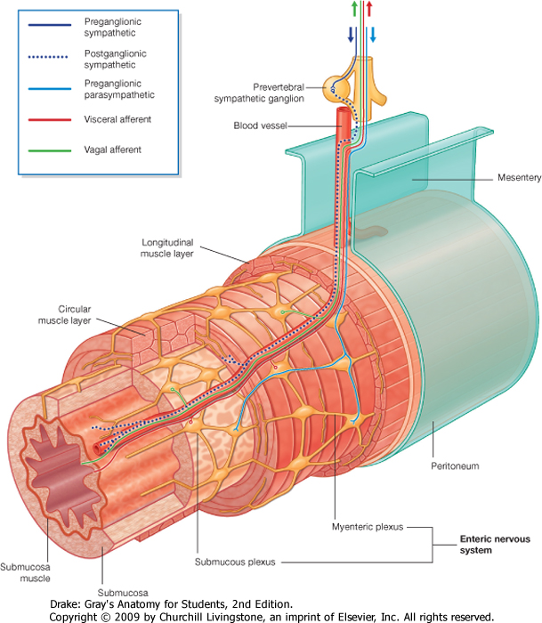
Intrinsic nerves of the oesophagus
This plexus of ganglia and axons within the oesophageal wall coordinates its activity
This can be up- or down-regulated by the autonomic nerves
It is part of the enteric nervous system

Slide 21
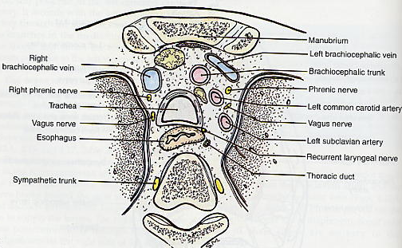
Compare the Positions of the Phrenic & Vagus Nerves and the Sympathetic Trunks in the Superior Mediastinum

