Slide 1
Lymphatic drainage of the thorax
Dr Paul Strutton
Department of Surgery & Cancer
Faculty of Medicine
Friday 1 March 2013

Slide 2
Why do we have a lymphatic system?
More fluid leaves blood capillaries than returns to them
Uncompensated fluid movement from blood to the extracellular fluid would result in oedema and loss of blood volume
Lymphatic vessels drain excess extracellular fluid back into the blood
Ensure foreign particles come into contact with immune system

Slide 3
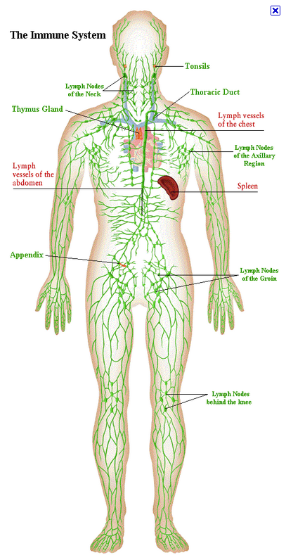
Lymphatic system

Slide 4
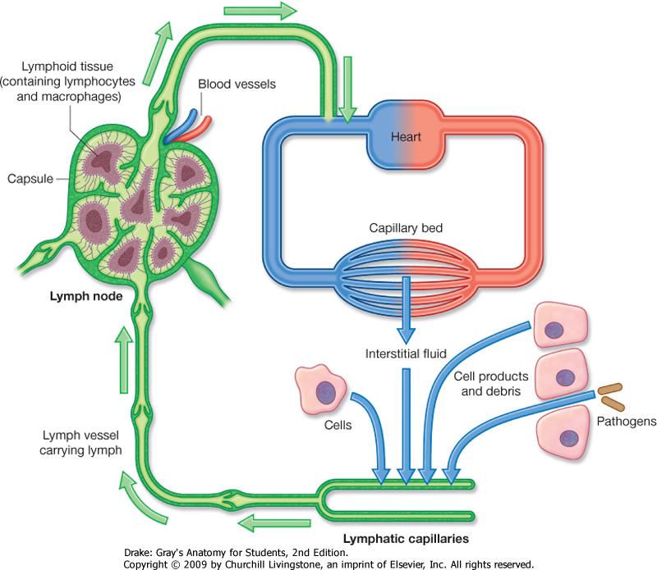
Lymphatic vessels
Pathogens
Hormones
Cell debris
Fats

Slide 5
Lymphatic vessels
Fats absorbed into small intestine packaged into chylomicrons (protein coated lipids)
Released into interstitial fluid
Drain into lymphatic capillaries (lacteals)
Return to venous system via the neck

Slide 6
Lymph
Clear and odourless in most vessels
Opaque and milky from the small intestine due to the chylomicrons
Called chyle

Slide 7
Movement of Lymph
Maintained by action of adjacent structures
Skeletal muscles and the pulses in arteries
Valves ensure flow is unidirectional

Slide 8
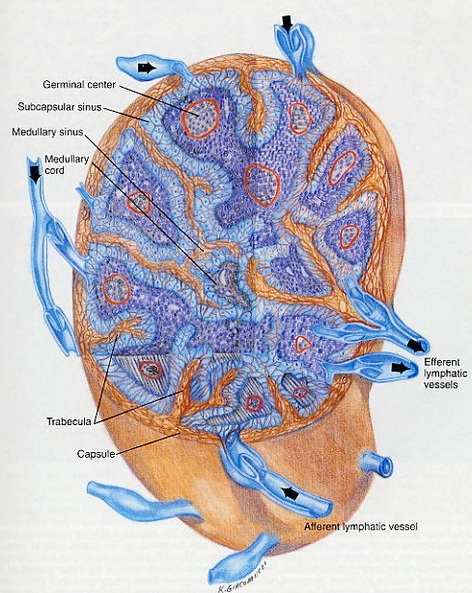
Anatomy of a lymph node
Small (<2.5cm long)
Found along lymph vessels
Contain lymphocytes and macrophages
Can act upon foreign bodies in the lymph
Drainage from infected regions detectable in enlarged lymph nodes
Armpit, groin, neck

Slide 9
Lymphatic drainage of the thorax
Breast
Thoracic wall
The thoracic duct
Lungs
Heart

Slide 10
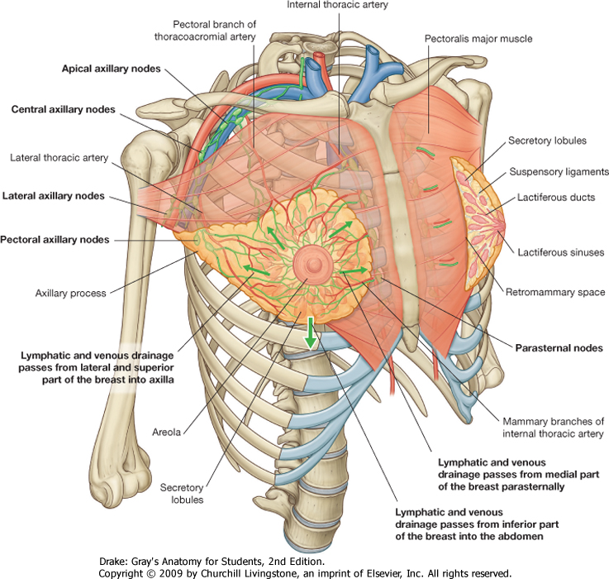
Lymphatics of the breast
Mrs Lewis’s lecture

Slide 11
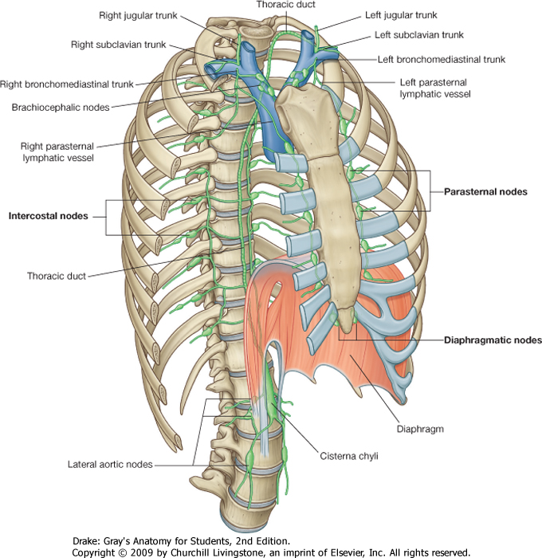
Lymphatics of the thoracic wall
Lymph drains into nodes associated with:
internal thoracic arteries (parasternal)
ribs (intercostal)
diaphragm (diaphragmatic)

Slide 12
Lymphatics of the thoracic wall
Parasternal
Bronchomediastinal trunks
Intercostal (upper)
Bronchomediastinal trunks
Intercostal (lower)
Thoracic duct
Diaphragmattic
Brachiocephalic
Aortic/lumbar
Superficial
Axillary or parasternal

Slide 13
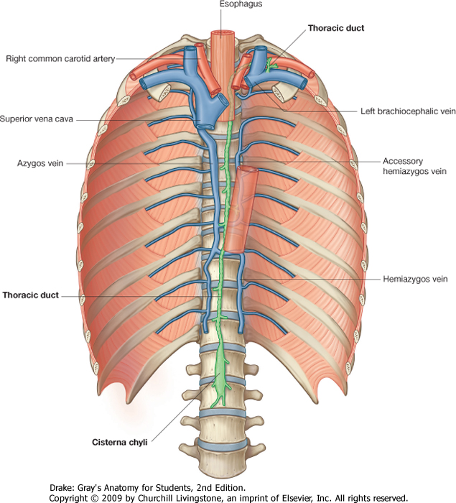
The thoracic duct
Main channel draining most of the body
Begins at the cisterna chyli
drains abdomen, pelvis, perineum and lower limbs
Begins at L2 vertebral level
Enters behind oesophagus through diaphragm
Ascends on right of midline
Between aorta and azygous vein
Crosses over onto left at T5
Empties into left subclavian vein

Slide 14
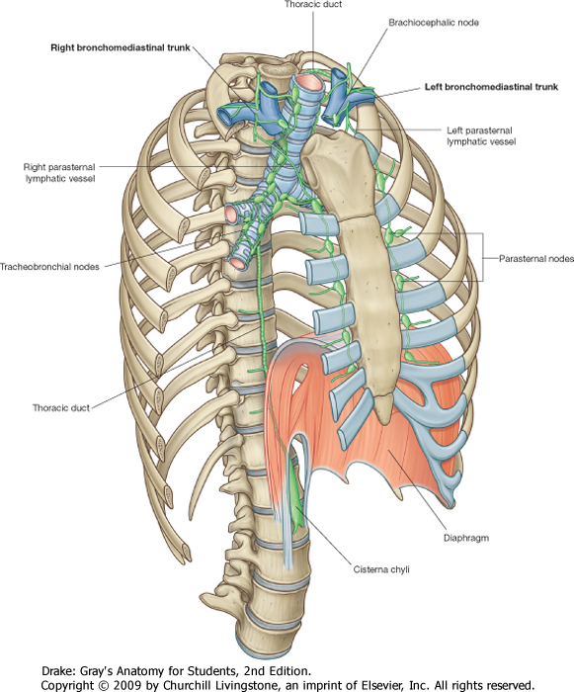
Lymphatics of the lungs
Tracheobronchial
Around bronchi and trachea
From within lung through hilum
Unite with vessels from parasternal and brachiocephalic nodes anterior to brachiocephalic veins to form:
Bronchomediastinal (left and right)

Slide 15
Lymphatics of the heart
Follow the coronary arteries and drain into:
Brachiocephalic
Tracheobronchial

Slide 16
Lymphatics of the posterior mediastinum
Nodes on aorta receive lymph from oesophagus, diaphragm, liver and pericardium and drain into to:
thoracic duct
Posterior mediastinal

