Slide 1
Bronchi, lungs, pleura and diaphragm
Dr Paul Strutton
Department of Surgery & Cancer
Faculty of Medicine
Monday 18th February 2013

Slide 2
Bronchial tree
Trachea
Extends from vertebral level C6 to T4/5
Held open by C-shaped cartilage rings
Lowest ring has a hook – carina (keel of ship)
Primary (main) bronchi (left and right)
Formed at T4/5
Right wider and more vertical than left
Lobar (secondary) bronchi
Formed within the lungs
Supply the lobes of the lungs
Segmental (tertiary) bronchi
Supply the bronchopulmonary segments

Slide 3
Bronchial tree
Trachea divides into two main bronchi at vertebral level T4/5:
Right and left main (primary) bronchi divide into:
Lobar (secondary) bronchi - supplying the lobes (2 left, 3 right)
The lobar bronchi further subdivide into segmental (tertiary) bronchi supplying self-contained independent units of lung tissue named bronchopulmonary segments

Slide 4
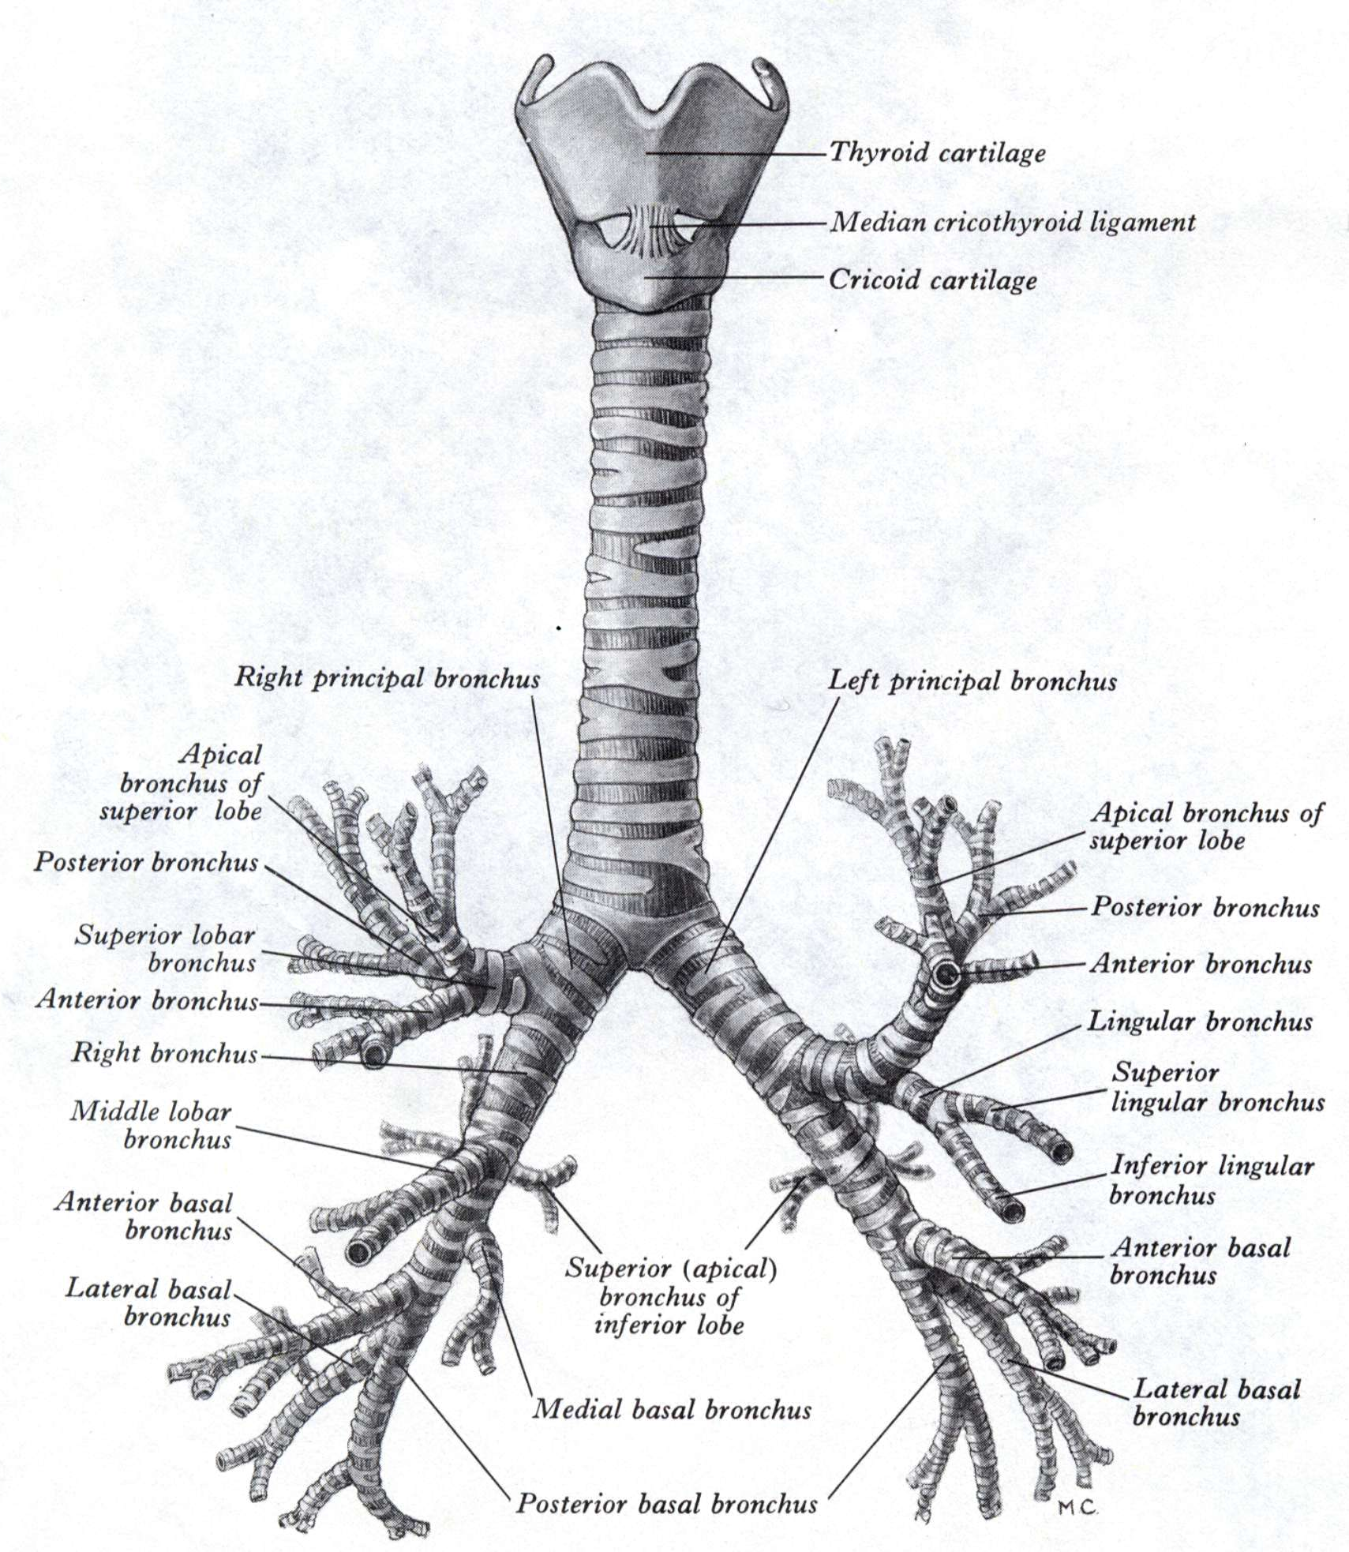
Bronchial tree:
Branching pattern of trachea into main, lobar and segmental bronchi

Slide 5
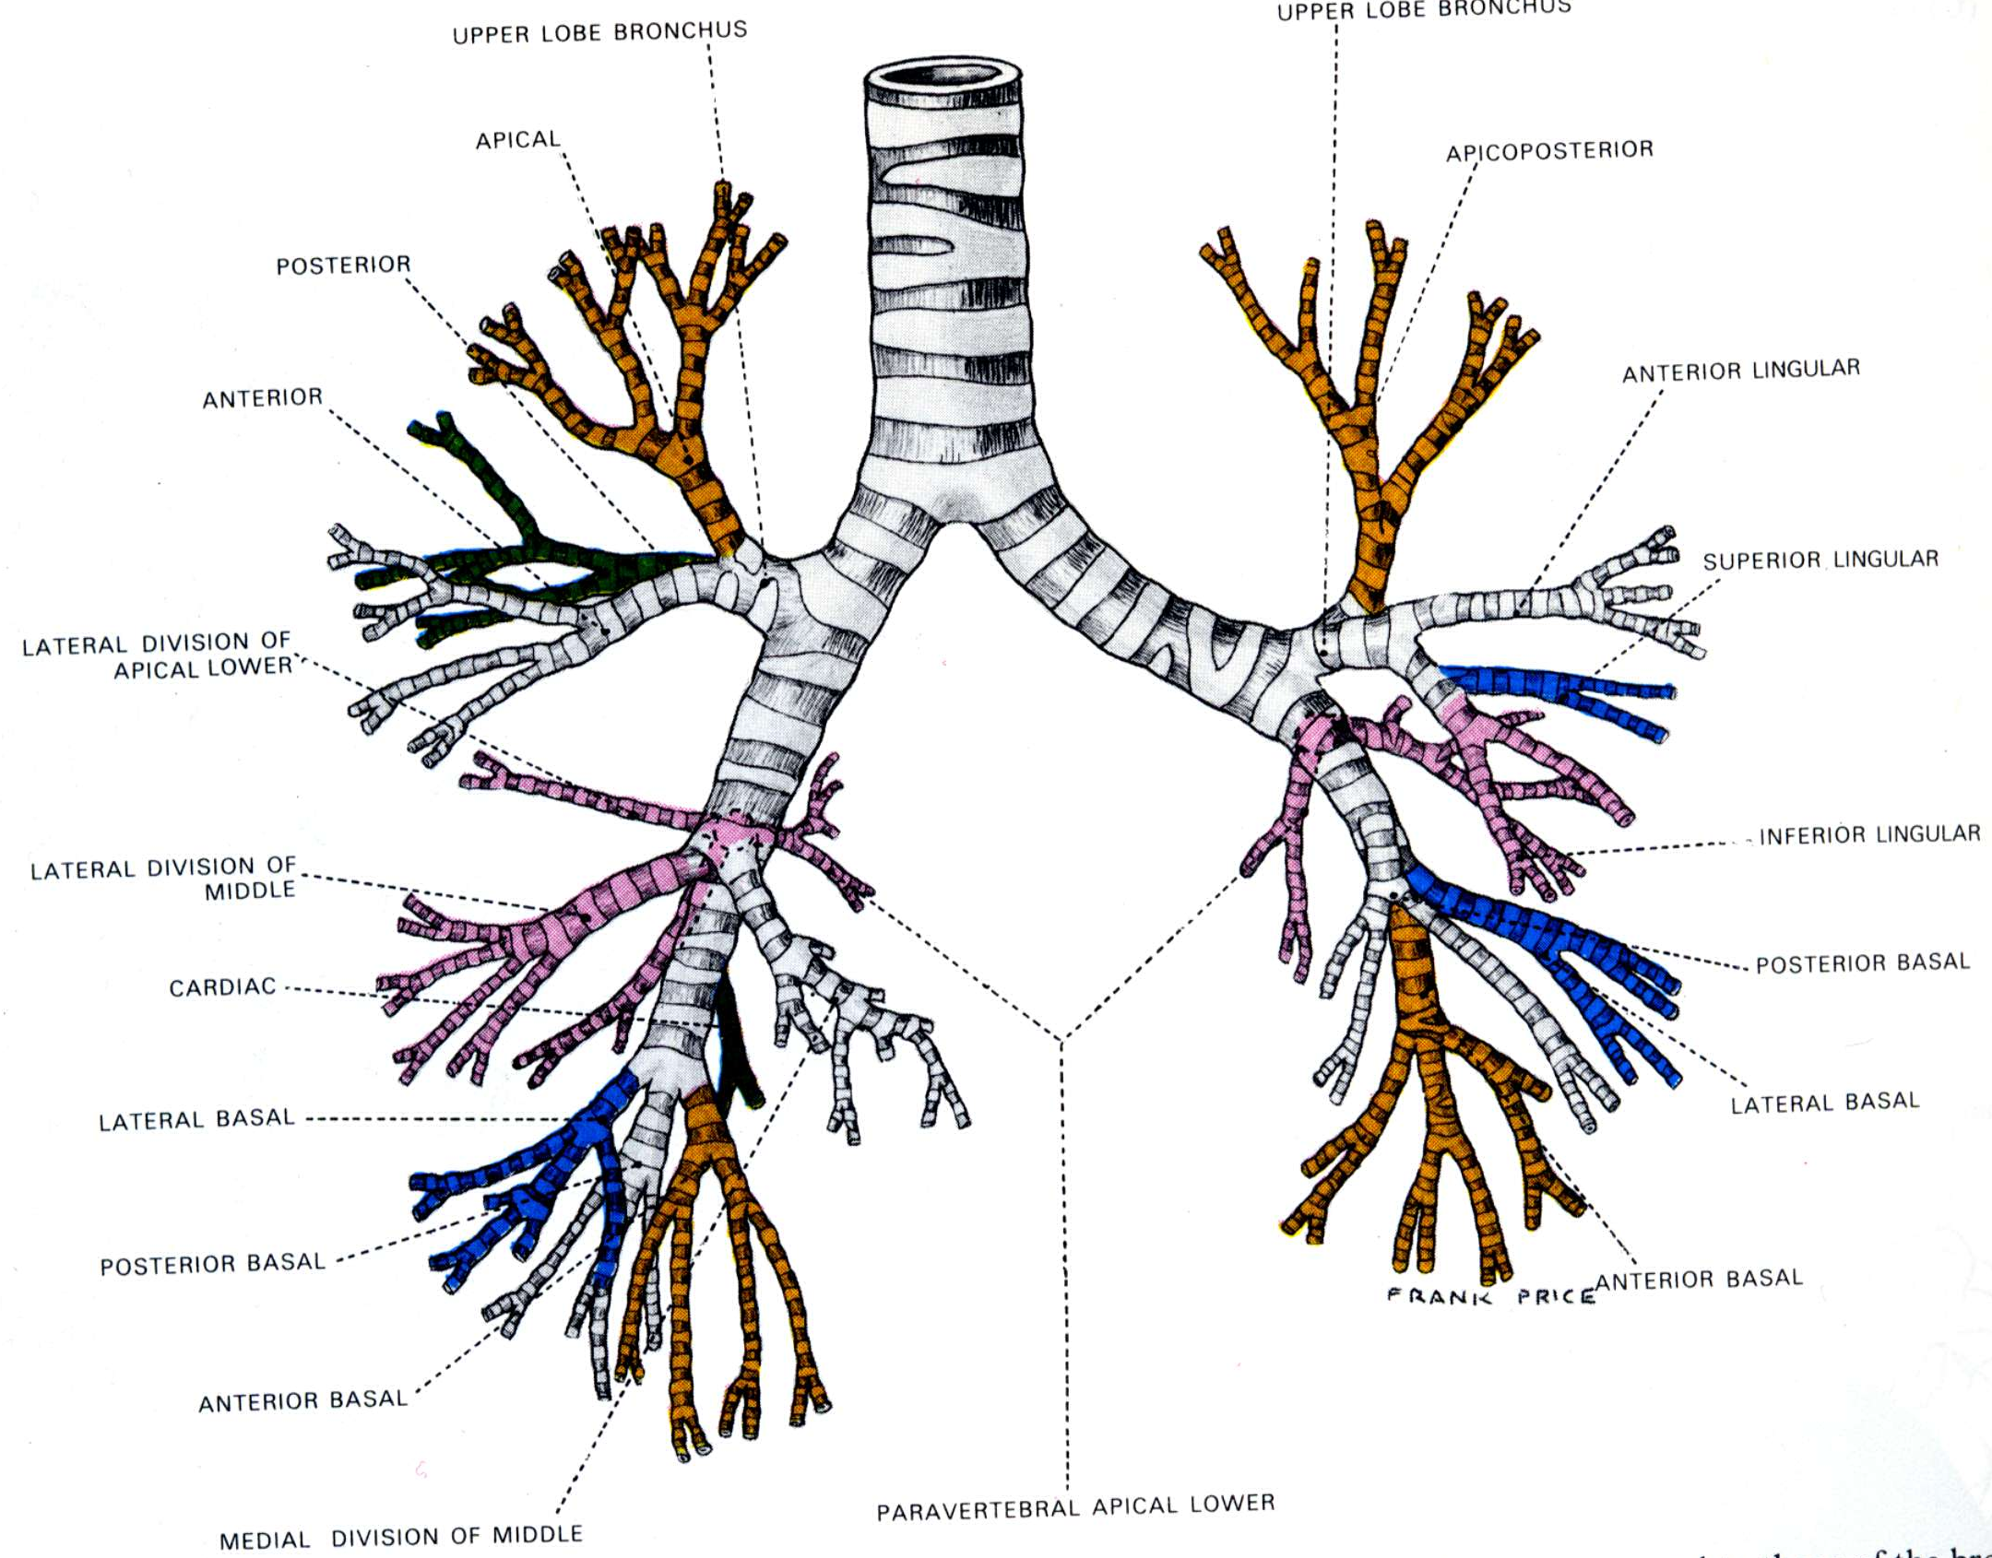
Segmental (tertiary) bronchi

Slide 6
Pattern of bronchopulmonary segments: lateral views of both lungs
Right
Left
10 segments in each lung – smallest, functionally independent region

Slide 7
The lungs
Essential organs of respiration
Situated in the thorax
Separated from each other by heart and other contents of the mediastinum
Each lies freely in its pleural cavity - apart from its attachment to the heart (via pulmonary vessels) and trachea at the lung root (hilum)

Slide 8
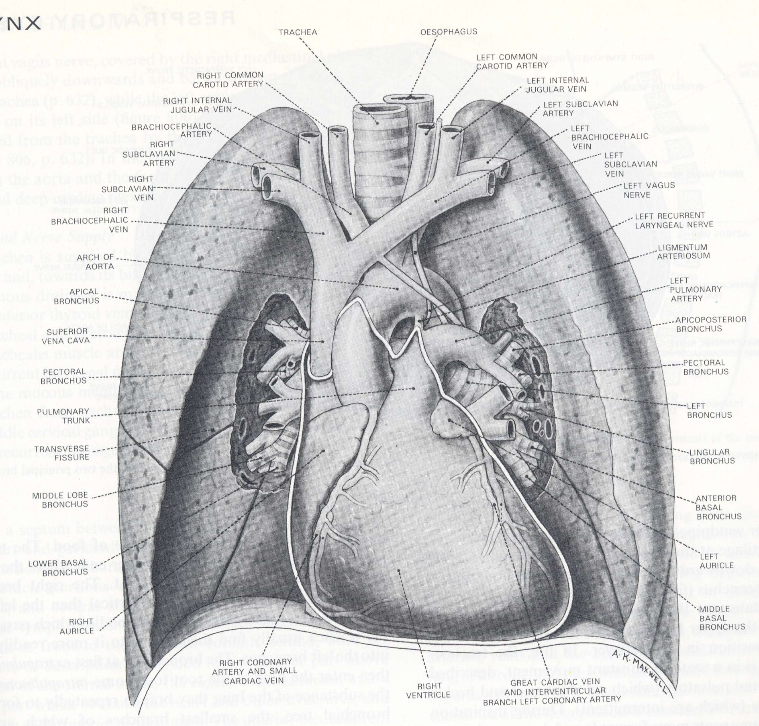
From the mediastinum, vessels, nerves and bronchi pass though the lung roots into the lungs

Slide 9
The Lungs
Conical in shape
Apex
thoracic inlet oblique - apex rises 3-4 cm above
level of first costal cartilage
Base
concave
rests on convex surface of diaphragm
3 borders - (edges) - anterior, posterior, inferior
3 surfaces - costal, medial (mediastinal), inferior (diaphragmatic)
Diaphragm separates
right lung from right lobe of liver
left lung from left lobe of the liver, stomach & spleen

Slide 10
Mediastinal surface of lung: general features
Posterior part in contact with thoracic vertebrae
Anterior part - deeply concave - accommodates the heart - cardiac impression larger on L than R because of position of heart
Above and behind cardiac impression - hilum of the lung where vessels, bronchi & nerves enter & leave the mediastinum

Slide 11
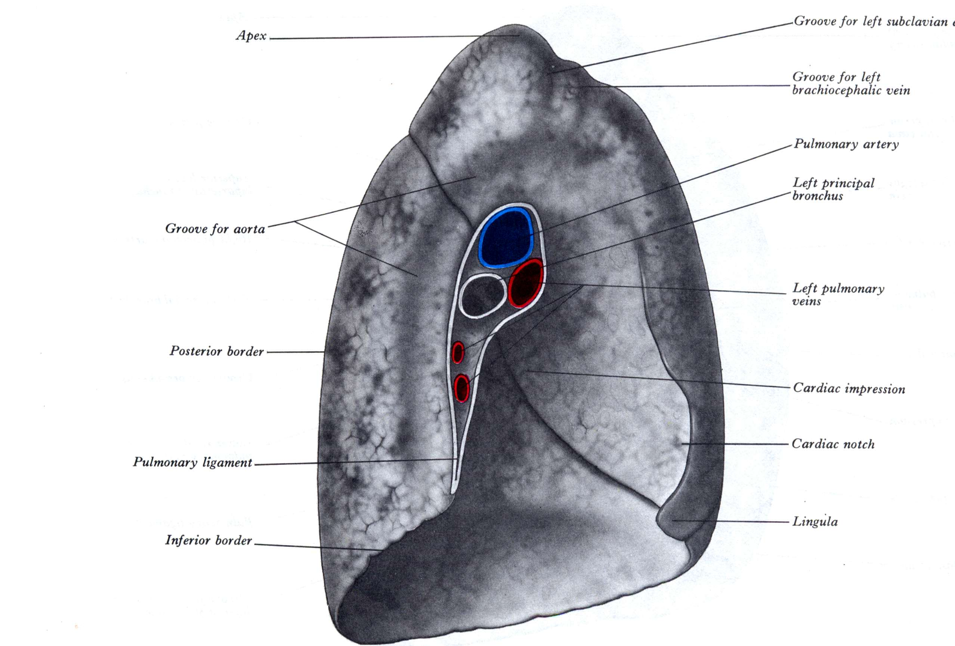
Left lung – mediastinal aspect

Slide 12
The left lung
Two lobes:
Superior
Inferior
separated by oblique fissure
Superior lobe lies above the fissure – includes:
Apex
Most of anterior part of lung

Slide 13
Right lung – mediastinal aspect

Slide 14
The right lung
Three lobes:
superior
middle
inferior
Separated by 2 fissures
oblique fissure - separates inferior lobe from the other 2 lobes
horizontal fissure - separates superior from middle lobe
The right lung is slightly larger than the left

Slide 15
The root (hilum) of the lung
Connects mediastinal surface to heart and trachea
formed by structures that enter or leave hilum:
Principal (primary) bronchus
Pulmonary artery (deoxygenated blood from RV)
2 pulmonary veins (oxygenated blood to LA)
Bronchial arteries (oxygenated blood from descending aorta) and veins
Pulmonary plexus of nerves (autonomic)
Lymph vessels and nodes
all enveloped in pleura

Slide 16
Hilum of left lung
Pulmonary artery
Pulmonary vein (upper lobe)
Primary bronchus
Bronchial artery
Lymph Node
Pulmonary ligament (inferior fold of pleura)

Slide 17
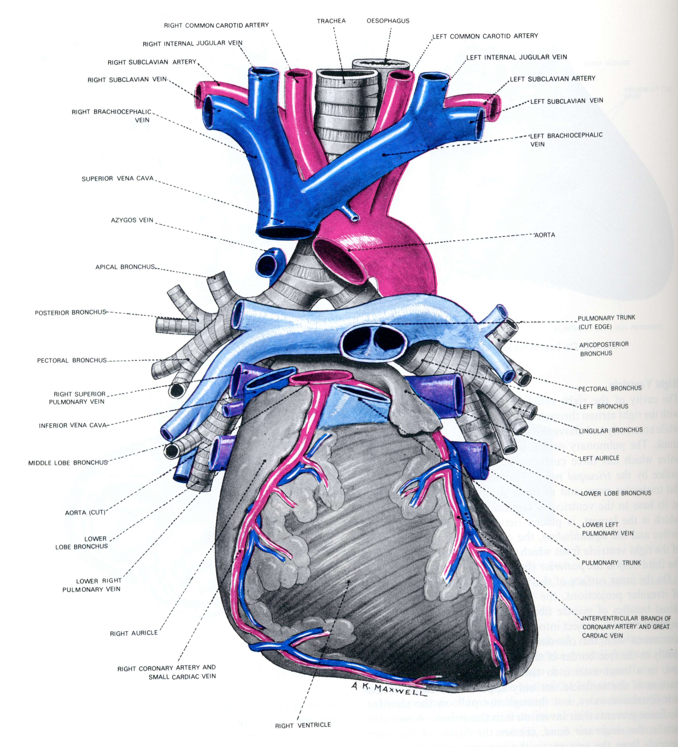
Anterior dissection showing pulmonary vessels and bronchi passing from mediastinum to lungs

Slide 18
The Pleura
A thin layer of flattened cells supported by connective tissue that lines each pleural cavity and covers the exterior of the lungs
2 layers
visceral pleura - covers surface lungs and lines fissures between the lobes
parietal pleura - lines inner surface of chest walls
Visceral and parietal pleura are continuous with each other around the root of the lung – this is the hilum
In health:
Pleural cavity is collapsed, but moist surfaces allow lungs to glide as they expand and collapse

Slide 19
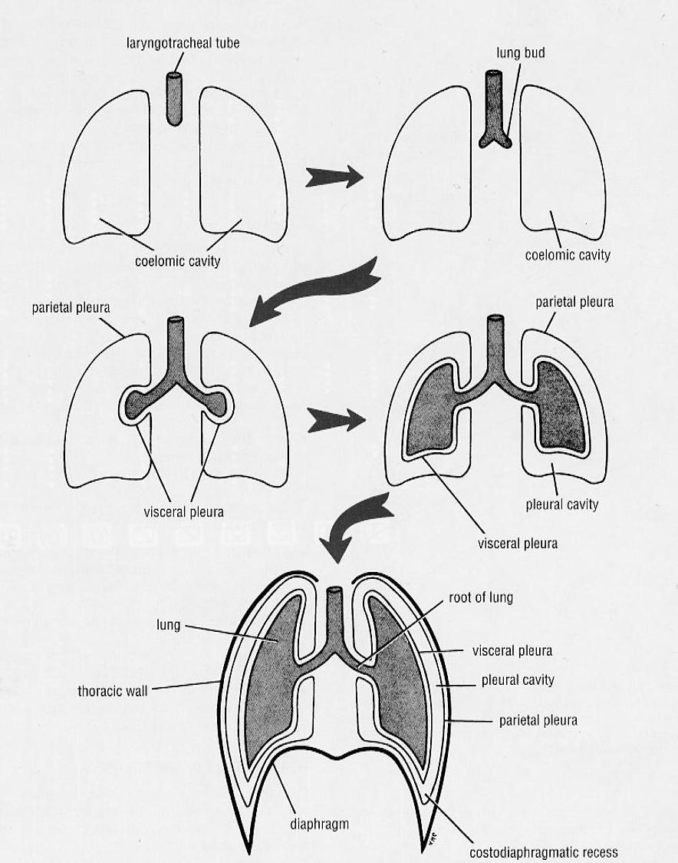
Pleural origin:
Pleural cavities inside chest wall
Lined by parietal pleura
Lung buds grow into them
Within covering of visceral pleura

Slide 20
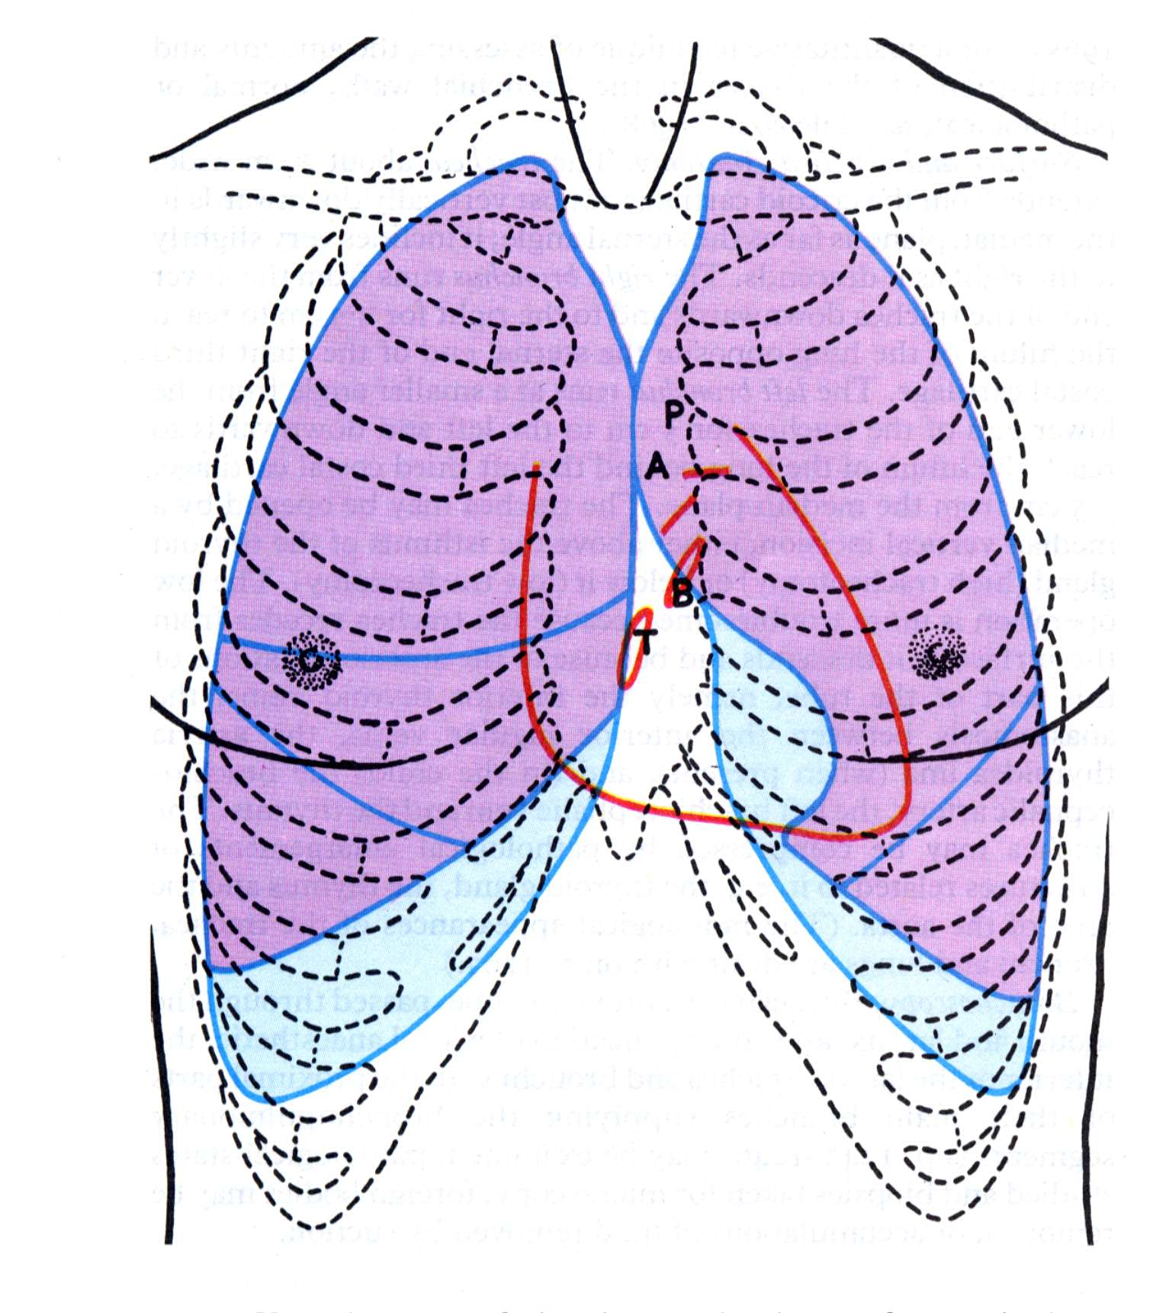
Anterior view of surface markings of the lungs (purple) and pleural cavity (pale blue)

Slide 21
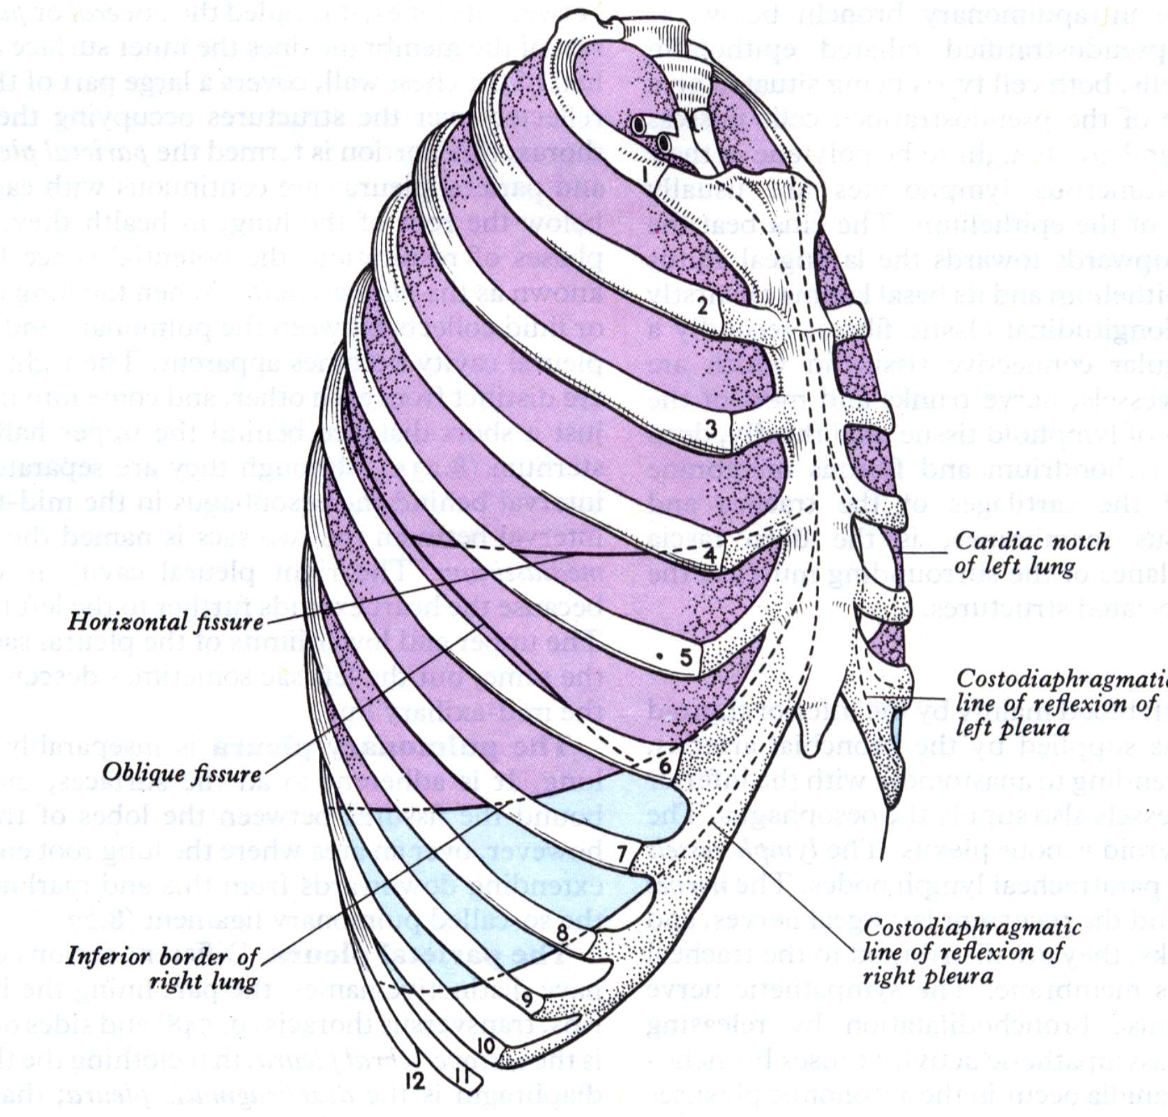
Anterolateral view of surface markings of the lungs (purple) and pleural cavity (pale blue)
Note the large costo-diaphragmatic recess of pleura – free of lung except in maximal inspiration

Slide 22
Breathing
Controlled by nervous system and produced by skeletal muscle
Brings about inhalation and exhalation of air into/out of the lungs, to ventilate the gas exchange areas - alveolar sacs
capacity of thoracic cavity can be increased:
by movements of the diaphragm
by movements of the ribs

Slide 23
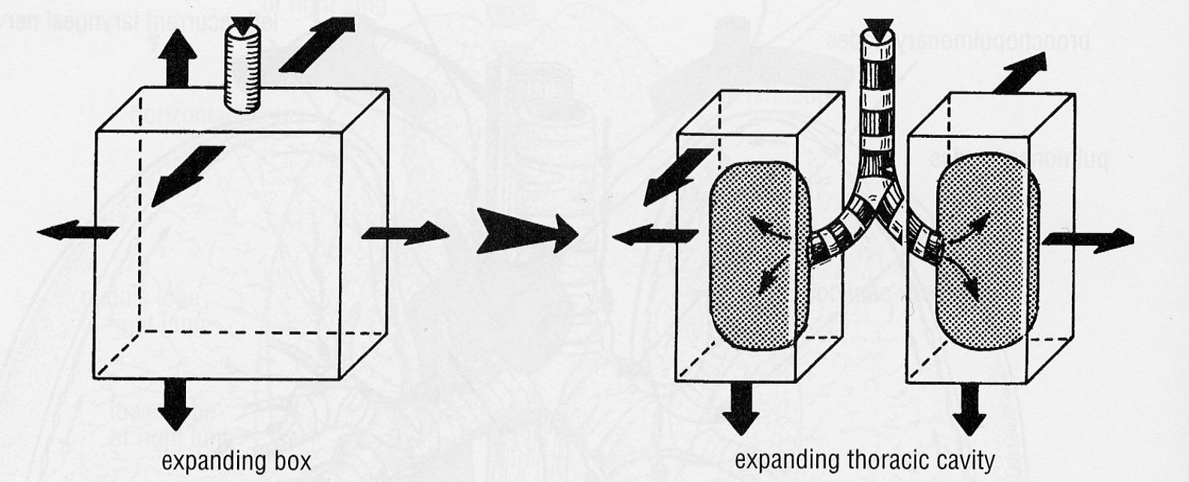
Mechanism of breathing
Pleural cavity is expanded by muscles in walls
Elastic lungs expand with the pleural cavity, sucking air down trachea and bronchi into lungs

Slide 24
The diaphragm: the main inspiratory muscle
Contraction of the diaphragm increases the vertical dimension of the thoracic cavity.
When it contracts, the diaphragm presses on the abdominal viscera which initially descend (because of relaxation of the abdominal wall during inspiration)
Further descent is stopped by the abdominal viscera, so more diaphragm contraction raises the costal margin
Increased thoracic capacity produced by diaphragm and rib movements in inspiration, reduces intrapleural pressure, with entry of air through respiratory passages and expansion of the lungs

Slide 25
Thoracic surface of diaphragm
Skeletal muscle from costal margin
A
Oe
Sheet-like central tendon
IVC
Pericardial sac

Slide 26
The margin of the diaphragm (black) is attached to the:
costal margin (lower border of the rib cage)
xiphoid process
ends of ribs 11 and 12
lumbar vertebrae

Slide 27
But:
The dome of the diaphragm (red) bulges high inside the rib cage.
So high abdominal organs such as liver are covered by diaphragm, pleura and lung

Slide 28
The ribs in breathing
Ribs elevated - anterior ends thrust forward and upwards - increases antero-posterior dimension of thoracic cavity.
At same time ribs are everted, increasing transverse diameter of thoracic cavity
Internal and external intercostal muscles stiffen the rib cage to increase efficiency of diaphragm

Slide 29
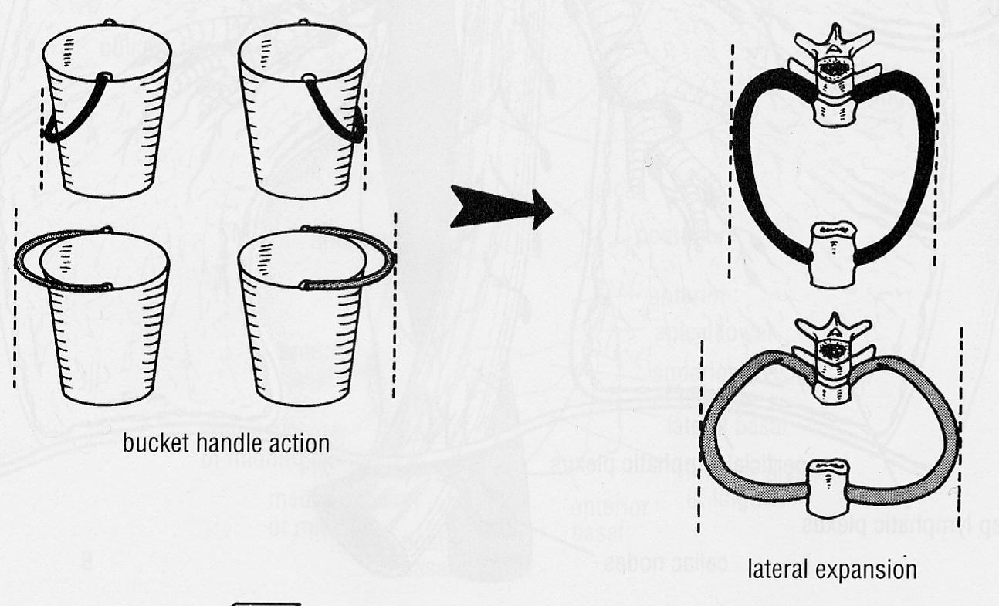
Raising the costal margin widens the pleural cavities by raising drooping lateral parts of ribs

Slide 30
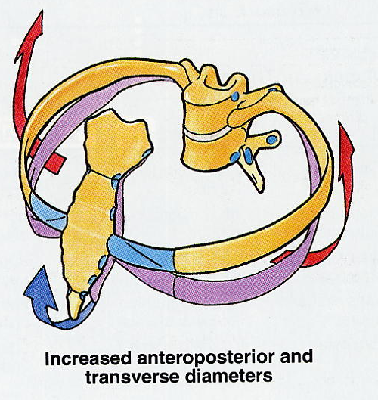
Another view of the bucket-handle movement of ribs to widen the pleural cavities (red arrows)

Slide 31
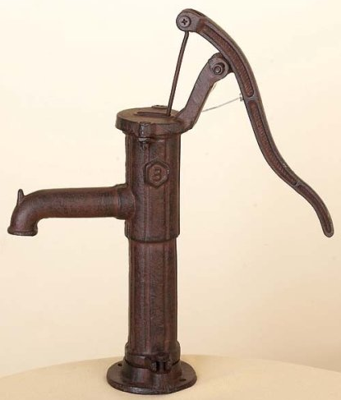
Raising the costal margin also raises drooping anterior ends ribs, tilting sternum upwards to increase antero-posterior diameter of pleural cavities (pump-handle action – blue arrow)

Slide 32
Breathing out
Quiet expiration is a passive activity not requiring muscles
It depends on elastic recoil in the elastic tissue throughout the lungs and in the rib cage
In deep or forced expiration, this is assisted by the muscles of the abdominal walls that squeeze the abdominal organs against the diaphragm and pull the lower ribs downward

