Slide 1
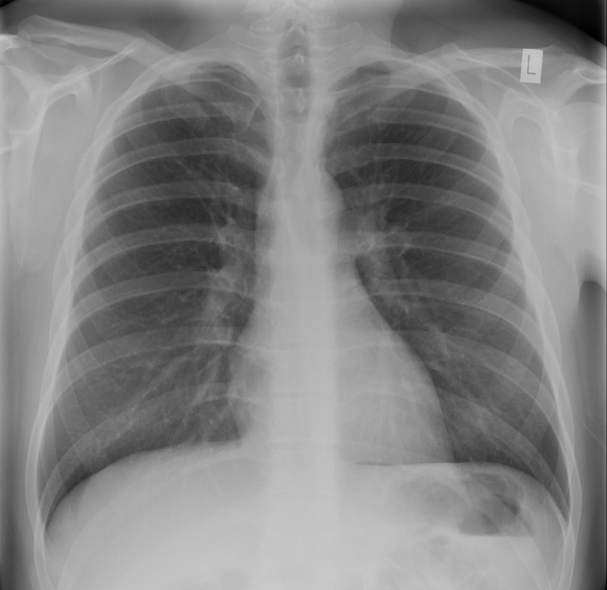
Introduction to ultrasound Thoracic applications
Dr Mary Roddie FRCP FRCR
Consultant Radiologist

Slide 2
Overview of session
Principles of ultrasonography
Probe selection
Normal appearance of chest wall
Pathology - pleural effusion
Normal diaphragmatic movement
PRACTICAL SESSION

Slide 3
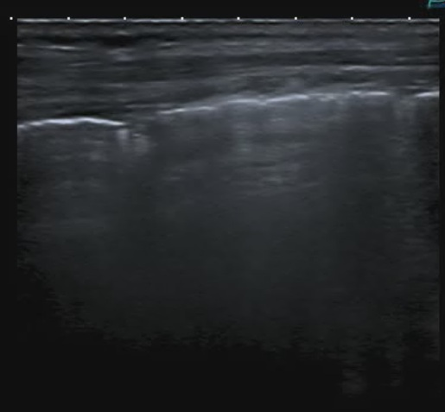
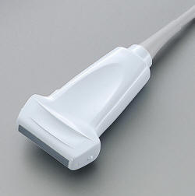
Choice of ultrasound probe
Linear array transducer = crystals arranged in a line
Rectangular field of view
High resolution images but limited depth of view

Slide 4
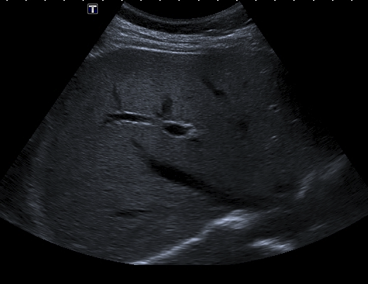
Choice of ultrasound probe
Sector transducer = curved array of crystals
Fan-shaped field of view
Improved depth of view at cost of resolution
Helpful when limited access e.g. between ribs

Slide 5
Ultrasound of the thorax
Normal appearance of pleura
Detect pleural effusion and guide drainage
Differentiate sub-pulmonary from sub-phrenic fluid
Assess tumour invasion of chest wall and pleura
Guide pleural and lung biopsy
Identification of pneumothorax
Assessment of respiratory muscle function

Slide 6
Ultrasound of the thorax
Normal appearance of pleura
Detect pleural effusion and guide drainage
Differentiate sub-pulmonary from sub-phrenic fluid
Assess tumour invasion of chest wall and pleura
Guide pleural and lung biopsy
Identification of pneumothorax
Assessment of respiratory muscle function

Slide 7
Normal appearance (10 - 12 MHz)
Rib
Rib
L
Visceral pleura seen as echogenic line deep to chest wall
Gliding pleura sign during respiration

Slide 8
Normal appearance (10 - 12 MHz)

Slide 9
gliding pleura sign

Slide 10
‘Comet tail’ artefacts

Slide 11
Transverse plane TS

Slide 12
Longitudinal plane LS

Slide 13
Small pleural effusion

Slide 14
Large pleural effusion

Slide 15
Respiratory muscles
Diaphragm
Internal intercostals
External intercostals
Accessory muscles (attached to sternum, clavicles and scapulae)
SCM, scalenes, serratus, pectorals

Slide 16
Intercostal anatomy

Slide 17
Muscles of inspiration
Muscles of expiration
Sternocleidomastoid
Scalenes
External intercostals
Internal intercostals
(interchondral part)
Internal intercostals
(excluding interchondral part)
Diaphragm
External oblique
Internal oblique
Transversus abdominus
Rectus abdominus

Slide 18
Muscles of inspiration
Muscles of expiration
Sternocleidomastoid
Scalenes
External intercostals
Internal intercostals
(interchondral part)
Internal intercostals
(excluding interchondral part)
Diaphragm
External oblique
Internal oblique
Transversus abdominus
Rectus abdominus

Slide 19
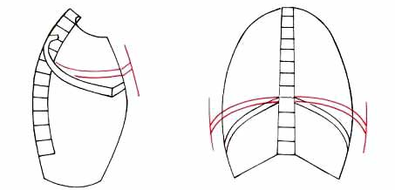
Forced inspiration (sniff)
Diaphragm contracts, moves down
Scalenes and SCM contract and elevate ribs and move sternum anteriorly
Intercostals contract , elevate ribs

Slide 20
Forced inspiration (sniff)
Tests function of phrenic nerve
Normal: rapid caudal movement
Abnormal: paradoxical cranial movement

Slide 21
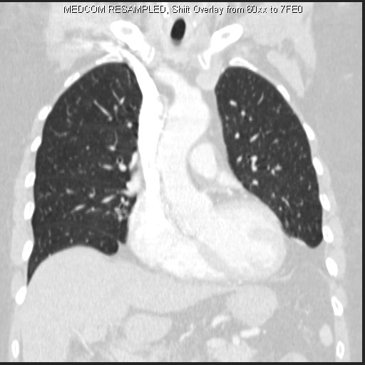
Diaphragm indistinguishable from liver on CT

Slide 22
Diaphragm is obscured by aerated lung so must be looked at from below

Slide 23
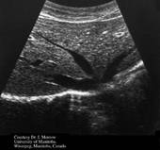
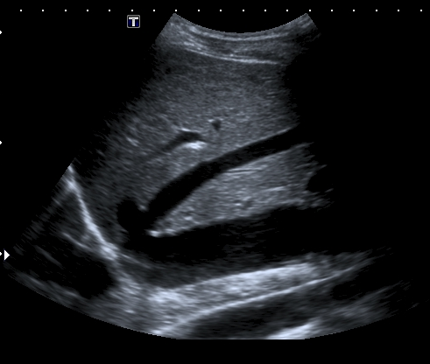
Diaphragm on US
Echogenic stripe

Slide 24
Assessment of diaphragmatic function

Slide 25
Quiet breathing

Slide 26
On sniffing, the normally innervated diaphragm moves sharply downwards

Slide 27
Practical demonstration
Gliding pleura sign
Sniff test

