Slide 1
Learning Outcomes
Distinguish between alveolar and pulmonary ventilation.
Define the common lung volumes and describe how they alter in restrictive and obstructive disease
Define anatomical and physiological dead space and recall approximate volumes for both in a typical healthy adult
Explain the effect of increased breathing frequency compared with increased depth of breathing on alveolar ventilation
Define Fick’s law of diffusion
Implement Fick’s law of diffusion to gas exchange in health and disease

Slide 2
Lung Volume and Capacities
Ventilation
Gas Exchange and Diffusion
Fick’s Law
Concentration / Pressure Gradient
Gas Solubility
Thickness of Alveolar Membrane
Surface Area
Ventilation Perfusion Matching

Slide 3
Lung Volumes and Capacities
Maximal inspiration
6.5 L
Inspiratory reserve volume
(IRV) 3.0 L
Vital capacity
(VC) 5 L
Tidal volume
(V_{T}) 0.5 L
Total lung capacity
(TLC) 6.5 L
Functional residual capacity
(FRC) 3.0 L
Expiratory reserve volume
(ERV) 1.5 L
Maximal expiration
Residual volume (RV) 1.5 L
0 L
Notes:
Lung compartments are described as volumes or capacities
2 or more volumes make a capacity

Slide 4
Lung Volumes
Tidal volume (V_{T})
Volume of air inspired during quiet respiration
Inspiratory reserve volume (IRV)
Volume of air inspired from V_{T} to maximal inspiration
Expiratory reserve volume (ERV)
Air expelled with forced expiration
Residual volume (RV)
Amount of air left in lungs which cannot be expelled

Slide 5
Lung Volumes and Capacities
Maximal inspiration
6.5 L
Inspiratory reserve volume
(IRV) 3.0 L
Vital capacity
(VC) 5 L
Tidal volume
(V_{T}) 0.5 L
Total lung capacity
(TLC) 6.5 L
Functional residual capacity
(FRC) 3.0 L
Expiratory reserve volume
(ERV) 1.5 L
Maximal expiration
Residual volume (RV) 1.5 L
0 L
Two or more volumes make a capacity
Notes:
Lung compartments are described as volumes or capacities
2 or more volumes make a capacity

Slide 6
Lung Capacities
Functional residual capacity (FRC)
Lung volume at end of normal quiet expiration (ERV + RV)
Vital capacity (VC)
Volume air maximal inspiration to maximal expiration (IRV + TV + ERV)
Total lung capacity (TLC)
Volume maximal inspiration to residual volume (IRV +VT + ERV + RV)

Slide 7
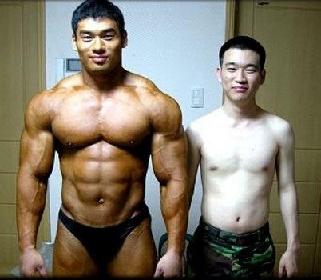
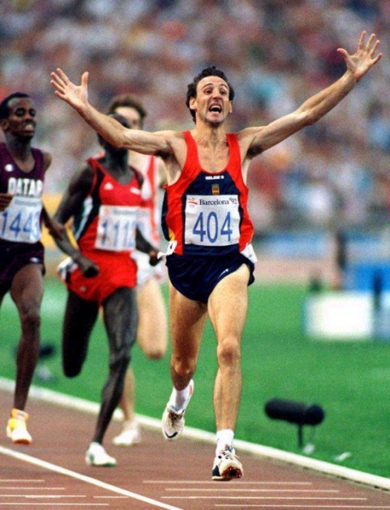
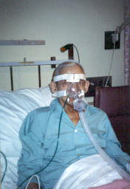
Factors affecting lung volumes
Body size
Age
Gender
Muscle training
Disease
(from Google images and patient image with permission)

Slide 8
Measuring Lung Volumes: Spirometry
This is a simple effort-dependent measurement, which is made using relatively inexpensive equipment
Used for diagnosis of respiratory disease and monitoring:
Disease progression
Deterioration
Drug efficiency
Efficient drug delivery system
Notes:
Allows measurement of certain lung volumes
Has both diagnostic and monitoring assessment function
Interested in
forced vital capacity (FVC)
FEV₁ & FEV₁% derived from the FVC

Slide 9
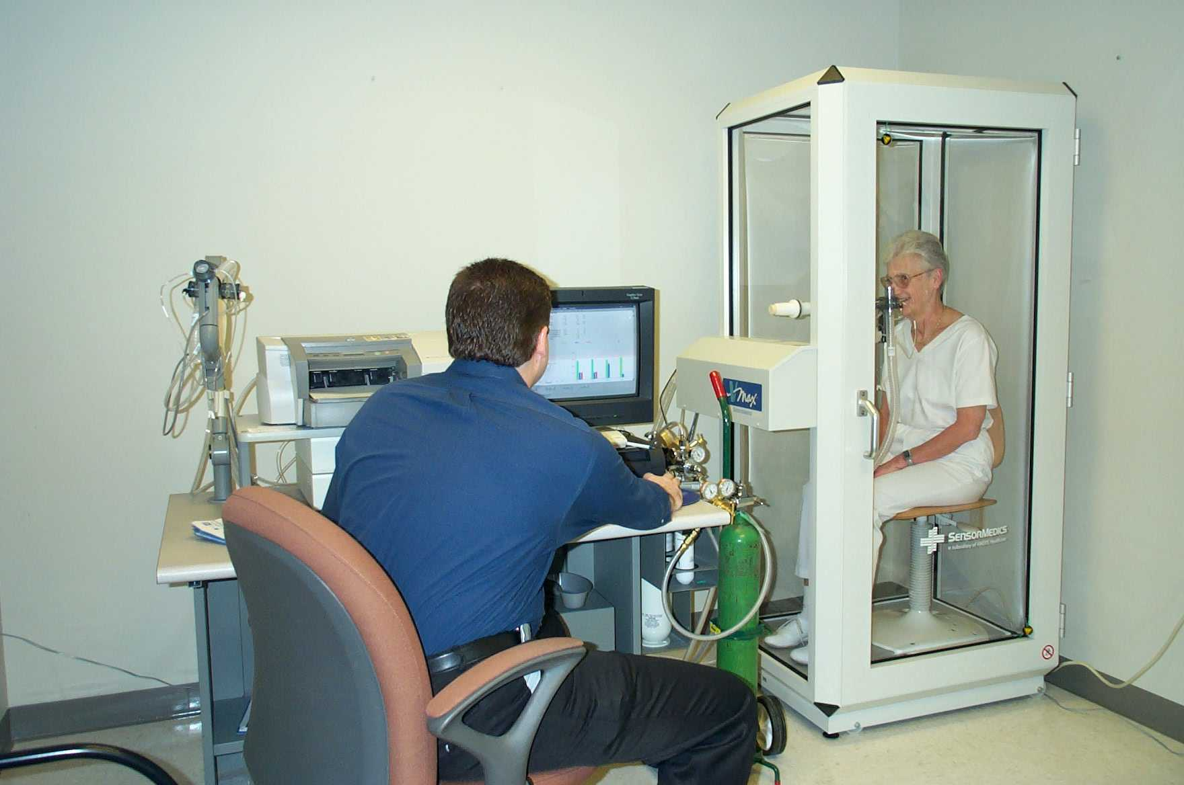
Volumes that can NOT be measured using a spirometry
RV can not be expired
RV and FRC cannot be measured with simple spirometry
These volumes are measured using gas dilution or body plethysmography
Gas Dilution Principle:
A spirometer is filled with a gas mixture of known concentration, including an inert gas
The patient breathes in (and out) from the spirometer so the gas mixes in lungs
Equilibration occurs; the expired gas concentration measured
The volume of gas in lungs is calculated from dilution effect

Slide 10
Helium Dilution
Helium (He): Not found in room air, inert and does not diffuse out of the lung
Spirometer filled with known volume of gas - 3.5L & known [He] 10%
Patient breathes freely to allow mixing
Final [He] measured as 5%
Calculate unknown volume using mass balance
Mass of He before mixing: (0*RV)+(10*3.5)
Mass of He after mixing:
(5*RV) + (5*3.5) or 5*(RV+3.5)
Mass = Concentration x Volume
(Example from GE Medicine 1st year Respiratory Course, Imperial College London)

Slide 11
Clinical Relevance of Lung Volumes and Capacities
Tidal volume (V_{T})
Adequate V_{T} necessary to maintain oxygenation and CO₂ clearance
Inspiratory reserve volume (IRV)
Required during cough & undertaking exercise
Functional residual capacity (FRC)
Essential to maintain distal lung patency on expiration
Residual volume (RV)
Can increase due to “air trapping”. Alters respiratory mechanics
Vital capacity (VC)
Critical value (1L) used to identify if patient is able to maintain spontaneous ventilation
Notes:
FRC - Point at which Tv breathing occurs
FRC is a product of the balance of opposing chest wall and alveolar recoil.
At FRC the lung as a whole is at it’s most compliant.
Discuss pain
Surgery
Posture
GA
Dx
Neuromuscular Dx

Slide 12
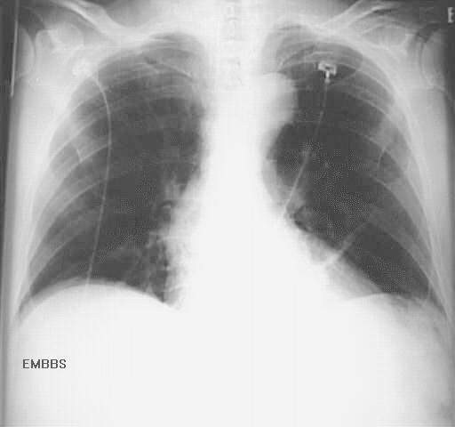
Bibasal atelectasis secondary to reduced FRC post surgery
Associated Problems
Reduced oxygenation
Poor CO₂ clearance
V/Q mismatch
Increased work of breathing
Breathlessness
Reduced exercise tolerance
Notes:
Raised hemi-diaph
Reduced bucket handle
>7th rib to diaph
Comp hyperinf upper lobes

Slide 13
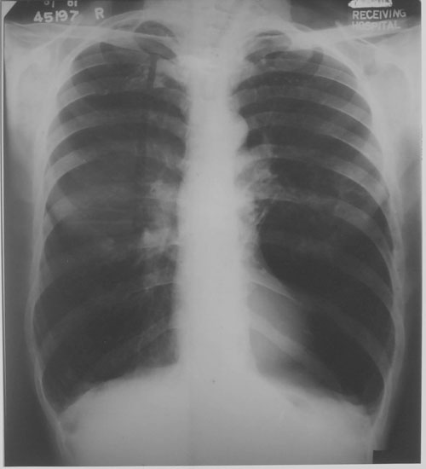
Hyperinflation secondary to air trapping ↑ RV
Associated Problems
Altered respiratory mechanics
Reduced tidal volume
V/Q mismatch
Poor gas exchange
Increased work of breathing
Breathlessness
Pursed lip breathing
Use of accessory muscles
Notes:
Flattened diaphragms
Hyperinflated lungs
Thin appearing heart and mediastinum
Parenchymal bullae or suprapleural blebs in patients with emphysema
Increased AP diameter (on a lateral CXR)
Increased pulmonary vasculature

Slide 14
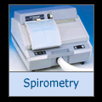
Classification of Respiratory Disease
Obstructive
COPD
Cystic Fibrosis
(Asthma)
Restrictive
Lung fibrosis
Motor neurone disease
Disease progression is also monitored using Peak Flow and Forced Expiratory Volume in 1 Second (FEV₁)
Notes:
In an obstructive lung disease, airway obstruction causes an increase in resistance. During normal breathing, the pressure volume relationship is no different from a normal lung. However, when breathing rapidly, greater pressure is needed to overcome the resistance to flow, and the volume of each breath gets smaller. The increase in the effort to breathe can cause an overdistention of the lungs.
The flow volume loop may show lower than normal FEV1 and FEF25-75, but it is not until a lung volume has been determined that an increase in TLC, FRC and RV can be confirmed.
Common obstructive disease include asthma, bronchitis and emphysema.
In a restrictive lung disease, the compliance of the lung is reduced which increases the stiffness of the lung and limits expansion. In these cases, a greater pressure than normal is required to give the same increase in volume.
The flow volume loop may show lower than normal FVC, but the FEV1 and FEF25-75 may only be mildly effected. The lung volume measurement will clearly show a reduction in TLC, FRC and RV.
Common causes of decreased lung compliance are pulmonary fibrosis, pneumonia and pulmonary edema. Patients whose respiratory muscles are unable to perform normally because of a neuromuscular disease or paralysis can show a restrictive pattern.

Slide 15
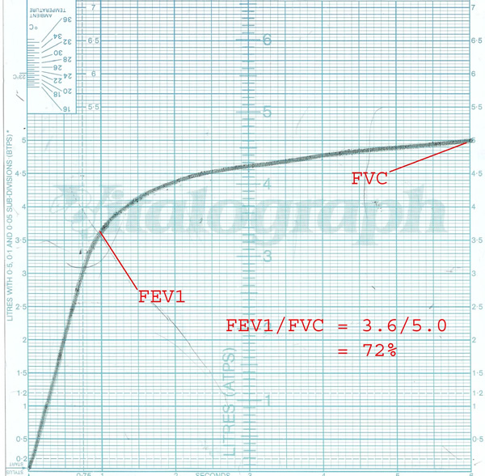
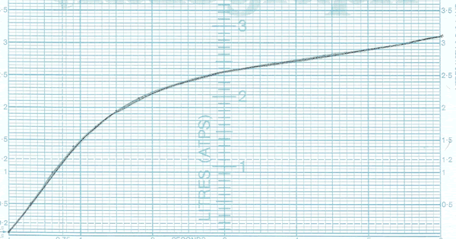
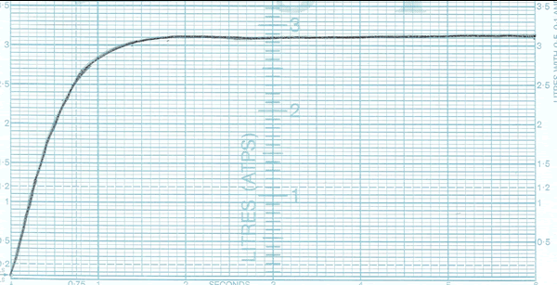
Spirometry FEV1 and FVC
Spirometry from a patient with obstructive disease
Spriometry from a patient with restrictive disease
Spirometry trace for healthy patient

Slide 16
Lung Volume and Capacities
Ventilation
Gas Exchange and Diffusion
Fick’s Law
Concentration / Pressure Gradient
Gas Solubility
Thickness of Alveolar Membrane
Surface Area
Ventilation Perfusion Matching

Slide 17
Ventilation
Tidal volume (V_{T}): The amount of air inspired during quiet respiration. Normal respiratory frequency 12 bpm, average volume 500 mls
Minute ventilation (V_{E}): The amount of air entering lungs per min (12 x 500 = 6.0 L min⁻¹)
Not all tidal volume air is used in gas exchange
Dead space is term for the V_{T} NOT involved in gas exchange. There are 2 types of dead space:
Anatomical Dead space
Alveolar Dead space
Notes:
Tidal volume (V_{T}) is volume of air breathed in = volume breathed out
Calculated using expiratory volume

Slide 18
Anatomical Dead Space
With each tidal volume 150mls remains in conducting zone up to terminal bronchioles
This is called anatomical dead space
Notes:
Size of subject
Tracheal intubation or tracheostomy
Hypoventilation
Make point that if DS increases and VT doesn’t less available air for gas exchange / alveolar ventilation

Slide 19
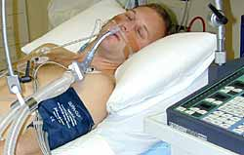
Anatomical Dead Space
With each tidal volume 150mls remains in conducting zone up to terminal bronchioles
This is called anatomical dead space
External tubes increase anatomical dead space in an intubated patient
Notes:
Size of subject
Tracheal intubation or tracheostomy
Hypoventilation
Make point that if DS increases and VT doesn’t less available air for gas exchange / alveolar ventilation

Slide 20
The Respiratory Tree
Trachea
Anatomical dead space
No gas exchange
Typical adult volume 150 ml
Conducting zone
Convection
16 generations
Respiratory zone
Diffusion
7 generations
Gas exchange
Alveolar ventilation

Slide 21
Alveolar Dead Space
Inspiratory gas reaching alveoli unable to participate in gas exchange due to insufficient blood supply
In healthy subjects alveolar dead space is almost zero
In disease it is affected by
Pulmonary emboli
ventilation of non-vascular air spaces (e.g. Bullae)
Notes:
Apices secondary to decreased blood flow
V/Q mismatch
Bullae

Slide 22
Physiological Dead Space
Physiological dead space is the sum of all parts of the tidal volume which does NOT participate in gaseous exchange
Alveolar dead space plus anatomical dead space are influenced by
age & sex
body size & posture
mechanical ventilation
pulmonary disease
Notes:
Increased in
Emphysema
Pulmonary embolism
Pulmonary fibrosis
Decreased in
Breath holding

Slide 23
Alveolar Ventilation
Alveolar ventilation is amount of minute ventilation reaching respiratory zone used in gas exchange
V_{T} – anatomical dead space = alveolar ventilation
500ml – 150ml = 350 mls
350ml x 12bpm = 4.2 L min⁻¹
12
0.35
8.4
12
0.85
10.2
Notes:
Alveolar ventilation of key importance as represents amount of fresh air available for gas exchange
Strictly speaking alveolar vent is calculated with Ve but in health same as Vi
If double RR with Vt isq not as effective as doubling VT with same RR
As DS not doubled
But with exercise do both
In disease most inc RR but if unable to inc VT
Inefficient so dec vol and ventilation falls

Slide 24
Alteration of Ventilation
Hypoventilation
When the ratio of CO₂ production to alveolar ventilation increases above normal values
i.e. inadequate alveolar ventilation
Hyperventilation
When the ratio of CO₂ production to alveolar ventilation decreases below normal values
i.e. excess alveolar ventilation

Slide 25
Impact on pH
Hypoventilation
Leads to decreased alveolar excretion of CO₂ which produces an increase in P_{A}CO₂ and P_{a}CO₂
↑CO₂ + H₂O <-> H₂CO₃ <-> HCO₃ + ↑ H+
Which reduces pH and leads to respiratory acidosis
Hyperventilation
Leads to increased alveolar excretion of CO₂ which produces a decreased in P_{A}CO₂ and P_{a}CO₂
↓ CO₂ + H₂O <-> H₂CO₃ <-> HCO₃ + ↓ H+
Which increases pH and leads to respiratory alkalosis

Slide 26
Causes of Hypoventilation and Hyperventilation in Respiratory Disease
Hypoventilation
Localised to particular lung lobe or segment:
Infection, sputum plug, atelectasis
Scattered throughout lung fields:
COPD, asthma
Generalised:
Pain, reduced respiratory drive or consciousness
Hyperventilation
Anxiety / fear
Metabolic disease
Airway obstruction
Parenchymal lung disease
Altitude

Slide 27
Alveolar Ventilation
Determines O₂ and CO₂ levels in alveolar gas
rate of O₂ consumption (VO₂)
rate of CO₂ production (VCO₂)
Hb content of blood
Hb affinity for O₂
atmospheric pressure O₂

Slide 28
Lung Volume and Capacities
Ventilation
Gas Exchange and Diffusion
Fick’s Law
Concentration / Pressure Gradient
Gas Solubility
Thickness of Alveolar Membrane
Surface Area
Ventilation Perfusion Matching

Slide 29
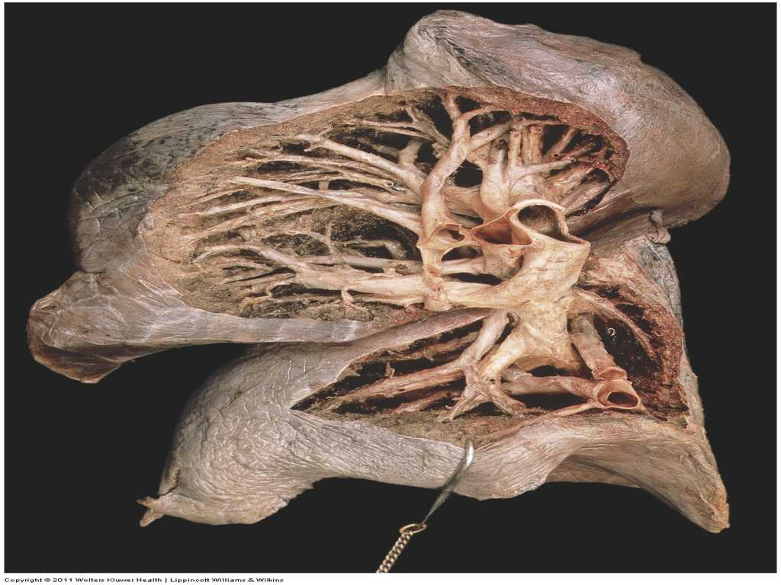
Gas Exchange
Gas exchange takes place in alveoli sac across the alveolar membrane, which is a boundary between the external environment and interior of the body
Gases cross the respiratory membrane by diffusion
In accordance with Fick’s Law

Slide 30
Fick’s Law
The rate of transfer of a gas through a sheet of tissue is proportional to
tissue area
difference in gas partial pressure between the 2 sides
diffusion constant
inversely proportional to tissue thickness

Slide 31
Diffusion across alveolar membrane
In accordance with Fick’s law diffusion is dependent on
Concentration / pressure gradient
Gas solubility
Thickness of alveolar membrane
Surface area of alveolar membrane
Ventilation – perfusion coupling
Notes:
The alveoli have a moist lining to help dissolve the gases and are surrounded by many tiny capillaries so there is plenty of blood for the gases to pass into and out of.

Slide 32
Lung Volume and Capacities
Ventilation
Gas Exchange and Diffusion
Fick’s Law
Concentration / Pressure Gradient
Gas Solubility
Thickness of Alveolar Membrane
Surface Area
Ventilation Perfusion Matching

Slide 33
Partial Pressure
In the context of the respiratory gases concentration is described using term partial pressure
Partial pressure describes the amount of gas dissolved in the plasma. For example:
PaO₂ amount of O₂ dissolved in plasma of arterial blood
PvCO₂ amount of CO₂ dissolved in plasma of venous blood

Slide 34
Pressure Gradient
Inspired air
PO₂ 150 mmHg PCO₂ 0 mmHg
Alveolar gas
PAO₂ 100 mmHg
PACO₂ 40 mmHg
Venous
Arterial
PVO₂ 40mmHg
PVCO₂ 45mm Hg
PaO₂ 100mmHg PaCO₂ 40mmHg
Capillary flow
Notes:
Partial pressures are equivalent to concentration gradients
The steeper the difference in pp between gas in alveoli & capillary blood the steeper the diffusion gradient is the faster & more efficient diffusion
Pv02 = 40mmHg (pulmonary capillaries)
PA02 = 100mHg
The diffusion gradient is steep, diffusion in direction of capillary is rapid & equilibrium (100mmHg both sides of the membrane) is quickly achieved.
the PpC02 is much less steep only 5mmHg
expect CO2 diffusion to be much less rapid than O2 - but diffusion of C02 capillary blood to alveoli is extremely rapid & efficient
in the time available equal amounts of C02 & 02 are exchanged @ the respiratory membrane

Slide 35
O₂ Transit Time
Notes:
The total transit time of a RBC within the pulmonary capillaries = 0.75 sec
it normally takes ~ 0.25 sec for O2 equilibration to occur (third of total time fully sat)
at normal pp of 02 there is a great time reserve – a significant safety margin.
So the velocity of blood flow can be significantly increased & full RBC saturation with 02 will still take place as on exercise
in health it is unusual for the respiratory system to limit exercise performance

Slide 36
Lung Volume and Capacities
Ventilation
Gas Exchange and Diffusion
Fick’s Law
Concentration / Pressure Gradient
Gas Solubility
Thickness of Alveolar Membrane
Surface Area
Ventilation Perfusion Matching

Slide 37
Gas Solubility
Both O₂ and CO₂ are soluble gases
CO₂ is 20 times more soluble than O₂
High solubility of CO₂ facilitates rapid diffusion despite small CO₂ gradient
Equal amounts of CO₂ & O₂ diffuse across the respiratory membrane in the same time period
In respiratory disease when diffusion is impaired O₂ will be primarily affected as it is less soluble
A significant impairment is required to lead to poor CO₂ transfer
Notes:
The slight Pp diffusion gradient and the fact that CO2 has a heavier molecular weight than O2 is compensated by the fact that C02 is eminently diffusible because it is ~ 20 times more soluble than 02.

Slide 38
Lung Volume and Capacities
Ventilation
Gas Exchange and Diffusion
Fick’s Law
Concentration / Pressure Gradient
Gas Solubility
Thickness of Alveolar Membrane
Surface Area
Ventilation Perfusion Matching

Slide 39
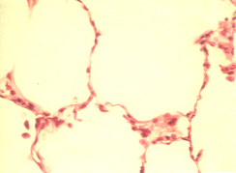
Thickness of Alveolar Membrane
Thickness is 0.5 to 1 μm
Diffusion efficiency is dependent on this distance
As the membrane is ultra thin gas exchange rapid and efficient
If the membrane is thickened this leads to a greater distance between alveoli and capillary
Diffusion slower and/or impaired, leading to hypoxia
Membrane thickening due to
Inflammation
Infection
Fibrosis
Notes:
ultra thin ~ 2,000 times thinner than skin
the total RBC transit time 0.75secs may not be adequate for Hb saturation to
occur – hence PaO2 & SaO2 may be compromised → hypoxia
CO₂ so soluble in real terms membrane thickening never a cause of hypercapnia

Slide 40
Lung Volume and Capacities
Ventilation
Gas Exchange and Diffusion
Fick’s Law
Concentration / Pressure Gradient
Gas Solubility
Thickness of Alveolar Membrane
Surface Area
Ventilation Perfusion Matching

Slide 41
Surface area of membrane
Adult lung contains around 300 million alveoli
Giving a gas exchange surface area 70-80m²
This huge capacity can be utilised to maintain acid-base balance e.g. during exercise
If the surface area is reduced, despite adequate diffusion sufficient gas exchange may not be possible
↓ O₂ and ↑ CO₂ and ↓ pH
Temporary loss surface area occurs in:
Bronchial obstruction (tumour, mucus plug), Atelectasis, Consolidation
Permanent loss surface area
Emphysematous bullae
Notes:
This is ~ 40 times greater than the surface area of skin
In some respiratory diseases there is marked loss of surface area available
even though diffusion may not be impaired Pa02 can not be satisfactorily maintained
Eg bronchial obstruction by a combination of oedema, mucus plugs, , bronchoconstriction, or tumours, foreign bodies --> alveolar collapse there is an effective loss of surface area for exchange – may → a decreased PaO2
/ increased PaCO2 & deranged pH.
In emphysema →structural breakdown of alveolar walls → formation of fewer larger alveoli instead of more numerous and smaller alveoli → with a significantly reduced total surface area available for gaseous exchange.

Slide 42
Lung Volume and Capacities
Ventilation
Gas Exchange and Diffusion
Fick’s Law
Concentration / Pressure Gradient
Gas Solubility
Thickness of Alveolar Membrane
Surface Area
Ventilation Perfusion Matching

Slide 43
Ventilation Perfusion Coupling
In respiratory physiology the V/Q ratio is used to describe efficiency and adequacy of matching two variables
V ventilation: the air which reaches the lungs
Q perfusion: the blood which reaches the lungs
The lungs are centered vertically around the heart
Part of the lung is superior to the heart and part is inferior
This has major impact on the V/Q ratio
Lower part (dependent) of lung is better ventilated and better perfused than apex

Slide 44
Ventilation / Perfusion Matching
Efficient gas exchange needs maximum coupling between ventilation and perfusion
V
Shunt
V
Alveolar gas
Capillary blood flow
Q
Alveolar gas
V
Alveolar dead space
Q
Capillary blood flow
Inadequacy of either V or Q will have significant impact on removal of CO₂ & oxygenation of blood
Alveolar gas
Capillary blood flow
Q

Slide 45
Key Points
Define the common lung volumes and describe how they alter in restrictive and obstructive disease
Define anatomical and physiological dead space and give approximate volumes for both in a typical healthy adult
Describe the effect of increased breathing frequency compared with increased depth of breathing on alveolar ventilation
Define Fick’s law of diffusion
Relate Fick’s law of diffusion to gas exchange in health and disease
Describe how ventilation/perfusion mismatching can occur

Slide 46
Suggested Further Reading
Respiratory Physiology A clinical Approach by Schwartzstein and Parker (Lippincott Williams and Wilkins)
Respiratory Physiology by John West (Williams and Wilkins)
The Respiratory System at a Glance by Ward, Ward, Wiener and Leach (Blackwell publishing)

