Slide 1
Exercise Physiology
Dr Luke Howard
Consultant Physician, Hammersmith Hospital, ICHNT
Honorary Senior Lecturer, National Heart & Lung Institute
l.howard@imperial.ac.uk

Slide 2
O₂ flow
Lungs
Muscle
Expired CO₂ – VCO₂
Circulation
O₂ consumption
CO₂ production
CO₂ flow
Inspired O₂ – VO₂

Slide 3
Basic exercise metabolism
Muscle contraction requires energy for contraction in the form of phosphate, “delivered by ATP”
Three sources of phosphate:
Anaerobic metabolism, incl. Creatine phosphate
Aerobic metabolism
Largest source is aerobic
Cardiac output needs to increase by 5-6 l/min per l/min oxygen consumption
If it fails, anaerobic metabolism required

Slide 4
Basic exercise metabolism
CO₂ + H₂0 ↔ H₂CO₃ ↔ H⁺ + HCO₃⁻
Total body H⁺ is 3.4 micromoles
H⁺ generated at walking speed is 40,000 micromoles per minute from CO₂ production
Cardiovascular system must remove CO2 to lungs where it is eliminated in proportion to rate of delivery
Small errors lead to large changes in pH

Slide 5
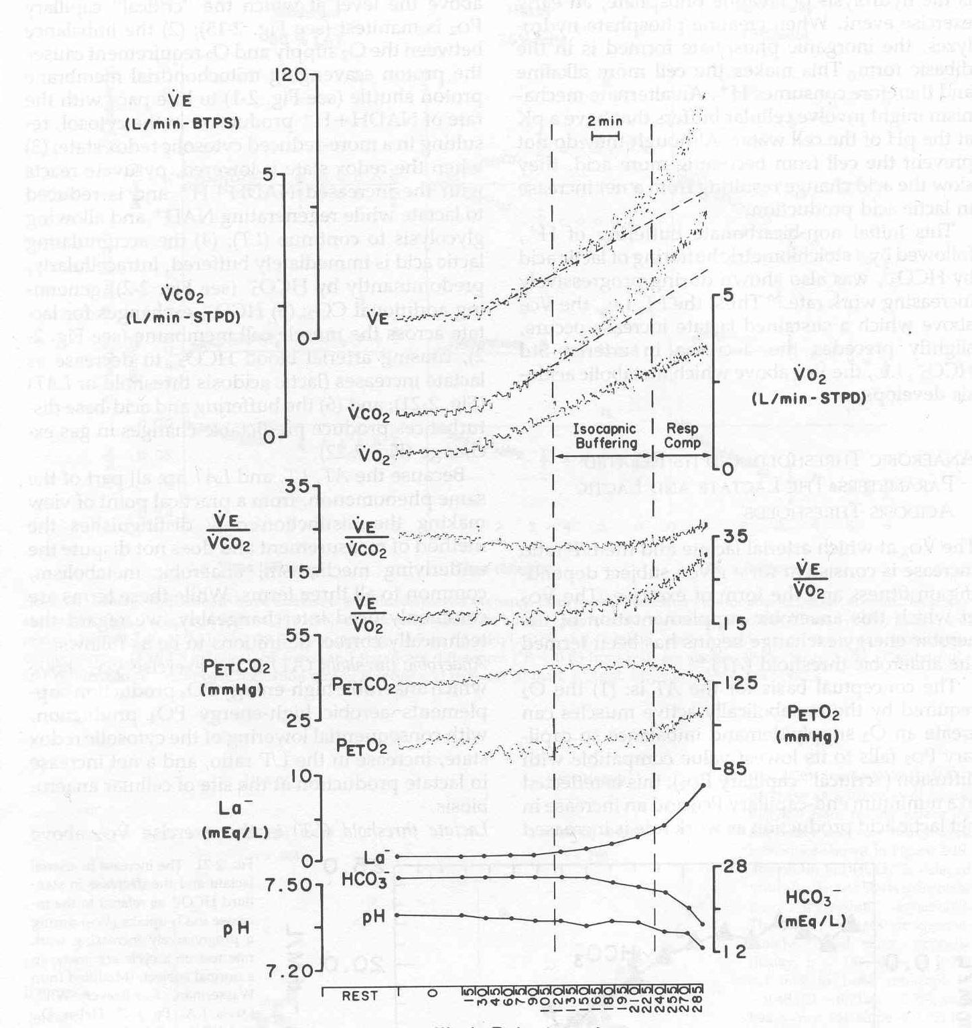

Slide 6
CO₂ flow
Lungs
Muscle
Expired CO₂ – VCO₂
Circulation
CO₂ production

Slide 7
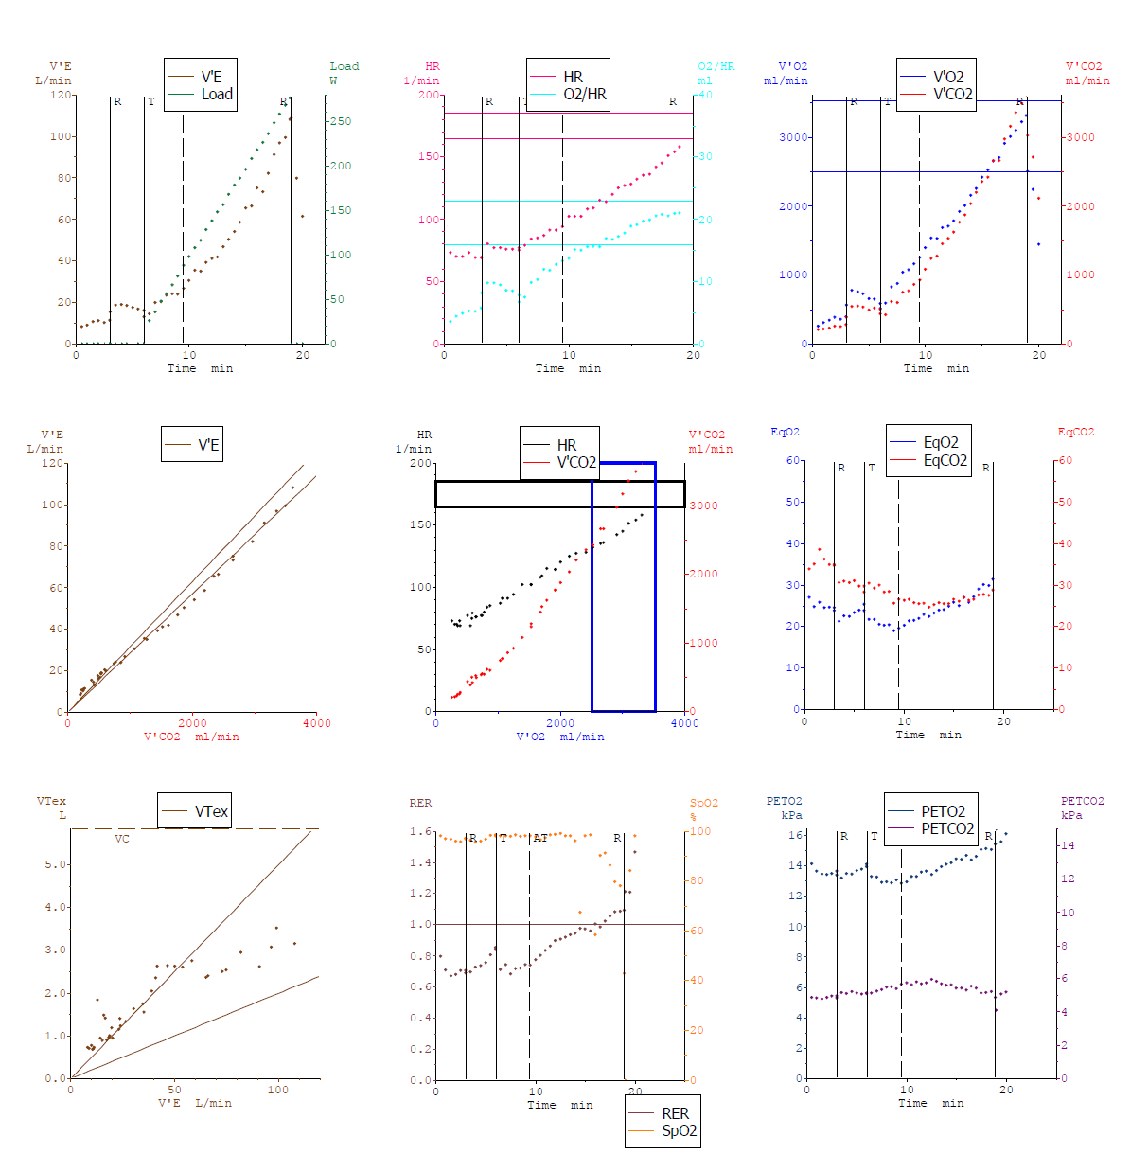

Slide 8
Carbon dioxide production drives exercise response to maintain normal pH
The relationship of ventilation to carbon dioxide production relates to the efficiency of the lungs

Slide 9
How is CO₂ cleared from the lung?
VCO₂
Ventilation increases in proportion to CO2 production
Deadspace fraction (VD/VT)
The more deadspace in your lung, the more you have to breathe to clear CO₂
CO₂ set-point
The lower the CO₂ in the blood and lung, the higher the ventilation to clear CO₂

Slide 10
Sources of CO2 Output during Exercise
1) Aerobic substrate catabolism
2) Bicarbonate buffering from H+ produced alongside lactate:
3) Pulmonary hyperventilation due to acidosis
Whipp - unpublished

Slide 11
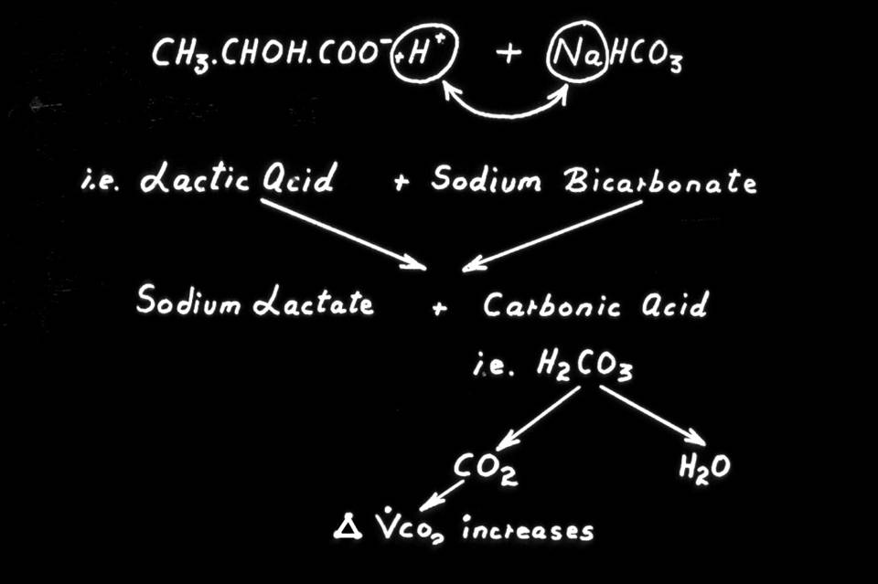
Whipp - unpublished

Slide 12
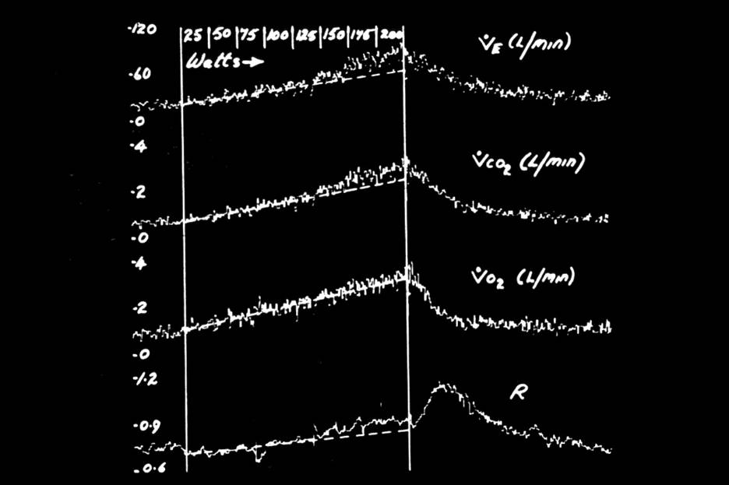
=VCO₂/VO₂
Whipp - unpublished

Slide 13
Ventilatory response to steady-state exercise
CO2 and pH are the most important regulators of ventilation in the physiological range. So if they stay constant during exercise, what causes the change in ventilation???
In response to changes in CO2 production
III
II
Cortical
Ergoreceptor
Cardiodynamic
I
Time

Slide 15
Components of the cardiovascular response
Speed of delivery bike
Number of oranges arriving in bike
Number of oranges leaving in bike
Rate of delivery of oranges
VO₂ = CO x (CaO₂ – CvO₂)
VO₂ = SV x HR x (CaO₂ – CvO₂)
VO₂ = SV x HR x 13.4 x Hb x (SaO₂ – SvO₂)
% basket occupied
Distance generated by each revolution of pedals
Cycling cadence
Capacity of basket

Slide 16
Components of the cardiovascular response
VO₂ = CO x (CaO₂ – CvO₂)
VO₂ = SV x HR x (CaO₂ – CvO₂)
VO₂ = SV x HR x 13.4 x Hb x (SaO₂ – SvO₂)
✓
✓
✓
✓

Slide 17
Components of the cardiovascular response
VO₂ = SV x HR x 13.4 x Hb x (SaO₂ – SvO₂)
VO₂ / HR = SV x 13.4 x Hb x (SaO₂ – SvO₂)
VO₂ / HR α SV x (SaO₂ – SvO₂)

Slide 18
VO₂ / HR = SV x (CaO₂ – CvO₂)
At peak exercise:
CaO₂ 21 ml/100ml
CvO₂ 5 ml/100ml
SV = O2 pulse /16 x 100

