Slide 1
Allergic airway disease
Professor A.B.Kay
Emeritus Professor of Allergy and Clinical Immunology
National Heart and Lung Institute
Imperial College

Slide 2
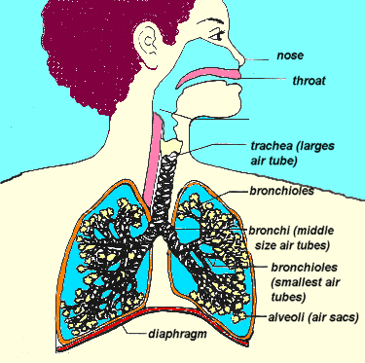
Allergic Airway Diseases
Upper airways
(Allergic rhinitis)
Bronchi
(asthma)
Alveoli (allergic alveolitis)

Slide 3
To define "Allergy" and to distinguish it from related terms such as "Intolerance", "Atopy" and "Hypersensitivity“
.
To understand the fundamental immunological mechanisms operative in the major forms of allergic airway diseases (i.e. allergic rhinitis, asthma and extrinsic allergic alveolitis)
To appreciate the scope of allergic airway disease
To appreciate the burden of allergic airway disease
To understand possible reasons for the rising trends in allergic disease.
To outline the principles of treatment of allergic airway diseases, including allergen specific immunotherapy.
Learning Objectives

Slide 4
Hypersensitivity
(exaggerated response)
Immunological
(“Allergy”)
Non-immunological
Intolerance
(e.g.food)
IgE-mediated
(i.e.the atopic
diseases
hayfever,
eczema
asthma
Non-IgE-mediated
allergic diseases
(e.g. Farmers lung)
Enzyme deficiency
(e.g.lactase DH def)
Pharmacological
e.g. Aspirin hypersensitivity

Slide 5
What is Allergy?
Allergy is an exaggerated immunological response
to a foreign substance (allergen) which is either
inhaled, swallowed, injected, or comes in contact
with the skin or eye.

Slide 6
Allergy is a mechanism (not a disease).
Allergic mechanisms play an important role in some diseases all the time, and in others for some of the time.

Slide 7
Asthma
Eczema
Urticaria
Angioedema
Drug
reactions
ALLERGY
Food
Reactions
Rhinitis

Slide 8
.
To understand the fundamental immunological mechanisms operative in the major forms of allergic airway diseases (i.e. allergic rhinitis, asthma and extrinsic allergic alveolitis)
Learning Objectives

Slide 9
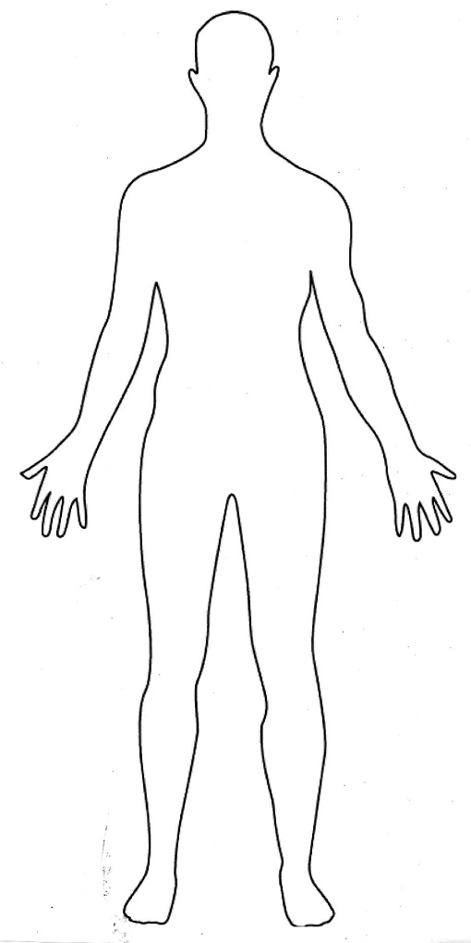
Immunity
Viruses
bacteria
fungi
protozoa
helminths (“worms”)
ectoparasites (“ticks”)
T helper type 1 (Th1)
Th17 cells, cytotoxic T cells
IgM, IgA and IgG subclasses
Th2 cells, IgE and IgG1 antibodies epithelial barriers, innate lymphoid cells, eosinophils, mast cells, basophils, activated macrophages.

Slide 10
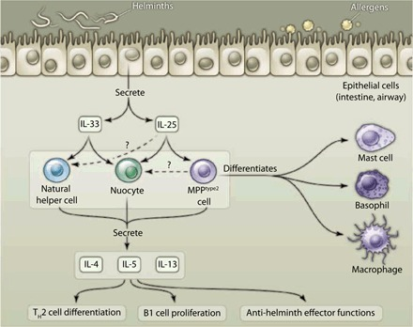
Path to TH2 responses.
R L Coffman Science 2010;328:1116-1117
Notes:
Path to TH2 responses. Parasitic helminths or allergens induce epithelial cells to produce cytokines that stimulate three populations of cells to produce other cytokines. This cytokine combination promotes differentiation of TH2 and B1 cells and stimulates effector functions, leading to parasite expulsion. MPPtype2 cells can give rise to multiple cell types, including basophils, which can bias toward TH2 differentiation. It is not clear whether natural helper, nuocyte, and MPPtype2 cells are different, or the same cell type viewed differently.

Slide 11
IgE-mediated allergic reactions in the upper and lower airways
Histamine
Acute
symptoms
of allergy
IgE antibody coating mast cell
Mast cell degranulation
Allergen
(e.g. pollen)
CD4
Th2
Chronic symptoms of allergy
APC
Th2 cytokines and chemokines

Slide 12
Th2 cells and allergic Inflammation
IL-4
IL-5
IL-9
IL-13
IgE synthesis
Eosinophil development
Mast cell development
IgE synthesis
Airway Hyperresponsiveness
CD4+
Th2 cell

Slide 13
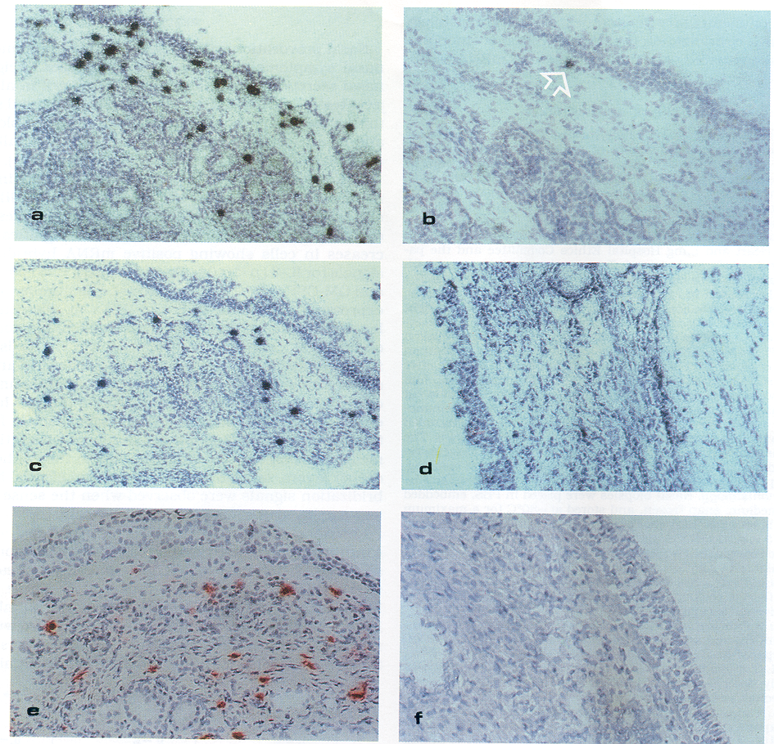
IL-4
IL-5
Eosinophils

Slide 14
Atopy (“out of place”)
Atopy is the hereditary predisposition to produce IgE
antibodies against common environmental allergens
The atopic diseases are allergic rhinitis, asthma and atopic eczema
Allergic tissue reactions (in atopic subjects) are characterised by infiltration of Th2 cells and eosinophils

Slide 15
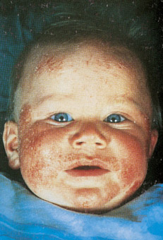
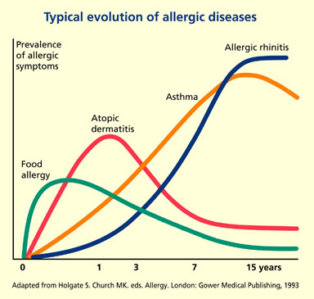
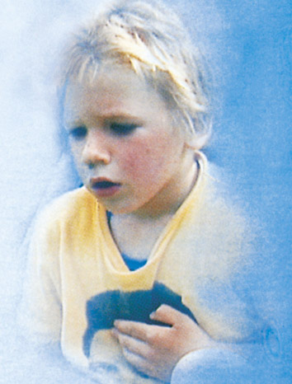
The ’allergic march‘ is the term describing the common progression from atopic dermatitis to allergic asthma
Notes:
Notes
A strict relationship between allergic rhinitis and allergic asthma has been seen recently, and in many ways respiratory allergy could be seen as a single disorder of the airways. The link between rhinitis and asthma can be elucidated only by studying the natural history of the disease over a long period (Lombardi C et al. Respir Med 2001;95:9-12). Atopic dermatitis and food allergy too have been linked with an increased risk of evolving into a more serious allergic disease such as asthma.

Slide 16
To appreciate the scope of allergic airway disease
Learning Objectives

Slide 17
Allergic rhino-conjunctivitis
(Seasonal and perennial)
Up to 17% of the population

Slide 18
Seasonal Allergic Conjunctivo-rhinitis (Summer Hay Fever)
-Effects 12-15% children, 11-17% adults
-UK prevalence highest in Europe
-Effect on school exams, time off school
-General effect on Q of L

Slide 19
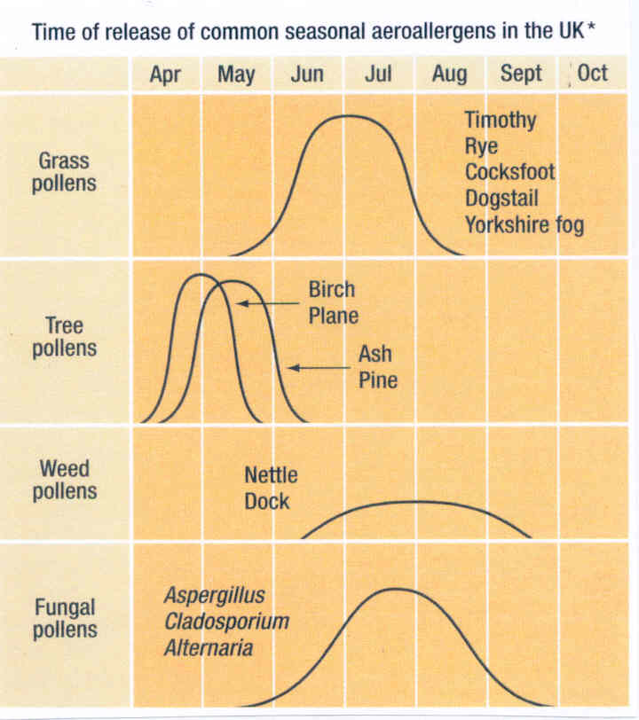

Slide 20
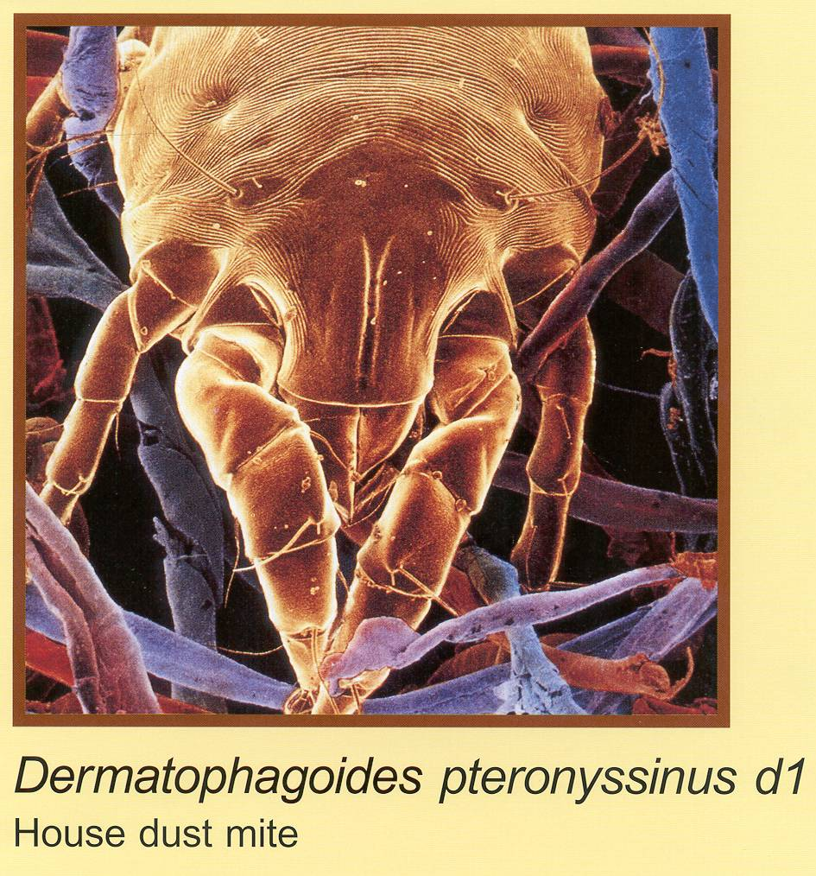
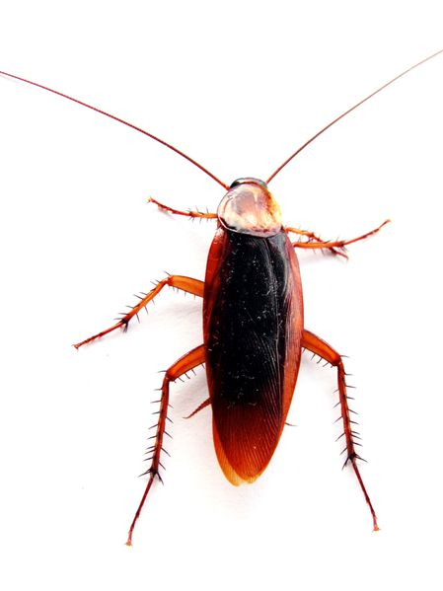
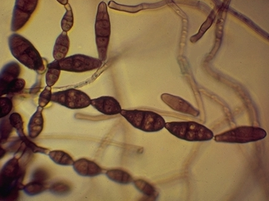
Common causes of perennial allergic rhinitis
and asthma
House dust mite
Cats
Dogs
Alternaria
Cockroach
Horses

Slide 21
Asthma
Effects 8-12% of the population

Slide 22
Asthma is a very heterogeneous disease
(Many phenotypes)
-Intermittent , mild, allergy frequently important
-Persistent, manageable, allergy often important
-Chronic severe, infection (not allergy) important

Slide 23
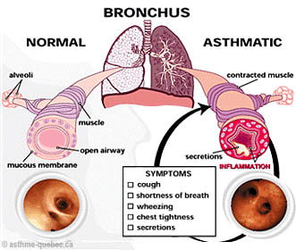

Slide 24
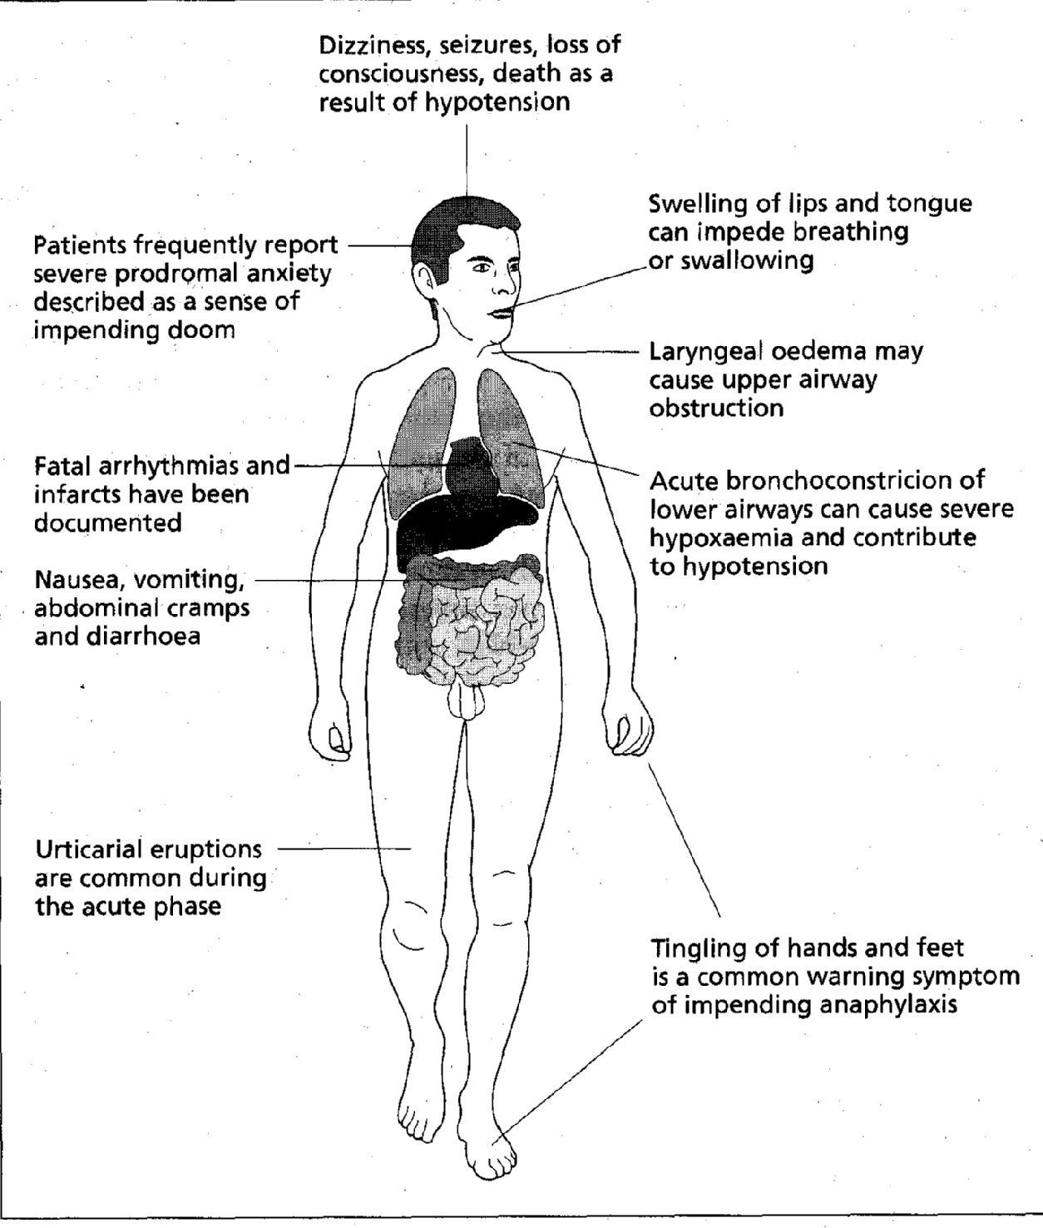
General Anaphylaxis
Dizziness, seizures, loss of consiousness
Lip, tongue
swelling
Anxiety
sense of gloom
Laryngeal
oedema
arrhythmia
Bronchoconstriction
Vomiting, diarrhoea
pain
Urticaria/hives
Tingling

Slide 25
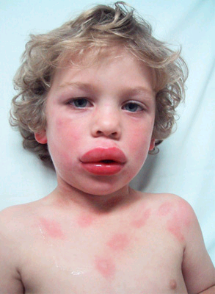
Acute anaphylaxis
with urticaria
and angioedema

Slide 26
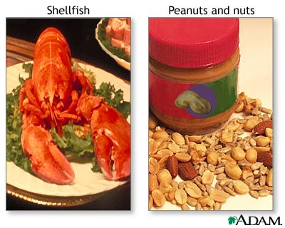
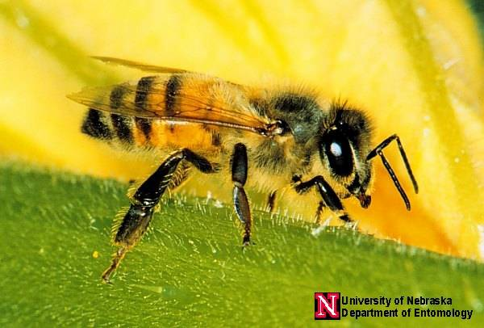
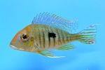
Causes of Anaphylaxis
-Drugs, such as penicillin
-Foods such as peanuts, tree nuts (walnuts, pecans)
milk, eggs, fish, shellfish, sesame seeds, soybeans,
celery, celeriac
-Insect stings from bees, wasps, hornets
-Latex

Slide 27
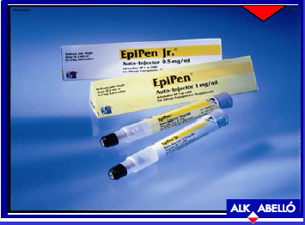

Slide 28
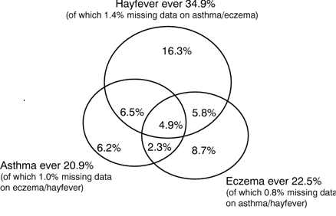
Overlap of Atopic diseases

Slide 29
Extrinsic Allergic alveolitis
Effects 0.1% of the population

Slide 30
Examples of Extrinsic Allergic Alveolitis
Farmer’s Lung Mouldy Hay
Bird Fancier’s lung Bird Droppings
Air Conditioner lung Air conditioner moulds
Mushroom workers lung Mushroom compost
Malt workers lung Mouldy malt or barley
Coffee workers lung unroasted coffee beans
Millers lung infested flour
Hot tub lung Bacterial contamination

Slide 31
Mechanisms in Extrinsic Allergic Alveolitis
Small allergenic particles
(less than 5 microns)
penetrate to the distal
airways and alveoli
Alveolus
Y
Y
Interstitium
Y
Y
Y
Y
Y
Y
Pulmonary capillary
Antigen/antibody complexes
Complement
Chemotactic factors
Neutrophils
Macrophages
Fibroblasts

Slide 32
To appreciate the burden of allergic airway disease
Learning Objectives

Slide 33
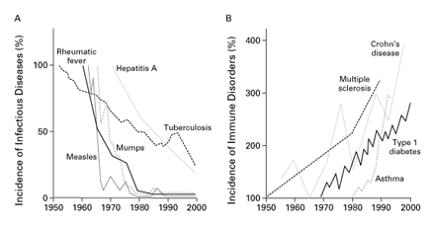
Decrease in Infectious Diseases mirrors an
increase in Allergy and Autoimmune disease
Bach J-F NEJM 2002

Slide 34
Prevalence of Allergic Diseases
An estimated 5.7 million people in England have been diagnosed with asthma
at some point in their lives
3.3 million people in England, approximately one in 15 people,
have a recorded diagnosis of allergic rhinitis at some point in their life
117% increase in the number of people suffering from
peanut allergy from 2001 to 2005
The number of hospital admissions due to anaphylactic
shock increased seven-fold from 1990 to 2000
(source QRESEARCH 2007)

Slide 35
To understand possible reasons for the rising trends in allergic disease.
Learning Objectives

Slide 36
Why is allergy on the increase?

Slide 37
Environment
“Allergy”
Asthma
Atopy
Genes

Slide 38
20th Century life and the Environment
either
Something has been put in
and/or
Something has been taken out

Slide 39
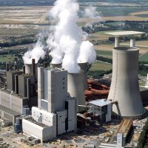
Everyone wants to blame pollution!

Slide 40
Germany
West East
Asthma/Hayfever 5.9 3.9
Atopy 36.7 18.2
AHR 8.3 5.5
Bronchitis 3.7 16.7
Germany
(percentages)

Slide 41
Strachan DP “Hay Fever, Hygiene and Household size BMJ 1989, 299, 1259

Slide 42
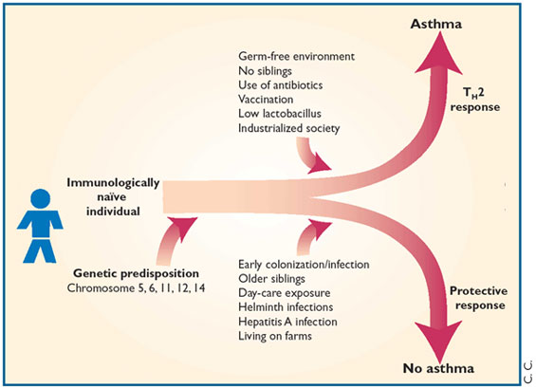
The hygiene hypothesis
Umetsu et al 2002

Slide 43
Farming environments confers protection against the development of allergy

Slide 44
Factors associated with allergy/asthma prevalence
Microbial
Water sanitation (less oro-faecal water born infections)
Food quality (lack of fermenting bacteria)
Poverty (high asthma rates in urban underprivileged)
Medical interventions (antibiotics in childhood,
possibly certain vaccinations)
Non-microbial
Pollution (air, water, food)
Diet and nutrition (lack of Vit D, fish oil, trace elements)
Obesity (may cause chronic inflammation)
Climate change (high pollen counts)
Stress (linked to chronic inflammation)
Wrong genes

Slide 45
Dendritic cells identify friend or foe
Toll-like receptors*
T_{reg}
Protect
Th0
Th1
Attack
Th2
*Example of pattern-recognition receptors (PPR)
Recognise Pathogen-associated molecular patterns (PAMP’s)

Slide 46
Dendritic cells identify friend or foe
Protect
Toll-like receptors
T_{reg}
IL-10
The Old friends
-Lactobacilli
-Saprophytic
Myobacteria
-Helminths)
Th0
Th1
Th2

Slide 47
Dendritic cells identify friend or foe
Toll-like receptors
T_{reg}
-Pathogens
-Allergens
Th0
IL-4, IL-5
INF-γ
Th1
Attack
Th2

Slide 48
To outline the principles of treatment of allergic airway diseases, including allergen specific immunotherapy.
Learning Objectives

Slide 49
The Principles of Treatment of Allergic Diseases
Allergen Avoidance
Anti-allergic medication
Immunotherapy (desensitisation/hyposensitisation)

Slide 50
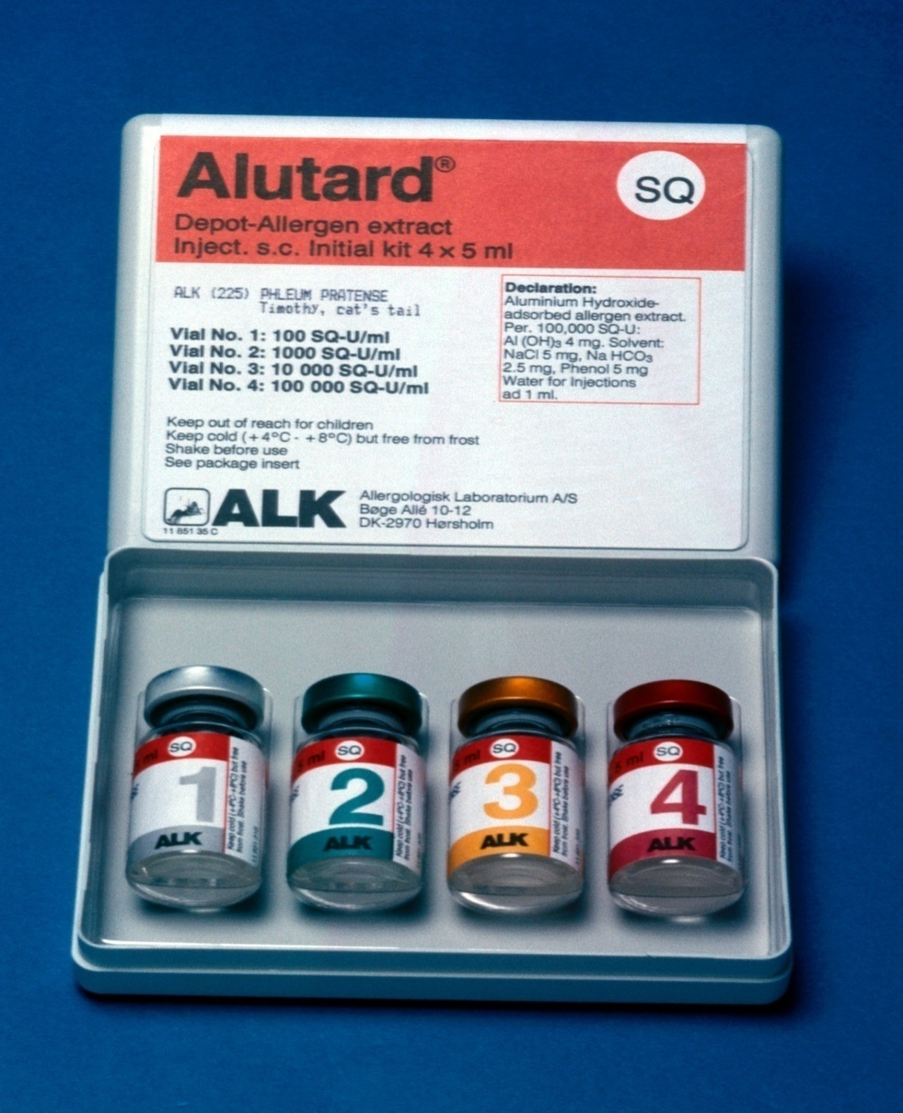
Allergen-injection immunotherapy
(hyposensitisation/desensitisation)

Slide 51
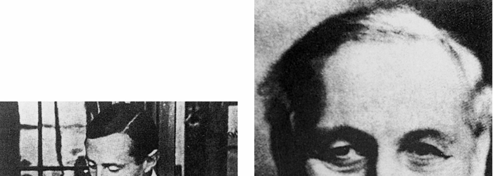
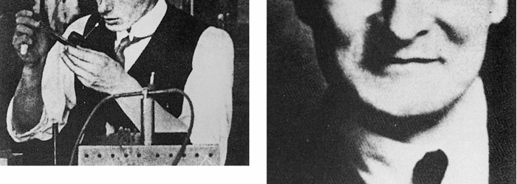
Leonard Noon (1877–1913).
John Freeman (1877–1962).
Noon and Freeman introduced the treatment of hayfever by immunization with pollen extracts

Slide 53
Allergen-injection immunotherapy
(hyposensitisation/desensitisation)
Advantages
Effective
Produces long lasting immunity
Disadvantages
Occasional severe allergic reaction
Time consuming
Standardisation problems

Slide 54
Indications for Allergen-Specific Immunotherapy in the UK
Grass and tree pollen allergic rhino-conjunctivitis uncontrolled by medication.
Bee or wasp sting anaphylaxis at risk for repeated stings.

Slide 55
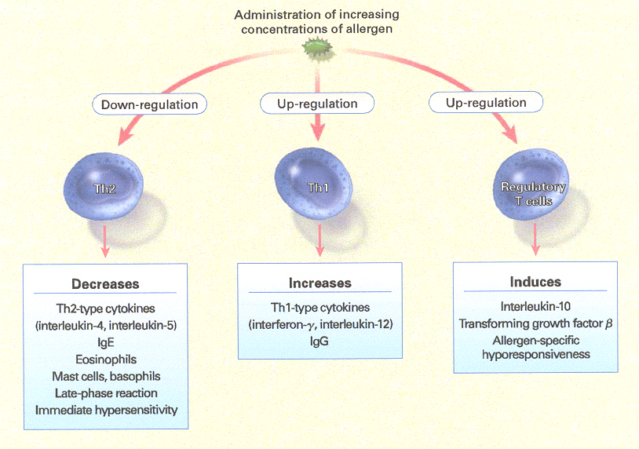

Slide 56
To define "Allergy" and to distinguish it from related terms such as "Intolerance", "Atopy" and "Hypersensitivity“
.
To understand the fundamental immunological mechanisms operative in the major forms of allergic airway diseases (i.e. allergic rhinitis, asthma and extrinsic allergic alveolitis)
To appreciate the scope of allergic airway disease
To appreciate the burden of allergic airway disease
To understand possible reasons for the rising trends in allergic disease.
To outline the principles of treatment of allergic airway diseases, including allergen specific immunotherapy.
Learning Objectives

