Slide 1
Regulation of the cardiovascular system
Dr Ken MacLeod
Cardiac Medicine, NHLI, Faculty of Medicine, Imperial College London, UK
Life Support Systems
Cardiovascular System
© Imperial College London

Slide 2
Topics covered - learning objectives
Local mechanisms regulating blood flow
  Autoregulation, the endothelium
Systemic regulation by hormones
  circulating vasoconstrictors, Kinins, ANP,
Neural regulatory mechanisms
  Nervous control of blood vessel diameter
  Cardiac innervation, changing cardiac contraction
  Baroreceptors
  Reciprocal innervation
Integration of control systems

Slide 3
Key equations
Stroke volume = end-diastolic volume - end systolic volume
  SV = EDV - ESV
Cardiac output = heart rate x stroke volume
  CO = HR x SV
Mean systemic arterial pressure = cardiac output x total peripheral resistance
  Mean BP = CO x TPR

Slide 4
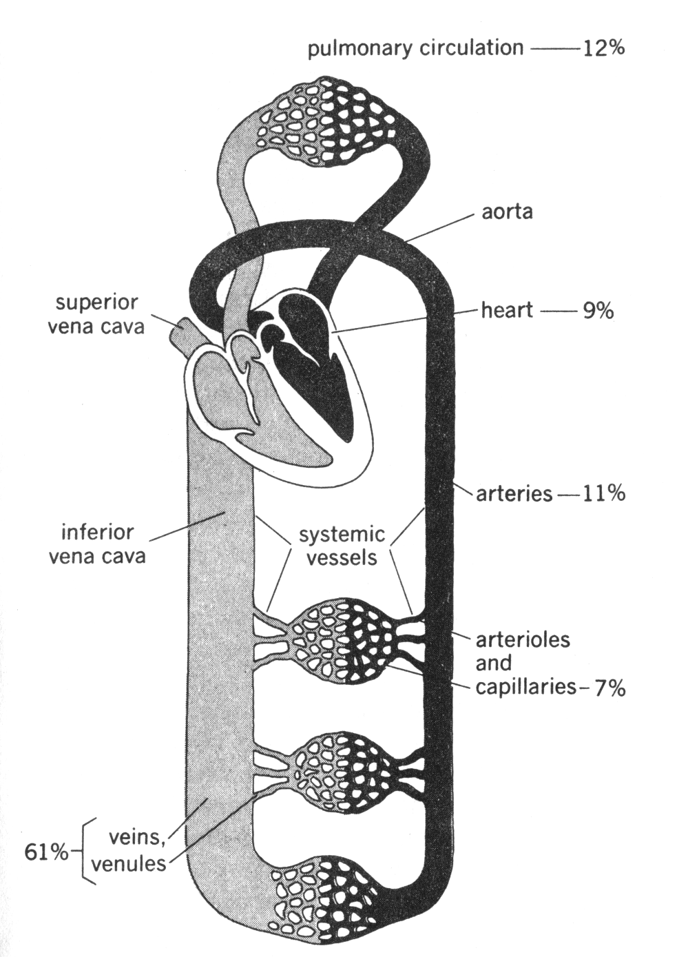
Design of the cardiovascular system
Systemic & pulmonary circulations
Right heart → lungs → left heart
Veins have capacitance
Venous volume distribution affected by
  peripheral venous “tone”
  gravity
  skeletal muscle pump
  breathing
Central venous pressure (mean pressure in the right atrium) determines the amount of blood flowing back to the heart.
The amount of blood flowing back to the heart determines stroke volume (using Starling’s Law of the Heart)

Slide 5
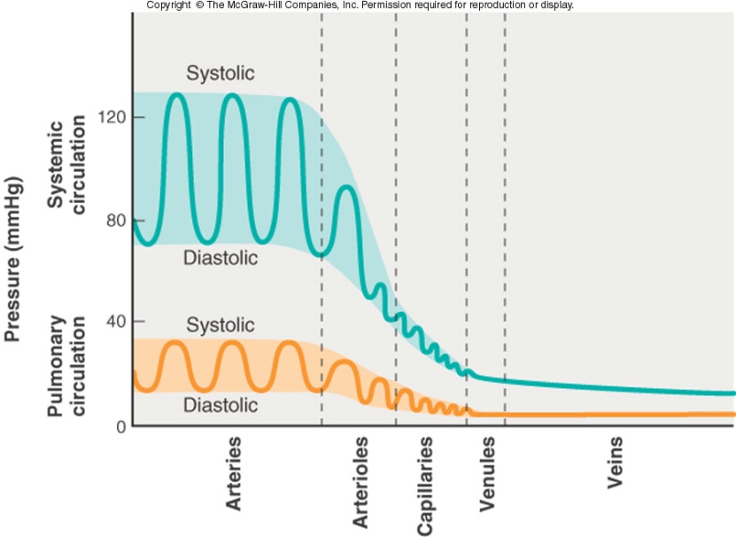
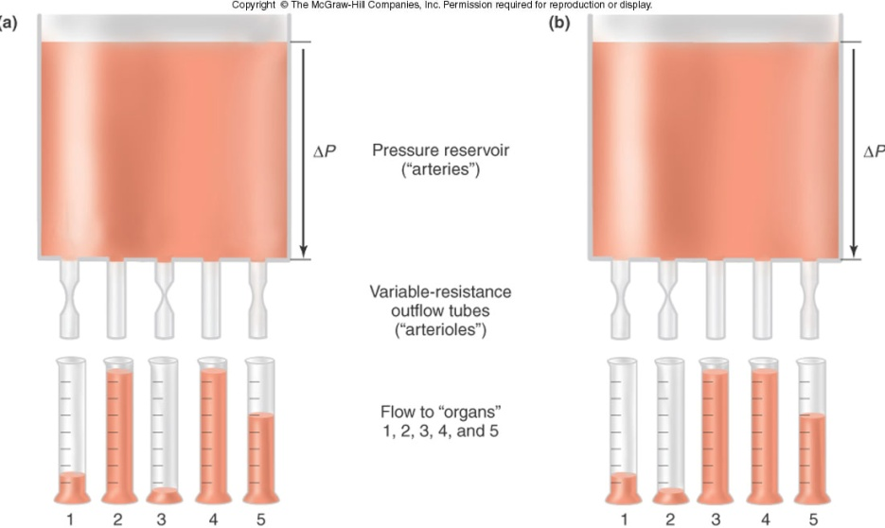
Flow control
Veins: Constriction determines compliance and venous return
Arterioles: Constriction determines
blood flow to organs they serve
mean arterial blood pressure
the pattern of distribution of blood to organs
Flow changed primarily
by altering vessel radius
Remember:

Slide 6
Ways of regulating blood flow
Local mechanisms
  intrinsic to the smooth muscle itself or closely associated
Systemic regulation
  circulating hormones
Autonomic nervous system

Slide 7
Local mechanisms regulating blood flow (1)
Autoregulation
(the intrinsic capacity to compensate for changes in perfusion pressure by changing vascular resistance)
passive constriction as the intravascular pressure falls
No autoregulation
  Myogenic theory (smooth muscle fibres respond to tension in the vessel wall; eg as pressure rises muscle fibres contract; stretch-sensitive channels involved)
  Metabolic theory (as blood flow decreases “metabolites” accumulate and vessels dilate; when flow increases “metabolites” are washed away)
  Injury (serotonin release from platelets causes constriction)
Resistance
autoregulation
500
Flow (ml/min)
300
No autoregulation
Pressure
100
(mm Hg)
70
e.g. CO₂, H⁺, adenosine, K⁺
0
2
4
6
Time (min)

Slide 8
Local mechanisms regulating blood flow (2)
Dr Chester's lecture - the endothelium is a generator of hormones (NO, prostacyclin, endothelin-1) that regulate vascular and cardiac muscle function
Substances released from the endothelium
  Nitric oxide (endothelium-derived relaxing factor synthesised from arginine; plays key role in vasodilation)
  Prostacyclin & thromboxane A2 (vasodilator & vasoconstrictor – relative amounts important for clotting)
  Endothelins (potent vasoconstrictors)

Slide 9
Systemic regulation of blood flow by hormones
Circulating hormones affecting the vascular system
Kinins
  e.g. bradykinin, have complex interactions with renin-angiotensin system; relax vascular smooth muscle
ANP
  atrial natriuretic peptide - secreted from the cardiac atria, vasodilator
Circulating vasoconstrictors
  ADH – antidiuretic hormone (also known as vasopressin) secreted from posterior pituitary,
  noradrenaline released from adrenal medulla,
  angiotensin II formed by increased renin secretion from kidney
Dr Schacter’s lecture on RAS

Slide 10
Design of autonomic NS
CNS
Peripheral nervous system
Parasympathetic
cranial
N
M
ganglion
thoracic
Sympathetic
lumbar
Pre-gangionic fibre
Post-ganglionic fibre
N
M
Parasympathetic
sacral
ACh
Transmitter at synapse
Sympathetic nervous system is important in controlling the circulation
NA
N
Parasympathetic nervous system is important in regulating heart rate
Receptor at para symp synapses
= Nicotinic
M
= Muscarinic

Slide 11
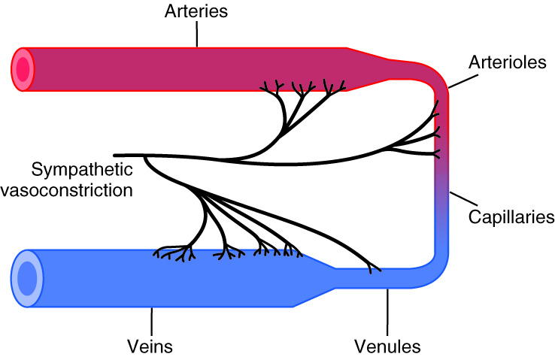
Sympathetic innervation to blood vessels
Sympathetic nerve fibers innervate all vessels except capillaries and precapillary sphincters and some metarterioles.
Large veins and the heart are also sympathetically innervated
Distribution of sympathetic nerve fibres elsewhere is variable. More innervate the vessels supplying kidneys, gut, spleen and skin and fewer innervate skeletal muscle and the brain.
Noradrenaline preferentially binds to α1-adrenoceptors to cause smooth muscle contraction and vasoconstriction.
Notes:
Circulating adrenaline binds with high affinity to smooth muscle β2-adrenoceptors to cause vasodilation in some organs; however, the effect of adrenaline is very concentration-dependent. While it has a higher affinity for β2 than α1 or α2-adrenoceptors, at high concentrations it does bind to αlpha adrenoceptors, which can override the vasodilatory effects of β2-adrenoceptor stimulation and produce vasoconstriction.

Slide 12
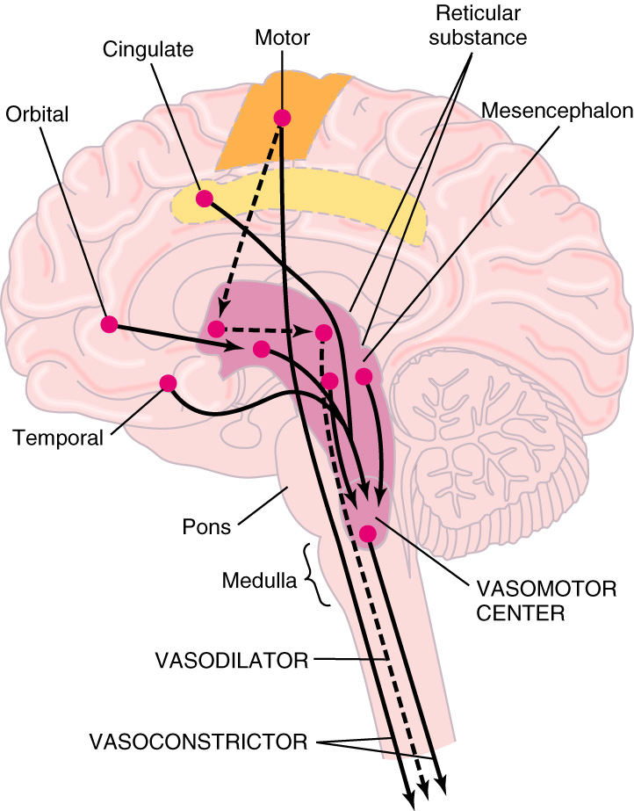
The vasomotor centre (VMC) in the brain
VMC is located bilaterally in the reticular substance of the medulla and the lower third of the pons.
The VMC is composed of a vasoconstrictor (pressor) area, a vasodilator (depressor) area and a cardioregulatory inhibitory area.
The VMC transmits impulses distally through the spinal cord to almost all blood vessels.
Many higher centers of the brain such as the hypothalamus can exert powerful excitatory or inhibitory effects on the VMC.
Lateral portions of VMC controls heart activity by influencing heart rate and contractility.
Medial portion of VMC transmits signals via vagus nerve to heart that tend to decrease heart rate.

Slide 13
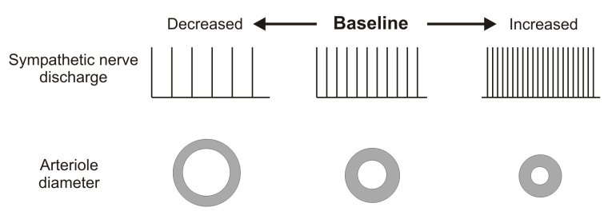
Nervous control of blood vessel diameter
Vasomotor centre
Blood vessels receive symp. post-ganglionic innervation Transmitter = noradrenaline
Always some level of tonic activity
Control of nerve activity can accomplish dilation or constriction
Generally no parasympathetic innervation to vascular system
Pressor
Depressor
*
-
+

Slide 14
Summary – control of blood vessel radius
Vessel radius
Sympathetic
vasoconstrictor
nerves
Circulating hormones eg
plasma noradrenaline
Local controls
O₂
K⁺
CO₂
H⁺
osmolarity,
metabolites

Slide 15
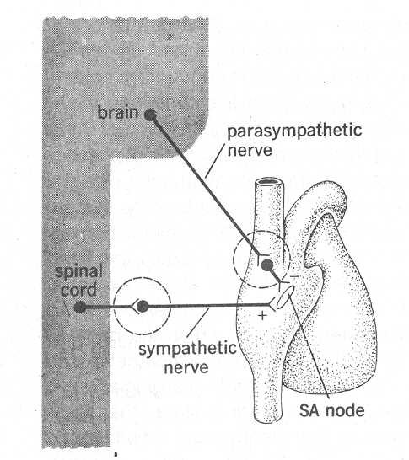
Cardiac innervation
HR
beats/min
Sympathetic
nerves stimulated
Parasympathetic
nerves cut
120
90
normal
60
Sympathetic
nerves cut
30
Parasympathetic
nerves stimulated
time
Heart rate
Activity of
sympathetic
nerves to heart
Activity of
parasympathetic
nerves to heart
Plasma
adrenaline

Slide 16
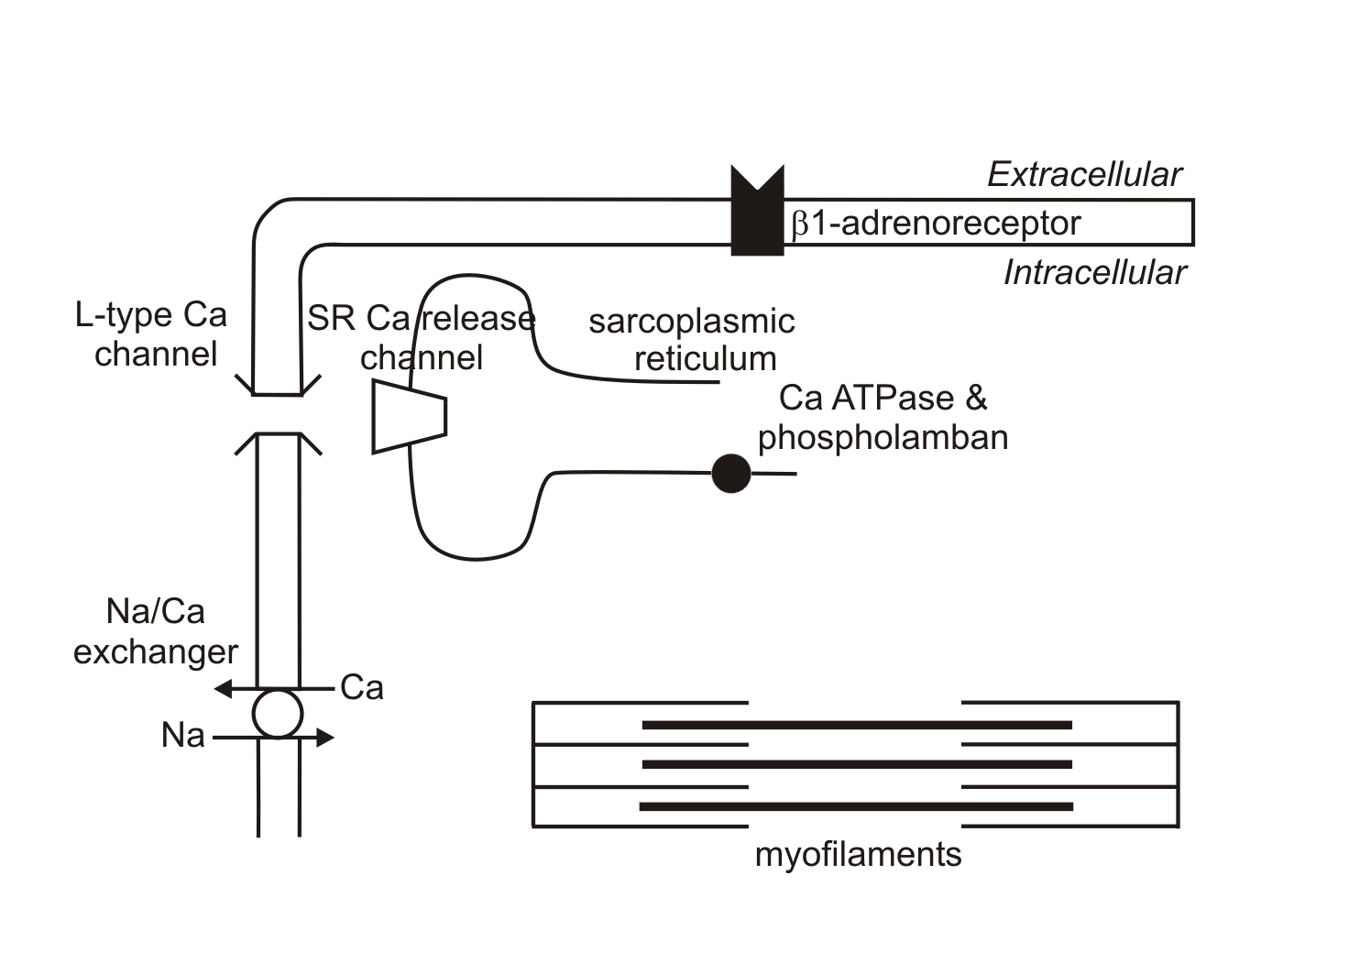
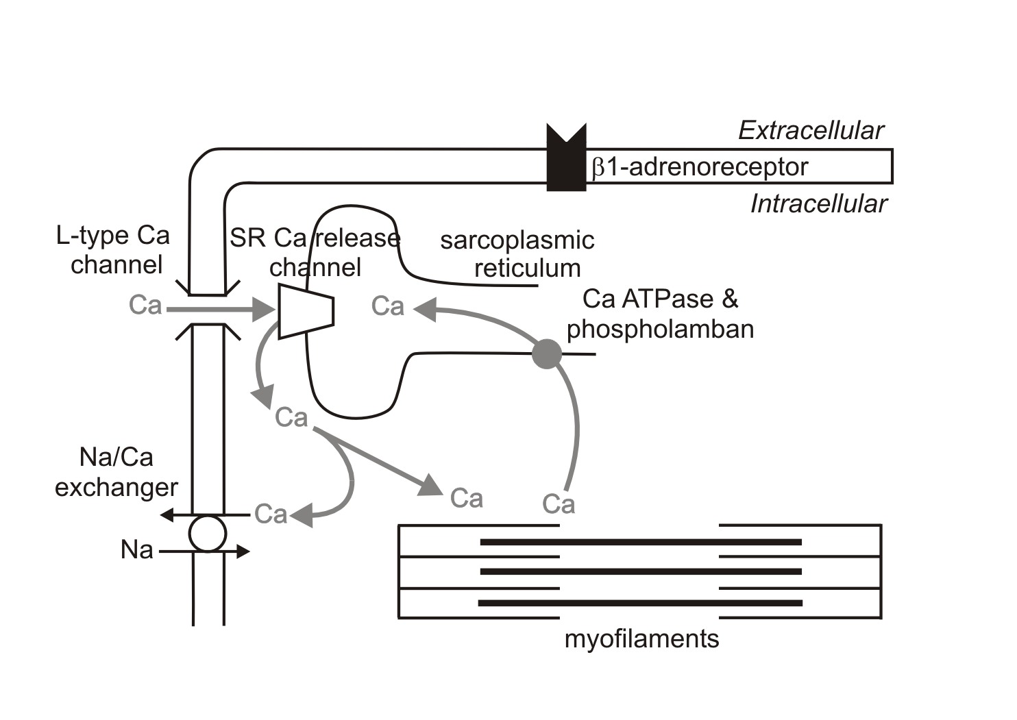
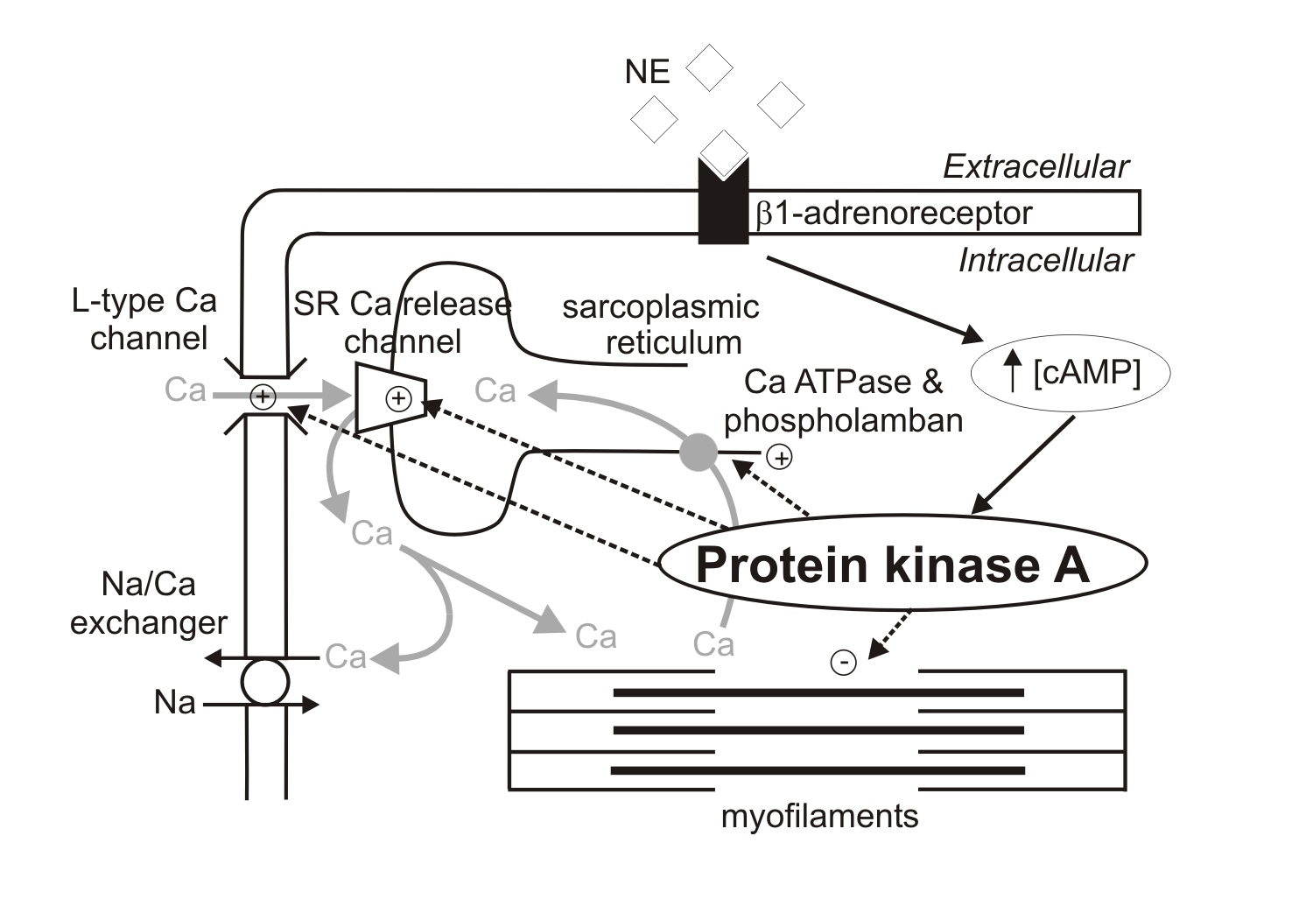
Controlling force of contraction
Ca influx increased
Ca uptake into intracellular stores increased

Slide 17
Controlling stroke volume
Stroke volume
Activity of
sympathetic
nerves to heart
Plasma
adrenaline
Starling’s
Law
End-diastolic
ventricular
volume
Extrinsic control
assists
Intrathoracic
pressure
Intrinsic control
Atrial
pressure
Venous return
Respiratory movements

Slide 18
Integration so far
Cardiac output = stroke volume x heart rate
Cardiac output
Fight or flight response
Stroke volume
Heart rate
End-diastolic
ventricular
volume
Plasma
adrenaline
Activity of
sympathetic
nerves to heart
Intrathoracic
pressure
Atrial
pressure
Respiratory movements
Activity of
parasympathetic
nerves to heart
Venous return

Slide 19
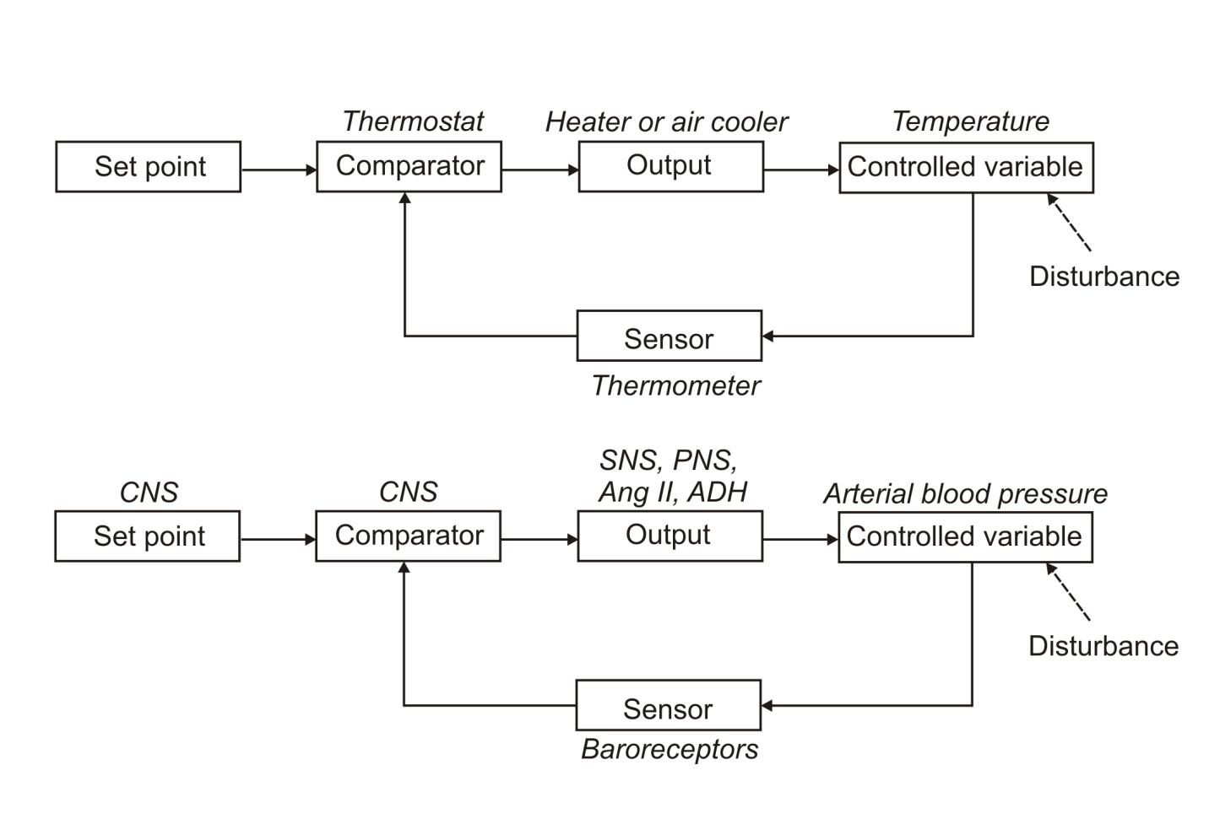
Providing feedback

Slide 20
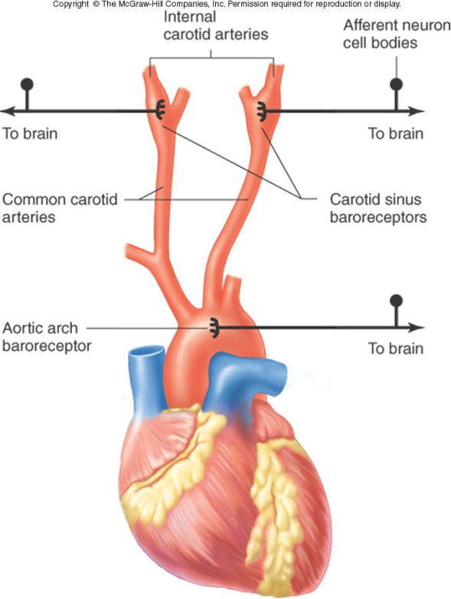
Providing feedback - baroreceptors
Glossopharyngeal nerve
Vagus nerve
Vasomotor
centre in the
medulla oblongata
Baroreceptors in the carotid sinus and aortic arch

Slide 21
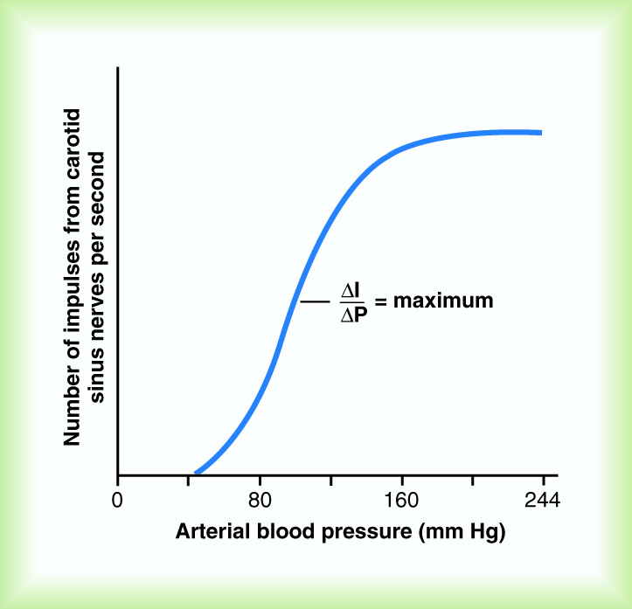
Baroreceptor activity
Carotid sinus baroreceptors respond to pressures between 60 and 180 mmHg.
Baroreceptors respond to changes in arterial pressure.
Baroreceptors reflex is most sensitive at pressures around 90 – 100 mmHg.

Slide 22
Reciprocal innervation
Afferent input
  Stimulates parasympathetic nerves to heart
  Simultaneously inhibits sympathetic innervation to heart, arterioles and veins
RECEPTOR
Afferent nerve
Parasymp.
nerve
Inhibitory
interneurone
HEART
-
Tonic activity
ARTERIOLES
AND VEINS
Symp. nerve

Slide 23
Stretch of baroreceptors
Vagus nerve (afferent)
*
Increase of blood pressure
Vagus nerve (parasympathetic)
Cardioregulatory
and vasomotor
centres in the
medulla oblongata
Increased parasympathetic stimulation of the heart decreases the heart rate.

Slide 24
Stretch of baroreceptors
Vagus nerve (afferent)
*
Increase of blood pressure
Cardioregulatory
and vasomotor
centres in the
medulla oblongata
Sympathetic
nerves
Decreased sympathetic stimulation of the heart decreases the heart rate and stroke volume.
.

Slide 25
Stretch of baroreceptors
Vagus nerve (afferent)
*
Increase of blood pressure
Cardioregulatory
and vasomotor
centres in the
medulla oblongata
Sympathetic
nerves
Sympathetic
chain
Blood vessels
Decreased sympathetic stimulation to the blood vessels produces vasodilation.
.

Slide 26
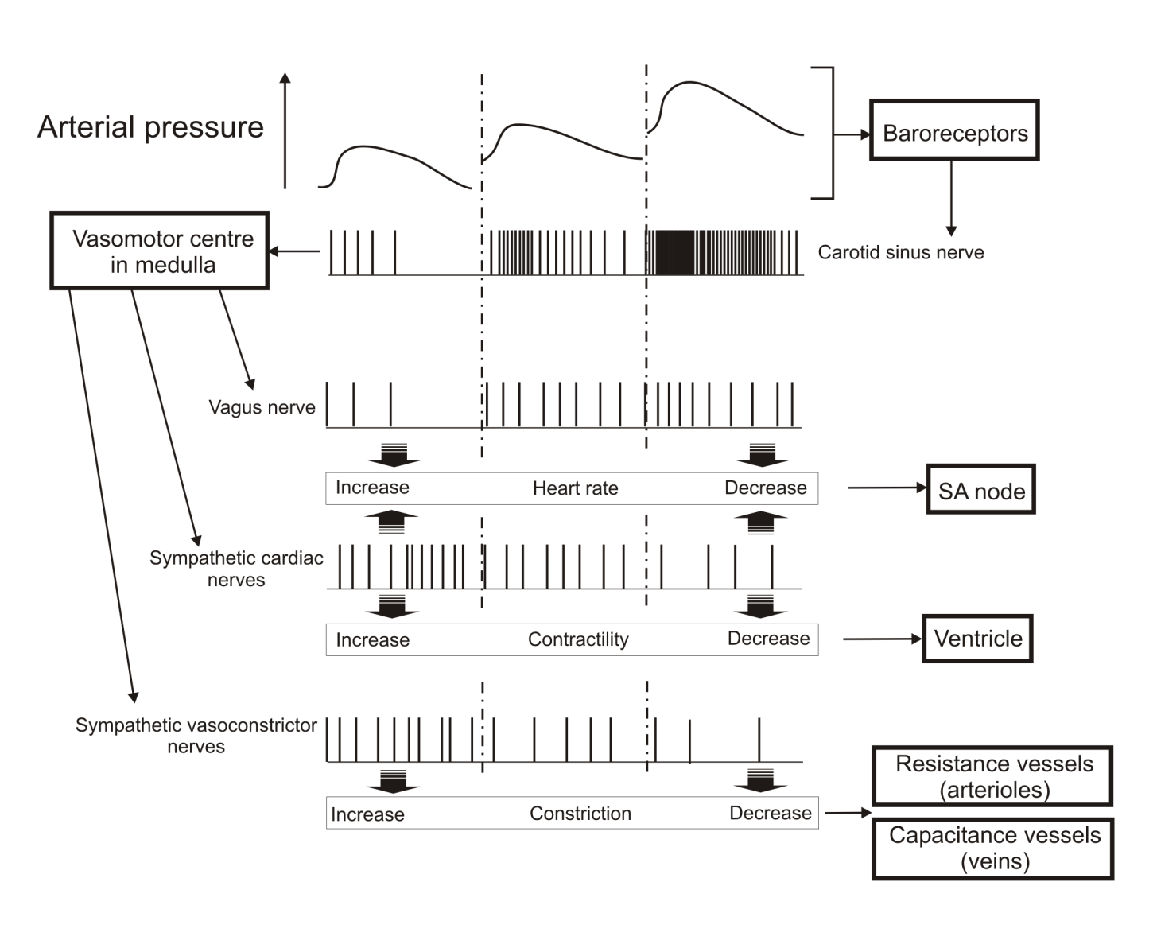
Reflexes controlled by carotid sinus nerve activity
control of venous return

Slide 27
Control of venous return
Atrial pressure
Venous return
Venous pressure
Blood volume
Respiratory
movements
Activity of
sympathetic
nerves to veins
Skeletal
muscle “pump”

Slide 28
Feedback for blood pressure control
haemorrhage
Blood volume
Venous pressure
Venous pressure
decrease
Venous return to heart
Atrial pressure
Venous constriction
increase
Ventricular end diastolic volume
Stroke volume
Sympathetic discharge
to veins
Arterial blood pressure
Baroreceptor feedback & reciprocal innervation
Cardiac output
reflexes

Slide 29
Maintaining arterial pressure
Mean systemic arterial pressure = cardiac output x total peripheral resistance
Arterial pressure
haemorrhage
Cardiac output
CO = HR x SV
Peripheral
resistance
Heart rate
Stroke volume
Ventricular end diastolic volume
Arterial pressure
Venous return
Arteriolar
constriction
Venous pressure
Firing of
baroreceptors
Cardiac
contractility
Venous tone
Parasymp
discharge
to heart
Symp discharge
to heart
Symp discharge
to veins
Symp discharge
to arterioles
Reflexes

Slide 30
Regulation of the cardiovascular system - summary
Local mechanisms regulating blood flow
  Autoregulation, the endothelium and paracrine effects
Systemic regulation by hormones
  circulating vasoconstrictors, kinins, ANP
Neural regulatory mechanisms
  Nervous control of blood vessel diameter
  Cardiac innervation, changing cardiac contraction
  Baroreceptors
  Reciprocal innervation
Integration of control systems

