Slide 1
Mechanical properties of the heart 2
Dr Ken MacLeod
Cardiac Medicine, NHLI, Faculty of Medicine, Imperial College London, UK
Life Support Systems
Cardiovascular System
© Imperial College London

Slide 2
Topics covered - learning objectives
The cardiac cycle
  Systole
  Diastole
Correlation of ECG events with changes in atrial, aortic & ventricular pressures
Heart sounds
Simple pressure/volume loops

Slide 3
The Cardiac Cycle
Heart beat is divided into two main phases
Diastole
Systole
ventricular relaxation during which the ventricles fill with blood
ventricular contraction when blood is pumped into the arteries
Split into four sub-phases
Split into two sub-phases

Slide 4
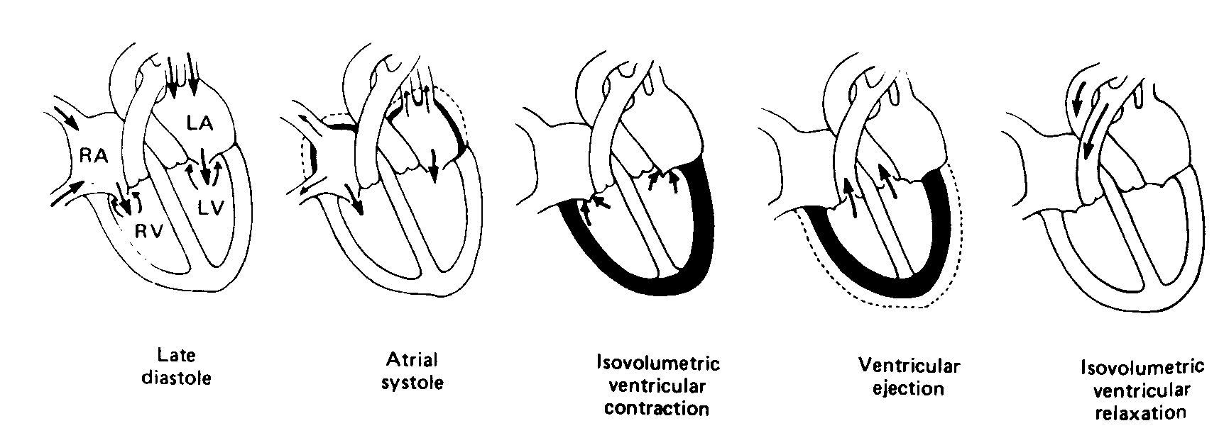
Cardiac Cycle – a description of mechanical and electrical events, volume changes and sounds associated with the heart beat
DIASTOLE
SYSTOLE
DIASTOLE
End-diastolic volume
-
End-systolic volume
= Stroke volume
Ejection fraction (EF) = SV / EDV

Slide 5
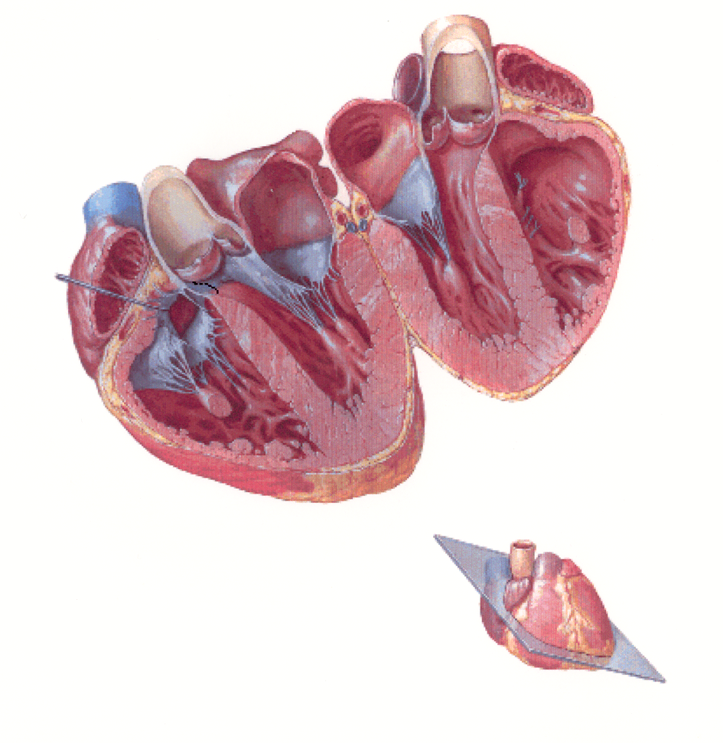
Quick review of anatomy - heart valves
Ascending aorta
Left atrium
Aortic valve
(a semilunar valve)
Mitral valve
Tricuspid valve
Left ventricle
Right ventricle

Slide 6
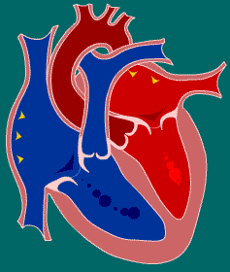
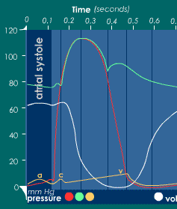
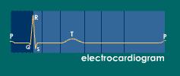
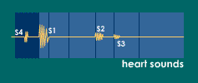
Atrial systole
Mechanical: just prior to atrial systole blood flowing passively through open AV valves
Atria contract “topping off” volume of blood in ventricle
Atrial contraction complete before ventricle starts
aortic, ventricle, atrial
ventricular vol
As atria contract “a” wave (orange) occurs
Blood also pushed back up jugular vein causing first discernable wave in jugular venous pulse
SA node activation depolarizes atria
P wave is atrial depolarization
4th heart sound – abnormal & occurs with congestive HF, pulmonary embolism or tricuspid incompetence

Slide 7
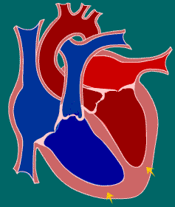
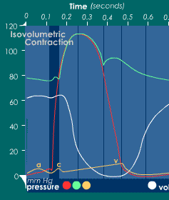
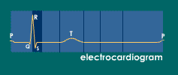
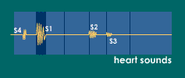

Isovolumic contraction
aortic, ventricle, atrial
The interval between AV valves (tricuspid & mitral) closing and semi-lunar valves (pulmonary & aortic) opening
Contraction of ventricles with no change in volume
AV valves close as ventricular pressure (red) exceeds atrial pressure (orange)
Pressure in ventricles increases without a volume change and approaches aortic pressure (green)
QRS complex marks ventricular depolarization
1st heart sound (“lub”) due to closure of AV valves and associated vibrations

Slide 8
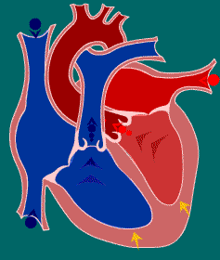
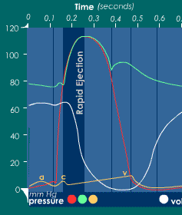
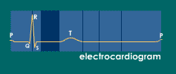
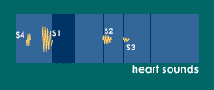
Rapid ejection
aortic, ventricle, atrial
Aortic & pulmonary valves open and mark the start of this phase
As ventricles contract pressure within them exceeds pressure in aorta and pulmonary arteries
SL valves open, blood pumped out and volumes of ventricles decreases
“c” wave caused by RV contraction pushing tricuspid valve into atrium so creating small wave into jugular vein

Slide 9
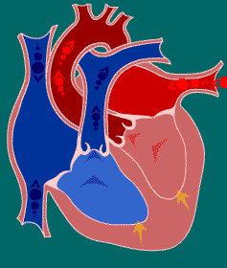
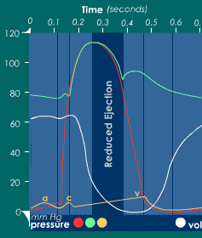
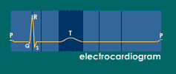
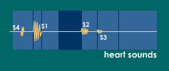
Reduced ejection
aortic, ventricle, atrial
This phase marks the end of systole
Aortic & pulmonary valves begin to close
Blood flow from ventricles decreases and ventricular volume decreases more slowly
As pressures in ventricles fall below that in arteries, blood begins to flow back causing SL valves to close
The T wave is due to ventricular repolarization marking the end of ventricular systole

Slide 10
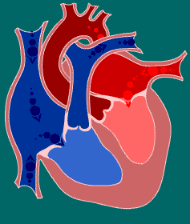
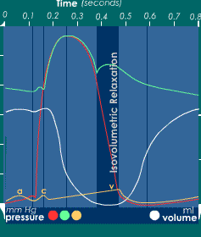
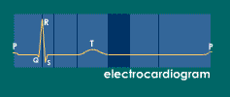
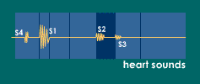
Isovolumic relaxation
aortic, ventricle, atrial
The beginning of diastole
The aortic & pulmonary valves have now just shut
AV valves remain closed until the end of this phase
Atria have now filled with blood but AV valves shut hence atrial pressure rises (orange). Blood pushing tricuspid valve gives second jugular pulse (“v” wave).
Dichrotic notch due to rebound pressure wave against aortic valve as distended aortic wall relaxes.
2nd heart sound (dub) occurs when aortic & pulmonary valves close
normal

Slide 11
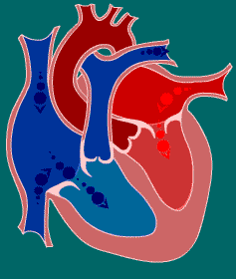
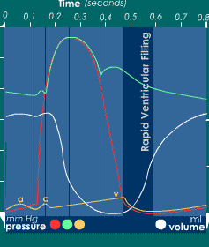
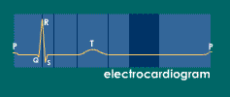
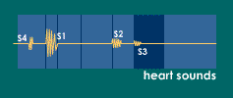
Rapid ventricular filling
aortic, ventricle, atrial
Presence of 3rd heart sound usually abnormal and can signify turbulent ventricular filling
Can be due to severe hypertension or mitral incompetence
Once AV valves open blood in the atria flows rapidly into the ventricles
Ventricular volume increases (white) and atrial pressures fall (orange)
S4
http://www.blaufuss.org/

Slide 12
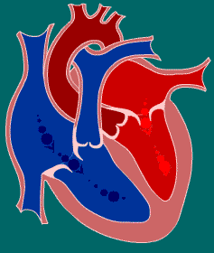
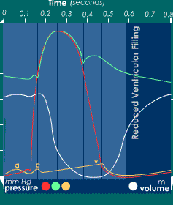
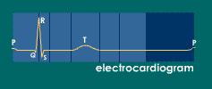
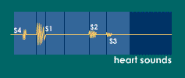
Reduced ventricular filling
aortic, ventricle, atrial
This phase can be called diastasis
Ventricular volume increases more slowly

Slide 13
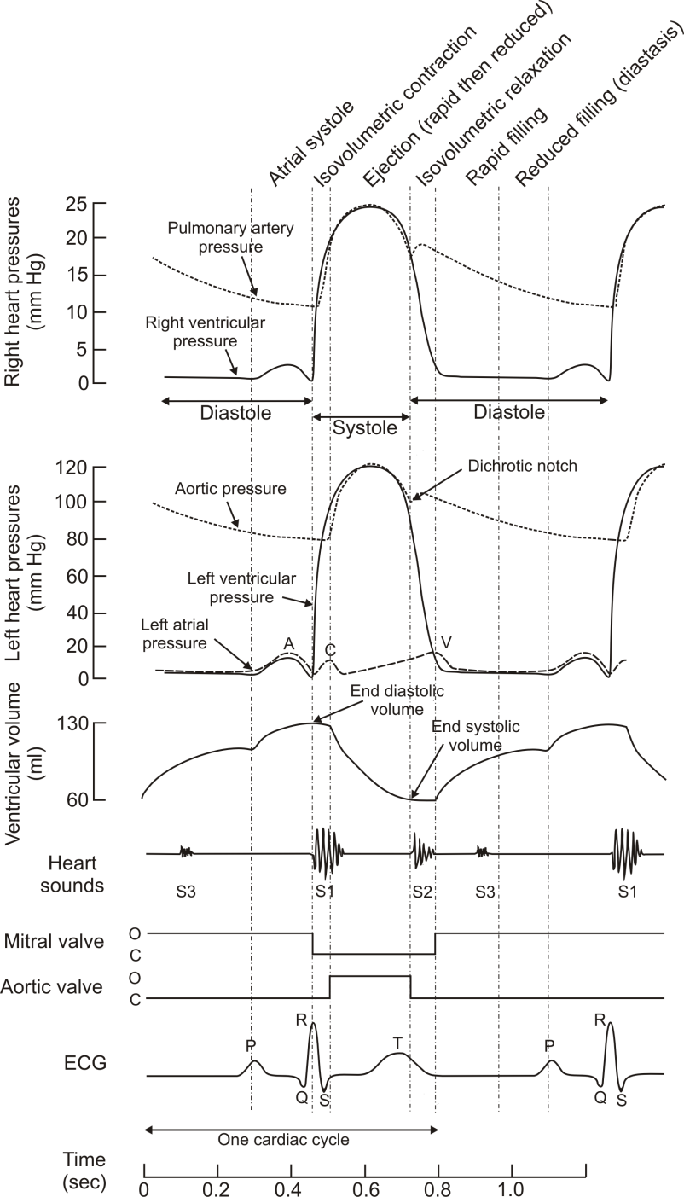
The Wiggers diagram

Slide 14
Pulmonary circulation pressures – a reminder
The patterns of pressure changes in the right heart are essentially identical to those of the left
Quantitatively, the pressures in the right heart and pulmonary circulation are much lower (peak of systole – 25mmHg in pulmonary artery)
Despite lower pressures right ventricle ejects same amount of blood as left!

Slide 15
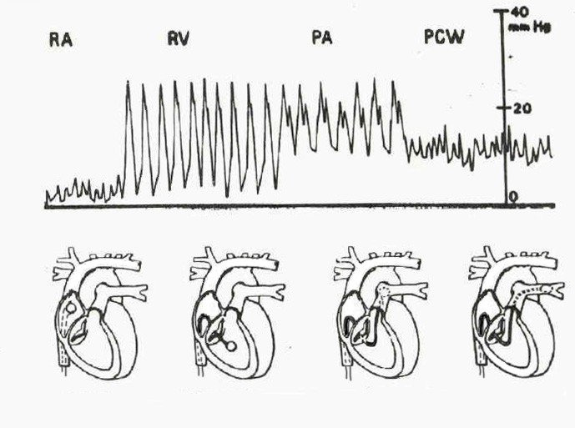
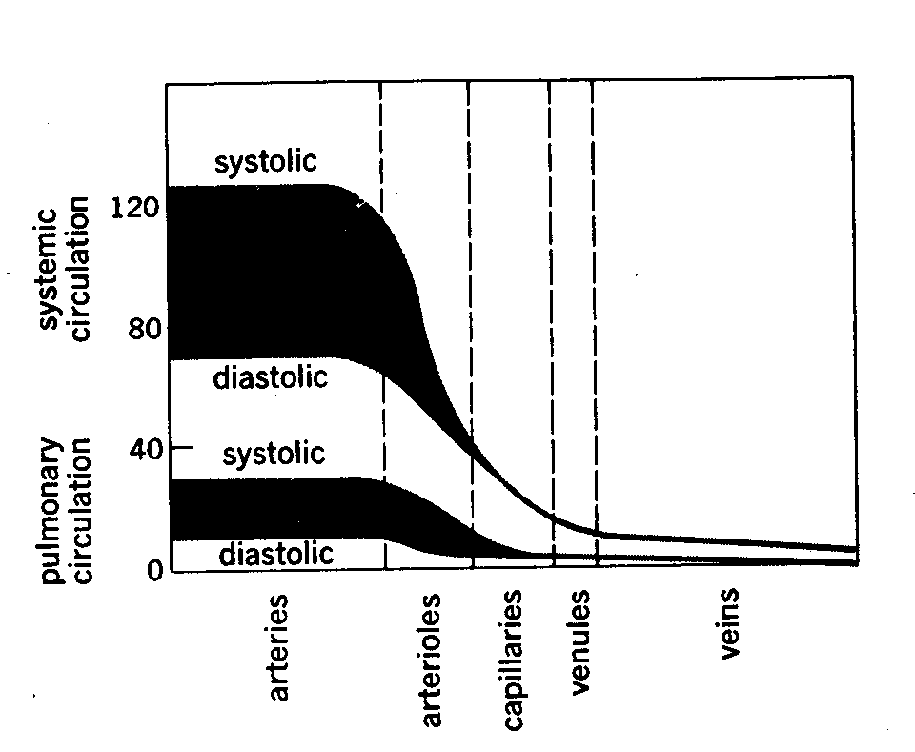
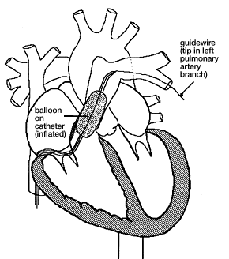
Pressures
Systemic and pulmonary circulations
  High and low pressures
120/80 vs 25/5 mmHg
Pulmonary artery wedge pressure (PAWP)
(Pulmonary capillary wedge pressure) elevated in
LV failure, mitral insufficiency, mitral stenosis

Slide 16
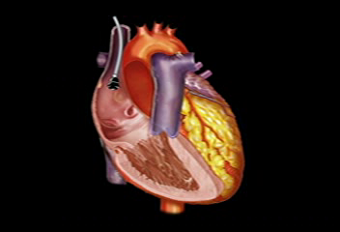
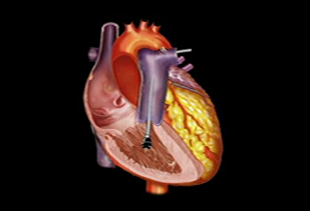
Pressure changes
Right atrium to right ventricle via tricuspid valve
Right ventricle to pulmonary artery via pulmonary valve

Slide 17
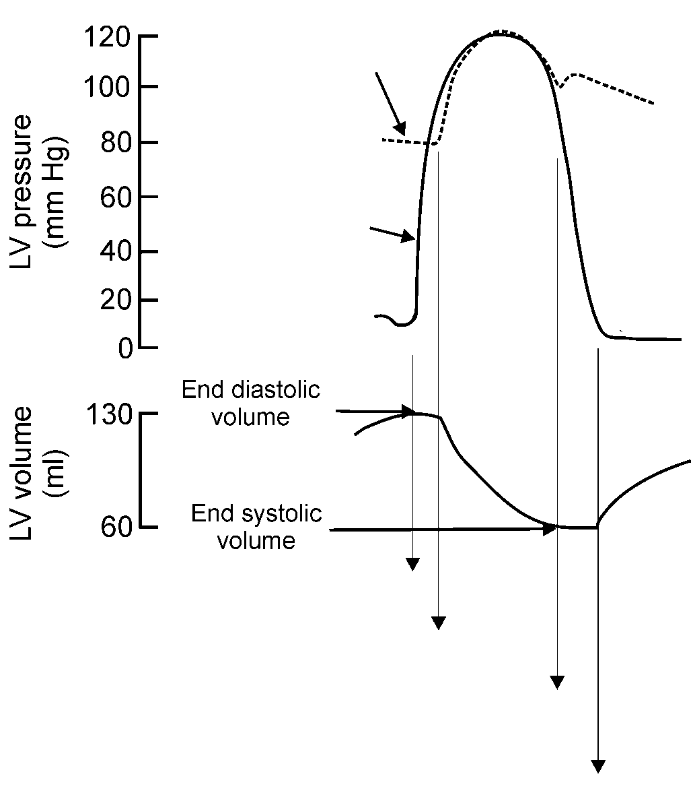
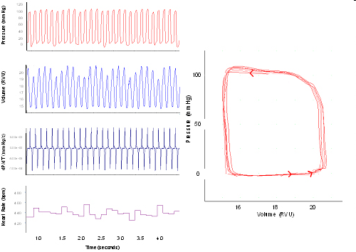
Pressure – volume loop in heart
Aortic pressure
ESV
Aortic pressure encountered
x
Left ventricular pressure
x
3
2
LV pressure
x
x
1
EDV
4
LV volume
1
2
3
4

Slide 18
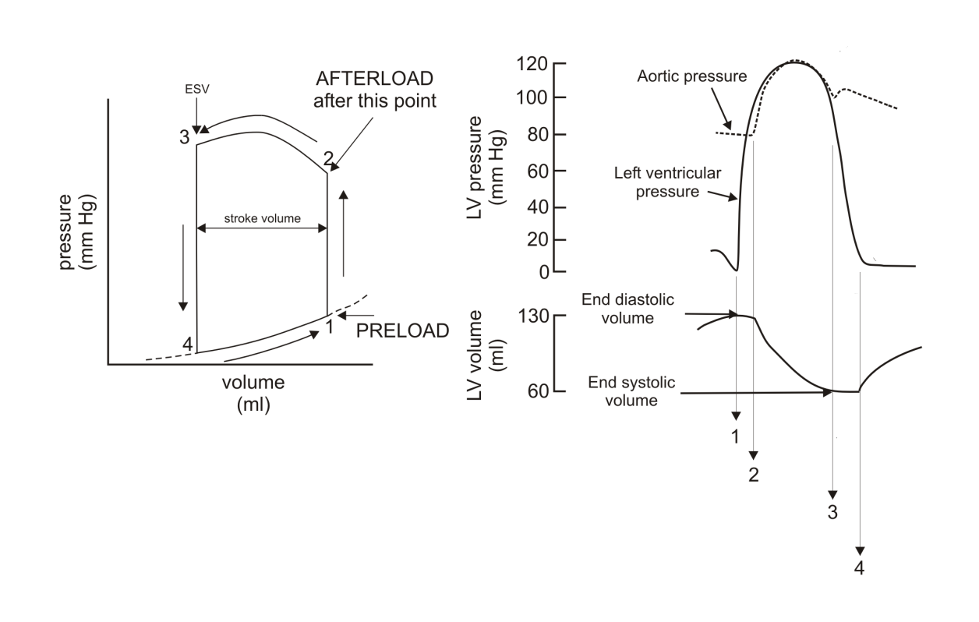
Preload and afterload on the pressure – volume loop
Blood filling the ventricle during diastole determines the preload that stretches the resting ventricle
The blood pressures in great vessels (aorta and pulmonary artery) represent the afterload

Slide 19
Frank-Starling relationship
Active force
End-systolic PV line
Force
Pressure
Passive force
Muscle fibre length
Volume

Slide 20
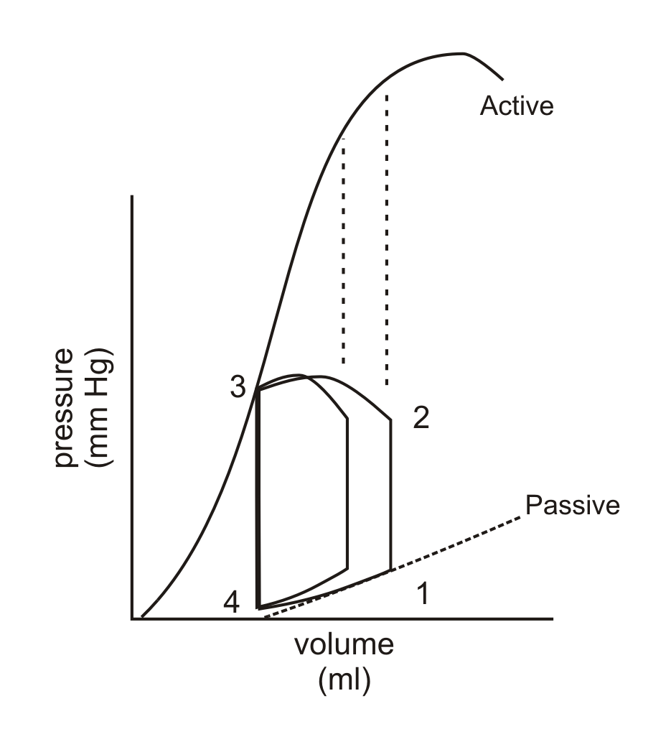
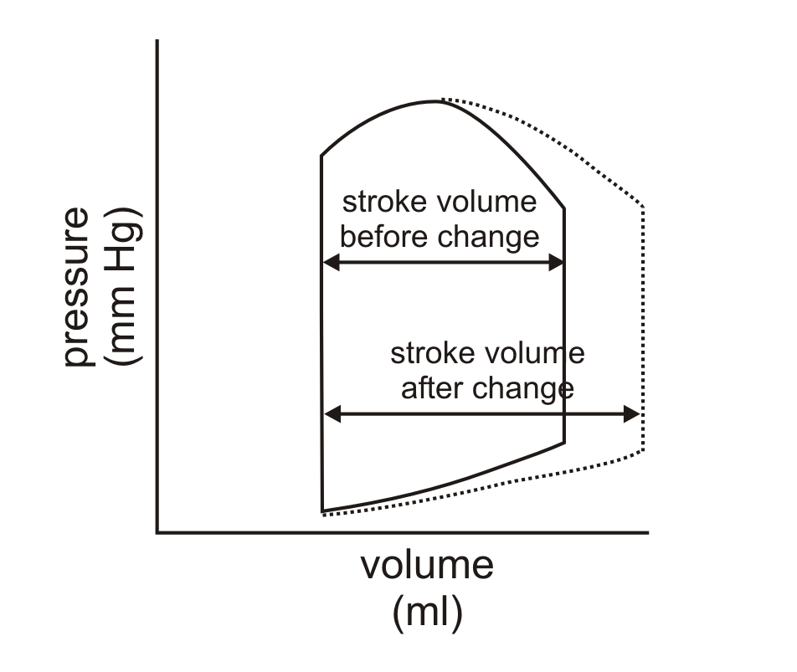
Increasing preload increases stroke volume

Slide 21
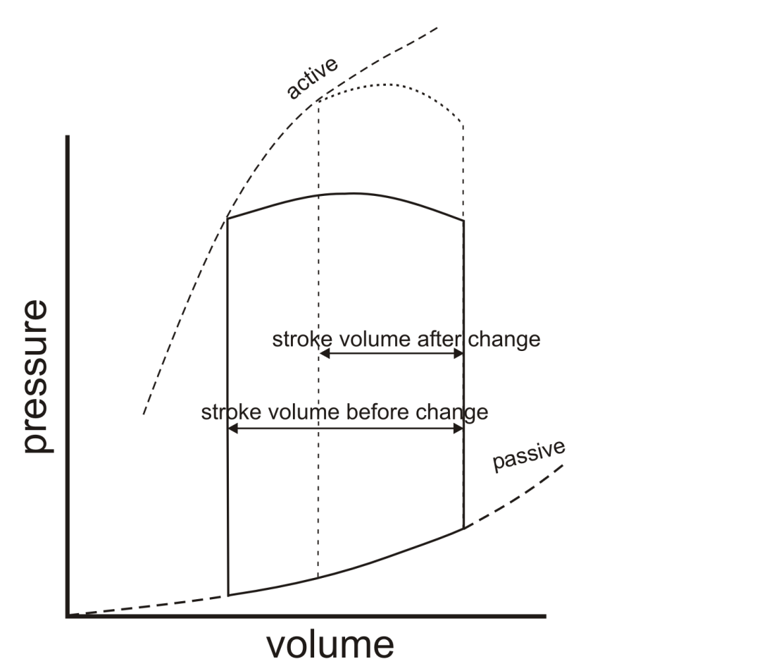
Increasing afterload decreases stroke volume
Less shortening as working against afterload
Greater pressure required to open aortic valve
End-systolic PV line
Remember from previous lecture that as afterload increases, the amount of shortening that occurs decreases

Slide 22
Changing cardiac output
Cardiac output = heart rate x stroke volume
Preload
Afterload
Contractility

Slide 23
Cardiac contractility
Definition: Contractile capability (or strength of contraction) of the heart
Simple measure of cardiac contractility is ejection fraction
Contractility is increased by sympathetic stimulation
Family of different Frank-Starling relations as cardiac contractility changes

Slide 24
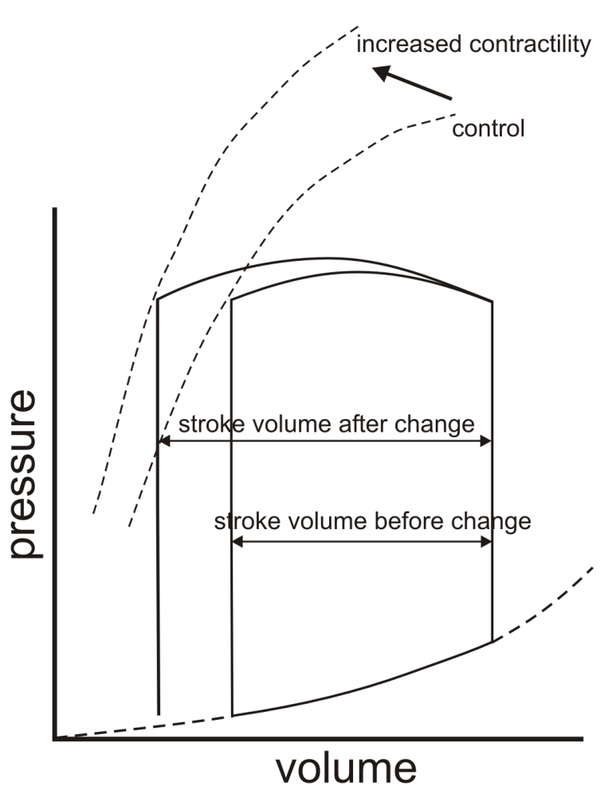
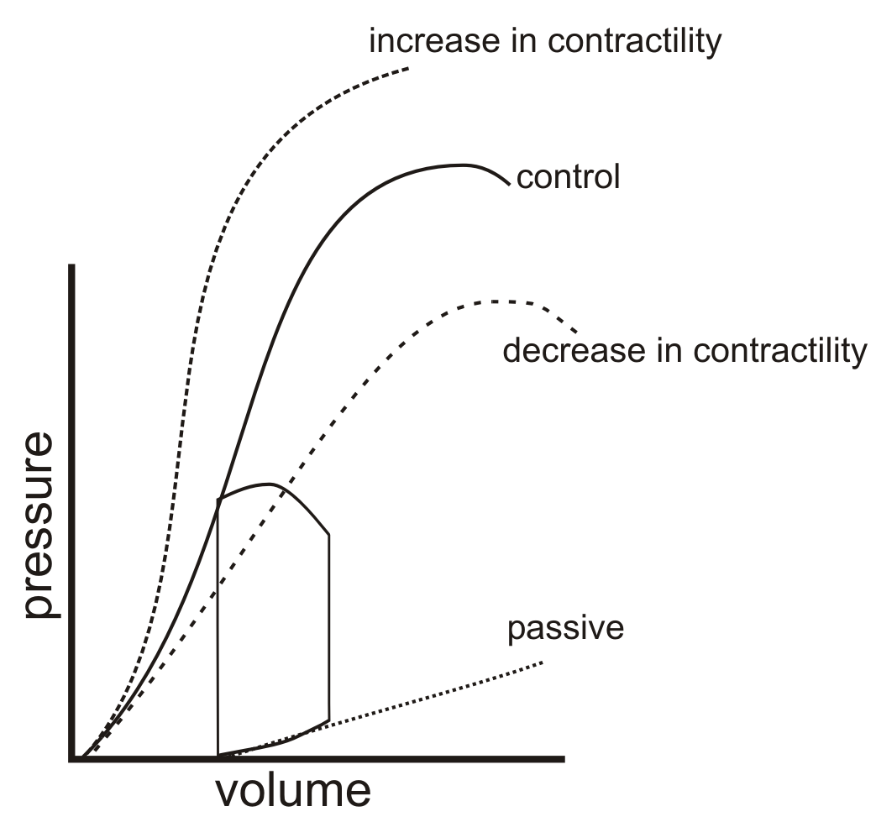
Different Frank-Starling relations as cardiac contractility changes
Family of ESV PV lines

Slide 25
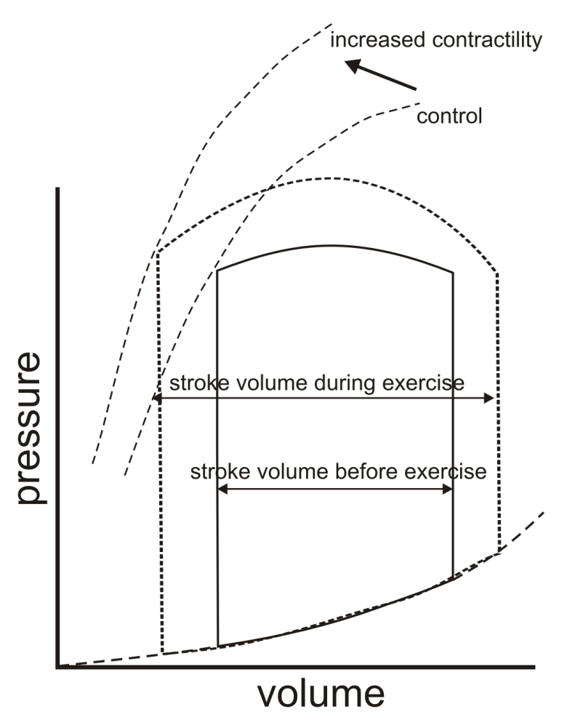
Changes occurring during exercise
During exercise contractility is increased due to increased sympathetic activity
During exercise end diastolic volume is increased due to changes in the peripheral circulation (venoconstriction and muscle pump)

Slide 26
Review – essential elements
The cardiac cycle
  Systole
  Diastole
  Atrial, aortic & ventricular pressures
  Heart sounds
Simple pressure/volume loops
How preload & afterload alter P/V loops
  Venous return → preload
  Aortic pressure → afterload
How extrinsic stimulation of the heart alters P/V loops
  Contractility, sympathetic stimulation and exercise

