Slide 1
Mechanical properties of the heart 1
Dr Ken MacLeod
Cardiac Medicine, NHLI, Faculty of Medicine, Imperial College London, UK
Life Support Systems
Cardiovascular System
© Imperial College London

Slide 2
Topics covered - learning objectives
Ca and the heartbeat
Excitation-contraction coupling in the heart
Length – tension relation in the heart
Concepts of preload and afterload
Starling’s Law of the heart
  Relation of force to length of muscle fibre
  Mechanisms underlying Starling’s Law
The Law of Laplace

Slide 3
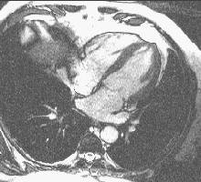
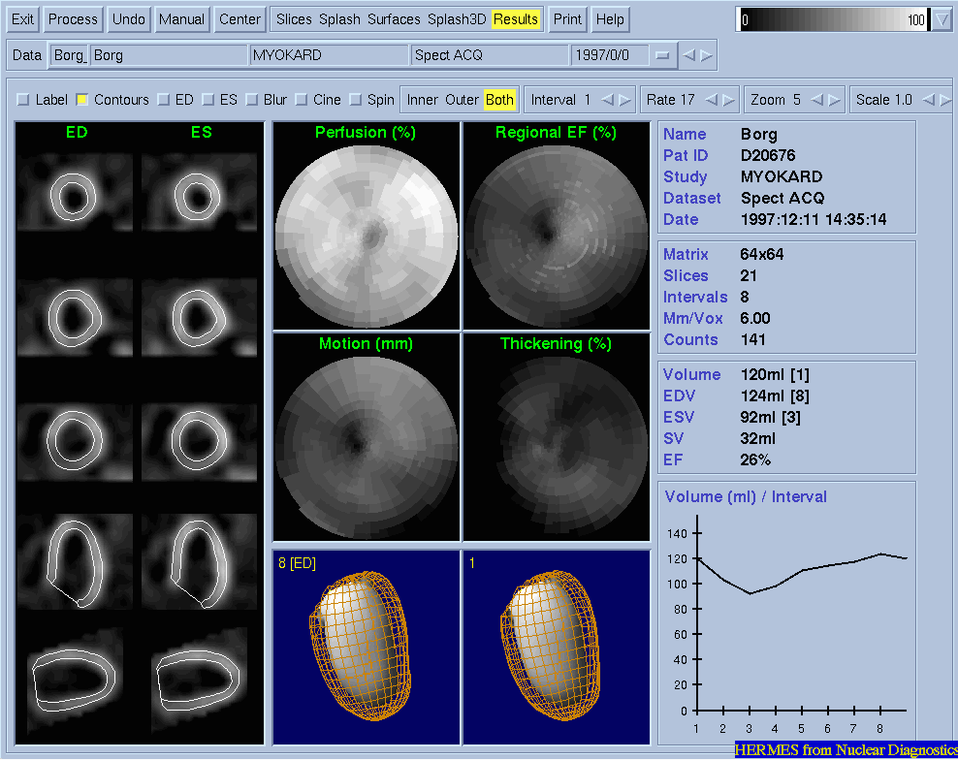
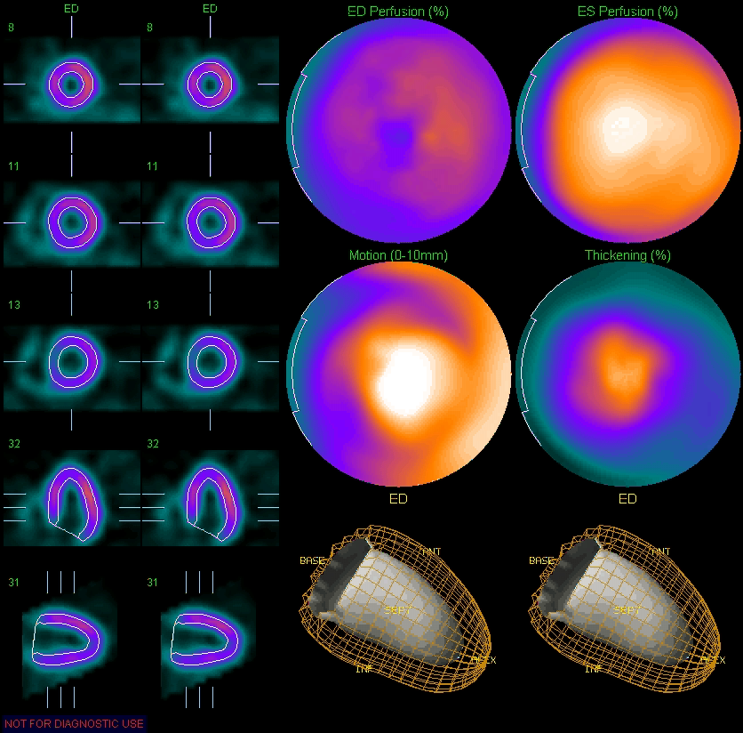
Contraction of the whole heart
Viewed by nuclear magnetic resonance
Dilated cardiomyopathy
4 chambered view
Normal
heart

Slide 4
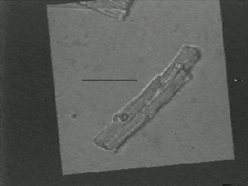
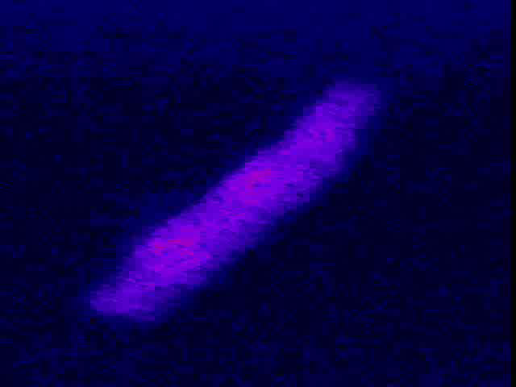
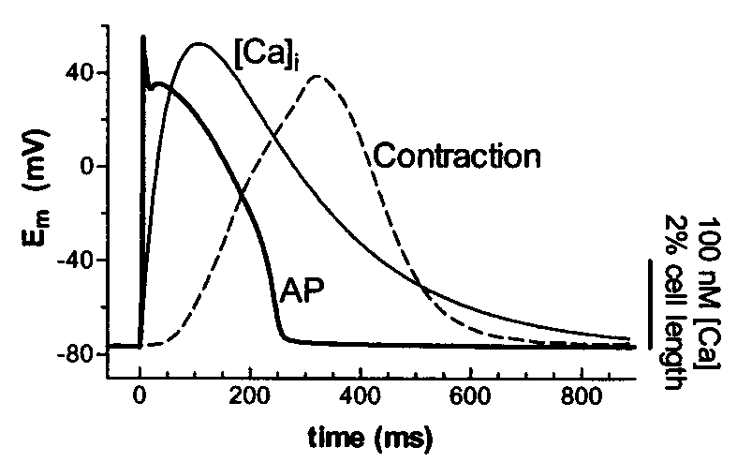
A single ventricular cell
contraction
calcium ion transient
Electrical event
Ca transient
Contractile event

Slide 5
Importance of Ca for the heart beat
Sidney Ringer MD – Prof. of Medicine at UCL (1883) Journal of Physiology 4, 29 – 42.
“I discovered that the saline solution which I had used had not been prepared with distilled water, but with pipe water supplied by the New River Water Company”
“I tested the action of the saline solution made with distilled water and I found that I did not get the effects described”
“The effects I had obtained are due to some of the inorganic constituents of the pipe water”
“The heart’s contractility cannot be sustained by saline solution with bicarbonate of soda and potassium chloride …. the addition of lime or a calcium salt will restore good contractility”

Slide 6
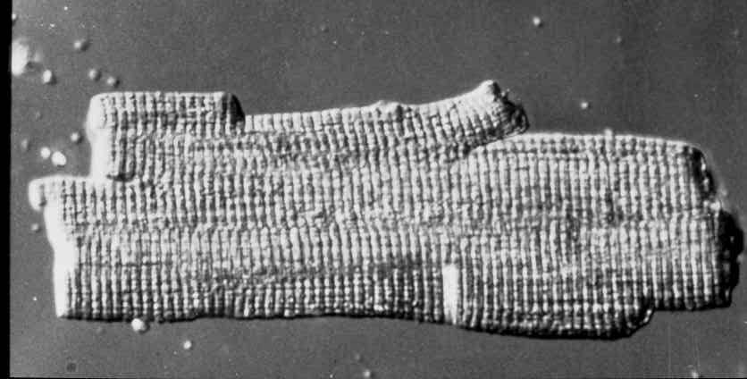
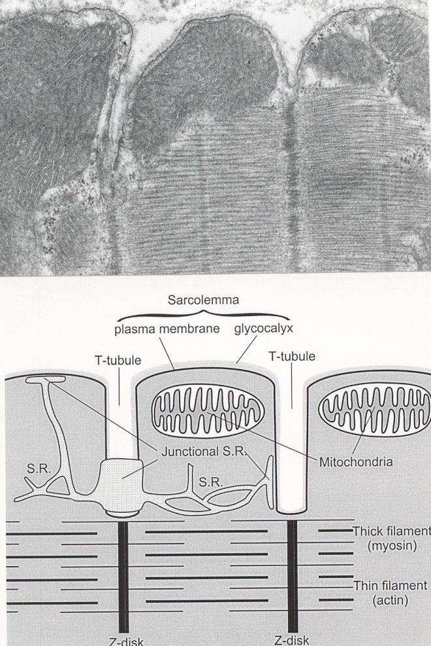
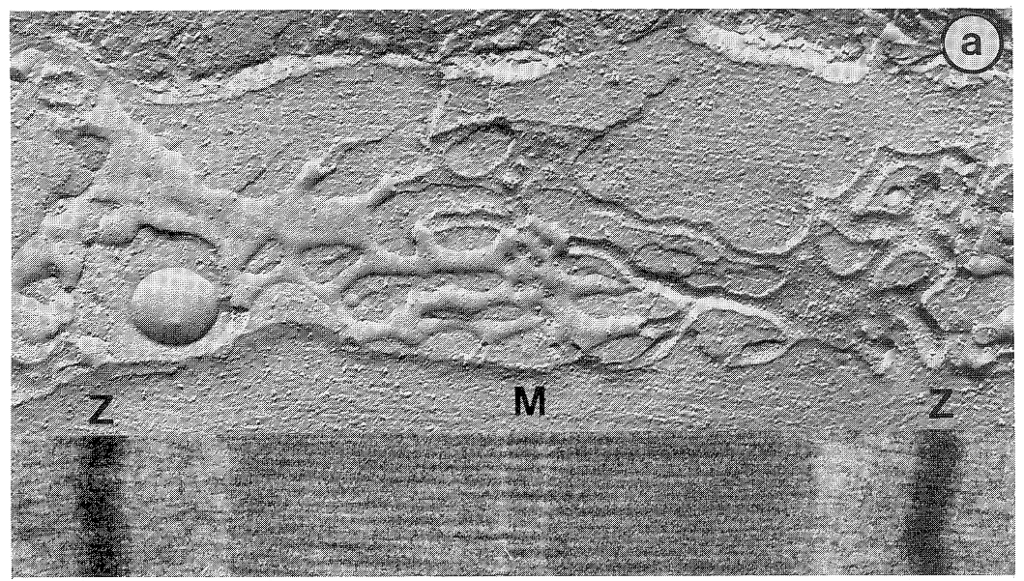
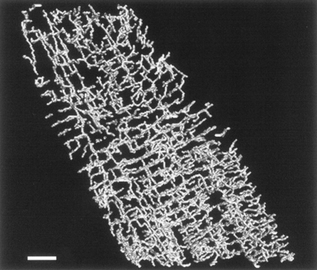
Single cell structure
Ventricular cells 100 μm long and 15 μm wide
T-tubules (transverse tubules) are finger-like invaginations from the cell surface
T-tubule openings up to 200 nm in diameter
Carry surface depolarisation deep into the cell
Spaced (approx. 2 μm apart) so that a T-tubule lies alongside each Z line of every myofibril.

Slide 7
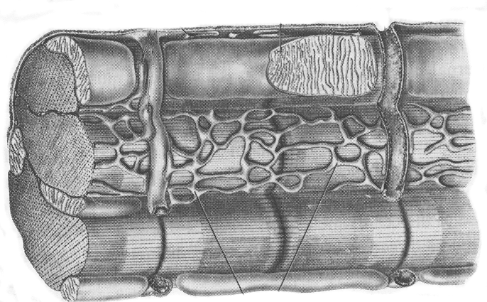
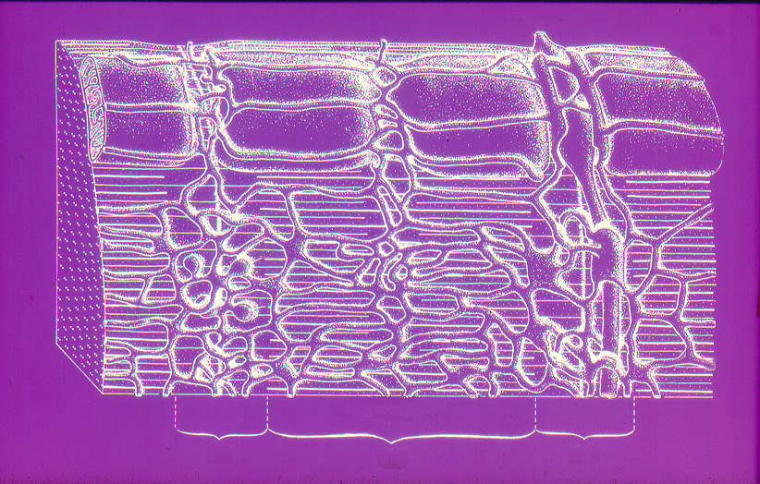
3D single cell structure
T
jsr
mito
sarcoplasmic reticulum
myofibril
Major components of the cell
Z
I
A
I

Slide 8
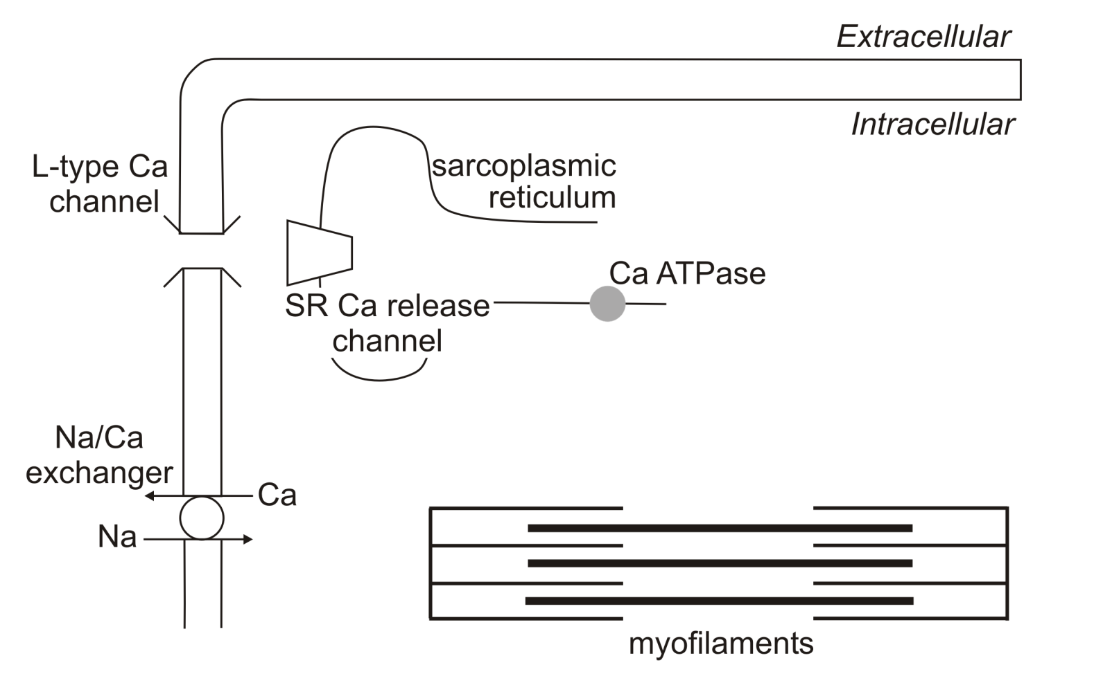
Excitation-Contraction (EC) coupling in the heart
Ca
Ca
Ca

Slide 9
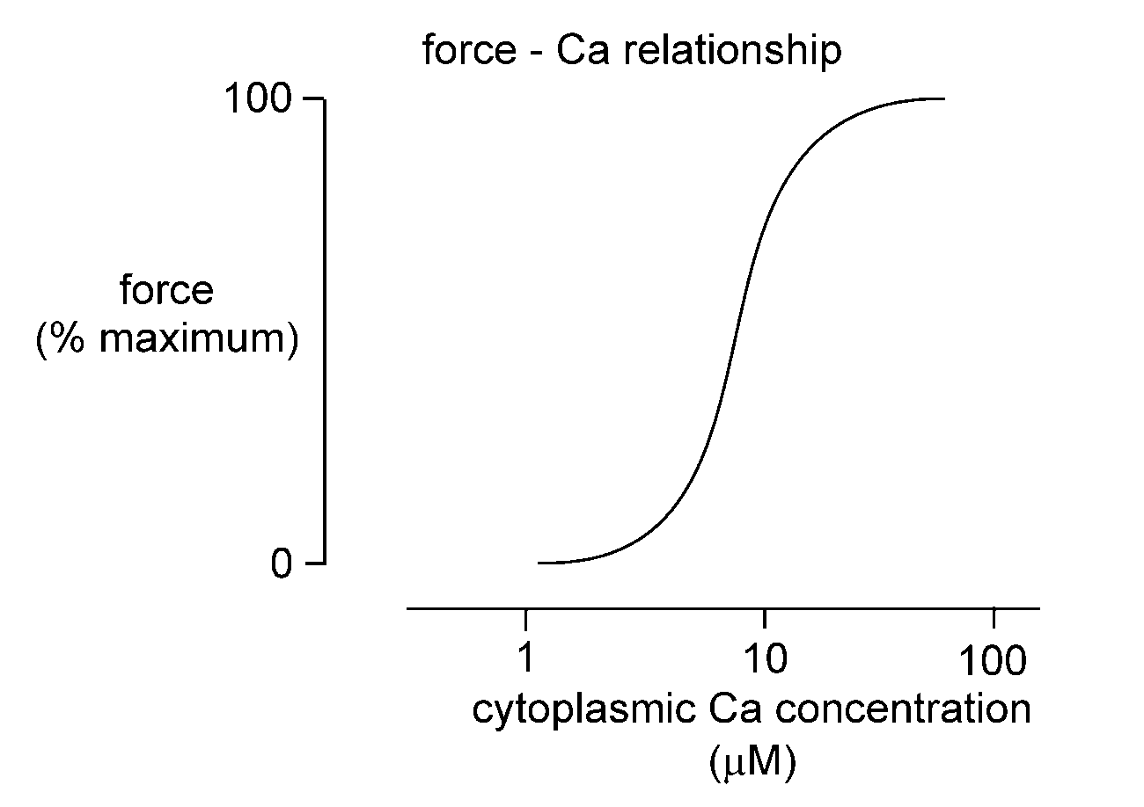
The relationship between force production and intracellular [Ca]

Slide 10
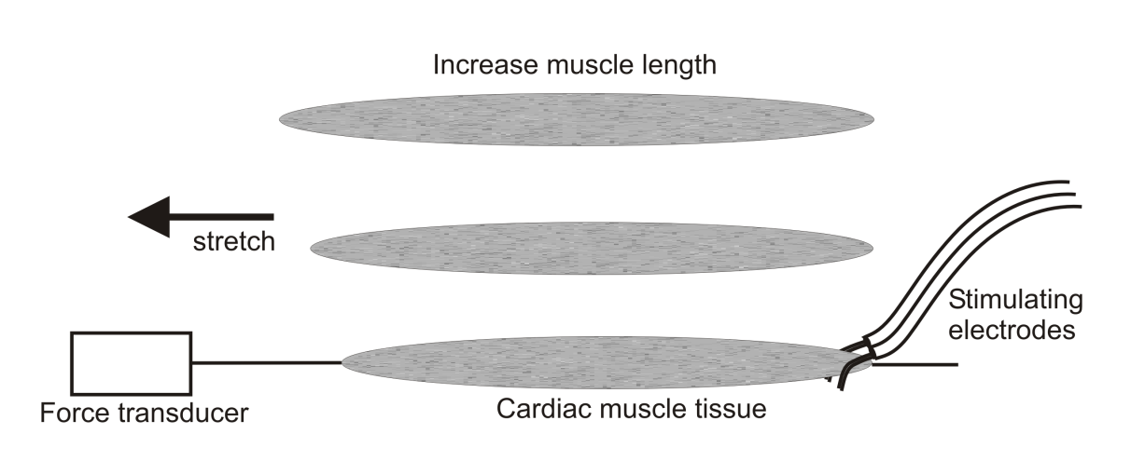
Length – tension relation in cardiac muscle
Active force production
Isometric (no shortening)
contraction
Force
Passive force
A
B
C
Muscle length
C
B
A

Slide 11
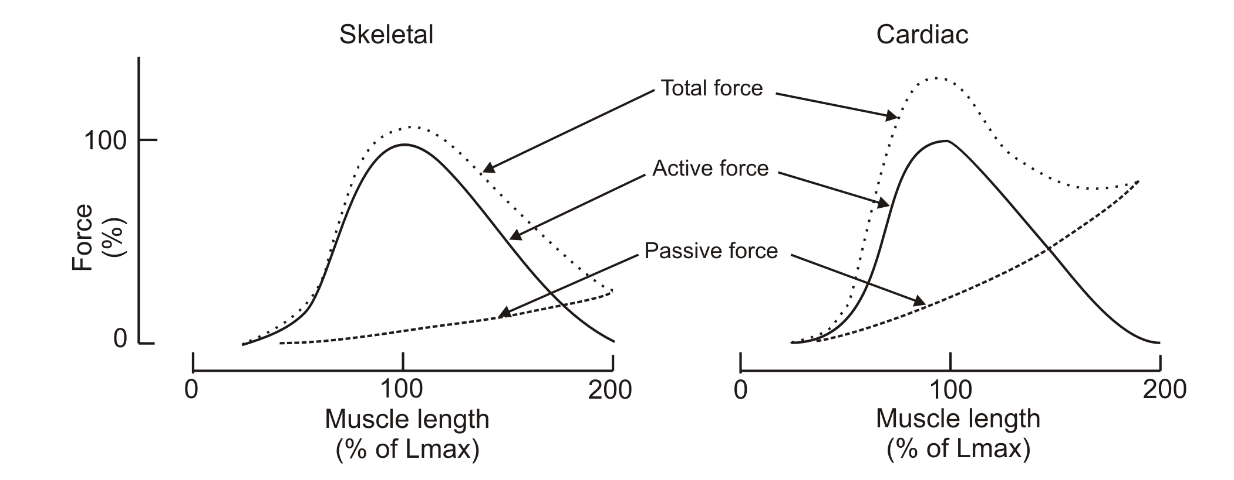
Length – tension relation
Cardiac and skeletal muscle compared
Cardiac muscle more resistant to stretch
Less compliant than skeletal muscle
Due to properties of the extracellular matrix and cytoskeleton
Only ascending limb of the relation important for cardiac muscle

Slide 12
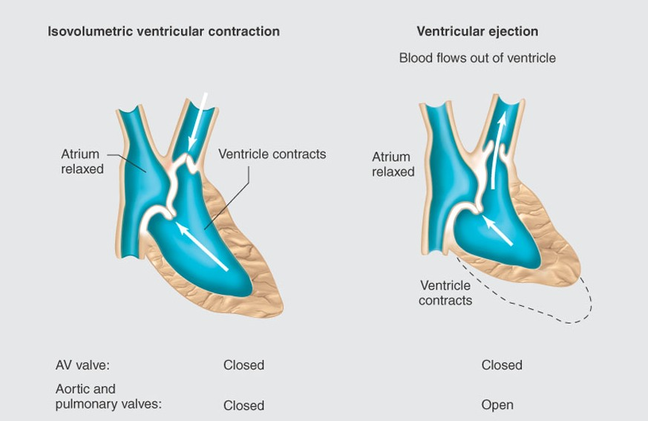
The heart uses two forms of contraction
Isometric – no shortening of fibres occurs but pressures in ventricles increase
Isotonic – shortening of fibres as blood is ejected

Slide 13
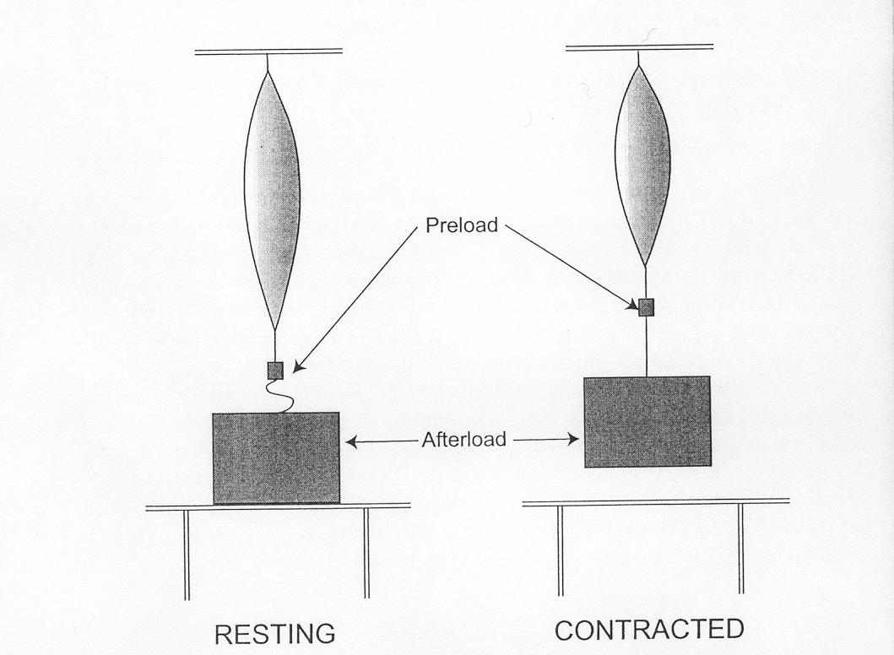
Changing muscle length before stimulation
Preload - weight that stretches muscle before it is stimulated to contract
Afterload - weight not apparent to muscle in resting state; only encountered when muscle has started to contract
Isometric (no shortening) contraction
Isotonic (shortening) contraction
Larger preload
Small preload
Force
Shortening
Velocity of
shortening
Preload (stretch)
Afterload
Afterload

Slide 14
in vivo correlates of preload
As blood fills the ventricles during the relaxation phase (or diastole) of the cardiac cycle it stretches the resting ventricular walls
The stretch or filling determines the preload on the ventricles before ejection
Preload is dependent upon venous return to the heart
Measures of preload: end-diastolic volume, end diastolic pressure, right atrial pressure

Slide 15
in vivo correlates of afterload
Definition: The load against which the left ventricle ejects blood after opening of the aortic valve
A simple measure of afterload is the diastolic arterial blood pressure
Any increase in afterload decreases the amount of isotonic shortening that occurs and decreases the velocity of shortening

Slide 16
How the contraction of the heart responds to ventricular filling and aortic pressure
Larger ventricular filling
Small amount
of ventricular filling
Force
Shortening
Velocity of
shortening
Preload (stretch)
Afterload
Afterload
Ventricular filling
Pressure in the aorta
Pressure in the aorta

Slide 17
Ways to alter contraction of the heart
Intrinsic mechanisms
  Frank-Starling relationship
  rate-induced regulation
Extrinsic mechanisms
  Autonomic nervous system
  Endocrine system
  Blood gases and pH

Slide 18
Frank-Starling relationship
From observations by Otto Frank (1895) and EH Starling (1914) that as the filling of the heart increased there was a more forceful contraction
Definition: Increased diastolic fibre length increases ventricular contraction
Consequence: Ventricles pump greater stroke volume so that, at equilibrium, cardiac output exactly balances the augmented venous return

Slide 19
Frank-Starling relationship
Due to two factors:
  Changes in the number of myofilament cross bridges that interact
  Changes in the Ca sensitivity of the myofilaments

Slide 20
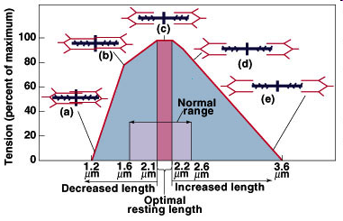
Changes in the number of cross bridges
At shorter lengths than optimal the actin filaments overlap on themselves so reducing the number of myosin cross bridges that can be made.

Slide 21
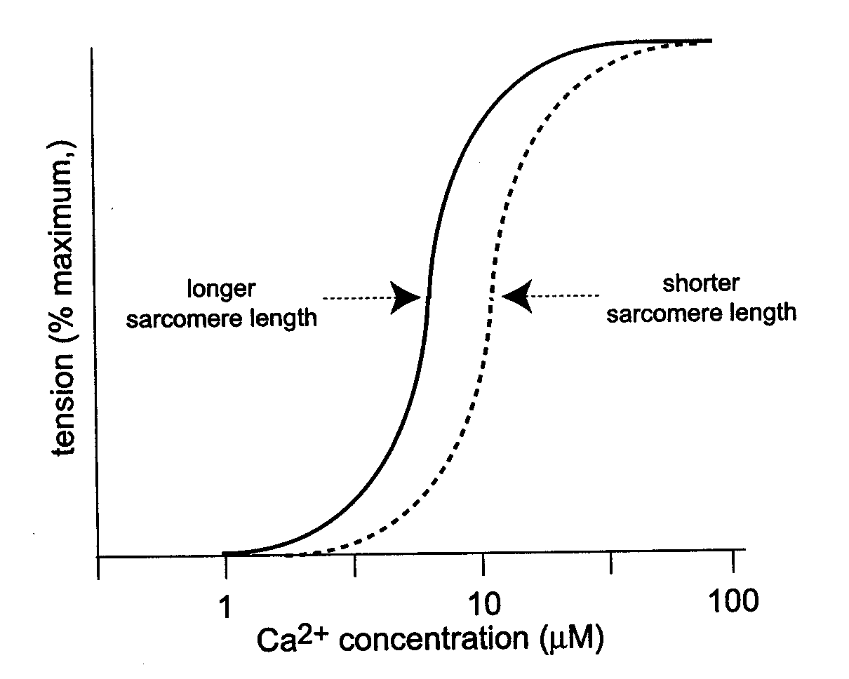
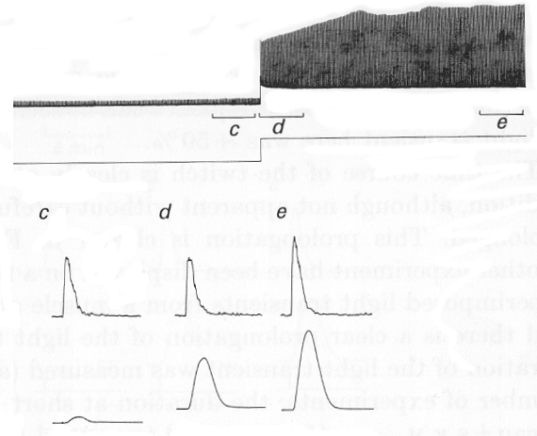
Length and myofilament sensitivity
Calcium required for myofilament activation
Troponin C is thin filament protein that binds Ca
TnC regulates formation of cross-bridges between actin and myosin
At longer sarcomere lengths the affinity of troponin C for Ca is increased
Less Ca required for same amount of force
Force
Length
[Ca]_{i}
Signal averaged traces over period shown
Force
Allen et al. (1988) J. Physiol. 406, 359

Slide 22
Work done by the heart
Work done by heart to eject blood under pressure into aorta and pulmonary artery
= Stroke work
Stroke work = volume of blood ejected during each stroke (SV) times the pressure at which the blood is ejected (P)
Preload and afterload greatly influence
Stroke work = SV x P
Structure greatly influences

Slide 23
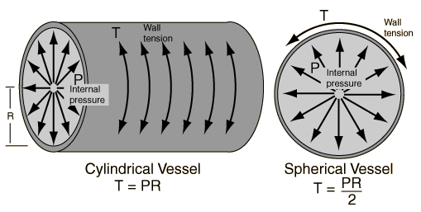
Law of Laplace
This Law states that: when the pressure within a cylinder is held constant, the tension on its walls increases with increasing radius
Including wall thickness (h)

Slide 24
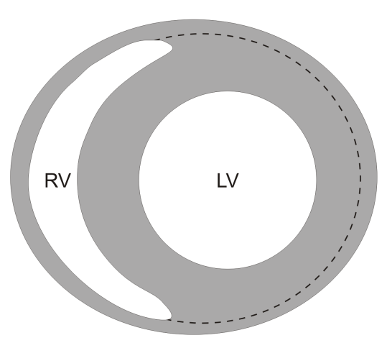
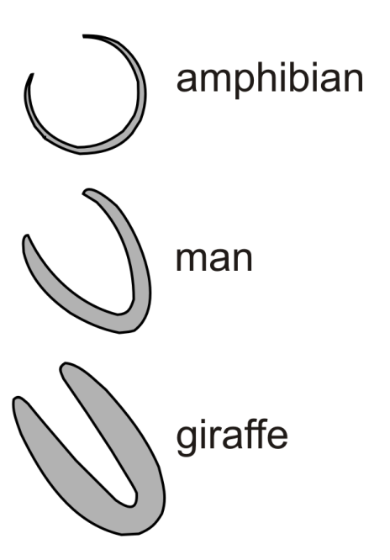
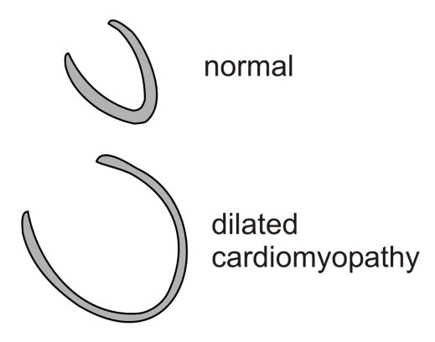
Physiological relevance of Laplace’s Law
Radius of curvature of walls of LV less than that of RV allowing LV to generate higher pressures with similar wall stress
Facilitates late ejection
Wall stress kept low in giraffe by long, narrow, thick-walled ventricle
In frog, where pressures are low the ventricle is almost spherical
Failing hearts often become dilated which decreases pressure generation and ejection of blood and increases wall stress
T = PR

Slide 25
Review – essential elements
Ca and the heartbeart
Excitation-contraction coupling in the heart
Length – tension relation in the heart
Concepts of preload and afterload
Starling’s Law of the heart
  Relation of force to length of muscle fibre
  Mechanisms underlying Starling’s Law
The Law of Laplace

