Slide 1
Cardiovascular System - Introduction
Dr Ken MacLeod
Cardiac Medicine, NHLI, Faculty of Medicine, Imperial College London, UK
k.t.macleod@imperial.ac.uk
Life Support Systems
Cardiovascular System
© Imperial College London

Slide 2
Cardiovascular course
Students often find cardiovascular course difficult
Concepts are new, lot to learn
Review material as soon as possible following lecture
Test yourself – questionnaires
Use self-study sessions wisely
Take good notes

Slide 3
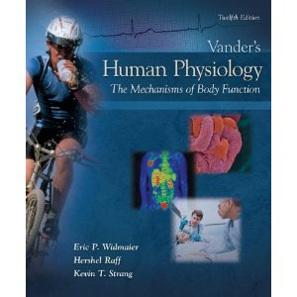
Recommended course text(s)
Vander’s Human Physiology – The mechanisms of body function (12th ed) Authors: Widmaier, Raff & Strang, Publishers: McGraw-Hill
One cardiology text

Slide 4
Timetable
Lectures
    Note that lectures on Wednesday 23rd January, Friday 8th and Tuesday 12th February are at Charing Cross campus
    Others are in the SAF building at South Ken
Practicals
    Please attend Dr Luther’s short presentation on Wednesday 13th February at 11:00am
    Please do not swap groups
  Blood pressure
  ECG
Tutorials
    The tutorial scenario will be handed out when you come to the tutorial
Quiz
    Five quiz sessions to test if you understand the basics

Slide 5
Course guide
The CVS course has produced a course guide book containing learning objectives and what we consider to be the key points in each lecture
The learning objectives help clarify, organize and prioritize your learning
All lectures available on the intranet in advance
Encourage you to take responsibility for your learning
Evaluate your progress with the small quiz sessions
For some lectures, additional material will be provided and put on the intranet and your attention also drawn to various useful web sites
Some material may be duplicated – this is usually because it is important

Slide 6
Student behaviour
Don’t talk - think!
If you don’t understand, ask the lecturer at the end or email; don’t get stressed…

Slide 7
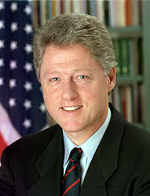
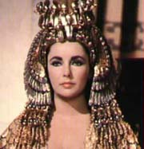
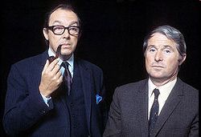
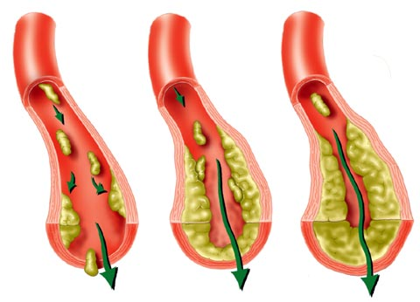
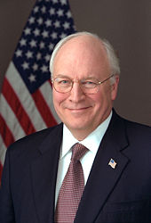

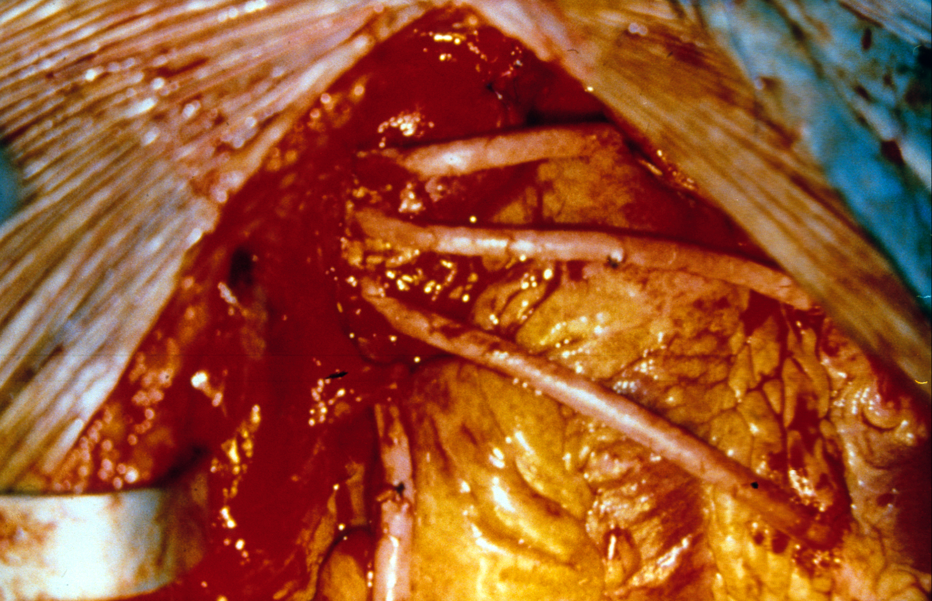

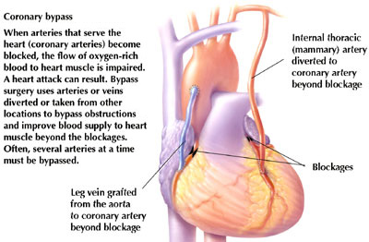
John Candy died aged 43 from advanced atherosclerosis, which caused a coronary embolism, leading to a myocardial infarction (heart attack) and a fatal cardiac arrhythmia.
His father died aged 35.
Bill Clinton – quadruple bypass surgery in 2004
Dick Cheney – (VP to GW Bush) quadruple bypass. Left-ventricular assist device (LVAD) fitted July 2010 to compensate for increasing congestive heart failure.
Elizabeth Taylor – congestive heart failure – died 2011
Sir Ranulph Fiennes – heart attack and bypass surgery – just left UK to try to be first to cross Antarctica during the its winter
Eric Morecambe – heart attack, bypass surgery, fatal heart attack.

Slide 8
Causes of death in UK – 2008 figures
CVD (incl. stroke) account for 191,000 deaths each year - 1 in 3 deaths
Although death rates from CVD are falling, particularly in age groupings over 55, CVD cost the NHS around £14.4 billion in 2006.
Include non-health care costs (production loss, care of sufferers) of £16.2 billion and total estimated cost of CVD to UK is nearly £31 billion.
According to UK Treasury figures the 2010-2011 budget allocated
£40 billion to defence, £89 billion to education, £122 billion to health
http://www.hm-treasury.gov.uk/budget2010_graphics.htm
Coronary heart disease statistics 2010 edition. British Heart Foundation: London.

Slide 9
Leading causes of mortality
Adults, 2003
15–59 years
60 years and over
2279
1331
1037
811
783
672
475
382
352
343
HIV/AIDS
Ischaemic heart dis.
Tuberculosis
Road traffic accidents
Cerebrovascular disease
Self-inflicted injuries
Violence
Cirrhosis of the liver
Lower respiratory infections
Chronic obstruc. pulm. disease
5823
4692
2399
1398
929
754
735
606
496
478
Ischaemic heart disease
Cerebrovascular disease
Chronic obstruc. pulm. dis.
Lower respiratory infections
Trachea, bronc., lung canc
Diabetes mellitus
Hypertensive heart disease
Stomach cancer
Tuberculosis
Colon and rectal cancers
(Deaths 000)
World Health Report 2003

Slide 10
CVD – a heavy burden on resources
Although number of deaths attributable to CVD has declined recently, the burden of disease remains high due to conditions tending to become chronic and hospitalization at some stage needed
Need better prevention and treatment strategies
Better health education to promote better health
Improvement in communication with patients and people
Development of appropriate public health policies
Better understanding of mechanisms
Discovery of new treatments and more effective medical and surgical techniques

Slide 11
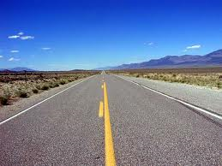
How far have we come?
A long way in a short time
Improvements in:
(1) public health
(2) medical care
(3) pharmacy
(4) diet

Slide 12
Expectation of life over centuries (E & W)
100
90
80
Women
Life
expectancy
(y)
70
60
Men
50
40
30
20
10
0
1500
1600
1700
1800
1900
2000
Redrawn from Office for National Statistics

Slide 13

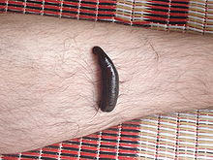
Pre 1900
Very little cardiology and no cardiac surgery
Heart attack not properly described
Diet and atherosclerosis not linked
Diabetes recognised but physiology not known
Treatments
  Digitalis from the Foxglove (Digitalis purpura) for heart failure
  Bed rest, leeches and bleeding
“An account of the foxglove and some of its uses”
William Withering (1785)

Slide 14
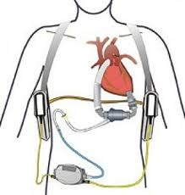
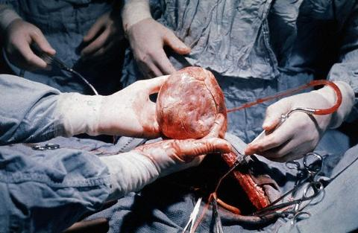
Now
Effective Drugs
For (1) Blood pressure control
  Beta blockers – BP, rhythm control, survival
  ACE inhibitors - BP, cardiac function, survival
(2) Lowering cholesterol
  Statins - reduce death rates from coronary disease
(3) Control of glucose levels
  Insulin and oral agents eg (sulfonylureas, biguanides, thiazolidinediones)
Devices and procedures
Pacemakers, implantable defibrillators Becoming more sophisticated
(2) Angioplasty
  overtaking surgery as the preferred way of revascularisation for coronary heart disease
(3) Open heart surgery
  Cardiopulmonary bypass technique
(4) Transplantation and mechanical hearts
  Assist devices
Public health
Appreciation that risk of CVD disease is a complex interaction of the main risk factors
  Cholesterol, diabetes, smoking, blood pressure, genetics

Slide 15
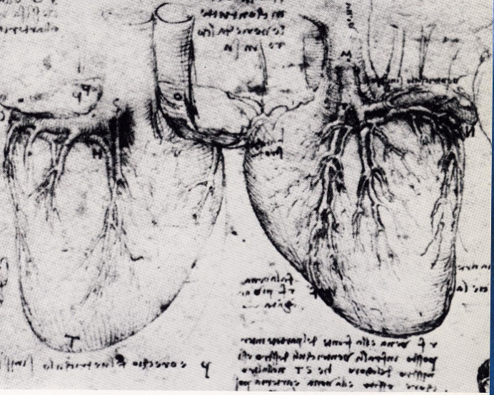
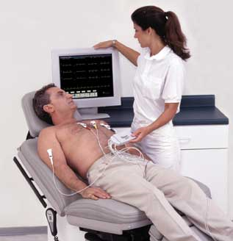
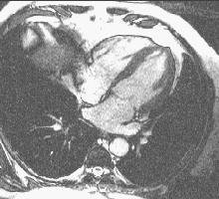
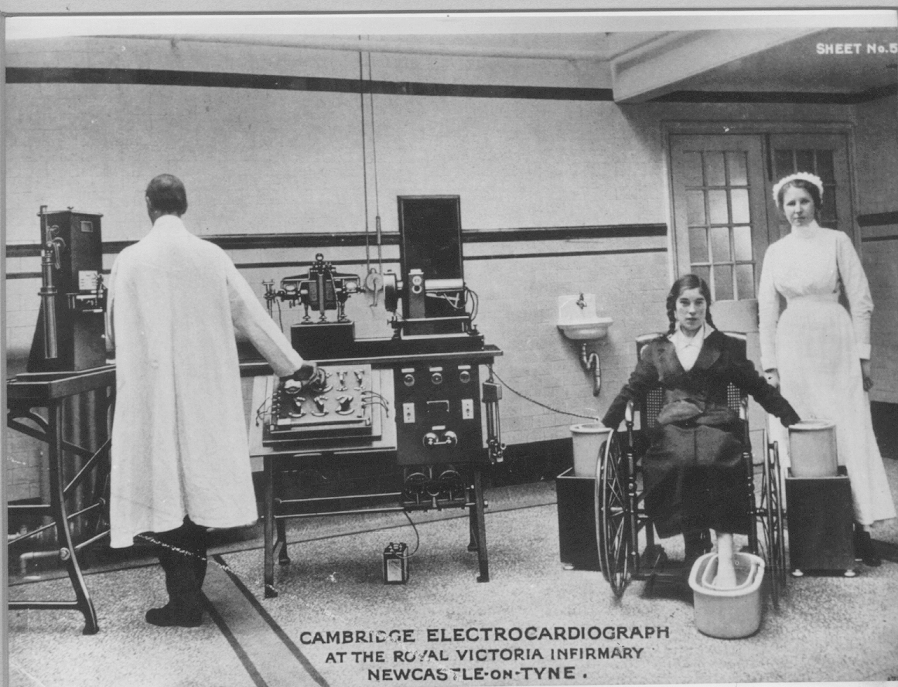
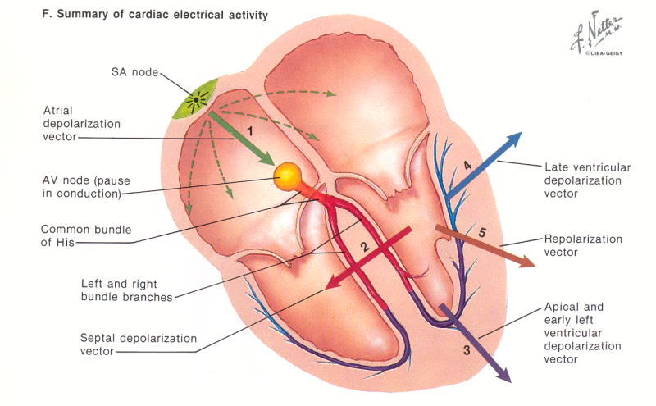
CVS course
Cardiac and CVS anatomy
Cardiac mechanics & electrophysiology
Leonardo da Vinci
1452-1519
Magnetic Resonance Imaging and fast computing

Slide 16
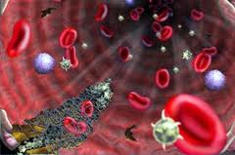
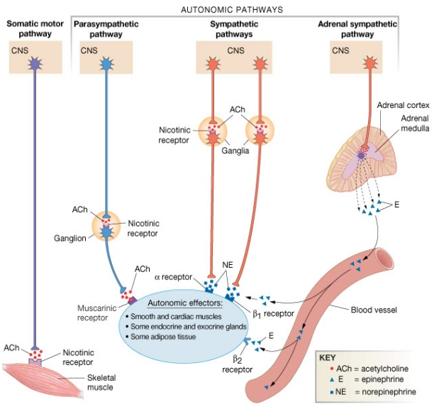
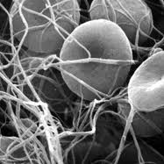
CVS course
Cardiac and CVS anatomy
Cardiac mechanics & electrophysiology
Blood vessels
Nervous and hormonal regulators of the CVS
Haemostasis
Damaged blood vessels constrict.
Platelets adhere to damaged endothelium to form platelet plug
Clots form upon conversion of fibrinogen to fibrin stabilising platelet plug

Slide 17
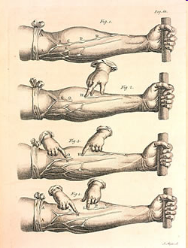
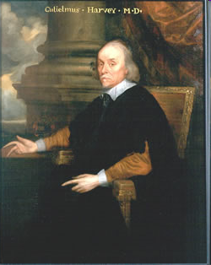
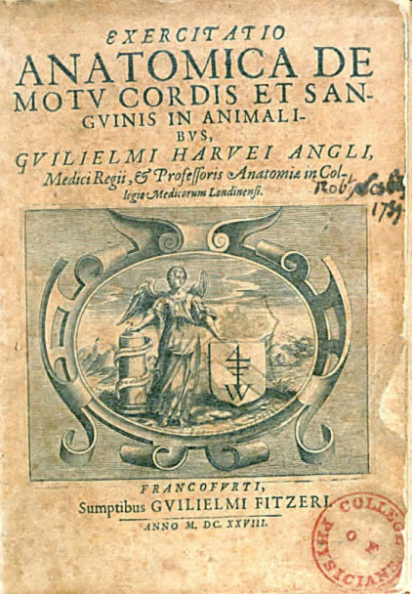
William Harvey (1578 – 1657)
English physician who first correctly described the systemic circulation and that blood was pumped around the body by the heart.
Exercitation anatomica de motu cordis et sanguinis in animalibus (An anatomical disputation on the movement of the heart and blood in animals). Generally known as De motu cordis.

Slide 18
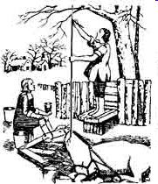
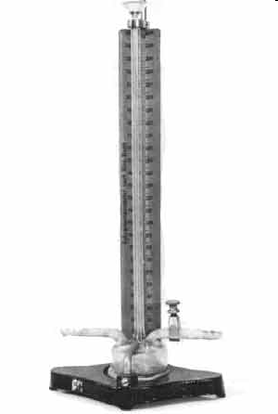
Stephen Hales - 1733
The first recorded instance of the measurement of blood pressure
Scipione Riva-Rocci developed the mercury sphygmomanometer in 1896 the design of which was the prototype of the modern mercury sphygmomanometer.

Slide 19
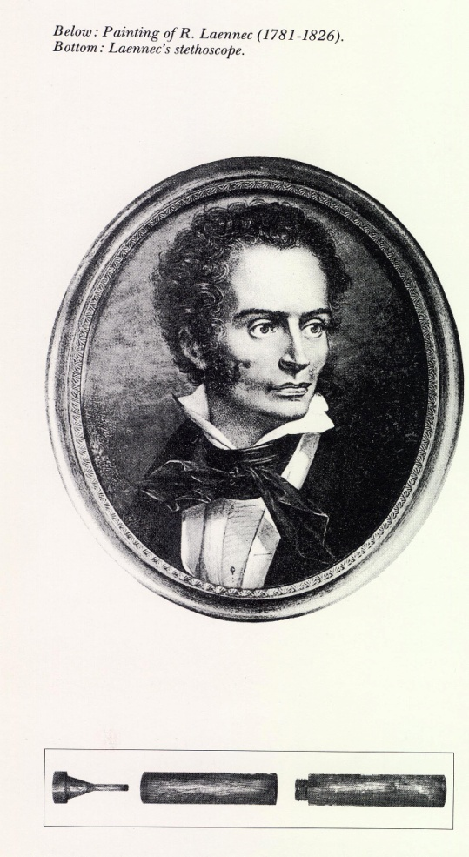
Rene Laennec (1781 - 1826)
Developed the modern stethoscope

Slide 20
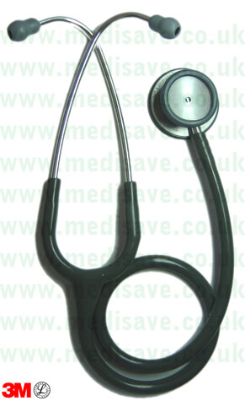
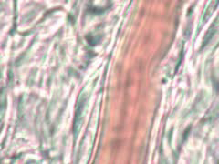
CVS course
Hypertension
Atherosclerosis
Coronary heart disease
Heart failure

Slide 21
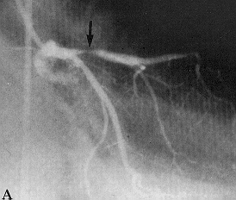
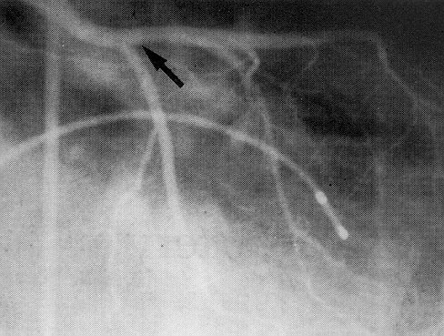
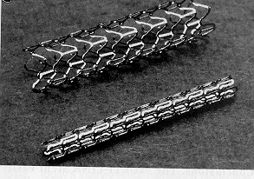
CVS course
Hypertension
Atherosclerosis
Coronary heart disease
Heart failure
coronary angioplasty
Stents – stop the vessel recoiling

Slide 22
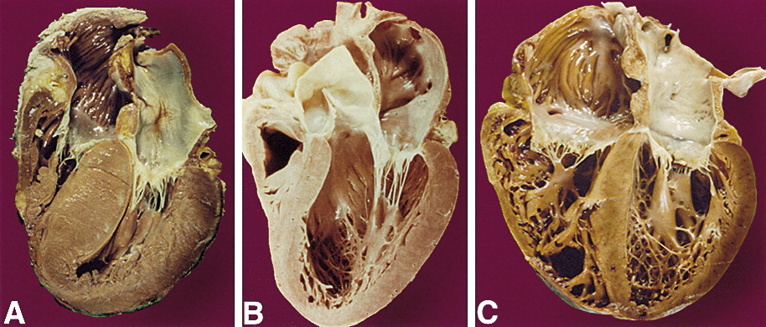
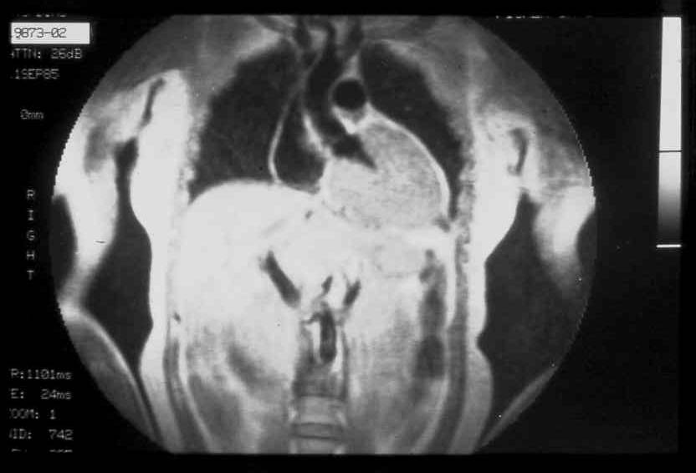
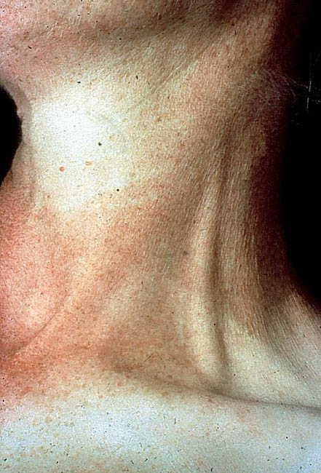
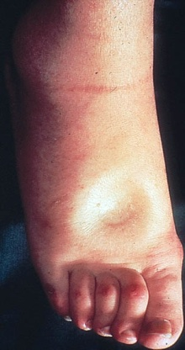
CVS course
Hypertension
Hypertrophied
(thick wall)
Normal
Dilated
Cardiomyopathy
(large chambers, thin wall)
Atherosclerosis
Coronary heart disease
Heart failure
Jugular venous distension
Pitting oedema – fluid retention

Slide 23
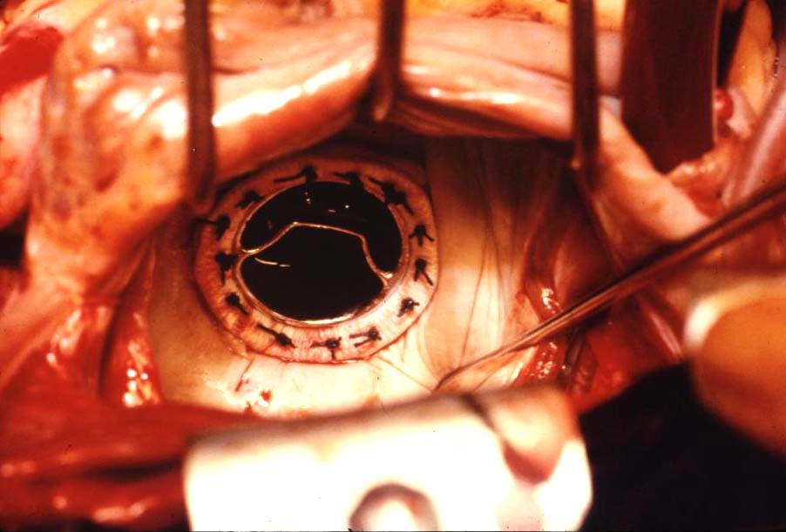
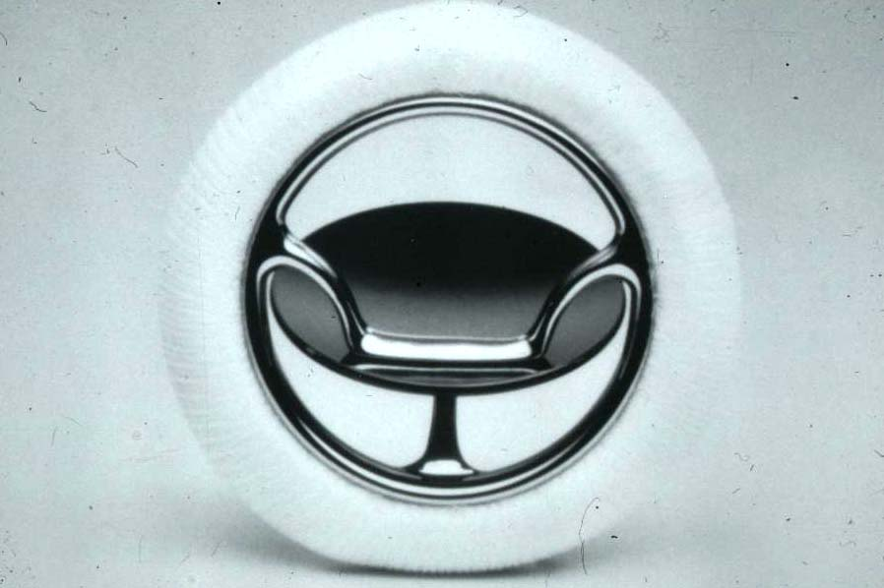

Slide 24
Future directions
Overcome diabetes and metabolic syndrome – perhaps the most potent and rapidly increasing cause of cardiovascular disease.
Improve angioplasty – prevent re-narrowing of the vessel after the procedure
Manipulate coronary arteries and heart muscle cells so they can replace dead cells and blocked vessels
Gene therapy
Stem cell therapy

Slide 25
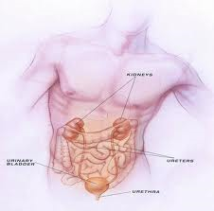
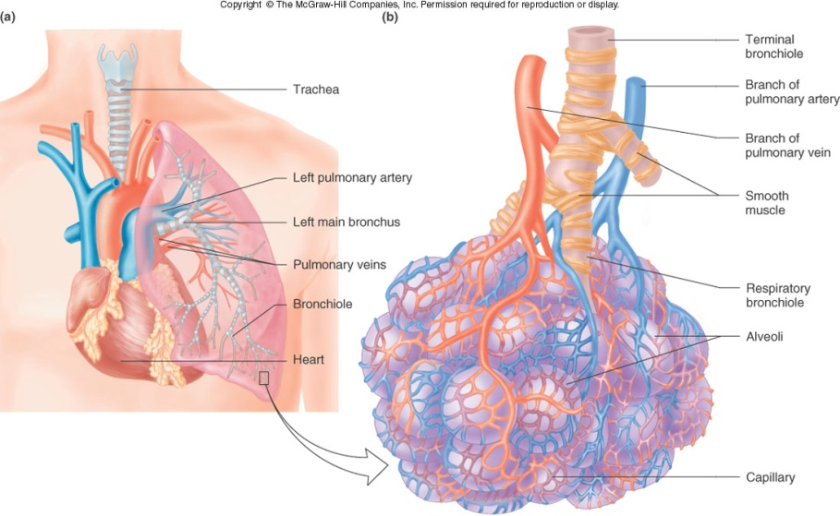
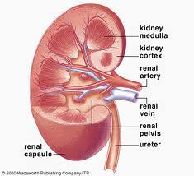
CVS – Relationship with other organ systems
Although Cardiovascular, Respiratory and Renal systems are taught as a separate entities, their functions are very closely integrated, particularly with regard to the effects of exercise, acid-base balance, fluid and blood volume control.
These systems have many underlying processes with common molecular functions. To help you recognize this please look at the “Integrated systems module”
https://education.med.imperial.ac.uk/e-lectures/LSS/player.html
Remember you will have a question in your final exam that requires integrated knowledge of CV, Resp and Renal systems!

Slide 26
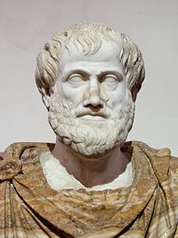
The importance of the heart
“Life begins with the first heart beat and ends with the last one”
Aristotle, 384-322 BC

Slide 27
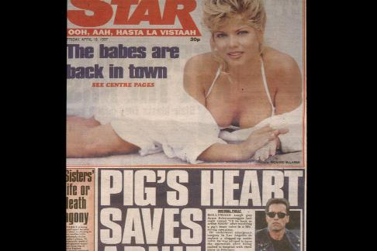
Arnie Schwarzenegger 1997 – Aortic valve replacement

