Slide 1

Hypertension
Alun Hughes
Alun Hughes, Clinical Pharmacology, NHLI, Imperial College London
© ADH 11/2006
© ADH 2013

Slide 2
Learning Objectives
Based on this lecture you should know that:
BP levels are continuously distributed in a population
Increased BP is associated with increased risk of cardiovascular disease – (strokes, myocardial infarction (heart attacks), heart failure and atheromatous disease)
The definition of hypertension is arbitrary and is based on the balance of the risks of elevated BP versus the risks of investigation and treatment
90-95% of cases of hypertension have no identifiable cause (primary or essential hypertension).
Secondary hypertension is rare, but important causes include renal disease, tumours secreting aldosterone (Conn’s syndrome), and tumours secreting catecholamines (pheochromocytoma)
Established hypertension is due to elevated peripheral vascular resistance
The increased peripheral resistance in hypertension is due to active vasoconstriction and structural narrowing of small arteries and loss of capillaries (rarefaction)
Hypertension is associated with left ventricular hypertrophy, increased wall thickness in large arteries, remodelling in smaller arteries and rarefaction of the microvasculature
The cause of primary hypertension is unknown but the strongest evidence implicates renal abnormalities and/or excessive activity of the sympathetic nervous system

Slide 3
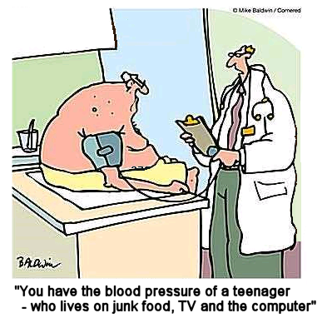
What is hypertension?

Slide 4
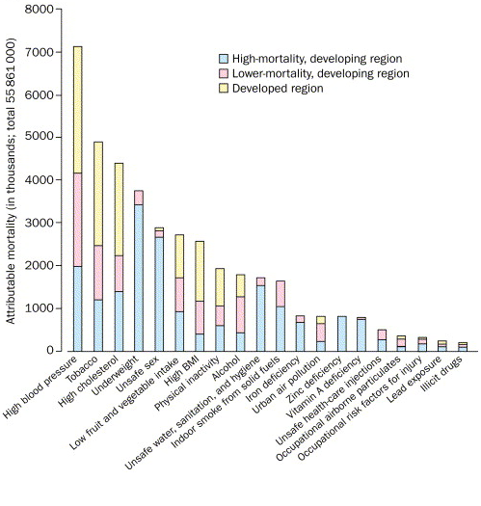
Mortality, due to leading global risk factors
Hypertension affects ~ 1 billion people worldwide
and is the leading global cause of death
Ezzati M. et al. Lancet 2002; 360:1347-1360; Lopez AD. et al. Lancet 2006; 367:1747-1757
Notes:
The slide shows the deaths worldwide attributable to various causes broken down by region. High BP causes more deaths than an other single cause and other data (not shown) indicates that it affects more than 1 billion people worldwide.

Slide 5
Distribution of blood pressure and hypertension
20
MRC (1985)
Australia (1980,’81)
15
Australia (1979)
% of screened population
Veterans Admin
(1967,’70)
10
Hamilton (1964)
5
0
50
60
70
80
90
100
110
120
130
Diastolic BP (mmHg)
BP distribution is unimodal and any distinction between normal and abnormal is arbitrary
Hypertension can be defined as the level of blood pressure above which investigation and treatment do more good than harm
Notes:
Although it is convenient to classify people into hypertensive and normotensive this obscures a more graded and continuous distribution of BP in any population. The distinction between normal and hypertensive is arbitrary and has changed over time.

Slide 6
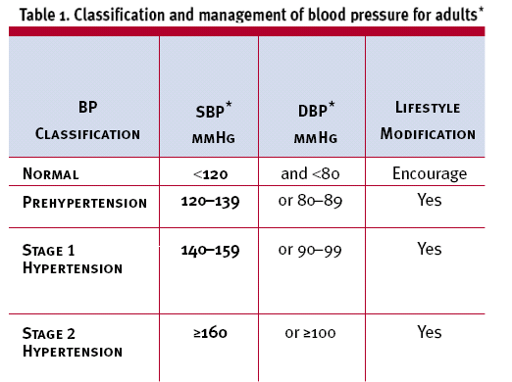
Current definitions of hypertension and ‘pre-hypertension
UK
USA
BHS Guidelines (2004)
USA: JNC 7 (2003)
Notes:
(For reference) these are the current hypertension guidelines in UK and USA. [you are not expected to learn this!]

Slide 7
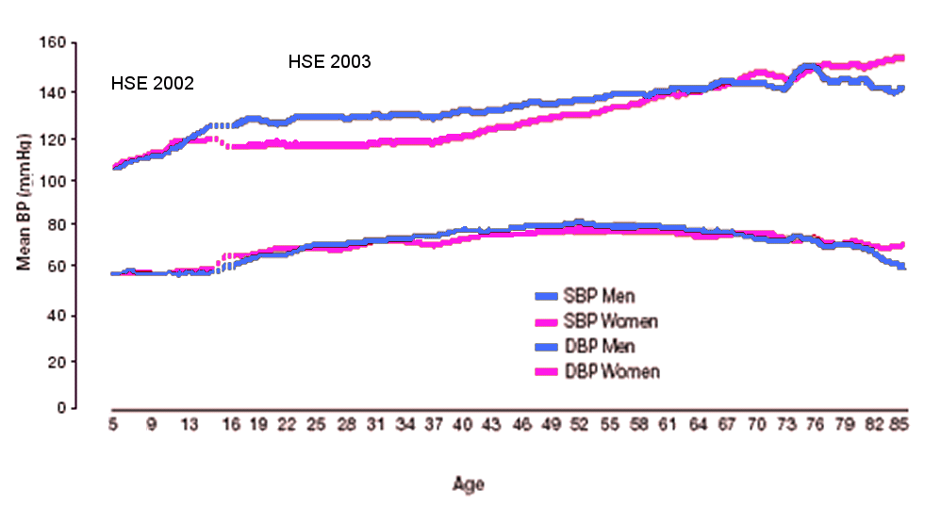
What happens to blood pressure with age?
Mean BP rise with age
Pulse pressure rises with age
The majority of people >60y would be expected to be hypertensive by current definitions, almost everyone hypertensive by >80y
Health Survey for England 2002 & 2003
Notes:
This issue of what is an normal blood pressure and how to diagnose hypertension becomes even more complex when changes in BP with aging are taken into account. In almost all societies (low salt communities are an exception) mean BP rises with age, pulse pressure also rises after mid-life. This means that the number of people diagnosed as hypertensive increases with age, recent data from the Framingham longitudinal study indicates that if you live long enough you will almost certainly become hypertensive by current definitions.

Slide 8
Blood pressure and risk in a population
25
5
20
4
15
3
Population distribution (%)
Stroke mortality / 1000 person years
10
2
5
1
0
0
100 120 140 160 180 200
Systolic BP, mmHg
There is no threshold for BP risk
Notes:
This slide plots a population distribution of systolic BP and the relationship between systolic BP and risk of stroke. The relationship between BP and risk is exponential (log linear) and there is no threshold for risk. Every 20mmHg increase in BP results in a doubling in risk of stroke (or CHD – not shown). Similar relationships have been shown for BP and coronary heart disease and other cardiovascular disease.

Slide 9
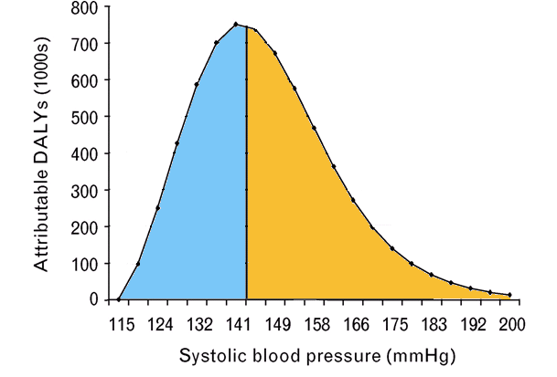
Blood pressure causes disease in the whole population not just hypertensive individuals
50% of attributable burden falls to the left of the solid line
¹ DALY = disability adjusted life years
J Hypertens 2006;24:423-30
Notes:
The relationship between BP and risk shown in the previous slide taken with the population distribution of BP means that a very large part of the disease burden imposed by BP is experienced by people with ‘normal’ BP as currently defined. The slide shows the attributable disease burden (expressed as disability adjusted life years (DALYs) due to BP divided into two halves – high and low. 50% of the burden of BP is experienced by people with a BP < 141mmHg.

Slide 10

Pathophysiology of ‘primary’ hypertension

Slide 11
Classification of hypertension
Identifiable causes – secondary <5%
e.g.
  Renal disease, including renal artery
  stenosis,
  Tumours secreting aldosterone (Conn’s
  syndrome)
  Tumours secreting catecholamines
  (pheochromocytoma)
  Oral contraceptive pill
  Pre-eclampsia/pregnancy associated
  hypertension
  Rare genetic causes (e.g. Liddle’s syndrome)
Unidentifiable cause – primary or essential
(90-95% of cases)
Notes:
The majority of cases of high BP have no identifiable cause – these are termed primary (or essential) hypertension. Cases where there is an identifiable cause are termed secondary hypertension and amount to around 5% of the total number of cases of hypertension – some causes of secondary hypertension are listed in the slide.

Slide 12
Genes and environment in etiology of primary hypertension
Genetics
  Monogenic (rare)
  Complex polygenic (common)
Environment
  Dietary salt (sodium)
  Obesity / overweight, lack of exercise
  Alcohol
  Pre-natal environment (~birthweight)
  Pregnancy (pre-eclampsia)
  Other dietary factors and environmental exposures?
Notes:
Genetic and environmental factors contribute to high blood pressure. Estimates suggest that the heritability of high blood pressure is around 30-50%. Classical single gene (monogenic) causes of hypertension are very rare, and it is believed that numerous genes each contributing only a small effect explain the heritable component of high BP. Important environmental influences on BP include dietary salt, obesity and alcohol consumption.

Slide 13
Genes and blood pressure
Twin and other studies suggest 30-50% of variation in blood pressure is attributable to genetic variation but to date identified SNPs only account for <4% of this variance¹.
Monogenic disease causes <1% of hypertension
  Liddle’s syndrome
    Mutation in amiloride-sensitive tubular epithelial Na channel
  Apparent mineralocorticoid excess
    Mutation in 11β-hydroxysteroid dehydrogenase
Complex polygenic causes
  Multiple genes with small effects (positive and negative)
  Interactions with sex, other genes, environment
¹Ehret et al., Nature 2011

Slide 14
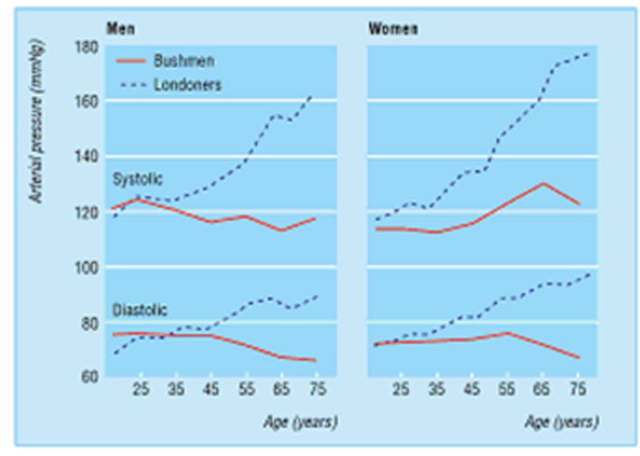
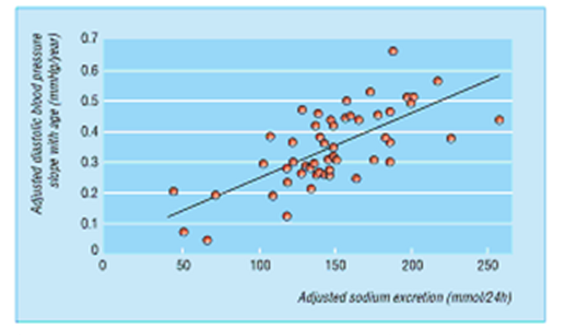


Blood pressure and age in a low salt environment
Dietary salt intake is a major factor in the rise in BP with age
Beevers et al., ABC of Hypertension 5th edition (2007), Wiley-Blackwell. ISBN-13: 978-1405130615
Notes:
There is extensive evidence that dietary salt consumption is a major factor in high BP and its rise with age. In 1954 Bushmen in Botswana had a low dietary salt intake and unlike Londoners showed no rise in BP with age. The Intersalt study demonstrated that there was a close correlation worldwide between dietary salt intake and BP.

Slide 15
Haemodynamics of hypertension
BP = CO x PVR
Typically, established hypertension is associated with:
Increased total peripheral resistance
Reduced arterial compliance (higher pulse pressure)
Normal cardiac output
Normal blood volume/extracellular volume
Central shift in blood volume
  secondary to reduced venous compliance
Notes:
The relationship between BP, cardiac output and peripheral resistance is key to understanding the haemodynamics of high BP. Numerous studies have shown that in established primary (essential) hypertension the increased blood pressure is due to elevated peripheral resistance.

Slide 16
What accounts for the elevated PVR in hypertension?
Active narrowing of arteries
  vasoconstriction (probably short-term)
Structural narrowing of arteries
  growth and remodelling (adaptive?)
Loss of capillaries
  rarefaction (adaptive/damage?)
Notes:
In theory the elevated peripheral resistance in hypertension could be due to a number of factors influencing small arteries and capillaries. Evidence supporting increased active vasoconstriction in hypertension is equivocal but there is good evidence that structural narrowing of small arteries and (to a lesser extent) loss of capillaries are important factors causing the sustained elevated peripheral resistance in hypertension.

Slide 17
Candidates causes of primary hypertension
Kidney
  Key role in BP regulation (Guyton)
  Best evidence especially in relation to salt intake
Sympathetic nervous system
  Evidence linking high sympathetic activity to the development of hypertension
Endocrine/paracrine factors
  Inconsistent evidence
Notes:
The underlying pathological mechanism(s) responsible for the elevated peripheral resistance in hypertension are still not well understood despite more than a century of research. Probably the best evidence indicates a key role for the kidney, although there is some evidence for over-activity of the sympathetic nervous system particularly in the development of hypertension.

Slide 18
The kidney as a cause of hypertension
The kidney exerts a major influence on BP through regulationof sodium/water/extracellular fluid volume¹
Impaired renal function or blood flow is the commonest 2º cause of hypertension (e.g. renal parenchymal disease, renal artery stenosis),
Most monogenic causes of hypertension affect renal Na⁺ excretion
Salt intake is strongly linked with blood pressures of human populations. Populations with low salt have low population blood pressures and no rise in BP with age.
Animals with reduced renal Na⁺ handling (genetic or experimental) develop hypertension. Excess salt intake in many animals results in elevated blood pressure
In rats hypertension can be ‘transplanted’ with the kidney, there is similar, though incomplete data, in man
¹Guyton AC Hypertension 1990; 16: 725.
Notes:
Evidence in favour of a key role for the kidney is summarised in this slide.

Slide 19

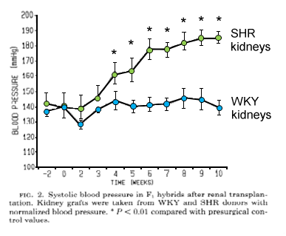
BP ‘follows’ the kidney
SHR (hypertensive)
WKY (normotensive)
Renal transplant
Renal transplant
F1 cross
F1
Rettig et al. Am J Physiol 1990; 258: 606
Notes:
This slide shows data from a classic experiment by Rettig and colleagues, who showed that when the kidney of a genetically hypertensive rat was transplanted to a normotensive rat the normotensive rat became hypertensive. This suggests that the transfer of kidney alone was sufficient to induce hypertension.

Slide 20
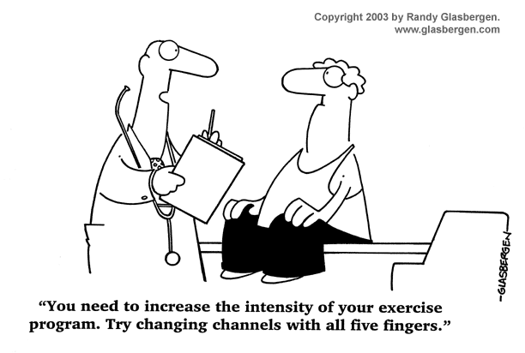
The damage due to high blood pressure

Slide 21
The major risks attributable to elevated blood pressure
Increased risk of
coronary heart disease
stroke
peripheral vascular disease/atheromatous disease
heart failure
atrial fibrillation
dementia /cognitive impairment
retinopathy
Notes:
High blood pressure results in a wide range of injury to the circulation and other organs. This is summarized in this slide.

Slide 22
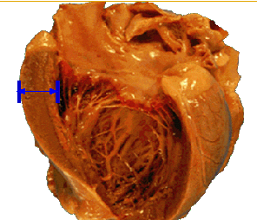
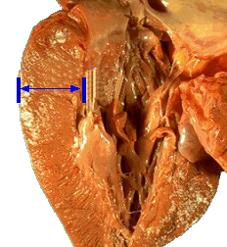
Hypertension & the heart
NT
HT
Hypertension is commonly associated with an increase in left ventricular wall mass (LVMI) and changes in chamber size
Notes:
High blood pressure causes changes to the heart. The wall of the left ventricle can become thickened (hypertrophy) and there can be a change in ventricular volume (remodelling).

Slide 23
Hypertension and CHF - changing pattern of disease
Vital Statistics of the United States, NCHS
People eligible for Medicare
500
Stroke
3
Men
450
CHD
2.5
Women
400
350
2
300
CHF (per 100,000 pt years)
CVD deaths (per 100,000 Population)
250
1.5
200
1
150
100
0.5
50
0
0
1994
1997
2000
2003
1950
1960
1970
1980
1990
2000
2005
2006
2007
The prevalence of heart failure (CHF) is increasing (in contrast to other CVD)
Hypertension increases the risk of CHF 2 -3 fold
Hypertension probably accounts for about 25% of all cases of CHF
Hypertension precedes CHF in 90% of cases
The majority of CHF in the elderly is attributable to hypertension
http://www.nhlbi.nih.gov/about/factbook/chapter4data.htm#gr7
Accessed 7/12/11
Curtis LH, et al. Arch Intern Med 2008; 168: 418-424.
Notes:
The prevalence of heart failure – the inability of the heart to adequately pump blood at normal filling pressures – is increasing markedly in most developed societies. Hypertension increases the risk of heart failure 2 -3 fold and probably accounts for about 25% of all cases of heart failure. Hypertension precedes heart failure in 90% of cases, and the majority of heart failure in the elderly is attributable to hypertension. When the impact of hypertension adds to the epidemics of obesity and diabetes apparent in younger individuals it seems likely that recent favourable trend in CVD will reverse and that the increase in heart failure will accelerate in future decades.

Slide 24
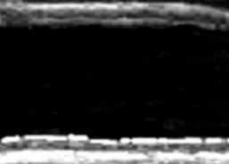
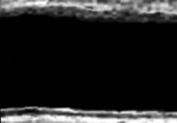
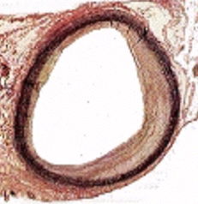
Hypertension & large arteries (1)
U/S of common
carotid artery (far wall)
NT
HT
Hypertension is commonly associated with thickened walls (hypertrophy) of large arteries and acceleration of atherosclerosis
Notes:
High BP also results in changes in large arteries. Typically hypertension is associated with thickened walls (hypertrophy) of large arteries and acceleration of atherosclerosis.

Slide 25
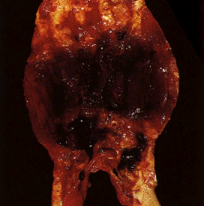
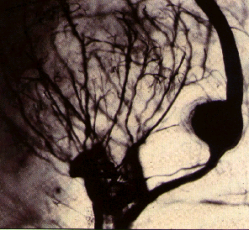
Hypertension & large arteries (2)
Aortic aneurysm
Charcot Bouchard (cerebrovascular) aneurysm
Hypertension may causes arterial rupture or dilations (aneurysms). This can lead to thrombosis or haemorrhage (e.g. strokes)
Notes:
Hypertension may also cause dilation of large arteries such as the aorta (aneurysms). This can lead to thrombosis or haemorrhage if the aneurysm ruptures.

Slide 26
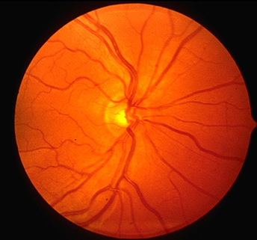
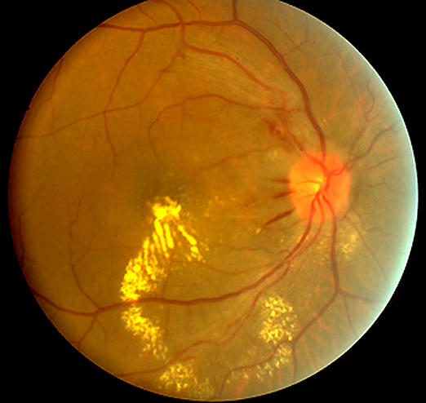
Hypertension & the retina
Normal
Hypertensive
Grade III retinopathy
Silver wiring
(wall thickening)
Haemorrhages
(wall rupture)
AV nipping
(wall thickening)
Hard exudates
(plasma leaks)
The retina illustrates microvascular damage in hypertension. There is thickening of the wall of small arteries, arteriolar narrowing, vasospasm, impaired perfusion and increased leakage into the surrounding tissue
Notes:
Hypertension also adversely affects the microcirculation. This is illustrated here using retinal photographs to show microvascular damage to the retinal microvasculature. There is thickening of the wall of the small arteries, arteriolar narrowing, vasospasm, impaired perfusion and increased leakage into the surrounding tissue (exudates).

Slide 27
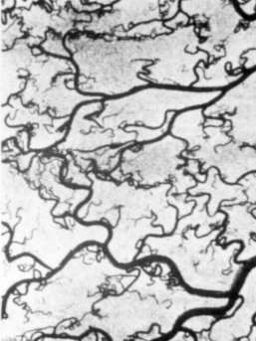
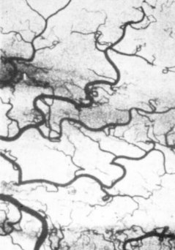
Hypertension & the microvasculature
Normal mesentery
Hypertensive
Hypertension is associated with:
reduction in capillary density → impaired perfusion?
→ increased PVR
elevated capillary pressure → damage and leakage
Notes:
This slide compares the mesenteric microvasculature (post mortem) in people with normal blood pressure and hypertension. It illustrates the sort of changes seen in the capillary circulation in association with hypertension. A clear reduction of capillary density is evident.

Slide 28
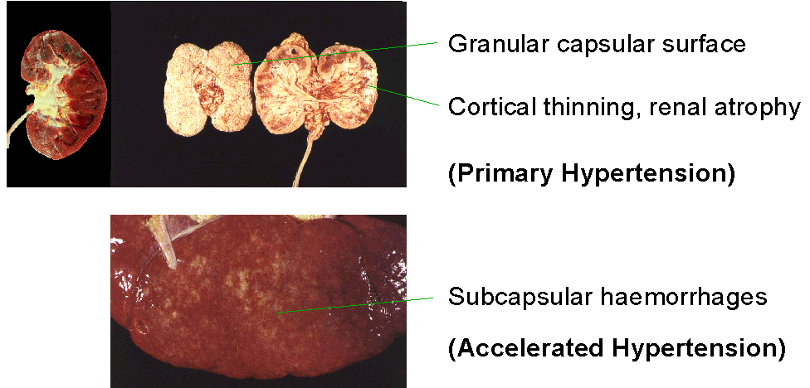
Hypertension & the kidney
Renal dysfunction is common in hypertension (e.g. increased (micro)albumin excretion in urine).
Extreme (accelerated/malignant hypertension) is now rare but leads to progressive renal failure
Notes:
Hypertension also adversely affects the kidney. The slide shows examples of marked renal damage due to very high (accelerated or malignant) hypertension. This degree of damage is relatively rare nowadays thanks to better treatment and control of hypertension. However more subtle damage to renal function is common in hypertension and is manifest as loss of albumin in the urine (micro- or macroalbuminuria).

Slide 29
Blood pressure and microalbuminuria
albuminuria
100
50
20
10
Urinary albumin (mg/L log scale)
5
2
1
100
110
120
130
140
150
160
170
SBP (mmHg)
Hypertension causes:
- increased albumin loss in the urine
- decline in GFR with age
Both indicative of renal damage
Gerber L, et al., 2001; Coresh et al., 2003
Notes:
The very severe kidney disease illustrated in the previous slide is rare nowadays. However more subtle evidence of kidney disease is evident in many people with high blood pressure. This slide shows that higher blood pressure is associated with increased loss of albumin in the urine (microalbuminuria), a marker of glomerular damage.

Slide 30
Effects of hypertension - summary
Structural changes in the circulation
Acceleration of atherosclerosis and microvascular damage
  Myocardial infarction
  Heart Failure
  Stroke
  Peripheral vascular disease
  Retinopathy
  Renal disease / failure
  Atrial fibrillation
  Dementia

Slide 31
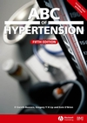

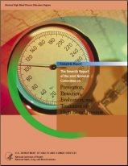

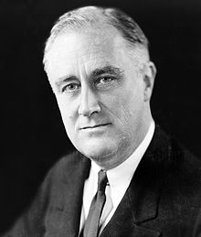
Further reading
ABC of Hypertension, 5th Edition. Gareth
Beevers
, Gregory Y. H. Lip,
Eoin
O'Brien
BMJ Books. ISBN: 978
-
1
-
4051
-
3061
-
5.
Excellent brief overview of the clinical aspects of hypertension
National Clinical Guidance Centre (August 2011). "Diagnosis of Hypertension,
Link from evidence to recommendations". Hypertension (NICE CG 127).
National Institute for Health and Clinical Excellence.
Recent amendment to UK Guidelines
Chobanian
AV,
Bakris
GL, Black HR, et al. (December 2003). "Seventh report of
the Joint National Committee on Prevention, Detection, Evaluation, and
Treatment of High Blood Pressure". Hypertension 42 (6): 1206
–
52.
Current
.
US guidelines
Kotchen
TA. "Historical trends and milestones in hypertension research: a model
of the process of translational research". Hypertension 2011; 58: 522-38.
Good
contemporary review from a basic science perspective
Bruenn
HG (1970). "Clinical notes on the illness and death of president Franklin D.
Roosevelt". Ann. Int. Med. 72 (4): 579
–
591.
Interesting
historical article about how hypertension changed the course of
history in the 20th Century

