Slide 1
Anatomy of the heart and circulation
Dr Paul Strutton
Department of Surgery & Cancer
Faculty of Medicine
Wednesday 23 January 2013

Slide 2
Learning objectives
Identify the pericardium in the cadaver and describe its organisation
Demonstrate the four chambers of the heart
List the vessels that enter or leave each of the chambers of the heart
Identify the origin of the brachiocephalic artery, the subclavian arteries and the carotid system of arteries in a cadaver
Describe the position and relations of the aortic arch and descending aorta
Explain how blood returns from the head and neck to the heart
Identify the superior vena cava in a cadaver
Outline the coronary circulation and be able to identify the main coronary arteries and cardiac veins
Identify and label the heart valves and their locations, and state the structural similarities and differences
Explain how blood leaving the heart reaches (a) head and neck, (b) lungs, (c) thoracic and abdominal cavities
Describe the components of the conduction system

Slide 3
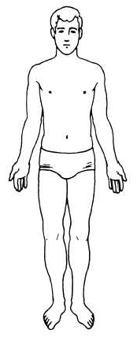
Orientation: the anatomical position
Doctors need to describe body positions and relations with complete clarity.
The system of terminology used is based on the Anatomical Position.
The body is always described as if it were in this position regardless of its actual position.
Anterior (ventral)
Posterior (dorsal)
Superior (cranial, rostral)
Inferior (caudal)
Midline (median) means mid-sagittal
Medial
Lateral
Proximal
Distal
Superficial
Deep
Sagittal
Frontal (coronal)
Horizontal (transverse or axial)

Slide 4
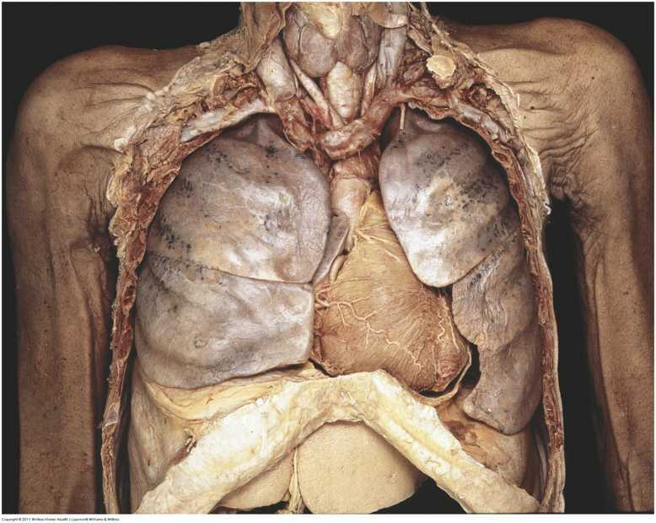
The heart in situ

Slide 5
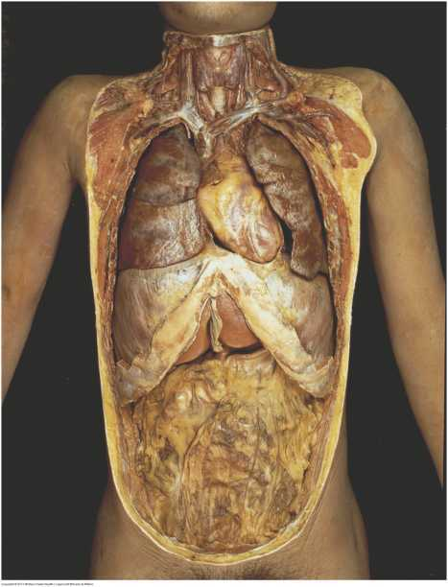
The heart in situ

Slide 6
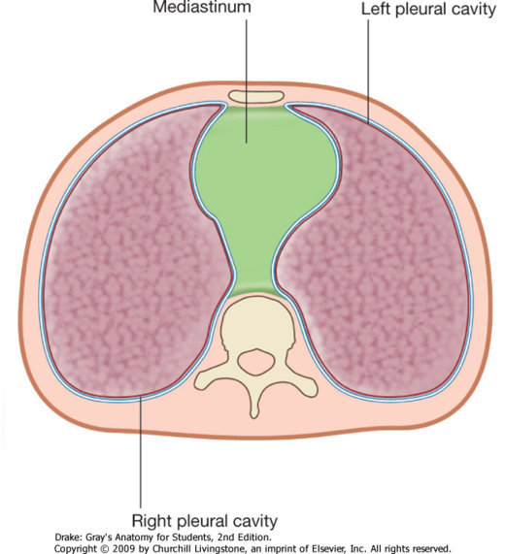
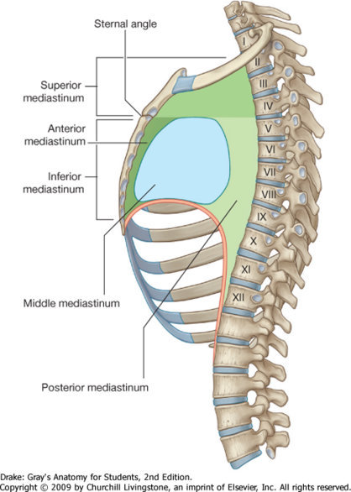
The mediastinum

Slide 7
Pericardium
Fibroserous sac surrounding heart and its great vessels
Consists of 2 layers
Fibrous and Serous
Serous has 2 parts
Parietal – lines fibrous
Visceral – adheres to heart

Slide 8
Pericardium

Slide 9
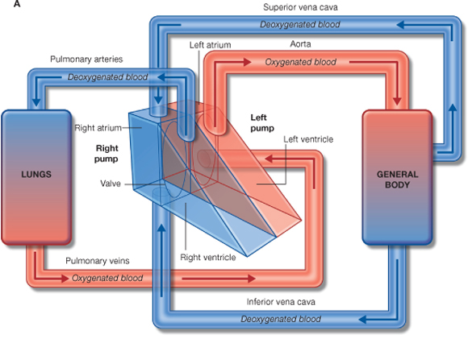
Two pumps

Slide 10
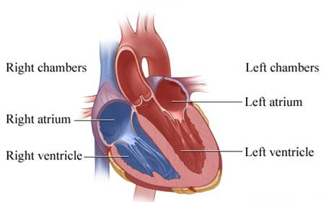
Four chambers

Slide 11
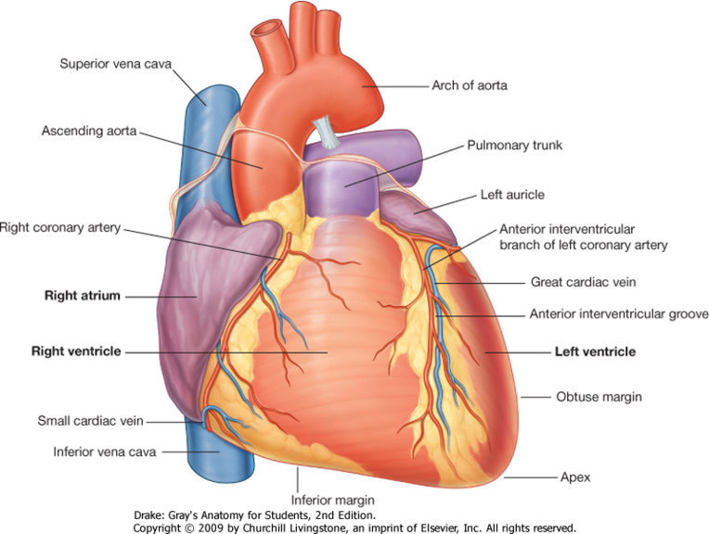
Main vessels of the heart

Slide 12
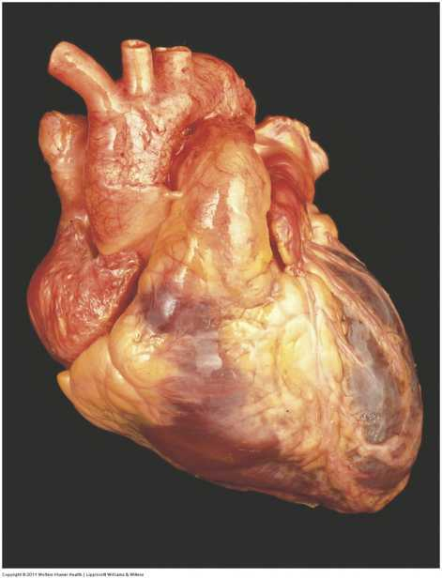
Main vessels of the heart
Aortic arch
Pulmonary veins (left)
Pulmonary trunk
Superior vena cava
Ascending aorta

Slide 13
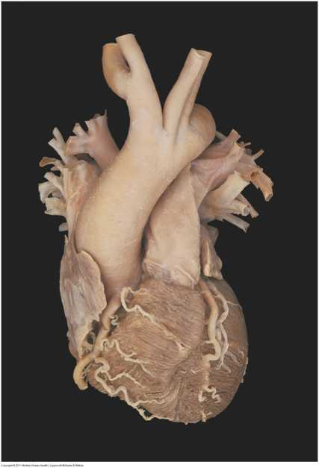
Branches of the aortic arch
Right subclavian artery
Right common carotid artery
Brachiocephalic trunk
Left common carotid artery
Left subclavian artery

Slide 14
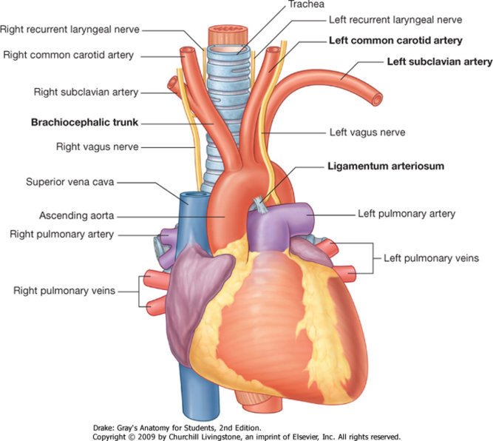
Branches of the aortic arch

Slide 15
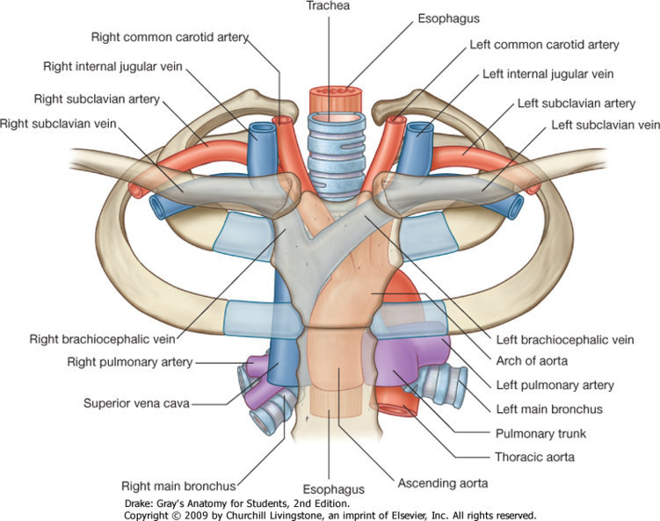
Brachiocephalic veins

Slide 16
Brachiocephalic veins
Internal jugular vein
Subclavian vein
Brachiocephalic vein
Superior vena cava
Internal jugular vein
Subclavian vein
Brachiocephalic vein

Slide 17
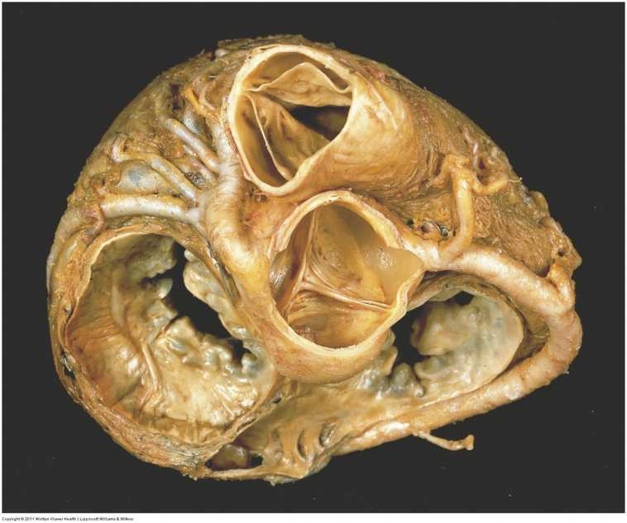
Valves of the heart
R AV (tc)
L AV (m)
AV
PV
Anterior

Slide 18
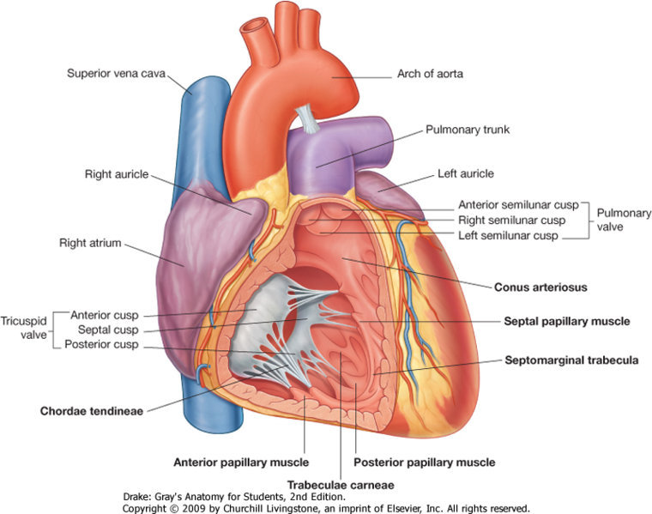
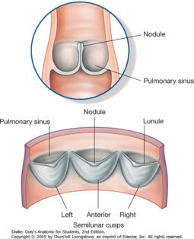
Valves of the right side of the heart

Slide 19
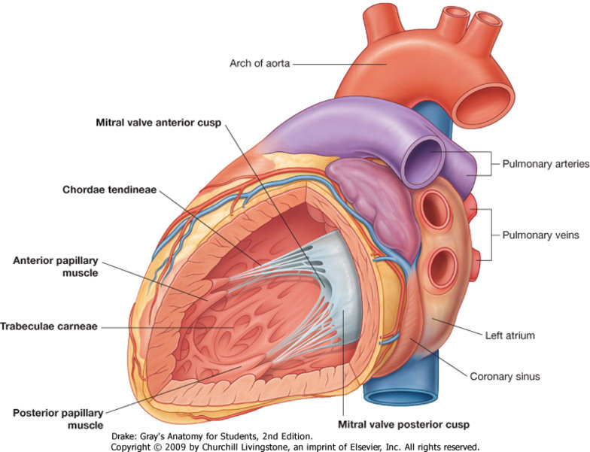
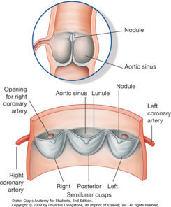
Valves of the left side of the heart

Slide 20
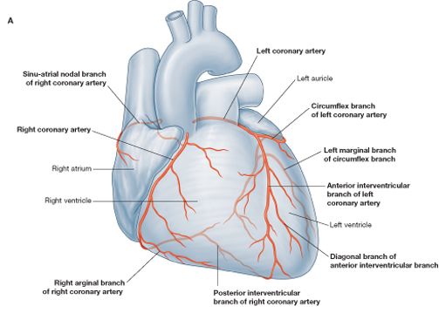
Coronary circulation - arteries

Slide 21
Coronary circulation - veins

Slide 22
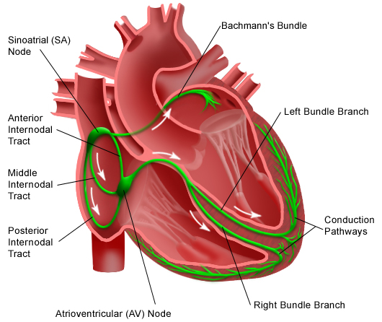
Conducting system

Slide 23
Conducting system

