Slide 1
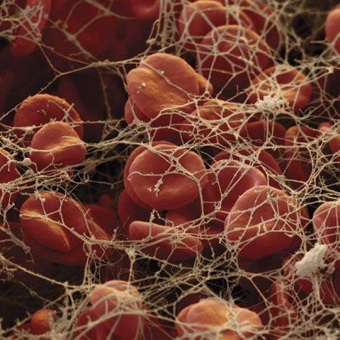
Haemostasis and thrombosis
13 February 2013
Lecture 1:
Basic Haemostasis
Professor David Lane
Centre for Haematology
Hammersmith Hospital Campus
(d.lane@imperial.ac.uk)
Lecture 2:
Clinical Haemostasis & Thrombosis
Professor Mike Laffan
Centre for Haematology
Hammersmith Hospital Campus
(m.laffan@imperial.ac.uk)

Slide 2
Lecture 1 and 2: Learning Objectives
The student should be able to:
Describe what is meant by abnormal bleeding
Describe patterns of abnormal bleeding with examples
Describe the manifestations of venous thrombosis
List the main risk factors for venous thrombosis
Give a rough estimate of its prevalence
Be acquainted with the principles of treatment of venous thrombosis

Slide 3
Haemostasis and Thrombosis: a Balance
Normal haemostasis: a state of equilibrium
Fibrinolytic factors,
anticoagulant proteins
Coagulation factors,
platelets

Slide 4
Bleeding
1
Coagulation factors,
Platelets
2
Fibrinolytic
factors,
Anticoagulant
proteins

Slide 5
Characteristics of abnormal bleeding
Bleeding that is:
  ‘Spontaneous’
  Out of proportion to the trauma/injury
  Unduly prolonged
  Restarts after appearing to stop
But ~12% of the population have ‘easy bruising’

Slide 6
A significant bleeding history: examples
Epistaxis not stopped by 10 mins compression or requiring medical attention/transfusion.
Cutaneous haemorrhage or bruising without apparent trauma (esp. multiple/large).
Prolonged (>15 mins) bleeding from trivial wounds, or in oral cavity or recurring spontaneously in 7 days after wound. Spontaneous GI bleeding leading to anaemia.
Menorrhagia requiring treatment or leading to anaemia, not due to structural lesions of the uterus.
Heavy, prolonged or recurrent bleeding after surgery or dental extractions.
Sadler 2005

Slide 7
Haemostatic Plug Formation
Response to injury to endothelial cell lining
Vessel constriction
Vascular smooth muscle cells contract locally
Limits blood flow to injured vessel
⇓
Formation of an unstable platelet plug
platelet adhesion
platelet aggregation
Limits blood loss + provides surface for coagulation
Primary
haemostasis
⇓
Stabilisation of the plug with fibrin
blood coagulation
Stops blood loss
⇓
Vessel repair and dissolution of clot
Cell migration/proliferation & fibrinolysis
Restores vessel integrity

Slide 8
Platelet adhesion
platelet
Von
Willebrand
factor
Endothelial
cells
or
platelet
GlpIb
GlpIa
collagen
Release of ADP
&
prostaglandins
Platelet aggregation
GlpIIb/IIIa
platelet
platelet
platelet
Fibrinogen
+
Ca2+

Slide 9
Defects of primary haemostasis (platelet plug formation)
Deficiency or defective:
  Collagen - vessel wall
  Von Willebrand factor
  Platelets
Common examples:
Steroid therapy, age
Von Willebrand disease (genetic)
Aspirin & other drugs
Thromobocytopenia

Slide 10
lumen
platelet
platelet
platelet
platelet
platelet
platelet
Collagen
Tissue Factor
Primary Haemostasis: platelet plug
Notes:
Consider damaged vessel. 2 crucial molecules exposed. Forget TF.

Slide 11
lumen
platelet
platelet
platelet
Collagen
Tissue Factor
VWD: failure of primary haemostasis
Notes:
Consider damaged vessel. 2 crucial molecules exposed. Forget TF.

Slide 12
Defects of primary haemostasis: pattern of bleeding
Immediate
Easy bruising
Nosebleeds (prolonged:>20 mins)
Gum bleeding (prolonged)
Menorrhagia (anaemia)
Bleeding after trauma/surgery
Petechiae (specific for thrombocytopenia)

Slide 13
Petechiae – typical of thrombocytopenia

Slide 14
Haemostatic Plug Formation
Response to injury to endothelial cell lining
Vessel constriction
Vascular smooth muscle cells contract locally
Limits blood flow to injured vessel
⇓
Formation of an unstable platelet plug
platelet adhesion
platelet aggregation
Limits blood loss + provides surface for coagulation
⇓
Stabilisation of the plug with fibrin
blood coagulation
Stops blood loss
Secondary
Haemostasis
(Coagulation)
⇓
Vessel repair and dissolution of clot
Cell migration/proliferation & fibrinolysis
Restores vessel integrity

Slide 15
Blood coagulation
XII
XIIa
XI
XIa
Tissue factor
VIIa
(vessel damage)
IX
IXa
VIIa
EXTRINSIC
PATHWAY
INTRINSIC
PATHWAY
VIIIa
Pl
X
Xa
X
Va
Pl
COMMON
PATHWAY
Prothrombin
thrombin (IIa)
Fibrinogen
Fibrin
thrombin
XIIIa
XIII
Crosslinked
fibrin

Slide 16
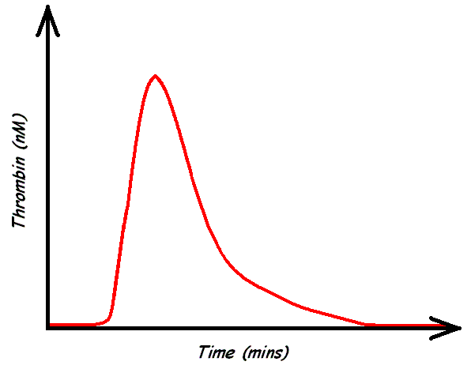
Thrombin generation by the coagulation cascade
Normal
Haemophilia
Factor VIII <1%
TF trigger
Notes:
We can visualise the process of coagulation by measuring thrombin generation over time. This is often called the thrombogram and looks like this…

Slide 17
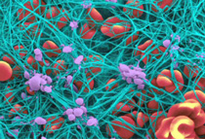
Fibrin mesh binds and stabilises platelet plug and other cells

Slide 18
Defects of secondary haemostasis (fibrin mesh formation)
Deficiency or defect of:
  Coagulation factors (I-XIII)
Common examples:
Haemophilia: FVIII or FIX (hereditary due to genetic defect)
Liver disease (acquired – most coagulation factors are made in the liver)
Drugs (warfarin – inhibits synthesis)
Dilution (results from volume replacement)
Consumption (DIC*) (acquired)
*DIC = disseminated intravascular coagulation

Slide 19
Acquired coagulation disorders
Disseminated intravascular coagulation
    Generalised activation of coagulation – Tissue factor
    Associated with sepsis, major tissue damage, inflammation
    Consumes and depletes coagulation factors & platelets
    Activation of fibrinolysis depletes fibrinogen
  Consequences
    Widespread bleeding, from iv lines, bruising, internal
    Deposition of fibrin in vessels causes organ failure

Slide 20
Bleeding in coagulation disorders
lumen
Haemostasis: fibrin clot stabilising platelet plug
Notes:
Consider damaged vessel. 2 crucial molecules exposed. Forget TF.

Slide 21
Bleeding in coagulation disorders
lumen
Haemophilia: failure to generate fibrin to stabilise platelet plug
Notes:
Consider damaged vessel. 2 crucial molecules exposed. Forget TF.

Slide 22
Defects of secondary haemostasis: pattern of bleeding
Often delayed (after primary haemostasis)
Deeper: joints and muscles
Not from small cuts etc.
Nosebleeds rare
Bleeding after trauma/surgery
After i/m injections

Slide 23
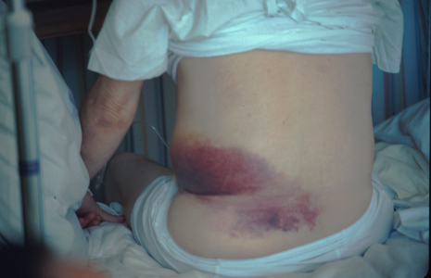
Easy bruising
(ecchymosis)
Virtually all bleeding disorders

Slide 24
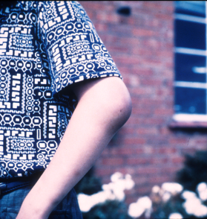
Haemarthrosis – hallmark of haemophilia

Slide 25
Haemostatic Plug Formation
Response to injury to endothelial cell lining
Vessel constriction
Vascular smooth muscle cells contract locally
Limits blood flow to injured vessel
⇓
Formation of an unstable platelet plug
platelet adhesion
platelet aggregation
Limits blood loss + provides surface for coagulation
⇓
Stabilisation of the plug with fibrin
blood coagulation
Stops blood loss
⇓
Vessel repair and dissolution of clot
Cell migration/proliferation & fibrinolysis
Restores vessel integrity
Fibrinolysis

Slide 26
Bleeding
1
Coagulation factors,
Platelets
2
Fibrinolytic
factors,
Anticoagulant
proteins

Slide 27
Defects of clot stability: excess fibrinolysis
Common examples:
Therapeutic administration
Some tumours
Antiplasmin deficiency (genetic)
Excess fibrinolytic (plasmin, tPA)
or
deficient antifibrinolytic (antiplasmin)

Slide 28
Unbalanced haemostasis: anticoagulant excess
Only due to therapeutic administration:
  Eg heparin or thrombin and Xa inhibitors

Slide 29
Thrombosis
1
Fibrinolytic factors,
anticoagulant proteins
2
Coagulation
factors,
platelets

Slide 30
Thrombosis
What is thrombosis?
  ‘Intravascular coagulation’
  ‘Inappropriate coagulation’
  Coagulation inside a blood vessel
  ‘Coagulation not preceded by bleeding’
  Thrombi may be Venous or Arterial

Slide 31
What are the effects of thrombosis?
Obstructed flow of blood
  Artery – myocardial infarction, stroke, limb ischaemia
  Vein – pain and swelling
Embolism
  Venous emboli, to lungs (pulmonary embolus)
  Arterial emboli, usually from heart, may cause stroke or limb ischaemia

Slide 32
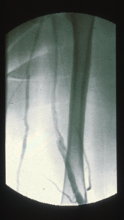
Deep vein
Thrombosis.
Venous return of blood is obstructed.
(painful, swollen
leg)

Slide 33
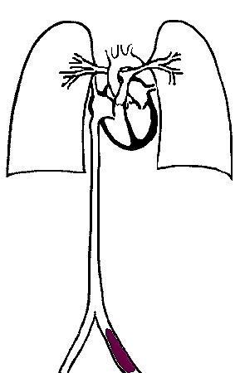
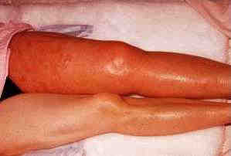
Deep vein thrombosis and pulmonary embolism

Slide 34
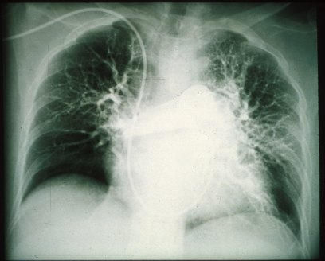
Pulmonary embolism (SoB, chest pain, sudden death)

Slide 35
Prevalence of venous thrombo-embolism
Overall 1 in 1000 - 10 000 per annum
Incidence doubles with each decade
PE is cause of 10% of hospital deaths
Estimated 25k preventable deaths per annum
Notes:
3
Point being that it is important. Overall not that many get thrombosis but in hospital it is a major and preventable cause of death.

Slide 36
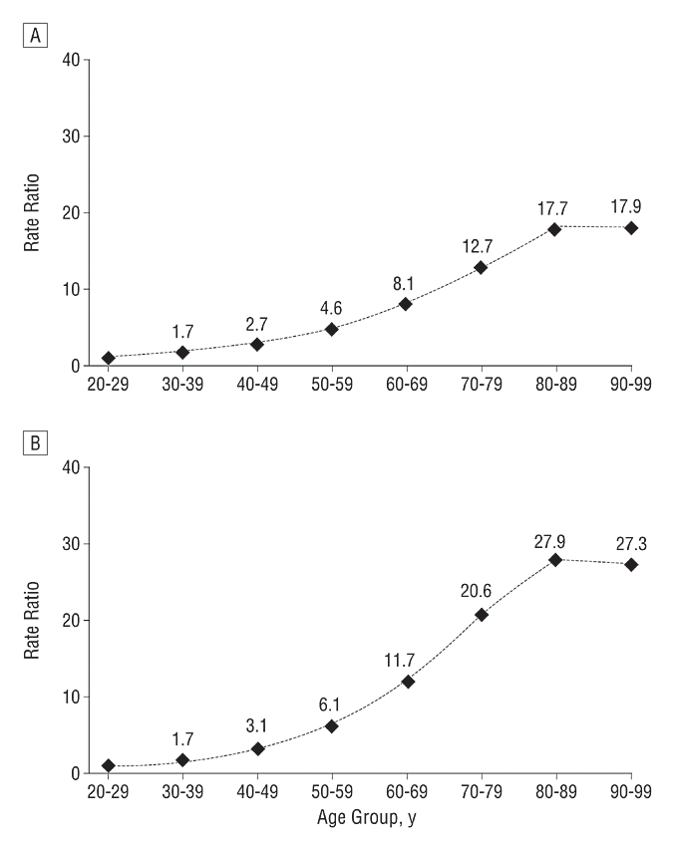
Venous thrombosis and age
DVT
PE
Stein 2004

Slide 37
Consequences of thrombo-embolism
Death VT mortality 5%
Recurrence 20% in first 2 years and 4%pa thereafter
Thrombophlebitic syndrome Severe TPS in 23% at 2 years (11% with stockings)
Pulmonary hypertension 4% at 2 years
Notes:
3
Point being that it is important. Overall not that many get thrombosis but in hospital it is a major and preventable cause of death.

Slide 38
Why do (some) people get thrombosis?
Genetic constitution
Effect of age and previous events, illnesses, medication
Acute stimulus

Slide 39
Thrombosis is Multi-Causal Arising from Interacting Genetic and Acquired Risk Factors
Risk
Acquired risk
Cumulative risk
Thrombotic
threshold
Risk from “ageing”
Genetic risk 2
Genetic risk 1
Age

Slide 40
How do genetic and acquired factors cause an increased risk of thrombosis?
Virchow's triad: There are three contributory factors to thrombosis:
blood dominant in venous thrombosis
vessel wall dominant in arterial thrombosis
flow complex, contributes to both

Slide 41
Venous thrombosis
Factors in the blood

Slide 42
Thrombosis
Fibrinolytic factors,
anticoagulant proteins
Coagulation
factors,
platelets

Slide 43
Increased risk of thrombosis:
Blood (1)
Deficiency of anticoagulant proteins
Antithrombin
Protein C
Protein S

Slide 44
Increased risk of thrombosis:
Blood (2)
Increased coagulant proteins/activity
Factor VIII
Factor II & others
Factor V Leiden (increased activity due to activated protein C resistance)
Thrombocytosis (increased platelets)

Slide 45
Thrombosis: absolute risks
Age 20 years 1/10000 pa
Age 60 years 1/1000 pa
Thrombophilic traits: relative risks
Freq.
Odds Ratio
Anticoagulant deficiency
Antithrombin
Protein C
Protein S
1-2%
2-4%
2-4%
25-50
10-20
Procoagulant excess
Factor V Leiden
Factor VIII (>1.5)
Prothrombin
Factor XI (>1.21)
20%
24%
6%
20%
6.6 (3.6-12.0)
4.8 (2.3-10)
2.8 (1.4-5.6)
2.2 (1.5-3.2)

Slide 46
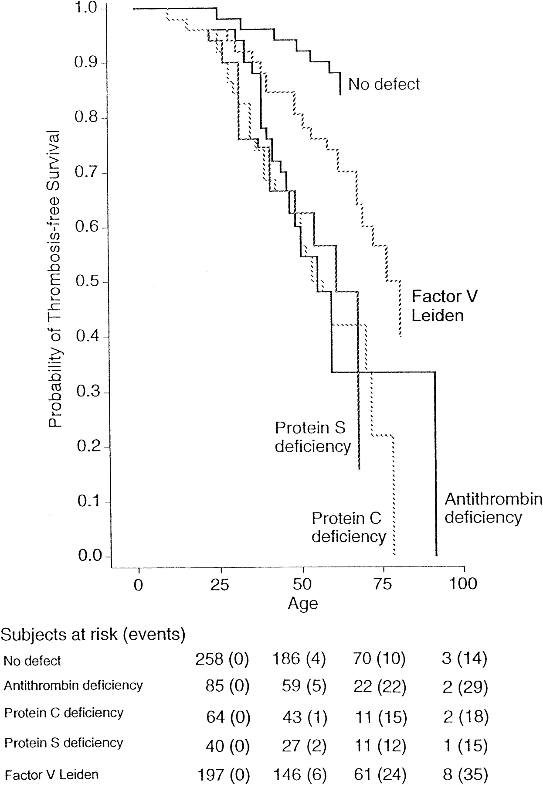
Thrombophilic traits: absolute risks
Martinelli 1998

Slide 47
Increased risk of thrombosis:
Vessel wall
We know relatively little about the role of
the vessel wall in thrombosis.
Many proteins active in coagulation are expressed on the surface of endothelial cells eg:
  Thrombomodulin
  Tissue factor
  Tissue factor pathway inhibitor
Expression altered in inflammation eg:
  Malignancy
  Infection
  Immune disorders

Slide 48
Increased risk of thrombosis:
Flow
Reduced flow (stasis) increases the
risk of venous thrombosis.
e.g.: surgery
fracture
long haul flight
bed rest

Slide 49
Increased risk of thrombosis: “thrombophilia”
Clinical:
  Thrombosis at young age
  ‘idiopathic thrombosis’
  Multiple thromboses
  Thrombosis whilst anticoagulated
Laboratory
  Identifiable cause of increased risk
    AT deficiency, Factor V Leiden, global measures of coagulation activity.

Slide 50
Combined risks for thrombosis
Numerous conditions will alter blood coagulation, vessel wall and/or flow to precipitate thrombosis or make it more likely. Eg:
  Pregnancy
  Malignancy
  Surgery
  Inflammatory response

Slide 51
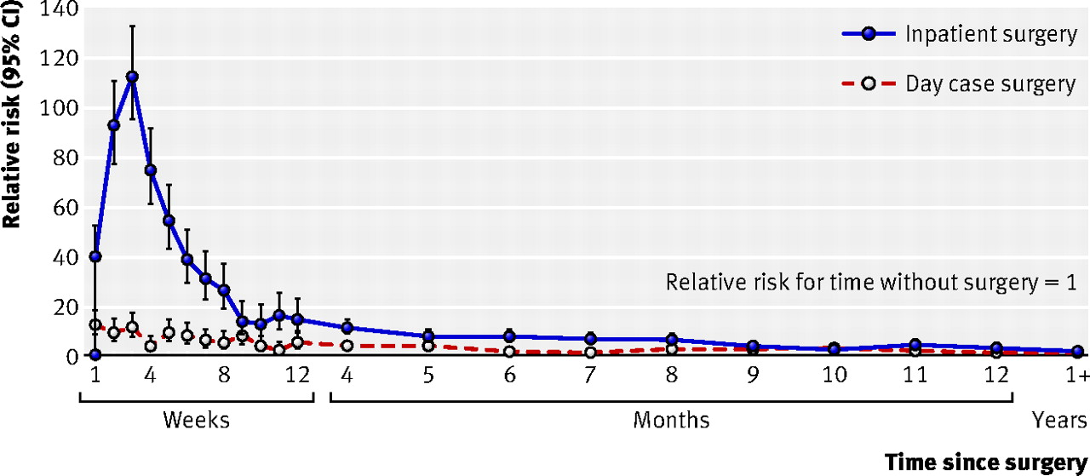
Risk of postoperative VTE
Sweetland 2009 (million women study)

Slide 52
Therapy and venous thrombosis
Treatment: to lyse clot
  eg tPA (high risk of bleeding)
Treatment: to limit recurrence/extension/emboli
  Increase anticoagulant activity
    e.g: heparin (immediate acting, parenteral)
  lower procoagulant factors
    e.g.: warfarin (oral, slow acting for long term therapy)
  New anticoagulants – direct inhibitors
    Rivaroxaban (Xa), Apixaban (Xa), Dabigatran (IIa)

Slide 53
Prevention (NICE Guidelines 2010)
  Assess individual risk and circumstantial risk
  All patients admitted should have VTE risk assessment
    (hospital target >90%)
  Give prophylactic antithrombotic therapy
    (eg heparin for in-patients)
    +/ TED stockings
http://publications.nice.org.uk/venous-thromboembolism-reducing-the-risk-cg92

Slide 54
Haemostasis and Thrombosis: a Balance
Normal haemostasis: a state of equilibrium
Fibrinolytic factors,
anticoagulant proteins
Coagulation factors,
platelets

Slide 55
Bleeding
Consumption
Dilution
Coagulation factors,
Platelets
Fibrinolytic
factors,
Anticoagulant
proteins

Slide 56
Thrombosis
Fibrinolytic factors,
anticoagulant proteins
Stasis
Inflammation
Coagulation
factors,
platelets

