Slide 1
Integration of responses to haemorrhage
Dr Ken MacLeod
Cardiac Medicine, NHLI, Faculty of Medicine, Imperial College London, UK
Life Support Systems
Cardiovascular System
© Imperial College London

Slide 2
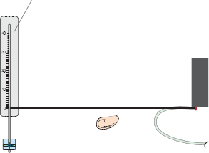
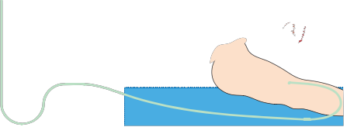
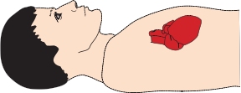
Tutorial Scenario
 | On admission | 48 hrs later
Pulse (beats/min) | 120 | 75
BP (mmHg) | 85/50 | 120/80
Central venous pressure (cm saline) | -7 | 5
Haemoglobin (g/l) | 130 | 83
Urea (mM/l) | 5 | 12
Male with partially severed femoral artery
On admission, he was
  pale,
  agitated,
  thirsty,
  cold extremities
Manometer system
Intravenous fluid
Manometer
Three-way tap

Slide 3
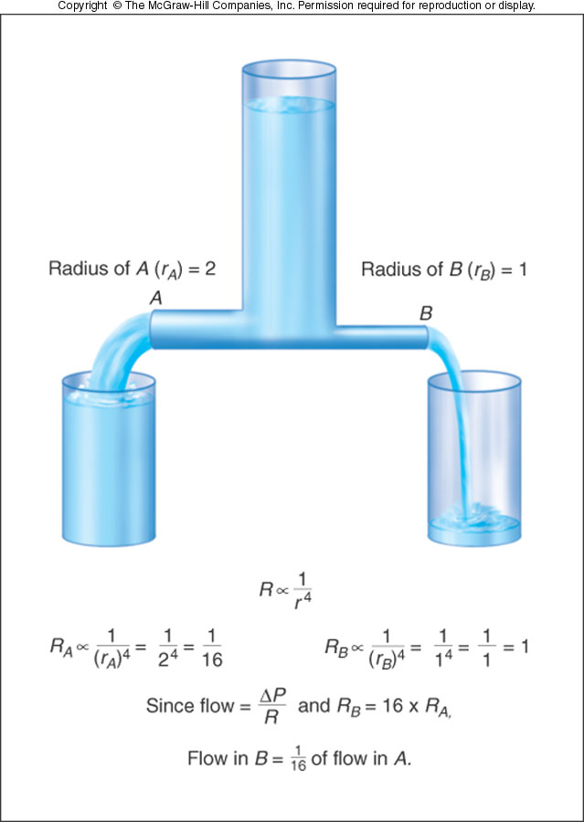
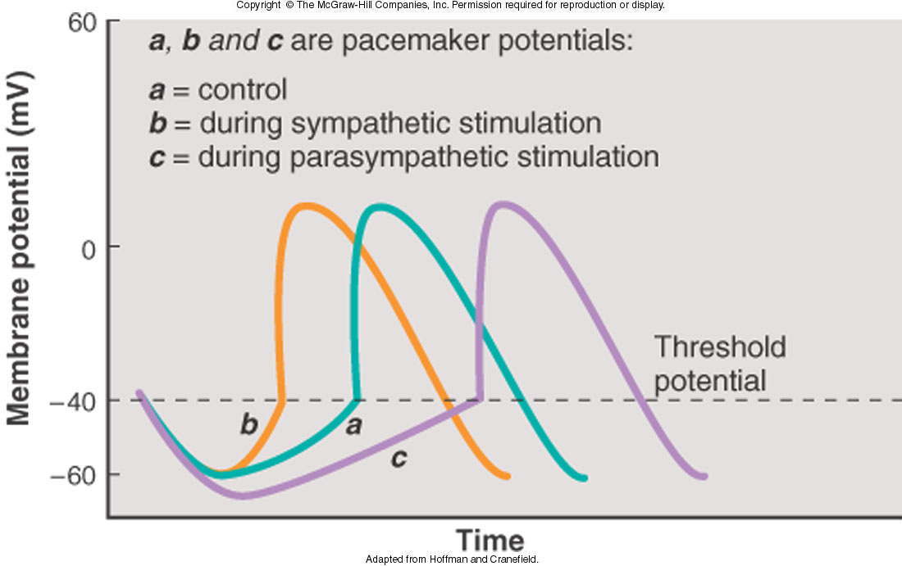
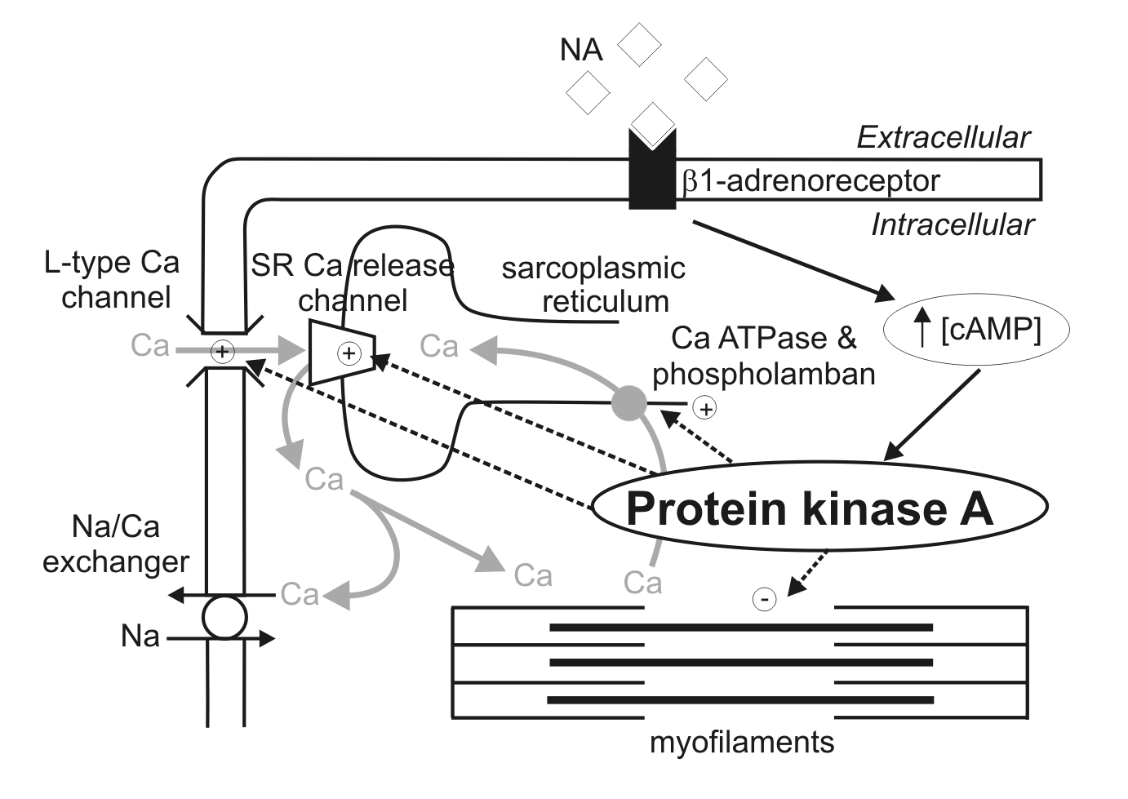
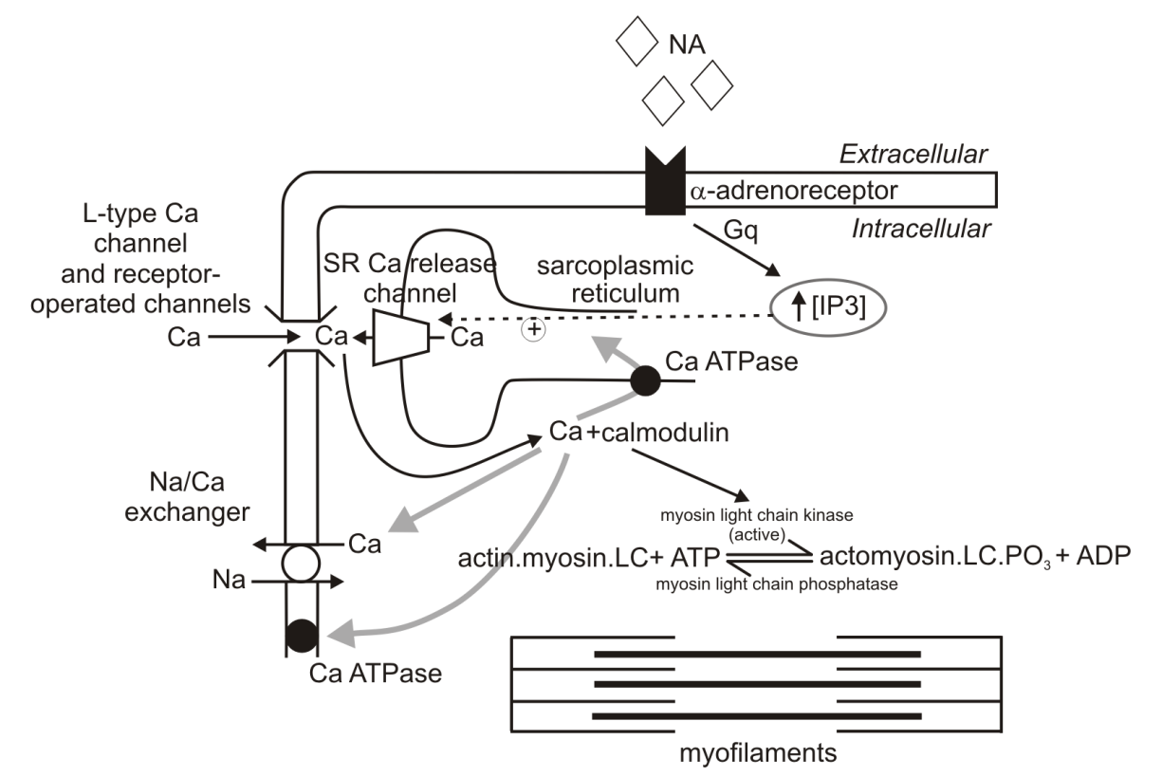
Less blood returning to heart – lower venous return
Central venous pressure low
Indicates low blood volume
Blood pressure
Cardiac output
Stroke volume
Parasymp. to heart
HR
Baroreceptor firing
Symp. to heart
Force of contraction
Mean BP = CO x TPR
Symp. tone to blood vessels
CO = HR x SV
TPR

Slide 4
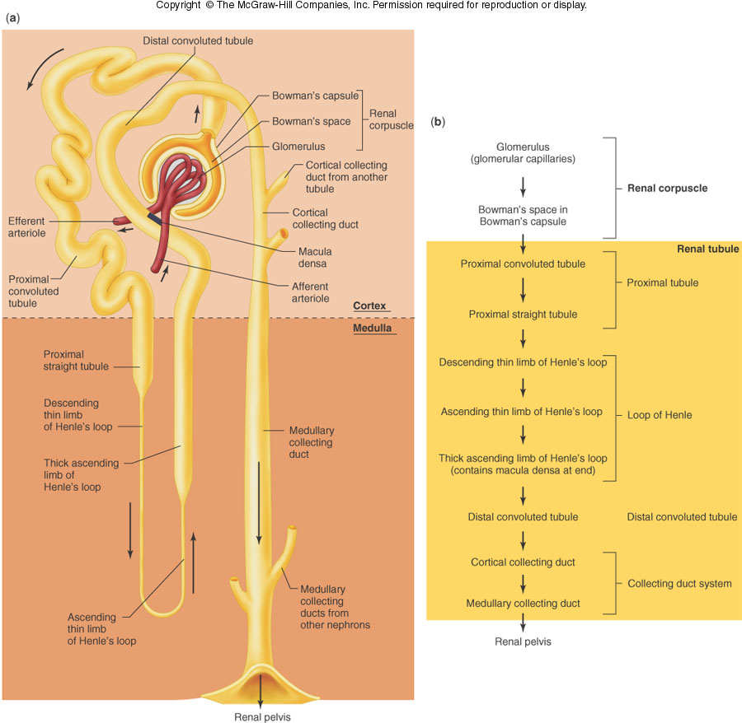
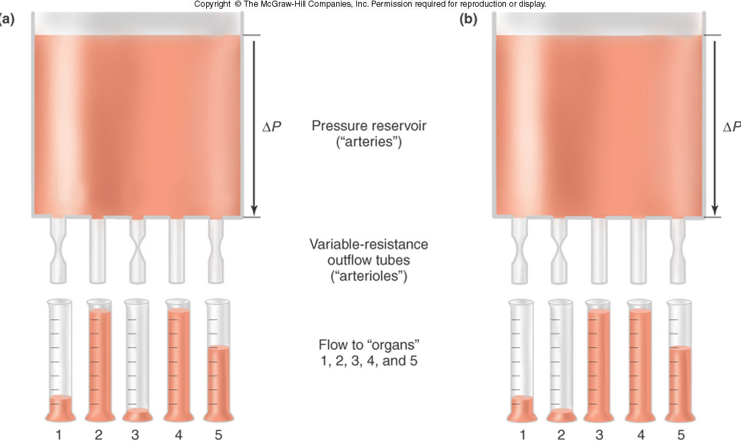
Redistribution of blood flow – sympathetic vasoconstriction is not uniform
Subject is pale and skin feels cold
Blood flow to skin
Blood flow to skeletal muscles
Blood flow to gut
Cerebral and cardiac blood flow unchanged
Blood flow to kidney
Angiotensinogen (liver)
Low renal artery pressure
renin
AI
ACE
Aldosterone (adrenal cortex)
AII
Vasoconstrictor
Thirst
Na retention

Slide 5
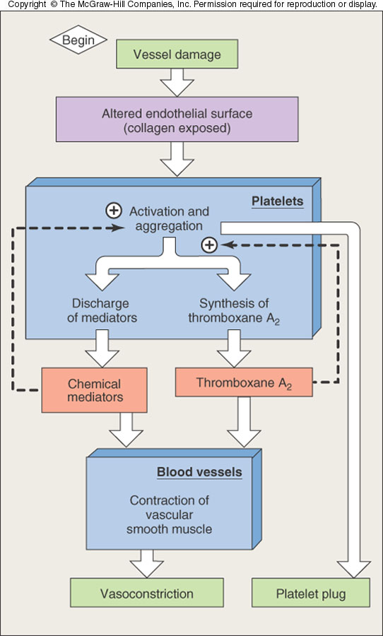
Low venous return
Left atrial pressure
Vessel damage
ADH secretion (post. pit)
Haemostatic mechanisms
Kidney tubule permeability to water
Preserve blood volume
Volume
replacement
H₂O reabsorption
Low urine output
Na retention

Slide 6
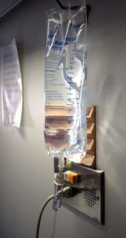
Volume Replacement
Crystalloid solutions
  Isotonic (0.9%) sodium chloride solution
  Ringer’s Lactate
Colloids (Haemacel, Gelofusin)
  ↑ plasma oncotic pressure
  Remain in intravascular space for hours
Blood products (if no response after infusion of 2 litres of crystalloid)
  Packed red blood cells
  Fresh Frozen Plasma (FFP)
  Whole blood crossmatched

Slide 7
Integration with other systems
Physiological challenge
renal response
CVS response
respiratory response
fluid, O₂ and CO₂ delivery and exchange
Preservation of the internal environment

Slide 8
Integration with other systems
Physiological challenge
renal response
CVS response
respiratory response
Integrated response
fluid, O₂ and CO₂ delivery and exchange
Preservation of the internal environment

Slide 9
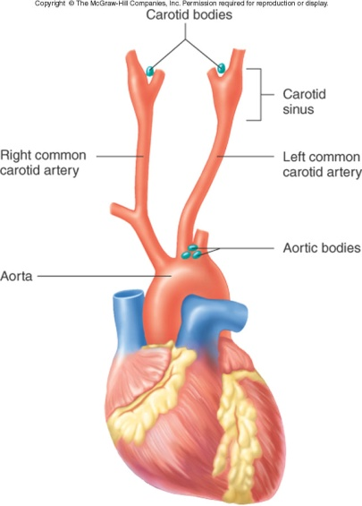
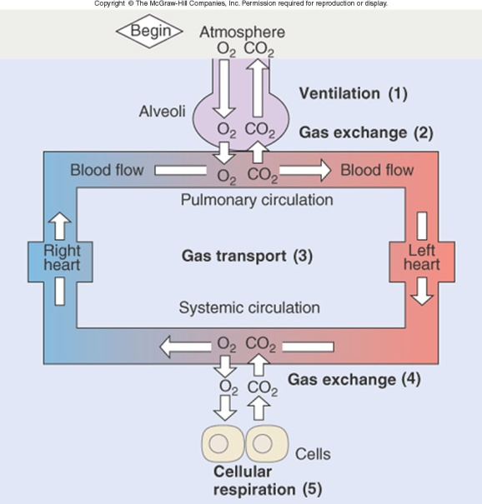
Respiratory system
Chemoreceptors are chemosensitive cells sensitive to oxygen lack, CO₂ excess, or H⁺ ion excess.
Chemoreceptors are located in carotid bodies near the carotid bifurcation and on the arch of the aorta.
Activation of chemosensitive receptors results in excitation of the vasomotor centre.
O₂
CO₂
chemoreceptors
vasomotor centre (VMC)
pH
sympathetic activity
blood pressure
Cardiovascular responses to respiratory needs

Slide 10
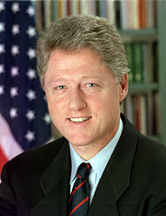
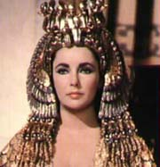

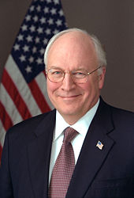


Hypertension
Atherosclerosis
Coronary heart disease
  Angina
  Myocardial Infarction
Thrombosis and embolism
Heart failure
All suffer(ed) from cardiovascular disease
It is not the strongest of species that survive, nor the most intelligent,
but the most adaptable
Charles Darwin

