Slide 1
Electrical properties of the heart
Dr Ken MacLeod
Cardiac Medicine, NHLI, Faculty of Medicine, Imperial College London, UK

Slide 2
Topics covered – learning objectives
How does a membrane potential form?
How is the ventricular action potential generated?
    Phase 0 through to Phase 4
The action potential in different parts of the heart
From cells to the whole heart
    conduction system
    Impulse propagation
ECG

Slide 3
The potassium hypothesis
-100
0
100
2 chambers separated by impermeable membrane
2 different concentrations of KCl added to each compartment (high conc. on one side & low conc. on the other)
Add measuring device
Chemical concentration gradient but since barrier is impermeable there is no potential difference between the chambers
0 mV
K
K
Cl
K
Cl
K
Cl
K
100mM
Cl
Cl
10mM
K
K
Cl
K
K
Cl
Cl
K
Cl
Cl
[KCl] gradient

Slide 4
The potassium hypothesis - 2
-100
0
100
Replace impermeable membrane with a semi-permeable one.
Make it permeable only to K
Cl ions are still separated by impermeable barrier so there is a concentration gradient for Cl ions but no movement of Cl from one chamber to another
0 mV
Cl
Cl
Cl
100mM
Cl
Cl
10mM
Cl
Cl
Cl
Cl
Cl
[Cl] gradient

Slide 5
The potassium hypothesis - 3
-100
0
100
K ions diffuse down their concentration gradient carrying positive charge with them
0 mV
-12 mV
K
K
K
K
K
K
K
K
K
-
K
+
[K] gradient
Electrical gradient

Slide 6
The potassium hypothesis - 4
-100
0
100
K ions diffuse down their concentration gradient carrying positive charge with them
Positive charge accumulates in the right hand compartment and an electrical gradient builds up
Electrical gradient opposes the movement of K
When the electrical gradient exactly balances the chemical gradient, equilibrium is achieved and there is no further net movement of ions
-12 mV
-58 mV
K
K
K
K
K
K
K
-
K
K
+
-
K
+
[K] gradient
Electrical gradient

Slide 7
The potassium hypothesis - 5
-100
0
100
At equilibrium, K ions more randomly back and forth
The driving force, the difference between the concentration and the electrical gradient, is zero at equilibrium
-12 mV
-58 mV
K
K
K
K
K
K
K
-
K
K
+
-
K
+
[K] gradient
Electrical gradient

Slide 8
The resting membrane potential
The membrane potential depends on the flow of K out of cells
We can predict what a potential will be across a semi-permeable membrane using the Nernst equation
If the membrane is only permeable to K at rest (diastole) then the potential across it will equal the K equilibrium potential, E_{K}
Equilibrium potential is calculated by solving the Nernst equation for K
K concentration maintained by Na/K ATPase
[K⁺]_{o} = 5 mM
[K⁺]_{i} = 120 mM
E_{K} = -80 mV

Slide 9
Changing the permeability of the membrane to Na
The membrane potential will change depending on the relative permeabilities of the membrane to various ions
We can predict what a potential will be across a semi-permeable membrane when the membrane is permeable to Na also using the Nernst equation.
If the membrane is only permeable to Na (during the upstroke of the action potential) then the potential across it will equal the Na equilibrium potential, E_{Na}
[Na⁺]_{o} = 140 mM
[Na⁺]_{i} = 10 mM
E_{Na}= +66 mV

Slide 10
Resting membrane potential – contd.
In reality membrane potential better described by Goldman-Hodgkin-Katz equation
Takes into account relative permeabilities of ions

Slide 11
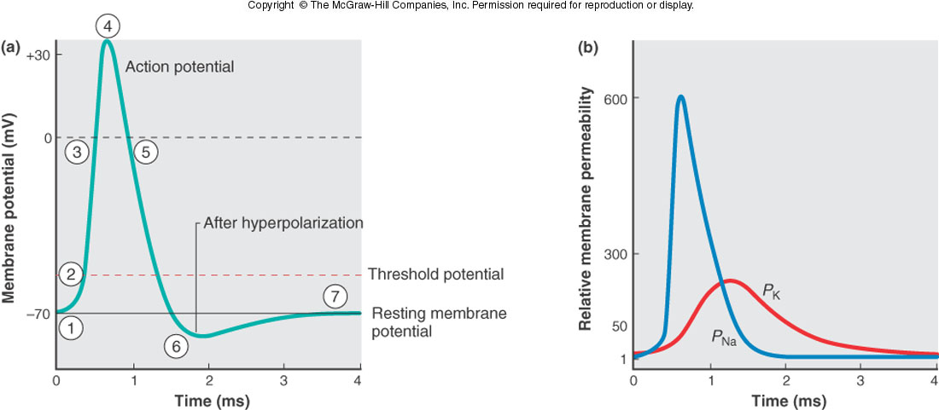
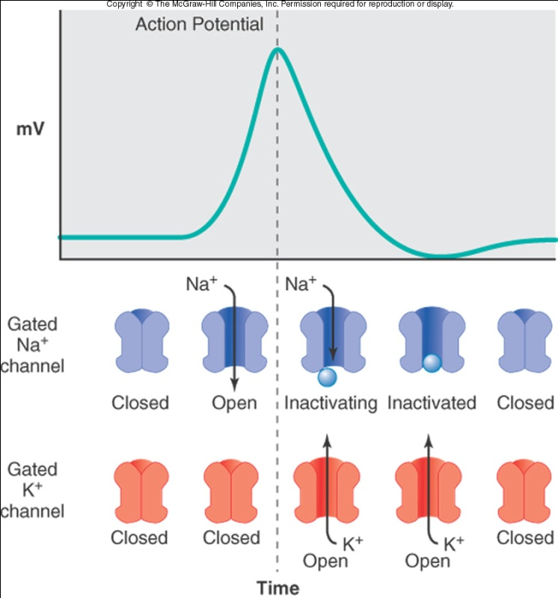
Nerve action potential - reminder

Slide 12
Cardiac action potential
Resting membrane potential
Absolute refractory period
Relative refractory period

Slide 13
Cardiac action potential
Cardiac action potential is long (several hundred milliseconds) e.g. compared with nerve
Duration of action potential controls the duration of contraction of the heart
Long, slow contraction is required to produce an effective pump
At rest membrane potential determined by K
Large P_{K} stabilizes membrane potential reducing risk of arrhythmias by requiring a large stimulus to excite the cells
Absolute refractory period = time during which no action potential can be initiated regardless of stimulus intensity
Relative refractory period = period after ARP where an AP can be elicited but only with stimulus strength larger than normal.
Full recovery time = the time at which a normal AP can be elicited with normal stimulus

Slide 14
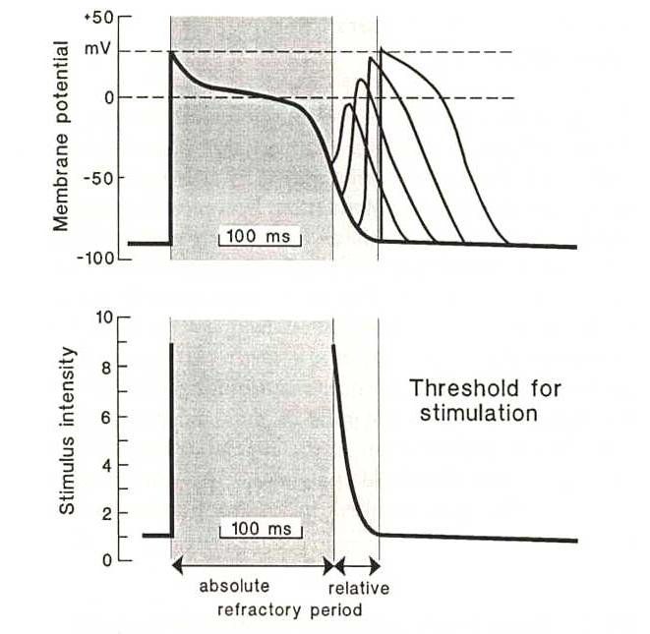
Refractory period
Occurs as a result of Na channel inactivation. Na channels recover from inactivation when the membrane is repolarized

Slide 15
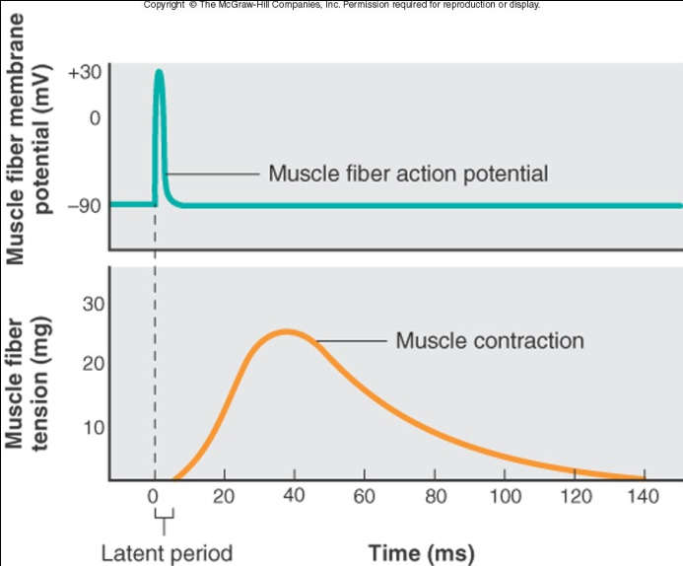
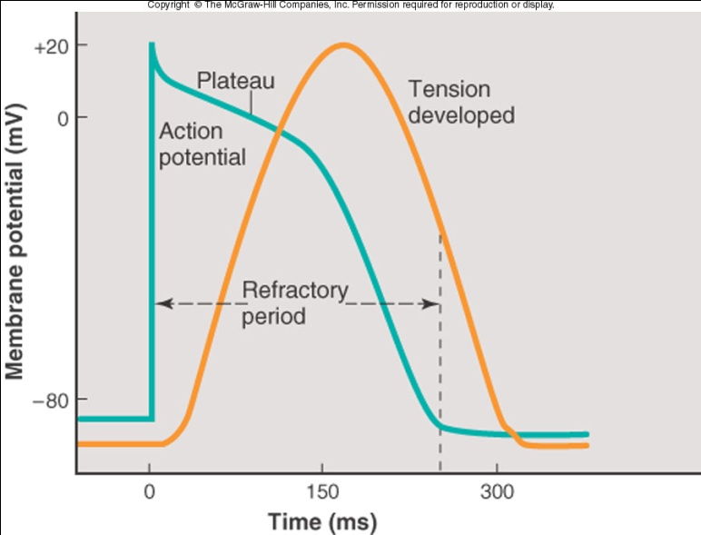
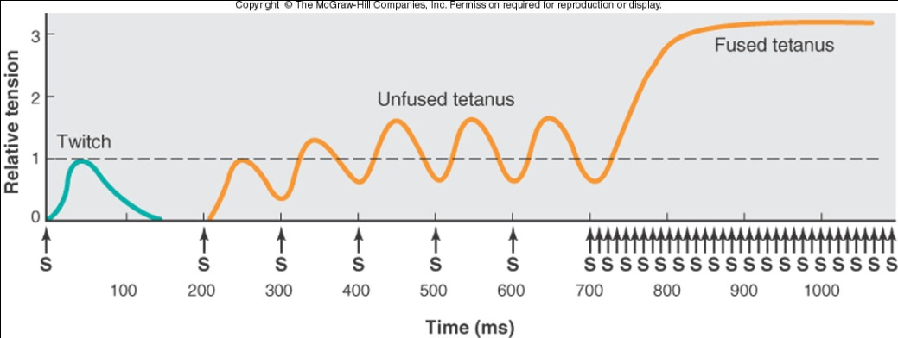
Muscle excitation and tetanus
Skeletal muscle
Cardiac muscle
In cardiac muscle it is not possible to re-excite the muscle until the process of contraction is well underway hence cardiac muscle cannot be tetanized.
In skeletal muscle repolarization occurs very early in the contraction phase making re-stimulation and summation of contraction possible.

Slide 16
The electrical properties of the heart are intrinsic (ie inherent to the heart itself)
Independent generation and propagation of electrical activity
Specialised conduction system
The heart can beat independently even after being separated from its nerve supply
The extrinsic nerve supply coming from the Autonomic Nervous System serves to modify and control the intrinsic beating established by the heart

Slide 17
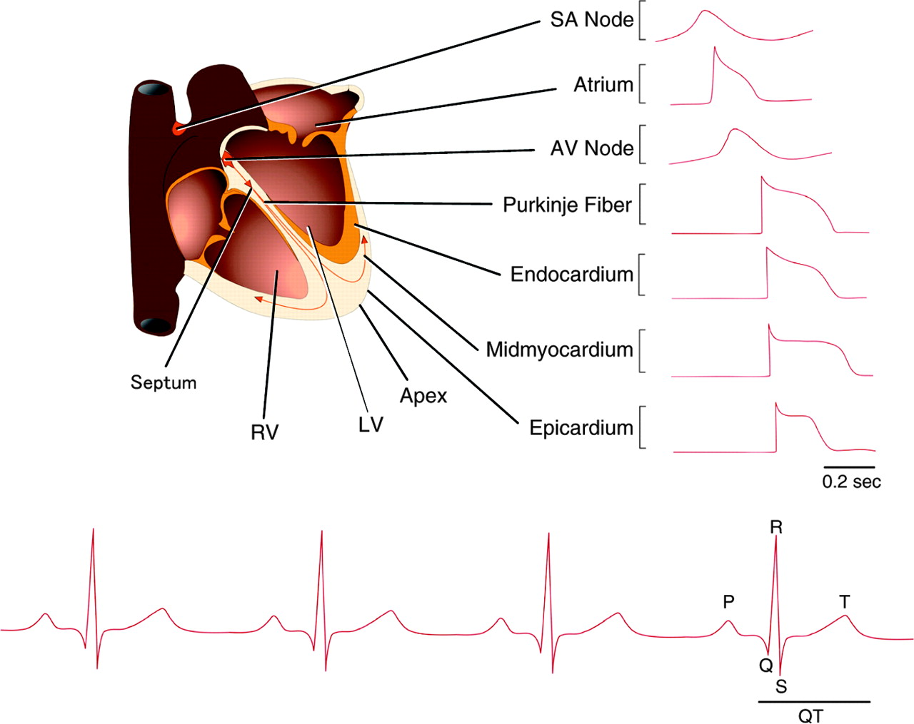
Action potential profiles
Different parts of the heart have different action potential shapes
Due to different ionic currents flowing
Different degrees of expression of ionic channels

Slide 18
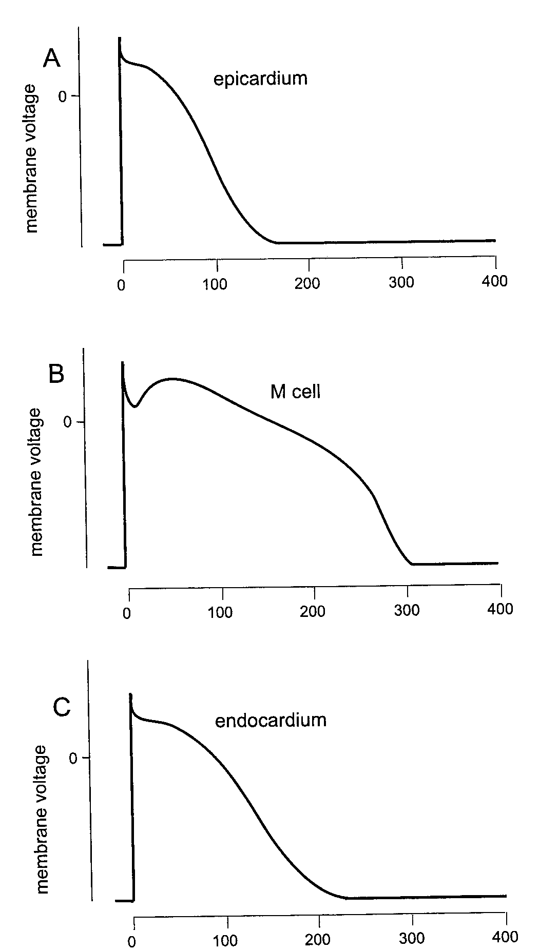
Action potentials through myocardial wall
outer wall
More channels expressed that give rise to I_{to} in epi- vs. endocardium
Channels that produce I_{K} are expressed about half as much in midmyocardium compared with epi- and endocardium
inner wall

Slide 19
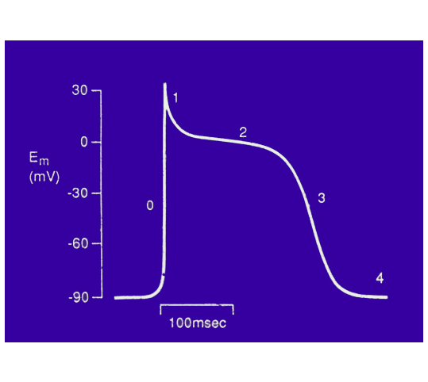
Phases of the action potential
Phase 0 = upstroke
Phase 1 = early repolarisation
Phase 2 = plateau
Phase 3 = repolarization
Phase 4 = resting membrane potential (diastole)

Slide 20
Phase 2 – Ca influx during early plateau
Ca influx required to trigger Ca release from intracellular stores
Required for contraction
Activates rapidly (within a few milliseconds) but upstroke dependent more on I_{Na}
Inhibited by dihydropyridine Ca channel antagonists
  Nifedipine
  Nitrendipine
  Nisoldipine

Slide 21
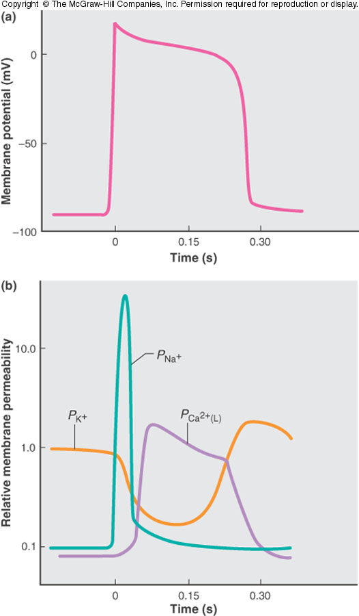
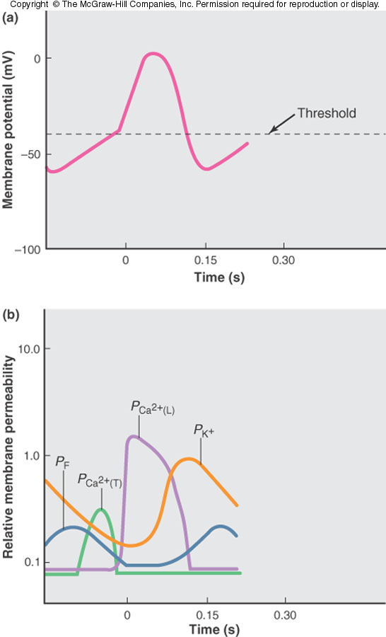
SA node
Ventricular cell
SA node cell
Most channels exist in SA node – to some extent
Exception is I_{K1} – no I_{K1} in SA node
Very little Na influx – upstroke produced by Ca influx
Also T-type Ca channels that activate at more negative potentials than L-type
I_{to} is very small
Pacemaker current (I_{f}) present

Slide 22
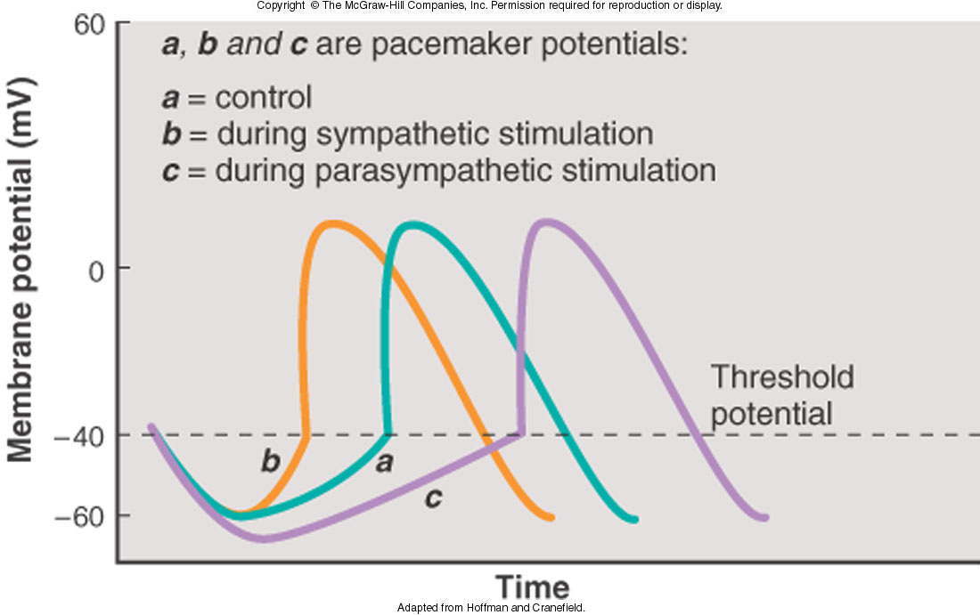
Pacemaker and heart rate

Slide 23
The conduction system
There are four basic components to the heart's conduction system
(1) sinoatrial node (SA node)
(2) inter-nodal fibre bundles
(3) atrioventricular node (AV node)
(4) ventricular bundles (bundle branches and Purkinje fibres)

Slide 24
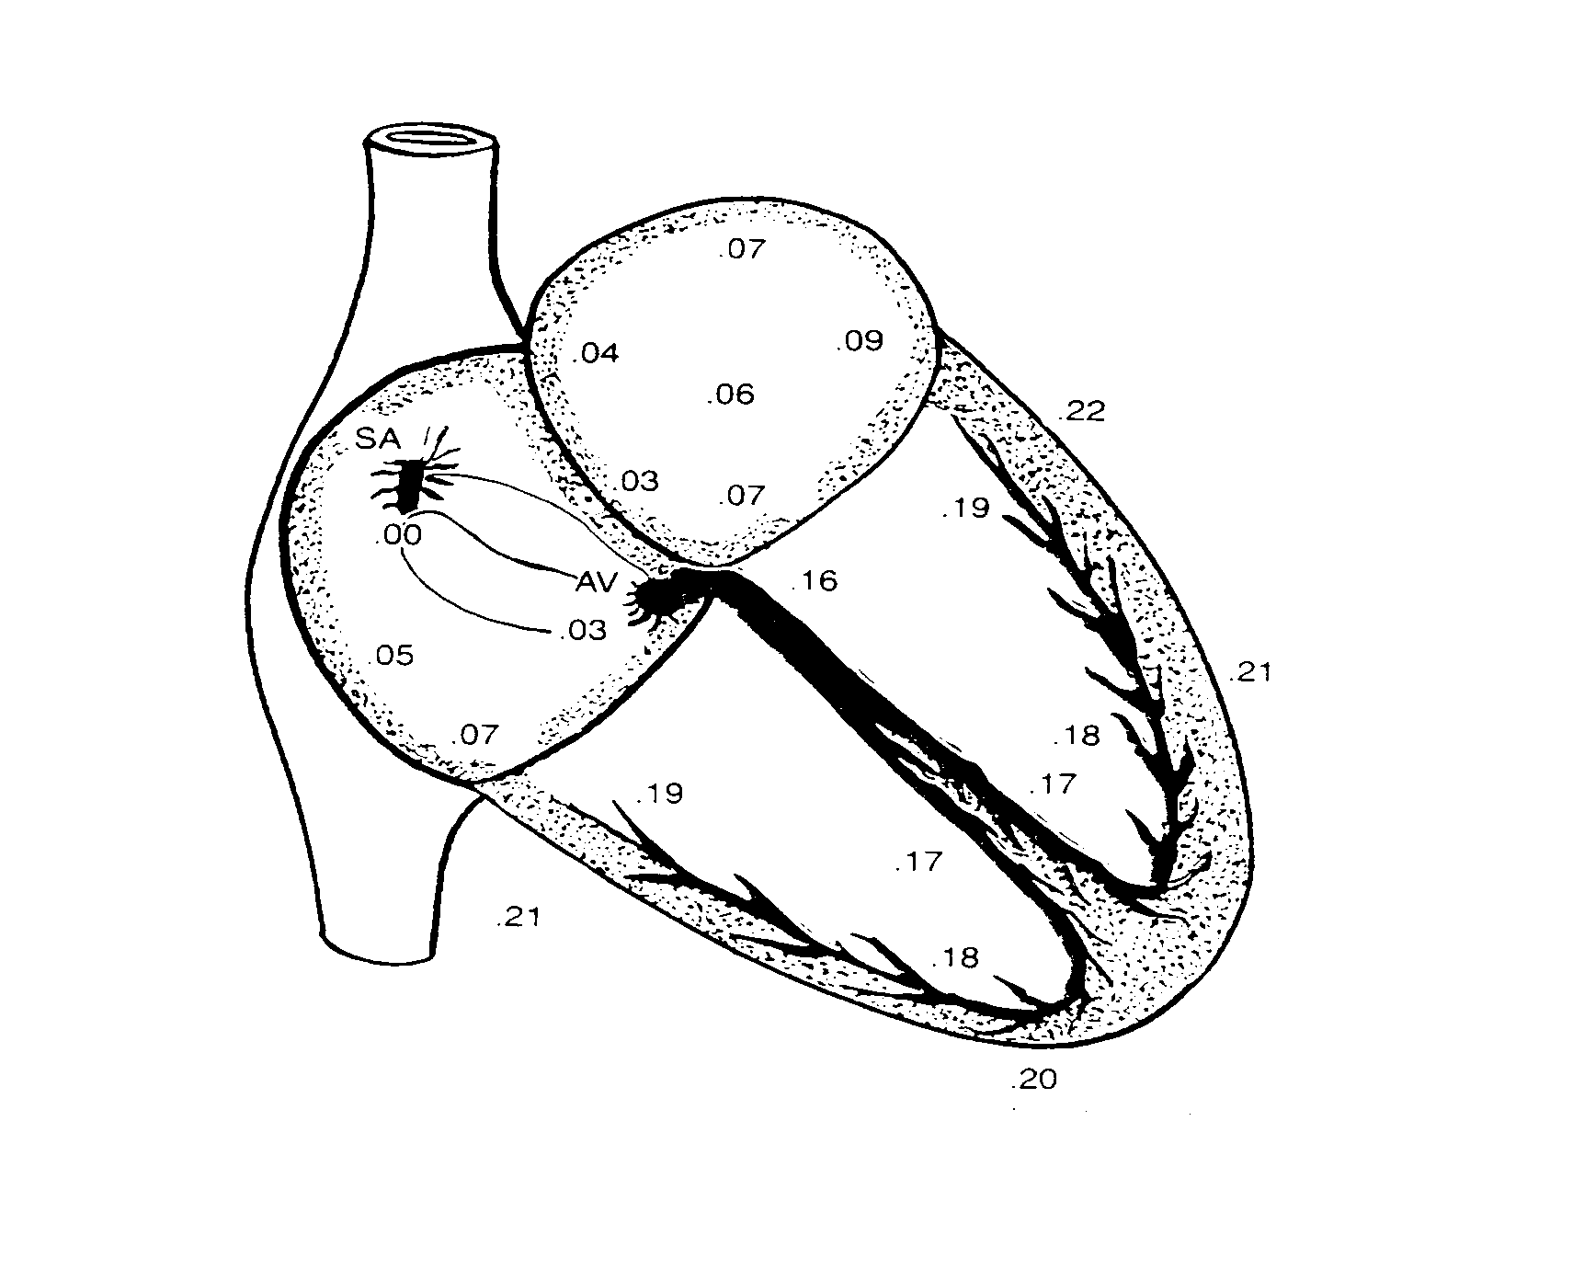
SA node
A small mass of specialised cardiac muscle situated in the superior aspect of the right atrium.
Located in the anterolateral margin between the orifice of the superior vena cava and the atrium.
Automatic self-excitation: it initiates each beat of the heart. Therefore, the SA node is the pacemaker of the heart.
Since the fibres of the SA node fuse with the surrounding atrial muscle fibres, the action potential generated in the nodal tissue spreads throughout both atria at a rate of approximately 0.3 meter per second and produces atrial contraction.
Left Atrium
Sino-Atrial Node
Inter-nodal fibre bundles and AV node:
Inter nodal fibre bundles: interspersed among the atrial muscle fibres; they conduct the action potential to the atrioventricular (AV) node with a greater velocity (approximately 1.0 meter per second) than ordinary atrial muscle.
AV node: located at the border of the right atrium near the lower part of the interatrial septum. Electrically connects the conduction system between atrial and ventricular chambers.
Produces short delay (approximately 0.1 second) in transmission of the impulse to the ventricles (important because it permits the atria to complete their contraction and empty their blood into the ventricles before the ventricles contract).
The delay occurs within the fibres of the AV node itself as well as in special junctional fibres that connect the node with ordinary atrial fibres.
Bundle of His and Bundle branches:
As the AV bundle leaves the AV node, it descends in the interventricular septum for a short distance (Bundle of His) and then divides into two large branches, the right and left bundle branches.
These comprise of specialised muscle fibres called Purkinje fibres which terminate in a finger-like fashion on the working myocardial cells.
They are very large; conduct the action potential at about six times the velocity of ordinary cardiac muscle (i.e., 1.5 to 4.0 meters per second).
Atrio-Ventricular Node
Purkinje fibres:
The terminal Purkinje fibres extend beneath the endocardium and penetrate approximately one-third of the distance into the myocardium.
They end on ordinary cardiac muscle within the ventricles, and the impulse proceeds through the ventricular muscle at about 0.3 to 0.5 meters per second.
The excitation of the ventricles proceeds upward from the apex of the heart toward its base.
Left Ventricle
Right
Atrium
Bundle of His
Bundle Branches
Right Ventricle
Purkinje Fibres

Slide 25
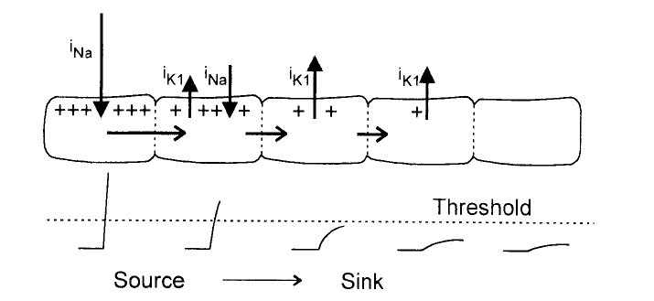
Impulse propagation
The propagation of the action potential is due to a combination of passive spread of current and the existence of a threshold.
Coupling resistance of the cells (gap junction resistance) determines extent of spread of current

Slide 26
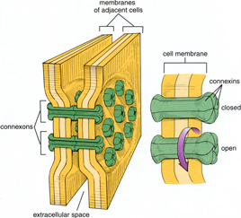
Conduction
Intercellular communication and impulse conduction from one cell to the next relies on gap junctions

Slide 27

Atrial Depolarisation

Slide 28

Ventricular Depolarisation

Slide 29
The basis of the ECG
The effects of a wave of depolarisation are detected as the potential difference between two electrodes.
When a wave of depolarisation is moving TOWARDS the positive electrode it causes an UPWARD deflection.
When it is moving AWAY from the positive electrode it causes a DOWNWARD deflection.
When a wave of repolarising current is moving AWAY the positive electrode it causes an UPWARD deflection.

Slide 30
Depolarising current on the ECG
Depolarisation
+
Depolarisation
+

Slide 31
Repolarising current on the ECG
Repolarising current is of opposite polarity to depolarising current
Repolarisation
+
Repolarisation
+

Slide 32
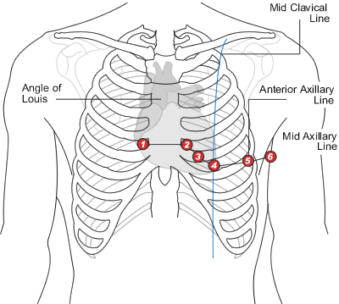
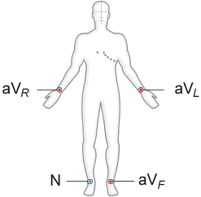
ECG leads
If we know the position of an ECG electrode relative to the heart we can predict the waveform that it should record assuming a normal process of excitation.
Limb lead configuration
Chest lead configuration
University of Nottingham
University of Nottingham

Slide 33
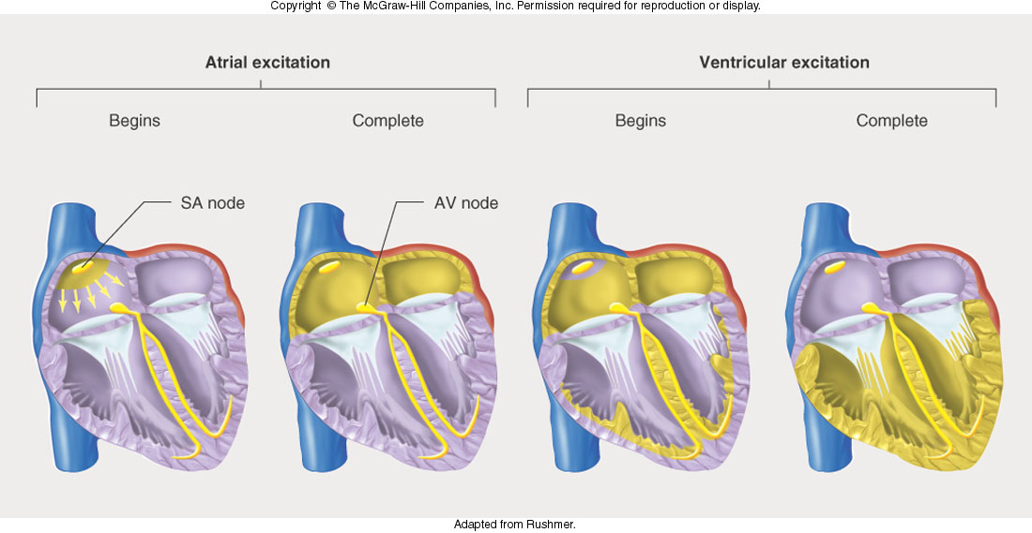
Excitation sequence
Electrode

Slide 34
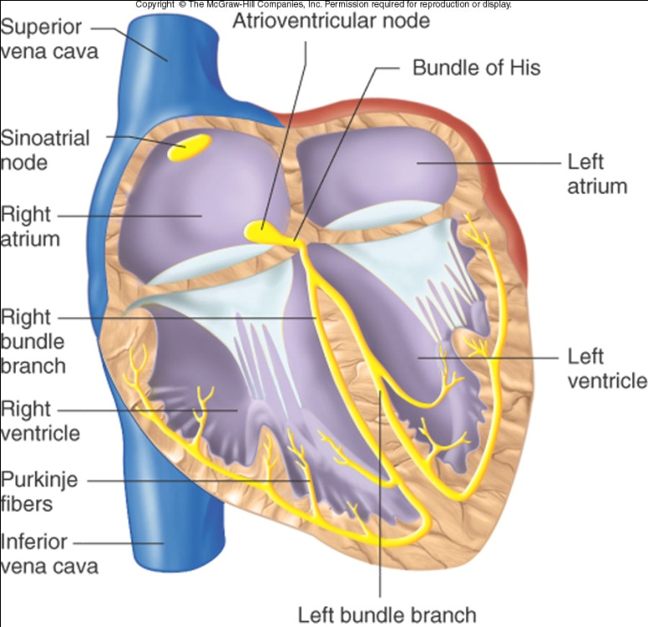
Repolarisation
Remember: repolarising current is of opposite polarity to depolarising current
Electrode

Slide 35
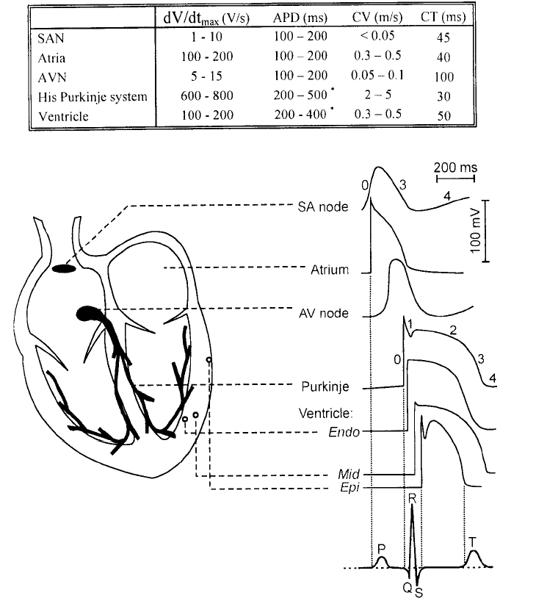
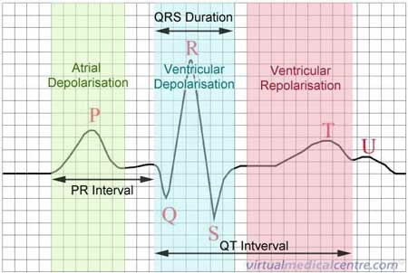
The Electrocardiogram (ECG)

