Slide 1
Atherosclerosis
Basics and roles of inflammatory cells
Dr Joseph J. Boyle
Vascular Sciences, NHLI & Dept of Histopathology
Imperial College, Hammersmith Hospital

Slide 2
The roles of lipids, macrophages and vascular smooth muscle cells in the pathology in atherosclerosis
After this lecture you should understand:
That atherosclerosis is a disease of global importance
That atherosclerosis is a primarily chronic inflammatory disease
How lipoproteins that are deposited in the arterial wall stimulate macrophage functions
The contrasting roles of macrophages and VSMCs in plaque instability and clinical consequences
How vascular smooth muscle cells (VSMC) protect plaque integrity
How macrophages promote plaque rupture

Slide 3
1990
World disease burden
2020
Lower respiratory infections
1
1
Ischaemic heart disease
Diarrhoeal diseases
2
2
Unipolar major depression
Perinatal conditions
3
3
Road traffic accidents
Unipolar major depression
4
4
Cerebrovascular disease
Ischaemic heart disease
5
5
COPD
Cerebrovascular disease
6
6
Lower respiratory infections
Tuberculosis
7
7
Tuberculosis
Measles
8
8
War
Road traffic accidents
9
9
Diarrhoeal diseases
COPD
10
10
HIV
Adapted from Lopez and Murray (1998) Nature Med 4: 1241

Slide 4
Acute
Medicine
(Heart attack
Stroke)
Metabolic medicine
(lipids)
Neurology
(cerebrovascular
disease)
Atherosclerosis
Cardiology
(coronary disease)
Endocrinology
(diabetes)
Cardiac
Surgery
(revascularization)
Vascular
Surgery
(revascularization)

Slide 5
Hypertension
x3
X4.5
x9
x16
X1.6
x6
x4
Smoking
High cholesterol

Slide 6
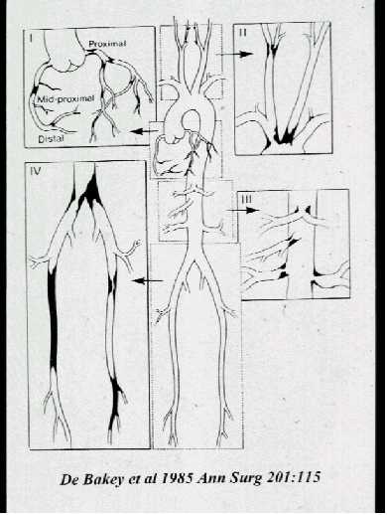
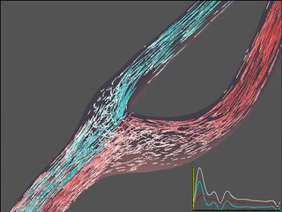
If risk factors are general, why is atherosclerosis focal ?
Courtesy of David Steinman
University of Western Ontario

Slide 7
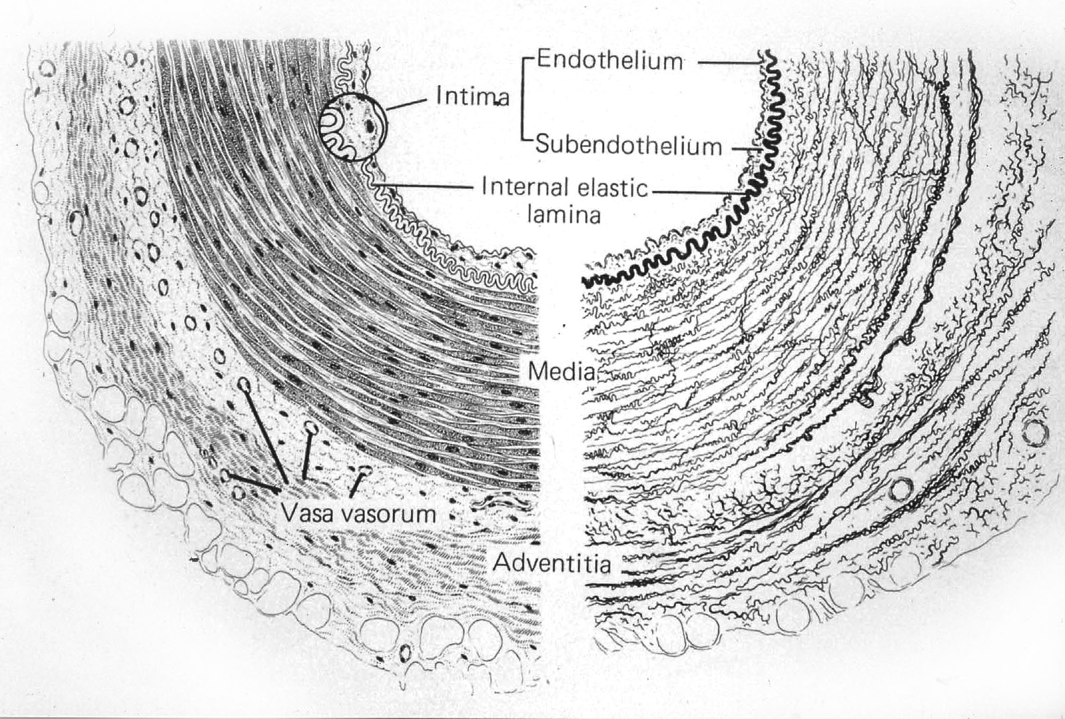
Low density lipoproteins (LDL) deposit in the subintimal space and binds to matrix proteoglycans

Slide 8
Progression of atherosclerosis
Type VI lesion

Slide 9
Main cell types and their roles
Vascular endothelial cells
  Barrier function (eg to lipoproteins)
  Leukocyte recruitment
Platelets
  Thrombus generation
  Cytokine and growth factor release
Monocyte-macrophages
  Foam cell formation
  Cytokine and growth factor release
  Major source of free radicals
  Metalloproteinases
Vascular smooth muscle cells
  Migration and proliferation
  Collagen synthesis
  Remodelling and fibrous cap formation
T lymphocytes
  Macrophage activation

Slide 10
Natural history of atherosclerosis
Complications
(eg stenosis, plaque rupture)
Intermediate lesions
Advanced lesions
Normal
neonatal
40 yrs
50 yrs
> 60 yrs
window of
clinical intervention
secondary prevention
catheter based interventions
revascularisation surgery
treatment of heart failure
window of opportunity
for primary prevention
life-style
risk factor management

Slide 11
Macrophages
White blood cells can injure host tissue if they are activated excessively or inappropriately
In atherosclerosis, the main inflammatory cells are macrophages
Macrophages are derived from blood monocytes
There are many different types of macrophages
Macrophage subtypes are regulated by combinations of transcription factors binding to regulatory sequences on DNA
We do not yet understand the regulation
Two main classes - resident or inflammatory macrophages
Inflammatory macrophages adapted to kill microorganisms (germs)
Resident macrophages – normally homeostatic
  suppressed inflammatory activity
  Alveolar resident macrophages (surfactant lipid homeostasis)
  Osteoclasts (calcium and phosphate homeostasis)
  Spleen (iron homeostasis)

Slide 12
Lipoproteins
Low density lipoprotein (LDL)
  ‘bad’cholesterol
  synthesised in liver
  carries cholesterol from liver to rest of body including arteries
High density lipoprotein (HDL)
  ‘good cholesterol’
  carries cholesterol from ‘peripheral tissues’ including arteries back to liver (=“reverse cholesterol transport”)
Oxidised LDL(s), modified LDL(s)
  Due to action of free radicals on LDL (see later)
  Not one single substance
  families of highly inflammatory and toxic forms of LDL found in vessel walls.

Slide 13
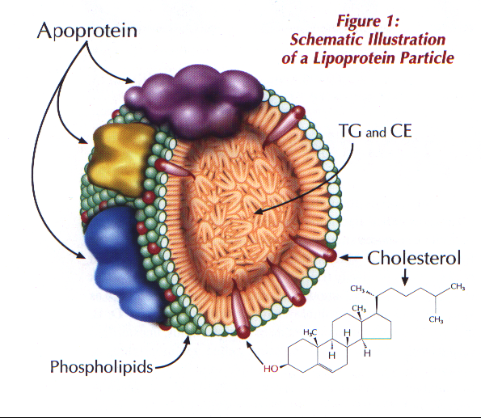
Low Density Lipoprotein
Docking molecule ‘molecular addresses for fat delivery’
Cargo – fat for fuel
Lipid monolayer - like cell membrane but on molecule thick

Slide 14
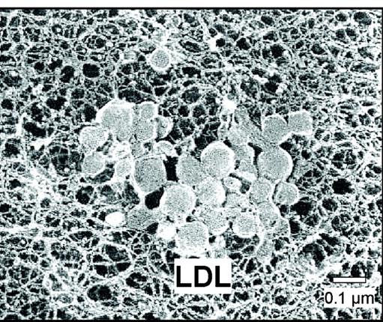
Subendothelial trapping of LDL
Low density lipoproteins (LDL) leak through the endothelial barrier by uncertain mechanisms
LDL is trapped by binding to sticky matrix carbohydrates (proteoglycans) in the sub-endothelial layer
Trapped LDL is susceptible to modification
Electron micrograph
LDL particles trapped in subendothelial meshwork
From: Tabas, I. et al. Circulation 2007;116:1832-1844

Slide 15
Modification of subendothelial trapped LDL
Best studied modification is oxidation
Chemically represents partial burning
LDL becomes oxidatively modified by free radicals
Oxidised LDL is phagocytosed by macrophages and stimulates chronic inflammation
Lipoproteins
uptake
mLDL
Chronic inflammation
mLDL
mLDL
mLDL
mLDL
mLDL
mLDL
Lipoprotein
oxidation
macrophage
foam cell

Slide 16
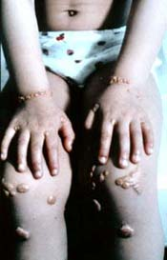
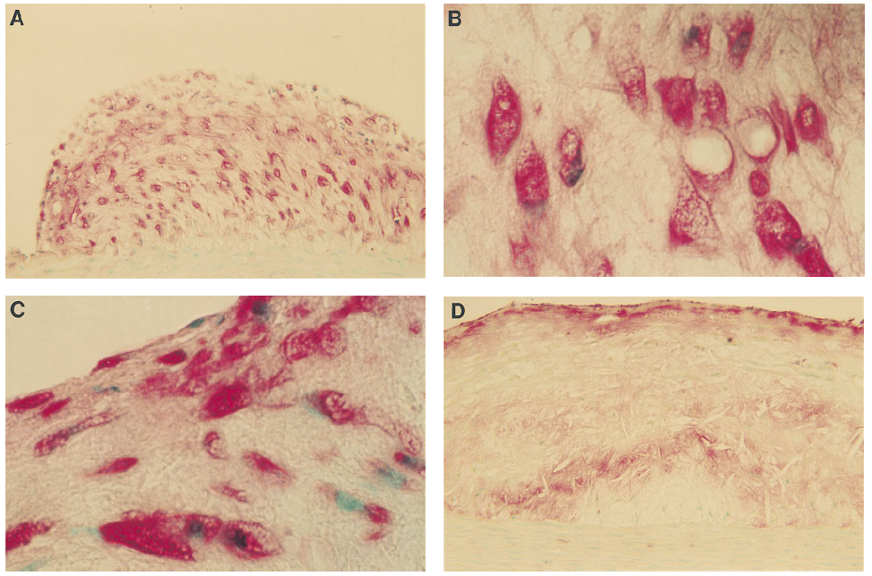
Familial hyperlipidemia (FH)
xanthoma
Autosomal recessive genetic disease
Massively elevated cholesterol (20mmol/L)
failure to clear LDL from blood
xanthomas and early atherosclerosis; if untreated fatal myocardial infarction before age 20
Foam cell

Slide 17
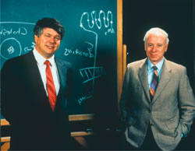
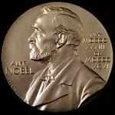
Brown & Goldstein
Brown
Goldstein
Nobel Prize for Medicine 1985
Hunted for gene for familial hypercholesterolaemia
Discovered LDL receptor (expression negatively regulated by intracellular cholesterol)
Cholesterol synthesis is also negatively regulated by cellular cholesterol
Led to the discovery of HMG-CoA reductase inhibitors (= “statins”) for lowering plasma cholesterol

Slide 18

Macrophages accumulate cholesterol
Brown
In LDLR-negative patients, macrophages accumulate cholesterol
Deduced a second LDL receptor - not under feedback control - in atherosclerotic lesions
Called the ‘scavenger receptor’ since it hoovers up chemically modified LDL (now known to be oxidised)
Now known that scavenger receptors are a family of pathogen receptors that ‘accidentally’ bind OxLDL
X
?
LDLR

Slide 19
Macrophage scavenger receptors
Macrophage scavenger receptor A
  CD204
  Binds to oxidised LDL
  Binds to Gram-positive bacteria like Staphylococci and Streptococci
  Binds to dead cells
Macrophage scavenger receptor B
  CD36
  Binds to oxidised LDL
  Binds to malaria parasites
  Binds to dead cells
Arterial Ox-LDL deposits
Activation of ‘bug-detector’ pathways
Safe clearance
reverse cholesterol transport
Inflammation
Homeostasis

Slide 20
Oxidised LDL in an atherosclerotic plaque
Subendothelial zone
Lipid necrotic core
Macrophage foam cell

Slide 21
Macrophages within plaques
Generate free radicals that further oxidise lipoproteins
Phagocytose/scavenge modified lipoproteins, and become foam cells
Become activated by modified lipoproteins/free intracellular cholesterol to express/secrete
  Cytokine mediators (eg TNFα, IL-1, MCP-1) that recruit more monocytes
  Chemoattractants and growth factors for VSMC
  Proteinases that degrade tissue (eg the fibrous cap)
  Tissue factor that stimulates coagulation upon contact with blood
Die by apoptosis – contributing to the lipid-rich core of the plaque

Slide 22
Macrophages have oxidative enzymes that can modify native LDL
NADPH Oxidase
  superoxide O₂⁻ ·
Myeloperoxidase
  HOCl hypochlorous acid (bleach) from ROS + Cl⁻
  HONOO Peroxynitrite

Slide 23
Macrophages within plaques
Generate free radicals that further oxidise lipoproteins
Phagocytose/scavenge modified lipoproteins, and become foam cells
Become activated by modified lipoproteins/free intracellular cholesterol to express/secrete
  Cytokine mediators (eg TNFα, IL-1, MCP-1) that recruit more monocytes
  Chemoattractants and growth factors for VSMC
  Proteinases that degrade tissue (eg the fibrous cap)
  Tissue factor that stimulates coagulation upon contact with blood
Die by apoptosis – contributing to the lipid-rich core of the plaque

Slide 24
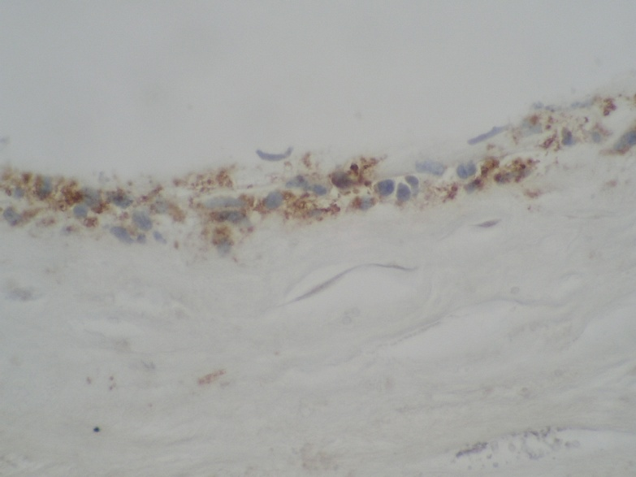
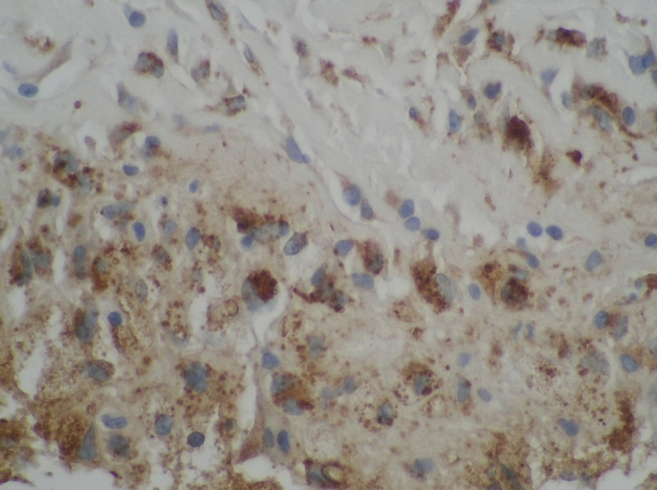
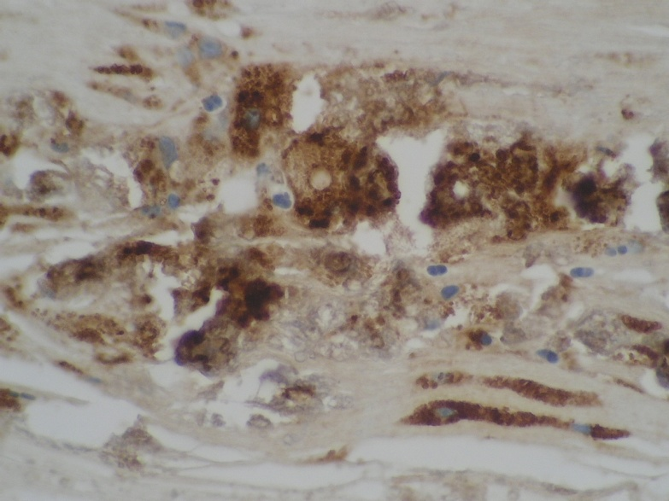
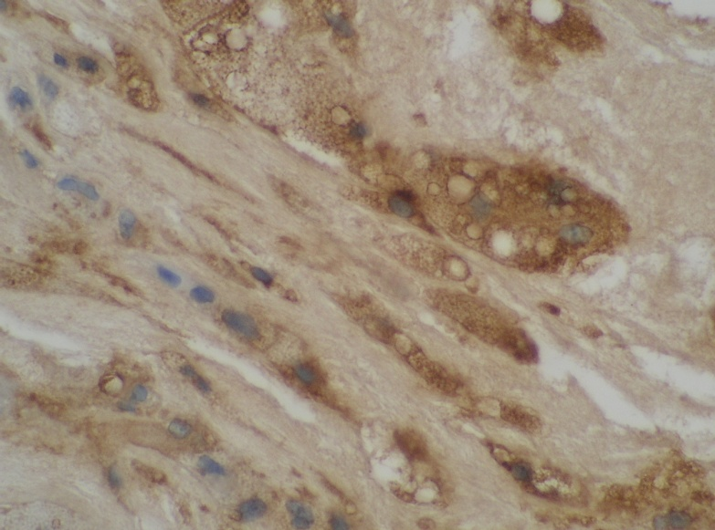
Macrophages accumulate modified LDL to become enlarged foam cells
100μm
100μm
Zone of sick and dying foam cells
Foam cell debris
100μm
100μm
All panels: same magnification, stained with brown-dyed antibody to CD68 – a macrophage lysosome protein

Slide 25
Macrophages within plaques
Generate the free radicals that modify (eg oxidise) lipoproteins
Phagocytose/scavenge modified lipoproteins, and become foam cells
Become activated by modified lipoproteins/free intracellular cholesterol/oxidised cholesterol forms to express
  Cytokine mediators (eg IL-1, MCP-1) that recruit more monocytes
  Chemoattractants and growth factors for VSMC
  Proteinases that degrade tissue (eg the fibrous cap)
  Tissue factor that stimulates coagulation upon contact with blood
Die by apoptosis – contributing to the lipid-rich core of the plaque

Slide 26
Plaque macrophages express inflammatory factors involved in monocyte recruitment
Cytokines – protein immune hormones that activate endothelial cell adhesion molecules
  Interleukin-1 upregulates vascular cell adhesion molecule 1 VCAM-1
  VCAM-1 mediates tight monocyte binding
  Atherosclerosis is reduced in mice without IL-1 or VCAM-1
Chemokines - small proteins chemoattractant to monocytes
  Monocyte chemotactic protein-1 (MCP-1)
  MCP-1 binds to a monocyte G-protein coupled receptor CCR2
  Atherosclerosis is reduced in MCP-1 or CCR2 deficient mice
Positive feedback loop / vicious cycle leading to self-perpetuating inflammation

Slide 27
Macrophages within plaques
Generate the free radicals that further oxidise lipoproteins
Phagocytose/scavenge modified lipoproteins, and become foam cells
Become activated by modified lipoproteins/free intracellular cholesterol to express/secrete
  Chemokine and cytokine mediators (eg MCP-1) that recruit more monocytes
  Chemoattractants and growth factors for VSMC
  Proteinases that degrade tissue (eg the fibrous cap)
  Tissue factor that stimulates coagulation upon contact with blood
Die by apoptosis – contributing to the lipid-rich core of the plaque

Slide 28
“Wound healing” role of the macrophage in atherosclerosis
Macrophages release complementary protein growth factors that recruit VSMC and stimulate them to proliferate and deposit extracellular matrix
Platelet derived growth factor
  Vascular smooth muscle cell chemotaxis
  Vascular smooth muscle cell survival
  Vascular smooth muscle cell division (mitosis)
Transforming growth factor beta
  Increased collagen synthesis
  Matrix deposition

Slide 29
Vascular smooth muscle cells
Normal medial
Atherosclerotic
Contractile filaments
↓ Matrix deposition genes
PDGF +
TGF-β
↑ Matrix deposition
↓ Contractile filaments
Synthetic
Contractile

Slide 30
Macrophages within plaques
Generate the free radicals that modify (eg oxidise) lipoproteins
Phagocytose/scavenge modified lipoproteins, and become foam cells
Become activated by modified lipoproteins/free intracellular cholesterol to express/secrete
  Cytokine mediators (eg TNFα, IL-1, MCP-1) that recruit more monocytes
  Chemoattractants and growth factors for VSMC
  Proteinases that degrade tissue (eg the fibrous cap)
  Tissue factor that stimulates coagulation upon contact with blood
Die by apoptosis – contributing to the lipid-rich core of the plaque

Slide 31
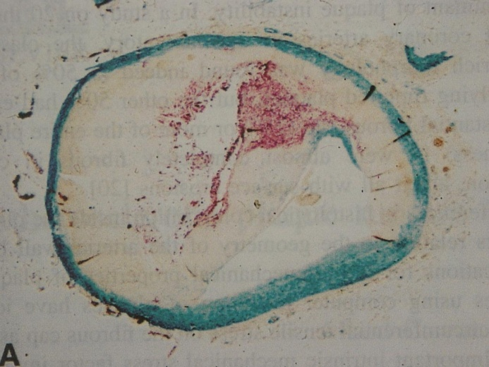
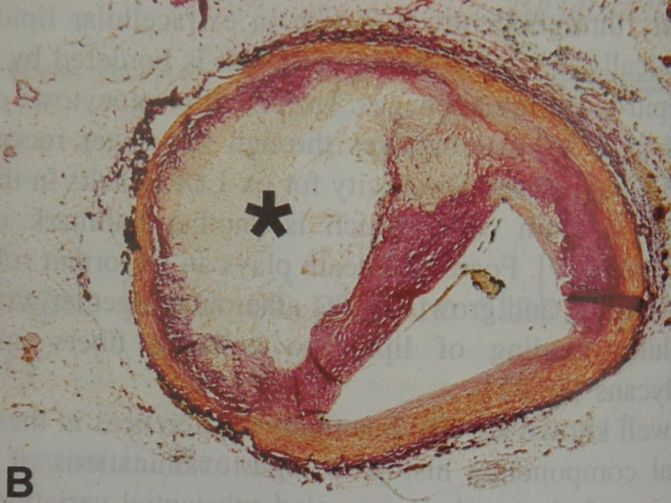
Macrophages Proteolyse Extracellular Matrix
Metalloproteinases (=MMPs)
  Family of ~28 homologous enzymes
  Activate each other by proteolysis
  Degrade collagen
  Catalytic mechanism based on Zn
Macrophages
Collagen
Van der Wal et al 1999 Cardiovascular Research 41:334

Slide 32
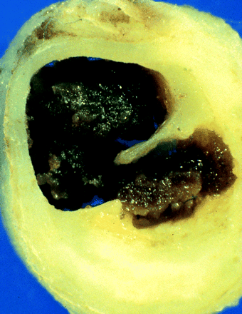
Effect of plaque erosion/rupture - occlusive thrombosis
Blood coagulation at the site of rupture may lead to an occlusive thrombus and cessation of blood flow
occlusive thrombus
Site of rupture

Slide 33
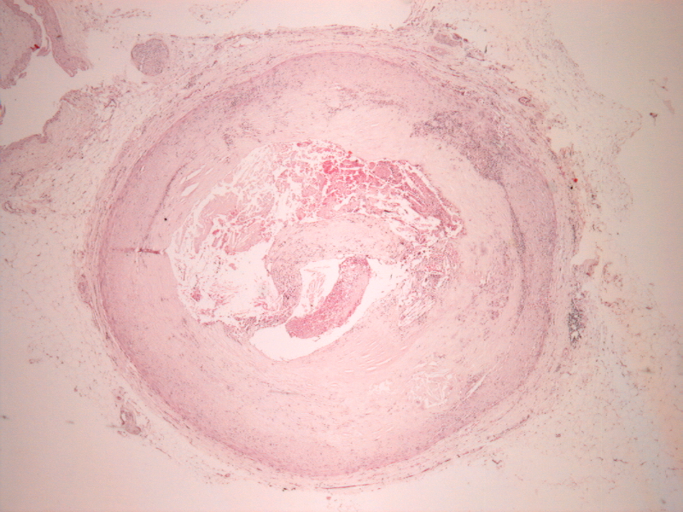
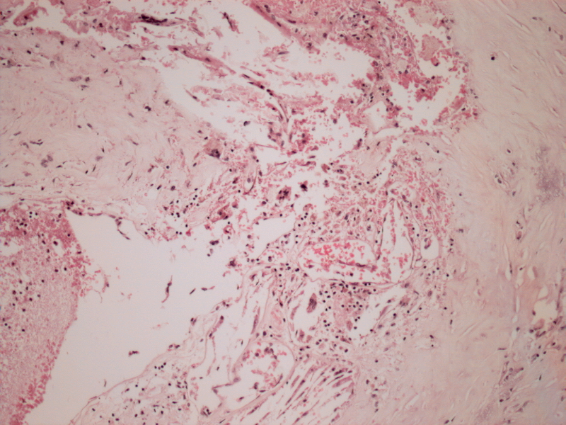
Pathology of a ruptured plaque
H&E – General stain
1mm
100μm
Inflammatory macrophage infiltrate
thrombus
J.Pathol. 1997

Slide 34
Characteristics of vulnerable and stable plaques
Large soft eccentric lipid-rich necrotic core
Thin fibrous cap
Reduced VSMC and collagen content
Increased VSMC apoptosis
Infiltrate of activated
macrophages expressing MMPs

Slide 35
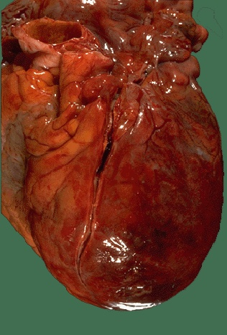
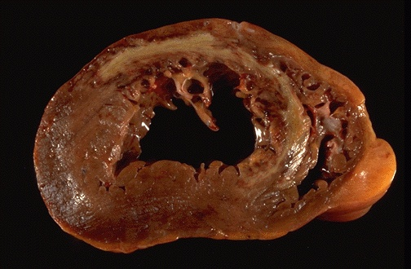
Coronary artery thrombosis and myocardial infarction
Thrombus occluding left anterior descending coronary artery
Anteroseptal myocardial infarction

Slide 36
Macrophages within plaques
Generate the free radicals that modify (eg oxidise) lipoproteins
Phagocytose/scavenge modified lipoproteins, and become foam cells
Become activated by modified lipoproteins/free intracellular cholesterol to express/secrete
  Cytokine mediators (eg TNFα, IL-1, MCP-1) that recruit more monocytes
  Chemoattractants and growth factors for VSMC
  Proteinases that degrade tissue (eg the fibrous cap)
  Tissue factor that stimulates coagulation upon contact with blood
Die by apoptosis – contributing to the lipid-rich core of the plaque

Slide 37
Plaque Macrophages express Tissue Factor
Crosstalk between inflammation and coagulation: healing wound need to clot blood and fight infection
Tissue factor (TF) is a 263 amino acid membrane protein expressed on activated macrophages
TF initiates the coagulation cascade
Macrophage TF is increased in atherosclerosis
Erosion/rupture of the fibrous cap leads to access of the plasma coagulation cascade to macrophage tissue factor with consequent thrombosis

Slide 38
Macrophages within plaques
Generate the free radicals that modify (eg oxidise) lipoproteins
Phagocytose/scavenge modified lipoproteins, and become foam cells
Become activated by modified lipoproteins/free intracellular cholesterol to express/secrete
  Cytokine mediators (eg TNFα, IL-1, MCP-1) that recruit more monocytes
  Chemoattractants and growth factors for VSMC
  Proteinases that degrade tissue (eg the fibrous cap)
  Tissue factor that stimulates coagulation upon contact with blood
Die by apoptosis – contributing to the lipid-rich core of the plaque

Slide 39
Macrophage apoptosis
OxLDL derived metabolites are toxic eg 7-keto-cholesterol
Macrophage foam cells have protective systems that maintain survival in face of toxic lipid loading
Once overwhelmed, macrophages die via apoptosis
Releases macrophage tissue factor and toxic lipids into the ‘central death zone’ called lipid necrotic core
Thrombogenic and toxic material accumulates, walled off, until plaque rupture causes it to meet blood

Slide 40
Diagrammatic summary - macrophages in atherosclerosis
Smoking
Hypertension
Diabetes
Hyperlipidaemia
Location – disturbed flow
Lumen
Collagen
LDL
OxLDL
Cytokines
Chemokines
Growth factors
Wall
ROS
MMPs
Scavenger Receptors
Death – release and accumulation of Tissue Factor and toxic oxidised-lipids
Reverse cholesterol transport

Slide 41
Summary
Macrophages are the major inflammatory cell type in atherosclerosis
Macrophages have protective functions in the plaque
  Clearing debris (modified lipoproteins, dead cells)
  Stimulating “wound healing” response involving VSMCs
..but also have deleterious functions
  Release of free radicals that modify LDL
  Recruitment of further monocytes via cytokines and chemokines
  Expression of MMPs that may destabilise the fibrous cap
  Expression of tissue factor that can stimulate thrombosis

Slide 42
Atherosclerosis
That atherosclerosis is a disease of global importance
That atherosclerosis is a primarily chronic inflammatory disease
How lipoproteins that are deposited in the arterial wall stimulate macrophage functions
The contrasting roles of macrophages and VSMCs in plaque instability
How vascular smooth muscle cells (VSMC) protect plaque integrity
How macrophages promote plaque rupture

