Slide 1
Understanding the ECG
Dr Pradeep Luther
p.luther@imperial.ac.uk
90

Slide 2
Aims of this Lecture
To understand how the 12-lead ECG is recorded in man.
To understand the term Mean Frontal Plane Axis and how it is related to the hexagonal reference system.
To appreciate why the ECG waveform varies between leads and between individuals.

Slide 3
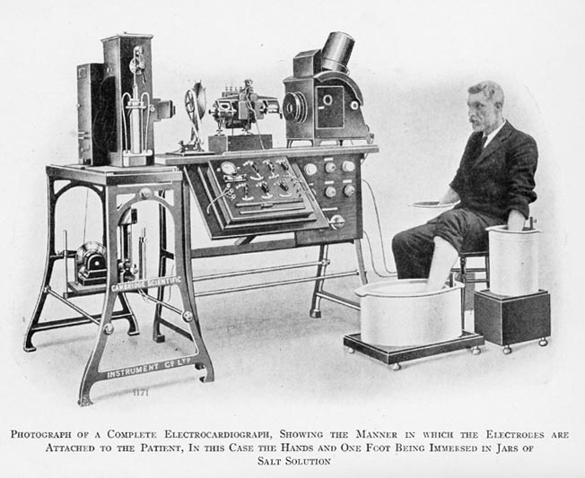
Historical note on ECG
Willem Einthoven made the major contributions on the use of ECG as we know it today. He invented the highly sensitive string galvanometer. This was connected to the limbs of a patient via electrodes in buckets of saline solution in which patients put their limbs. Einthoven was a physicist; he collaborated with English physician Thomas Lewis to test and develop the technique. He won the Noble Prize in 1924. The compact machines of today contrast with the 600 lb original machines which required 5 operators.

Slide 4
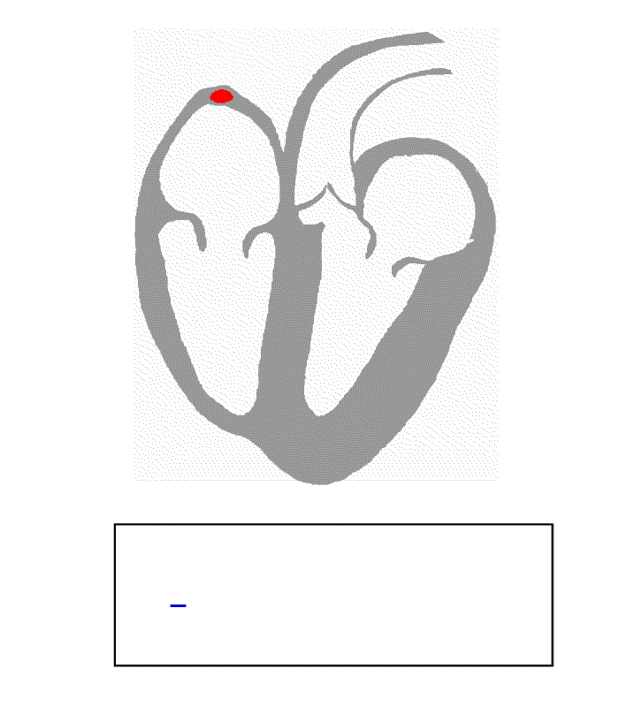
Spatial and temporal relationship
of electrical activity in the heart
The signal that we see at any time in the ECG is the vector sum of all the action potentials in the heart. This is not so complicated as only particular zones of the heart are active at any one time and in these regions, the action potentials are synchronized and easily summable. The ECG value at any instant therefore refers to a particular part of the heart.

Slide 5
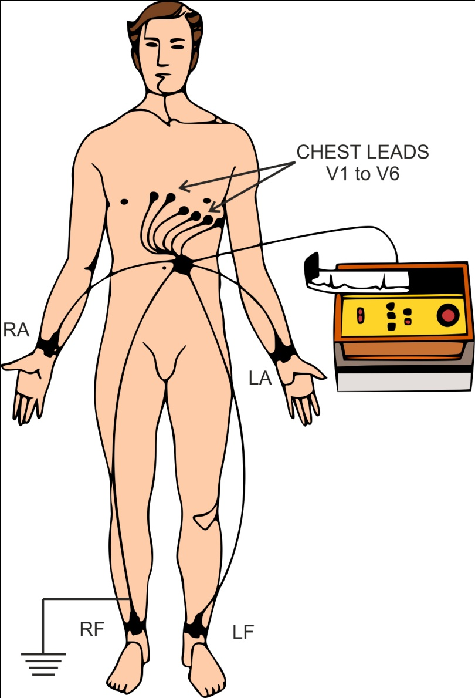
Attachment of electrodes for 12-lead ECG
Source of confusion:
12-lead ECG but only 10 wires/electrodes. Lead does not refer to the physical wire but to a “picture” of the heart.
The right foot is always used as a zero volt reference point.

Slide 6
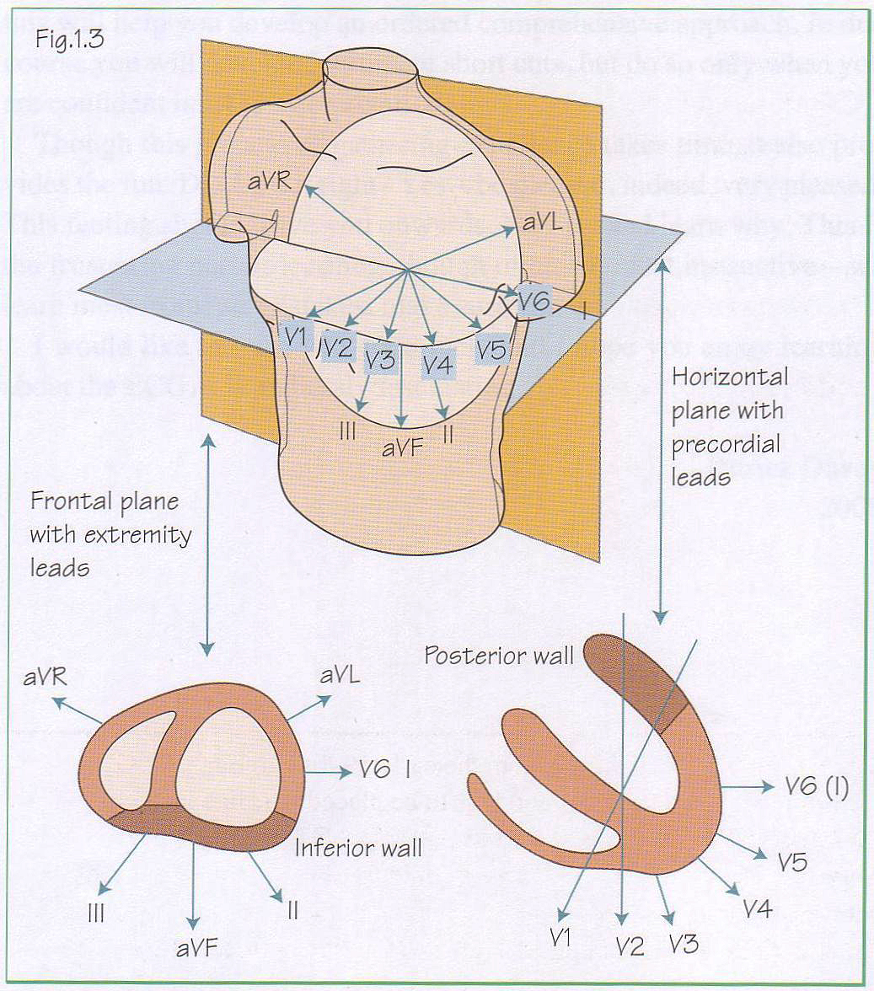
Planes of the ECG: Frontal and Horizontal
The ECG is recorded about two perpendicular planes.
The limb leads view the heart about the frontal plane.
In this plane the mean vector of depolarisation of the ventricles gives the mean frontal plane axis.
The chest leads view the heart about a horizontal plane.
The ECG is important because it gives us pictures of the heart about these twelve different positions.

Slide 7
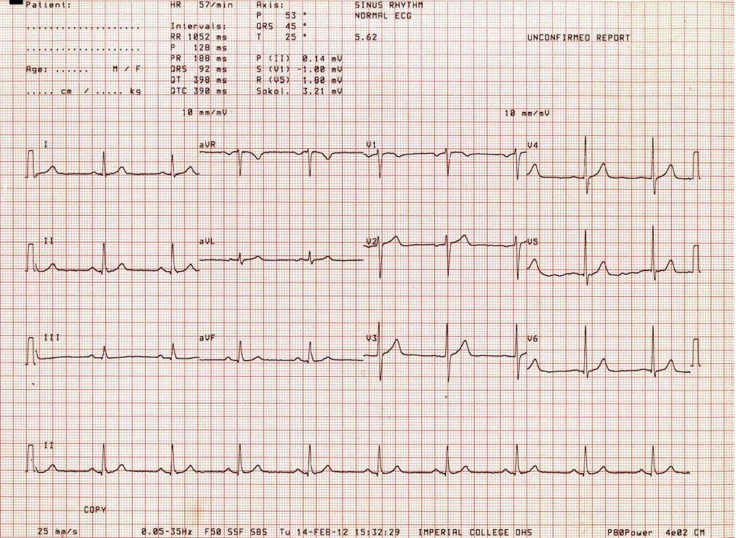
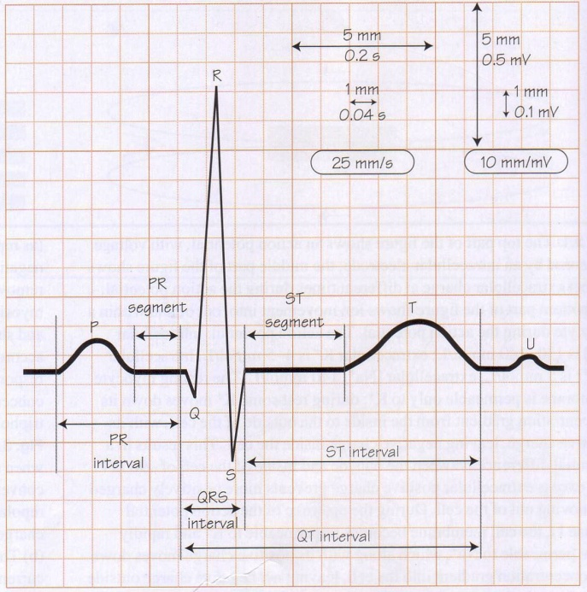
Example of a12-lead ECG
A basic ECG recorded at a standard paper speed of 50 mm/s, sensitivity of 10 mm/mV, showing the timings of normal ECG.
1 small square = 40 ms
1 large square = 200 ms
A typical 12-lead ECG from a patient in normal sinus rhythm, showing 6 limb leads and 6 chest leads. At bottom is the rhythm strip; this is used to examine the rhythm of the heart.

Slide 8
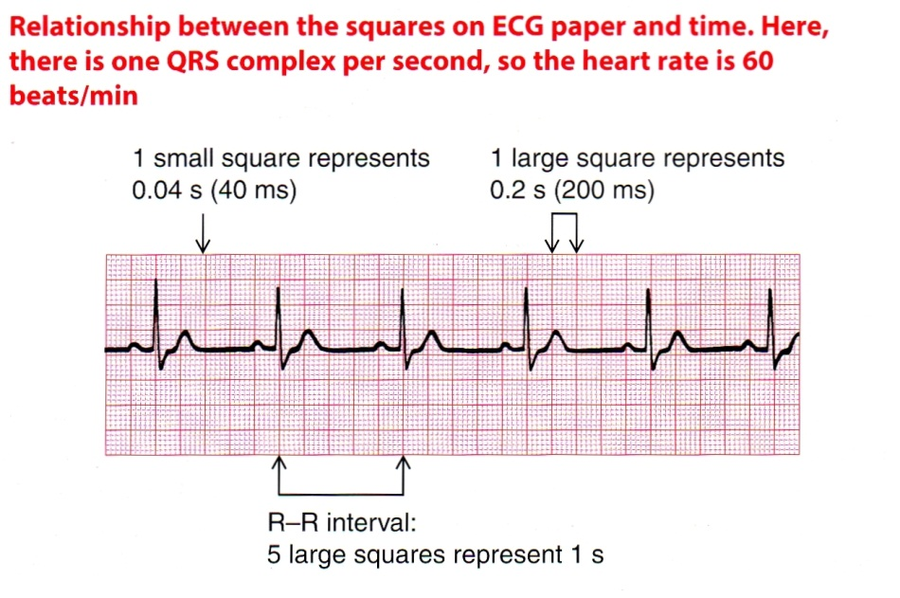

Slide 9
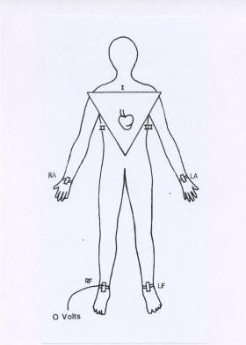
Limb electrodes: attachment and use
The right foot is always used as a zero volt reference point.
This leaves the two arms and the left foot for recording signals.
RA
LA
RF
LF

Slide 10
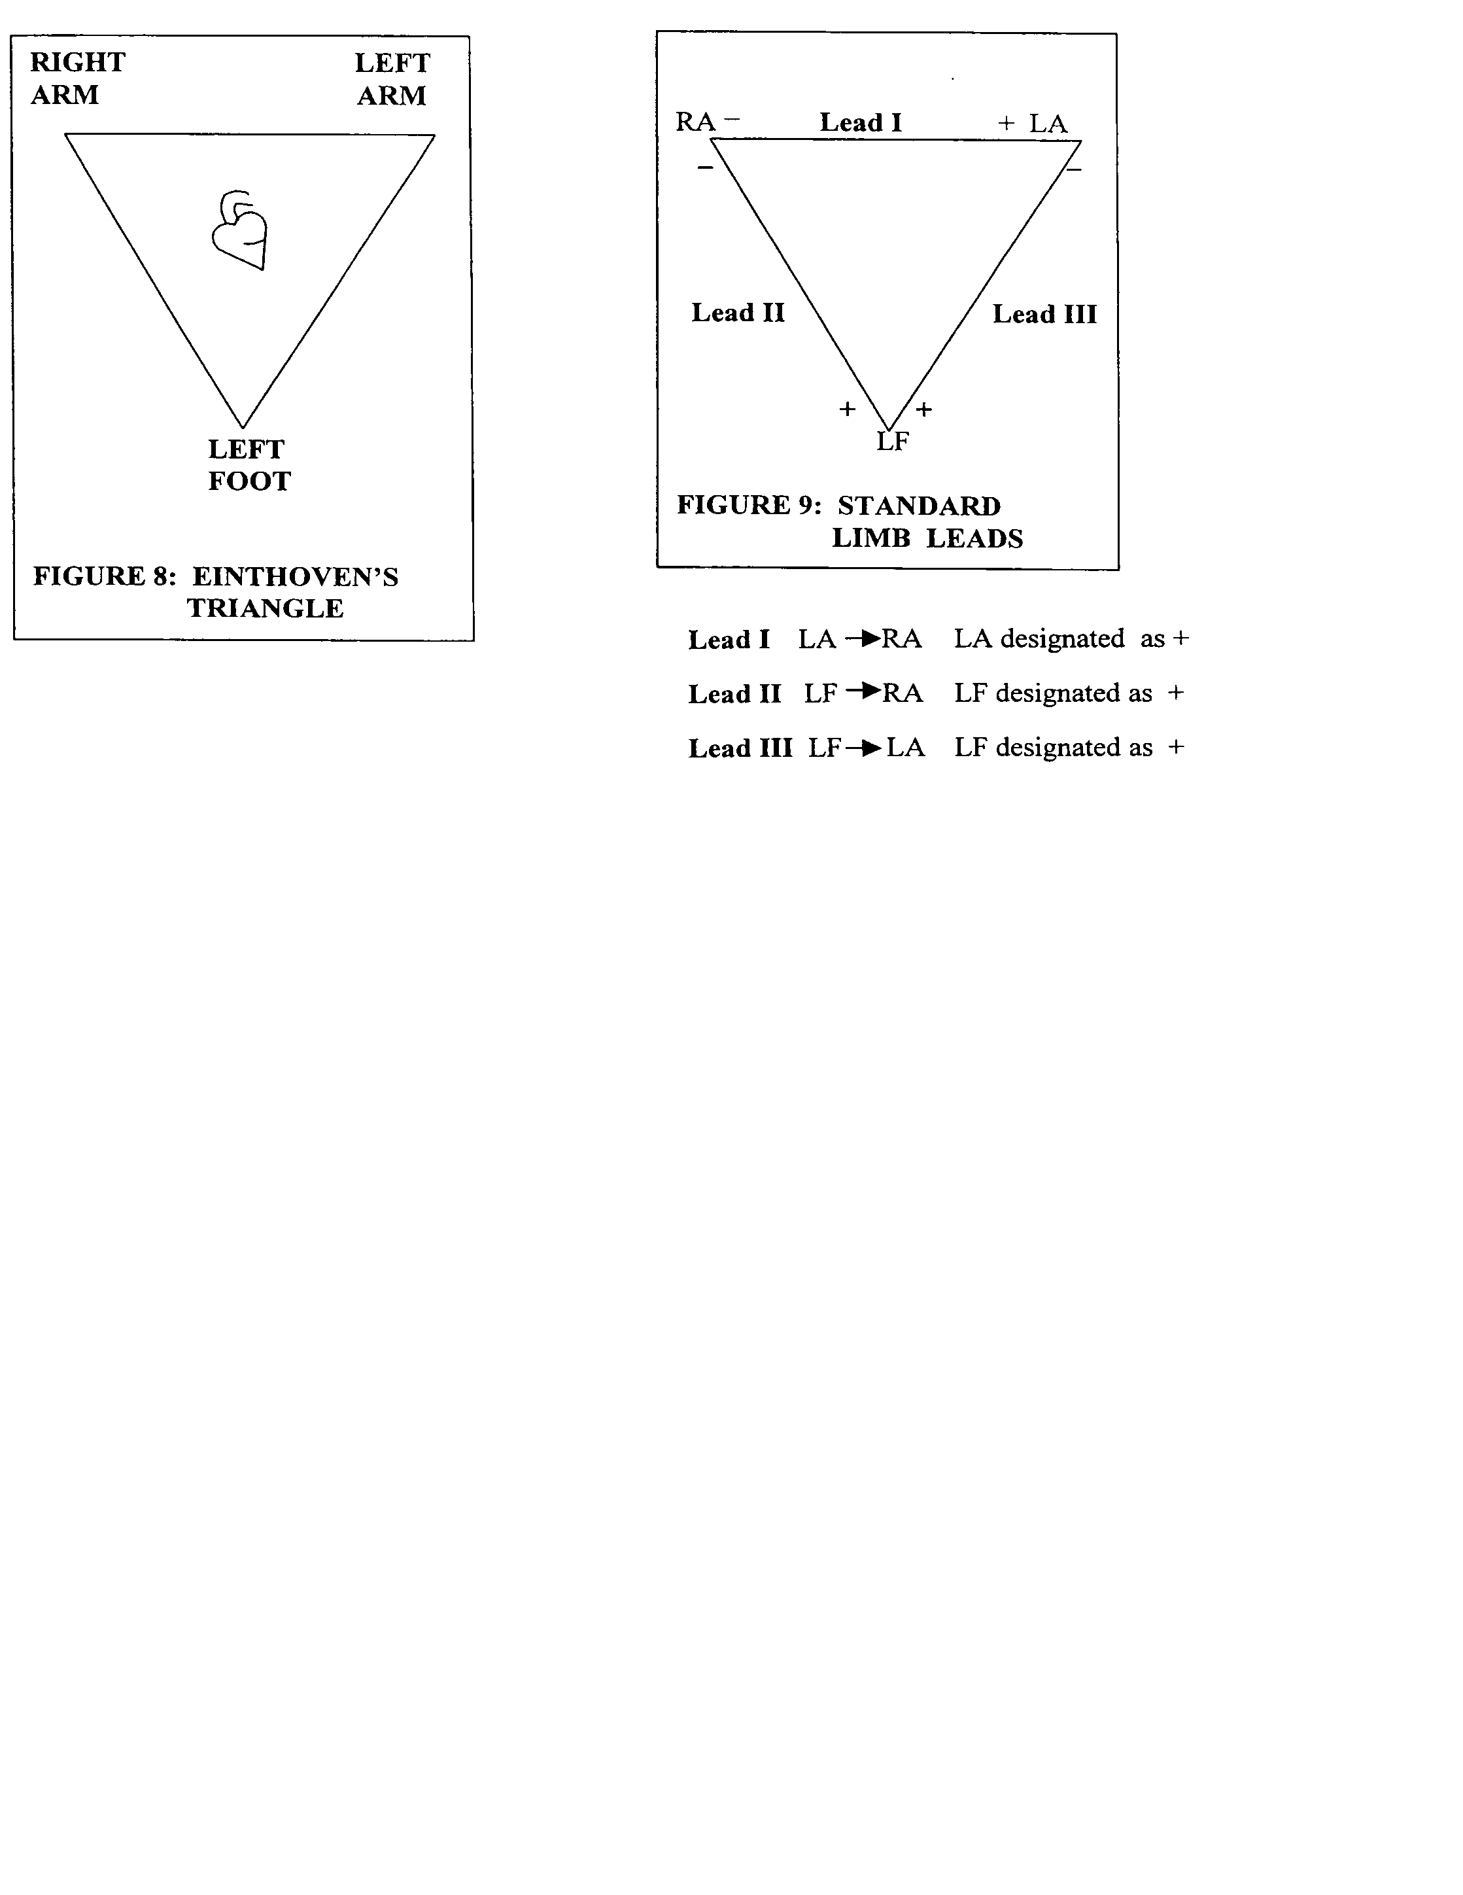

Slide 11
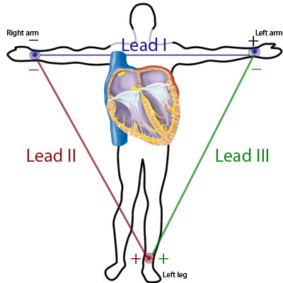

Slide 12
0º
120º
60º

Slide 13
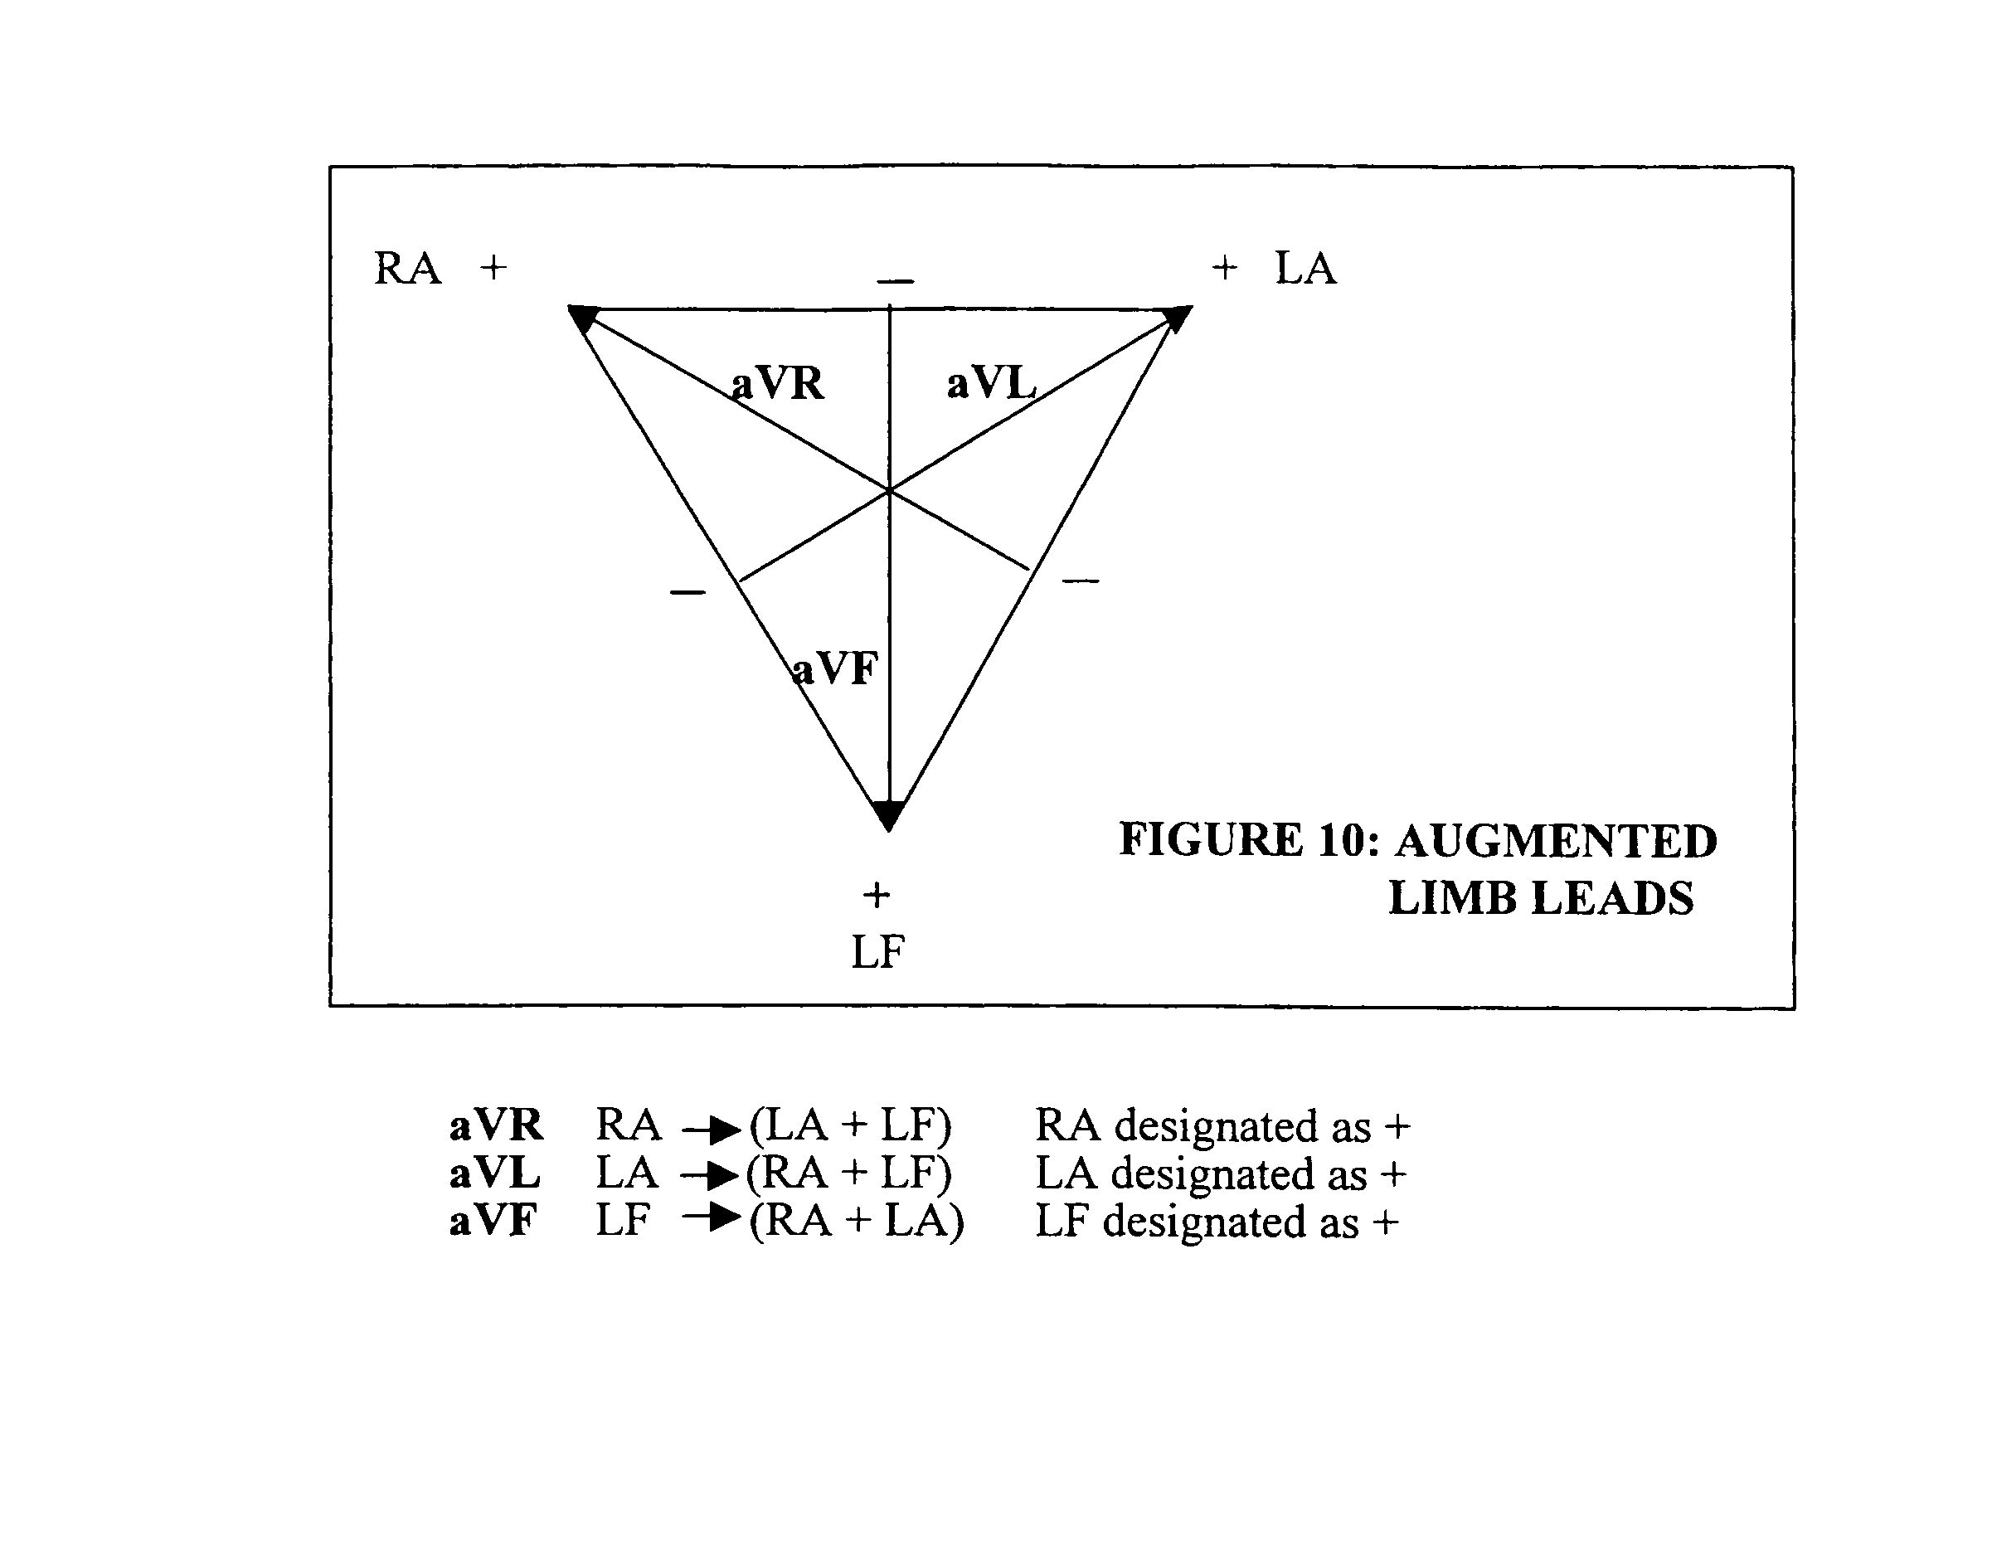

Slide 14
-150º
- 30º
aVR
aVL
aVF
90º

Slide 15
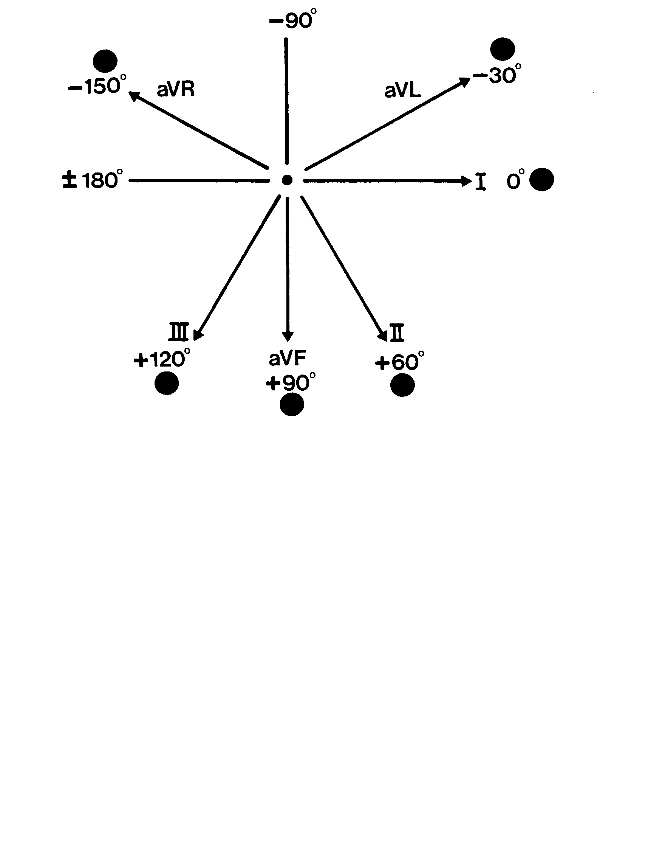
Hexagonal Reference System

Slide 16
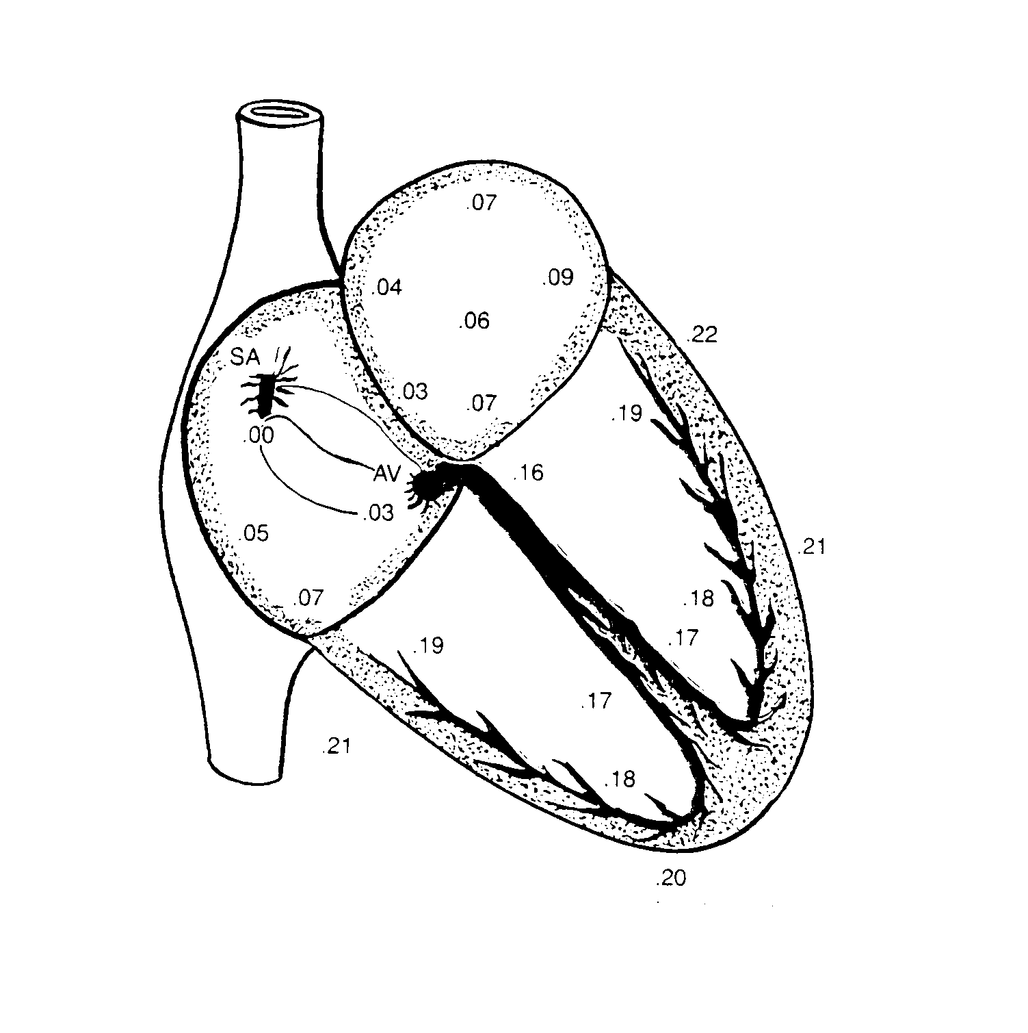
Mean Frontal Plane Axis
Mean Frontal Plane Axis of the Ventricles

Slide 17
The effects of a wave of depolarisation are detected as the potential difference between two electrodes.
REMEMBER !!
When a wave of depolarisation is moving TOWARDS the positive electrode it causes an UPWARD deflection.
When it is moving AWAY from the positive electrode it causes a DOWNWARD deflection.

Slide 18
Hexagonal Reference System
MFPA = 0º

Slide 19
 | Lead | Lead II | Lead III | Lead avL | Lead avR | Lead aVF
MFPA 0º
MFPA 90º
I

Slide 20
Hexagonal Reference System
MFPA = 90º

Slide 21
 | Lead | Lead II | Lead III | Lead avL | Lead avR | Lead aVF
MFPA 0º
MFPA 90º
I

Slide 22
Why do waveforms vary in size?
Signal in I = MFPA cos a
As a = 60º, cos a = 0.5
I = MFPA x 0.5
I
a
b
The signal is half max. size.
aVF
II
MFPA = 60º
Lead II is exactly on MFPA
Therefore signal is max size
Signal in aVF = MFPA cos b
As b = 30º, cos b = 0.87
aVF = MFPA x 0.87
The signal is 0.87 max. size

Slide 23
Equipotential and Negative Waves
The value of cos 90º is zero.
Hence the value of (MPFA cos 90º) is also zero.
This explains why a lead with its axis at right angles to the MFPA show no signal (or a small equipotential).
Cosines of angles between 90º and 270º are negative.
Thus when a lead is more than 90º to MFPA the ECG will show downward (negative) rather than upward deflections.

Slide 24
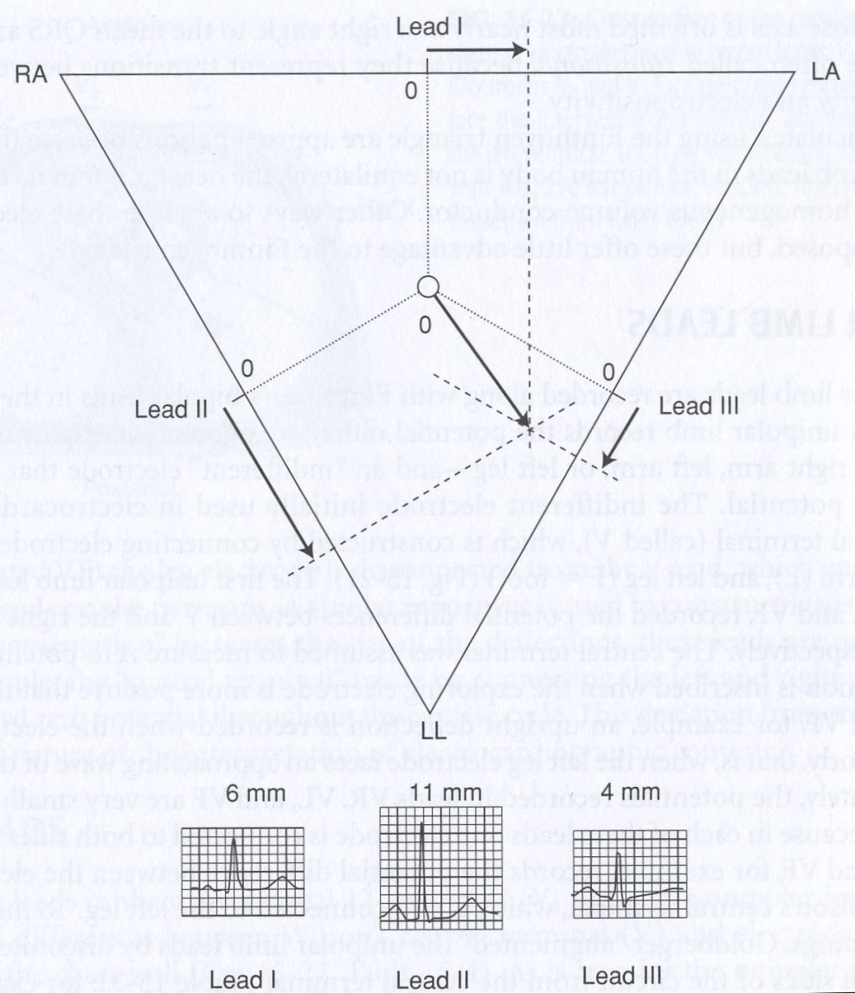
Calculation of Mean Frontal Plane Axis from the limb leads - 1

Slide 25
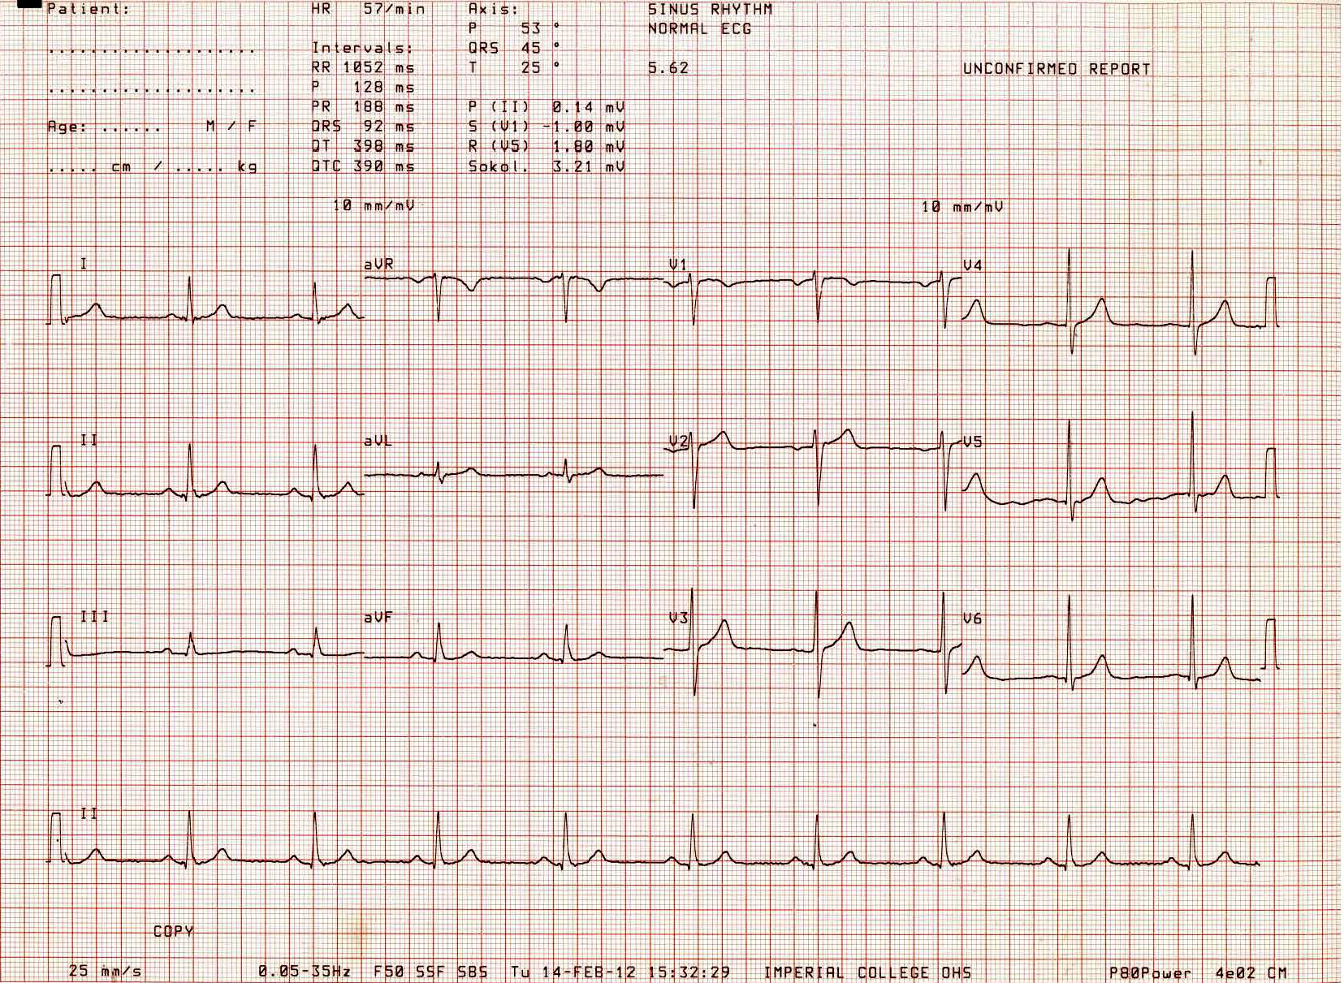
Calculation of Mean Frontal Plane Axis from the limb leads - 2

Slide 26
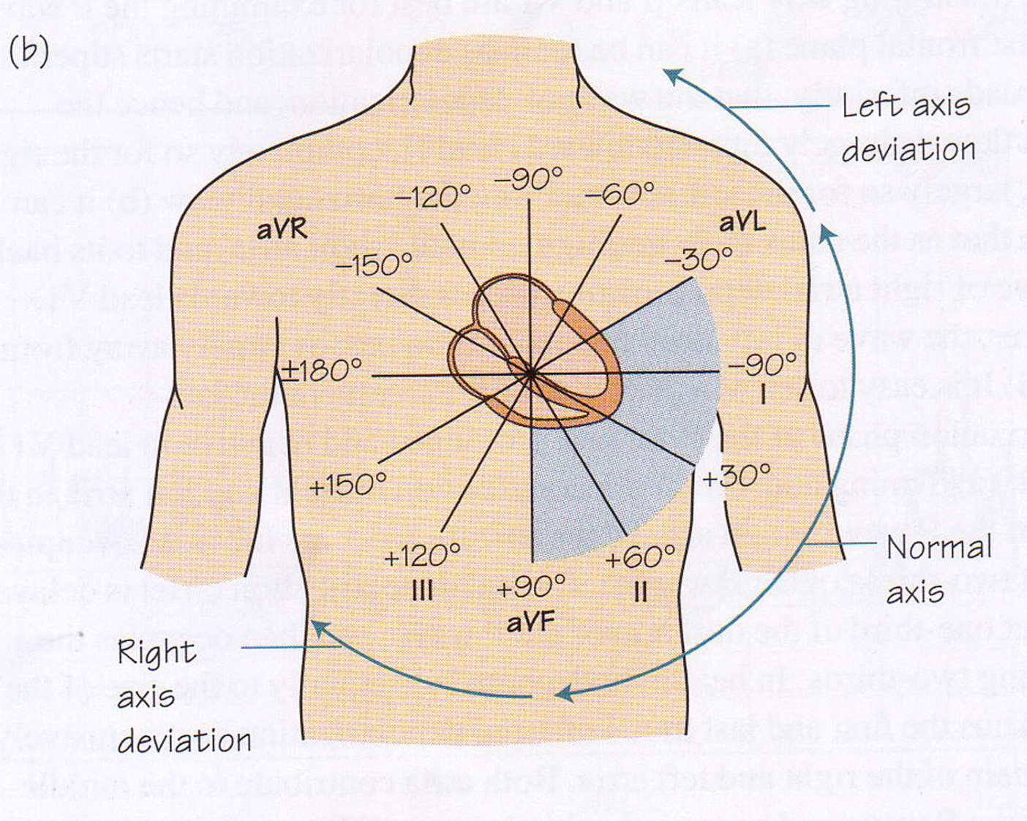
Range of Normal Mean Frontal Plane Axis
-30 to +90º

Slide 27
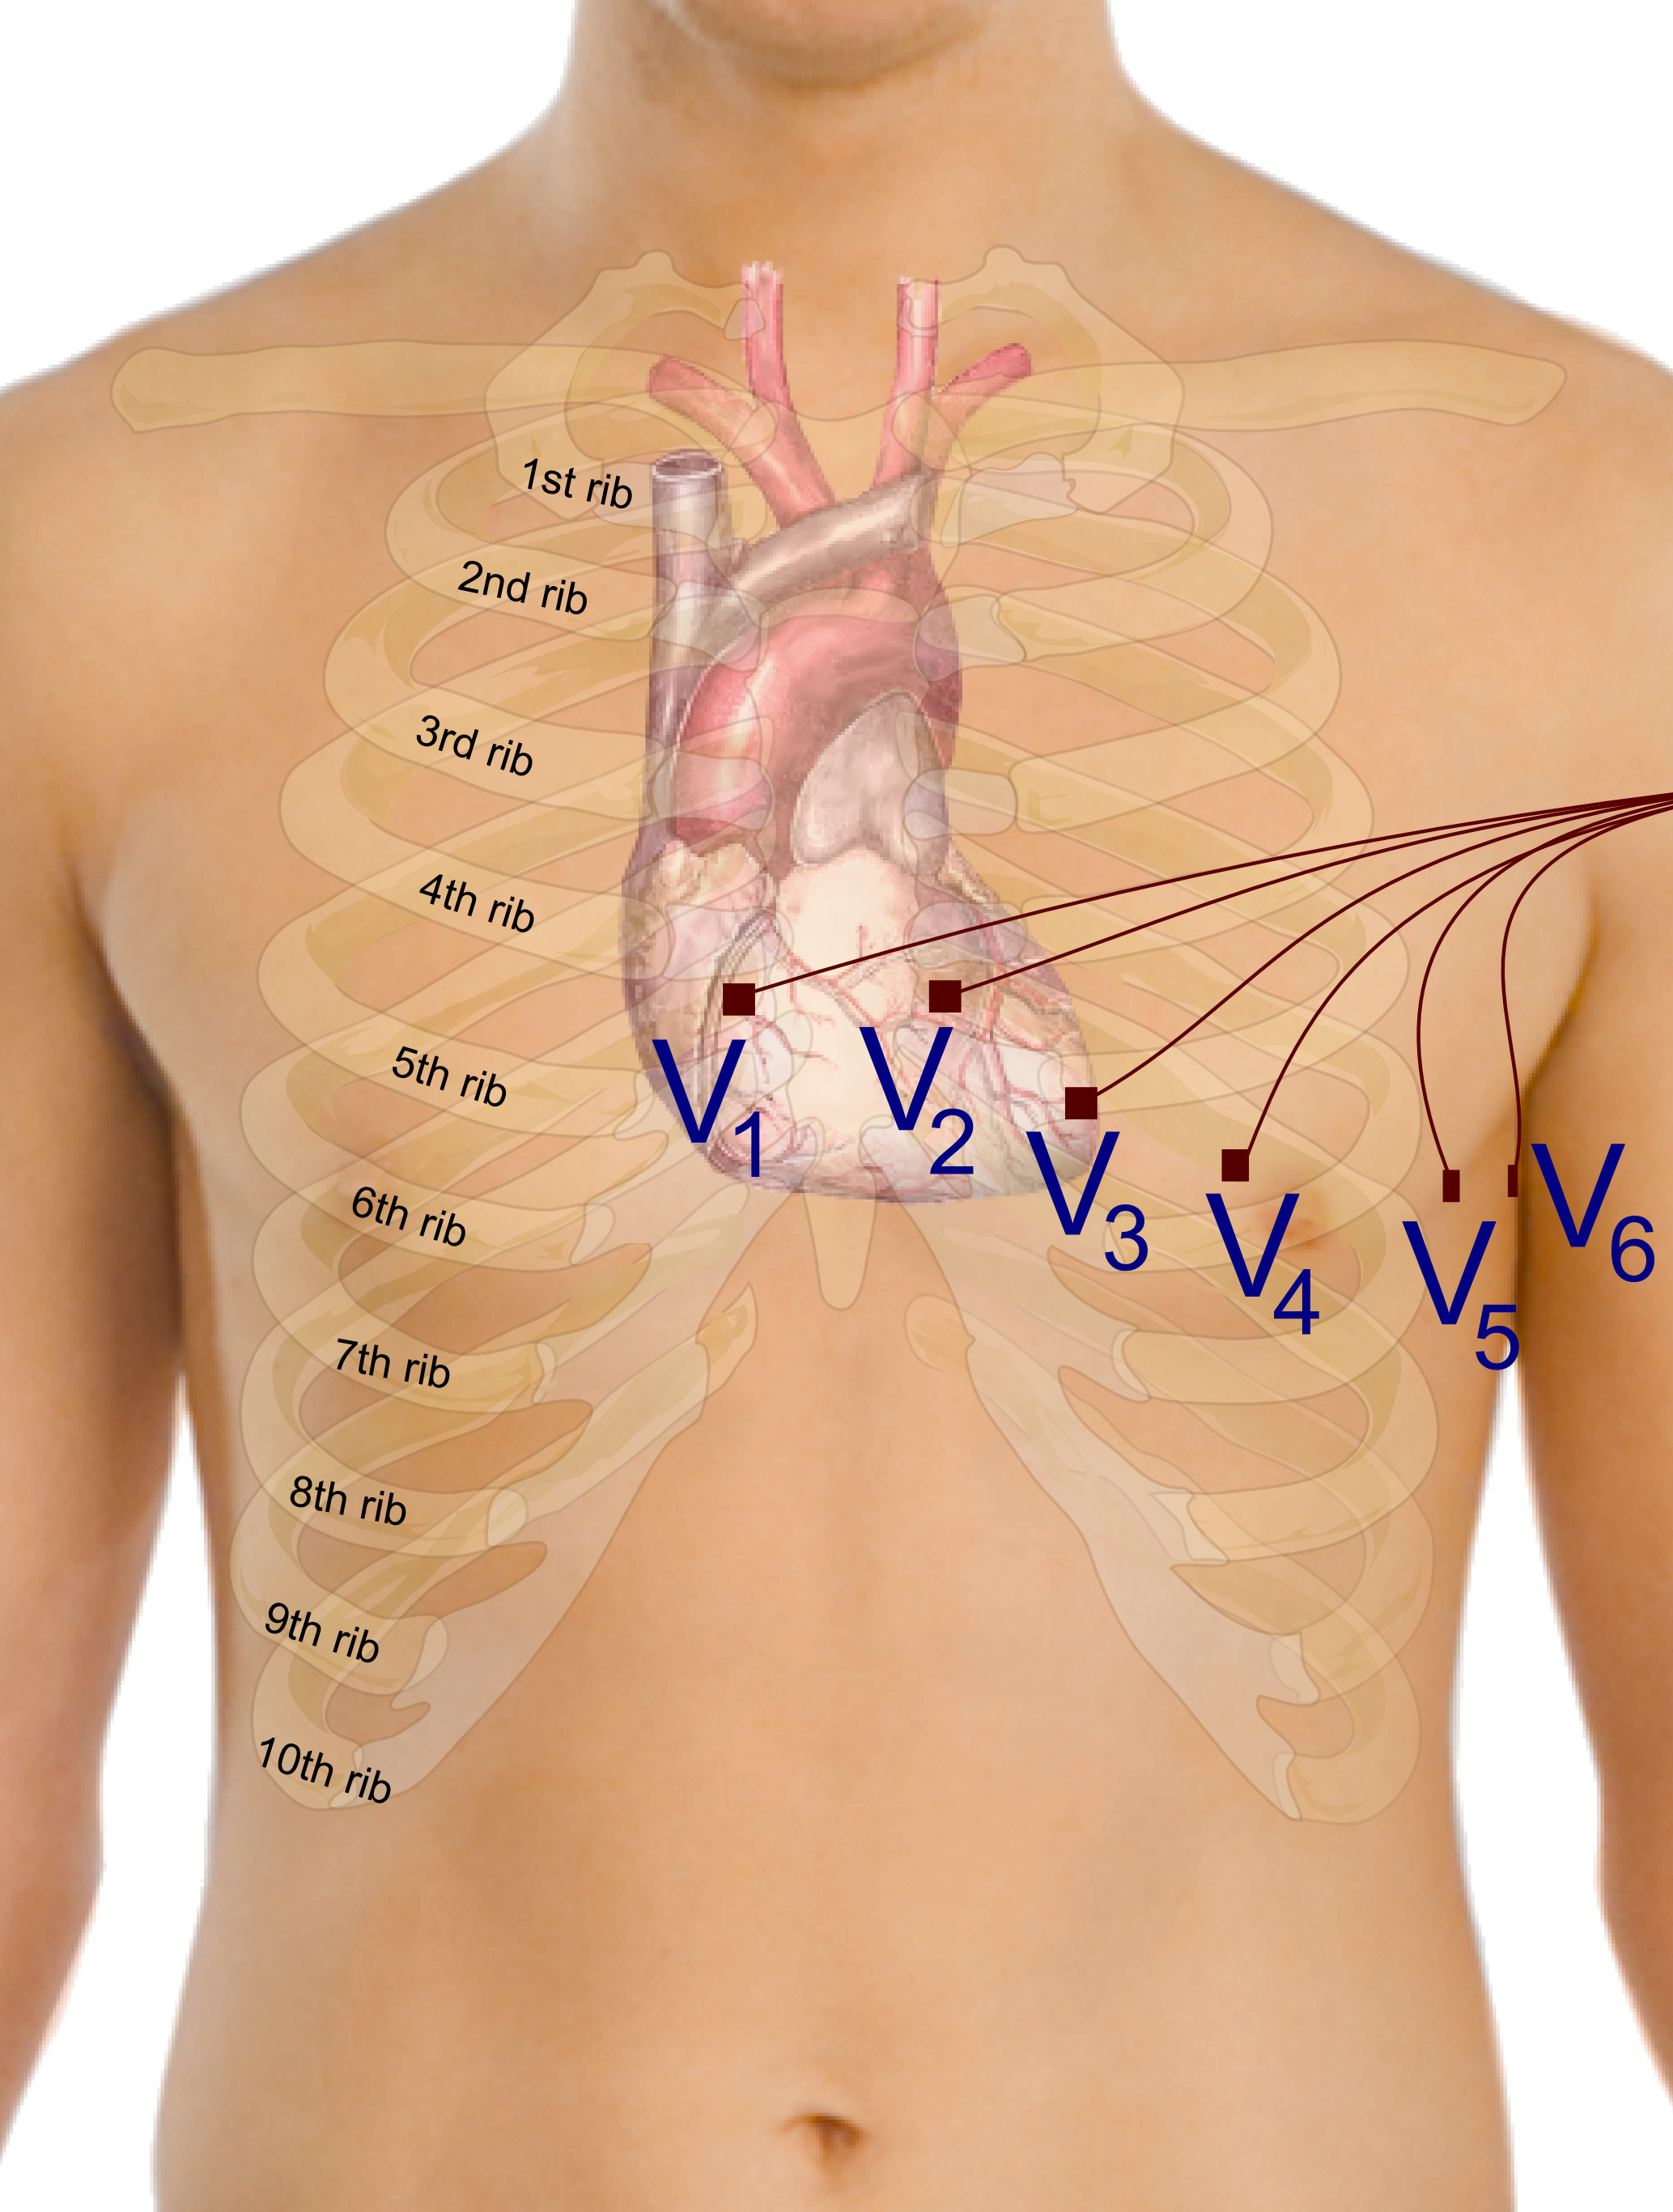
Chest leads – view the heart about horizontal plane

Slide 28
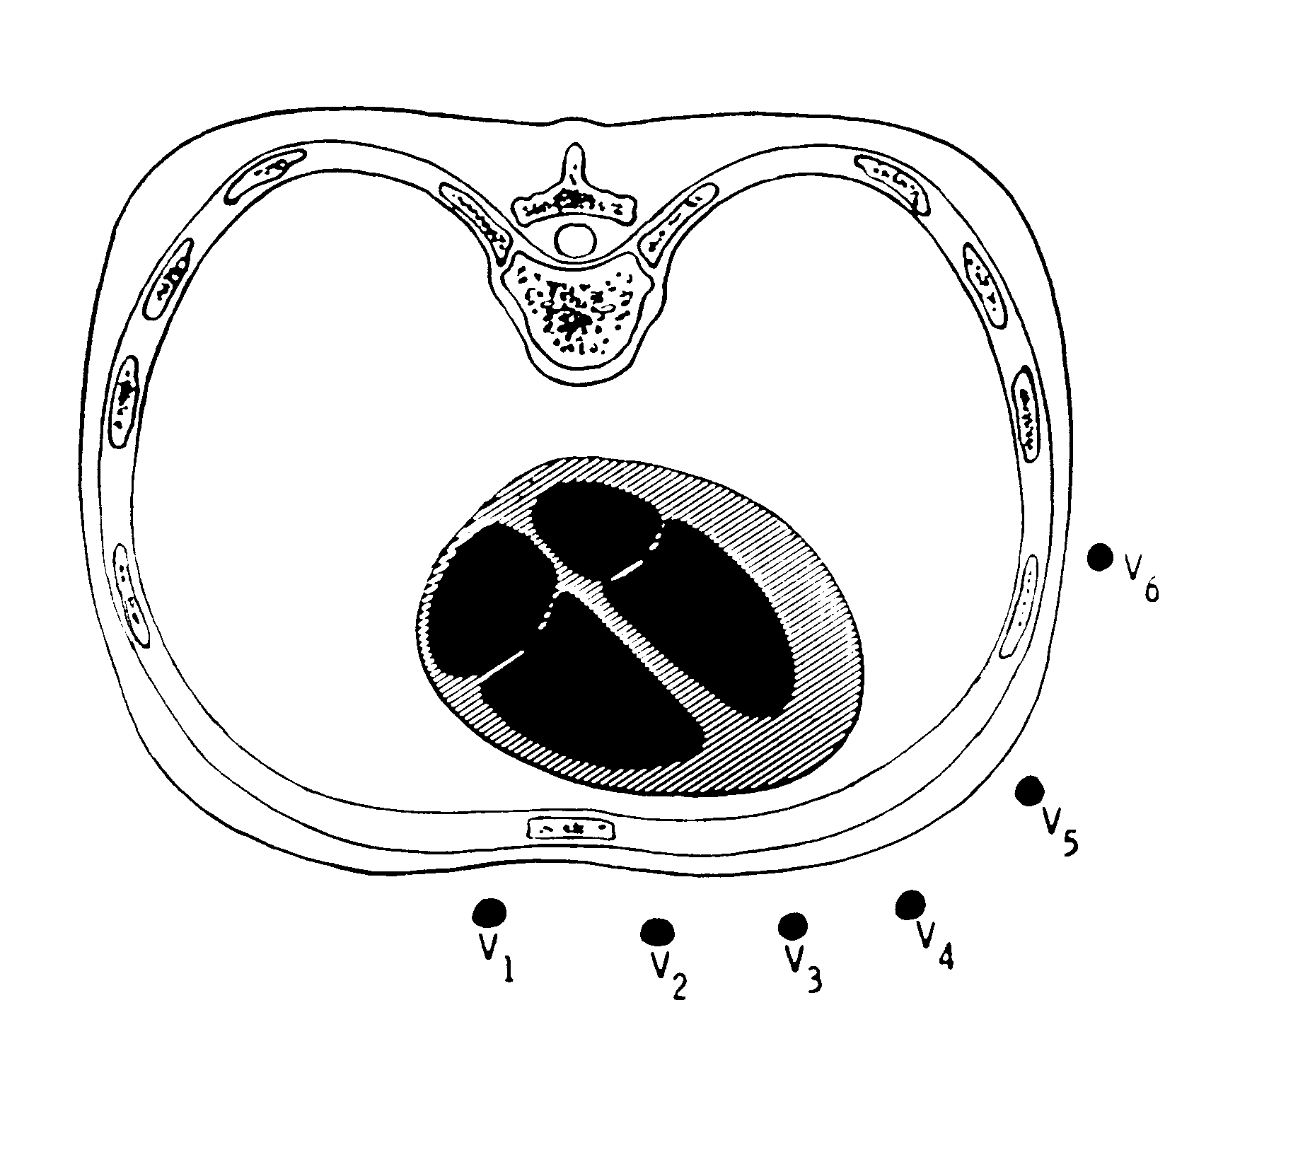
qR
TRANSITION ZONE
rS

Slide 29
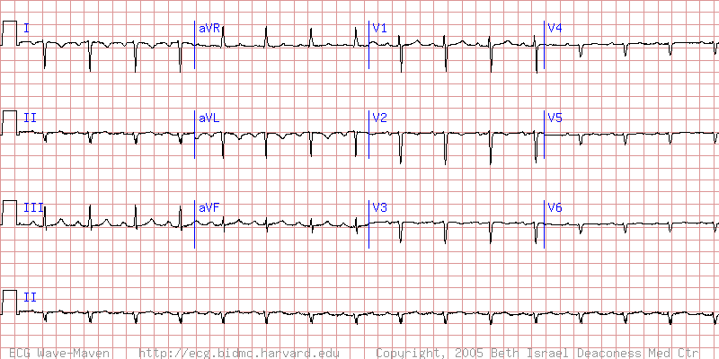
ECG of patient with situs inversus with dextrocardia
… pathological ECGs to be discussed in detail in next lecture!

Slide 30
Electrocardiography is essentially a practical subject.
You will have the opportunity to record an ECG yourselves in the practical classes.

