Slide 1
Male pelvis and perineum
Dr M Thavarajah
PhD (Sheffield), MMedSc( Sheffield), BDS (Ceylon)
Human Anatomy Unit
Department of Surgery and Cancer
Total: 42 slides
Text: 32 slides
Titles: 5
Self study & reference: 5

Slide 2
Prerequisites
You should be familiar with:-
General features of bony pelvis
Structure of the pelvic wall & diaphragm, bladder and anal canal
2/42

Slide 3
Male & Female Pelves (plural)
X = dist. between symphysis pubis to ant margin of acetabulum
Y = diameter of acetabulum
Self-study slide
Superior pubic ramus
Male
Female
x
x
y
y
 | Female Pelvis (singular) | Male Pelvis
Pelvic inlet | Oval/round | Narrow/heart shaped
Sub pubic angle | Wide > 80 degrees | Narrow 50 -60 degrees
Ischial spines | Not projecting medially | Project medially
Greater (false) pelvis | Shallow | Deep
Lesser (true) pelvis | Wide, shallow & cylindrical | Narrow, deep & tapering
Y:X ratio (acetabulum) | Less than one | 1 or > 1

Slide 4
Orientation of the Pelvic Girdle Male & Female
In the anatomical position: ASIS and pubic tubercles are in the same plane
Greater and lesser pelves are continuous
Orientation of the axes of the abdominal & pelvic cavities (last lecture)
Greater pelvis
ASIS
Lesser pelvis
Pelvic inlet
Pubic
tubercle
Pelvic outlet

Slide 5
Peritoneum & Pelvic Fascia Male & Female
Parietal peritoneum continues into pelvic cavity but does not reach the pelvic floor.
Pelvic viscera (except uterine tubes) are not completely covered by peritoneum.
Several folds and pouches are formed
Space between pelvic wall and peritoneum not occupied by viscera contains pelvic fascia
Pelvic fascial condensations form “ligaments” supporting viscera like cervix, vagina, prostate

Slide 6
Contents of Male Pelvic Cavity
Ureter, bladder, urethra
Prostate, ductus deferens, seminal vesicles, bulbourethral glands
Rectum
Some of the abdominal GI tract spills into the greater pelvis- Caecum, appendix, parts of sigmoid colon and ileum
Vessel, nerves and lymphatics

Slide 7
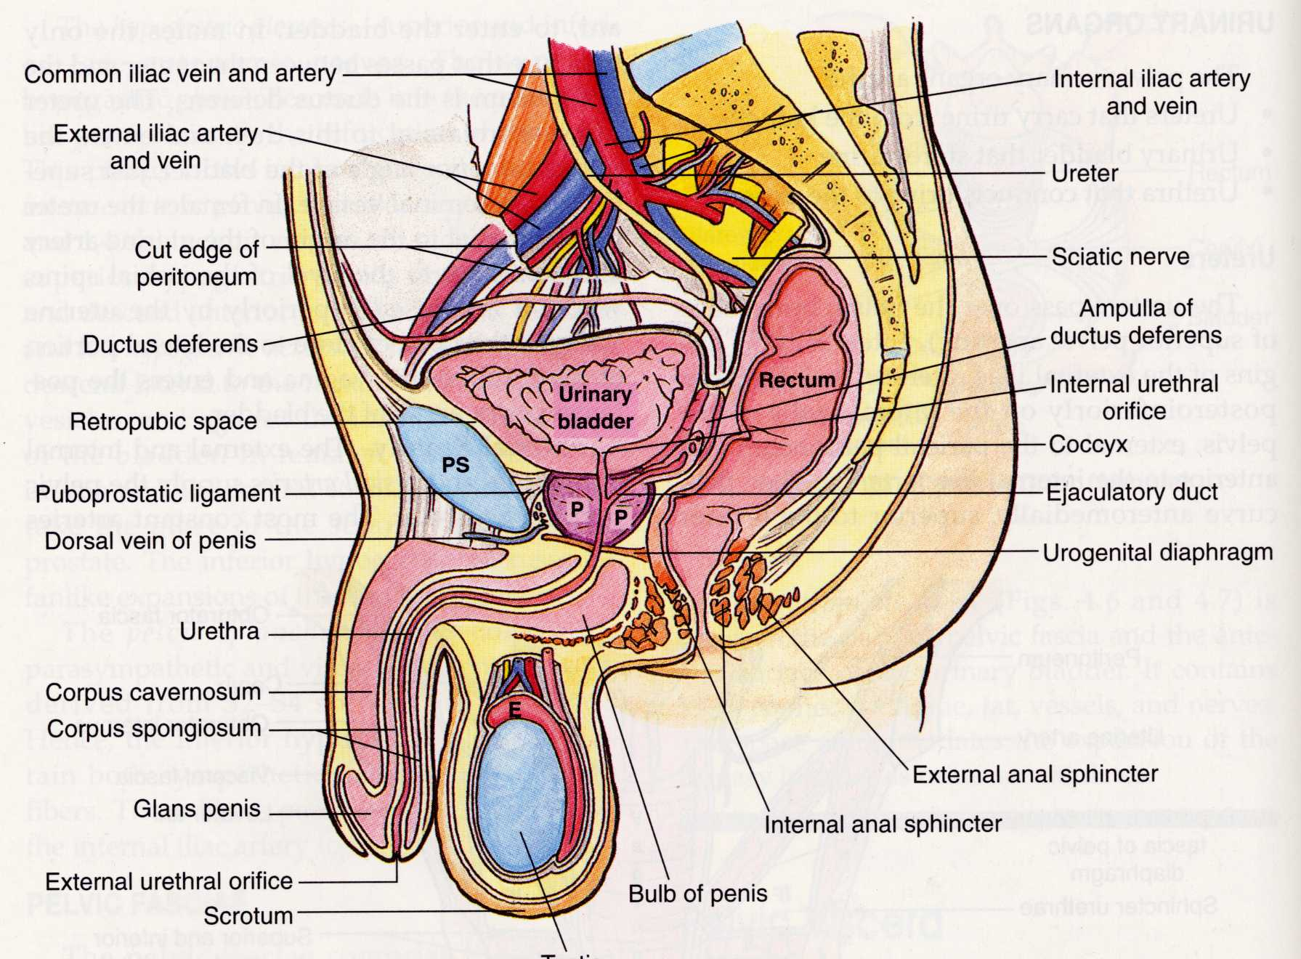
Male Pelvic Organs: Overview
pelvis
Ureter (25 cm)
Parietal
Peritoneum –cut edge
Ampulla of
ductus deferens
Ductus deferens
Ejaculatory duct
Seminal vesicle not shown
1
Urethra
20 cm long
2
pelvis
Prostate gland
perineum
Testis
Sagittal section
Organs from several systems are packed in a small space. GI, urinary, reproductive, Nerves, vessels and lymphatics. Note the pelvis/perineum boundary. 1 & 2 indicates normal curvatures in male urethra

Slide 8
Review of Male Pelvis
What structures in the male pelvis can be felt on a digital rectal examination (DRE) of a healthy man?
Which of the two (1 or 2) bends of the male urethra can be straightened before passing a catheter?

Slide 9
The Male Pelvic Organs
Prostate gland surrounds 1st (prostatic) part of urethra
Ductus deferens from testis passes through inguinal canal, then over, and behind ureter to enter the urethra through the prostate
Seminal vesicles on back of bladder - open into ductus deferens between ampulla and ejaculatory duct

Slide 10
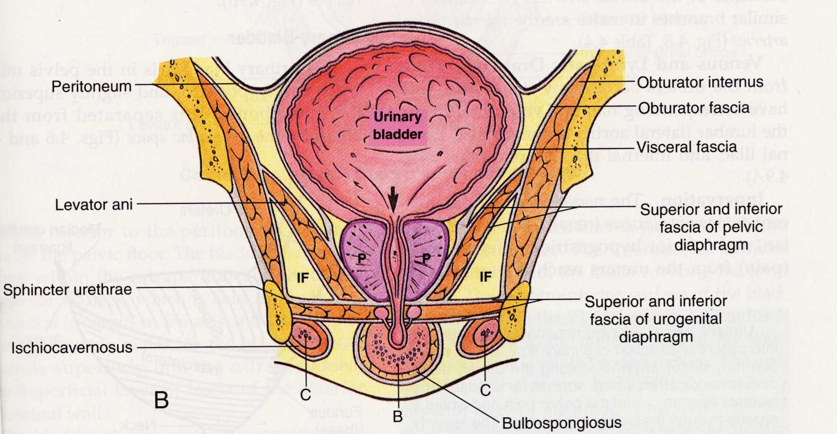
Male: Bladder and Prostate
Prostate & urethra
Bulbourethral gland
Corpus cavernosum
Coronal section
– anterior view
Root of penis
The male bladder ‘sits’ on the prostate, which is transfixed by the first (prostatic) part of the urethra. A urinary catheter, must negotiate a 90⁰ bend in the urethra as it passes from the perineum to the pelvis.

Slide 11
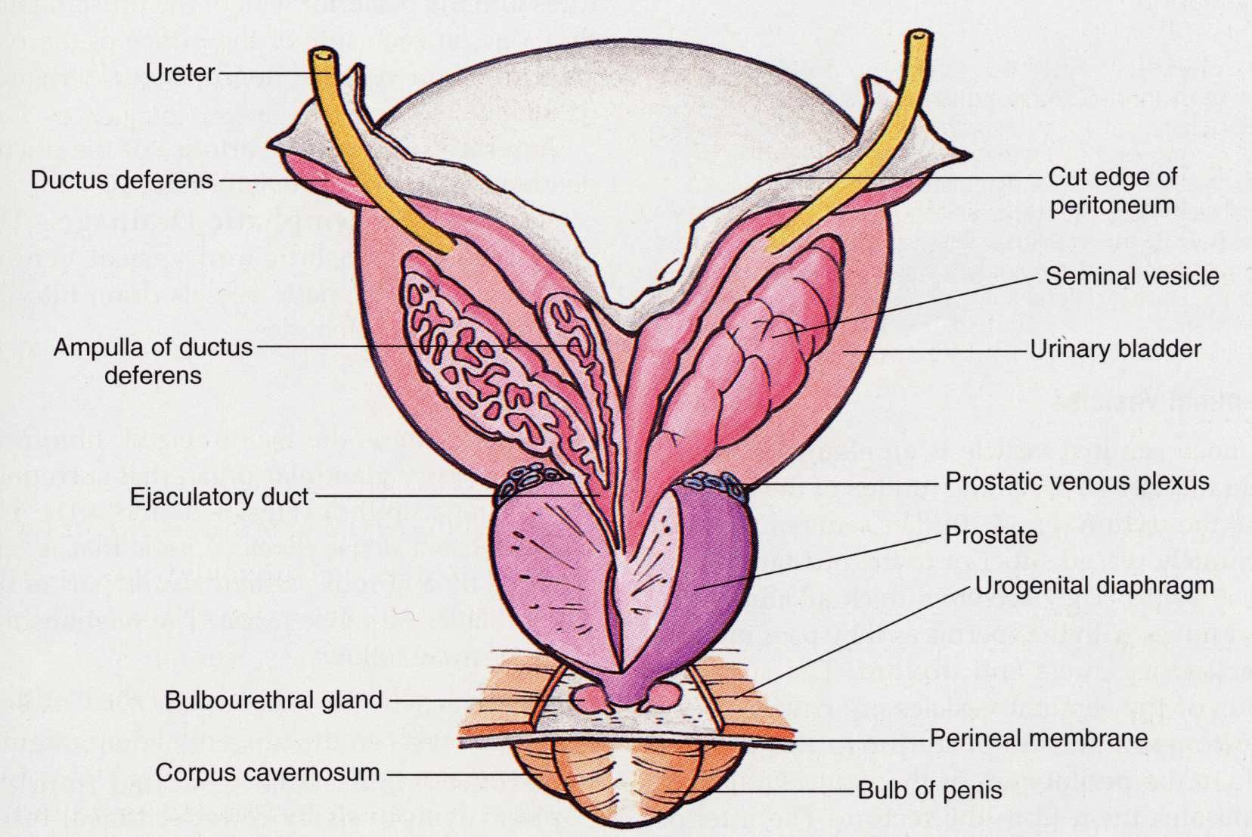
Prostate & Seminal Vesicle
Ureter
Bladder
Ductus deferens
and ampulla
Seminal vesicle
Ejaculatory duct
Prostatic urethra
Posterior view
The ductus deferens, seminal vesicles & prostate empty into the prostatic urethra to form the semen

Slide 12
Prostatic Urethra where urinary & reproductive tracts meet
Internal urethral sphincter (smooth muscle)
Internal urethral sphincter:
Smooth muscle, well organized in males (not in females)
Closed during ejaculation by sympathetic stimulus.
(Parasympathetic stimulation relaxes the sphincter)
Prostatic utricle
(a cul-de-sac)
Openings of ejaculatory ducts
External urethral sphincter (skeletal muscle)
Posterior wall
The tip of a urethral catheter can also become lodged in the prostatic utricle

Slide 13
Male Urethra Basic arrangement
1.5 cm
2.5 cm
2 cm
15 cm
External urethral orifice (narrowest part)
Yellow arrows indicate areas of narrowing or obstruction for the navigation of a catheter.

Slide 14
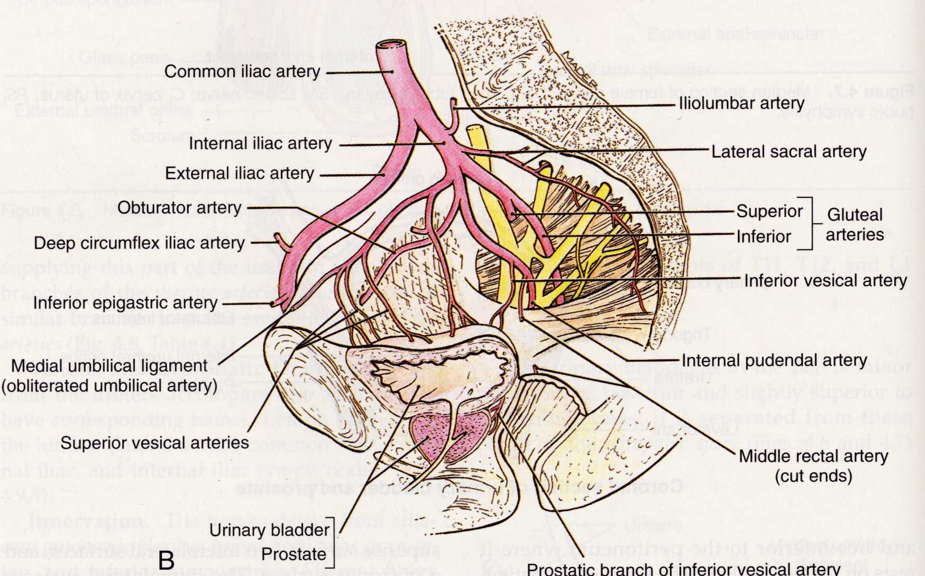
Arterial Supply of Male Pelvis
to prostate, bladder
& ductus deferens
to bladder & ductus deferens
to prostate
Testis receives arterial supply from testicular artery arising form the abdominal aorta. (not from internal iliac artery)

Slide 15
The Male Perineum

Slide 16
The Perineum - 1
Diamond-shaped area between pubic symphysis, ischial tuberosities and coccyx
Living anatomy: diamond shaped area between the thighs when the person lies on the back with thighs flexed and abducted
Divided into anterior (urogenital) and posterior (anal) triangles
15/42

Slide 17
The Perineum - 2
Posterior compartment: there is ischio-anal fossae - fat-filled spaces separating anal canal and levator ani from pelvic walls
Anterior triangle divided into superficial and deep parts (or pouches) by the perineal membrane

Slide 18
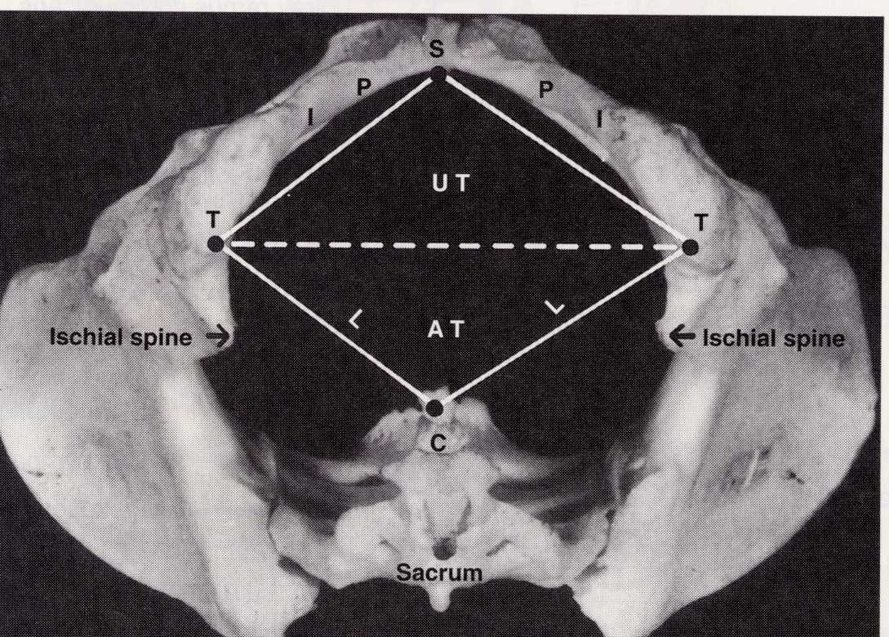
Urogenital and Anal Triangles of the Perineum
Pubic Symphysis
Urogenital triangle
Ischial Tuberosity
Anal triangle
Coccyx
Bony landmarks from the inferior aspect of the pelvis

Slide 19
Urogenital triangle
The structures in the male and female differs

Slide 20
Male Perineum
Inferior view
Urogenital triangle
Anal triangle
Male perineum in lithotomy position
Structures in the anal triangle are same in both sexes

Slide 21
Perineal Spaces (or Pouches)
Perineal membrane (PM): Thick triangular fascial structure attached to pubic arch. Posterioly free margin. Anteriorly a small gap.
Deep perineal space: is above the PM and below the fascia of pelvic diaphragm.
Superficial perineal space: is below PM and perineal fascia (subcutaneous tissue)
These spaces are potential spaces and they become real only when for eg: fluid leaks into them

Slide 22
Superficial Perineal Structures of Male
Body of penis
Crus of penis
Glans of penis
Perineal membrane
Ischiopubic ramus
Bulb of penis
Levator ani (pelvic floor)
muscles not shown
Perineal body
Perineal membrane fills the urogenital triangle. The erectile tissues and associated skeletal muscles are anchored to this.

Slide 23
Superficial Perineal Pouch- Contents
Median erectile tissue mass (corpus spongiosum) - bulb of penis
In females it divides round the vestibule to form vestibular bulbs
Lateral erectile tissue masses (corpora cavernosae) attached to ischiopubic rami
These meet to form shaft and head of penis or clitoris (in female)
Erectile tissue within perineum surrounded by skeletal muscles

Slide 24
Deep Perineal Structures of Male
(Skeletal muscle)
Bulbourethral glands and ducts open into the urethra below the perineal membrane

Slide 25
Anal Triangle
Common structures in male and female
25/42

Slide 26
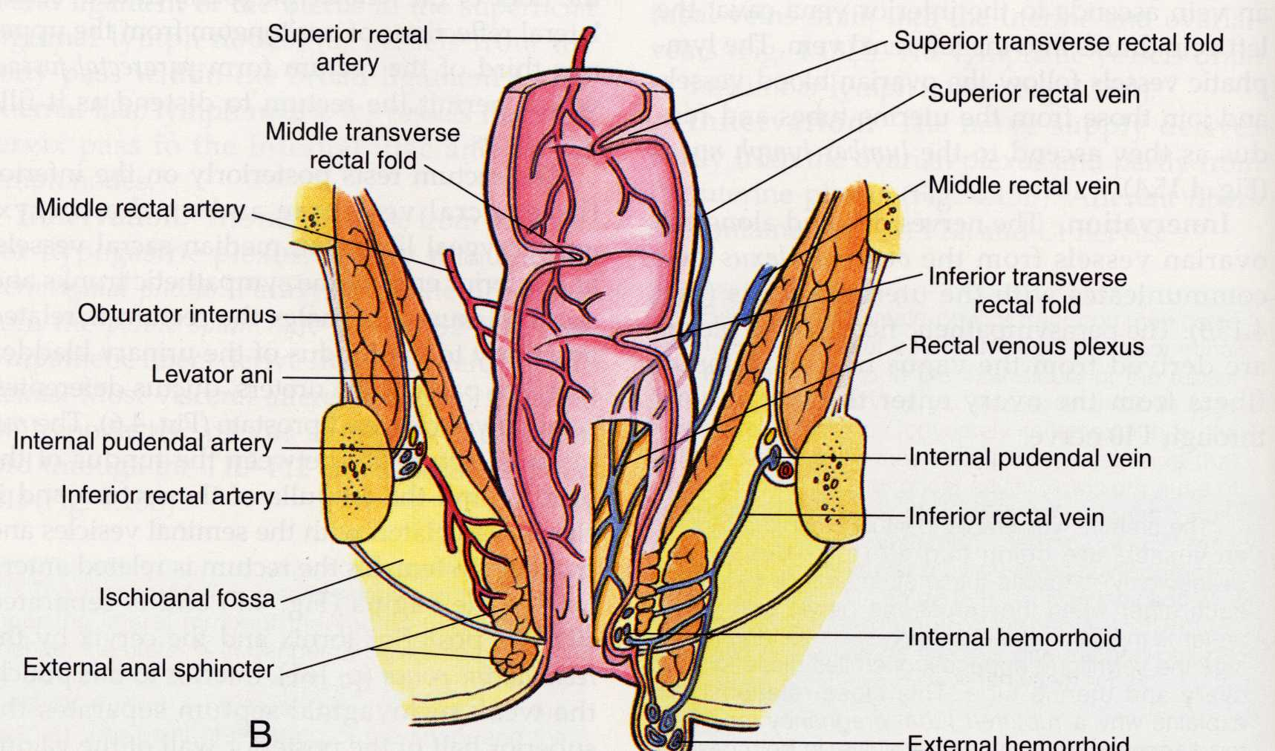
Rectum and Anal Canal
The rectum receives one pair of arteries from the inf. mesenteric artery and two pairs from the internal iliac artery. The venous drainage is similar, thus, there is an important portal-systemic venous anastomosis around the lower rectum and anal canal.

Slide 27
Rectum and Anal Canal
The ischioanal fossae are fat-filled spaces in the anal triangle. They allow recto-anal and vaginal expansion. In their lateral wall is the pudendal neuro-vascular bundle supplying the perineum including the lower rectum.

Slide 28
Male reproductive Tract
ureter
Lateral view
Vas deferens
Deep inguinal ring
Ampulla of vas deferens
Seminal vesicles
Superficial inguinal ring
Spermatic cord
Ejaculatory ducts
Prostate gland
Vas deferens
Bulbourethral glands
Perineal membrane
Start here
Testis in scrotum
Urethra
Glans

Slide 29
Testis and Associated Structures
Longitudinal section
Self-study slide
5
4
3
Spermatozoa
produced here
1
2
4
Spermatozoa stored
here until ejaculation
29/42

Slide 30
Penis Structure
Corpus cavernosum (paired)
v
Glans –
part of corpus spongiosum
v
Corpus spongiosum - single

Slide 31
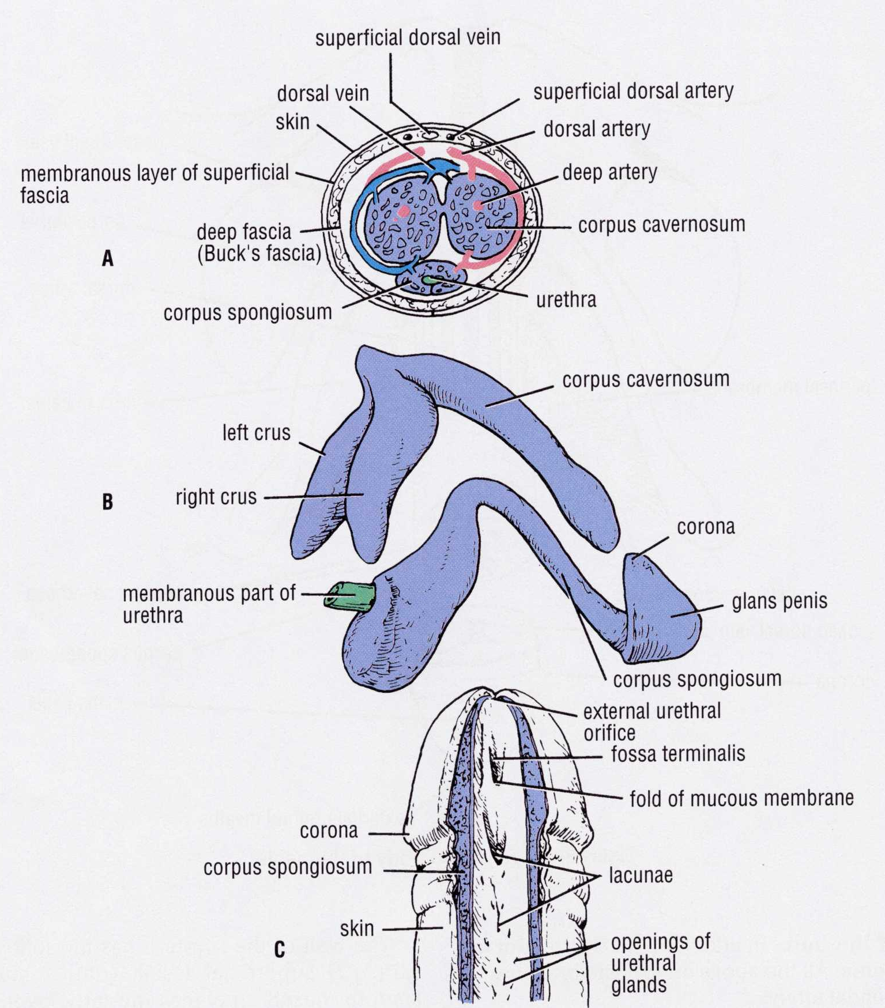
Erectile Tissue in the Male
The crura (legs) of the corpora cavernosae attach to the ischiopubic rami.
The urethra traverses the length of the corpus spongiosum.
Catheters can get caught in the navicular fossa (fossa terminalis).
Corpus cavernosum
Corpus spongiosum
root
body
Right crus
body
Membranous
urethra
root
glans
Bulb
Navicular fossa
(fossa terminalis)

Slide 32
Blood Supply of the Penis
Main supply: Internal pudendal artery from internal iliac
Deep artery – supplies corpora cavernosa
Dorsal artery – supplies the skin and connective tissue
Artery of the bulb – bulb, corpus spongiosum, glans and urethra.
Branches supplying the cavernous spaces are usually coiled – helicine arteries
Parasympathetic stimulation causes helicine arteries to relax allowing blood flow
What is the blood supply of the testis?

Slide 33
Nerves of Pelvis
Pelvic contents supplied by autonomic nerves only
Sympathetic from lower thoracic and upper lumbar (T10 - L2) segments via hypogastric plexus
Parasympathetic from S2-4 outflow
Pelvic sensation is visceral and poorly localised - pain is referred to suprapubic region and perineum

Slide 34
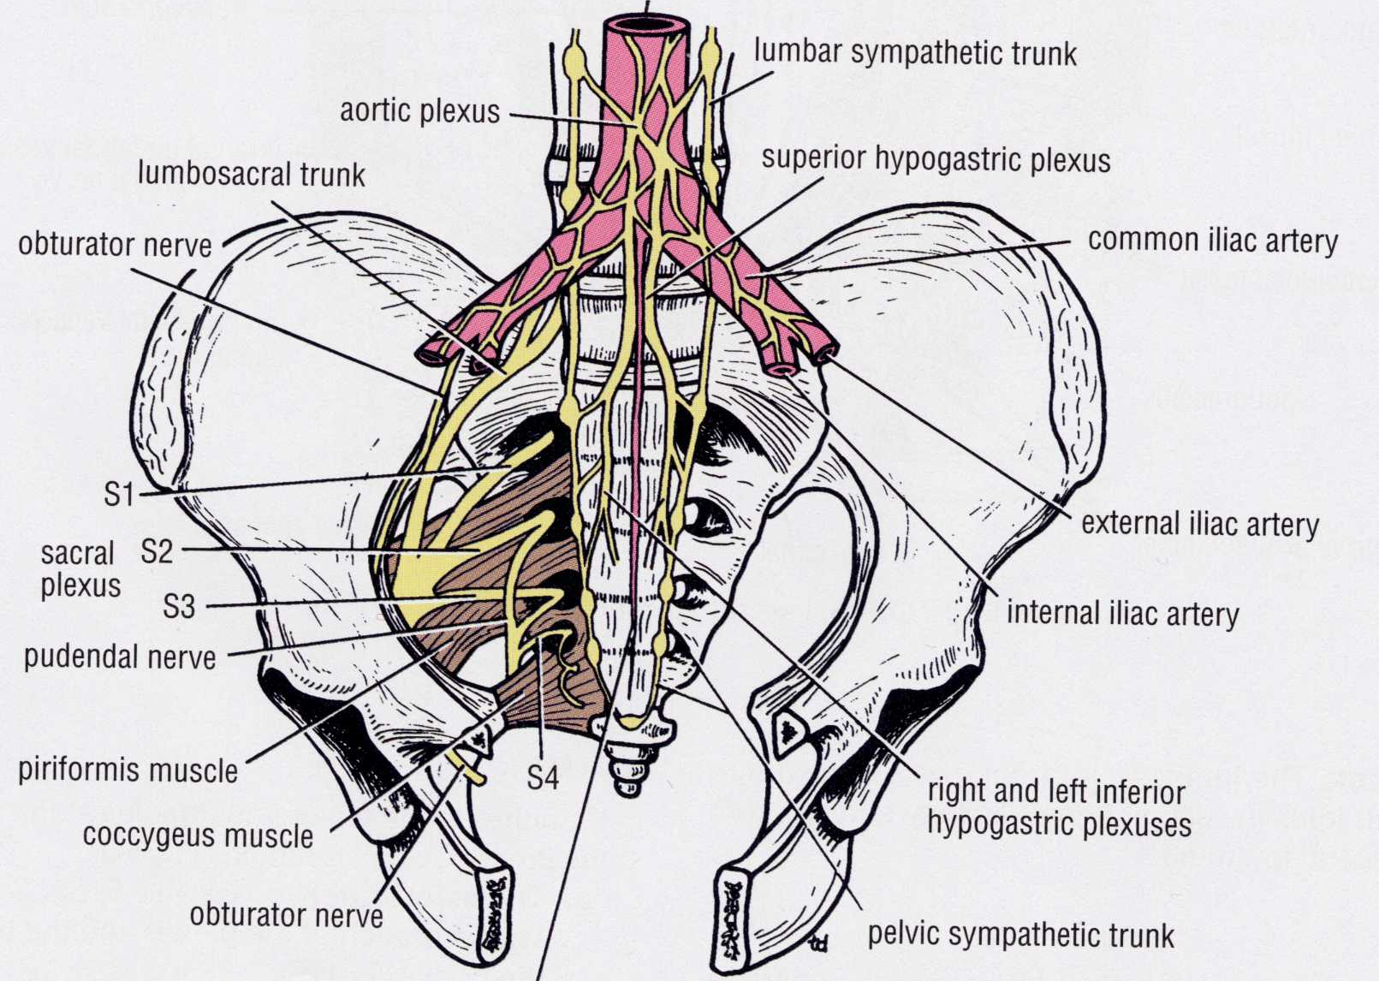
Nerves of the Pelvis & Perineum
Superior hypogastric plexus
The parasympathetic out flow from S2-S4 joins the inferior hypogastric plexus. It is not shown in the diagram.
Pudendal nerve
S2-S4 (somatic)
inferior hypogastric plexus – Rt & Lt
Pelvic sympathetic trunk
Pelvic and perineal nerves: Pelvic sympathetic – T10 - L2 via hypogastric plexus; Pelvic parasympathetic – sacral outflow from S2-S4; Perineum (somatic) – Pudendal nerve S2-S4

Slide 35
Summary of Nerve Function
1) Somatic: Pudendal nerve from S2 - S4
Sensory - Dorsal nerve of penis –sensory to penile skin, glans
Motor – to perineal muscles bulbospongiosus and ischicavernosus -causing ejaculation + external urethral sphincter
2) Parasympathetic – from S2 - S4
Vasodilation of arterioles in erectile tissue (male & female)
Secretion in prostate, bulbourethral glands
3) Sympathetic – from L1 - L2
Contraction of smooth muscles of epididymis, vas deferens, seminal vesicles, prostate causing emission.
Contraction of internal urethral sphincter (in males) to prevent reflux of semen

Slide 36
Nerves of Perineum
Somatic nerves, mainly from sacral segments
Most important nerve is pudendal (S2-4)
Supplies all perineal skeletal muscles
Sensory to penis, lower urethra, lower rectum and anal canal
36/42

Slide 37
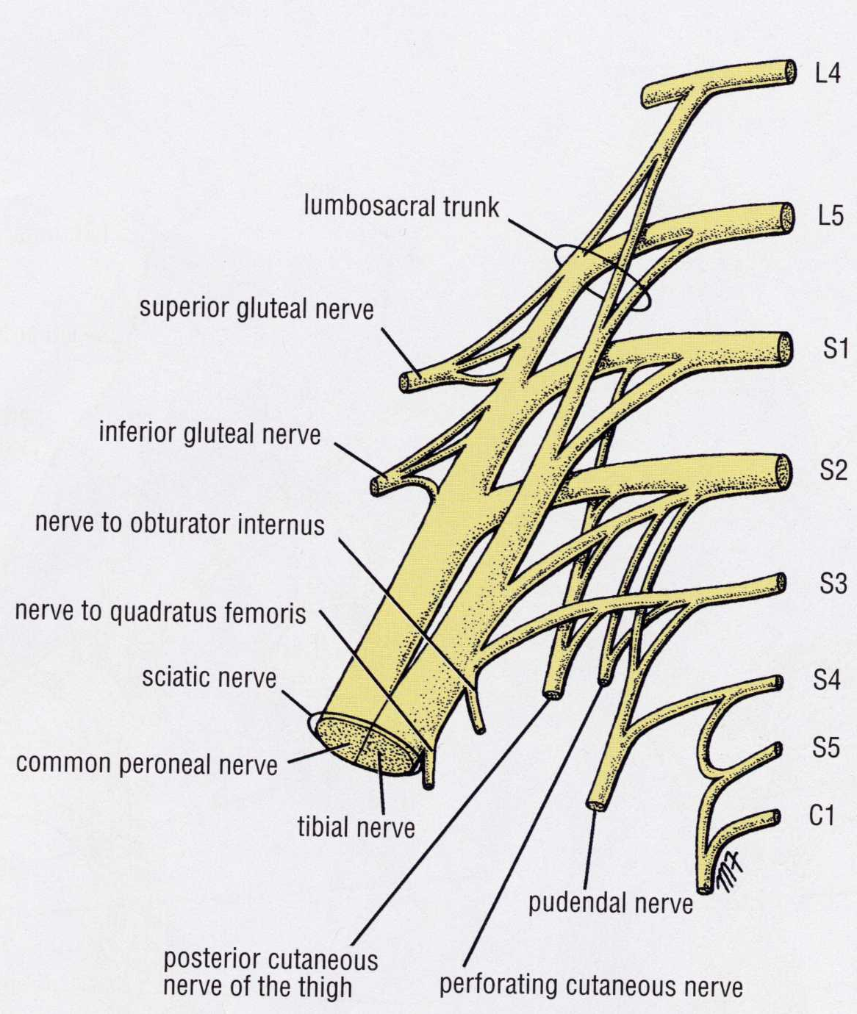
Lumbosacral Plexus
Somatic nerves leave the pelvis from the lumbosacral plexus:
The main supply to the perineum is from the pudendal nerve S2-S4
‘Pudendal’ derives from Latin pudere – to be ashamed of

Slide 38
Pudendal Nerve
Pudendal nerve in the pudendal canal in fascia of obturator internus
Important somatic nerve of perineum
The pudendal nerve passes briefly from pelvis to buttock, thus passing behind the fibrous posterior edge of Levator ani (the sacrospinous ligament).
It passes forward below Levator ani, first in the lateral wall of the ischioanal fossa (posterior perineum) then branching to anterior perineum, penis/clitoris and scrotum/vulva.
Inferior rectal N (anal sphincter, levator ani m.)
Levator ani
Perineal N
dorsal nerve of
Penis (or clitoris)
Motor brs to perineal muscles
Post. Scrotal nerve
(or labia)

Slide 39
Erection, Emission & Ejaculation Neuro-vascular mechanisms
Self-study slide
1 Erection:
Central parasympathetic pathway activated by psychic stimulation.
Pudendal artery/arterioles relax and allow blood flow into cavernous spaces of erectice tissue (male & female).
2 Secretion:
Stimulation of para-sympathetic ganglia on prostate, seminal vesicles, and other glands (in females)
.

Slide 40
Erection Emission & Ejaculation Neuro-vascular mechanism
Self-study slide
3 Emission: Central sympathetic pathway activated and smooth muscle contraction of vasdeferens, prostate, seminal vesicles.
Internal urethral sphincter (male) contracts. Bladder muscle contraction is prevented by sympathetic inhibitory action (no urine flow)
4 Ejaculation: Entry of semen into urethra triggers somatic reflex (via pudendal nerve) causing contraction of bulbospongiosus muscle (skeletal).
5 Detumescence: Selected sympathetic nerves supplying pudendal arterioles are activated causing arteriolar constriction to restrict blood supply to cavernous spaces.

Slide 41
Erection Emission & Ejaculation Summary of Neural pathways
Self-study slide
Reference diagram for previous two slides
41/42

Slide 42
End
Male Pelvis and Perineum

