Slide 1
Liver, portal circulation, biliary system, and spleen
Dr M Thavarajah
PhD (Sheffield) MMedSc(Sheffield) BDS(Ceylon)
Human Anatomy Unit
Department of Surgery and Cancer
5 revision slides out of 30

Slide 2
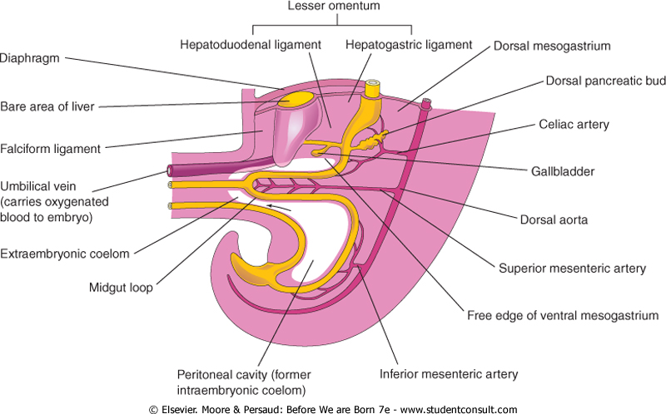
Dorsal & Ventral Mesenteries in Relation to Stomach, Liver, Pancreas & Diaphragm
Revision slide
Embryo 5th Week IUL
2/30

Slide 3
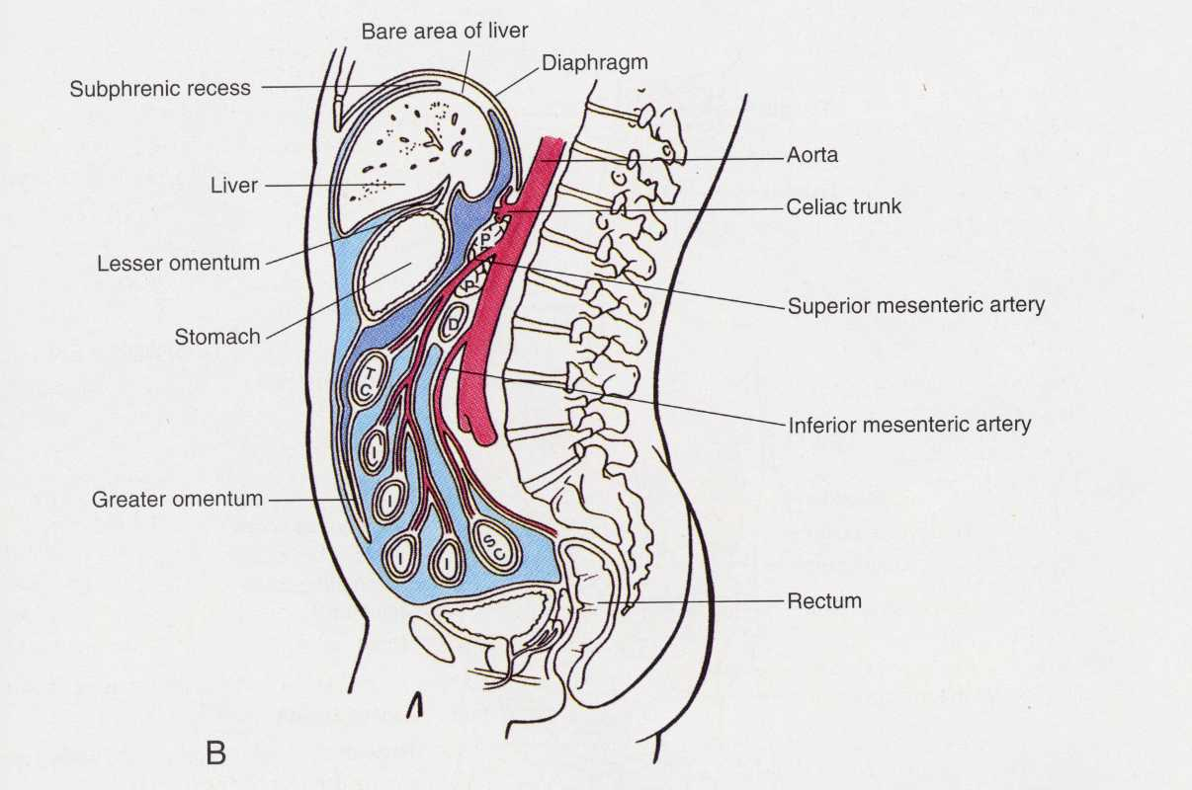
Mesenteries in Relation to the Stomach, Liver, Pancreas & Diaphragm
Revision slide
Bare area of liver
Omental bursa
(lesser sac of peritoneal cavity)
Lesser omentum
Pancreas
Mesentery of small intestines
Greater omentum
Sagittal section
Left lateral view

Slide 4
Anterior/Ventral
Falciform Ligament
Liver
Lesser Omentum
- Gastrohepatic lig
- Hepatoduodenal lig
Stomach
Gastrosplenic Ligament
Spleen
Splenorenal Ligament
Mesenteries in Relation to the Stomach, Liver, and Spleen
Kidneys
Posterior/Dorsal

Slide 5
Liver Mesenteries and the Bare Area
Liver develops in the ventral foregut mesentery
Connected to anterior abdominal wall by Falciform Ligament
Connected to stomach by Lesser Omentum
Direct contact with part of Diaphragm (Bare Area of Liver)

Slide 6
Surface Anatomy of the Liver
Deep to: ribs 7 -11
Mostly under the cover of ribs
Extends across:
Rt hypochondrium
Epigastrium
Lt hypochondrium
Nipple
Liver
We will work on this in the living anatomy class

Slide 7
Liver in situ
The anterior abdominal wall has been removed

Slide 8
Anatomical Lobes of Liver
Diaphragmatic surface
Anatomical boundary
Remnant of
Umbilical vein
The peritoneal reflections divide the liver externally into two main lobes and 2 accessory lobes
8/30

Slide 9
Anatomical Lobes of the Liver
Remnant of Umbilical vein
Anatomical
boundary
Visceral surface
Remnant of ductus venosus

Slide 10
Functional Lobes of the Liver
Right Vascular Lobe
Left VascularLobe
Remnant of Umbilical vein
Diaphragmatic surface

Slide 11
Functional Lobes of the Liver
Quadrate lobe
Remnant of Umbilical vein
Vascular Right lobe
Porta hepatis
Vascular Left lobe
Caudate lobe is functionally separate from the right and left lobes
Remnant of
Ductus venosus
Visceral surface

Slide 12
The Visceral Surface of the Liver
Gall bladder and inferior vena cava mark the separation into functional R and L lobes
Grooves for fetal veins mark out minor parts of functional L lobe (quadrate and caudate Lobes)
Porta of the liver separates quadrate and caudate lobes.
Porta carries the 1) Hepatic Artery 2) Portal Vein 3) Common bile duct, and lymphatics

Slide 13
Anatomical Relations of Liver
The liver and part of the stomach were removed.

Slide 14
Anatomical Relations of the Liver
Covered by costal margin except in upper epigastrium
Convex diaphragmatic surface
Complex visceral surface in contact with stomach, duodenum, right kidney and colon

Slide 15
Visceral Surface Relations
Left
Posterior view

Slide 16
Blood Supply of the Liver- Arterial

Slide 17
The Portal Venous System
Revision slide
Superior
mesenteric vein
Small intestine removed
17/30

Slide 18
Formation of the Portal Vein
Revision slide
Splenic vein

Slide 19
Blood Supply of the Liver
Hepatic artery, derived from the coeliac axis, supplies arterial blood to the liver
Portal vein drains, venous blood from the GI tract and spleen, into the liver
Venous blood from the liver drains directly into the inferior vena cava via 3 short hepatic veins
20/30

Slide 20
Portal-Systemic Anastomoses
Sites of Anastomoses
Site A
Oesophageal v - Sys
Lt gastric v - port
Site B
Inferior rectal v - Sys
Superior rectal v – port
Site C
Epigastric v - Sys
Paraumbilical v – port
Site D
Retroperitoneal v - Sys
Visceral v – port
Sys – systemic venous
Port – portal venous
Revision slide
A
Retroperitoneal veins
C
Visceral veins
D
B

Slide 21
Portal-Systemic Anastomoses
May become dilated if portal blood flow through the liver is obstructed in liver disease.
Important sites of PSA are lower oesophagus, rectum, and para-umbilical veins
Haemorrhage is common from the first two sites

Slide 22
The Biliary Ducts & Gall Bladder
Pancreatic duct and bile duct join to form the hepatopancreatic ampulla (of Vater)
3 sphincters- whole arrangement is ampulary sphincter of Oddi
Only bile duct sphincter is always present
Neoplasms of head of pancreas can obstruct the ducts here
Sphincter of
bile duct
Main pancreatic duct
Hepato
pancreatic
sphincter
Sphincter of
pancreatic duct

Slide 23
Biliary Tract
L and R hepatic ducts form the common hepatic duct
Cystic Duct from the gall bladder joins the common hepatic duct and becomes the common bile duct.
Common bile duct passes behind 1st part of duodenum and head of pancreas to enter 2nd part of duodenum at the major papilla, usually joining the major pancreatic duct.

Slide 24
Relations of the Gall Bladder
Site of cholecystoenteric fistula .
Large gall stones may enter directly into the duodenum
First part

Slide 25
The Spleen
Largest lymphoid organ in the body
Fist -sized, suspended in dorsal foregut mesentery (gastro-splenic and lieno-renal ligaments)
Lies posteriorly on L side under ribs 9-11
Relations with stomach, L kidney, L (splenic) flexure of colon, tail of pancreas
Traumatic rupture causes severe haemorrhage

Slide 26
Surface Anatomy of Spleen
Mid-axillary line
RH
Epigastric
LH
A) Antrior view
B) Left lateral view
We will work on this in the living anatomy class

Slide 27
Relations
Stomach and transverse colon partly removed
Anterior view

Slide 28
Hilar Surface
superior
tail of pancreas
inferior
anterior

Slide 29
Splenic Ligaments
Both ligaments are part of greater omentum
Blood vessels to the spleen enter through these ligaments
Transverse section
29/30

Slide 30
Liver, Portal Circulation, Biliary System, and Spleen
Any Questions?

