Slide 1
The Gut and the Peritoneal Cavity
Dr M Thavarajah
PhD (Sheffield) MMedSc(Sheffield) BDS(Ceylon)
Human Anatomy Unit
Department of Surgery and Cancer
7 May 2013

Slide 2
In this Class
The peritoneum
Formation of the peritoneal cavity
Gastrointestinal Tract- anatomy
- Blood supply
- Lymphatic drainage
- Nerve supply

Slide 3
The Peritoneum
Lines the abdominal cavity.
SINGLE continuous membrane of simple SQUAMOUS epithelium – MESOTHELIUM.
Abdominal Wall
Abdominal Cavity
Peritoneum
Notes:
Start with a few important definitions:
Abdominal wall – muscle and connective tissue deep to which lies the abdominal cavity.
Peritoneum – continuous membrane lining the abdominal cavity consisting of mesothelial layer supported by a layer of connective tissue

Slide 4
The Peritoneal Cavity
The peritoneal cavity is a POTENTIAL space within the layer of peritoneum.
Components of the GI tract are suspended in peritoneal reflections – MESENTERIES.
Abdominal Wall
Peritoneum
Peritoneal Cavity
Notes:
Peritoneal cavity is the space enclosed by the peritoneum.
In life there is nothing in the peritoneal cavity proper apart from a small amount of fluid – it is potential space.
Intra-abdominal organs are suspended in peritoneal reflections called mesenteries.
The situation is analogous to the plural cavities in which the lungs are suspended.

Slide 5
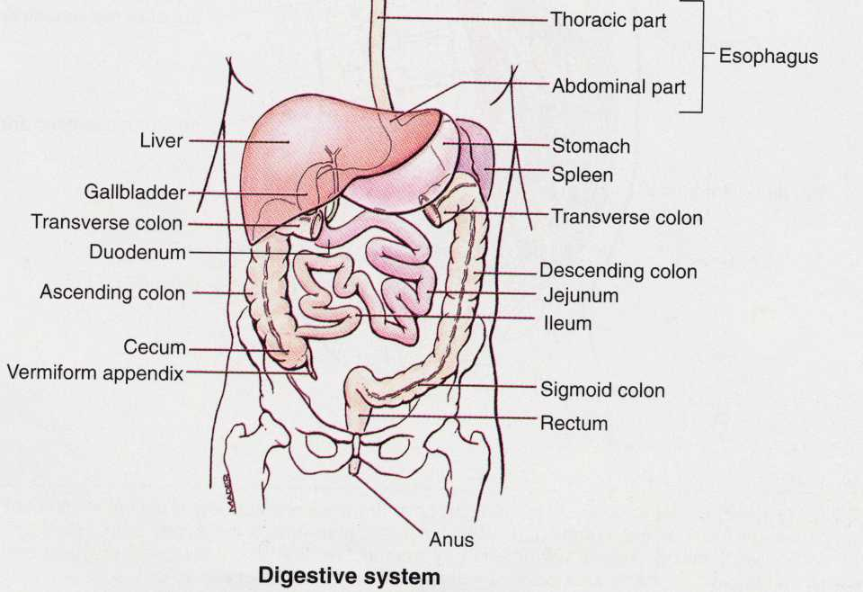
The Abdomino-Pelvic Cavity
and the Digestive Tract
This part is under the thoracic cage just below the thoracic diaphragm
 | Mouth and pharynx
 | Esophagus
 | Stomach
 | Duodenum
 | Jejunum & ileum
 | Caecum and large intestine
 | Sigmoid colon, rectum and anus
This part is within the pelvic cavity just above the pelvic floor

Slide 6
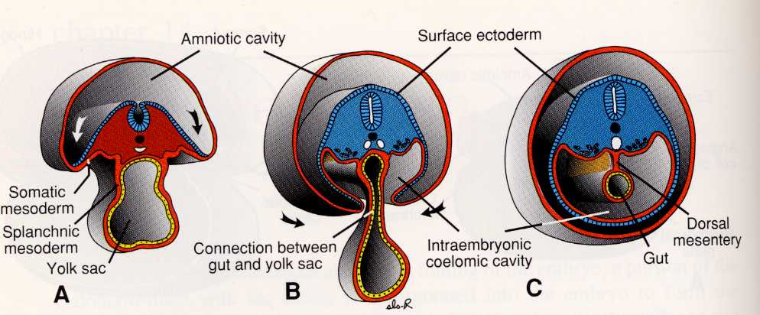
Early Development - Gut Tube
endoderm
Splanchnic mesoderm
+ 4 wk IUL
The gut tube originates from the endoderm and splanchnic mesoderm (splanchnic Gr.= pertaining to visceral organ)
It is suspended from the posterior abdominal wall by a peritoneal fold – the dorsal mesentery

Slide 7
Mesenteries
Peritoneal folds attaching viscera to the abdominal wall.
Conduit for VESSELS, NERVES and LYMPHATICS supplying viscera.
VISCERAL peritoneum – covering the suspended organs
PARIETAL peritoneum – lines the abdominal wall.
Parietal Peritoneum
Visceral Peritoneum
Mesentery
Viscera
e.g. Bowel
Peritoneal Cavity
Posterior/Dorsal
Notes:
Mesenteries – peritoneal folds attaching viscera to the abdominal wall
They contain the vessels, nerves and lymphatics that supply the viscera
Two types of peritoneum can be defined by the presence of abdominal organs
Visceral peritoneum surrounding the viscera
Parietal peritoneum lines the abdomainl cavity.

Slide 8
INTRAperitoneal vs. RETROperitoneal
INTRAperitoneal – structures, e.g. most of small intestine, suspended from the abdominal wall by mesenteries.
RETROperitoneal – structures, e.g. kidneys and great vessels that lie between parietal peritoneum and abdominal wall.
Anterior/Ventral
INTRAperitoneal
RETROperitoneal
Great Vessels
Kidneys
Notes:
We describe viscera that are surrounded by peritoneum (e.g. most of small intestine) as being intraperitoneal.
IMPORTANT – notice that the viscera are not actually within the peritoneal cavity.
Again the situation is analagous to the plural cavities where the lungs are not actually within the plural cavities.
One way to better understand the anatomy is to visualise the peritoneum as a plastic bag. Imagine wrapping your hand in the plastic bag rather than putting you hand inside the bag.
Intraperitoneal is therefore a misnomer.
Abdominal organs that are not surrounded by peritoneum (e.g. kidneys) are called retroperitoneal.

Slide 9
Retroperitoneal Organs
On the posterior abdominal wall:
Kidneys & ureters
Suprarenal glands
Aorta/Inferior vena cava
Nerves: lumbar plexus, sympathetic trunk
Oesophagus
Rectum
Duodenum (except the first part) *
Pancreas (tail is INTRAperitoneal) *
Colon (ascending and descending only)*
* These organs originally had a mesentery, then became secondarily retroperitoneal when the mesentery fused with the body wall

Slide 10
Divisions of the GI tract
FOREGUT – Distal 3rd of oesophagus to the 2nd part of the duodenum at the entrance of the bile duct (Major duodenal papilla).
MIDGUT – 2nd part of the duodenum to two-thirds along transverse colon.
HINDGUT – Distal third of transverse colon to the rectum.
Notes:
Before we discus the formation of the GI tract you must understand the various divisions:
Forgut – abdominal oesophagus – dueodenum at enttrance of common bile duct (Major duodenal papilla)
Midgut – Major duodenal papilla – 2/3rds along transverse colon
Hindgut – distal third of transverse colon to rectum
Each part of the GI tract has its own arterial supply, coeliac trunk, superior mesenteric artery and hindgut.

Slide 11
Dorsal & Ventral Mesenteries
The ENTIRE gut tube is suspended from a DORSAL mesentery
In addition, the FOREGUT has a VENTRAL mesentery
Notes:
Before we discus the formation of the GI tract you must understand the various divisions:
Forgut – abdominal oesophagus – dueodenum at enttrance of common bile duct (Major duodenal papilla)
Midgut – Major duodenal papilla – 2/3rds along transverse colon
Hindgut – distal third of transverse colon to rectum
Each part of the GI tract has its own arterial supply, coeliac trunk, superior mesenteric artery and hindgut.

Slide 12
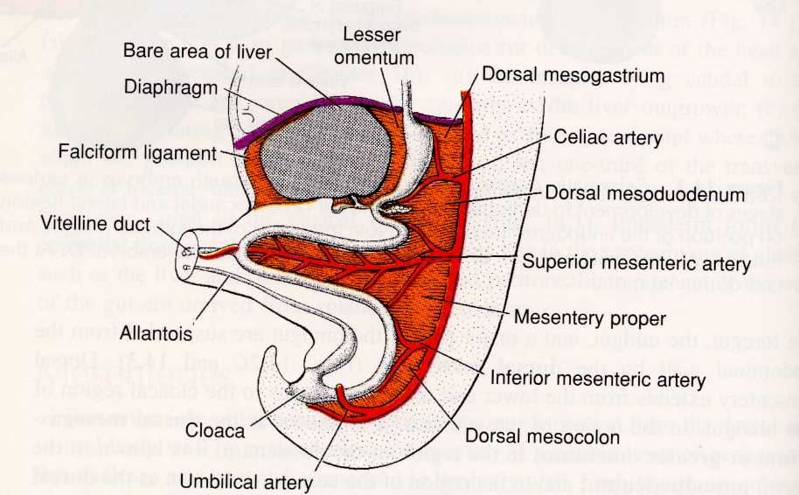
Dorsal & Ventral Mesenteries
Ventral
Dorsal mesentery
The foregut also has a ventral mesentery containing the liver, which splits it into the falciform ligament and the lesser omentum

Slide 13
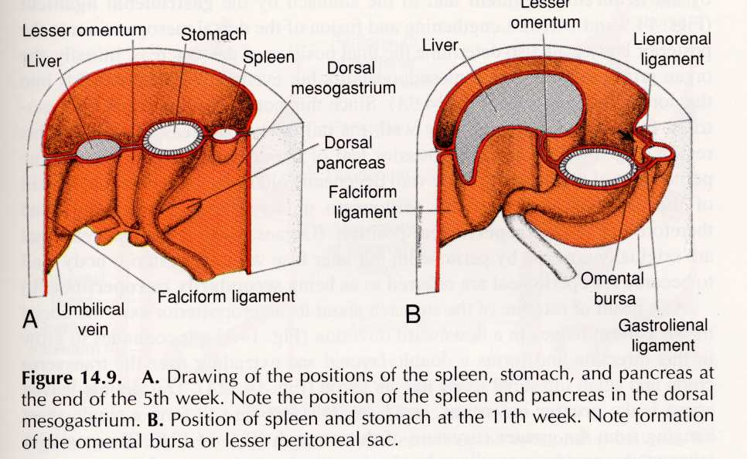
Formation of the Omental Bursa (lesser sac) of the peritoneal cavity
right
right
posterior
anterior
As the liver grows, it moves to the right while the dorsal mesentery and spleen move to the left. The original right side of the upper peritoneal cavity is now posterior – the lesser sac of the peritoneal cavity

Slide 14
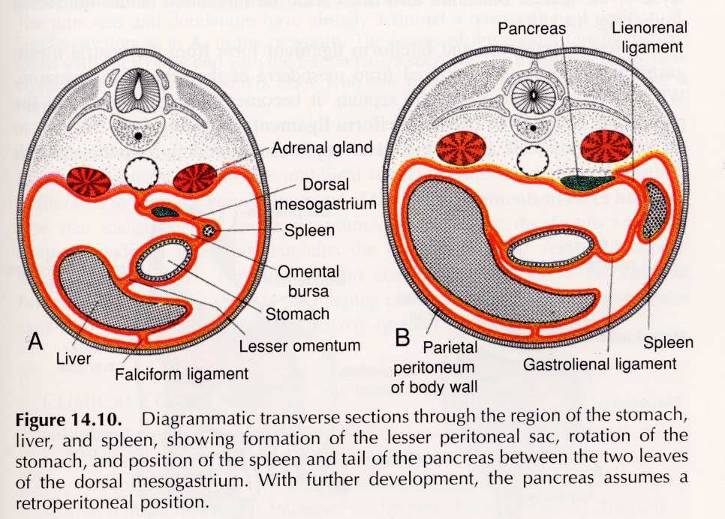
Omental Bursa (lesser sac)
right
Right
Omental bursa
stomach
Another view of formation of the lesser peritoneal sac (omental bursa). This is difficult but important – work on it!

Slide 15
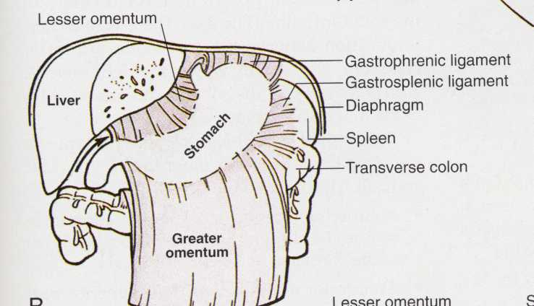
Greater and Lesser Omentum
diaphragm
Epiploic foramen- the entrance to the lesser sac
The lower part of the dorsal foregut mesentery extends down as a double fold called the greater omentum (= apron) anterior to the intestine. The lesser omentum is part of the ventral foregut mesentery.

Slide 16
Rotation of the gut, formation of the omental bursa and the greater omentum
This slide is reserved for a video clip

Slide 17
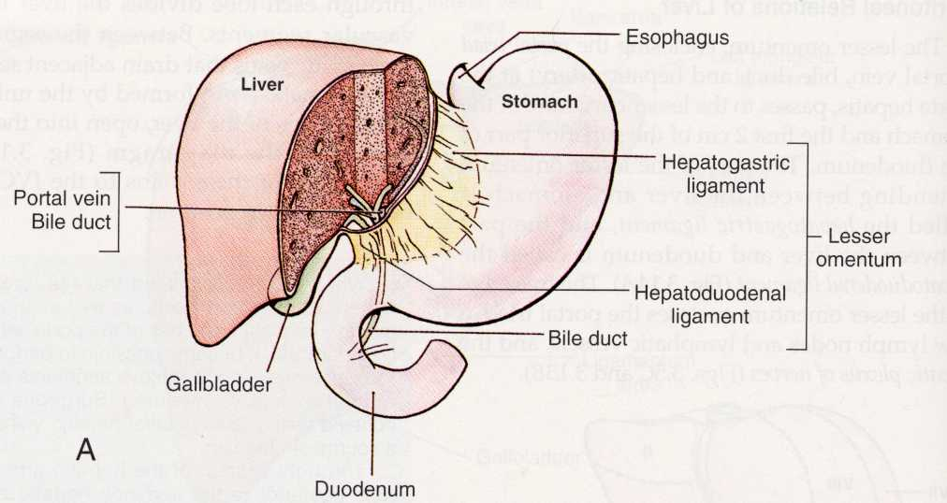
Lesser Omentun
lesser omentum
portal vein, hepatic artery and bile duct run here
The portal vein, hepatic artery and bile duct run between the posterior abdominal wall and liver within the lesser omentum near its free edge. This free edge is present because the ventral mesentery ends at the start of the midgut.

Slide 18
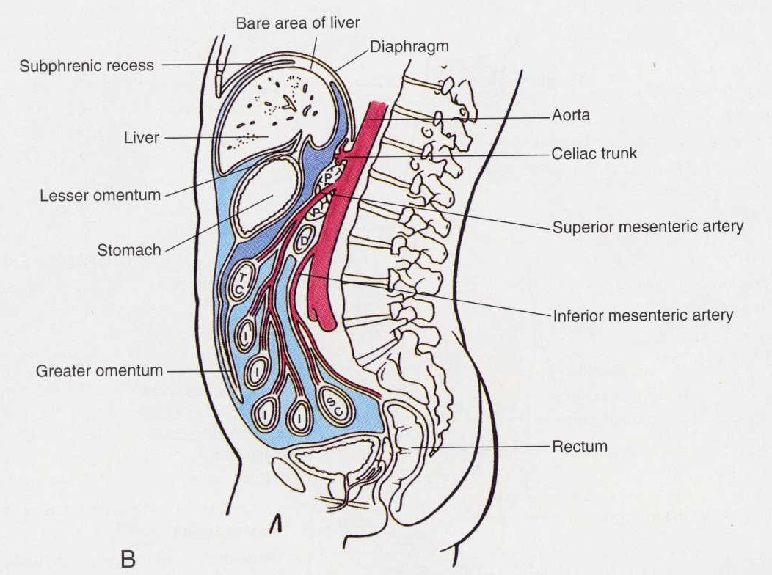
Greater & Lesser sacs in a sgittal view
lesser sac
greater sac
Peritoneal cavity in sagittal section showing the arrangement of the grater sac (light blue) and lesser sac (dark blue). Please note that these are potential capillary thin spaces which are exaggerated in this picture for illustrative purposes

Slide 19
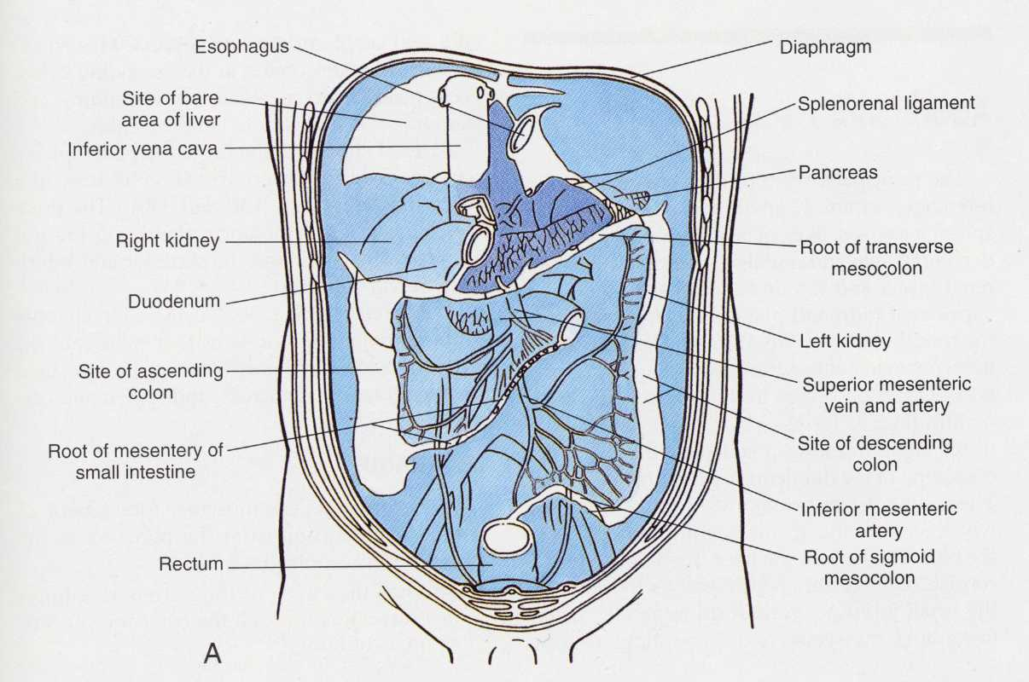
Peritoneal Compartments
Supracolic compartment
Mesentery of transverse colon
Infracolic
Compartment
(Right & Left)
Rt. paracolic gutter
Lt. paracolic gutter
Mesentery of small intestine
Posterior abdominal wall
Anterior view

Slide 20
Directions of Fluid Movement
Inflammatory exudate towards pelvis
peritoneal fluid towards diaphragm
Panel A
Panel B

Slide 21
GI Tract – General Plan
Mesentery
Muscularis:
Mucosa:
Serosa:
submucosa

Slide 22
Abdominal Oesophagus
T10
Right crus of diaphragm
T12
Aorta
Oesophagus
Oesophagus pierces diaphragm at T10
Pierces muscular part of diaphragm – contributes to LOWER OESOPHAGEAL SPHINCTER (LOS)
Notes:
Moving on to discuss the abdominal organs
Distal oesophagus pierces the diaphragm at T10
Goes through the muscular part of the diaphragm which is important because it contributes to the formation of the Lower Oesophageal Sphincter which prevents gastro-oesophageal reflux

Slide 23
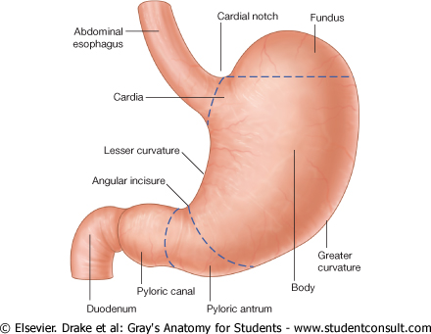
Stomach
Fundus
Pyloric
canal
Body
Pyloric
antrum
A ring of smooth muscle at distal end of PYLORIC CANAL prevents food entering duodenum – PYLORIC SPHINCTER
25/47
Notes:
Four main parts to the stomach:
-the cardia surrounding the openning
-the fundus
-the body
-pyloric region consisting of pyloric antrum and pyloric canal
Clinical note – on chest x-rays be aware that you can often see a gas bubble in the fundus of the stomach lying directly beneath diaphragm. Do not confuse this air bubble with air in the peritoneum, say from an intestinal perforation.
Pyloric canal contains pyloric sphincter which prevents food entering the duodenum

Slide 24
Duodenum
1
2
4
3
FIRST part of duodenum = DUODENAL CAP
Most duodenal ulcers occur here
SECOND part of duodenum contains entrance for common bile duct – MAJOR DUODENAL PAPILLA
Most of the duodenum is RETROPERITONEAL.
Notes:
Duodenum split into four parts:
Superior / first part – duodenal cap, common place for peptic ulcers. Passes anteriorly to bile duct, gastroduodenal artery, portal vein and IVC.
Descending / second part – contains minor and major duodenal pappillae where accessory pancreatic duct and bile duct enter respectively.
Inferior / third – part – crosses IVC and has SMA anterior to it.
Ascending / fourth part – terminates at duodenaojejunal flexure.
The relations of the duodenum are important clinically. Anurysms can compress the duodenum or ulcers can erode into the walls of vessels.

Slide 25
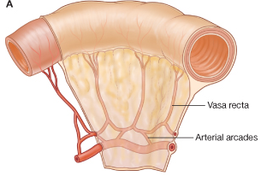
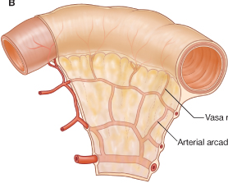
Jejunum Vs Ileum
Vasa
recta
Arterial arcades
Proximal two-fifths
Larger in diameter
Upper left quadrant of abdomen
Less prominent ARTERIAL ARCADES
Longer VASA RECTA
Distal three-fifths
Smaller in diameter
Lower right quadrant of abdomen
Prominent ARTERIAL ARCADES
Shorter VASA RECTA
Notes:
Jejunum and ileum make up the rest of the small intestine and are intraperitoneal.
It is difficult to distinguish the jejunum from the ileum by diameter alone but there are other features, particularly the arterial arcades and the vasa recta.

Slide 26
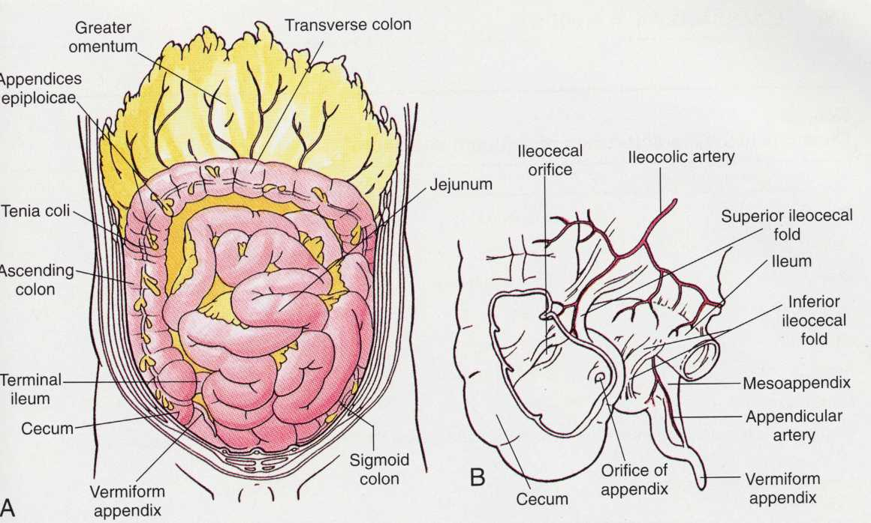
The Large Intestine
Haustra (pocketed walls)
Note the features distinguishing large from small intestine: fatty tags (appendices epiploicae), ribbons of longitudinal muscle (taeniae coli) and segmented or pocketed walls. Diameter is not always a reliable guide.

Slide 27
Blood supply to the gut
3 UNPAIRED arteries arising from the anterior of the AORTA
COELIAC TRUNK = FOREGUT, liver, pancreas and spleen
SUPERIOR MESENTERIC ARTERY (SMA) = MIDGUT
INFERIOR MESENTERIC ARTERY (IMA) = HINDGUT
Notes:
Remember – GI tract is divided into three, each with their own blood supply arising from the aorta.

Slide 28
Arterial Supply of Liver, Spleen & GI Tract
Coeliac Trunk (artery to forgut)
Inferior mesenteric (artery to hindgut)
Superior mesenteric (artery to midgut)

Slide 29
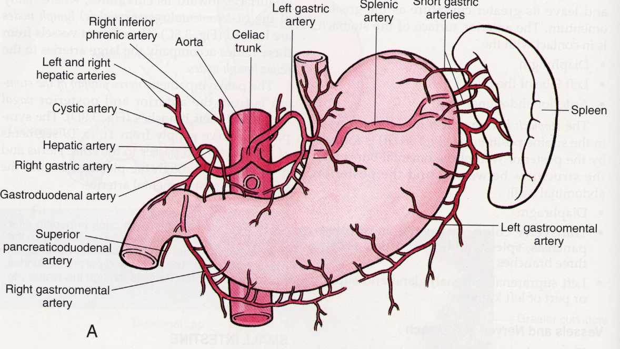
The Coeliac Trunk
Coeliac trunk
Common hepatic artery
The coeliac trunk (or axis) supplies the entire foregut (lower oesophagus, stomach, upper duodenum) and its derivatives (liver and part of pancreas). The spleen, though not part of the alimentary system, shares its blood supply from the coeliac trunk.

Slide 30
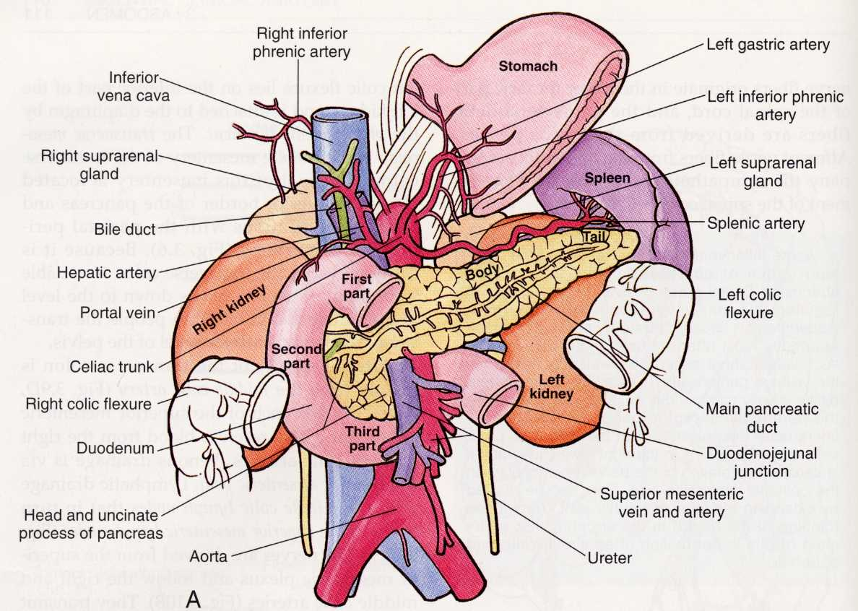
Structures Behind the Stomach and Liver
Coeliac trunk
Superior Mesenteric
artery & vein
This “block” of structures forms the posterior relations of the liver and stomach & is part of the retroperitoneum

Slide 31
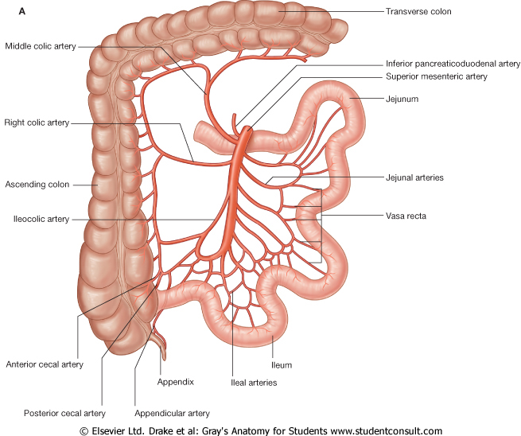
Branches of Superior Mesenteric Artery
Middle colic artery
Right colic artery
Jejunal arteries
ileocolic artery
Ileal arteries

Slide 32
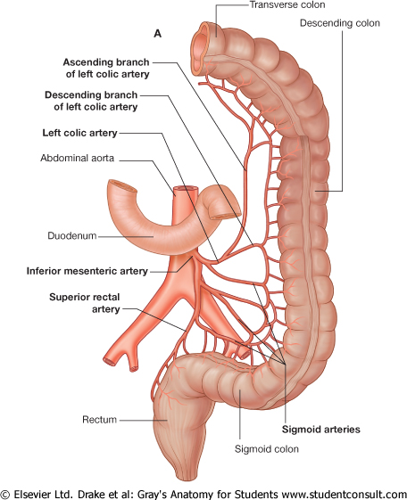
Branches of Inferior Mesenteric Artery
The junction of the mid- and hindgut is near the left (splenic) flexure of the colon.
There is a change from superior to inferior mesenteric artery supply at this level, but with anastomoses between them.

Slide 33
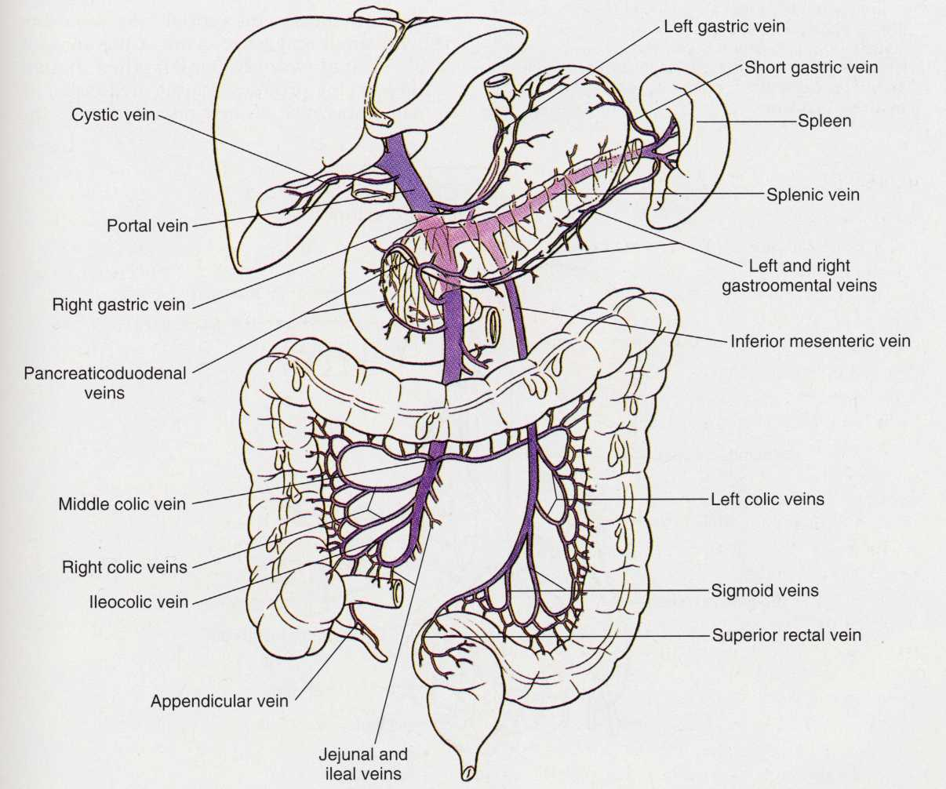
Venous Drainage
Splenic v
Portal vein
Inferior mesenteric vein
Superior mesenteric v
The portal vein arises from the superior mesenteric and splenic veins posterior to the 1st part of the duodenum / pylorus of the stomach. It then runs in the free edge of the lesser omentum to the liver. It drains blood from all abdominal viscera and liver

Slide 34
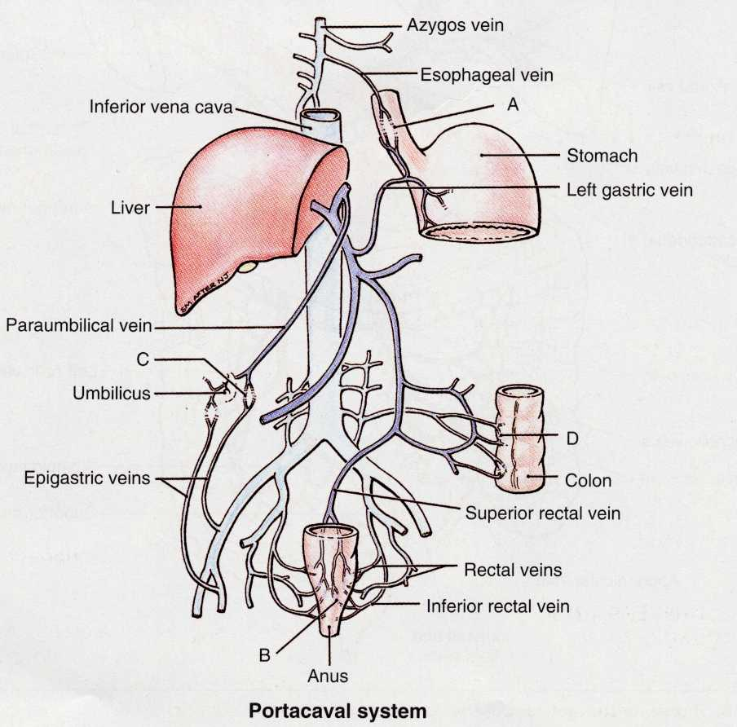
A
The portal-systemic anastomoses are where veins draining to the portal vein and the IVC communicate.
Liver or portal obstruction causes these veins to dilate widely, possibly leading to severe venous haemorrhage from oesophagus or rectum
Colic veins and posterior abdominal wall veins
D
C
B
Porto-systemic anastomses

Slide 35
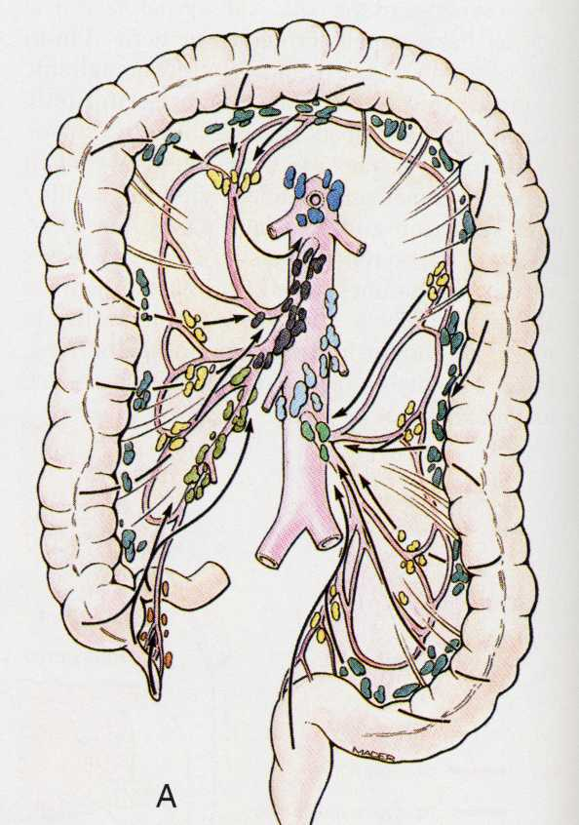
Lymphatics
Thoracic duct
Coeliac nodes
The lymphatic drainage of the bowel follows the arterial supply, not the venous drainage.
All lymph drains into the cisterna chyli.
Cisterna chyli is an elongated lymphatic sac located in front of the L1 & L2 bodies
The thoracic duct commences from the cisterna chyli
Cisterna chyli
Superior mesenteric nodes
inferior mesenteric nodes

Slide 36
Innervation of the gut
Abdominal viscera supplied by AUTONOMIC nervous system.
Sensory fibres most important
Parasympathetic sensory (regulate reflex gut function):
VAGUS NERVE
PELVIC SPLANCHNIC NERVES (S2-S4)
Sympathetic sensory (mediate PAIN):
THORACIC SPLANCHNIC (T5-T12)
LUMBAR SPLANCHNIC (L1+L2)
Notes:
Clinically, sensory fibres are most important because they relay pain.

Slide 37
Thoracic Splanchnic Ns.
Greater Splanchnic N. (T5-T9)
Lesser Splanchnic N. (T10-T11)
Least Splanchnic N. (T12)
Thoracic Splanchnic N. (T5-T12)
Lumbar Splanchnic N. (L1 + L2)
Pelvic Splanchnic N. S2-S4

Slide 38
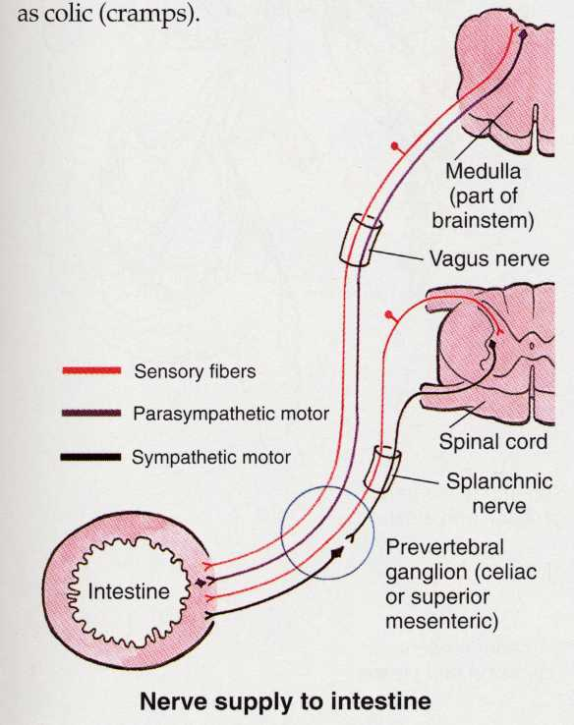
Innervation: the sensory fibres are most important.
In the viscera:
Sensory fibres running with the sympathetic (T1-L2) mediate pain
Sensory fibres running with the parasympathetic (vagus or sacral) are involved in reflex regulation of gut function

Slide 39
The Gut and the Peritoneal Cavity
To see an animation of the embryological development of the gut and mesentery please access the SIMBRYO Software at:
https://education.med.imperial.ac.uk/Systems/Simbryo/index.html
Any Questions?

