Slide 1
Water balance
Paul Kemp

Slide 2
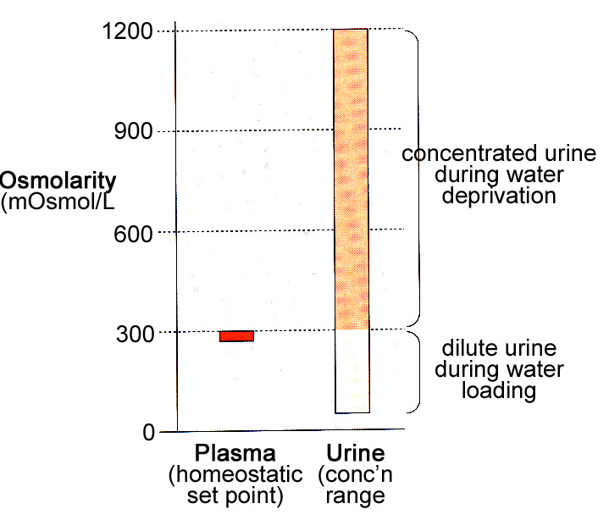
Osmolarity = measure of the solute concentration in a solution (osmoles/liter; 1 Osmole = 1 mole of dissolved solutes per liter); depends on the number of dissolved solutes present. The greater the number of dissolved particles, the greater the osmolarity

Slide 3
Water flows across a semi permeable membrane from a region of low osmolarity to a region of high osmolarity

Slide 4
H₂O

Slide 5
H₂O

Slide 6
Variable osmolarity
Increased salt
Decreased water
Decreased salt
Increased water
Increased osmolarity
Decreased osmolarity
Regulation of water and salt balance are inter-related
Increased volume
Decreased volume
Increased salt
Increased water
Decreased salt
Decreased water
Constant osmolarity

Slide 7
On an average day we consume 20-25% more water and salt than we need to replace that lost.

Slide 8
Must get rid of the excess volume
Or you will become oedematous and your blood pressure will increase
Must get rid of any excess water
or you will dilute the salt in your body
Cells will swell
Must get rid of any excess salt
or you will have too high a level of salt
Cells will shrink
Notes:
.

Slide 9
Plasma composition
Normal plasma osmolarity
= 285-295 mosmol/l
Sodium ~ 140 mmol/l
chloride ~ 105 mmol/l
bicarbonate ~ 24 mmol/l
potassium ~ 4 mmol/l
Glucose ~ 3-8 mmol/l
Calcium ~ 2 mmol/l
Protein ~ 1 mmol/l
Water: most abundant component of the plasma and ECF
Sodium: most prevalent solute in the plasma and ECF

Slide 10
Water balance is used to regulate plasma osmolarity
The level of salt determines the ECF volume

Slide 11
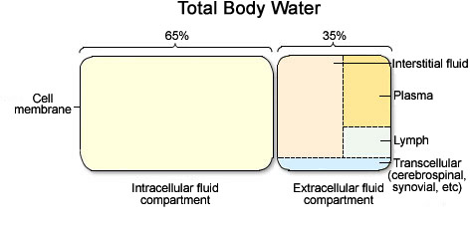
25L 15L
Notes:
.

Slide 12
How do we get rid of water?
fever
Skin and sweat: variable but uncontrollable
Normally about 450 mls/day
climate
activity
Faeces: uncontrollable
normally about 100 ml/day
Diahorrea up to 20L/day with cholera!
Respiration: uncontrollable
350mls/day
activity
Urine output: variable and controllable
1500 mls/day
Notes:
.

Slide 13
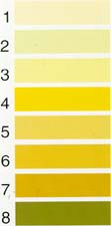
Target range
Dehydration
Severe Dehydration

Slide 14
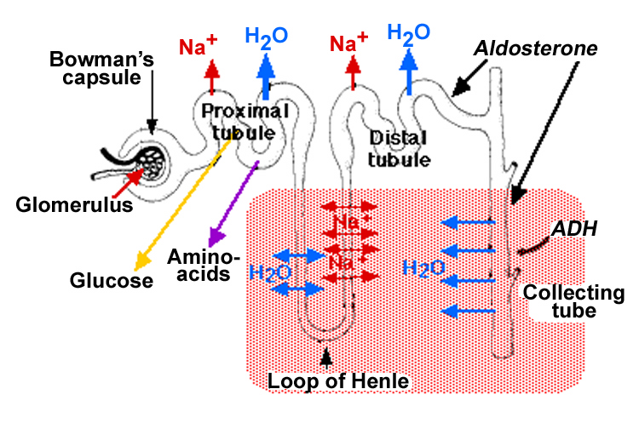

Slide 15
Water
Fraction of filtered load reaching different points in the nephron
~ 20%
125mls/min
180L/day
~ 30%
~ 40mls/min
~ 60L/day
Very Variable << 1% to ~ 10%
0.7-1.4mls/min
1-2L/day

Slide 16
So, how do the kidneys make concentrated (or dilute) urine?

Slide 17
Water moves by Osmosis
How can you concentrate urine above normal plasma osmolarity?
Produce a region of ‘hyperosmolar’ interstitial fluid

Slide 18
Interstitial osmolarity
290
Cortex
290
400
Outer
medulla
550
800
Inner
medulla
1000
Cannot pump water so must have the gradient
1200
mosmol/l
How is this gradient established?

Slide 19
Generating the gradient
Na+/Cl-
Water out
Urea

Slide 20
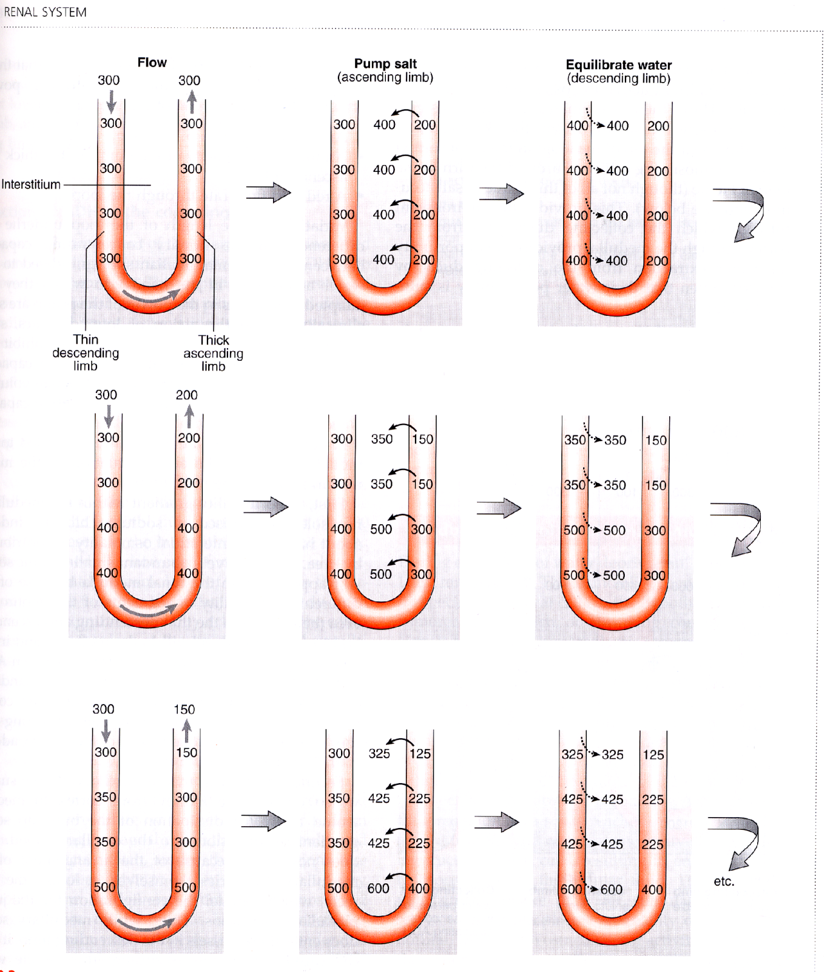
Establishing the gradient

Slide 21
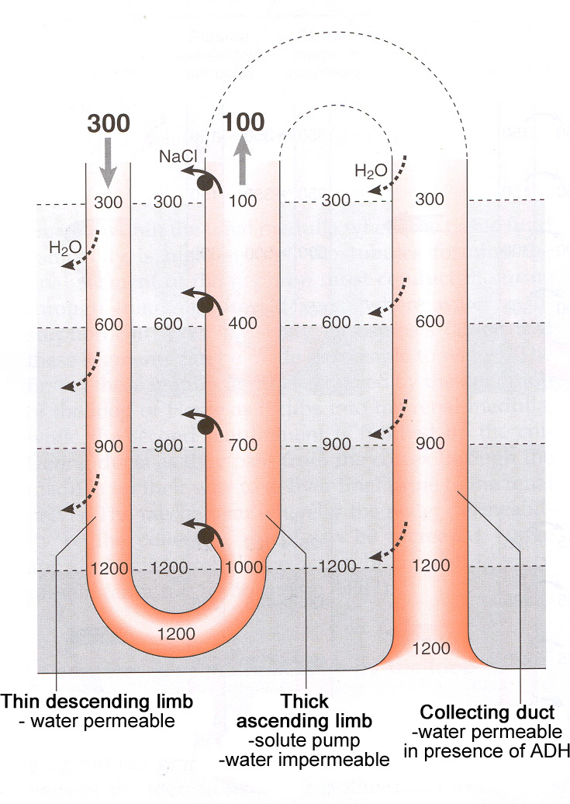
Permeable to Urea
UREA

Slide 22
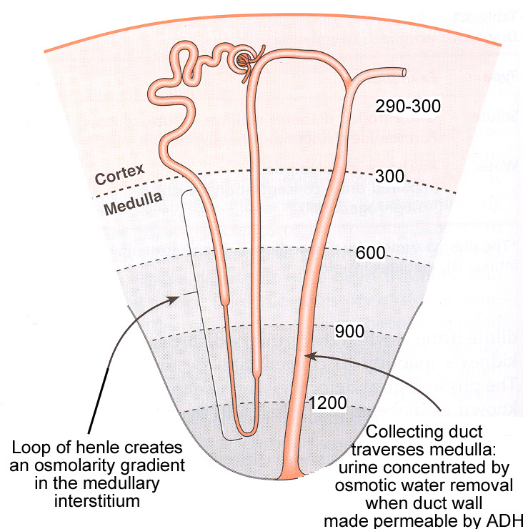
Very tight cell junctions

Slide 23
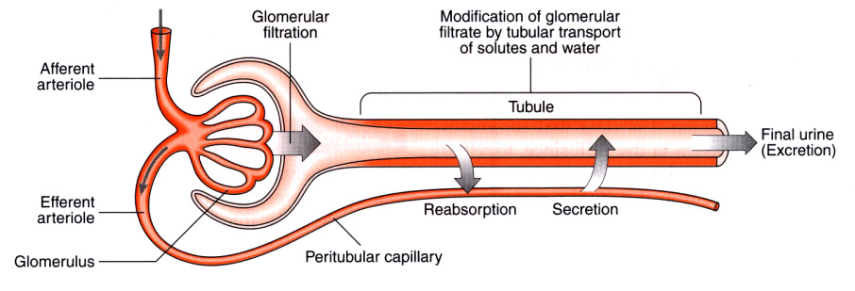
Why doesn’t medullary blood flow eliminate countercurrent gradient?
Notes:
.

Slide 24
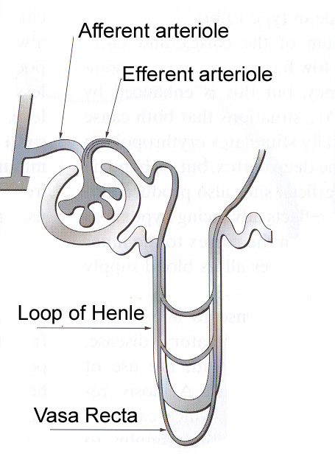
Vasa Recta
Permeable to water and solutes.
Water diffuses out of descending limb and solutes diffuse into descending limb.
In the ascending limb the reverse happens.
Thus oxygen and nutrients are delivered without loss of Gradient.

Slide 25
where does the variability come from?
Loop of Henle generates a hyperosmolar environment
~ 20%
125mls/min
180L/day
Vasopressin/ADH
~ 30%
~ 40mls/min
~ 60L/day
Very Variable << 1% to ~ 10%
0.7-1.4mls/min
1-2L/day

Slide 26
Peptide hormone
(9 amino acids)
Synthesised in the hypothalamus
Packaged into granules
Vasopressin (ADH; antidiuretic hormone)
Secreted from the posterior pituitary (neurohypophysis)
Binds to specific receptors on basolateral membrane of principal cells in the collecting ducts

Slide 27
Regulation of a passive uptake system
Causes insertion of water channels (aquaporins) into the cells luminal membrane, hence increasing water permeability
Also stimulates urea transport from IMCD into thin ascending limb of loop of Henle and interstitial tissue
ADH

Slide 28
What triggers ADH release?
-Plasma osmolarity is normally 285 - 295mosmol/L;
-ADH release regulated by osmoreceptors in the hypothalamus (if osmolarity rises above 300mOs = triggers release)
-Also stimulated by a marked fall in blood volume or pressure (monitered via baroreceptors or stretch receptors)
-Ethanol inhibits ADH release, which leads to dehydration as urine volume increases

Slide 29
Water permeability
Cortex
Outer
medulla
Inner
medulla
Water permeability
permeable
impermeable
ADH-dependent

Slide 30
Water Load
Increased fluid loss will tend to raise plasma osmolarity
Plasma
osmolarity
Hypothalamic
osmoreceptors
Urine flow
rate
ADH release
Collecting duct
water permeability

Slide 31
Water diuresis (low ADH)
NaCl
NaCl
Cortex
285
285
85
285
70
285
Outer
medulla
Result:
A large
volume
of dilute
urine
400
60
Inner
medulla
600
NaCl
Solute reabsorption without water reabsorption can lower urine osmolarity to 50 mosmol/l
800
50

Slide 32
Dehydration
Increased water intake will tend to lower plasma osmolarity
Thirst
Plasma
osmolarity
Hypothalamic
osmoreceptors
Decreased fluid loss will tend to lower plasma osmolarity
Urine flow
rate
ADH release
Collecting duct
water permeability

Slide 33
Maximal antidiuresis (high ADH)
NaCl
NaCl
Cortex
H₂O
295
295
95
H₂O
295
295
Outer
medulla
Result:
A small
volume
of
concentrated
urine
H₂O
600
600
Inner
medulla
H₂O
900
900
NaCl
Osmotic equilibration in cortex & medulla leads to high urine osmolarity
H₂O
1200
1200

Slide 34
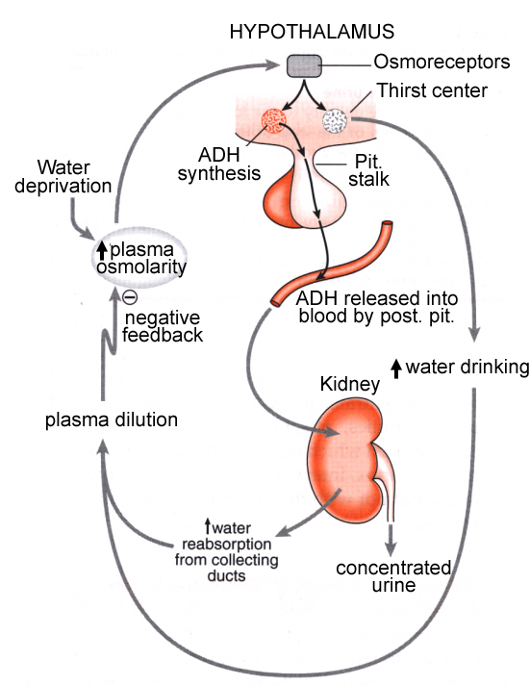

Slide 35
-Feedback control via ADH keeps plasma osmolarity in a normal range (and determines urine output and water balance)

Slide 37
Disorders of water balance
No / insufficient production of ADH
No detection of ADH
No response to ADH signal (mutant aquaporin)
(mutant ADH receptor)
x
x
x
Cortex
x
Cortex
H₂O
H₂O
H₂O
295
H₂O
295
295
295
95
295
295
95
295
95
Outer
medulla
Excretion of large amounts of watery urine (as much as 30 litres each day)
Unremitting thirst
Outer
medulla
x
x
H₂O
H₂O
95
600
600
600
x
x
H₂O
Inner
medulla
H₂O
Inner
medulla
900
95
900
900
NaCl
x
NaCl
x
Diabetes insipidus
H₂O
H₂O
95
900

Slide 38
Summary
-Loop of Henle establishes concentration gradient of Na and Cl in medulla.
-ADH controls permeability of Collecting duct to water (due to high osmolarity in medulla, water will in presence of ADH, by osmosis, move into medulla and into peritubular veins).
-ADH released by posterior pituitary.
-ADH keeps ECF osmolarity in tight range by controlling water reabsorption (but does not determine ECF volume).

