Slide 1
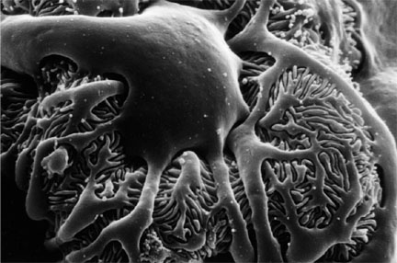
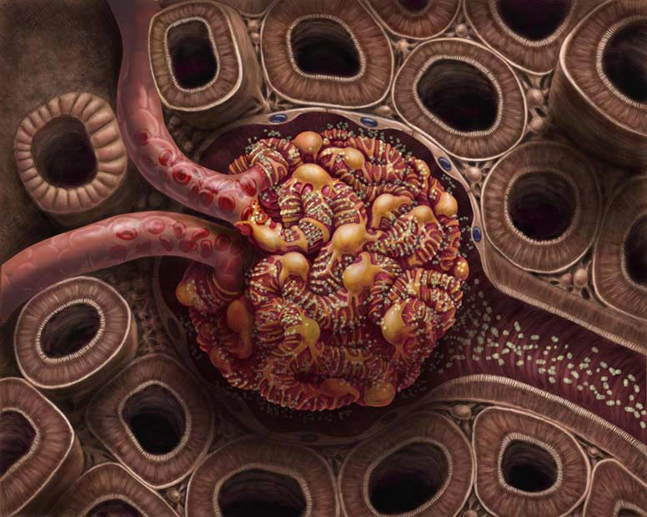
Renal blood flow and glomerular filtration
Dr Michael Emerson
National Heart and Lung Institute
Imperial College London
m.emerson@imperial.ac.uk
10 May 2013

Slide 2
Glomerular filtration?
What is kidney failure?

Slide 3
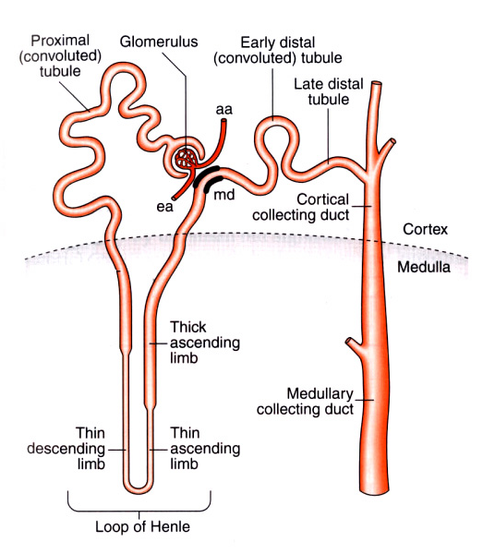
Glomerular filtration
Definition: formation of an ultrafiltrate of plasma in the glomerulus
An abrupt fall in glomerular filtration is renal failure
Abnormalities in renal circulation lead to reduced glomerular filtration i.e. renal failure.

Slide 4
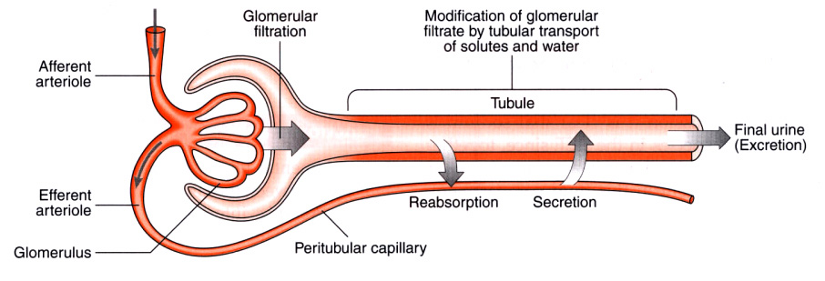
Glomerular filtration
Passive process: fluid is ‘driven’ through the semipermeable (fenestrated) walls of the glomerular capillaries into the Bowmans capsule space by the hydrostatic pressure of heart.
The filtration barrier (fenestrated endothelium of capillaries and semipermeable Bowman’s capsule) is highly permeable to:
fluids
small solutes (these are “freely filtered”: same concentration in filtrate and plasma)
But impermeable to:
cells
proteins
drugs etc carried bound to protein
A clear fluid (ultrafiltrate), completely free from blood and proteins, is produced containing electrolytes and small solutes = ‘primary urine’

Slide 5
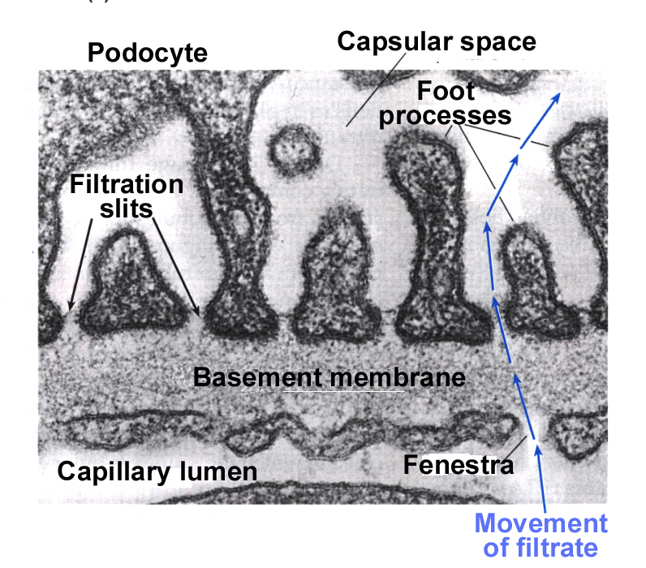

Slide 6
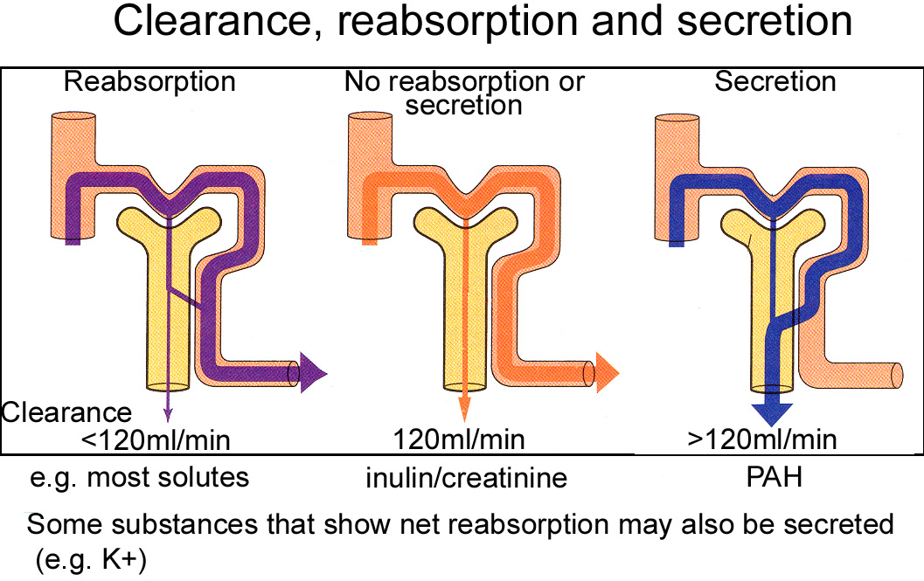
Basic Renal Process
Primary urine
Renal input = renal artery
Amount
excreted
=
Amount
filtered
+
Amount
secreted
-
Amount
absorbed
Renal output = renal vein
and ureter
Not all substances undergo all processes

Slide 7
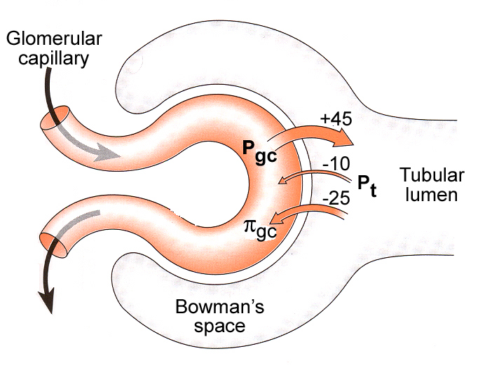
Glomerular Filtration Pressures
Driving force = hydrostatic pressure in glomerular capillaries (due to blood pressure) (P_{gc})
Opposing pressures: hydrostatic pressure of tubule (P_{t})
osmotic pressure of plasma proteins in glomerular capillaries (π_{gc})
Together these determine the net ultrafiltration pressure (P_{uf})
P_{uf} = P_{gc}- P_{t}- π_{gc}

Slide 8
Dynamics of ultrafiltration
P_{uf} = P_{gc} - P_{t} - π_{gc}
Ultimately there is a net ultrafiltration pressure of 10-20mmHg.
Glomerular Filtration Rate:
GFR = P_{uf} x K_{f}
Where K_{f} is an ultrafiltration coefficient (membrane permeability and available for filtration).
Any changes in filtration forces or K_{f} will result in GFR imbalances.
Kidney diseases may reduce number of functioning glomeruli = reduced surface area = K_{f}
Dilation of glomerular arterioles by drugs/hormones will K_{f}

Slide 9

Glomerular Filtration Rate (GFR)
GFR = The amount of fluid filtered from the glomeruli into the Bowmans capsule per unit of time (ml/min).
Sum of filtration rate of all functioning nephrons
Loss of nephrons = loss of surface area = fall in K_{f} = fall in GFR
Index of kidney function

Slide 10
Renal Blood Blow
Delivers oxygen, nutrients and substances for excretion
Renal blood flow (RBF) = approx (1/5 of cardiac output)
Renal plasma flow (RPF) = approx
Filtration fraction (FF) = 0.2 (ratio between RPF and amount of filtrate filtered by glomerulus, which is normally 20%)
Glomerular filtration rate (GFR) = RPF x FF and is approx (volume of filtrate formed in 1 minute) – is kept within a narrow range….
What influences the GFR? How does it work?
80%
20%
100%

Slide 11
GFR depends on a number of factors:
Glomerular capillary pressure (P_{gc})
Plasma oncotic pressure (π_{gc})
Tubular pressure (P_{t})
Glomerular capillary surface area or permeability (K_{f}).
GFR is not a fixed value but is subject to physiological regulation. This is achieved by neural or hormonal input to the afferent/efferent arteriole resulting in changes in P_{uf}.

Slide 12
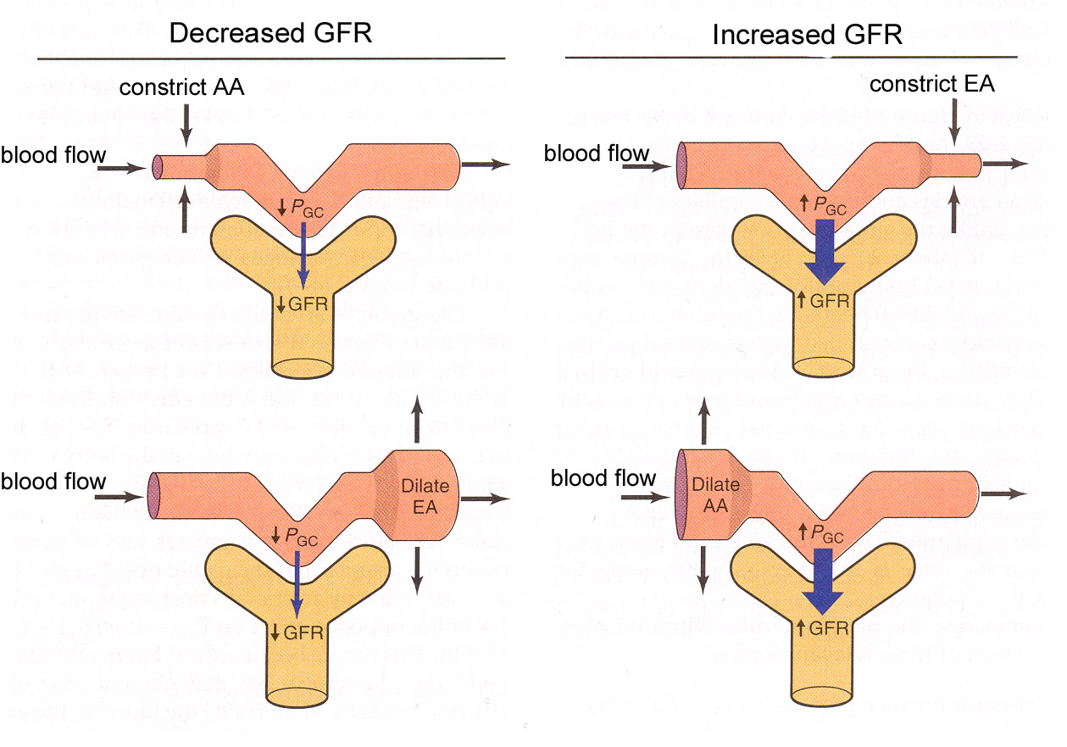
Autoregulation of the GFR
Autoregulation ensures fluid and solute excretion remain reasonably constant (otherwise varying pressure will vary urine production and cause loss of important ions).

Slide 13
Mechanisms of Autoregulation (1)
1. Myogenic mechanism:
Vascular smooth muscle constricts when stretched.
Keeps GFR constant when blood pressure rises.
Arterial pressure rises → afferent arteriole stretches →
arteriole contracts → (vessel resistance increases)→ blood flow reduces and GFR remains constant:

Slide 14
Mechanisms of Autoregulation (2)
2. Tubuloglomerular feedback
NaCl concentration in fluid sensed by macula densa in juxtaglomerular apparatus
Macula densa signals afferent arteriole and changes its resistance and so GFR
↑NaCl
ATP released by
Macula densa
Vasoconstrict
afferent arteriole
↓filtration
Negative feedback

Slide 15

Events affecting GFR
Cause Effect on GFR
Severe haemorrhage
Obstruction in nephron tubule
Reduced plasma protein concentration
Small increase in blood pressure
In a normal individual carrying out a daily routine, GFR and RBF will be maintained at 120ml/min.

Slide 16
Quantifying renal function: Renal clearance
As substances in the blood pass through the kidney they are filtered to different degrees. The extent to which they are removed from the blood is called clearance. Clearance is the number of litres of plasma that are completely cleared of the substance per unit time.
Defined by equation: C = U x V ml/min
P
U = concentration of substance in urine
P = concentration of substance in plasma
V = rate of urine production
e.g for Na, suppose P = 145mM, U = 290mM, V = 1ml/min.

Slide 17

Estimation of GFR using clearance:
If a molecule is freely filtered and neither reabsorbed nor secreted in the nephron then the amount filtered equals amount excreted. Thus GFR can be measured by measuring clearance of this molecule
Hard to find such a molecule.. However…..
Inulin: - a plant polysaccharide
- freely filtered and neither reabsorbed nor secreted
- not toxic
- measureable in urine and plasma.
Gives a clearance value of which is GFR for average adult.
But not found in mammals so needs to be transfused therefore use an endogenous molecule with a similar clearance.

Slide 18
Practical measurement of GFR:
GFR in humans is normally estimated from creatinine clearance.
Creatinine:
a waste product from creatine in muscle metabolism
amount of creatinine released is fairly constant
if renal function stable, amount creatinine in urine is stable
low values of creatinine clearance may indicate renal failure
high plasma creatinine may indicate renal failure

Slide 19
Some values for renal clearance:
Na 1.0ml/min
K 11.0ml/min
Ca 1.8ml/min
Mg 3.6ml/min
Phosphate 6.4ml/min
Glucose 0.05ml/min
Urea 17.0ml/min
Inulin 120.0ml/min
PAH 625.0ml/min

Slide 20
Renal Plasma Flow (RPF)
Measured by PAH (Para aminohippurate) clearance = 625ml/min
Filtered and actively secreted in one pass of the kidney, thus can be used to measure RPF.
In other words the all of the PAH is removed from the plasma passing through the kidney so its clearance equals the renal plasma flow (look again at the definition of clearance).

Slide 21
Clearance, reabsorption and secretion
The amount of substance appearing in the urine reflects the combined effects of filtration, reabsorption from nephron tubule to blood and secretion from blood into the tubular fluid, such that:
Amount excreted = amount filtered - amount reabsorbed + amount secreted
Controlled excretion
GFR
RPF

Slide 22
RENAL DIAGNOSTICS
A fall in GFR is the cardinal feature of renal disease
If GFR falls, excretory products will build up in the plasma.
A raised plasma concentration of creatinine is diagnostic of renal disease.
Excretion of many other substances will also be impaired in renal failure - including some drugs. This needs to be taken into account when calculating drug doses - PHARMACOKINETICS.

Slide 23
You should know:
Where in the kidney nephron filtration occurs and understand the concept of filtration (concentration).
Why measuring glomerular filtration is important
Filtration is a passive process through fenestrated barriers producing a clear ultrafiltrate
The pressures which determine the net ultrafiltration pressure and GFR (equations) and their significance
How a constant GFR is maintained (myogenic mechanism and tubuloglomerular feedback)
Factors affecting GFR (and why)?
Understand the concept of renal clearance
How to measure GFR and renal blood flow using clearance

Slide 24
Integrated functions of the kidney
Excretion of metabolic products e.g. urea, uric acid, creatinine
Excretion of foreign substances (drugs) -
Homeostasis of: body fluids
electrolytes
acid-base balance
Regulate blood pressure -
Secrete hormones (renin, erythropoietin) -
Cell volume

