Slide 1
The oesophagus & stomach; structure function relationships
Chris John
Monday 29 April 2013

Slide 2
Lecture Plan
List the main functions of the oesophagus
2. Define the anatomical levels and relations of the oesophagus
3. Summarize the organization of muscle types and function within the oesophagus
4. Define the structural basis for the gastro-oesophageal sphincter
5. Define the epithelial type that lines the oesophagus and explain how this is adapted to its function
6. List the main functions of the stomach
7. Demarcate the functionally distinct regions of the gastric mucosa
8. Sketch and label a typical acid- and enzyme-secreting gastric gland
9. Summarize the functions of the cell types named in 8
10. Using simple diagrams, explain the mechanism of secretion of pepsinogen by the chief cells
11. Using simple diagrams, explain the mechanism of secretion of HCl by the oxyntic cells
12. Summarize the control of gastric secretion and outline the basis for the use of H2 inhibitors and proton pump inhibitors in pharmacological control of gastric acid secretion

Slide 3
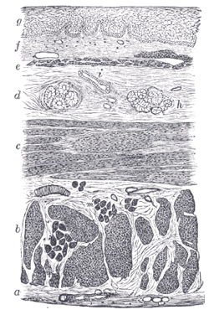
Basic Plan of Gut Wall
Mucosa: epithelium
lamina propria (loose connective tissue) muscularis mucosae
Submucosa: connective tissue (containing nerve plexus)
Muscularis: smooth muscle
(containing nerve plexus)
Serosa/Adventitia:
connective tissue +/-
epithelium
Oesophagus

Slide 4
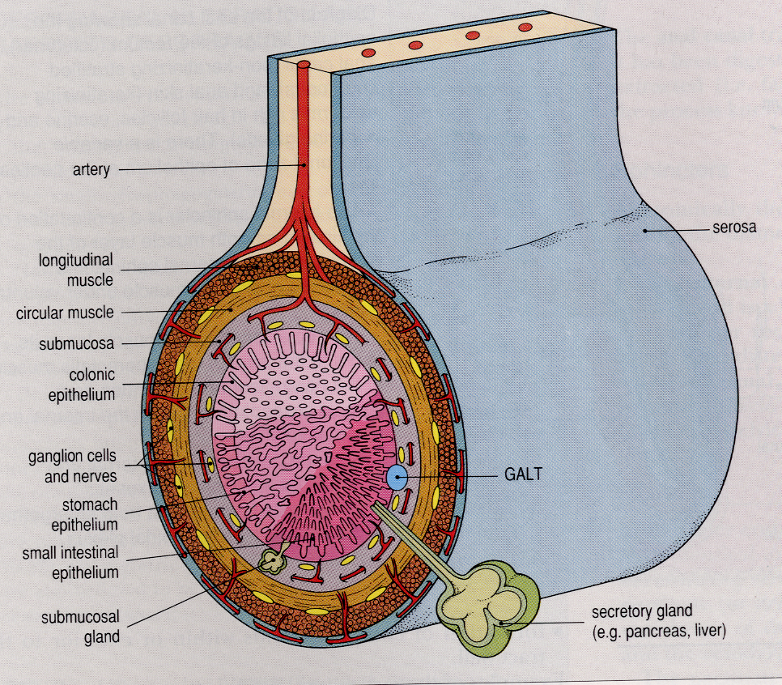
Basic Plan of Gut Wall
1 = Mucosa
2 = Sub-mucosa
3 = Muscularis
4 = Serosa/
Adventitia
3
4
3
2
1
2, 3
1
1
2

Slide 5
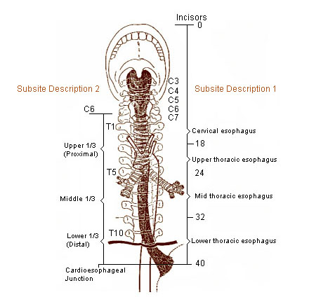
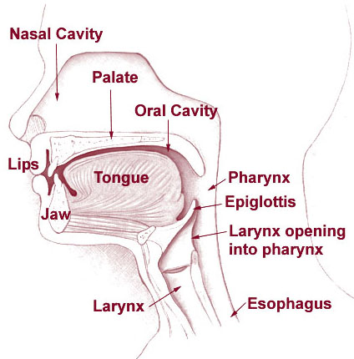
LO2
The oesophagus:
Impt;
Recurrent laryngeal
nerves
Pericardium
Start
Trachea
Aorta
End
Diaphragm

Slide 6
The oesophagus:
LO1, LO5
Function: Conduit for food, drink and swallowed secretions from pharynx to stomach
Structure-function relationship - Epithelium
-Non-keratinising
‘Wear & Tear’ lining
(extremes of temp. & texture)
Lubrication – Mucus secreting glands
(also saliva)

Slide 7
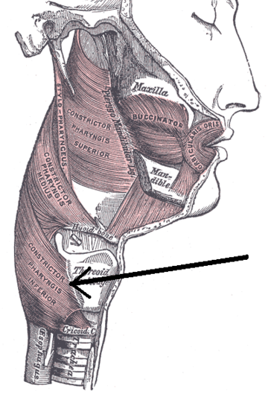
The oesophagus:
LO1, 4 & 5
Function: Conduit for food, drink and swallowed secretions from pharynx to stomach
Structure-function relationship - Muscle
Upper oesophageal
sphincter
Lower oesophageal
sphincter
Tonically active
Swallowing center
Skeletal
muscle
Skeletal
& smooth
muscle

Slide 8
The oesophagus:
LO1, 4 & 5
Function: Conduit for food, drink and swallowed secretions from pharynx to stomach
Structure-function relationship - Muscle
Skeletal
Skeletal
/Smooth
Smooth

Slide 9
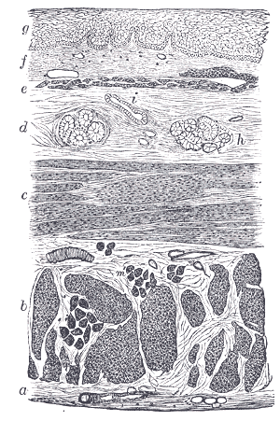
LO3
The oesophagus:
Function: Conduit for food, drink and swallowed secretions from pharynx to stomach
Structure-function relationship - Muscle
Peristalsis
Circular Muscle
Circular
Contract
Longitudinal
Food
Relax

Slide 10
LO4
Gastro-Oesophageal Junction:
Gastro-Oesophageal Junction: Reflux – prevented by diaphragm Epithelial transition Gastric folds - rugae

Slide 11
LO6
Stomach
Functions: Break food down into smaller particles stored (due to acid & pepsin); hold food and release at a controlled steady rate into duodenum; kill parasites & certain bacteria
Invaginates into mucosa – Tubular glands
Cardia & Pyloric Region: Mucus only Body & Fundus: Mucus, HCl, pepsinogen Antrum: Gastrin

Slide 12
LO7, 8, 9
Stomach
Antrum Body & Fundus Cardia & Pyloric
Acid
2L/day
150mM H⁺
(3 mill x that in blood)
Mucins = gel
Coating
HCO³⁻ trapped
in mucus gel
pH at;
Epithelial surface = 6-7
Lumen = 1-2
Pepsinogen
HCl
Mucus
HCO³⁻/
Mucus
Gastrin

Slide 13
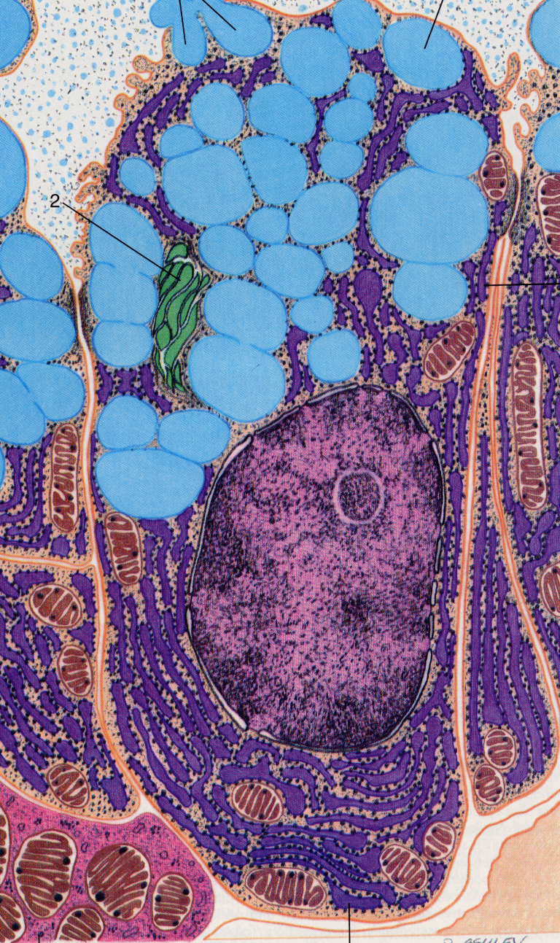
LO10
Stomach – Chief Cell
Gastric Chief Cell
Protein-secreting epithelial cell
Abundant RER
Golgi packaging and modifying for export
Masses of apical secretion granules
Secretes pepsinogen

Slide 14
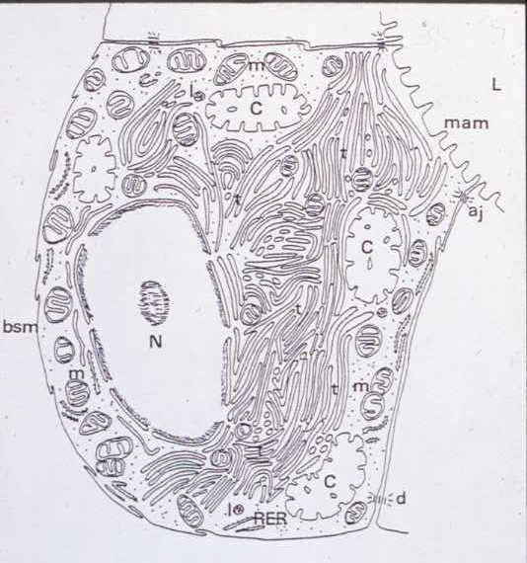
LO10
Stomach – Parietal Cell
Parietal Cell: Resting
Many mitochondria (requires lots of ATP)
Cytoplasmic tubulovesicles (contain H⁺/K⁺ ATPase)
Internal canaliculi (extend to apical surface)
M
C
M
M
C
M
T
M
T
T
T

Slide 15
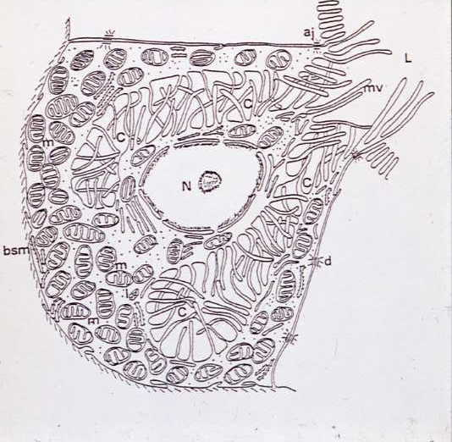
LO11
Stomach – Parietal Cell
Parietal Cell: Secreting
Tubulovesicles fuse with membrane and microvilli project into canaliculi

Slide 16
LO11
Stomach – Parietal Cell
Gastric lumen
Cannaliculi
(fused with TV
∴↑ H+/K+ ATPase)
Cl⁻
ATP
H⁺
HCO₃⁻
Parietal cell
Carbonic
Anhydrase
Na⁺
+H₂O
CO₂
K⁺
Interstitial fluid/Capillaries

Slide 17
LO11
Stomach – Parietal Cell
Gastric lumen
H⁺
Cannaliculi
(fused with TV
∴↑ H+/K+ ATPase)
Cl⁻
K⁺
ATP
HCO₃⁻
Parietal cell
+H₂O
Carbonic
Anhydrase
CO₂
Na⁺
Interstitial fluid/Capillaries

Slide 18
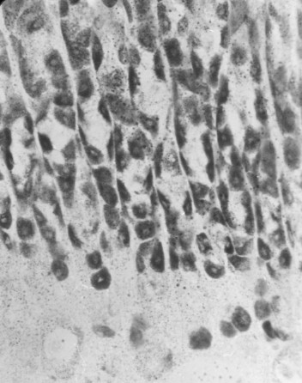
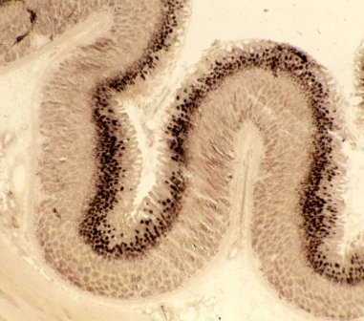
LO11
Stomach – Parietal Cell

Slide 19
LO11
Stomach – Parietal Cell
WTF?

Slide 20
LO11
Stomach – Parietal Cell
H+/K+ ATPase
Carbonic Anhydrase

Slide 21
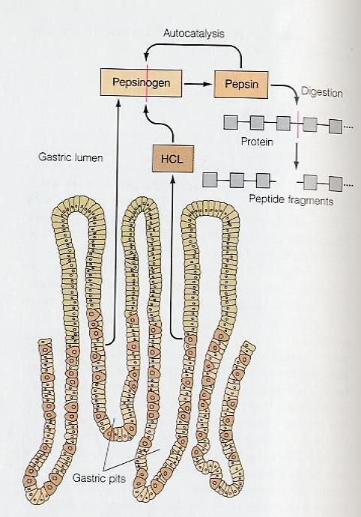
LO10
Stomach – Pepsinogen

Slide 22
Stomach – Gastrin
Pyloric antrum
Local peptide hormones – Gastrin
Stimulate histamine release from
chromaffin cells (lamina propia)

Slide 23
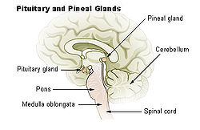
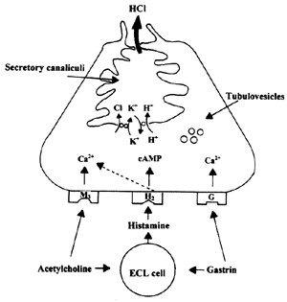
Three Phases of Gastric Secretion 1 – Cephalic Phase
LO12
Thought, sight, smell & taste of food (conditioned)
Cardiac
sphincter
Vagus
Pyloric
sphincter
Fundus
Middle
Pylorus
HCl
pepsin
gastrin

Slide 24
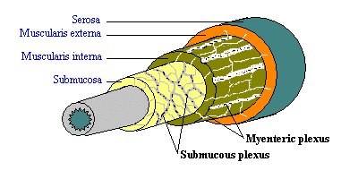
Three Phases of Gastric Secretion 2 – Gastric Phase
LO12
Food in stomach – stretch - and chemo-receptors
Local reflexes
Vagus
Distension
Vagus
Fundus
Middle
Pylorus
Pyloric
sphincter
HCl
pepsin

Slide 25
Three Phases of Gastric Secretion 3 – Intestinal Phase
LO12
Excitatory intestinal phase:
Protein concentration in
Duodenum
Stimulates gastrin secretion.
1.
Fundus
Middle
Pylorus
Gastric inhibitory peptide
Cholecystokinin
Secretin
Pyloric
sphincter
X
HCl
pepsin
Enterogastrones:
Enterogastric reflex
pH < 2
or lipids
3.
2.
Chyme

Slide 26
Stomach – Pharmacology
LO12
Omeprazole
Ranitidine

