Slide 1
Immunological mechanisms and infections of the alimentary tract

Slide 2
Why Mucosal Immunology?

Slide 3
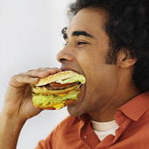
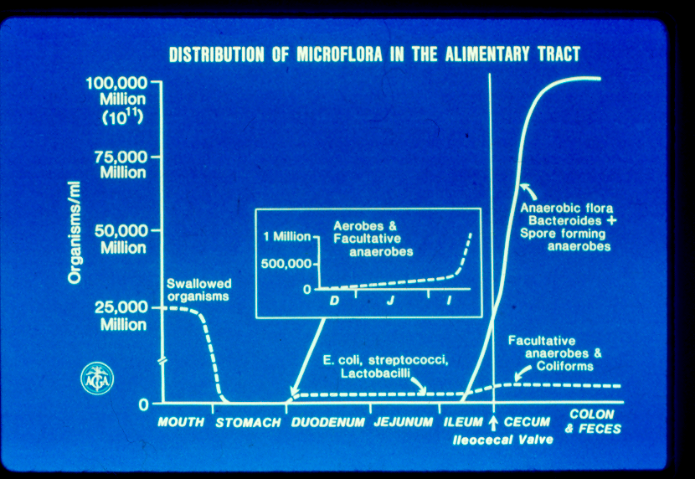
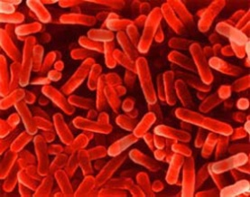
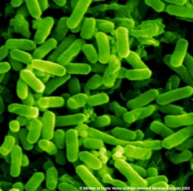

Slide 4
Oral candidiasis

Slide 5
Gastric: Helicobacter pylori

Slide 6
Traveller’s diarrhoea.
Main causes
Escherichia coli (E coli)
Shigella
Salmonella
Cholera
Rotavirus
Norovirus
Giardia

Slide 7
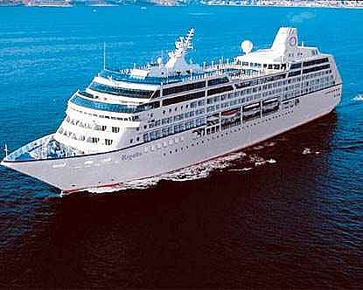
Norovirus
acute gastroenteritis <3 days
incubation 24-48 hours
Faeco-oral transmission
May be infectious for up to 2 weeks
NORWALK VIRUS GASTROENTERITIS ABOARD A CRUISE SHIP: AN OUTBREAK ON FIVE CONSECUTIVE CRUISES
ROBERT A. GUNN1, WILLIAM A. TERRANOVA1, HARRY B. GREENBERG2, JOHN YASHUK1, G. WILLIAM GARY3, JOY G. WELLS1, PHILIP R. TAYLOR1 and ROGER A. FELDMAN1

Slide 8
CHOLERA: Vibrio cholerae
MILD……..FULL BLOWN
Liquid stool…….coma in 4-12 hours
Peristalsis …..gurgling
Rice water stools
Salt and water loss
Hypovolaemic shock

Slide 9
Cholera - treatment
Fluid replacement
Salt
Water
Sugar
IV fluids

Slide 10
E coli
STRAINS AND TOXINS
Enterotoxigenic:
Cholera like toxin
watery diarrhoea
Enterohaemorrhagic:
EO157/H7
Verotoxin/shigatoxin
Haemolytic uraemic syndrome
Enteropathogenic: EPEC
nurseries
Enteroinvasive:
shigella like illness
bloody diarrhoea
megacolon

Slide 11
E coli
Route
School trips to farms
Unpasteurised milk
Burgers
Treatment
Supportive usually
Severe infection:
antibiotics

Slide 12
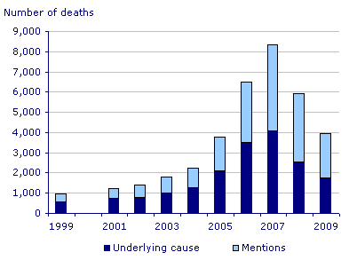
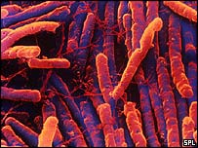
Superbugs for the 21st century
Superbug kills almost as many as die on roads
By Celia Hall, Medical Editor
Last Updated: 1:12AM BST 06/04/2007
Deaths from the hospital superbug, Clostridium difficile, are fast approaching the number of road fatalities, an expert says today. He says that patients due to have routine operations should be screened for the bug in an attempt to stop the rise in infections. Dr John Starr, reader in geriatric medicine at the University of Edinburgh, says that cases of C difficile rose by 5.5 per cent over a year while MRSA cases fell by 4.3 per cent. "With more than 2,200 deaths attributed to C difficile in death certificates in England and Wales, the mortality rate is fast approaching that for road traffic accidents and is now around half that for suicide," he says in the British Medical Journal.
Road deaths in 2004 were 2,915
Notes:
Hospitals. Elderly people. Cause through excessive use of antibiotics. Since more rational use of antibiotics the superbug cases havegone down.

Slide 13
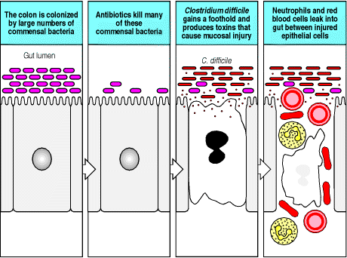
Superbugs for the 21st century

Slide 14
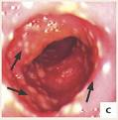
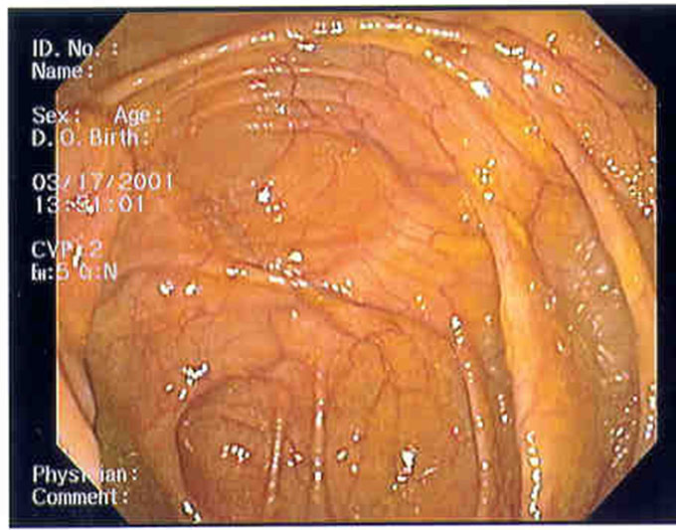
C Difficile
Pseudomembranous colitis (antibiotic associated colitis)
A+B toxins
Notes:
Normal colon. Inflamed colon. White bits are pseudomembraneous colitis

Slide 15
Treatment
Isolate
Stop current antibiotics
Metronidazole
Vancomycin

Slide 16
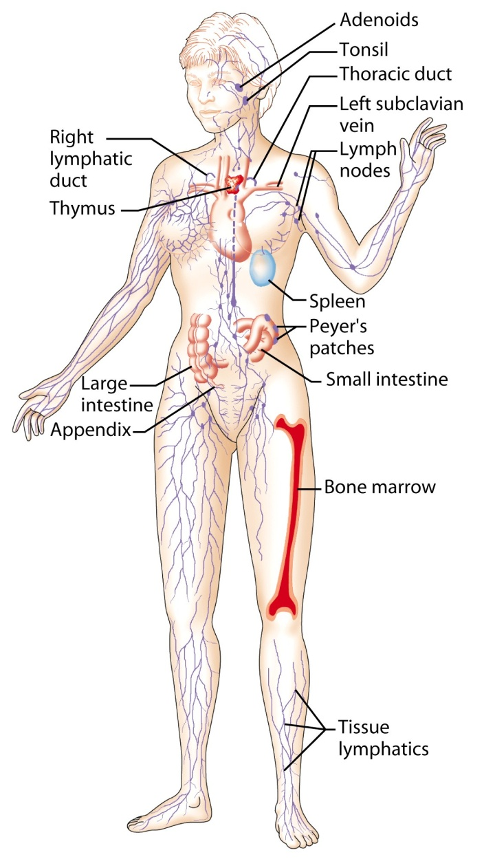
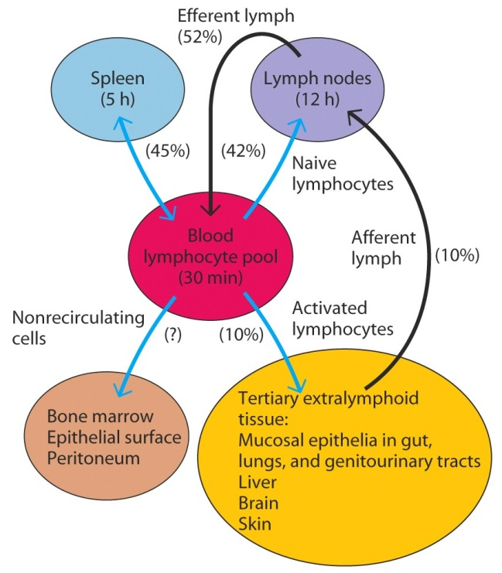
Lymphoid tissues
Lymphoid circulation

Slide 17
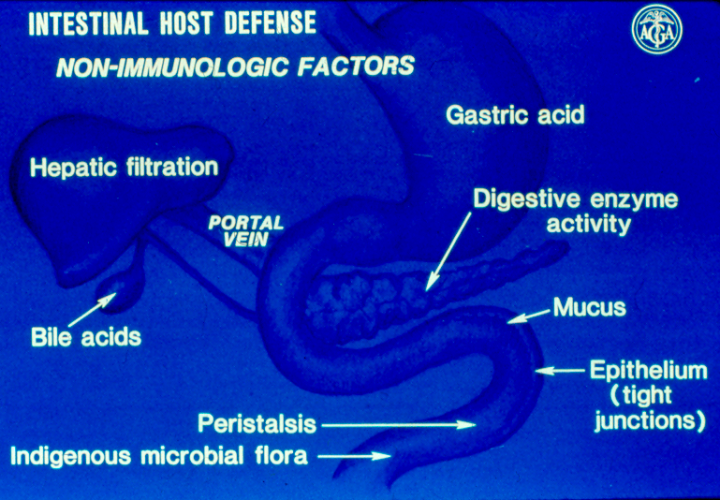
Mucosal defence
Non-immune mechanisms
Anatomical
Peristalsis
Mucus
Enterocyte membrane
Chemical
Gastric acid
Enzymes (proteases)
Oral flora
Peristalsis
Commensal bacteria
Oral and Gut flora
Immune mechanisms: MALT, GALT

Slide 18
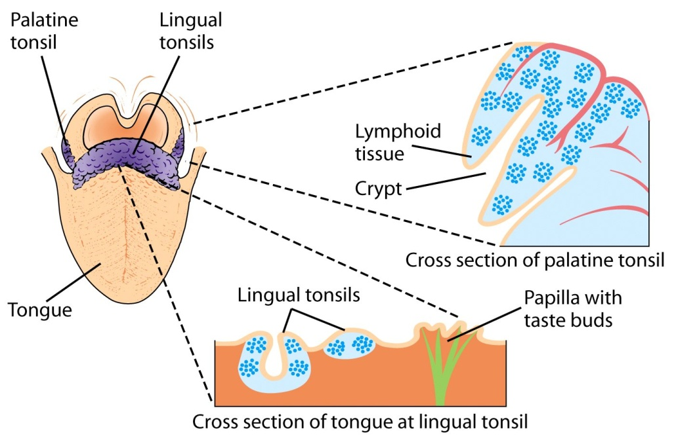
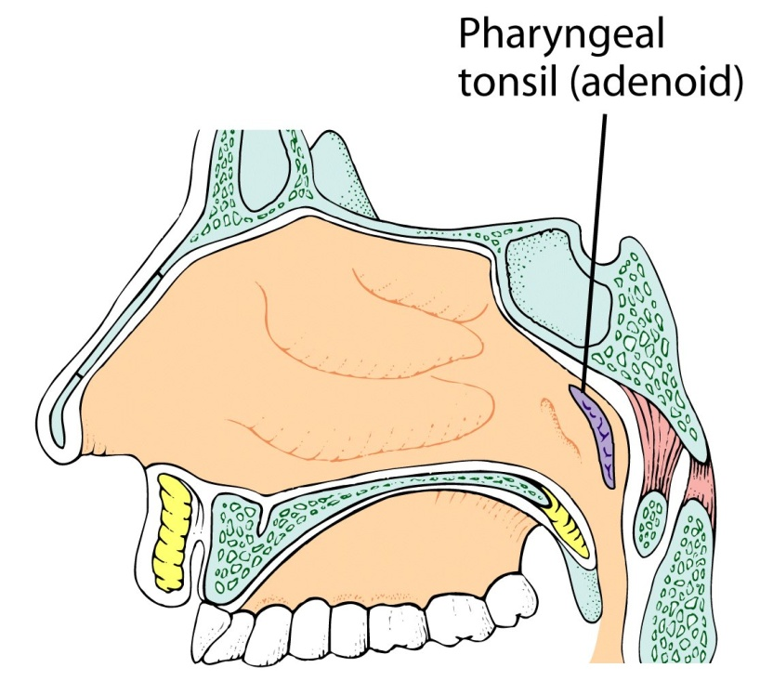
The oral cavity is rich in immunological tissue (MALT: mucosa associated lymphoid tissue)

Slide 19
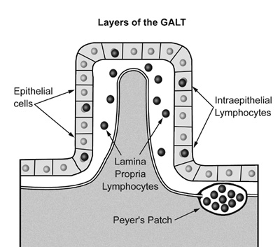
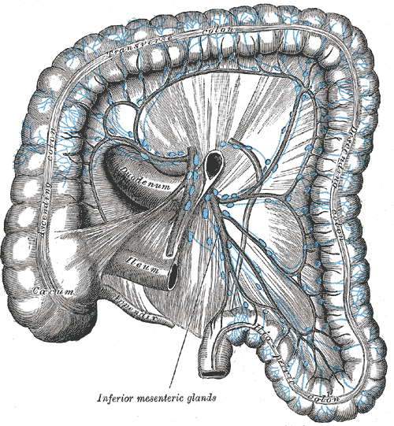
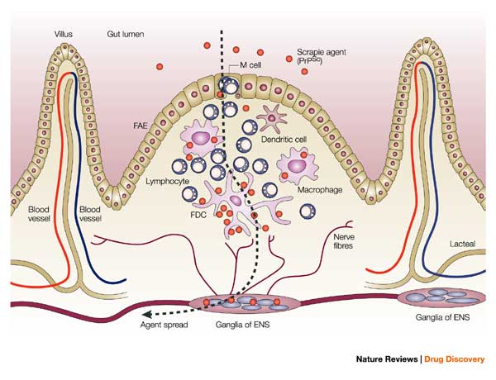
GALT (Gut Associated Lymphoid Tissue)
Not organised
Intra-epithelial lymphocytes
Lamina propria lymphocytes
Organised
Cryptopatches
Peyer’s patches
Isolated lymphoid follicles
Mesenteric lymph nodes

Slide 20
GALT - what it does
Generates lymphoid cells and antibodies
IgA secretory and interstitial
IgG
IgM
Cell mediated immunity

Slide 21
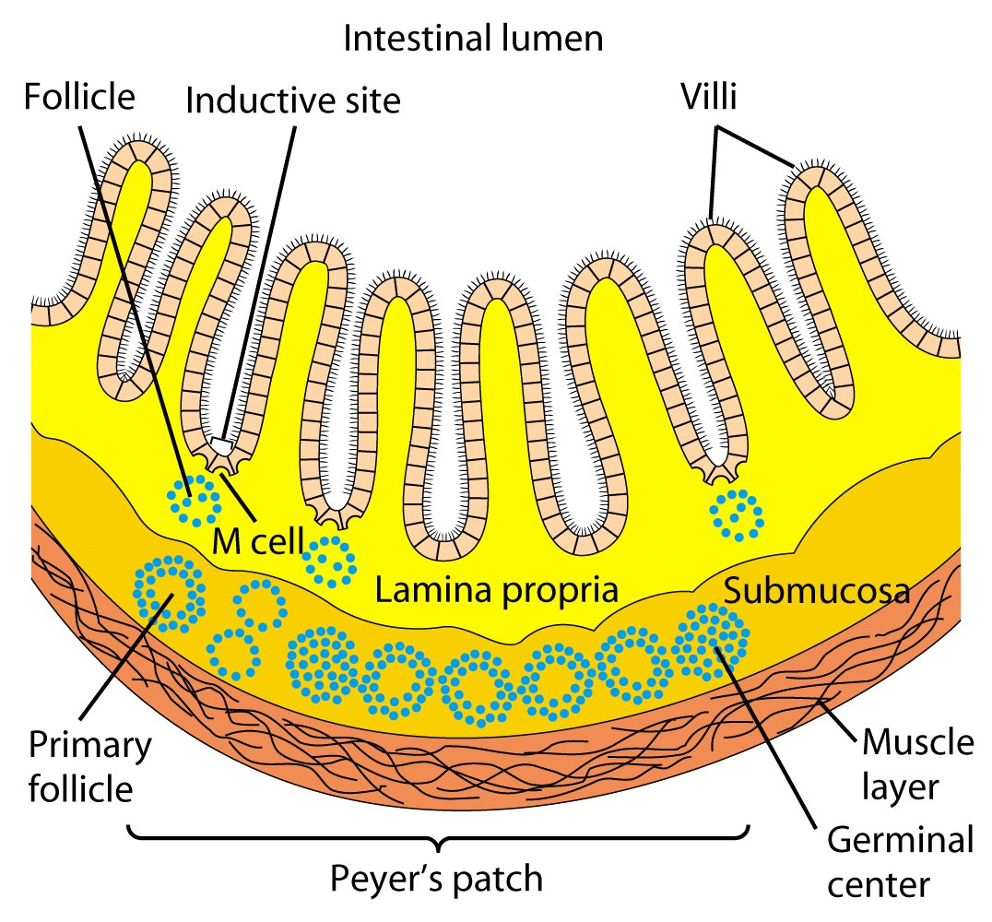
Organisation of GALT 1:
Dome epithelium

Slide 22
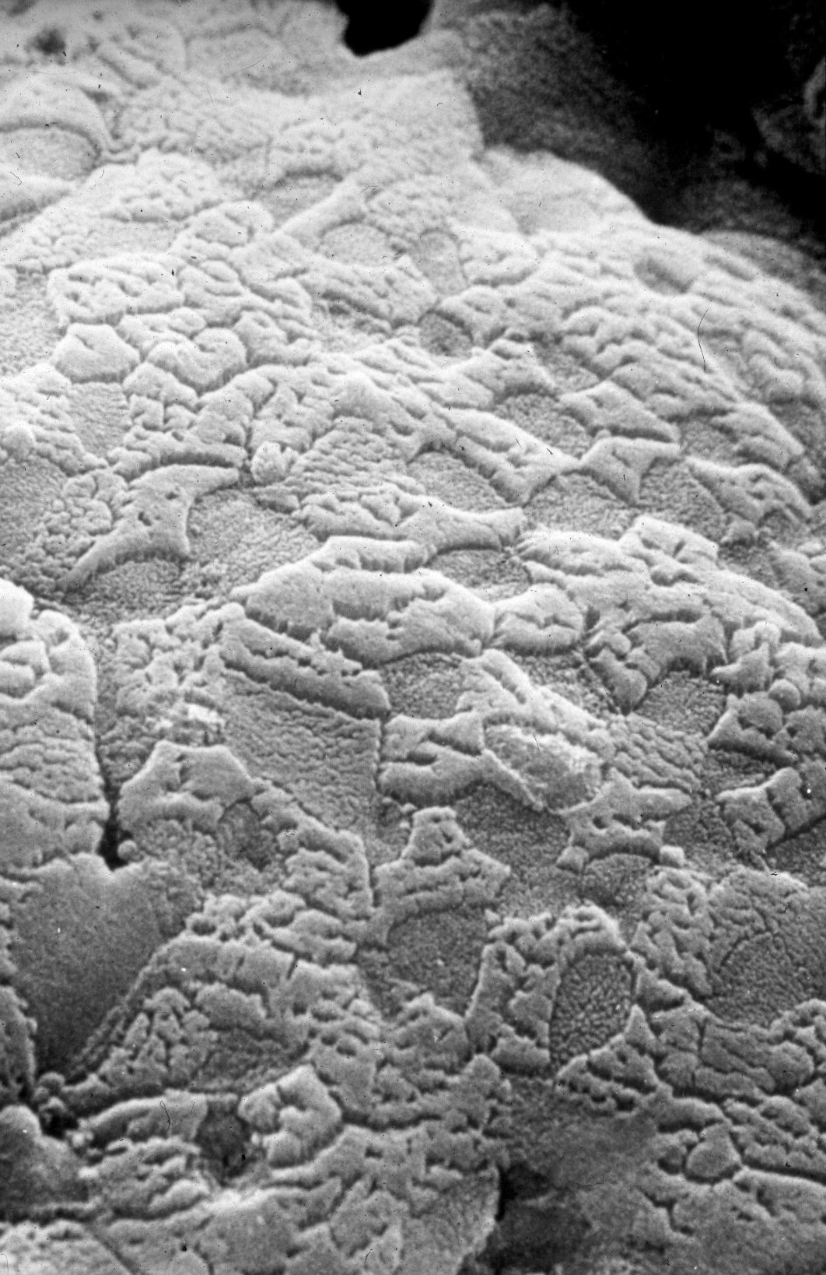
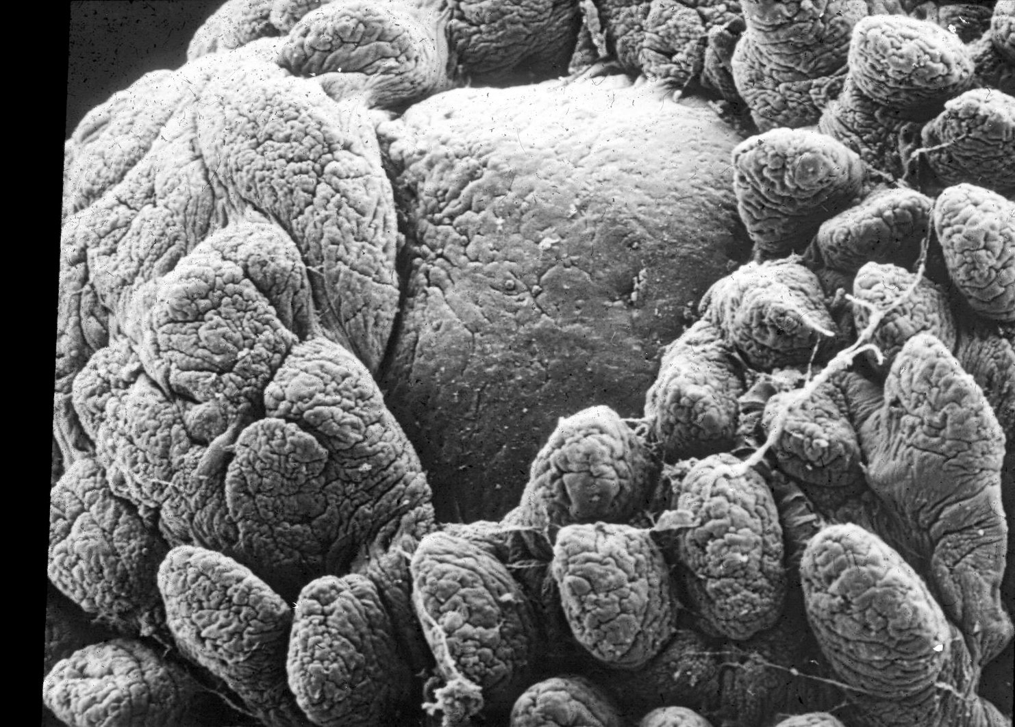
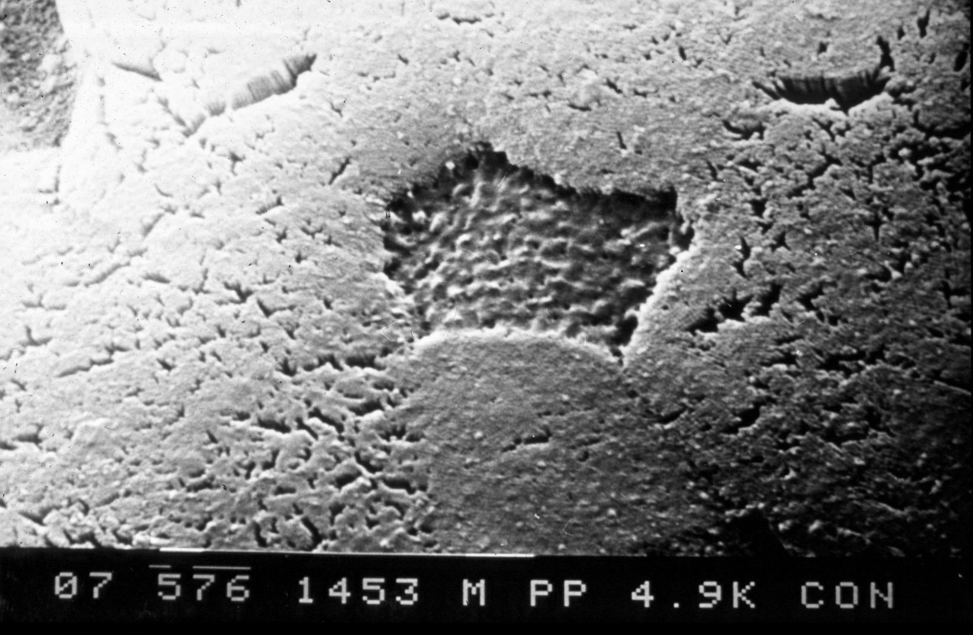
M Cells
Ag

Slide 23
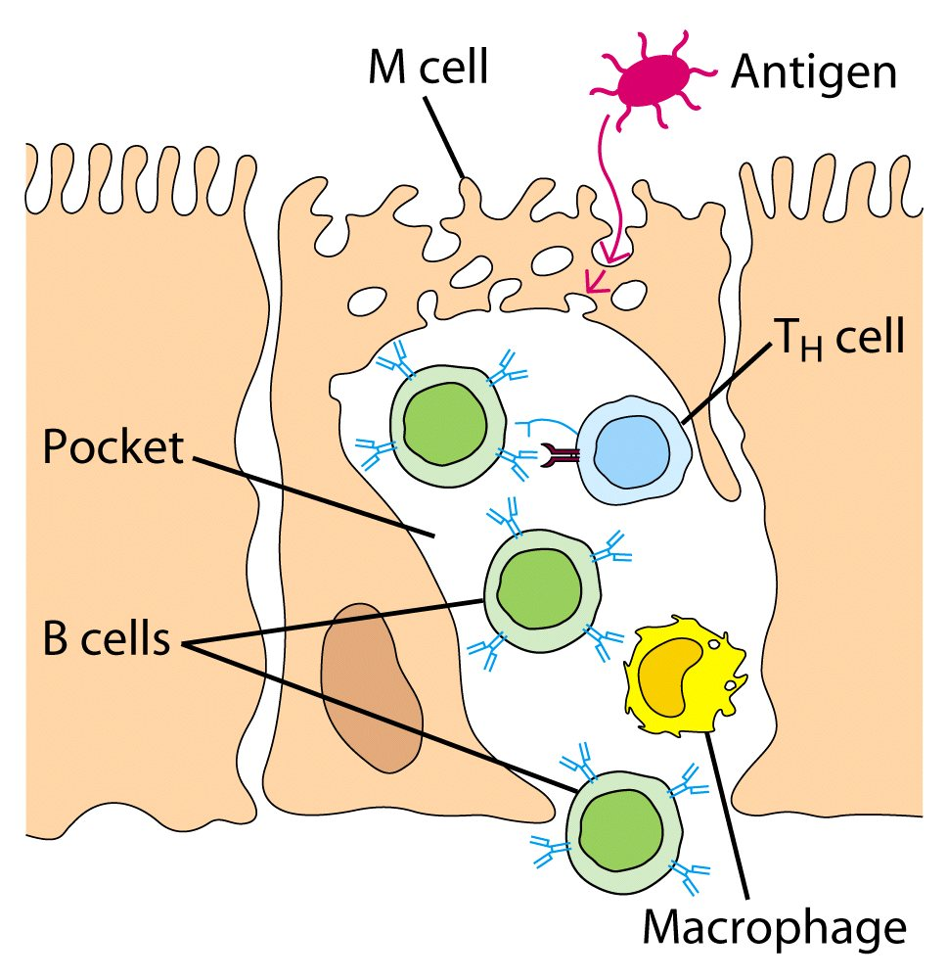
Antigen sampling: M cells

Slide 24
Trans-epithelial Antigen Sampling
Tight-junction proteins
Mucosal Epithelial Cells
Mesenteric
Lymph
Node

Slide 25
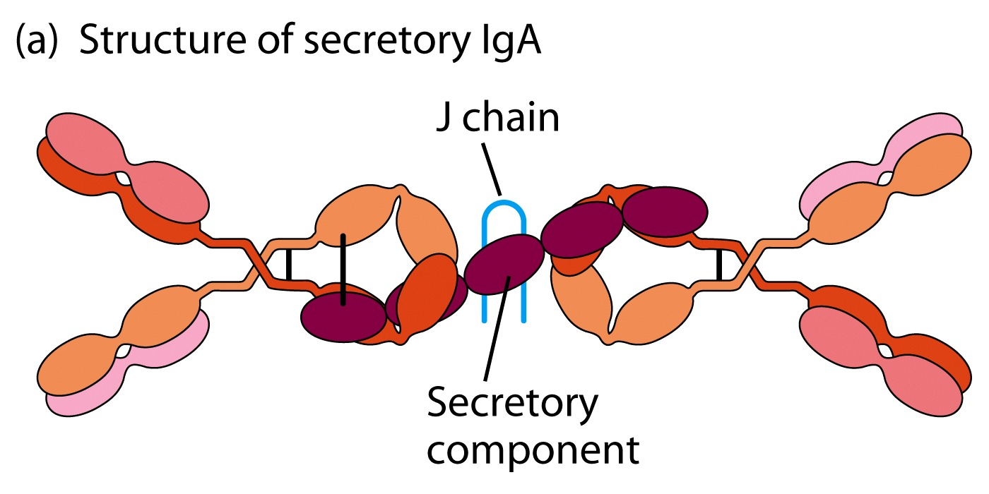
IgA: the specialised immunolgobulin of the gut

Slide 26
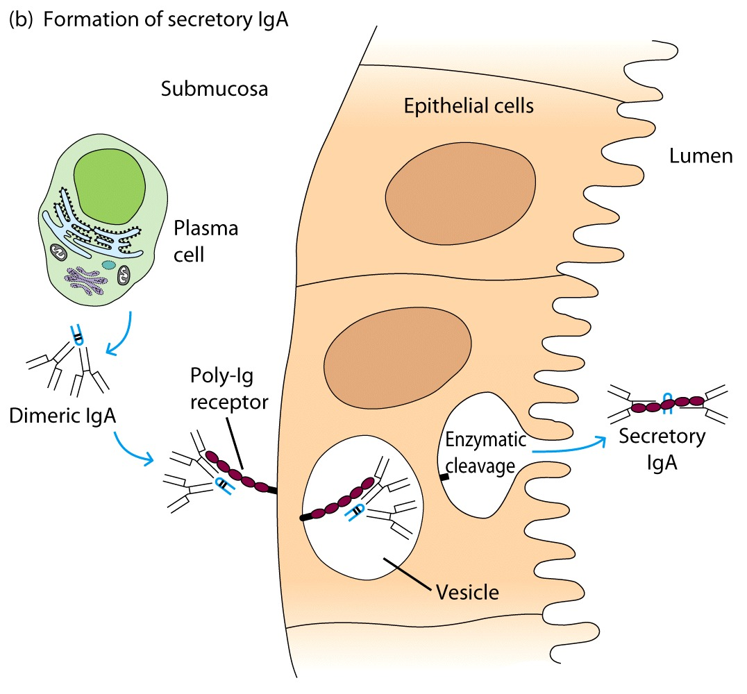
IgA is transported from submucosa to lumen by transcytosis

Slide 27
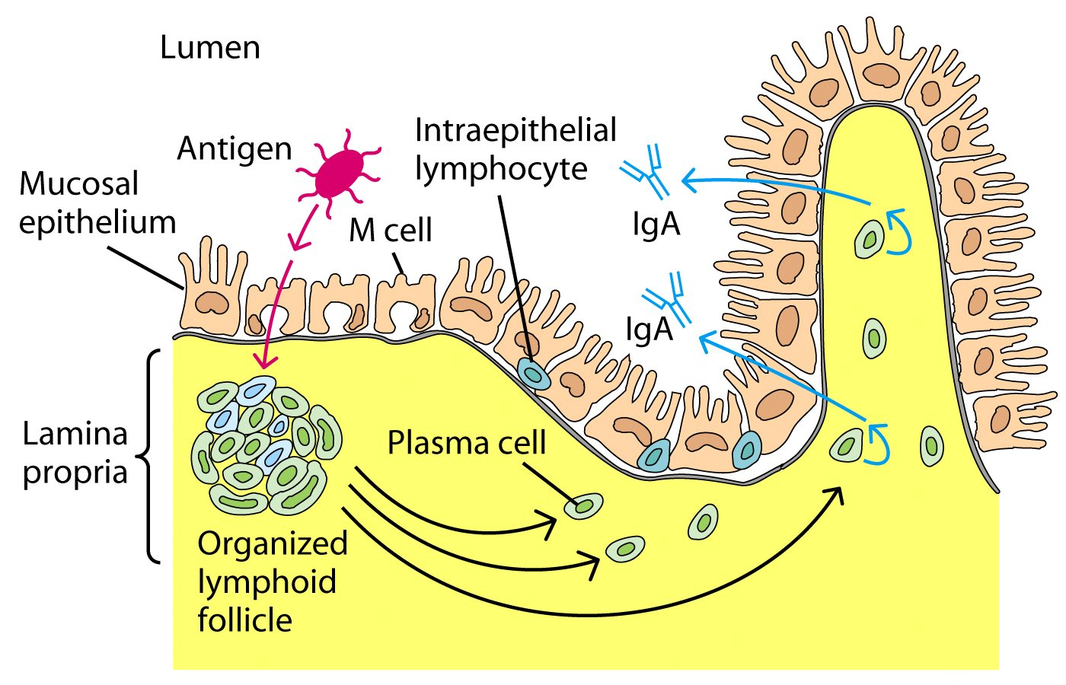
Gut associated adaptive immune response

Slide 28
Intra-epithelial lymphocytes
Make up one fifth of the intestinal epithelium
Conventional T cells (also lamina propria)
Migrated from other tissues
Unconventional T cells (Innate)
Resident
Express unusual combinations of CD4, CD8 or γδ T cell receptor

Slide 29
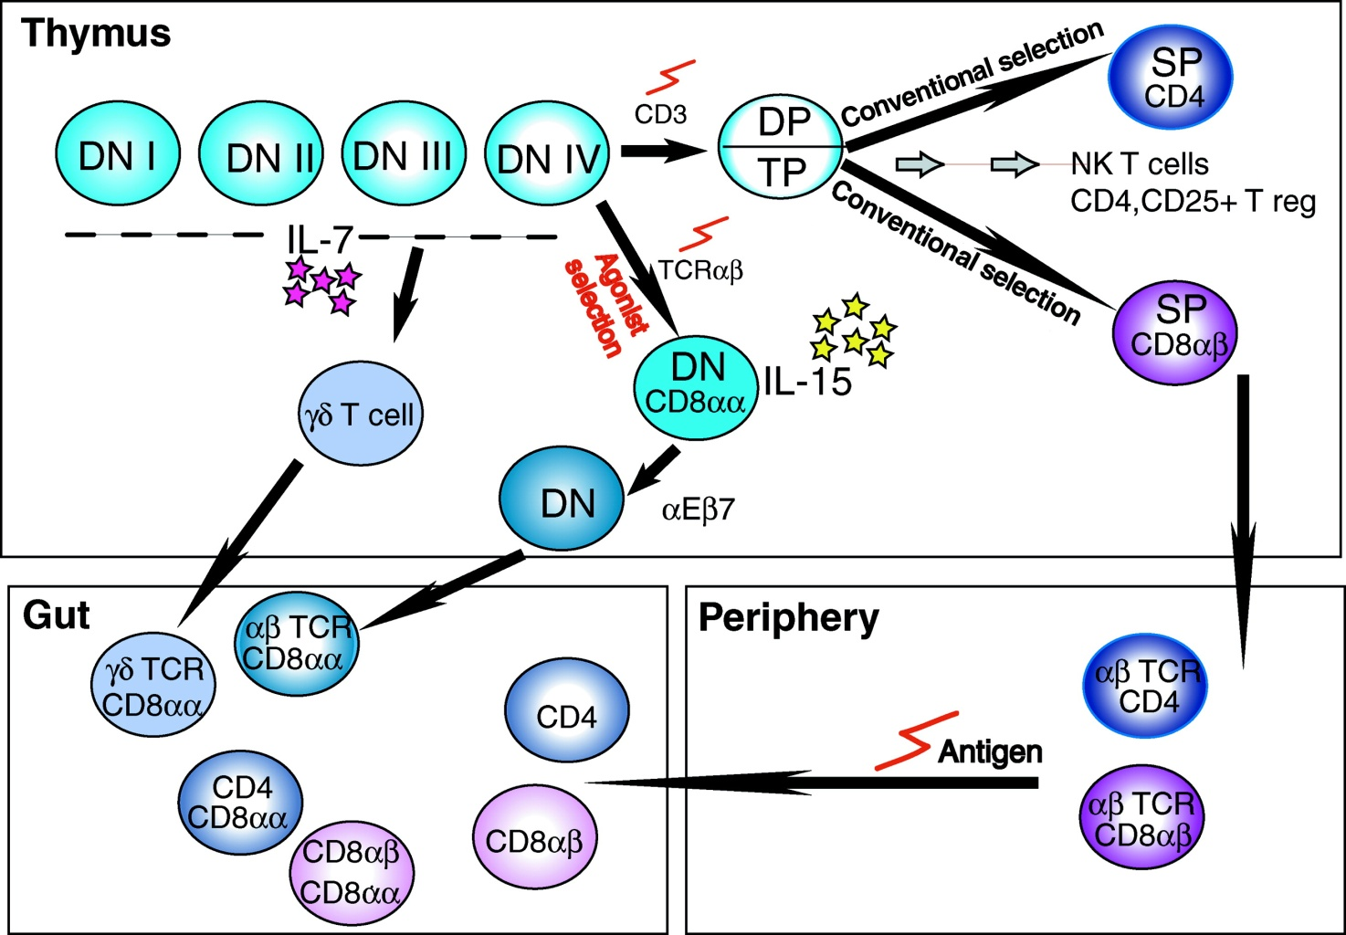
The gut contains lymphocytes of the innate immune system
conventional
innate

Slide 30
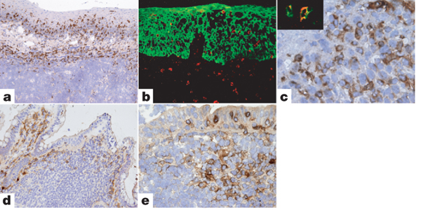
NKp44⁺ NK cells are prominently found within MALT.
tonsil
In lamina propria
NKp44+ NK cells (like Th17)
Make IL-10 IL-22, IL-26
Express RORγ
Clear Citrobacter Rodentium
Dome region of peyers patches
Appendix
M Cella et al. Nature 000, 1-4 (2008) doi:10.1038/nature07537

Slide 31
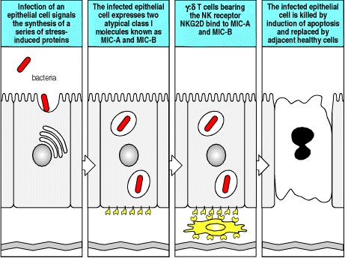
Gut associated innate immune response

Slide 32
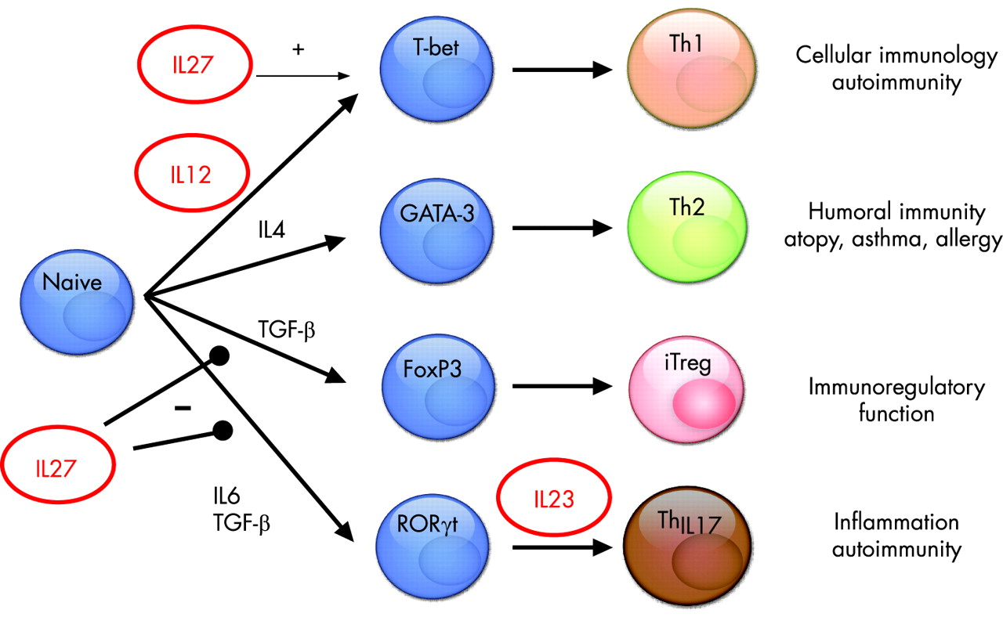
CD4 cells: a complex group

Slide 33
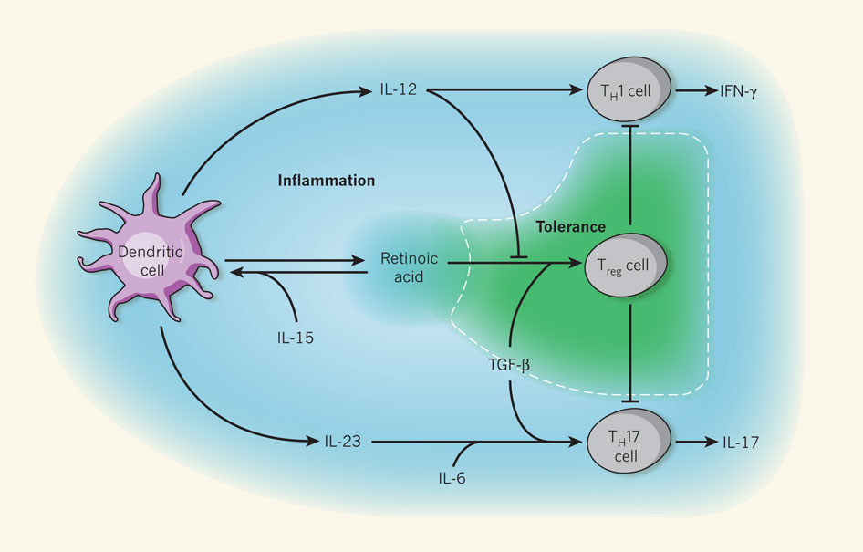
The cytokine milieu affects T cell development in the gut

Slide 34
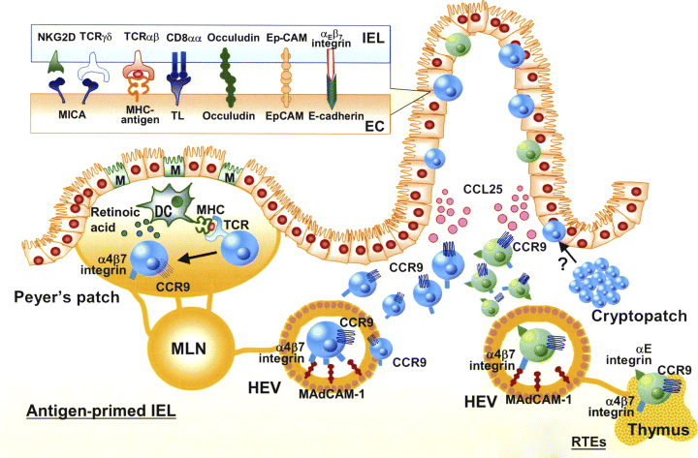
Orchestration of gut immune response

Slide 35
A dual immunological role for the gut
tolerance
Food antigens
Commensal bacteria
immunoreactivity
Pathogens

Slide 36
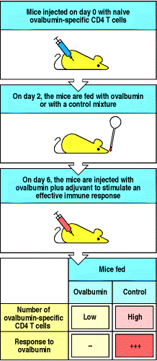
Oral tolerance: most antigens don’t elicit an immune response

Slide 37
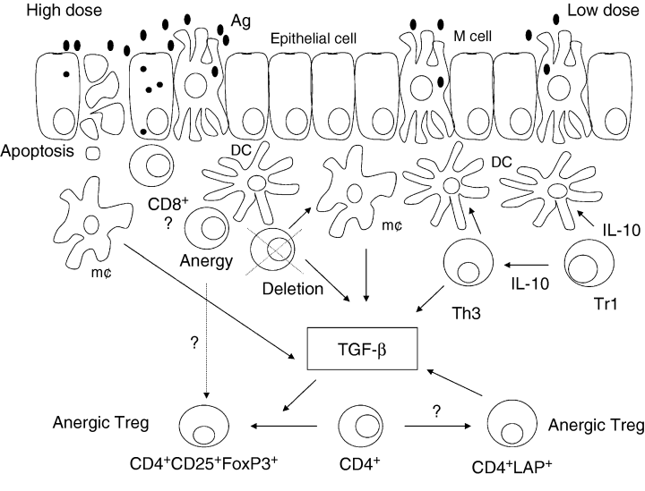
Potential mechanisms for oral tolerance
Anergy
Deletion
Cytokine secretion
-IL-10

Slide 38
The cytokine milieu affects T cell development in the gut

Slide 39
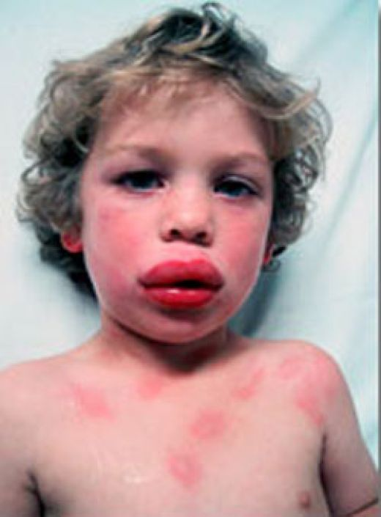
Intolerant of food
Food allergy:
Nuts
Hen egg white
Cows milk
Wheat
Sesame seeds
Soya
Shell fish

Slide 40
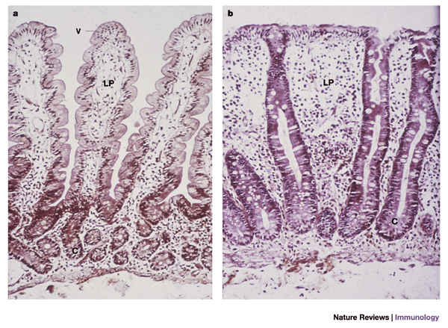
Coeliac disease

Slide 41
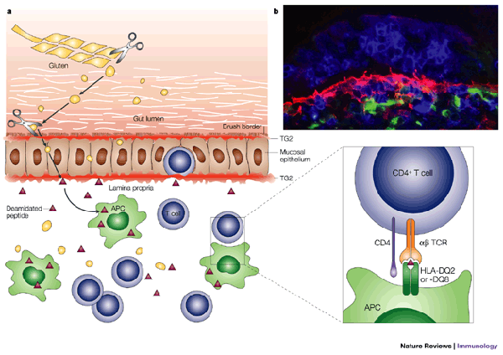
Pathogenesis of coeliac disease
DQ2

Slide 42
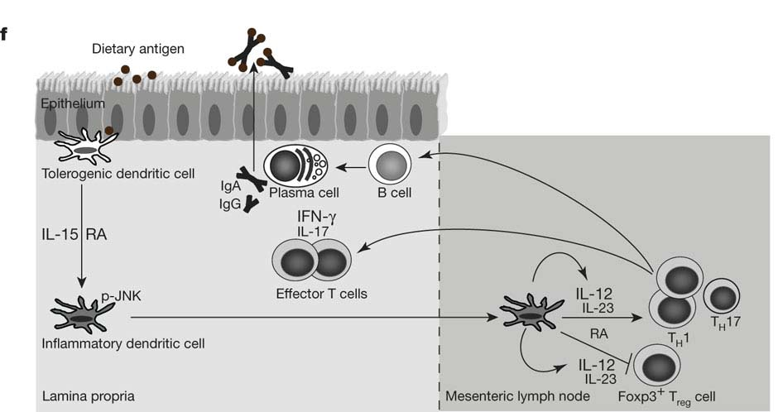
Coeliac disease pathogenesis 2
R. W. DePaolo et al. Nature 000, 1-5 (2010) doi:10.1038/nature09849

Slide 43
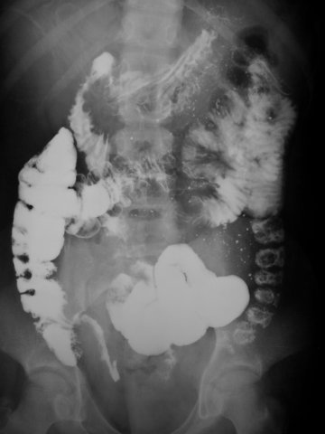
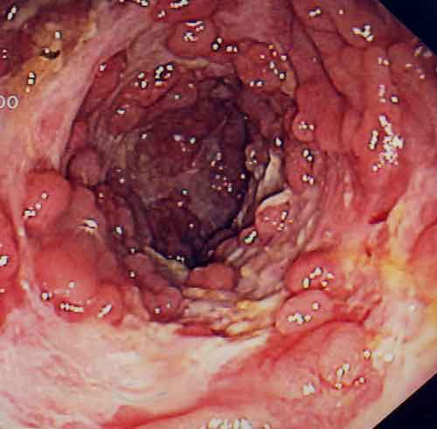
Crohns disease

Slide 44
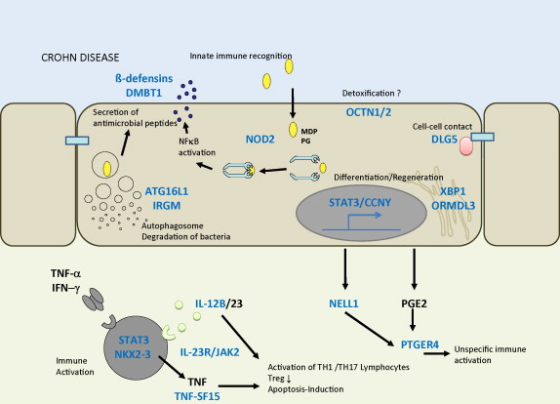
A molecular risk map of Crohns disease

Slide 45
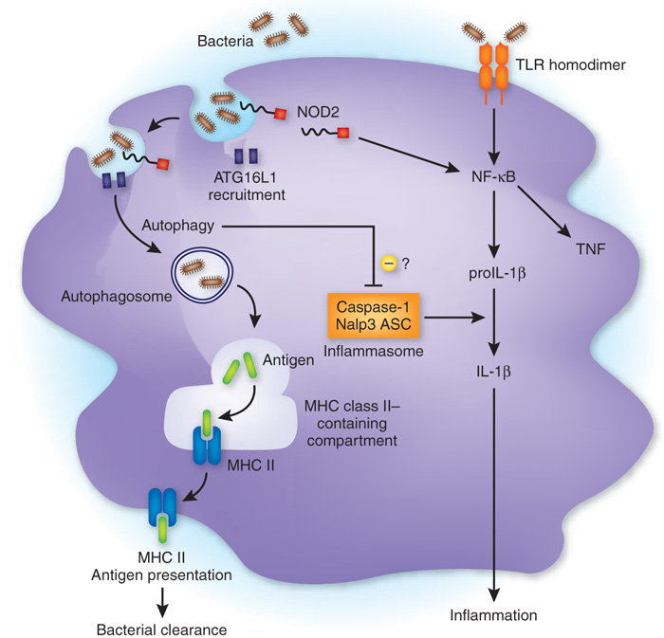
NODophagy
?dysregulation→Crohns Disease

Slide 46
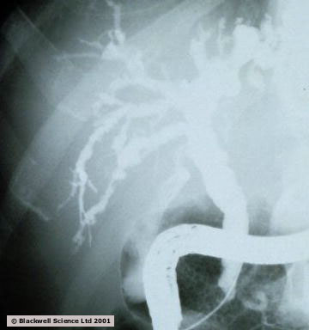
Primary Sclerosing cholangitis
Inflammatory condition of the biliary tree
Associated with IBD
Leads to cholangiocarcinoma

Slide 47
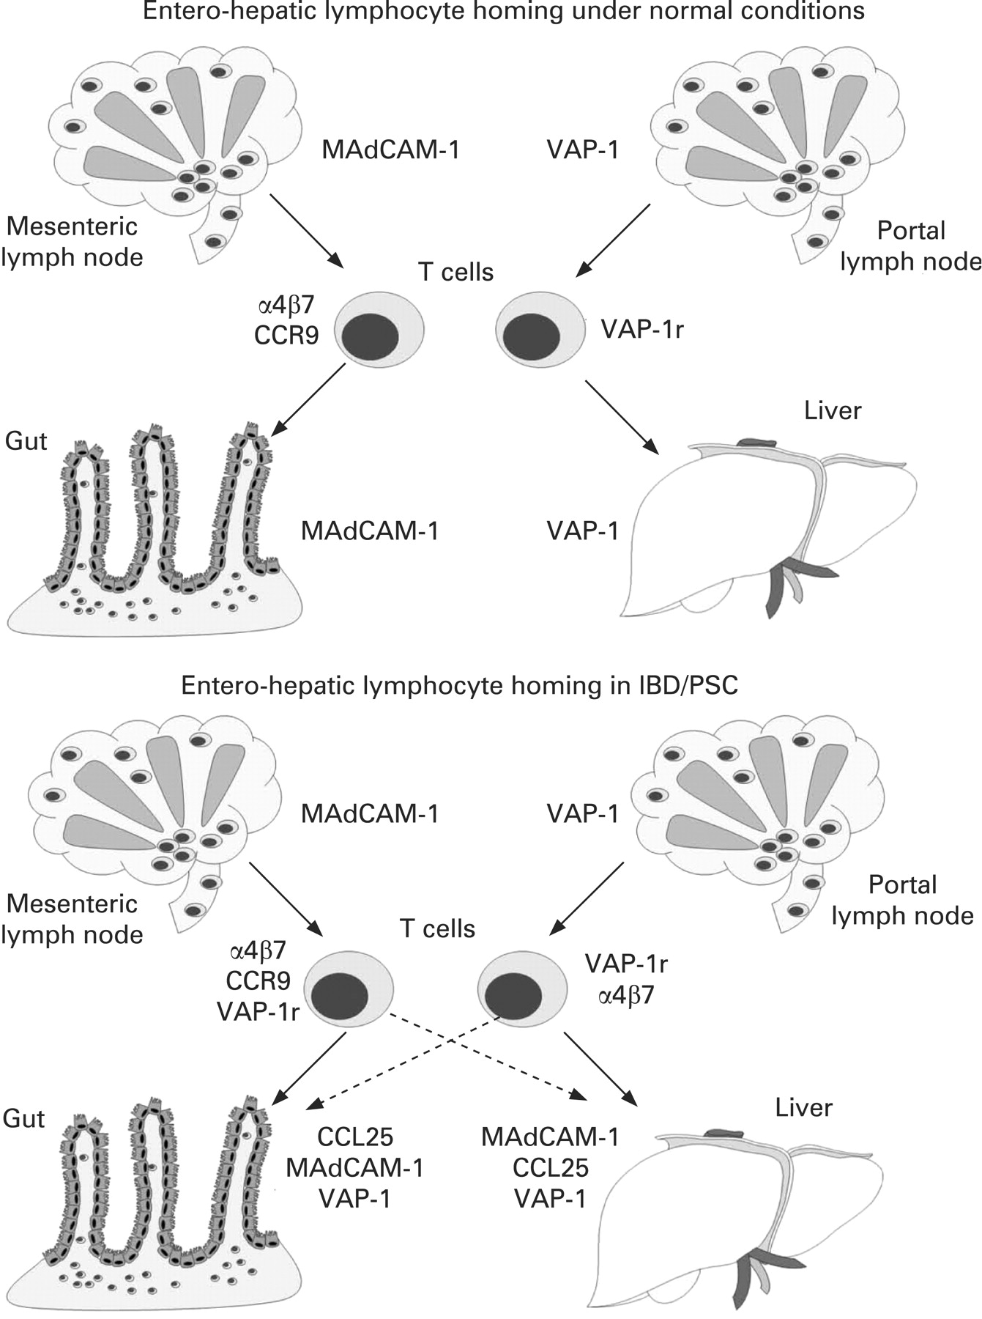
Under normal physiological conditions enteric antigens are presented to naive lymphocytes in the draining mesenteric lymph nodes.
Adams D H et al. Gut 2008;57:838-848
©2008 by BMJ Publishing Group Ltd and British Society of Gastroenterology

Slide 48
Summary
Gut is at the interface of self and non-self
Following invasion:
Recognize
Mount a successful response:
not too much (immunopathology)
not too little (chronic infection)
Terminate the response (immunopathology)
In times of health
No response (autoimmunity)

