Slide 1
Diarrhoea in children
Gareth Tudor-Williams
Reader in Paediatric Infectious Diseases
Imperial College London
Imperial College Healthcare NHS Trust,
St Mary’s campus

Slide 2
Dhaulagiri, in the Annapurna Himal, seen from Baglung, West Nepal
Notes:
This is a view of Dhaulagiri, the 5th highest mountain in the world, from Baglung in West Nepal where I worked for 2 years for Save the Children Fund.

Slide 3
One billion people worldwide lack access to clean water 2.5 billion do without adequate sanitation
HEALTH WARNING
Diarrhoea is a global problem
Notes:
Definition –
Sanitation – ‘collection, treatment and disposal or reuse of human excreta, domestic wastewater and solid waste, and associated hygiene’

Slide 4
8.8 million deaths 6 million (68%) due to infectious diseases Top 3 causes: pneumonia, diarrhoea, malaria Lancet 2010; 375: 1969-87
Notes:
Data derived from vital registrations, backed up by verbal autopsies. Note this is an improvement from the 2000-2003 data ‘Where and why are 10 million children dying every year?’

Slide 5
Causes of death in < 5yr olds

Slide 6
A principle cause of morbidity and mortality in children <5 yr
Median episodes per year = 3.2
Accounts for 21% of all deaths in children < 5 in developing countries
Estimated 2.5 million deaths p.a.
Kosek, et al. Bulletin of WHO, Mar 2003

Slide 7
‘In the past decade, diarrhoea has killed more children than all the people lost to armed conflict in the last 50 years’
Kosek, et al. Bulletin of WHO, Mar 2003

Slide 8
Definitions of diarrhoea

Slide 9
Definition
Increase in stool frequency with change to loose or watery stool
But breast fed infants…. Departure from normal stool pattern with increased volume and frequency
Notes:
Approach to taking history/examination of child with diarrhoea?

Slide 10
Classification
ACUTE
< 2 weeks
Infection
Viral
Bacterial
Protozoal
Major complication = dehydration
CHRONIC
> 2 weeks
Large differential diagnosis
Major complication = growth failure
Notes:
Ie dehydrat vs malnutrition - and risk of death

Slide 11
Types of diarrhoea
Secretory: active secretion, or inhibited absorption, without structural damage.
Cholera & some E.coli toxins: switches on chloride pump
Osmotic: water drawn to gut lumen passively
Maldigestion (e.g. pancreatic disease)
Osmotic laxatives
Inflammatory: damaged mucosa cannot absorb
Infections
Inflammatory diseases eg Crohn’s
Hypermotility eg toddler diarrhoea, hyperthyroidism

Slide 12
Case study: acute diarrhoea
6 month old boy brought to A&E at St Mary’s
2 days D&V, now drowsy, cold, parents worried

Slide 13
Assessment of child with diarrhoea
History
Still eating/feeding?
Still passing urine?
Poo – blood? Mucus? Freq?
Food eaten - new? Off?
Travel
Swimming
Pets
Immunodeficiency
Examination
ABC
Any other focus for infection?
Degree of dehydration
Notes:
Let’s say: no feeding last 12 h, stool 2-3x per hour watery, no blood; no travel; elder sib - mild gastroenteritis; no pets, no PMH

Slide 14
Clinical features
Dark, sunken eyes
No tears
Low turgor
Dry mucous membranes
Sunken fontanelle
Delayed capillary refill time

Slide 15
Clinical assessment of dehydration
 | Moderate: 5-10% | Severe: >10%
General | Drowsy | Limp, sweaty, cold, cyanotic
Pulse | Tachycardic | Rapid, weak
BP | May be normal | Low
Urine output | Reduced | Absent
Notes:
Percent estimates refer to percentage of BODY WEIGHT. If you lose 15% of your body weight you become MORIBUND!
Crucial in paediatric practice as we estimate how much fluid to give – if the child weighs only 10kg, you don’t want to stick 3 litres of fluid into them to correct their dehydration.

Slide 16
Oral rehydration solution
“The discovery that Na and glucose transport are coupled in the small intestine = the most important medical advance this century.”
The Lancet, Aug 1978

Slide 17
Oral rehydration solution
“The discovery that Na and glucose transport are coupled in the small intestine = the most important medical advance this century.”
The Lancet, Aug 1978
“Cholera victims should drink a profuse quantity of tepid water in which rock salt and molasses have been dissolved.”
Sushruta Samhita, 1500 B.C.
Notes:
See nice pic to use

Slide 18
How to rehydrate?
Oral rehydration best: child absorbs correct water/electrolytes
Suitable for mild-moderate dehydration
Use Oral Rehydration Solution
Reduced osmolarity ORS launched by WHO 2002 - may be absorbed better

Slide 19
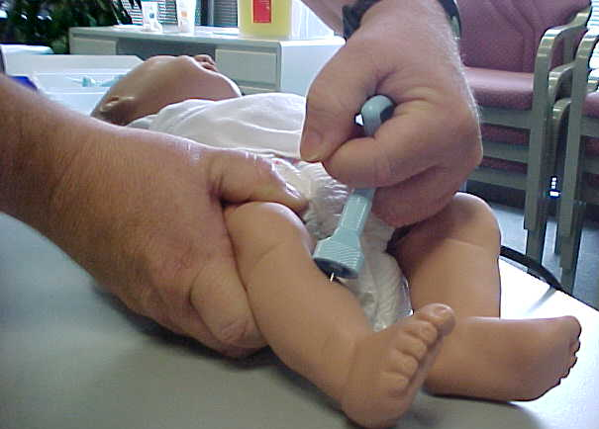
Severe dehydration
Shock? Give bolus of normal saline
Access likely to be difficult – may need intra-osseous approach
Then correct over 24-48hr
Care of blood sodium:
Total body depletion
Kidneys may not be working well
Don’t correct hypernatraemia fast – can cause fits!

Slide 20
Management of acute diarrhoea
Nutrition (breast milk, vitamin A, zinc)
NOT anti diarrhoea drugs
NOT antimicrobials
Probiotics - poor evidence
Follow Integrated Management of Childhood Illness (IMCI) guidelines
Notes:
IMCI - buzz word. Look up.

Slide 21
Infants: continue breast-feeding
Notes:
Breast-feeding mothers should continue to feed

Slide 22
Viral causes of diarrhoea
Rotavirus
Caliciviruses
Noroviruses (Norwalk virus, SRS)
Sapporo virus
Adenovirus
Enteroviruses
1 g. of faeces may contain 10,000,000 virus particles!

Slide 23
Rotavirus
Virtually every child infected by age 5 yrs
Faecal-oral spread
Enterocyte destruction: osmotic diarrhoea
Rehydration is key
Followed by temporary lactase insufficiency
Vaccines available

Slide 24
BACTERIA
Enterotoxigenic E.coli (ETEC) traveller’s diarrhoea
Shigellae spp. Invasive. Dysentery
Enteroinvasive E.coli
Vibrio cholerae
Salmonellae
Campylobacter
Yersinia
PROTOZOA
Cryptosporidium - swimming pools
Giardia
Entamoeba histolytica - amoebic dysentery
1g faeces contains 1,000,000 bacteria
or 1,000 parasite cysts
Notes:
Also: enterotoxigenic E.coli (ETEC - non-invasive, toxin-producing, cause travellers’ diarrh; no blood). Can be secretory diarrho (cf cholera), but protective Ab response develops – hence travellers’
Next is Shigella – includes various shigella spp incl Sh. sonnei, dysenteriae – invasive, responsible 15% of deaths
parasites: most common is cryptosporidium - esp in HIV
In developed countries:
Rotavirus
Salmonella
Campylobacter
Almost half – rotavirus
Fever: look for salmonella, Shigella, campylobacter
Blood: look for E.coli O157
Persistent, or after travel: also look for parasites (Giardia, cryptosporidium, schistosomiasis)
Recent hospitalisation: rotavirus, norovirus, Clostridium difficile

Slide 25
Top causes of acute diarrhoea
In developed countries:
Rotavirus
Salmonella
Campylobacter
Poor countries:
Rotavirus
Shigella
E.coli
INVESTIGATIONS
Always look for viruses
Fever: look for salmonella, Shigella, campylobacter
Blood: look for enteroinvasive types eg E.coli O157
Persistent, or after travel: look for parasites (Giardia, cryptosporidium, schistosomiasis)
Recent hospital stay: rotavirus, norovirus, C. difficile

Slide 26
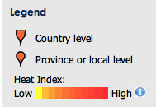
http://www.healthmap.org/en

Slide 28
Greetings in a time of cholera
?

Slide 29
Greetings in a time of cholera

Slide 30
Preventing death from acute diarrhoea
Mortality attributable to acute diarrhoea in children < 5 yrs
1954 -79 13.6 per 1000 per year
1980 - 89 5.6
1992 - 2000 4.9
Parashar et al. Bulletin of the WHO, 2003

Slide 31
Reasons for declining mortality
Use of oral rehydration solution (ORS)
Promotion of breast-feeding
Improved supplemental feeding / nutrition
Female education
Measles immunisation, and in the future, vaccines for e.g. rotavirus
Infrastructure: improved water, hygiene and sanitation
Notes:
ORS is great advance of 20th Cent
Continue feeding - esp breast
Kerala: better female education
Measles: affects gut mucosa - diarrh, with malnutrit

Slide 32
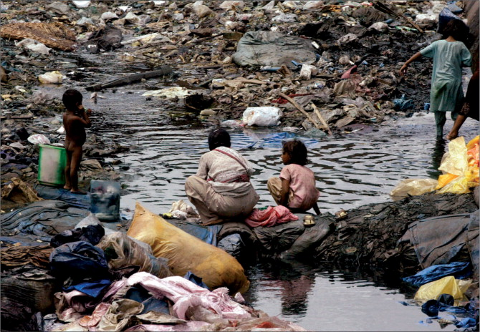
Excreta are the main source of childhood diarrhoeal diseases
Notes:
Explain faecal-oral transmission
Also role for direct spread

Slide 33
Improved hygiene & sanitation
Notes:
Clean water
Personal hygeine
Sanitation - sewers
Which is most important in reducing diarrhoea?

Slide 34
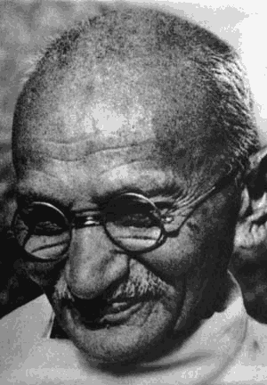
“… a meticulous sense of cleanliness, not only personal, but also in regard to one’s surroundings is the alpha and omega of corporate life. Where the rules of personal, domestic and public sanitation are strictly observed… there should be no occasion for illness or disease.”
Mahatma Gandhi

Slide 35
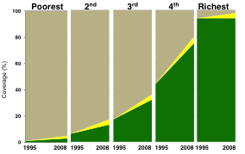
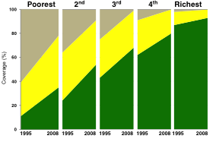
Progress often inequitable
India Bangladesh
UNICEF, 2010

Slide 36
Randomised controlled trial. Luby et al. LANCET 2005
Notes:
RCT of soap

Slide 37
Effect of handwashing on child health: a randomised controlled trial. Luby et al, Lancet 2005
Karachi, Pakistan
25 neighbourhoods - handwashing promotion and free soap
11 control neighbourhoods
53% reduction in incidence of diarrhoea and pneumonia

Slide 38
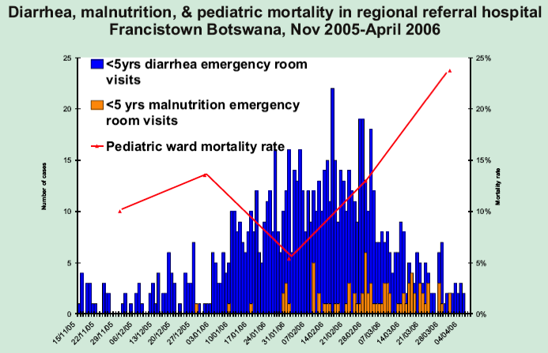
Role of Infant feeding and HIV in a severe diarrhoea outbreak in Botswana 2006 Free formula available for HIV positive mothers
Notes:
Creek T et al CROI 2007
523 deaths, 35000 cases - diarrhoea outbreak (type?)
(normally in 20s)
So: see the progression diarr to malnut and then death

Slide 39
Acute diarrhoea - summary
Diarrhoea accounts for 20% of mortality < 5 years
Acute diarrhoea causes dangerous dehydration
Diarrhoea is secretory,osmotic or inflammatory
Assess degree of dehydration: oral rehydration better for mild-moderate cases
In severe cases careful rehydration required
Avoid antibiotics, anti-diarrhoeal drugs
Most common pathogen is rotavirus; bacterial types vary
Sanitation is most important strategy to reduce deaths worldwide

Slide 40
Case study: chronic diarrhoea
8 month old child
Failure to thrive since 4 months age
Normal birthweight
Feeds well, wide range of food
Offensive, loose stool for last two months

Slide 41
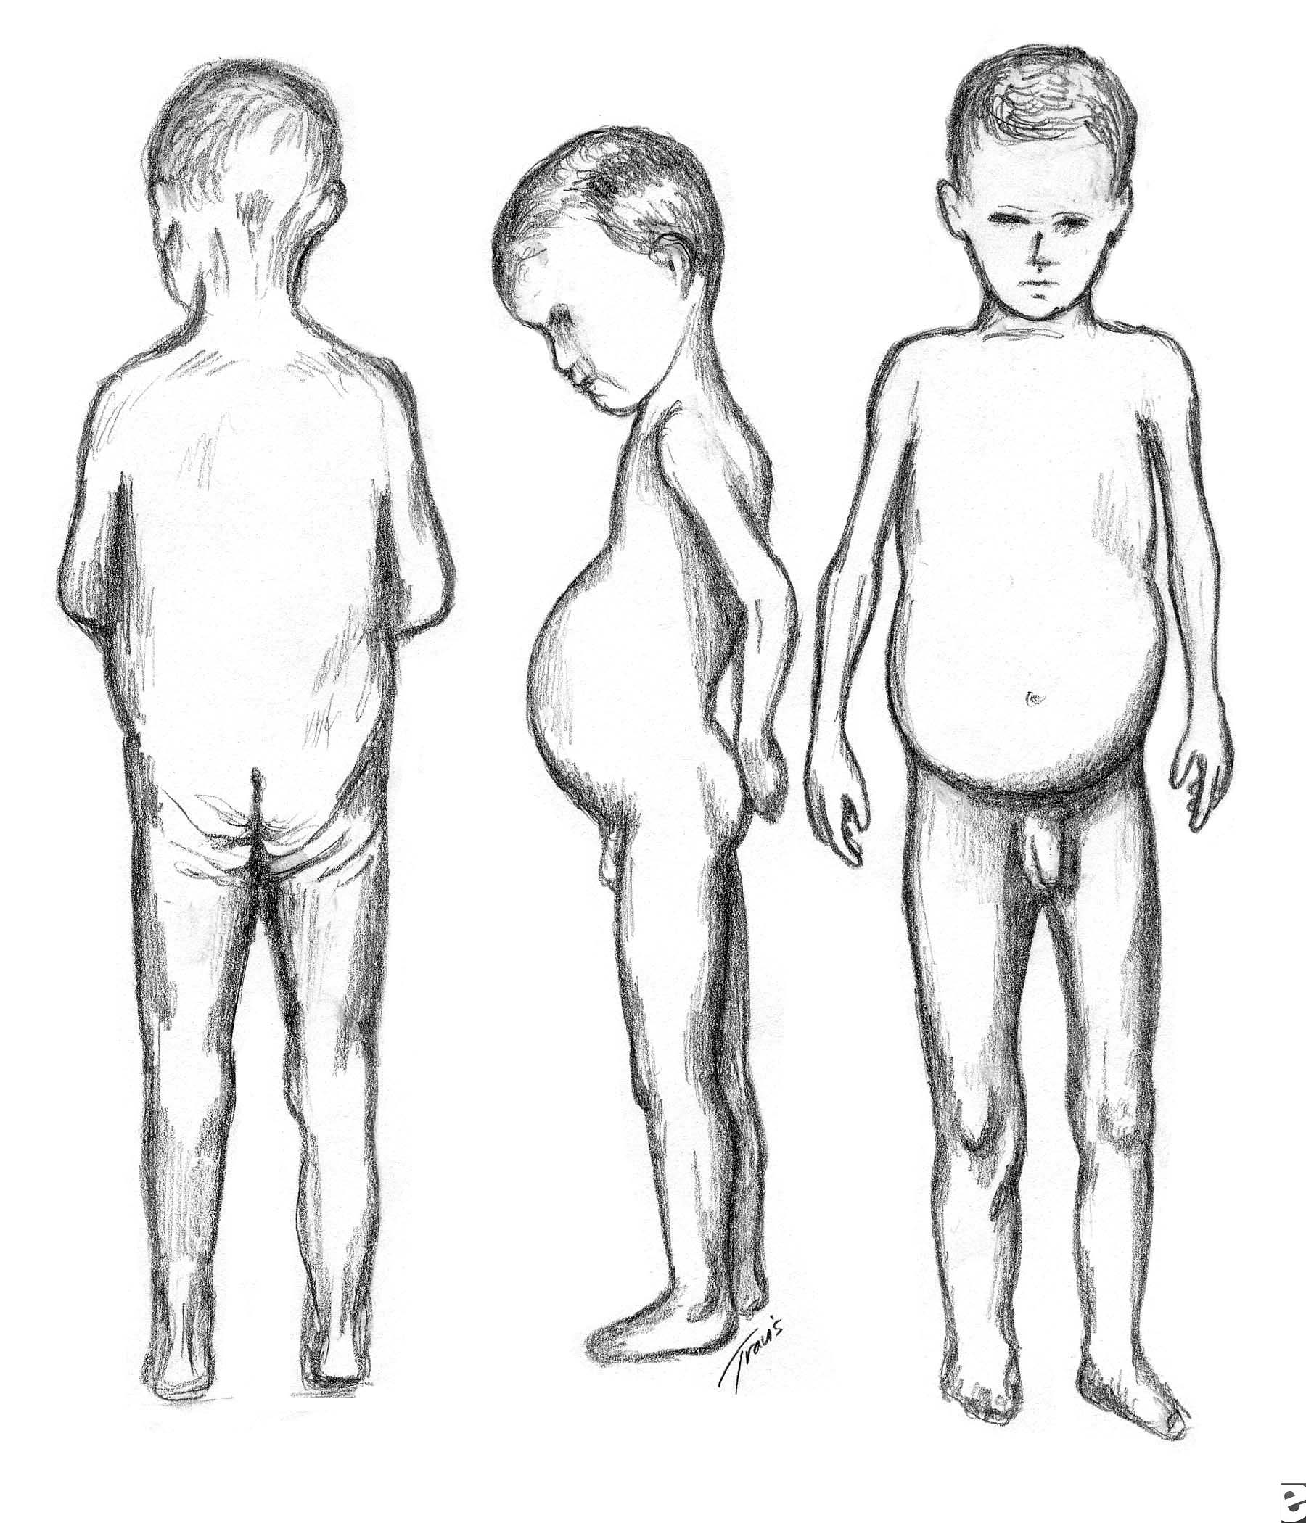
Coeliac disease
This child not dehydrated, but stunted
Immune-mediated enteropathy (to gluten)
Diarrhoea secondary to villous atrophy
Pot-belly
Muscle wasting

Slide 42
Chronic diarrhoea - many causes
Infections, and post infection syndromes
Carbohydrate intolerance
Food sensitivities
permanent (eg Coeliac Disease)
temporary ( eg Cow’s milk protein intolerance)
Motility disorders (including toddlers’ diarrhoea)
Inflammatory bowel disease
Pancreatic disease (eg. Cystic fibrosis)
Intestinal lymphangiectasia
Notes:
Talk about growth curves

Slide 43
Consequence of chronic diarrhoea
Malnutrition
Susceptibility to infection
Poor growth, delayed puberty
Anaemia, ricketts
Cognitive impairment

Slide 44
Malnutrition - central to both diarrhoea and respiratory illness

Slide 45
Chronic diarrhoea - summary
Chronic diarrhoea causes growth failure and malnutrition
Wide range of causes - inherited & acquired
It is associated with higher mortality from respiratory and other infections

Slide 46
Another child with diarrhoea will die in the time it takes to read this sentence.
One death every 14 seconds…………..

Slide 48
Correcting hypernatraemia
A: cells and plasma in balanced osmolality
B: early dehydration - plasma sodium & osmolality increase; cells lose water
C: later dehydration - organic osmolytes pumped into cells, water follows - balanced osmolality
D: rapid rehydration - plasma osmolality decreases, water moves into cells, cells swell

