Slide 1
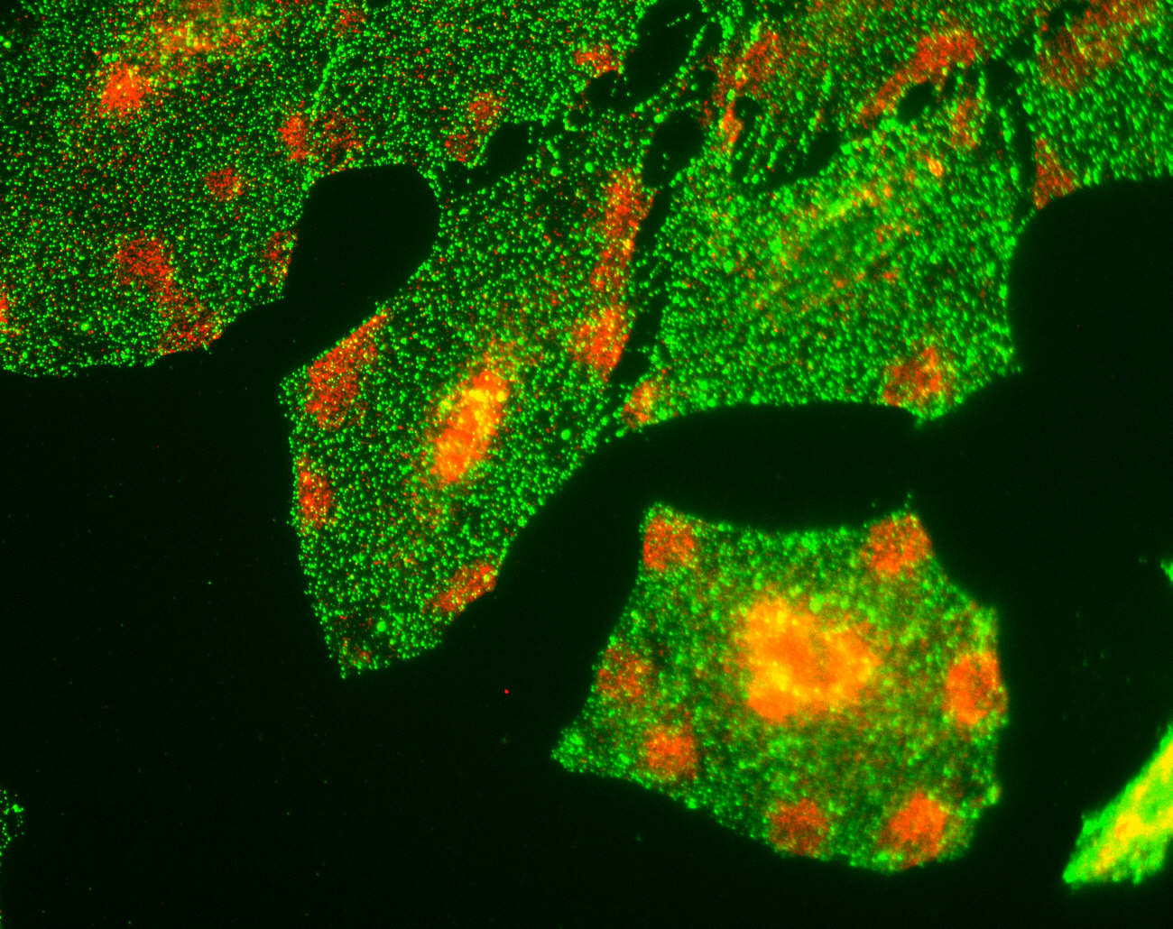
Neuro session 1
Basic organisation of the nervous system
Dr Jane Saffell
Division of Brain Sciences
Department of Medicine
Hammersmith Hospital campus
j.saffell@imperial.ac.uk

Slide 2
Session contents today
1. (Briefly) Your Neuro trajectory through MBBS & beyond [Me]
2. Basic organisation of the nervous system [Me]
3. Introduction to clinical neurology
[Dr Ronald Pearce]
(Two breaks – after the second, you must be back by 3.55 for Ron’s talk)

Slide 3
Year 1
Eight sessions this term January & February:
Session 1 Basic organisation of the nervous system & Introduction to neurology
Session 2 Cells of the nervous system
Session 3 The resting potential &
Action potential generation & conduction
Session 4 Neurotransmitters
Session 5 CNS
Session 6 PNS
Session 7/8 ANS
These combine lectures, clinical videos & demonstrations, practical exercises, discussion groups

Slide 4
e.g. from 2012-13 Year 2 intranet:
Fri 5 Oct | Development of the nervous system - Dr Maggie Lowrie
 | Spinal function and dysfunction - Dr Maggie Lowrie
 | Organisation of brainstem and cranial nerves - Professor Steve Gentleman
 | Blood supply to the central nervous system - Professor Steve Gentleman
 | Cerebral blood flow regulation and the blood brain barrier - Professor John Laycock
Thurs 11 Oct | Thalamus and hypothalamus - Dr Maggie Lowrie
 | Neuroanatomy practical worksheet answers [Word]
 | Cellular organisation in the CNS worksheet answers [Word]
Wed 17 Oct | Touch and proprioception - Dr Maggie Lowrie
 | Nociception - Dr Maggie Lowrie
 | Psychology of pain - Dr David Murphy
 | Exercise on somatosensory pathways - answers [Word]
Tues 23 Oct | Neuromuscular and spinal cord control of movements - Dr Paul Strutton
 | Cortical motor function - Dr Ben Simpson
 | Basal ganglia and cerebullum - Dr Ben Simpson
Thurs 1 Nov | Hearing 1: Sound conduction + hearing test answers [Word] - Dr Maggie Lowrie
Mon 5 Nov | Structure and function of the eye [pdf] - Dr Richard Cheong-Leen
Wed 7 Nov | Control of posture and gait + handout - Professor Michael Gresty
Thurs 8 Nov | Organisation of the cerebral cortex - Dr Maggie Lowrie
 | Cerebral cortical function - Professor Richard Wise
Wed 14 Nov | Introduction to consciousness [pdf] - Dr David Soto
 | Sleep - Dr Maggie Lowrie
 | Olfaction and the limbic system - Professor Steve Gentleman
Mon 7 Jan | Learning theory - Dr David Murphy
 | Health beliefs and behaviour - Dr David Murphy
Year 2
(From Neuro Y2 guide)
13 Sessions (Autumn term)
Organisation of the CNS 1
Organisation of the CNS 2
Organisation of the CNS 3
Organisation of the CNS 4
Somatosensory systems
Motor systems
Sensorimotor integration (pract)
Hearing and balance
Hearing and balance (pract)
Vision
Posture and gait
Cortical structure & function
Consciousness & limbic system

Slide 5
NB: Years 1 and 2 should be considered as a block preparing for your clinical Y3
Revise Y1 material before starting Y2 Neuro in the autumn term next year to build up layers of knowledge, understanding and insight effectively.

Slide 6
Year 3
Introductory Day
1st 10 Week Attachment in General Surgery/Medicine
Background to Clinical Specialties Course
2nd 10 Week Attachment in General Surgery/Medicine
Holiday
3rd 10 Week Attachment in General Surgery/Medicine

Slide 7
Year 4
Neuroscience & Mental Health BSc
Introductory module (2 weeks)
Module 1 – Cellular and developmental neurobiology
Module 2 – Neurological and psychiatric disorders of the CNS
Module 3 – Neurodevelopment, mental health & mental illness
10-week research project (lab, clinical or meta-analysis)

Slide 8
Years 5 & 6
Clinical
Y5 –Psychiatry 6-week block
Y6 – Neurology 2-week block
Neuro infuses many other specialties

Slide 9
After…
Neurologist
Psychiatrist
Neurosurgeon
Neuropathologist, etc, etc
PhD? Clinician scientist specialising in neuroscience

Slide 10
Basic organisation of the nervous system
(A brief overview)
1. Organisation
Anatomical arrangement
Cellular level
Regeneration
Neurological diagnosis exercise
BREAK

Slide 11
Learning objectives
From engaging with this session students should be able to
Define the following terms used to describe the nervous system (NS) and explain how they interact with each other:
Central NS, Peripheral NS, Autonomic NS, Somatic NS
Define the terms afferent and efferent as applied to axons, giving specific examples of neurons in each category
Recognise at list three additional names for the Autonomic NS
State the difference in the regenerative capacity of injured axons between the CNS and PNS
Draw or interpret a simplified circuitry diagram for spinal cord inputs and outputs, and ascending/descending sensory/motor pathways to cortex.

Slide 12
1. Organisation

Slide 13
The nervous system is divided structurally into two parts:
Central nervous system (CNS)
Brain & spinal cord
Peripheral nervous system (PNS) Nerves and ganglia (clusters of neuronal cell bodies) - outside the brain and spinal cord

Slide 14
The PNS is functionally divided into:
Somatic PNS
Controls motor and sensory function for the body wall, e.g. skin (sensory neuron), skeletal muscles (motor neuron)
Autonomic nervous system
(Also called visceral PNS, vegetative NS, involuntary NS)
Regulates function of the viscera: internal organs, smooth (involuntary) muscle, pupils, sweating, blood vessels, bladder, intestine, glands etc, and controls heart contraction rate. Has sympathetic & parasympathetic arms.
[Details in Y1 ANS sessions (Chris Johns, John Laycock)]

Slide 15
Direction of information flow
Axons enter and leave the CNS through pairs of spinal nerves and cranial nerves
Afferent axons propagate action potentials towards the brain & spinal cord from the PNS (e.g. sensory neurons, both somatic and ANS).
Efferent axons propagate action potentials from the brain and spinal cord to the periphery (e.g. motor neurons, both somatic and ANS)
Interneurons are CNS neurons that synapse with other CNS neurons within the brain or spinal cord.

Slide 16
NB: Details to be given in the following Y1 sessions:
Action potential generation and propagation in Session 3 (Mark Smith)
Synaptic transmission in Session 4 (Jackie de Belleroche, Martin Croucher)
Nerve conduction practical in Session 6 (Paul Strutton)

Slide 17
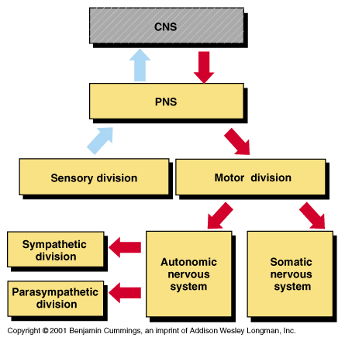
Summary of organisation and information flow
Brain
Spinal cord
Somatic
sensory
Autonomic sensory
[Spinal nerves only]
Autonomic
motor
division
Somatic motor
division
[Spinal nerves & cranial nerves]
[Spinal nerves & cranial nerves]

Slide 18
Anatomical arrangement
Very brief overview
Details in later sessions:
Session 5 on CNS (Maggie Lowrie & Steve Gentleman)
Session 6 on PNS (Maggie Lowrie & Paul Strutton)

Slide 19
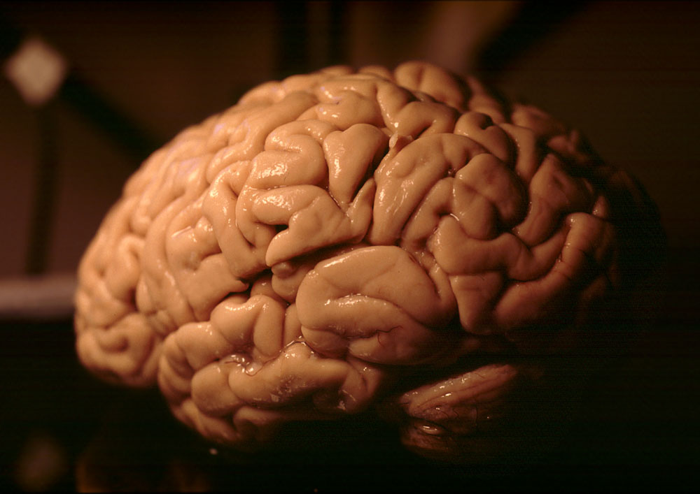
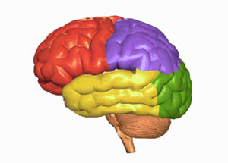
Brain

Slide 20
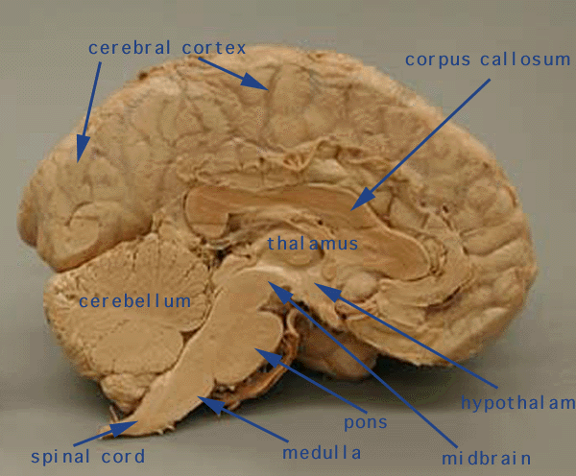
Cerebral cortex (cerebrum)
Two hemispheres
In general, each receives sensory info from and controls movement of opposite side of the body.
Cerebellum (“little brain”)
Controls co-ordination of movement
Brain stem
Most primitive part
Densely packed fibres
Regulates vital functions (e.g. consciousness, breathing).
Damage here usually fatal.

Slide 21
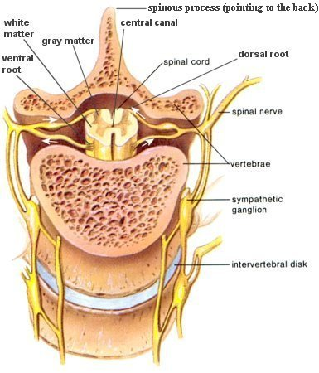
Spinal cord
The CNS ends at the margins of the spinal cord.
The dorsal and ventral roots that emerge from the spinal cord are part of the PNS.
Dorsal root gangion
[somatic]
[ANS]

Slide 22
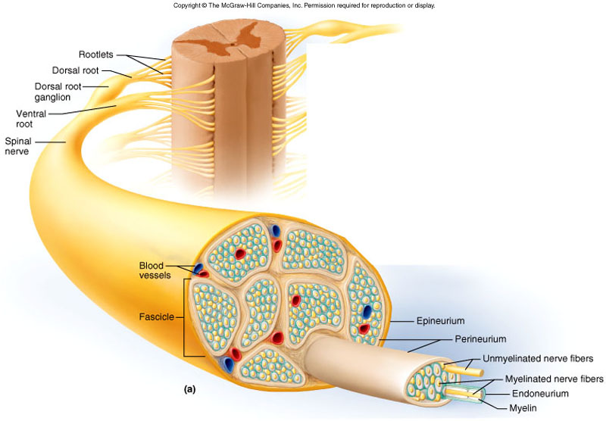
Axon packaging into nerves.
Spinal nerves contain both afferent and efferent axons
They are bundled into fascicles surrounded by perineurium.
The whole nerve is in a tough epineurium capsule.
Individual axons are also wrapped with myelin and endoneurium, though some are unmyelinated, e.g. nociceptive (pain) neurons

Slide 23
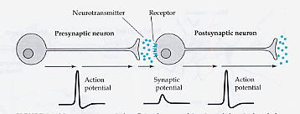
3. Cellular level
The function of a neuron is to transmit and receive action potentials, or stimulate target tissue, e.g. contraction of skeletal/smooth muscle, secretion from gland.
When action potentials reach a neuronal chemical synapse, neurotransmitters released by a presynaptic terminal bind to post-synaptic receptors of the neuron/muscle/gland it is synapsing with.

Slide 24
Many other cell types essential to nervous system function
Complex interrelationships
Details in Session 2 (Richard Reynolds)
Many key features of cell biology & neuronal interactions indicated on following slide…

Slide 25
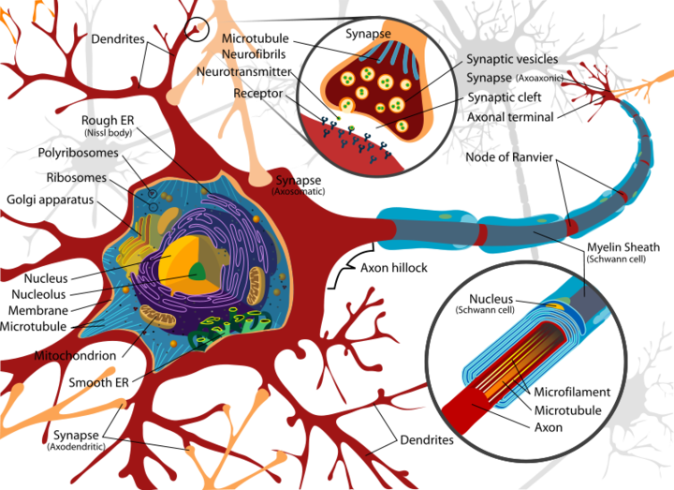

Slide 26
Regeneration
Differs considerably between PNS and CNS
Axons in peripheral nerves can regenerate after injury.
Recovery is often compromised by non-specific target reinnervation & aberrant axon sprouting – e.g. can lead to neuropathic pain.
Axons in the CNS are unable to regenerate over long enough distances to be useful. Why?
inhibitory molecules in CNS but not PNS (e.g. myelin differences)
Absence of guidance cues that stimulate axon growth during development
Some loss of intrinsic axon growth capability by neurons
[CNS regeneration is module in Y4 Neuroscience & Mental Health BSc]

Slide 28
Neurological diagnosis exercise
Brief reminder of neurons providing spinal cord inputs and outputs
Purpose of investigating reflex activity
Look at some simplified somatic motor & sensory circuitry between periphery, spinal cord and cortex
Patient histories
Diagnosis in groups
Feedback of suggested injury sites with reasons

Slide 29
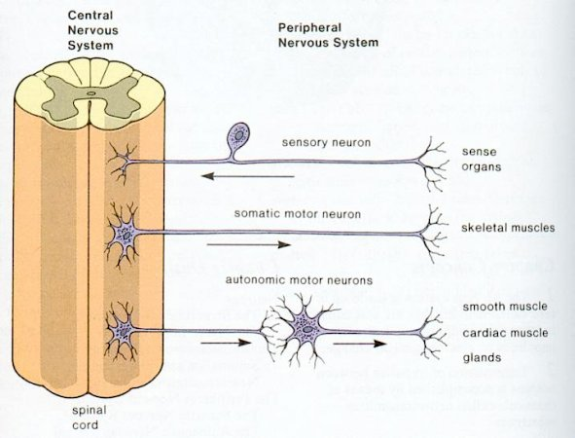
Neuronal cell bodies are in the grey matter.
White matter comprises ascending and descending axon tracts to and from the brain.

Slide 30
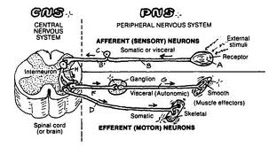
For this exercise, only the somatic sensory inputs, interneurons and somatic motor outputs are relevant. These are needed for a fast reflex response.
In addition, sensory axons synapse on other neurons that transmit action potentials upward to the brain for conscious registering of the stimulus. These ascending tracts, and also descending axons from brain motor regions are not shown …

Slide 31
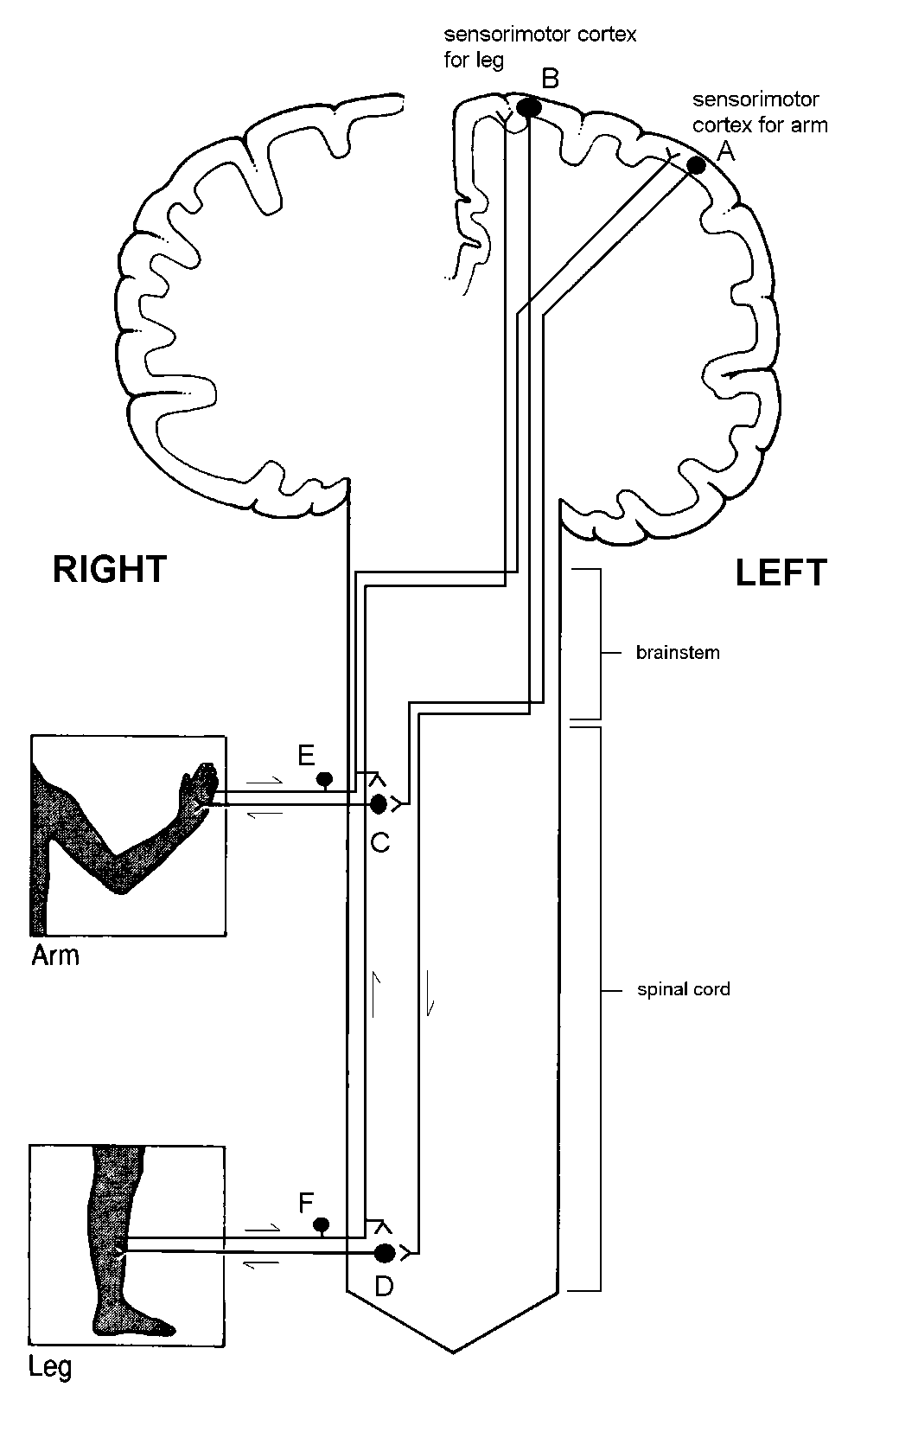
Sensorimotor cortex for leg
Sensorimotor cortex for arm
Neurones A, B, C and D form the motor pathways controlling voluntary movement.
C and D are motor neurons in the spinal cord which innervate skeletal muscle to stimulate contraction directly.
A and B are cortical neurons in the motor cortex which activate motor neurons C and D respectively.
Somatic sensory neurons convey sensory information from the body to the sensory cortex where sensation is perceived. Others trigger spinal cord motor neurons in reflex activity.
Here, for simplicity, the sensory pathways for the limbs are represented only by single neurons E and F.
B
A
Left
Right
brainstem
E
Left arm & leg
Spinal cord
F

Slide 32
Sensorimotor cortex for leg
Sensorimotor cortex for arm
B
A
The white matter of the spinal cord and brainstem therefore contains
ascending sensory axon tracts
and
descending motor axon tracts
[Detailed anatomy in Y2)
Left
Right
brainstem
E
Left arm & leg
Spinal cord
F

Slide 33
Sensorimotor cortex for leg
Sensorimotor cortex for arm
B
Exercise:
Three patients have suffered focal injury to the nervous system.
All the patients have some kind of sensorimotor dysfunction but the injury is located in a different part of the nervous system in each patient.
Discuss with your neighbors & be ready to report back where on this simplified diagram of the nervous system you think the injury might have occurred in each patient
A
Left
Right
brainstem
E
Left arm & leg
Spinal cord
F

Slide 34
Sensorimotor cortex for leg
Sensorimotor cortex for arm
B
Some of their symptoms:
Joe is a 72 year-old retired accountant. He has lost voluntary movement and sensation in his left arm, but the muscles still show reflex activity. His right arm and both legs function normally.
Sophie is a 19 year-old motorcyclist. She has lost voluntary movement and sensation in her left arm. The muscles do not show reflex activity. Her right arm and both legs function normally.
Adam is a 49 year-old taxi-driver. He has lost voluntary movement and sensation in his left arm and leg but the muscles still show reflex activity. His right arm and leg function normally.
A
Left
Right
brainstem
E
Left arm & leg
Spinal cord
F

Slide 35
Sensorimotor cortex for leg
Sensorimotor cortex for arm
Joe
Voluntary movement AND sensation lost but only LEFT arm, and legs fine.
Injury must be to a region in RIGHT hemisphere containing both motor and sensory neurons/axons – but only from arm.
Injury likely to be close to the sensorimotor cortex for arm.
Not peripheral nerve as reflex activity intact.
Not spinal cord as only ONE arm affected affected and legs fine.
Retired 72-year old accountant –stroke?
B
A
Left
Right
brainstem
E
Left arm & leg
Spinal cord
F

Slide 36
Sensorimotor cortex for leg
Sensorimotor cortex for arm
B
A
Sophie
Voluntary movement AND sensation lost but only from one side – but NO reflex activity. (Legs fine)
Likely to be a peripheral nerve injury to the left arm/shoulder since there is no reflex activity.
Unlikely to be spinal cord as legs and right arm fine
Young – motorbike fall/accident?
Left
Right
brainstem
E
Left arm & leg
Spinal cord
F

Slide 37
Sensorimotor cortex for leg
Sensorimotor cortex for arm
B
A
Adam
Injury not peripheral as reflex activity intact, plus both arm AND leg affected.
Unlikely to be spinal cord as only ONE side affected.
Injury likely to be in right brain sensorimotor cortex as only left limbs affected, but spread across regions for both arm and leg.
Middle aged - Brain tumour? Stroke?
Left
Right
brainstem
E
Left arm & leg
Spinal cord
F

Slide 38
Learning objectives
From engaging with this session students should be able to
Define the following terms used to describe the nervous system (NS) and explain how they interact with each other:
Central NS, Peripheral NS, Autonomic NS, Somatic NS
Define the terms afferent and efferent as applied to axons, giving specific examples of neurons in each category
Recognise at list three additional names for the Autonomic NS
State the difference in the regenerative capacity of injured axons between the CNS and PNS
Draw or interpret a simplified circuitry diagram for spinal cord inputs and outputs, and ascending/descending sensory/motor pathways to cortex.

Slide 39
BREAK
Be back promptly by 3.55
Questions?

