Slide 1
Imperial College
London
LCRS
NEUROSCIENCE AND MENTAL HEALTH
Autonomic reflexes
Chris John

Slide 2
CARDIOVASCULAR REGULATION
CO ≅ MABP
TPR
where CO = cardiac output
MABP = mean arterial blood pressure
TPR = total peripheral resistance
Note: TPR = 1 (r= radius of blood vessel)
r ⁴

Slide 3
Autonomic nervous system. Control of Cardiac output
CO = SV x HR
Sympathetic stimulation of the heart:
  a) inotropic effect (increased SV)
  b) chronotropic effect (increased HR)
Consequently Cardiac Output increases

Slide 4
TOTAL PERIPHERAL RESISTANCE
SYMPATHETIC TONE
INCREASED sympathetic activity:
vasoconstriction
increased total peripheral resistance

Slide 5
THE BARORECEPTOR REFLEX
Decreased inhibition
of sympathetic nervous system
BRAIN
decreased
stretch of receptors
HEART
INCREASED ACTIVATION
Blood vessels
Baroreceptors
(in carotid sinus and aortic arch)
Cardiopulmonary volume receptors
Sympathetic ganglia
Increased circulating catecholamines
ADRENAL MEDULLA
DECREASED BLOOD PRESSURE
INCREASED ACTIVATION
OF SYMPATHETIC NERVOUS SYSTEM
Notes:
5

Slide 6
BARORECEPTOR REFLEX
INCREASED ARTERIAL BLOOD PRESSURE
Stimulates baroreceptors
Increased afferent nerve activity
Decreased sympathetic nerve activity
and also increased
vagal tone
Decreased vasomotor tone
Decreased heart rate
and force of contraction
DECREASED ARTERIAL BLOOD PRESSURE

Slide 7
Normal cardiovascular response to gaining an upright posture
Decreased
cardiac output
Reduced venous return
Decreased
arterial blood pressure
Pooling of
blood in lower
limbs
Decreased stimulation of baroreceptors and cardio-pulmonary receptors
Decreased vagal
tone to heart
INCREASED
sympathetic nerve activity
Increased
arterial blood pressure
Increased cardiac output
Increased total peripheral resistance

Slide 8
POSTURAL HYPOTENSION
Reduced venous return
Pooling of
blood in lower
limbs
Decreased
cardiac output
Decreased
arterial blood pressure
Decreased stimulation of baroreceptors and cardio-pulmonary receptors
FAINT
Decreased vagal
tone to heart
decreased
cerebral blood flow
impaired
sympathetic nerve response
arterial blood pressure
not maintained
Little change in cardiac output
NO increase in total peripheral resistance

Slide 9
POSTURAL HYPOTENSION
Autonomic (sympathetic) impairment:
  acute reduced sympathetic response
  postural hypotension
Blood flow to the brain impaired
  loss of consciousness results
Once body supine:
  blood flow to the brain restored
  and consciousness is (usually) regained

Slide 11
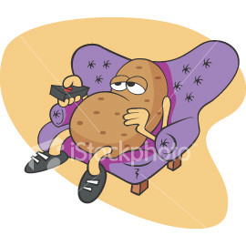
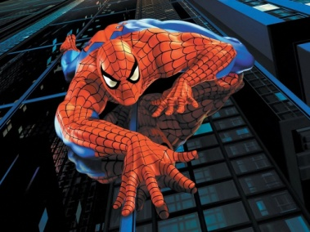
SCHEMATIC DIAGRAM OF THE AUTONOMIC NERVOUS SYSTEM
Parasymp
Cranial
sacral
Pre
Post
ACh
ACh
Effector
organ
Pre
Post
ACh
NA
Effector
organ
ANS
Pre
Sympathetic – thoracic/lumbar
ACh
Adrenal
medulla
A (and NA)
via bloodstream
Effector
organ
Pre
Effector
organ
e.g. sweat gland
ACh
Post
ACh
ACh = acetylcholine A = adrenaline (epinephrine)
NA = noradrenaline (norepinephrine)

Slide 12
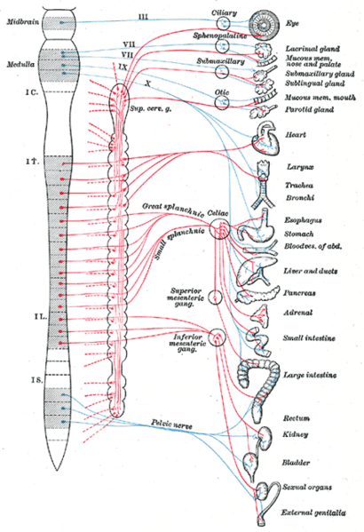
SCHEMATIC DIAGRAM OF THE AUTONOMIC NERVOUS SYSTEM

Slide 13
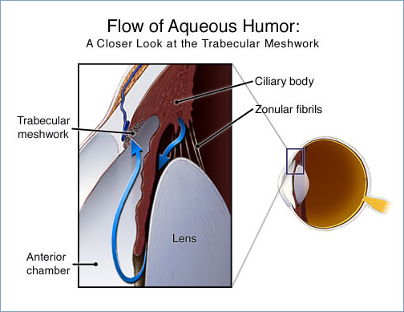
Structure of the eye
Parasympathetic
=
Sympathetic
=

Slide 14
Regulation of pupil diameter
Parasympathetic
=
Sympathetic
=

Slide 15
ACTIVATION OF THE PARASYMPATHETIC SYSTEM

Slide 16
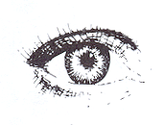
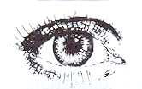
Effect of pilocarpine on pupil diameter
Eye with
pilocarpine
Parasympathetic
=
Miosis
Sympathetic
=
Untreated eye

Slide 17
BLOCKADE OF THE PARASYMPATHETIC SYSTEM

Slide 18
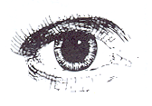
Effect of atropine on pupil diameter
Untreated eye
Parasympathetic
=
Mydriasis
Sympathetic
=
Eye treated
with atropine

Slide 19
THE LIGHT REFLEX
ROLE OF THE PARASYMPATHETIC SYSTEM

Slide 20
The pupillary light reflex
(pupil constricts in response to light)
LIGHT
Sphincter pupillae
Ciliary ganglion
(parasympathetic)
Optic nerve
(cranial II
sensory)
Oculomotor nerve
(cranial nerve III, motor)
Edinger-
Westphal nucleus
Pretectal nucleus

Slide 21
The consensual reflex
(both pupils constrict)
LIGHT
Ciliary
ganglion
Ciliary
ganglion
Optic nerve
(cranial II
sensory)
Oculomotor nerve
(cranial nerve III, motor)
Oculomotor
Nerve (cranial
nerve III, motor)
Edinger-
Westphal nucleus
Edinger-
Westphal nucleus
Pretectal nucleus

