Slide 1
Dr Mark A Smith mark.smith@imperial.ac.uk
Resting Potential
Action potential generation and conduction

Slide 2
Recommended Reading
Much of the lecture material is from the textbooks by:
Lauralee Sherwood, Human Physiology, 3rd edition.
Tortora & Grabowski, Principles of Anatomy and Physiology, 9th edition.

Slide 3
Nervous system
Transmits information reliably and quickly over long distances
How?

Slide 4
Outline
Mechanisms responsible for Action Potential (AP)
Time-course voltage vs time: 5 stages
Voltage-gated ion channels & ion movement
Permeability changes vs time
Regenerative nature of AP
Propagation (travel) of AP
Velocity

Slide 5
The ionic basis of the action potential
Key concepts
Permeability depends on channel state (open or closed)
When permeability of an ion increases it crosses the membrane down its electrochemical gradient
This movement changes the membrane potential toward the equilibrium potential for that ion
****Changes in membrane potential during the action potential are NOT due to ion pumps****

Slide 6
Outline
Mechanisms responsible for Action Potential (AP)
Time-course voltage vs time: 5 stages
Voltage-gated ion channels & ion movement
Permeability changes vs time
Regenerative nature of AP
Propagation (travel) of AP
Velocity

Slide 7
Phases of the action potential
Generated in the axon

Slide 8
Phase 1. Resting membrane potential
P_{K} >> P_{Na}
Membrane potential nearer equilibrium potential for K⁺ than that for Na⁺

Slide 9
Phase 1. At the resting potential, voltage-gated ion channels (Na⁺ & K⁺) are closed
They are different to non-voltage gated K⁺ & Na⁺ channels cause the resting potential

Slide 10
Phase 2. Depolarizing stimulus
The stimulus (exaggerated here) depolarizes the membrane potential
Moves it in the +ve direction towards threshold

Slide 11
Phase 3. Upstroke
Starts at threshold potential
P_{Na} ↑↑↑ because the voltage-gated Na⁺ channels open quickly
Na⁺ enter the cell down the electrochemical gradient
P_{K} ↑ as the voltage-gated K⁺ channels start to slowly open
K⁺ leave the cell down the electrochemical gradient
Less than Na⁺ entering
Membrane potential moves toward the Na⁺ equilibrium potential

Slide 12
Phase 3. At start of the upstroke voltage-gated Na⁺ open before K⁺ channels
Na⁺ channel activation gate open
K⁺ channel closed
Na⁺ Channel inactivation gate open
As upstroke progresses, more and more voltage-gated K⁺ channels open

Slide 13
Phase 4. Repolarization
P_{Na} ↓↓↓ because the voltage-gated Na⁺ channels inactivate
Na⁺ entry stops
P_{K} ↑↑ as more voltage-gated K⁺ channels open & remain open
K⁺ leaves the cell down the electrochemical gradient
Membrane potential moves toward the K⁺ equilibrium potential

Slide 14
Phase 4. At start of repolarization
Na⁺ channel activation gate open
K⁺ channel
open
Na⁺ channel inactivation gate closed
Absolute refractory period
Inactivation gate is closed
New action potential cannot be triggered even with very strong stimulus

Slide 15
Phase 4. Later in repolarization
Na⁺ channel activation gate closed
K⁺ channel
open
Na⁺ channel inactivation gate closed
Absolute refractory period: continues

Slide 16
Phase 5. After-hyperpolarization
At rest voltage-gated K⁺ channels are still open
K⁺ continues to leave the cell down the electrochemical gradient
Membrane potential moves closer to the K⁺ equilibrium
Voltage-gated K⁺ channels then close
Membrane potential returns to the resting potential

Slide 17
Phase 5. During after-hyperpolarization
Na⁺ channel
activation gate
closed
K⁺ channel
open
Na⁺ channel
inactivation gate
open
Relative refractory period
Inactivation gate is open
Stronger than normal stimulus required to trigger an action potential

Slide 18
Outline
Mechanisms responsible for Action Potential (AP)
Time-course voltage vs time: 5 stages
Voltage-gated ion channels & ion movement
Permeability changes vs time
Regenerative nature of AP
Propagation (travel) of AP
Velocity

Slide 19
Time-course of changes in permeability

Slide 20
Outline
Mechanisms responsible for Action Potential (AP)
Time-course voltage vs time: 5 stages
Voltage-gated ion channels & ion movement
Permeability changes vs time
Regenerative nature of AP
Propagation (travel) of AP
Velocity

Slide 21
Regenerative relationship between P_{Na} and membrane potential
Threshold
once reached action potential is triggered
Action potential
“All-or-Nothing” nature
once triggered, a full sized action potential occurs
Refractory state
unresponsive to threshold depolarization

Slide 22
Regenerative relationship between P_{Na} and membrane potential

Slide 23
Regenerative relationship between P_{Na} and membrane potential
Once threshold is reached the cycle continues
Positive feedback behaviour

Slide 24
Regenerative relationship between P_{Na} and membrane potential
Once threshold is reached the cycle continues
Positive feedback behaviour
Cycle continues until the voltage-gated Na⁺ channels inactivate
closed and voltage-insensitive
Membrane remains in a refractory (unresponsive) state until the voltage-gated Na⁺ channels recover from inactivation

Slide 25
Ion movements during the action potential
Na⁺ enters the cell and K⁺ leaves the cell
BUT only a very small number of ions cross the membrane and change the membrane potential
The concentration change is extremely small, less than 0.1%
****Ion pumps are NOT directly involved in the ion movements during the Action Potential****
Na⁺/K⁺ pumps returns ions that moved during the AP

Slide 26
Outline
Mechanisms responsible for Action Potential (AP)
Time-course voltage vs time: 5 stages
Voltage-gated ion channels & ion movement
Permeability changes vs time
Regenerative nature of AP
Propagation (travel) of AP
Velocity

Slide 27
Passive propagation
Only resting K⁺ channels open
Internal (or axial) & Membrane Resistance alters propagation distance and velocity

Slide 28
Active Propagation of the Action Potential

Slide 29
Active Propagation of the Action Potential

Slide 30
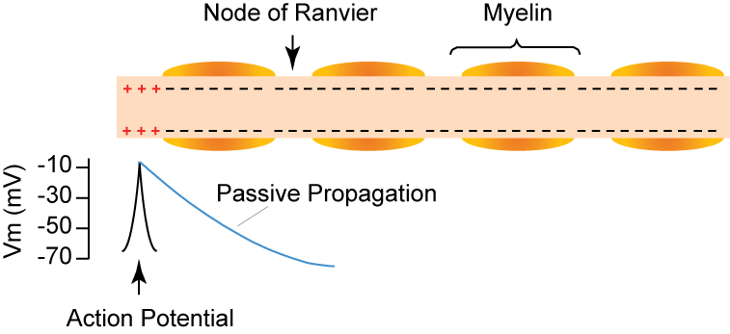
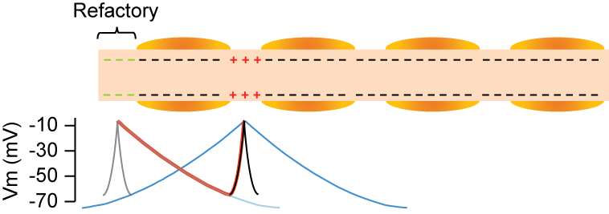
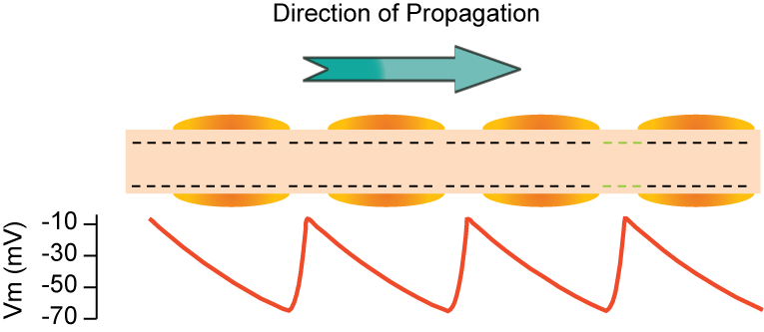
Nodes of Ranvier
Voltage-gated channels mostly located at nodes

Slide 31
Velocity
Action potential travels quickly
Velocity range in mammals axons:
Large diameter, myelinated axons 120 m/s
Small diameter, non-myelinated axons 1 m/s
Note. velocity of sound in air 331 m/s
Axon diameter and myelination changes conduction velocity

Slide 32
Conduction velocity
Increases with axon diameter
less resistance to current flow inside large diameter axons
Higher in myelinated than non-myelinated axons of the same diameter
action potentials only occur at nodes of Ranvier
Conduction velocity is slowed by
reduced axon diameter (i.e. re-growth after injury)
reduced myelination (i.e. multiple sclerosis and diphtheria)
cold, anoxia, compression and drugs (some anaesthetics)

