Slide 1
Molecules working together: force and movement
Dr Paul Strutton
16 January 2013

Slide 2
Outline
Skeletal muscle – structure
Crossbridge cycle
How force is varied in vivo
Energy demand & supply
Cardiac muscle
Smooth muscle

Slide 3
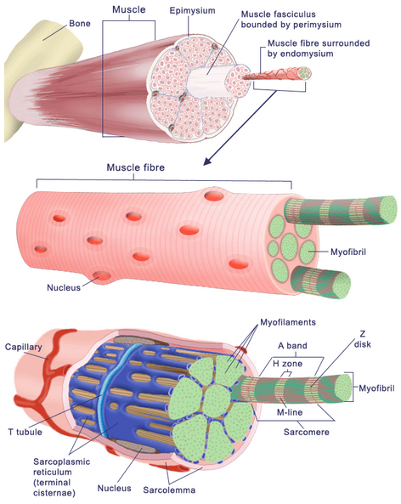
Skeletal muscle structure

Slide 4
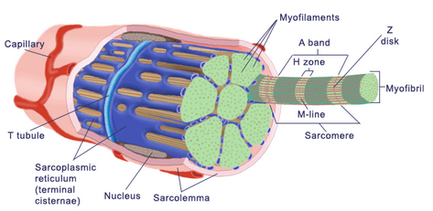
Myofibers
Covered by plasma membrane – sarcolemma
T-tubules tunnel into centre
Cytoplasm called sarcoplasm – myoglobin and mitochondria present
Network of fluid filled tubules – sarcoplasmic reticulum
Composed of myofibrils

Slide 5
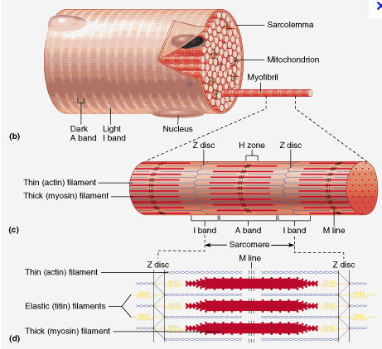
Myofibrils
1-2μm in diameter
Extend along entire length of myofibrils
Composed of two main types of protein – actin and myosin

Slide 6
Myofilaments
Light and dark bands give muscle striated appearance
Do not extend along length of myofibril
Overlap and are arranged in compartments called sarcomeres

Slide 7
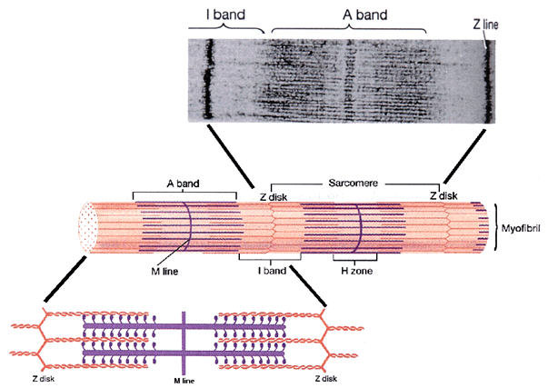
Myofilaments
Dense protein Z-discs separate sarcomeres
Dark bands – A band (thick - myosin)
Light bands – I band (thin - actin)
Myosin and actin filaments overlap

Slide 8

Actin and myosin
myosin
actin
Thick filaments
Thin filaments

Slide 9
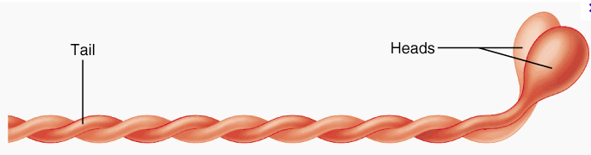
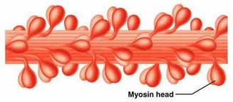
Thick filaments - myosin
Two globular heads
Single tail formed by two α-helices
Tails of several hundred molecules form one filament

Slide 10

Thin filaments - actin
Actin molecules twisted into helix
Each molecule has a myosin binding site
Filaments also contain troponin and tropomyosin

Slide 11
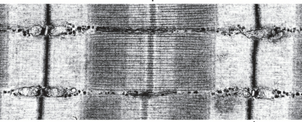
Sliding filament theory - observations
During contraction I band became shorter
A-band remained same length
H-zone narrowed or disappeared
A-band
Z-disc
H-zone
I-band
M-line
Sarcomere

Slide 12
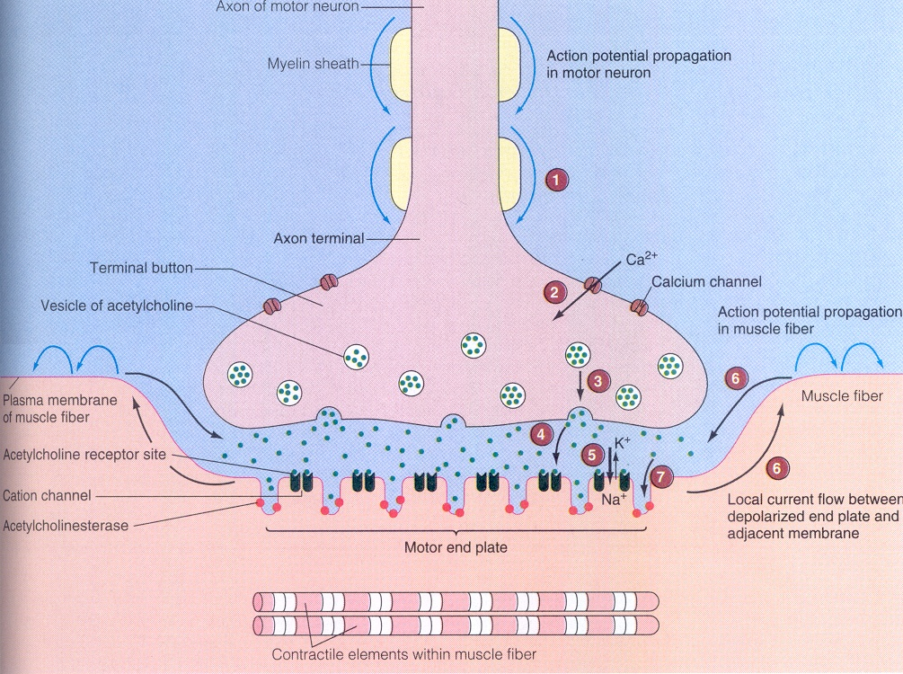
Initiation of muscle contraction
STEPS
1
1. Action potential open V-gated Ca²⁺ channels
2
3
2. Ca²⁺ enters
4
3. Ca²⁺ triggers exocytosis of vesicles
5
4. Acetylcholine diffuses in cleft
5. Acetylcholine binds to receptor-cation channel & opens channel
Na⁺ gain > K⁺ loss

Slide 13
6. Local currents flow from depolarized region and adjacent region
6
Action potential triggered and
7
6
spreads along surface membrane
7. Acetylcholine broken down by acetylcholine esterase (enzyme). Muscle fibre response to that molecule of Acetylcholine ceases.

Slide 14
Activation & Relaxation: Structures
T tubule opening
Surface membrane = sarcolemma
T tubule
myofibril
sarcoplasmic reticulum (SR)

Slide 15
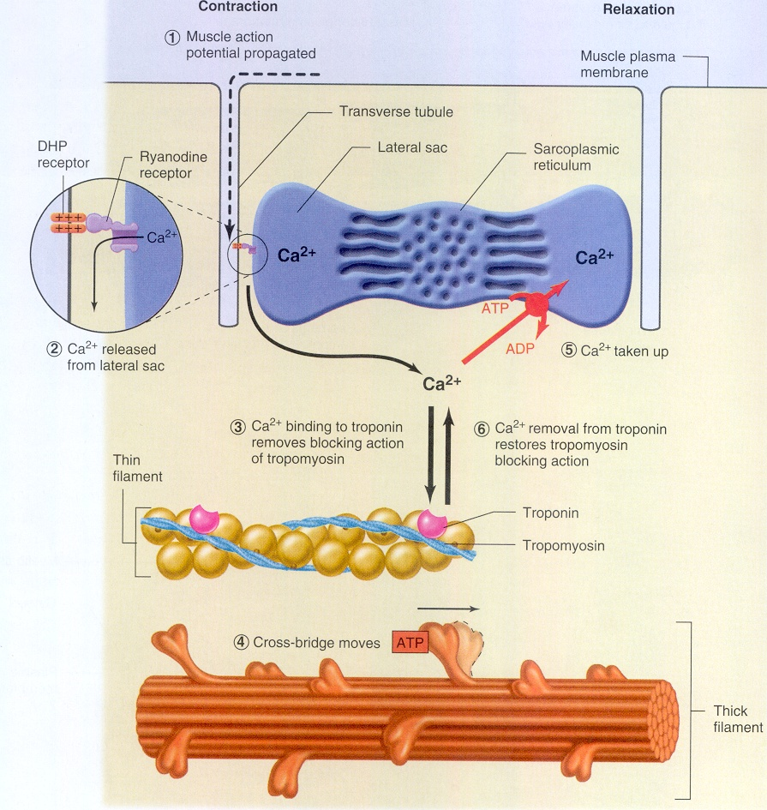
Activation process
1. Action potential propagates along surface membrane and into T-tubules
1
2. DHP (dihydropyridine) receptor in T-tubule membrane: senses ΔV & changes shape of the protein link to Ryanodine receptor,
2
5
6
opens the Ryanodine receptor Ca²⁺ channel in the SR membrane
3
Ca²⁺ released from SR into space around the filaments
4
crossbridges attach

Slide 16
3. Ca²⁺ binds to Troponin & Tropomyosin moves allowing
1
4. Crossbridges to attach to actin
5. Ca²⁺ is actively transported into the SR continuously while action potentials continue. ATP- driven pump (uptake rate < or = release rate).
2
5
3
6
4
crossbridges attach

Slide 17
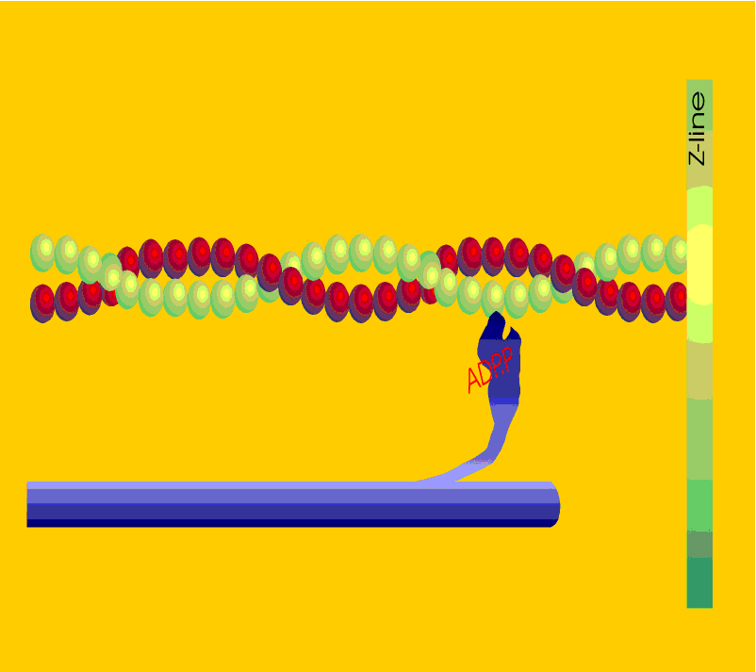
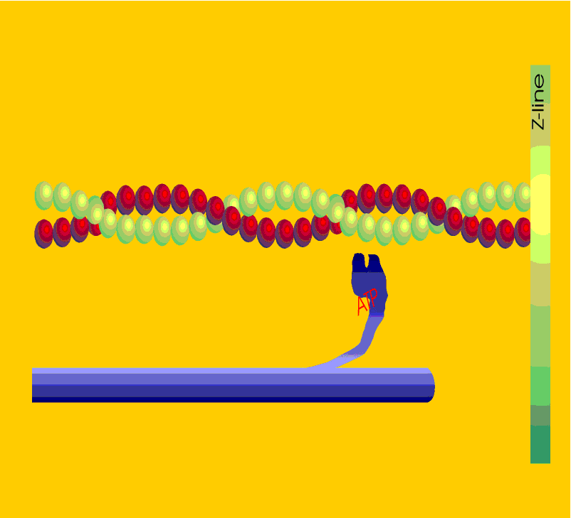
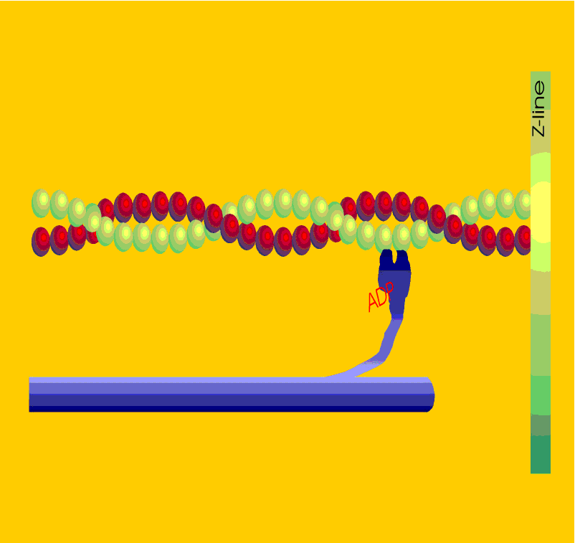
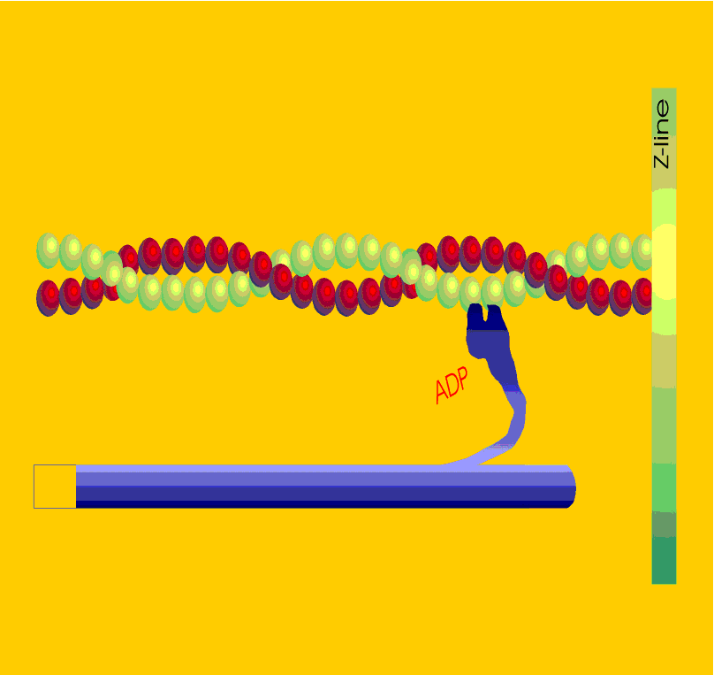
2
Z
Pi release & weak to strong force
attach
Does not occur when [Ca] low
ADP Pi
Pi
1
Z
Z
3
ADP Pi
ADP
detach & ATP hydrolysis
Z
ATP binding
4
Z
ADP
5
ADP release & filament sliding
ATP
ATP
Notes:
t tubules carry impulses
calcium release into the SR
binds to troponin- conformational shift of tropomyosin
Myosin head bound to ATP
Myosin head contains ATPase - splits high energy phosphate bond of ATP to produce ADP + Pi
the ADP and Pi stay on the energised myosin head
Myosin head attaches loosely to the actin and the Pi is lost and attachment strengthens
proteins in myosin head undergo conformational change which causes a change in the angle at which myosin binds to actin - power stroke
After power stroke ADP is exchanged for ATP
Results in release of the myosin head from the actin

Slide 18
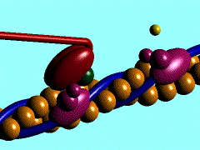
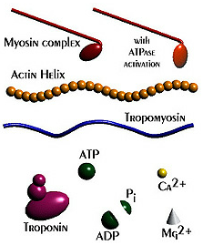
Ca²⁺binds to troponin, tropomyosin moves to reveal myosin binding site on actin
Myosin head bound to ATP – this myosin head contains ATPase - splits high energy phosphate bond of ATP to produce ADP + Pi (needs Mg²⁺)
ADP and Pi stay on the energised myosin head
Myosin head attaches loosely to the actin and the Pi is lost and attachment strengthens
Proteins in myosin head undergo conformational change which causes a change in the angle at which myosin binds to actin - power stroke
After power stroke ADP is exchanged for ATP
Results in release of the myosin head from the actin – cycle starts again
Notes:
t tubules carry impulses
calcium release into the SR
binds to troponin- conformational shift of tropomyosin
Myosin head bound to ATP
Myosin head contains ATPase - splits high energy phosphate bond of ATP to produce ADP + Pi
the ADP and Pi stay on the energised myosin head
Myosin head attaches loosely to the actin and the Pi is lost and attachment strengthens
proteins in myosin head undergo conformational change which causes a change in the angle at which myosin binds to actin - power stroke
After power stroke ADP is exchanged for ATP
Results in release of the myosin head from the actin

Slide 19
Cross-bridge Cycle: Key Features
1) ATP is used in each cycle to provide the energy
Rigor mortis occurs if ATP concentration = 0 (Ca²⁺ pumps stop)
2) Direction of force is one-way (toward M-line at the centre of the sarcomere)
If bridges produce enough force compared to external load, sliding in the shortening direction
If bridges do not produce enough force, either no sliding (isometric), or bridges act as a brake & resist sliding in the lengthening direction
3) Step size is small during shortening: sliding produced by one cycle is only about 1% of the sarcomere length
Many cycles occur in succession to cause large movements (as in running, walking, etc)

Slide 20
Relaxation of muscle
Muscle relaxes when Ca²⁺ is sequestered back into the SR
This is an energy demanding, active transport process
For every 2 Ca²⁺ transported 1 ATP split
The process of Ca²⁺ sequestration takes longer than release (2-3x)

Slide 21
Relaxation process
action potentials cease, 1 & 2 stop and 3 Ca²⁺ release from SR ceases
X
1
5. Active transport of Ca²⁺ into the SR by ATP- driven pump continues.
6. Ca²⁺ dissociates from TN when free Ca²⁺ declines
2
5
X
3
6
X
7. TM block prevents new crossbridge attachment
7
Tropomyosin blocks binding site
8
8. Active force declines due to net crossbridge detachment
crossbridges detach

Slide 22
Outline
Skeletal muscle
Crossbridge cycle
How force is varied in vivo to match task
Energy demand & supply
Cardiac muscle
Smooth muscle
1) recruitment of motor units
2) frequency of action potentials
3) filament overlap
4) velocity and direction of movement

Slide 23
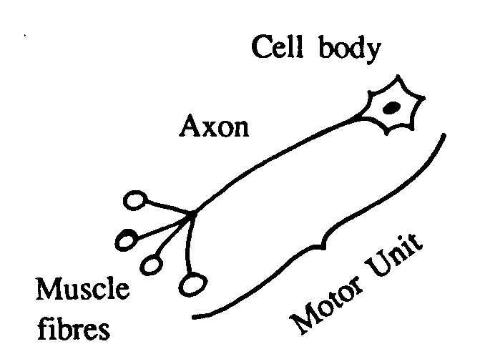
1.
Recruitment
Background
Motor unit: one motoneurone and all the muscle fibres it innervates (has synapses with).
The functional unit of normal skeletal muscle.
Motoneuron
Action potential in the motoneurone always triggers an action potential in all the muscle fibres in the motor unit

Slide 24
1.
Recruitment - vary the number of motor units that are active and thus vary force.
One motor unit recruited
Three motor units recruited, more muscle fibres producing force

Slide 25
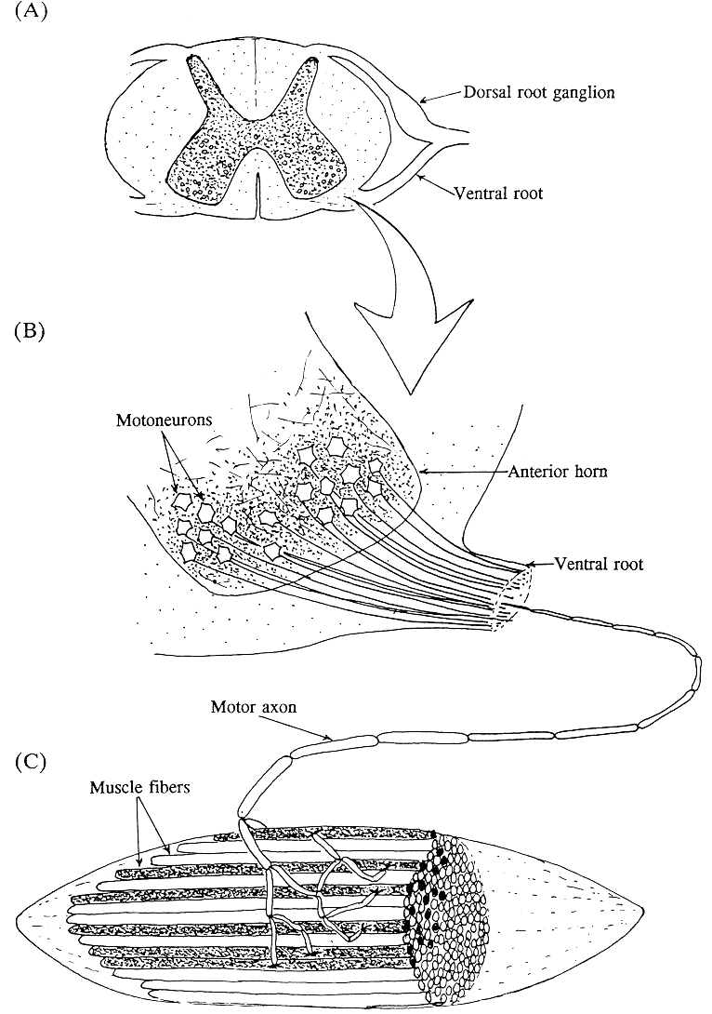
Functional anatomy of motor units
*
*
Motor unit size varies (number of muscle fibres per motoneurone)
Scattered distribution within muscle

Slide 26
2.
Frequency of action potentials
3 Hz
0
twitch force & action potential
unfused tetanus force
10 Hz
0
unfused tetanus force
20 Hz
0
fused tetanus force
30 Hz
Force summates (increases), but action potentials do NOT
0

Slide 27
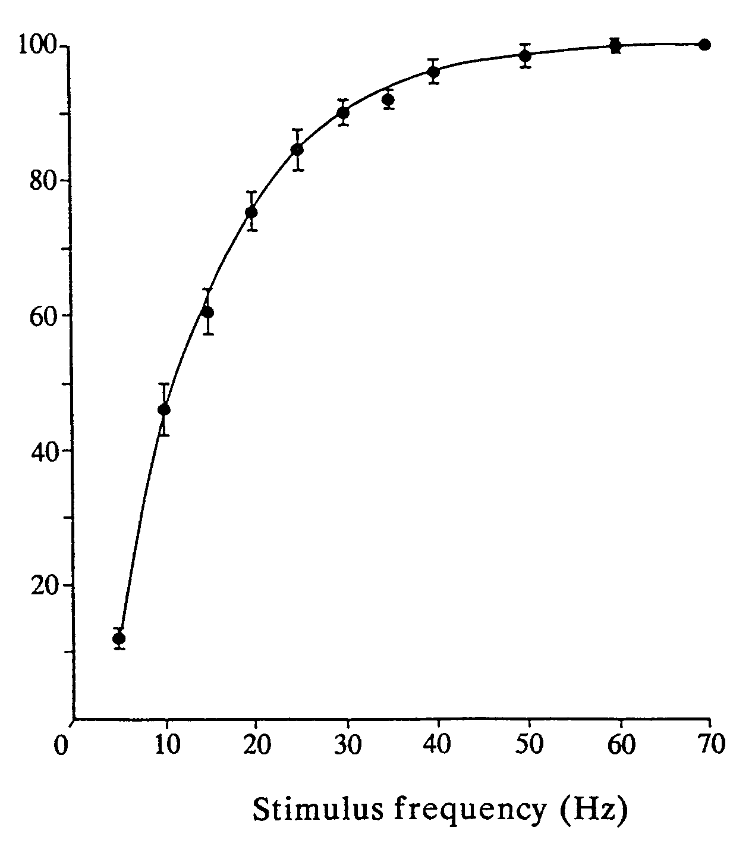
Summary of effect of action potential frequency on force
Particularly important for getting high forces In vivo
Force
(% of maximum)
Mechanism?
What is happening inside muscle cell that makes force high when action potential frequency is high?

Slide 28
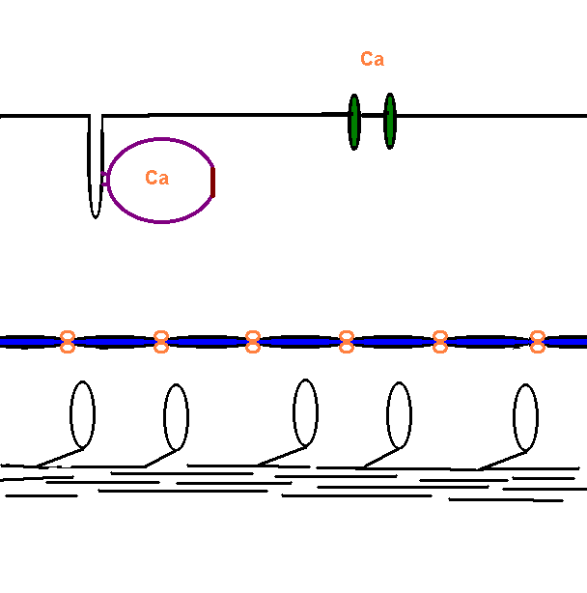
Relaxed skeletal muscle
Ca in SR, not bound to troponin.
Crossbridges cannot attach to actin &
cannot produce force or sliding
T-tubules
out
in
Sarcoplasmic reticulum
troponin
Thin filament
Thick filament

Slide 29
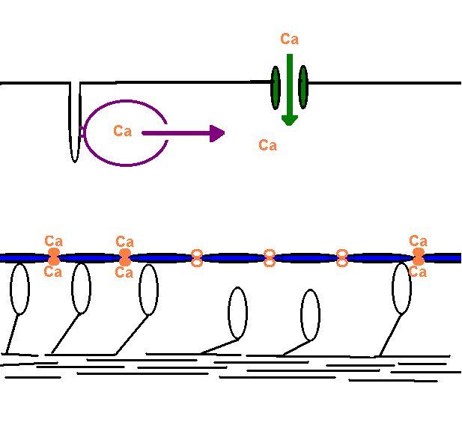
Action potentials in T-tubules ⇒ release Ca from SR ⇒ Ca binds to troponin ⇒ crossbridges attach ⇒ produced force and/or sliding
Higher freq action potentials ⇒ more Ca release ⇒ more Ca binding ⇒ more bridges attach ⇒ more force
out
in

Slide 30
3.
Force depends on filament overlap
Dependence of isometric force on sarcomere length
Force (% of max)
Experiment: adjust muscle length (sarcomere length) of relaxed muscle, then stimulate to cause action potentials while keeping muscle length constant (isometric contraction).
Measure force produced & plot vs sarcomere length ( ).
Mechanism?
What is happening inside the muscle cell to give this relationship?
Sarcomere length (% of optimum)

Slide 31
3.
Force depends on filament overlap
Dependence of isometric force on sarcomere length
Force (% of max)
Sarcomere length (% of optimum)

Slide 32
Drawing hints
1. Align thick filament first, then draw thins
2. Draw bridges attached
Force (% of max)
Sarcomere length (% of optimum)

Slide 33
Types of muscle contraction
Isometric
force produced without a change in muscle length
Isotonic
constant force with change in length
Isovelocity
force with constant velocity of shortening or lengthening

Slide 34
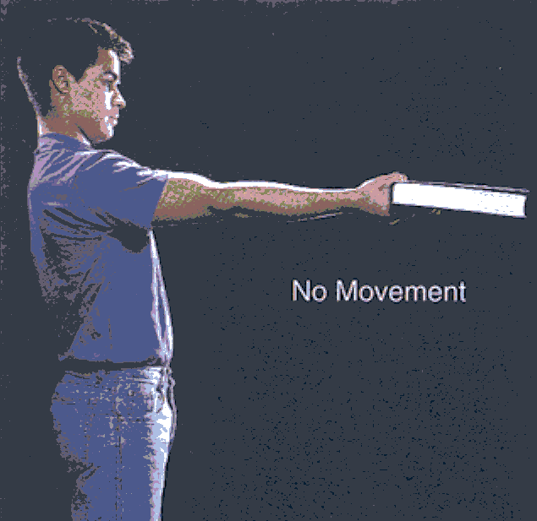
Isometric contraction
The muscle force resists gravity and prevents the arm and book falling

Slide 35
Types of muscle contraction*
Concentric
muscle shortens
Eccentric
muscle lengthens
*The word “contraction” means the muscle is active, not resting. Contraction does not necessarily mean the muscle is getting shorter

Slide 36
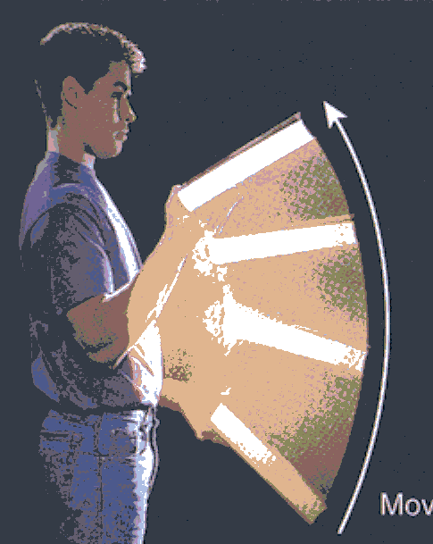
Concentric (shortening) contraction
Biceps contracts and its shortening flexes the elbow
Biceps does work lifting the book
Movement

Slide 37
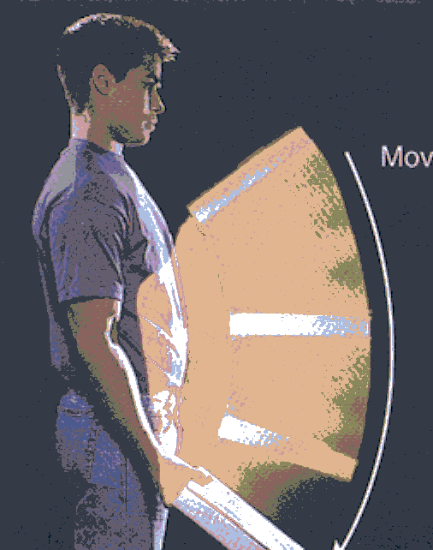
Eccentric (lengthening) contraction
The book is lowered in a slow, controlled movement
Biceps acts as a brake resisting gravity
The elbow extends as the length of biceps increases due to the book & gravity
Work is done on biceps.
Movement

Slide 38
Force depends on the velocity and direction of movement
4.
Force (% of Isometric)
Mechanism?
This behaviour cannot be understood in terms of one crossbridge. It is due to a large number of bridges acting together.
Force depends on the:
proportion of bridges that are attached
and
force each attached bridge produces.
100
0
100
Velocity (% of max shortening V)
lengthening
shorten
isometric

Slide 39
Outline
Skeletal muscle
Crossbridge cycle
How force is varied in vivo
Energy demand & supply
Cardiac muscle
Smooth muscle

Slide 40
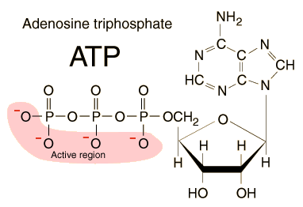
Adenosine triphosphate (ATP)
The energy currency of living organisms

Slide 41
Adenosine triphosphate
Adenine
Adenosine
Ribose
Phosphate groups

Slide 42
Adenosine triphosphate
Energy-transferring reaction is hydrolysis
  addition of molecule of water (H₂O)
In doing so, energy is liberated and ADP is converted to ADP + one phosphate group (P_{i})

Slide 43
ATP to ADP
H₂O
ATP
ADP
P_{i}
Energy
ATPase

Slide 44
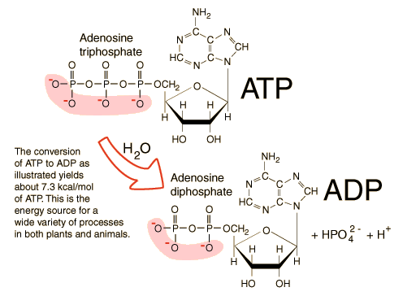
ATP to ADP

Slide 45
ATP in muscles
Needed for:
  Energising myosin heads for “power stroke” of contraction
  Disconnecting myosin head from actin
  Active transport of Ca²⁺ back into sarcoplasmic reticulum (Ca²⁺)
Each of these reactions requires ATPase enzymes

Slide 46
Adenosine triphosphate
Skeletal muscle can use ATP at a very high rate
ATP would be depleted in a few seconds
It need to be replenished
Metabolic processes exists within skeletal muscles fibres to do this

Slide 47
Replenishment of ATP
ATP utilised at very high rate.
Can be > 100 times resting rate for brief periods
Replenishment can be carried out:
  Immediately (utilising phosphocreatine)
  In the short term (glycolysis) – does not require O₂
  In the longer term (oxidation) – requires O₂

Slide 48

Immediate replenishment of ATP
Unlike many other cells, muscles have large supply of energy reserve – phosphocreatine
Formed in liver and transported via blood for storage in muscles

Slide 49
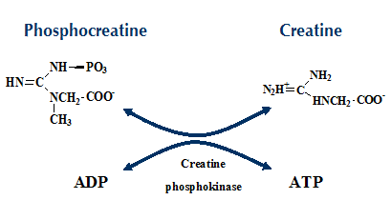
Phosphocreatine (PCr)
Following intense muscle contraction, PCr can anaerobically donate P_{i} to ADP to form ATP.
1 ATP produced

Slide 50
Glycolysis
Conversion of glucose to pyruvic acid
Sources of glucose
  As blood glucose
  From breakdown of glycogen into glucose within the muscle cell
  Can supply ATP very quickly
Does not require oxygen

Slide 51
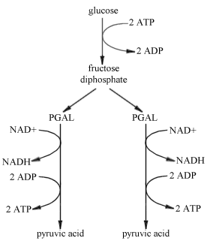
Glycolysis
2 ATPs produced

Slide 52
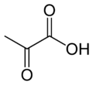
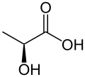
Pyruvic acid in muscles
Can enter citric acid (Krebs) cycle in presence of O₂
Produces lactic acid in absence of O₂
  Some lactic acid remains in muscle - fatigue
lactacte dehydrogenase
reduction
Pyruvic acid
Lactic acid

Slide 53
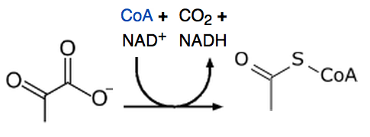
Oxidative (aerobic) metabolism
oxidative decarboxylation of pyruvate
pyruvate dehydrogenase
complex
Acetyl-CoA
Pyruvate
Enters citric acid cycle

Slide 54
Citric acid cycle
series of chemical reactions to generate energy derived from:
  carbohydrates
  fats
  proteins
producing CO₂ and H₂O
36 ATPs produced

Slide 55
Mitochondria
Mitochondria are the power stations of our cells and the sites of oxidative phosphorylation. The enzymes for fat metabolism (β-oxidation), the Krebs cycle, electron transport chain are located inside the mitochondria.
Mitochondrial DNA
Krebs cycle
Electron transport chain
F₀F₁ ATP synthase
Pathways (e.g. b-oxidation)
Transporters (e.g. ATP/ADP, FAs)

Slide 56
Activity
Fuel supply during activity
Sustained, low intensity
ATP, PCr, fatty acids, glycogen & glucose
ATP, PCr, fatty acids, glycogen & glucose
Sustained, high intensity
Sprint
ATP, PCr

Slide 57
Summary – production of ATP
1 ATP
Hydrolysis of phosphocreatine (PCr)
Glycolysis
Oxidative (aerobic) metabolism
2 ATPs
36 ATPs

Slide 58
Outline
Skeletal muscle
Crossbridge cycle
How force is varied in vivo
Energy demand & supply
Cardiac muscle
Smooth muscle

Slide 59
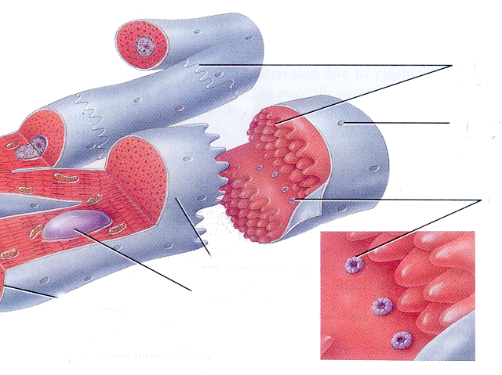
Cardiac muscle fibres (=cell = cardiomyocyte)
Intercalated discs, mechanical links between fibres
Opening of T-tubule
Gap junctions, where ionic currents (action potentials) flow between fibres
Cardiac muscle fibre
nucleus
small cells
action potentials spread between cells
some cardiac cell types have spontaneous action potentials
Striated - contractile mechanism as in skeletal muscle

Slide 60
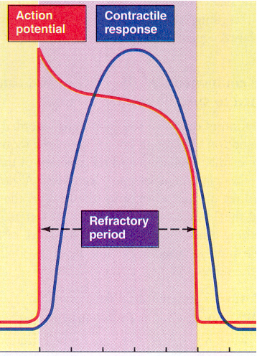
Action potential and Ca sources - very important differences from skeletal muscle
Timing of ventricular action potential and isometric force
Force is already relaxing during the membrane’s refractory period
AP scale (mV)
force scale (N)
Therefore cardiac muscle CANNOT produce a fused tetanus
Designed for pumping
0
200
Time (ms)

Slide 61
Between action potentials
Voltage-gated Ca channels
closed
T-tubules
out
in
Sarcoplasmic reticulum
troponin
Thin filament
Thick filament

Slide 62
During the cardiac action potential
Sources of Ca:
from SR and
entry into the cell during the plateau of the action potential via voltage-gated Ca channels
out
in

Slide 63
Outline
Skeletal muscle
Crossbridge cycle
How force is varied in vivo
Energy demand & supply
Cardiac muscle
Smooth muscle

Slide 64
Smooth muscle
Arranged in sheets forming walls of tubular organs
  blood vessels,
  gastro-intestinal tract
  reproductive tract, etc.

Slide 65
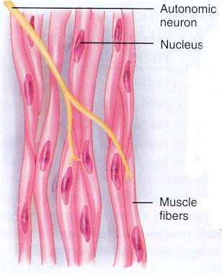
Smooth muscle fibres
Cells appear smooth (not-striated) in micrographs.
Contain filaments, but they are not arranged in regular arrays.
Contractile mechanism (crossbridge cycle) is similar to skeletal and cardiac muscle
Activation by Ca is different from skeletal and cardiac muscle.
Smooth muscle does NOT contain any Troponin.

Slide 66
Mlck = myosin light …..chain kinase
Relaxed Smooth muscle
Cm = calmodulin
Ca
out
in
sr
Ca
Inactive myosin: cannot bind to actin
ATP
ADP-Pi-Myosin
Mlck
Cm

Slide 67
Mlck = myosin light …..chain kinase
Activation by intracellular Ca
Cm = calmodulin
Ca
out
in
sr
Ca
Ca
ATP
ADP-Pi-Myosin
Mlck
Mlck-Cm-Ca
ADP-Pi-Myosin
Cm
Active myosin: can bind to actin
Pi
ADP

Slide 68
Mlck = myosin light …..chain kinase
Relaxation
Cm = calmodulin
Ca
out
in
sr
Ca
Inactive myosin: cannot bind to actin
Pi
ATP
ADP-Pi-Myosin
phosphatase
Mlck
ADP-Pi-Myosin
Cm
Pi

Slide 69
Skeletal
Striated
Contraction is when Ca²⁺ binds to troponin
Cardiac
Striated
Contraction when Ca²⁺ binds to troponin
Smooth
Not striated
contraction when Ca²⁺ binds to calmodulin, MLCK activated, myosin is phosphorylated

Slide 70
The end – thanks!

