Slide 1
Electromyography
Dr Paul Strutton
16 January 2013

Slide 2
Aims
To show how muscle force can be recorded in a human subject.
To show what an electromyogram (EMG) is and how it can be recorded.
To show the relationship between excitation (both percutaneous electrical stimulation and voluntary excitation), emg response and force response.

Slide 3
Learning objectives
You should be able to define the following terms and explain what is happening in the nerve and in the muscle:
  Twitch
  Tetanus
  Summation
  Electromyogram
You should know the following about the responses to a single stimulus: approximately how long the EMG lasts and approximately how long the muscle force response lasts.

Slide 4
EMG = electromyography
recording of the action potentials occurring in skeletal muscle fibres
Extra-cellular recording: both electrodes outside the muscle fibres. Record the emf (potential) between 2 locations both outside the cells

Slide 5
Other examples of extra-cellular recordings
ECG (EKG), electrocardiogram, recording action potentials from the heart. Electrodes on limbs, or chest.
EEG, electroencephalogram, recording action potentials from the brain. Electrodes on the scalp.

Slide 6
Intracellular and Extracellular recording
Understand the differences between them

Slide 7
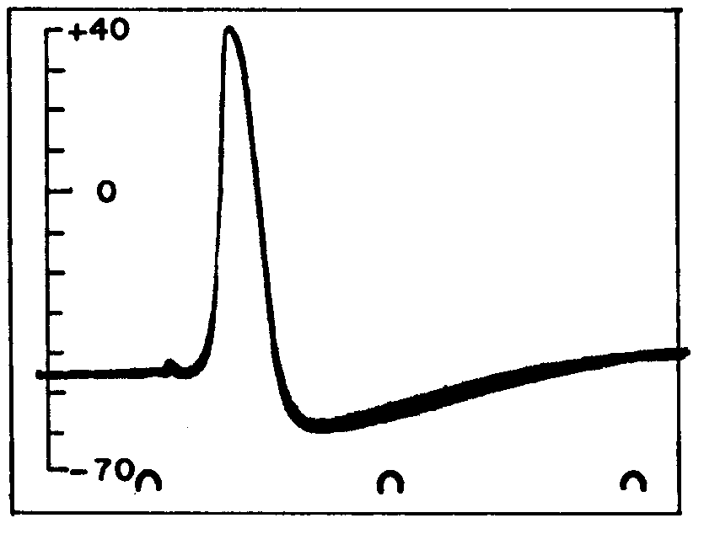
Intracellular recording: one electrode inside the cell.
Measure emf between inside and outside cell.
mV
reference
-70 mV
0
2
4
Time (ms)
axon
saline

Slide 8
Extracellular recording: both electrodes outside the muscle fibres
Measure emf between 2 sites ( & ) outside the fibres
V
0
skin
V
time
reference
+ + + + + + + + + + + + + + + + + + + + + + + + + + + + + + + + + +
- - - - - - - - - - - - - - - - - - - - - - - - - - - - - - - - - - - - - - - - - - - - - - - -
- - - - - - - - - - - - - - - - - - - - - - - - - - - - - - - - - - - - - - - - - - - - - - - -
- - - - - - - - - - - - - - - - - - - - - - - - - - - - - - - - - - - - - - - - - - - - - - - -
Skeletal muscle fibres

Slide 9
Extracellular recording: both electrodes outside the muscle fibres.
Measure emf between 2 sites outside the fibres.
V
0
V
time
reference
+ + + - - - - + + + + + + + + + + + + + + + + + + + + + + + + + + + +
- - - - + + + - - - - - - - - - - - - - - - - - - - - - - - - - - - - - - - - - - - - - -
- - - - + + + - - - - - - - - - - - - - - - - - - - - - - - - - - - - - - - - - - - - - -
- - - - + + + - - - - - - - - - - - - - - - - - - - - - - - - - - - - - - - - - - - - - -
Active area at peak of action potential

Slide 10
Extracellular recording: both electrodes outside the muscle fibres.
Measure emf between 2 sites outside the fibres.
V
0
V
time
reference
+ + + + + + + + + + + + + - - - - - + + + + + + + + + + + + + + + + +
- - - - - - - - - - - - - - - - - - + + + + - - - - - - - - - - - - - - - - - - - - - - - - - - -
- - - - - - - - - - - - - - - - - - + + + +- - - - - - - - - - - - - - - - - - - - - - -
- - - - - - - - - - - - - - - - - - + + + + - - - - - - - - - - - - - - - - - - - - - - - -
Active area at peak of action potential

Slide 11
Extracellular recording: both electrodes outside the muscle fibres.
Measure emf between 2 sites outside the fibres.
V
0
V
time
reference
+ + + + + + + + + + + + + + + + + + + + + + + + + + + + + + - - - +++
- - - - - - - - - - - - - - - - - - - - - - - - - - - - - - - - - - - - - - - - - - + + + - -
- - - - - - - - - - - - - - - - - - - - - - - - - - - - - - - - - - - - - - - - - - + + + - -
- - - - - - - - - - - - - - - - - - - - - - - - - - - - - - - - - - - - - - - - - - + + + - -
Active area at peak of action potential

Slide 12
Extracellular recording: both electrodes outside the muscle fibres.
Measure emf between 2 sites outside the fibres.
V
0
V
time
reference
+ + + + + + + + + + + + + + + + + + + + + + + + + + + + + + + + - -
- - - - - - - - - - - - - - - - - - - - - - - - - - - - - - - - - - - - - - - - - - - - - + +
- - - - - - - - - - - - - - - - - - - - - - - - - - - - - - - - - - - - - - - - - - - - - + +
- - - - - - - - - - - - - - - - - - - - - - - - - - - - - - - - - - - - - - - - - - - - - + +
Active area at peak of action potential

Slide 13
Relevant Anatomy

Slide 14
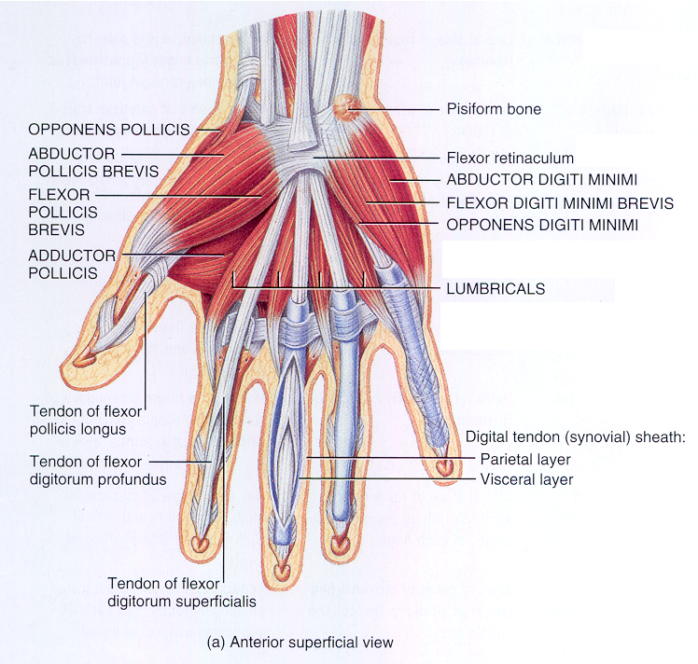
Anatomy
Thenar group

Slide 15
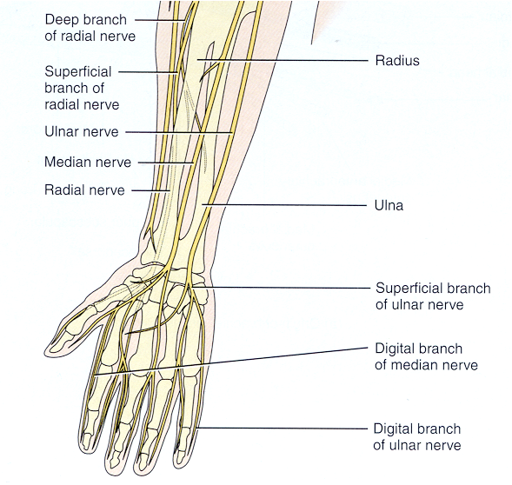
Anatomy

Slide 16
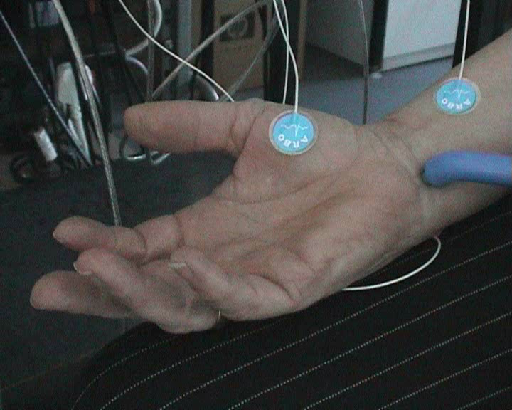
Ulnar nerve stimulation

Slide 17
Example records of EMG
Voluntary & electrical stimulation, force and EMG

Slide 18
Gradually increasing, then decreasing voluntary contraction

Slide 19
The next 5 slides show records made with a single stimulus at different stimulus strengths (shown in mA). The EMG and the force response are shown on each record.
How does the force change as stimulus strength is increased?
What is happening in the ulnar nerve and in the adductor pollicis as stimulus strength is increased?

Slide 20
Single stimulus, Strength = 3 mA
EMG
Twitch Force
(arbitrary units)
Seconds

Slide 21
Single stimulus, Strength = 5 mA
EMG
Twitch Force
(arbitrary units)
Seconds

Slide 22
Single stimulus, Strength = 7 mA
EMG
Twitch Force
(arbitrary units)
Seconds

Slide 23
Single stimulus, Strength = 9 mA
EMG
Twitch Force
(arbitrary units)
Seconds

Slide 24
Single stimulus, Strength = 10 mA
EMG
Twitch Force
(arbitrary units)
Seconds

Slide 25
The next slide show records made at different stimulus frequencies (number of stimuli per s). The stimulus strength was the same in all cases.
How does the force change as stimulus frequency is increased?
What is happening in the ulnar nerve and in the adductor pollicis as stimulus frequency is increased? How does this account for the change in force?

Slide 26
EMG and Force during electrical stimulation at different frequencies (constant stimulus strength)

Slide 27
The next slide shows a record of a voluntary contraction and a record made during stimulation at a frequency of 20 stim/s.
What are the similarities and differences
in the records?
in what is happening in the ulnar nerve and in the adductor pollicis?

Slide 28
EMG and Force during voluntary contraction and during electrical stimulation

Slide 29
The end – thanks!

