Slide 1
Thyroid disorders
Professor Karim Meeran
First year
18 January 2013

Slide 2
The Thyroid Gland - Aims of Lecture
Fill in the handout
The anatomy, microanatomy and physiology of the thyroid
Describe the hypothalamo-pituitary-thyroid axis
Understand the effects of thyroid hormone deficiency and excess

Slide 3
The Thyroid Gland - Aims of Lecture
Fill in the handout - and help you to UNDERSTAND what you read
All these slides are on the intranet
Only write when told. Put pens down.

Slide 4
Anatomy of the thyroid
In the neck
Shield shaped

Slide 5
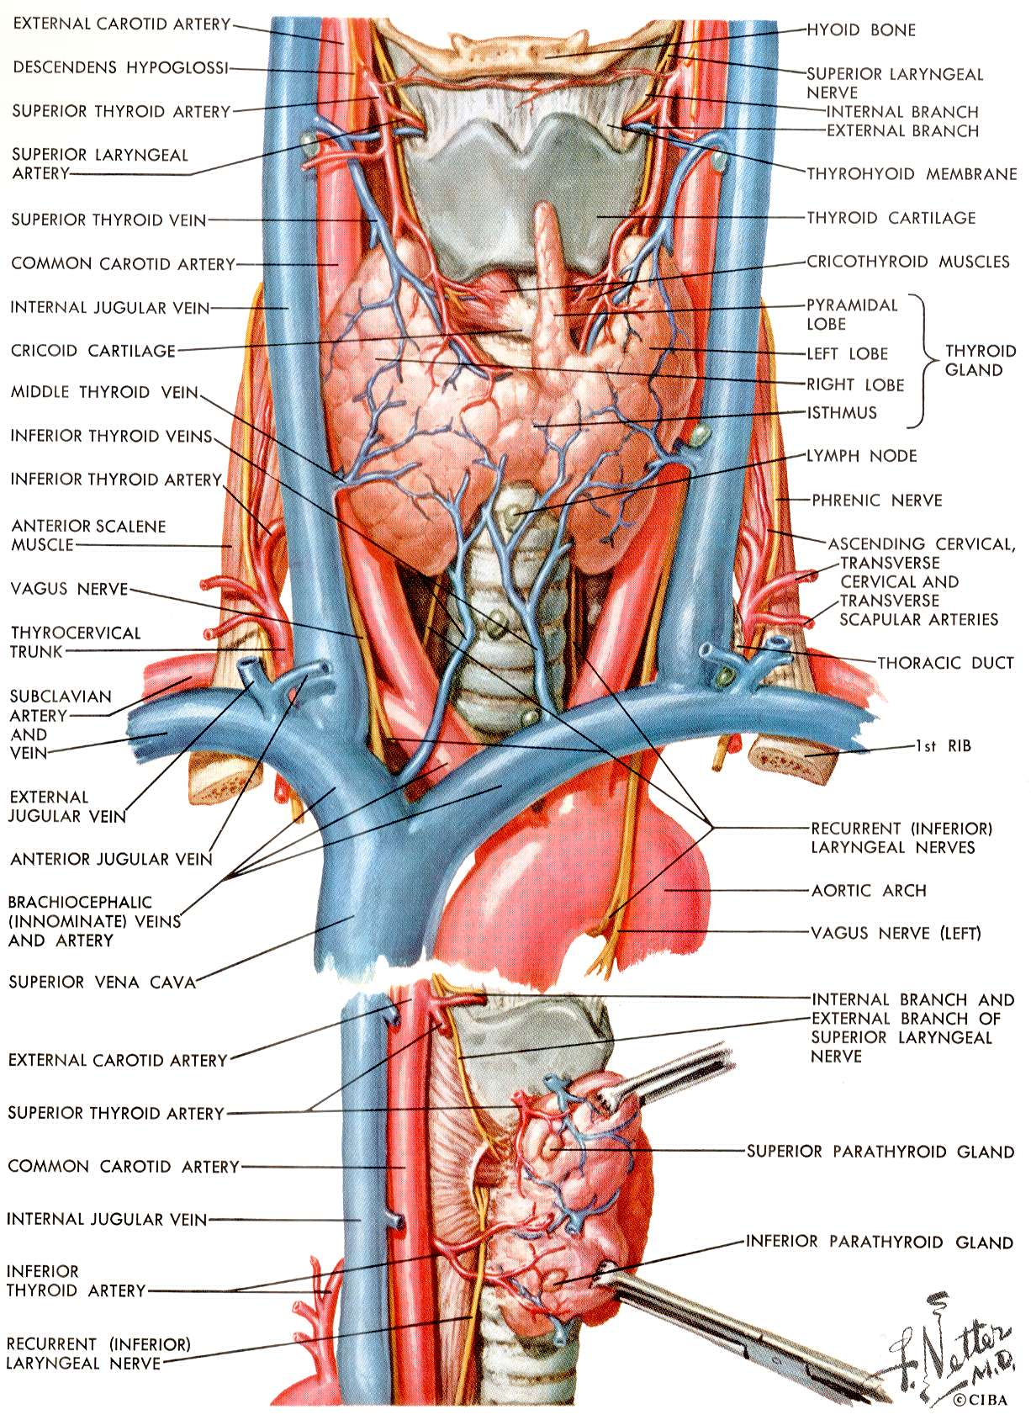

Slide 7
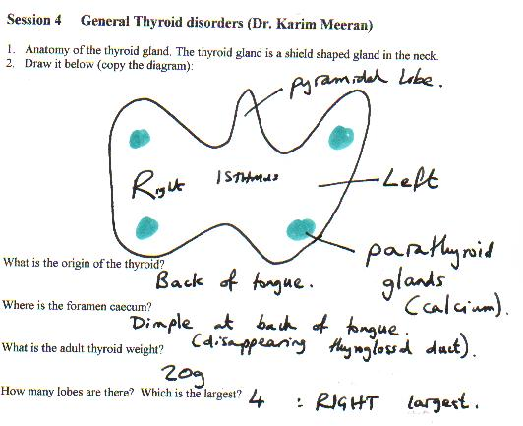

Slide 8
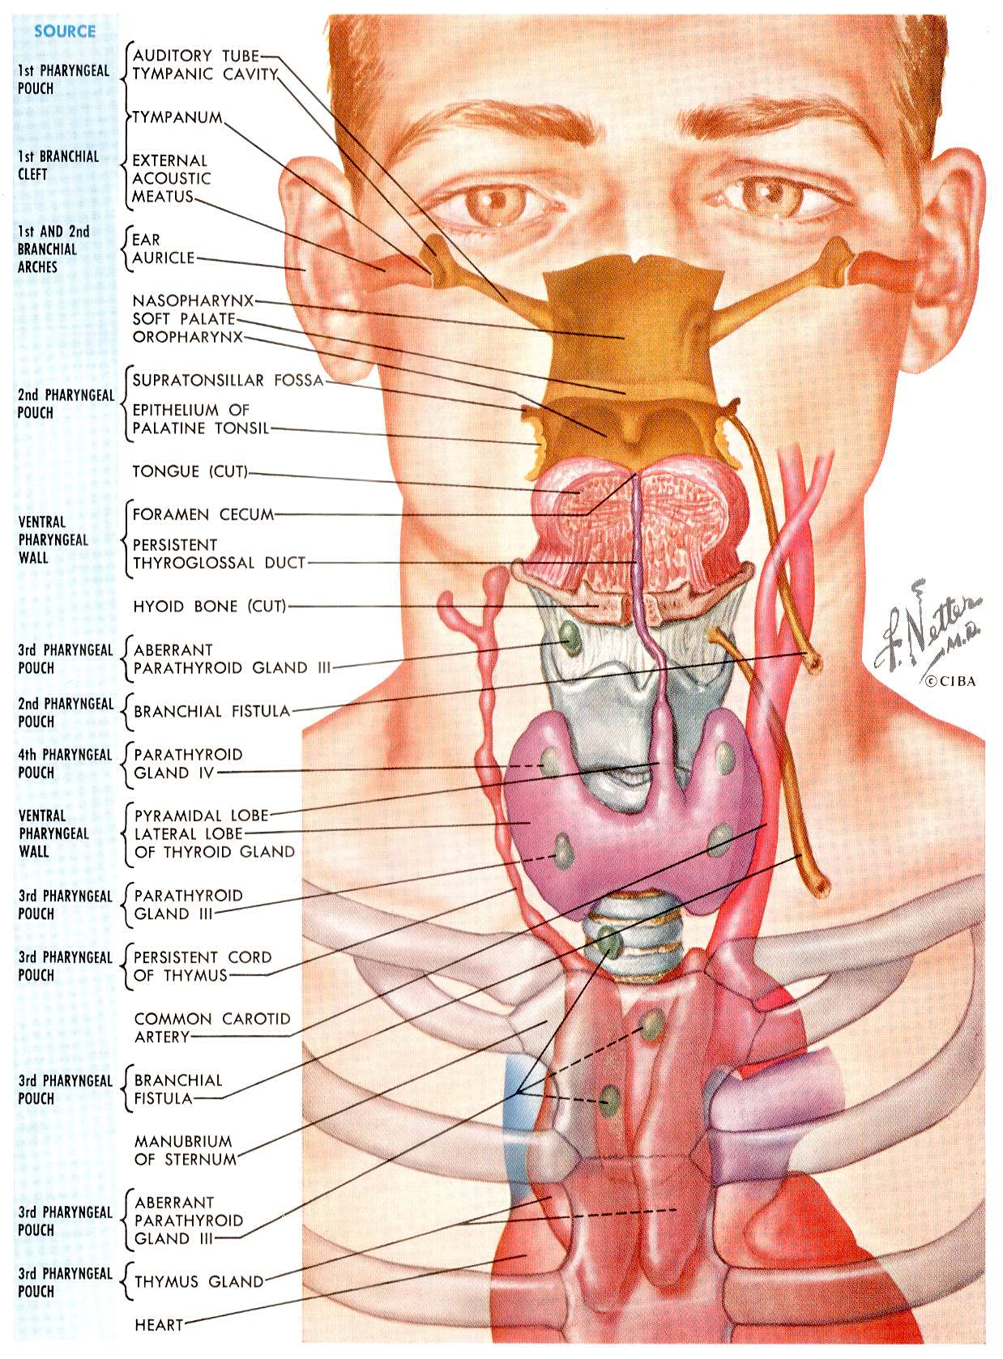

Slide 10
Embryology of the thyroid (1)
Midline outpouching of floor of pharynx (ie base of tongue is origin)
Outpouching forms a duct which elongates down (thyroglossal duct)
Migrates down neck and divides into two lobes.

Slide 11
Embryology of thyroid (2)
Final position by week 7
The duct disappears leaving the foramen caecum
The thyroid gland then develops

Slide 12
Anatomy of thyroid
Adult weight = 20 grams
Each lobe = 4 x 2.5 x 2.5 cm
Right lobe larger than left

Slide 13
Anatomy of thyroid
Right, and left lobes + isthmus
Occasional pyramidal lobe above isthmus
parathyroid glands embedded in thyroid
Left recurrent laryngeal nerve runs close (vocal cord supply)

Slide 14
Recurrent laryngeal nerve
Damage can cause changes in quality of voice, or even difficulty talking
Thus all thyroid surgeons mention this when obtaining consent for thyroidectomy

Slide 15
Problems with development
Agenesis (complete absence)
Incomplete descent (ie base of tongue to trachea)
thyroglossal cyst (Segment of duct persists and presents as a lump years later)

Slide 16
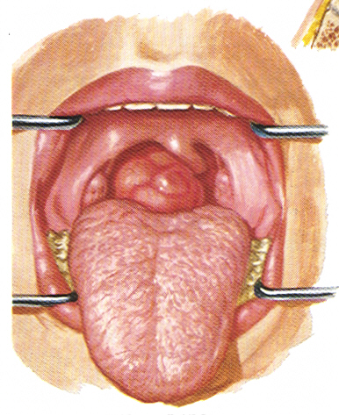
Lingual thyroid

Slide 17
Thyroxine is essential for normal brain development
Neonates with thyroxine deficiency in utero have irreversible brain damage :
CRETIN

Slide 18
Cretin
An individual with irreversible brain damage caused by lack of thyroxine

Slide 19
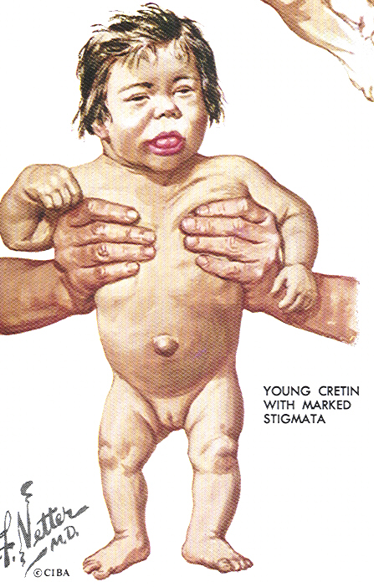
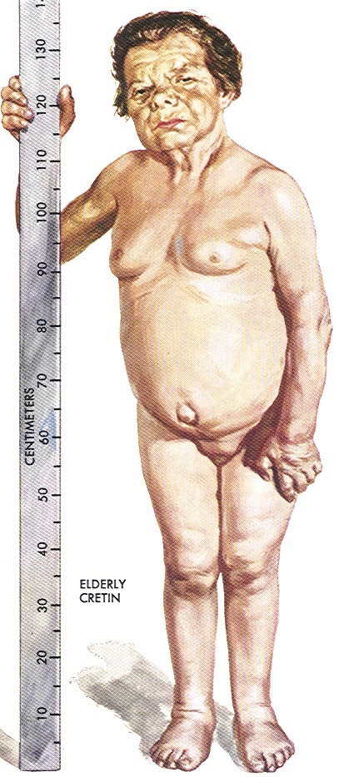
Young cretin
Elderly cretin

Slide 20
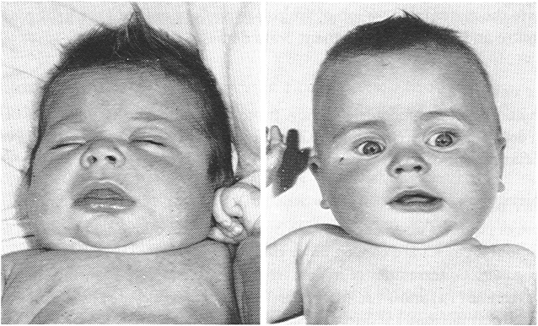
CRETIN before and after thyroxine

Slide 21
Prevention of cretinism
All babies have a heel prick for a blood test for thyroid function (measuring TSH) at the same time as the Guthrie test (for phenylketonuria) at 5-10 days of age
Given thyroxine immediately if the TSH is found to be high

Slide 22
Thyroid follicular cell
The site of thyroxine synthesis

Slide 23
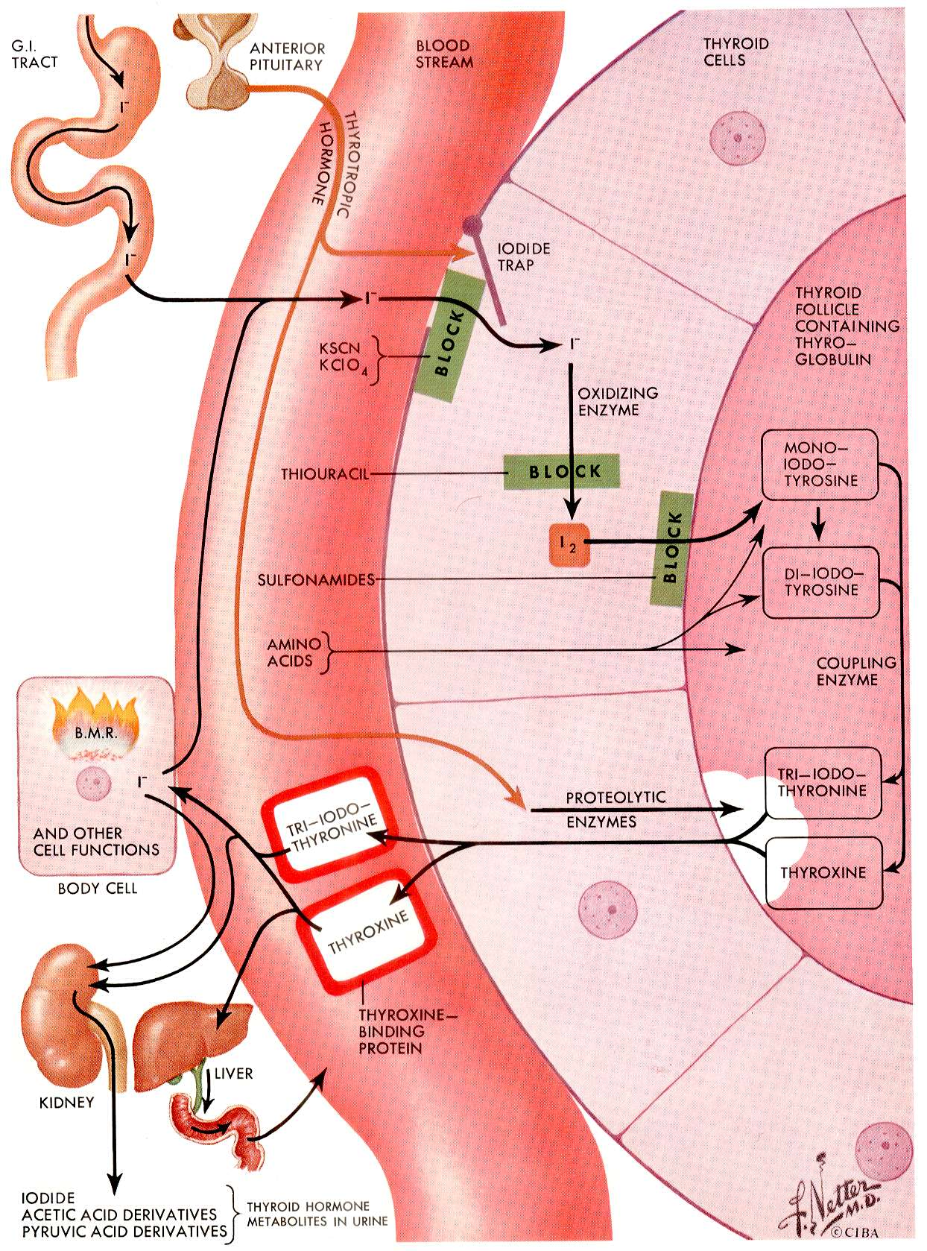
Thyroid follicular cell

Slide 24
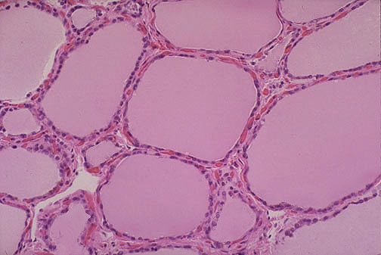

Slide 25
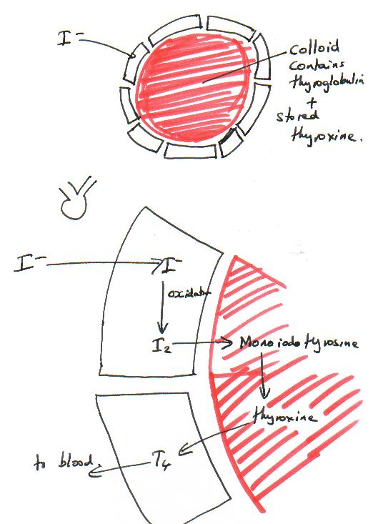

Slide 26
BEWARE
Thyroglobulin is not thyroxine binding globulin
Thyroxine binding globulin bonds 75% of thyroxine in the circulation whereas thyroglobulin is INSIDE the thyroid gland only.

Slide 27
IODOTHYRONINES
NH₂
HO
CH₂
CH
TYROSINE
COOH
MONOIODOTYROSINE
DIIODOTYROSINE
I
NH₂
I
NH₂
I
NH₂
HO
CH₂
CH
HO
CH₂
CH
HO
CH₂
CH
COOH
COOH
COOH
I
I
I
I
NH₂
I
I
NH₂
HO
O
CH₂
CH
HO
O
CH₂
CH
I
COOH
I
I
COOH
TRI-IODOTHYRONINE (T3)
TETRA-IODOTHYRONINE (T4)
also known as THYROXINE

Slide 28
Thyroid gland
Normally responsible for synthesis, storage and secretion of thyroid hormones
Thyroid hormones regulate growth, development and metabolic rate

Slide 29
Thyroid disease
Affects 5% of the population
Female : male ratio = 4 : 1
(Much more common in females)
Overactive : underactive = 1 : 1

Slide 30
Primary Hypothyroidism (Myxoedema)
Primary thyroid failure
Autoimmune damage to the thyroid (or operation)
Thyroxine levels decline
TSH levels climb
Now draw HPT axis.

Slide 31
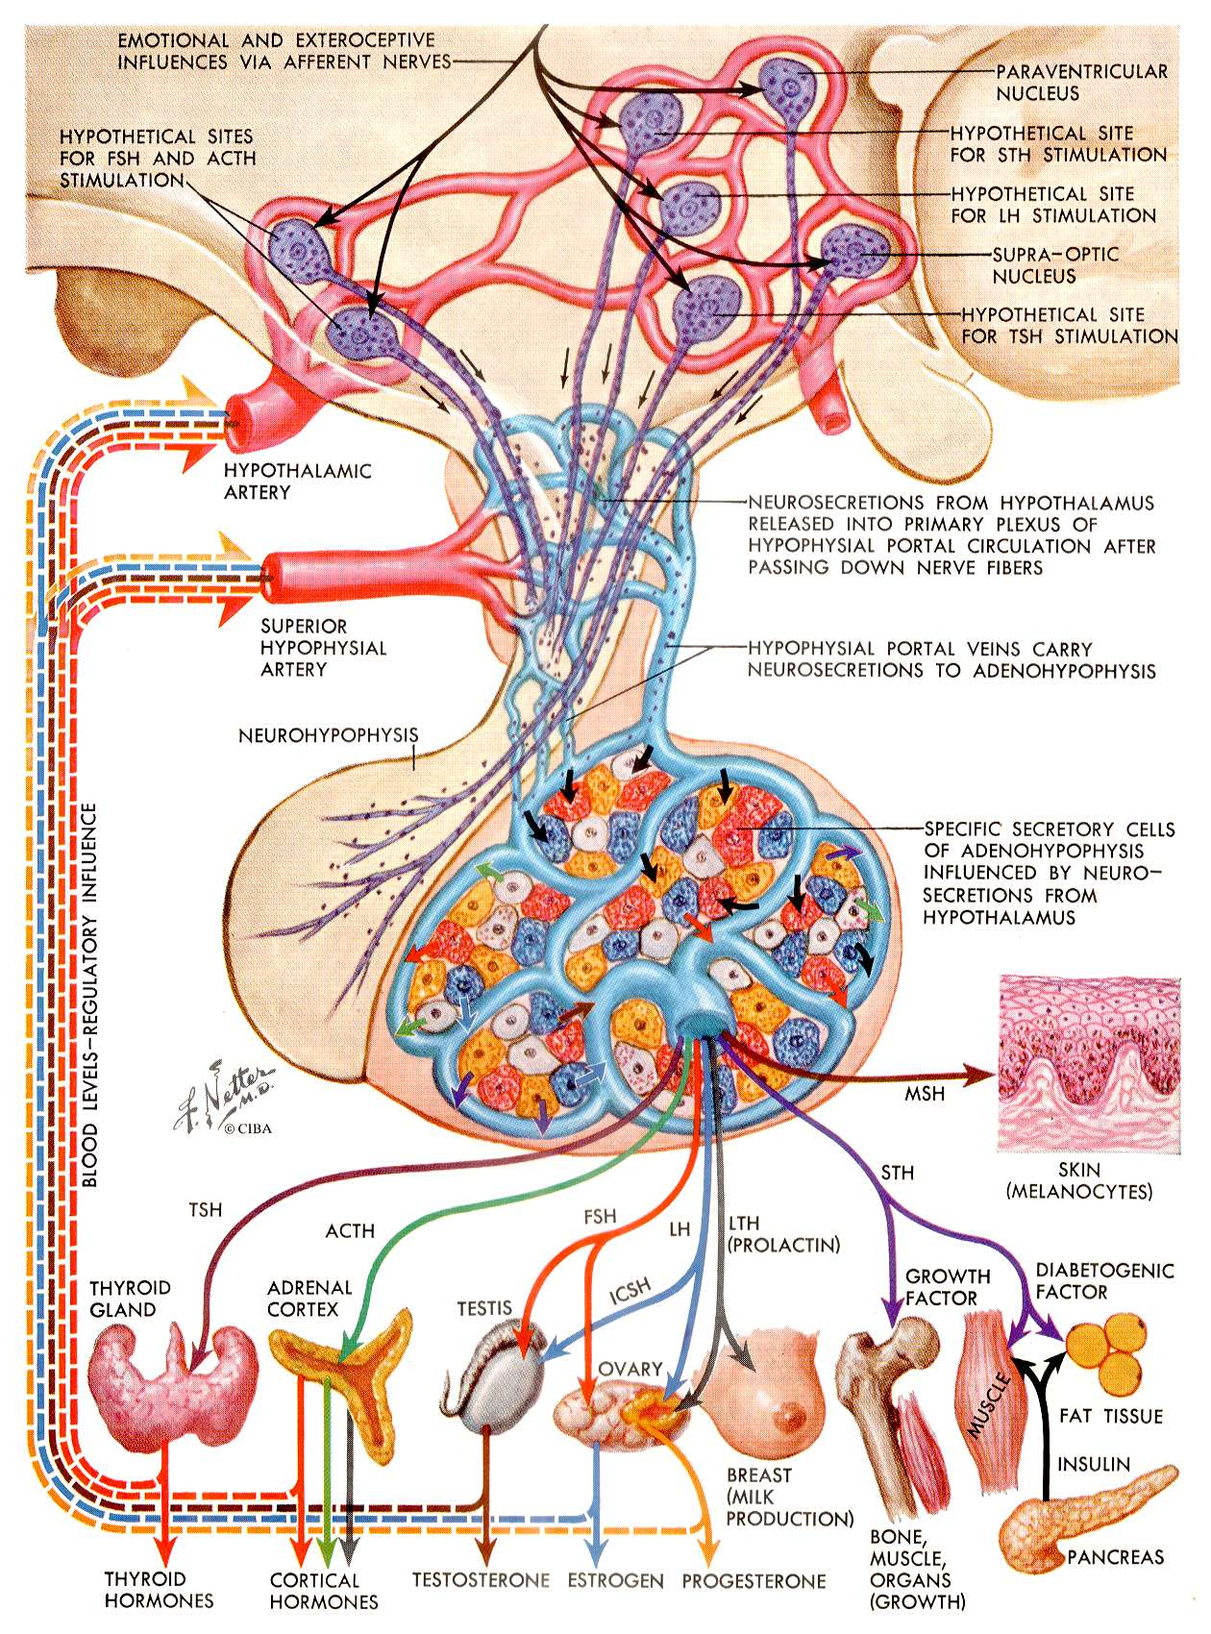
Hypothalamo-pituitary-thyroid axis
TRH
Diagram

Slide 32
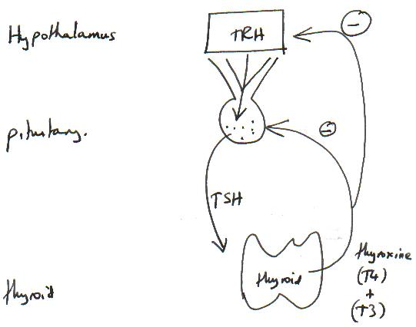

Slide 33
Hypothalamo-pituitary-thyroid axis
TRH = thyrotropin releasing hormone
TSH = Thyroid stimulating hormone (thyrotropin)

Slide 34
Features of Primary Hypothyroidism
Deepening voice
Depression and tiredness
Cold intolerance
Weight gain with reduced appetite
Constipation
Bradycardia
Eventual myxoedema coma

Slide 35
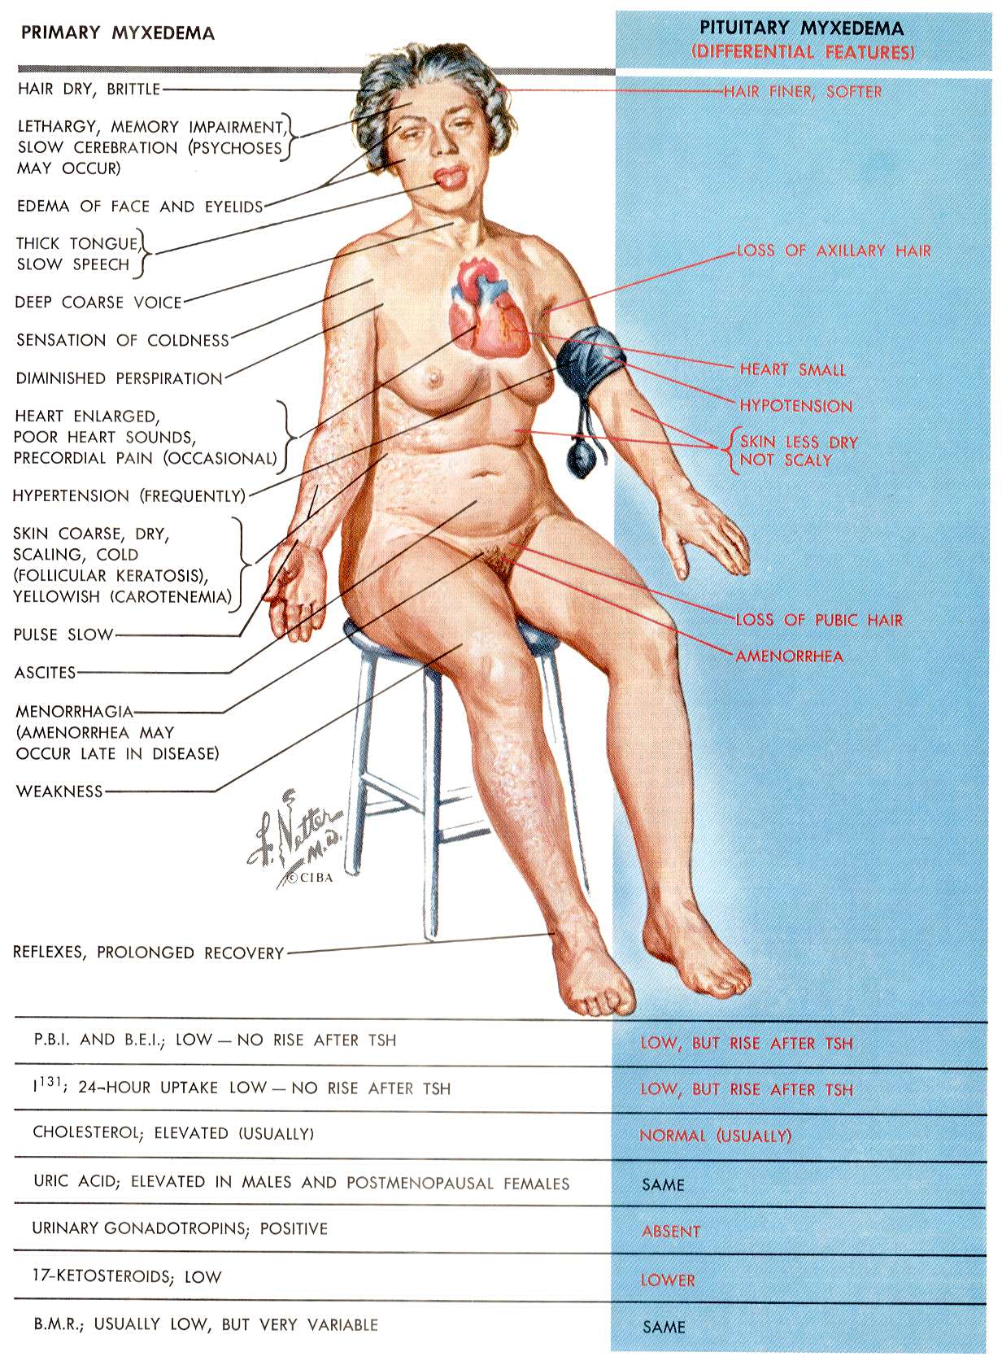
Hypothyroidism

Slide 36
Treatment of hypothyroidism is essential
Otherwise patients will die
They will perform poorly
Cholesterol goes up - causing death from heart attacks and strokes

Slide 37
Treatment of hypothyroidism is easy
Simply replace thyroxine - usually one tablet (100 micrograms on average) daily
Monitor the TSH and adjust dose until TSH is normal

Slide 38
Overactive thyroid gland
Make too much thyroxine
TSH levels fall to zero
(thyrotoxicosis or hyperthyroidism)

Slide 39
Overactive thyroid gland
Make too much thyroxine
Raised basal metabolic rate
Raised temperature
Burn up calories and lose weight
Increased heart rate
Every cell in the body speeds up !

Slide 40
List the features of hyperthyroidism (Video)
Myopathy, Mood swings
Feeling hot in all weather
Diarrhoea
Increased appetite but weight loss
Tremor of hands
Palpitations
Sore eyes, goitre

Slide 41
List the causes of hyperthyroidism
Graves’ disease, where the whole gland is smoothly enlarged and the whole gland is overactive

Slide 42
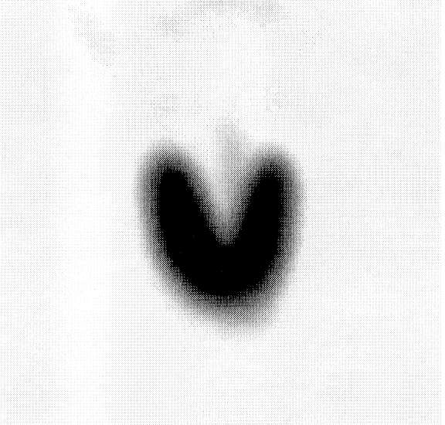
Thyroid scan in Graves’

Slide 43
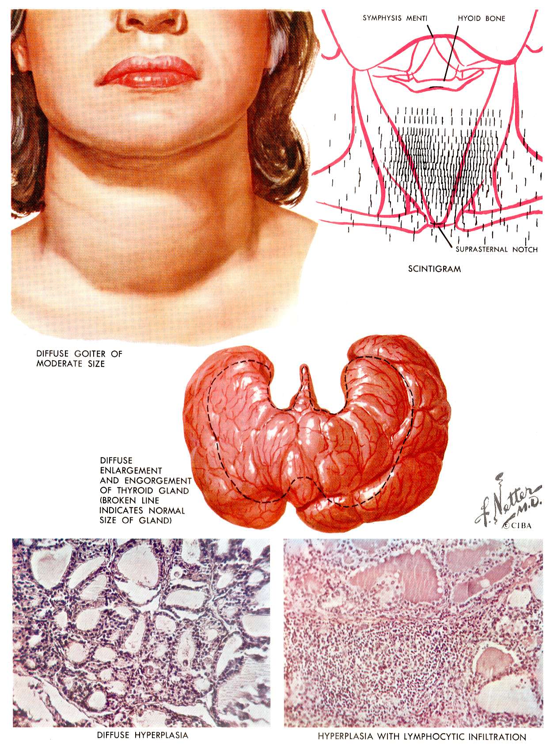

Slide 44
Graves’ Disease
Autoimmune
Antibodies bind to and stimulate the TSH receptor in the thyroid
Cause goitre (smooth) and hyperthyroidism

Slide 45
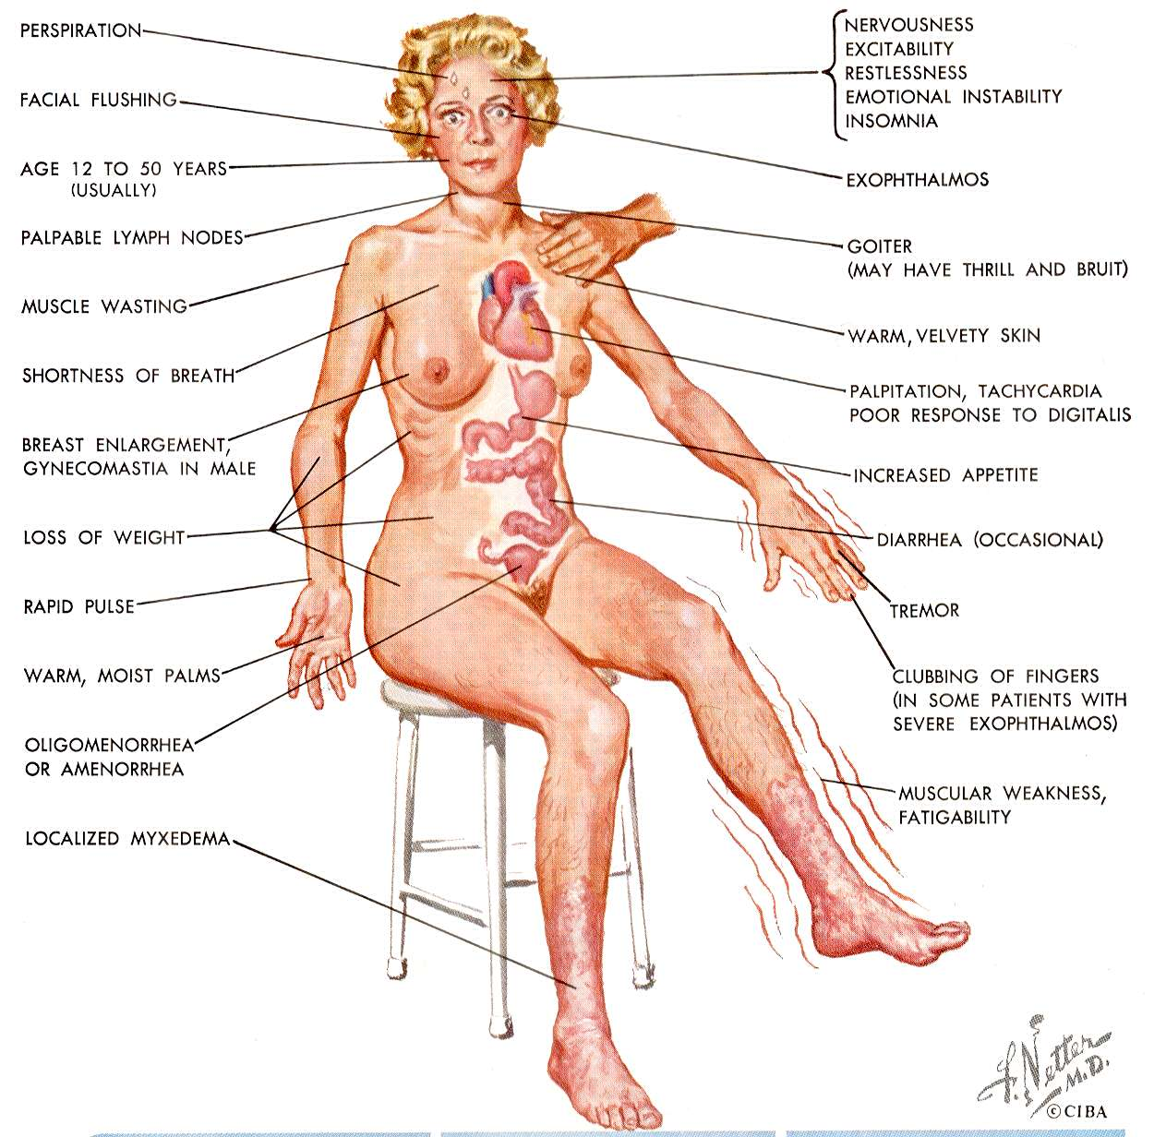
Graves’

Slide 46
Graves’ Disease
Other antibodies bind to muscles behind the eye and cause exophthalmos
Other antibodies stimulate growth of the shins and cause PRETIBIAL MYXOEDEMA (hypertrophy)

Slide 47
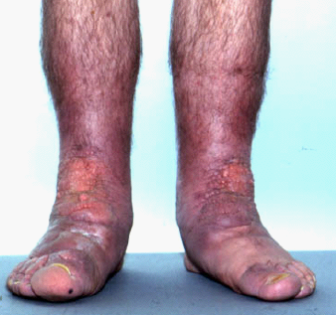
Pretibial myxoedema

Slide 48
Pretibial myxoedema
The swelling (non-pitting) that occurs on the shins of patients with Graves’ disease: growth of soft tissue.
Not to be confused with myxoedema=hypothyroidism

Slide 49
Treatment of hyperthyroidism
More complicated - will be covered in November

Slide 50
The Thyroid Gland
Tutorial

