Slide 1
Adrenal disorders
First Year
Karim Meeran
Tuesday 22 January 2013
Internet version

Slide 2
Endocrine diseases
Abnormal amounts of messenger cause cells to misbehave all over the body: syndromes of excess and deficiency
Thyroid earlier
Adrenal failure = Addison’s
Excess cortisol = Cushing’s

Slide 3
Aims
Anatomy and Biochemistry of the adrenal
Recap on hormones and enzymes
Syndromes of excess and deficiency of adrenal hormones

Slide 4
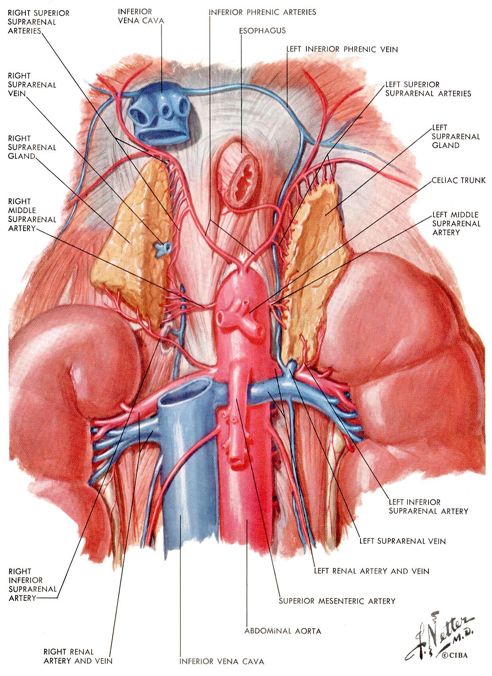

Slide 5
Anatomy of the adrenal glands
Left adrenal vein drains into renal vein
Right adrenal vein drains into IVC
Both adrenals have many arteries but only one vein

Slide 6
Anatomy of the adrenal glands
Spleen at risk with left adrenalectomy
therefore immunise with HIB (haemophilus influenzae (B)) and pneumovax before elective left adrenalectomy

Slide 7
Draw adrenal anatomy
(On one quarter of blank page)

Slide 8
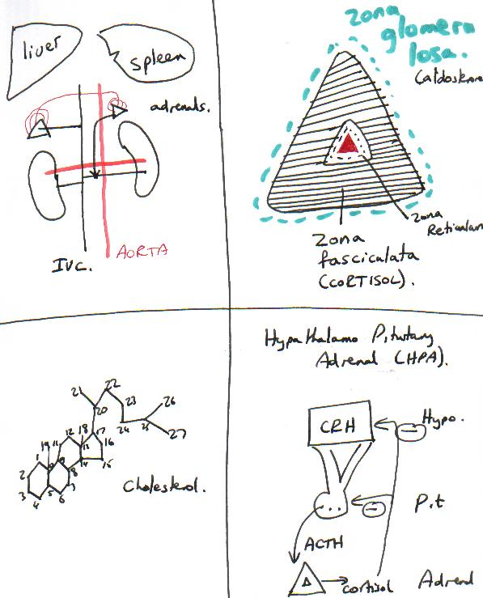

Slide 9
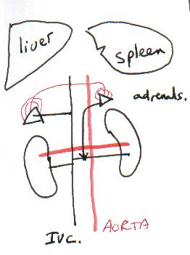

Slide 10
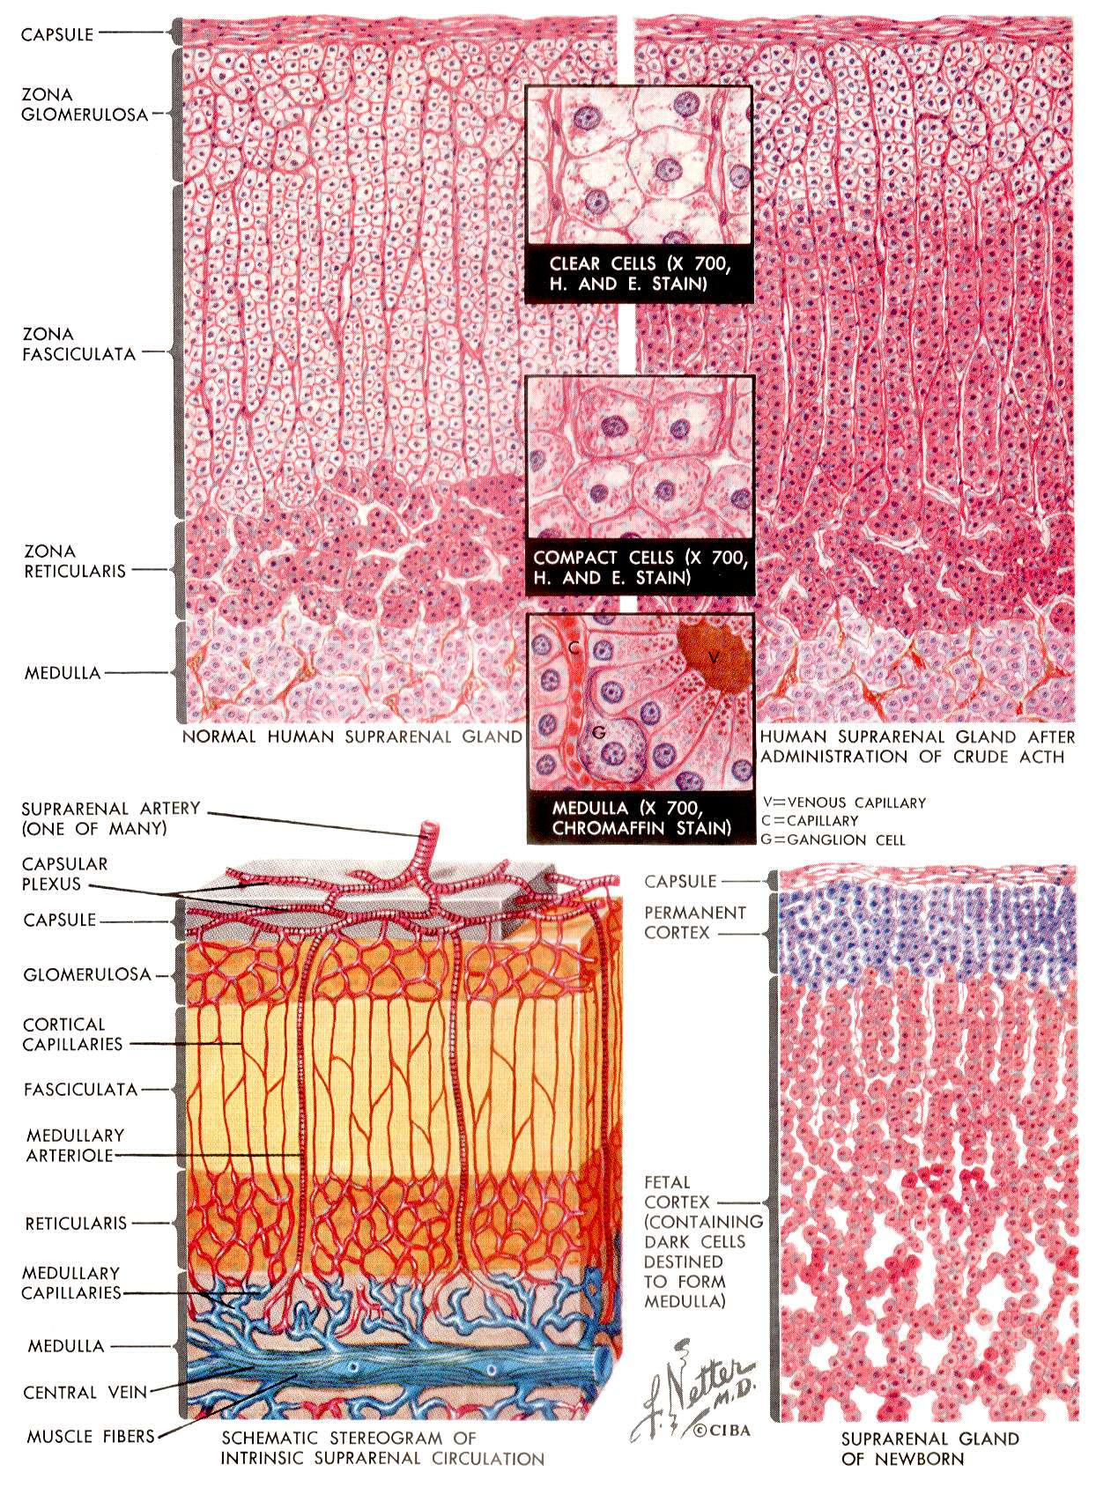

Slide 11
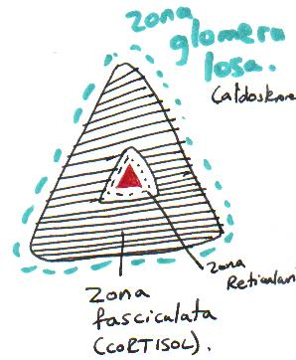

Slide 12
Adrenal gland secretions:
Cortisol
aldosterone
sex steroids
Precursor : cholesterol

Slide 13
Hormone:
Blood borne (circulating) messenger
Peptides (prolactin, GH, ACTH)
steroids (testosterone, cortisol)
amines (adrenaline)

Slide 14
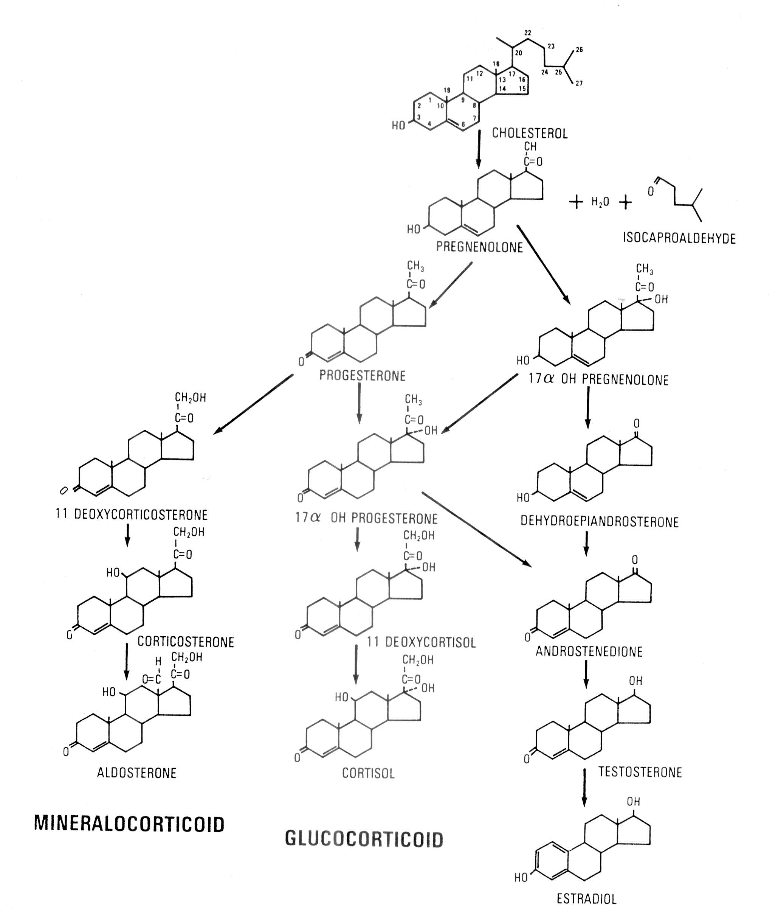
C 27

Slide 15
Enzyme (do not copy)
Protein that catalyses a specific reaction
various enzymes present in cells
specific enzymes catalyse the synthesis of particular alterations to the molecule

Slide 18
cholesterol
17
Sex
steroids
progesterone
17 OH prog
21
21
11 deoxy corticosterone
11 deoxycortisol
(androgens)
11
11
corticosterone
cortisol
(oestrogen)
18
aldosterone

Slide 19
Messengers must be regulated by other messengers: hormones regulate hormones
Cortisol controlled by ACTH

Slide 20
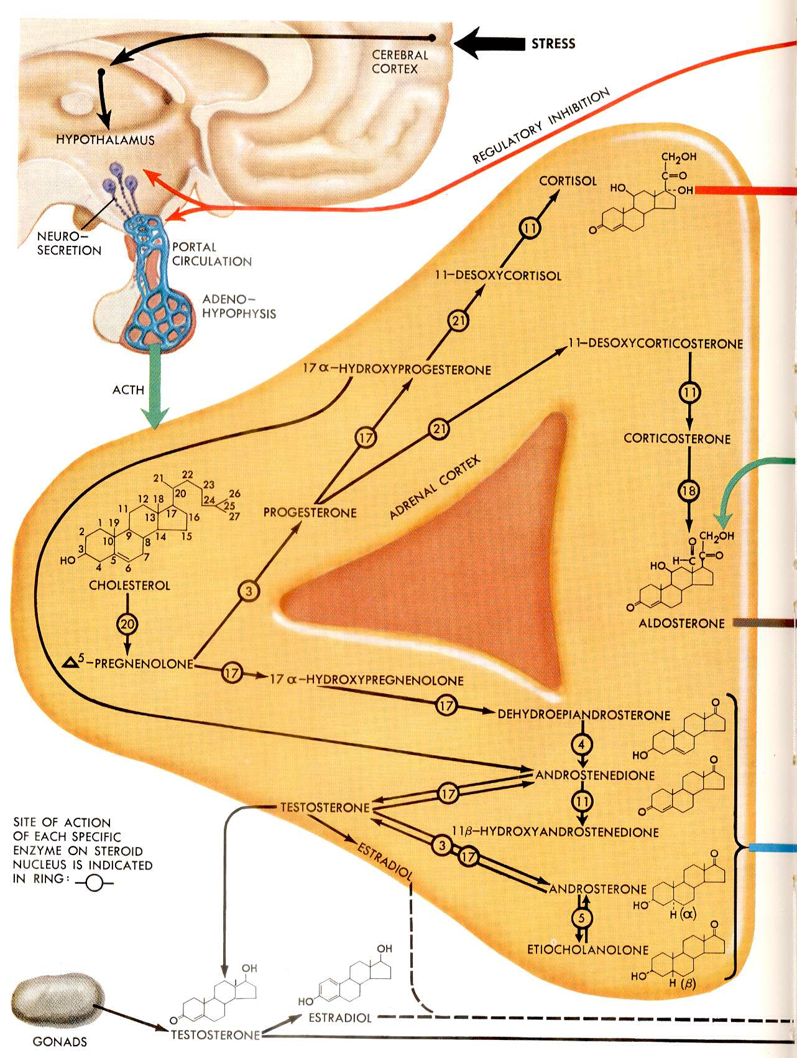

Slide 21
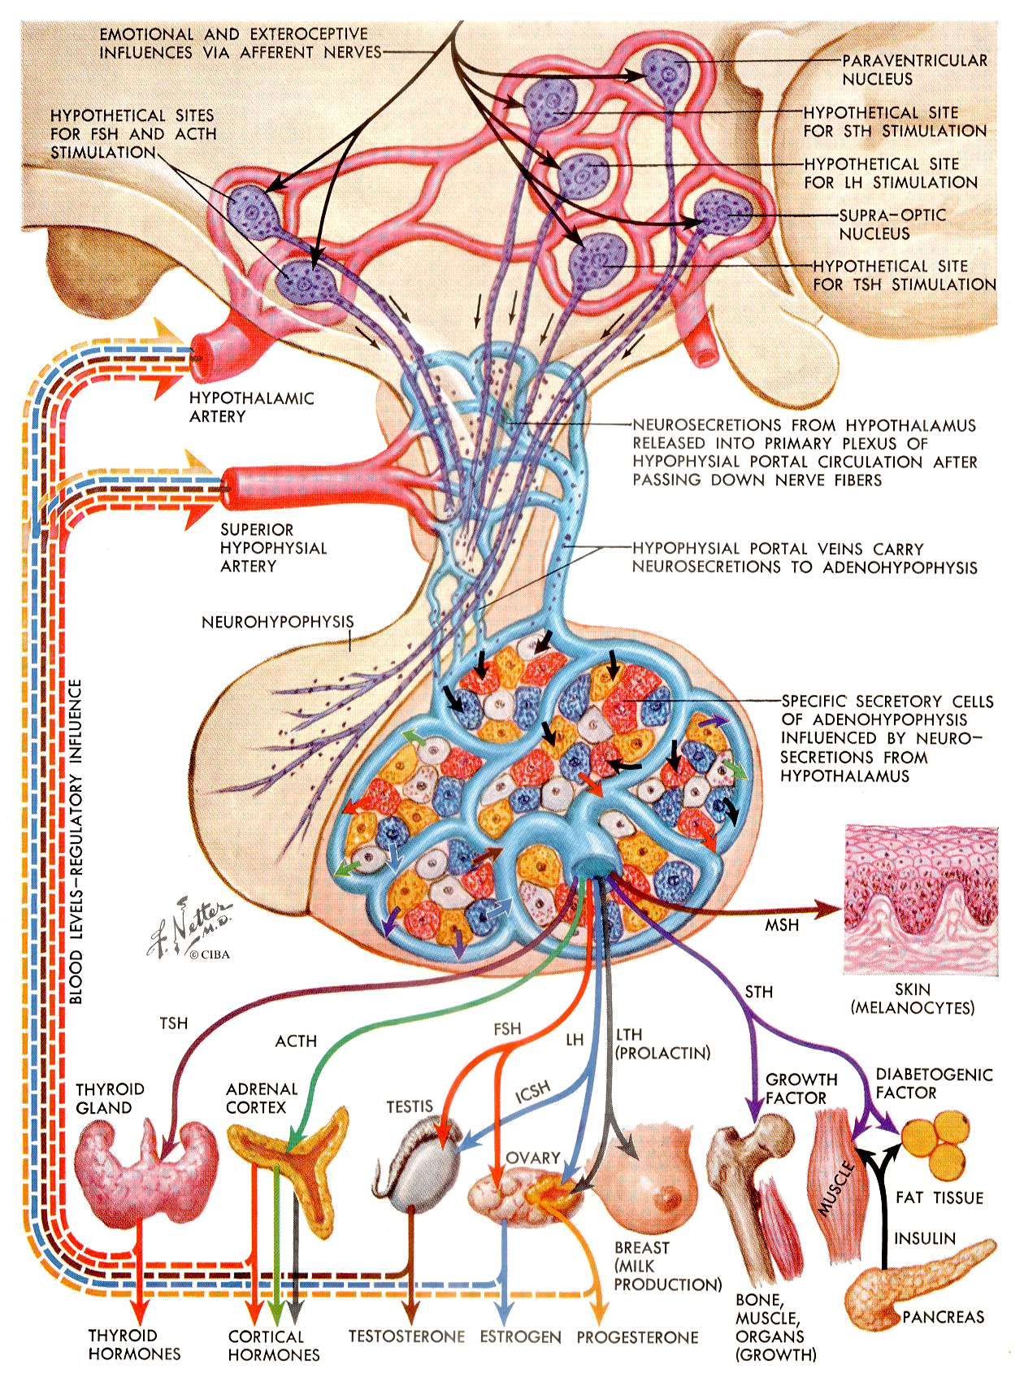

Slide 22
Draw HPA axis

Slide 23
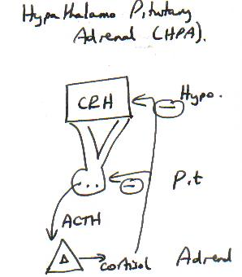

Slide 24
POMC = pro-opio-melanocortin
POMC is a large precursor protein that is cleaved to form a number of smaller peptides, including ACTH, MSH and endorphins
Thus people who have pathologically high levels of ACTH may become tanned

Slide 25
POMC
ACTH
MSH

Slide 26
Addison’s disease
Thomas Addison (18th century)
Primary adrenal failure
autoimmune disease where the immune system decides to wipe out the adrenal cortex (UK)
tuberculosis of the adrenal glands (commonest cause worldwide)

Slide 27
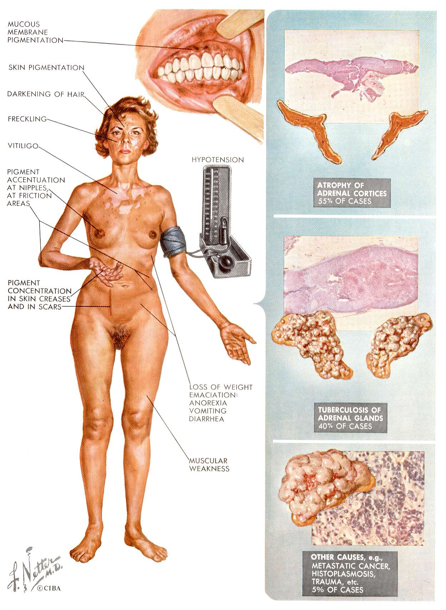
Pituitary starts secreting lots of ACTH and hence MSH

Slide 28
POMC
ACTH
MSH
Pituitary starts secreting lots of ACTH and hence MSH
tan

Slide 29
Addison’s disease
Increased pigmentation
autoimmune vitiligo may coexist
no cortisol or aldosterone, so low blood pressure

Slide 30
Urgent treatment of Addisonian crisis
Rehydrate with normal saline
Give dextrose to prevent hypoglycaemia which could be due to the glucocorticoid deficiency
give hydrocortisone or another glucocorticoid

Slide 31
Summary: Addison’s
Cortisol deficiency
Salt loss
Low blood pressure
Eventual death

Slide 32
Biological actions of excess cortisol
Impaired glucose tolerance (diabetes)
weight gain (increase fat, lose protein)
thin skin and easy bruising
striae (stretch marks)
proximal myopathy (muscle weakness)
mental changes (depression)

Slide 33
Biological actions of excess cortisol (2)
Hypertension
fat redistribution
moon face
buffalo hump (interscapular fat pad)

Slide 34
Cushings video
Page 55

Slide 35
Cushings video
Impaired glucose tolerance (diabetes)
weight gain
hirsutism (facial hair) and acne
thin skin and easy bruising
striae (stretch marks)
proximal myopathy (muscle weakness)
mental changes (depression)

Slide 36
Cushing’s syndrome
Occurs due to an excess of cortisol or other glucocorticoid
List four possible causes of Cushing’s syndrome

Slide 37
Causes of Cushing’s syndrome
Taking steroids by mouth (common)
pituitary dependent Cushing’s disease (pituitary adenoma)
Ectopic ACTH (lung cancer)
adrenal adenoma or carcinoma

Slide 38
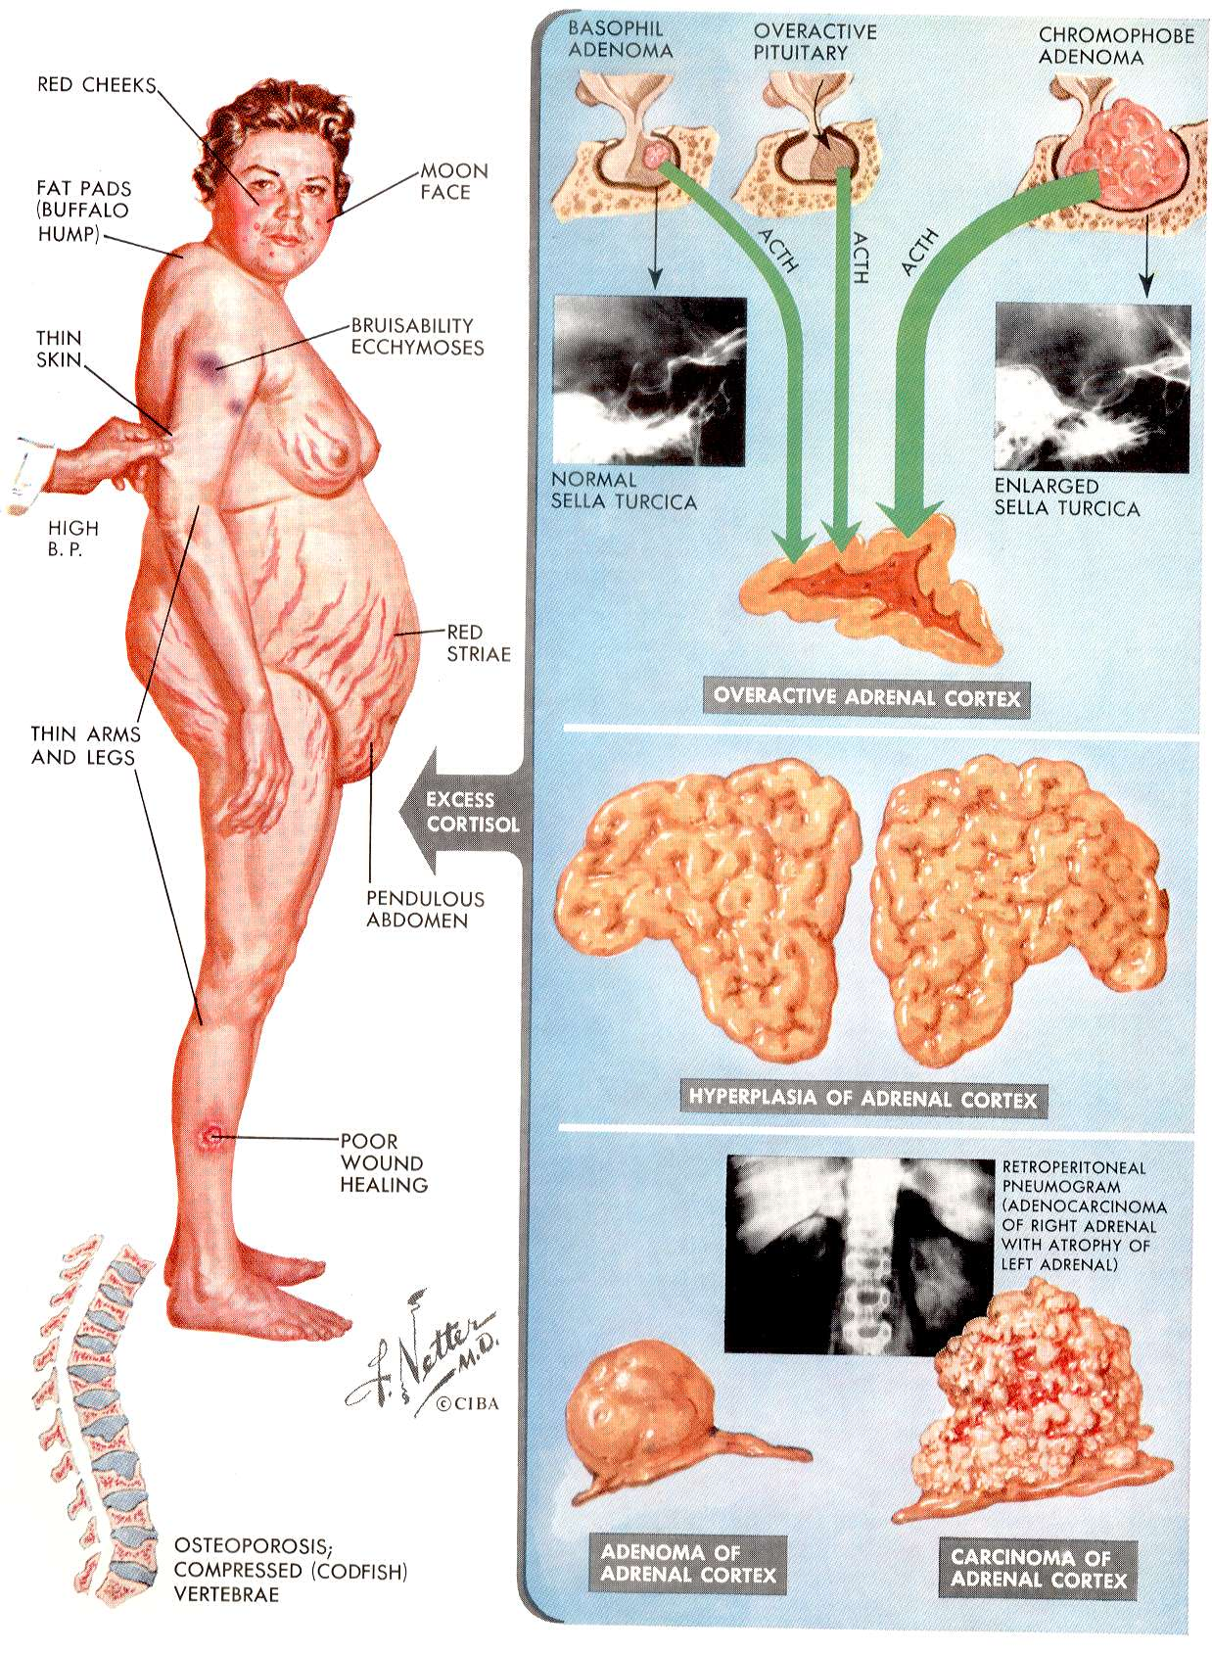

Slide 39
Clinical signs of Cushing’s
Thin skin
proximal myopathy
centripetal obesity (lemon on sticks)
diabetes, hypertension and osteoporosis
immunosuppression (reactivation of TB)
moon face

Slide 40
Anatomy of the adrenals
Left adrenal vein drains into renal
Right adrenal vein drains into IVC
Left adrenalectomy can result in accidental loss of spleen, so it is important to vaccinate these people with HIB and pneumovax

Slide 41
Cushing’s syndrome
Moon face
Striae
hypertension
thin skin etc.
ANY CAUSE

Slide 42
Cushing’s disease
Where the cause is known to be a pituitary adenoma

Slide 43
Causes of Cushing’s syndrome
Taking steroids by mouth
Pituitary dependent Cushing’s disease
ectopic ACTH
adrenal adenoma

Slide 44
Side effects of “steroids”
Hypertension
Diabetes
Osteoporosis
reactivation of infection (immunosuppression)
easy bruising
poor wound healing, thin skin

Slide 45
Aldosterone producing adenoma
Conn’s syndrome
Hypertension (difficult to treat)
oedema
low potassium

Slide 46


