Slide 1
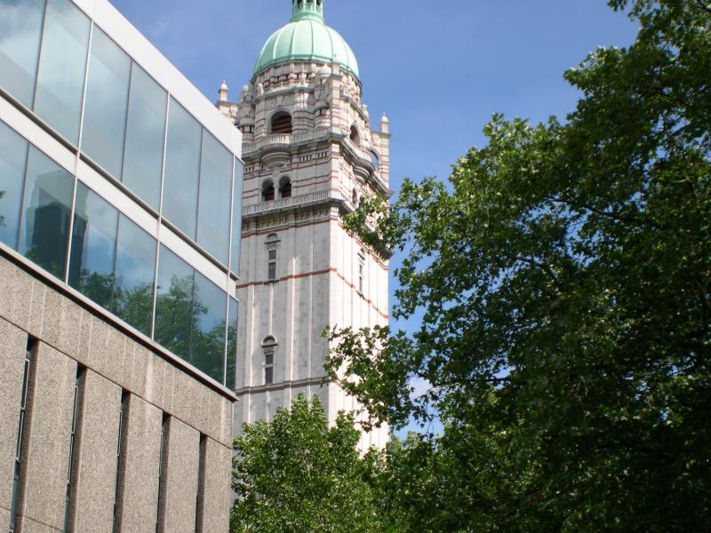
LCRS
HUMAN LIFE CYCLE
Imperial College London
Is sex necessary?
Glenda Gillies
Jan 2013

Slide 2
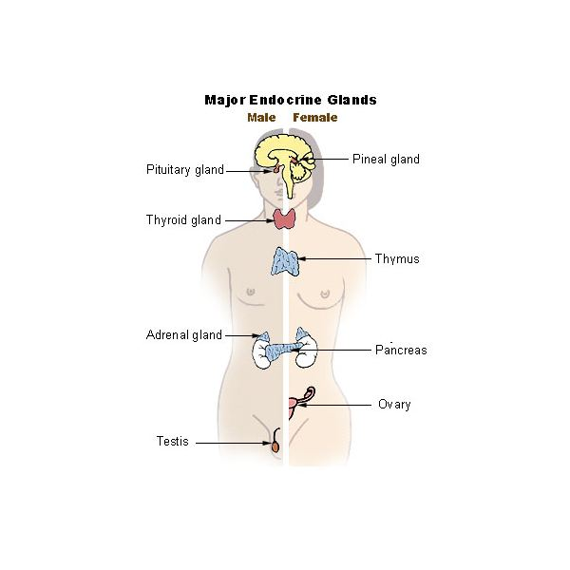
The Hypothalamo-pituitary gonadal axis – controller of sexual reproduction
Hypothalamus
Gonadotrophin releasing hormone
Pituitary gland
Pituitary
Gonadotrophins
LH/FSH
Thyroid gland
Adrenal gland
Ovary
Oestrogens
Progesterone
Ovary
Testis
Testerone
Notes:
But I diverge from sex differences. This summarizes why sex differences in hypothalamic circuitry are important for reproduction and reproductive behaviours.
The hypothalamic neurones governing the hypothalamo pituitary gonadal axis produce gonadotrophin releasing hormone that stimulates release of the gonadotrophins, LH and FSH and, consequently, oestrogens and progesterone from the ovaries or testosterone from the testes. As E2 levels rise over the menstrual cycle, this stimulates the gonadotrophin releasing hormone neurones, which generated an LH surge that is the trigger for ovulation and, in rats, the trigger for sexual receptivity. If you give E2 to males, they cannot mount an LH surge and this is one example that suggests that the hypothalamic hard-wiring is different between the sexes.

Slide 3
What do we mean by ‘sex’
Sex
Biological sex Distinguishes male or female subjects according to the reproductive organs and functions that derive from the chromosomal complement (male XY or female XX sex chromosomes); production of male gametes (spermatozoa/sperm) or female gametes (ova/egg cells)
Sexual reproduction involves combining male and female gametes to form offspring that inherit traits from both parents.

Slide 4
Definitions
Sex
Sexual intercourse sexual activity; acts for the purposes of sexual pleasure; often plays a strong role in human bonding

Slide 5
Definitions
Gender
A [human] subject’s self-representation as male or female

Slide 6
IS SEX NECESSARY?
The key reason for sex is for the human species to procreate – i.e. to reproduce.
Focus: cells and tissues involved insexual reproduction

Slide 7
Is sex necessary?
Procreation is the purpose, and an important driver to copulation is the pleasure associated with it
Likely to involve specific neural pathways in the brain.
Responsibilities and behaviours associated with parenthood are at least partly linked to the activation of specific neuroendocrine pathways.

Slide 8
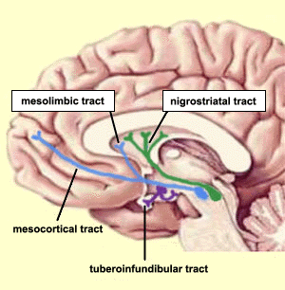
Sex and the brain
Pathways for reward and pleasure
mesolimbic dopaminergic system
Neuroendocrine pathways regulating
fertility and parenting

Slide 9
Is sex necessary?
Before we can attempt to discuss this further, it is necessary to know exactly what human reproduction involves.

Slide 10
reproductive system
either sex : gonads
internal duct system
external genitalia

Slide 11
male reproductive system
gonads : testes
Internal duct system:
seminiferous tubules
90% of testicular volume
efferent ducts (testis)
epididymis
vas deferens
urethra
external genitalia:
penis
scrotum (sac containing testis)

Slide 12
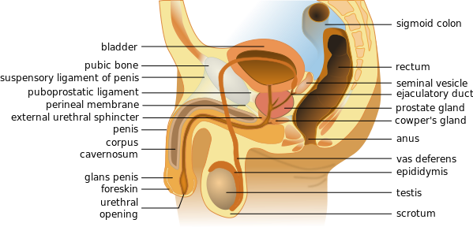
90% of testicular volume comprises
Seminiferous tubules

Slide 13
testes
located in the scrotum
spermatic cord (vas deferens and associated structures)
joins with seminal vesicle - ejaculatory duct
Opens into urethra
(prostatic, membranous, penile sections)

Slide 14
Composition of testis
Seminiferous tubule
(coiled 60cm)
Composed of
germ cells & sertoli cells
lumen
Leydig (interstitial) cells
Synthesize androgens, principally testosterone
bv

Slide 15
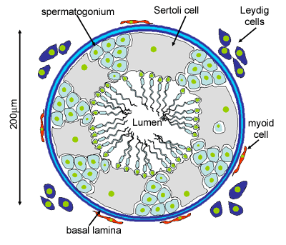
Seminiferous tubule
Sertoli cells
Nutritional & hormonal support for spermatogenesis
Germ cells
Spermatogonium
near basement membrane
urethra
Primary spermatocyte
Vas deferens
meiosis
epidiymis
Early spermatids
late spermatids
Released into lumen of seminiferous tubule

Slide 16
Each testis
Consists of
seminiferous tubules
  made up of Sertoli cells that aid maturation of the
  germ cells into spermatocytes; spermatids; spermatozoa, i.e. sperm production:
(Interstitial) Leydig cells - production of testosterone

Slide 17
The Hypothalamo-pituitary gonadal axis – controller of sexual reproduction
Hypothalamus
Gonadotrophin releasing hormone (GnRH)
Pituitary gland
Thyroid gland
Pituitary
Gonadotrophins
LH/FSH
Adrenal gland
Ovary
Ovary
Testis
Testosterone
Sperm
200 million per day
Notes:
But I diverge from sex differences. This summarizes why sex differences in hypothalamic circuitry are important for reproduction and reproductive behaviours.
The hypothalamic neurones governing the hypothalamo pituitary gonadal axis produce gonadotrophin releasing hormone that stimulates release of the gonadotrophins, LH and FSH and, consequently, oestrogens and progesterone from the ovaries or testosterone from the testes. As E2 levels rise over the menstrual cycle, this stimulates the gonadotrophin releasing hormone neurones, which generated an LH surge that is the trigger for ovulation and, in rats, the trigger for sexual receptivity. If you give E2 to males, they cannot mount an LH surge and this is one example that suggests that the hypothalamic hard-wiring is different between the sexes.

Slide 19
female reproductive system
gonads : ovaries
Internal duct system:
uterine (Fallopian) tubes
(also known as the oviduct)
uterus
vagina
external genitalia:
vulva

Slide 20
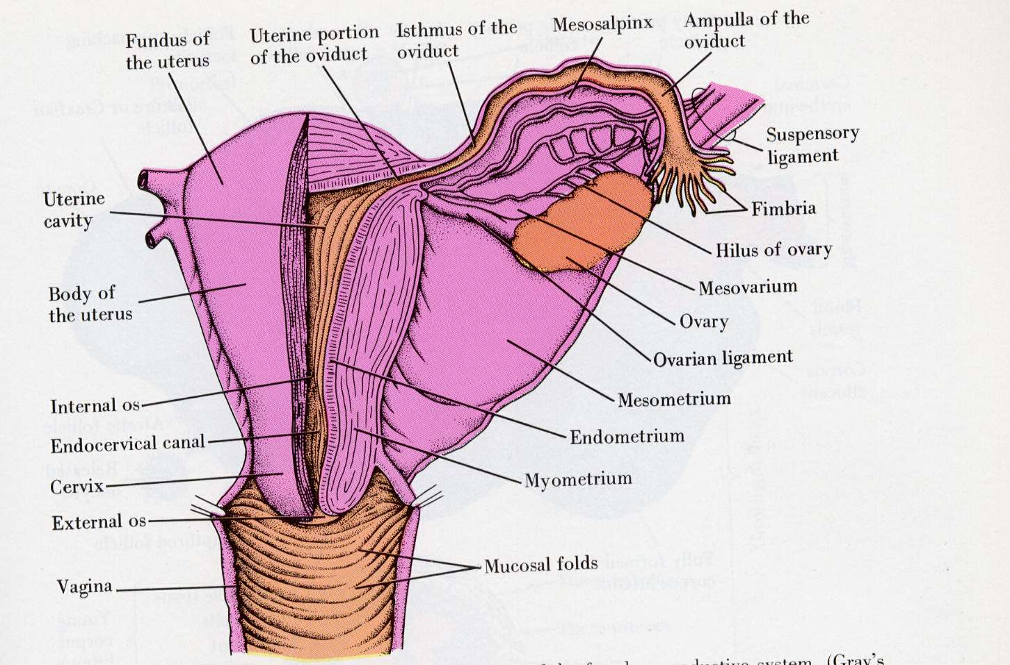

Slide 21
ovaries
cortex - contains follicles (primordial follicles) with oocytes (primary oocytes); ~400,000 at puberty
medulla - vascular area
no duct system
at ovulation - developing ‘ovum’ ruptures through ovarian wall (secondary oocyte) into peritoneal cavity
Ovum picked up by end of fallopian tube
transported to uterus

Slide 22
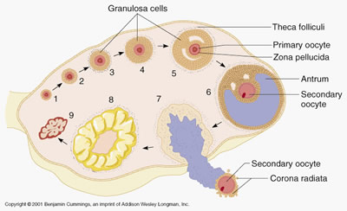
The ovarian cycle
~ 400,000 primordial follicles (primary oocyte) are present at puberty
~20 begin to mature at each cycle
Normally 1 reaches full maturity (Graafian follicle); the rest regress (atresia)
Oestrogen synthesis
Primordial follicle
Single cell layer surrounds oocyte
separates oocyte & granulosa cells
cavity
after 1st meiotic division
Granulosa cells forms corpus luteum; secretes E2 & P
expelled into peritoneal cavity

Slide 23
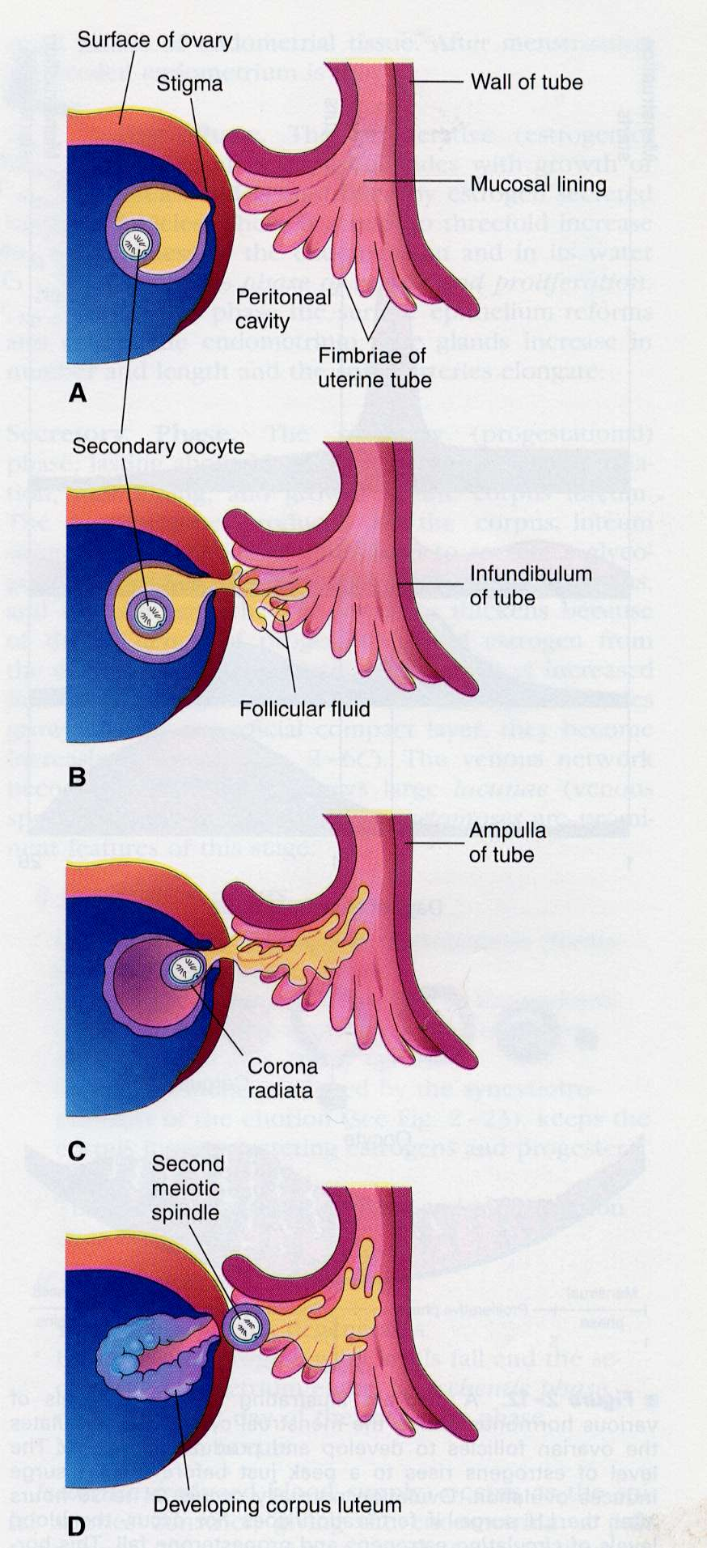
ovulation
secondary oocyte formed just prior to ovulation (plus first polar body, ejected) i.e. first meiotic division occurred
secondary oocyte second meiotic division stops in metaphase; not completed until penetration of sperm
ovulated into pelvic cavity
caught by fimbriae of Fallopian tube

Slide 24
menstrual cycle (endometrial/uterine)
endometrium - 3 layers
stratum compactum
stratum spongiosum
stratum basale (basal layer)
cyclical events (~28 days)
menstruation, ovulation
pregnancy
functional zone (or layer)

Slide 25
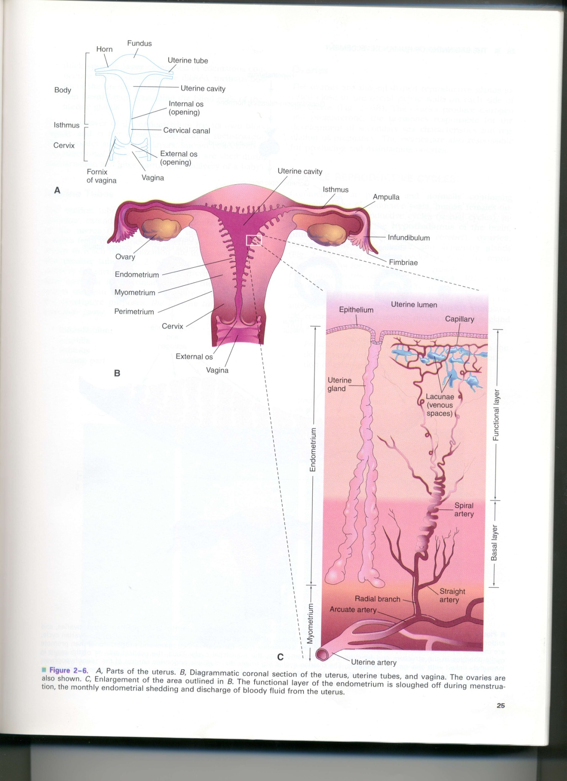
The endometrium
functional
layer
basal layer

Slide 26
THE MENSTRUAL CYCLE
OVARIAN CYCLE
ENDOMETRIAL CYCLE
FOLLICULAR PHASE
OESTROGEN
(17β-OESTRADIOL)
OVULATION
PROLIFERATIVE PHASE
LUTEAL PHASE
PROGESTERONE
and
17β-OESTRADIOL
SECRETORY PHASE

Slide 27
The Hypothalamo-pituitary gonadal axis – controller of sexual reproduction
Hypothalamus
Gonadotrophin releasing hormone (GnRH)
Pituitary gland
Thyroid gland
Pituitary
Gonadotrophins
LH/FSH
Adrenal gland
Ovary
Oestrogens
Progesterone
Ovum
1per cycle
Ovary
Testis
Testosterone
Sperm
200 million per day
Notes:
But I diverge from sex differences. This summarizes why sex differences in hypothalamic circuitry are important for reproduction and reproductive behaviours.
The hypothalamic neurones governing the hypothalamo pituitary gonadal axis produce gonadotrophin releasing hormone that stimulates release of the gonadotrophins, LH and FSH and, consequently, oestrogens and progesterone from the ovaries or testosterone from the testes. As E2 levels rise over the menstrual cycle, this stimulates the gonadotrophin releasing hormone neurones, which generated an LH surge that is the trigger for ovulation and, in rats, the trigger for sexual receptivity. If you give E2 to males, they cannot mount an LH surge and this is one example that suggests that the hypothalamic hard-wiring is different between the sexes.

Slide 28
Follicular phase
Luteal phase
menses
LH
FSH
mU/l
mU/l
(
)
(
)
Ovulation
17β-OESTRADIOL
PROGESTERONE
nmol/l
pmol/l
( )
(
)
0
5
14
28
DAYS
BASAL
BODY TEMP
ºC
38.0
17OH-P
37.0

Slide 29
The Hypothalamo-pituitary gonadal axis – controller of sexual reproduction
Hypothalamus
Gonadotrophin releasing hormone (GnRH)
Pituitary gland
Thyroid gland
Pituitary
Gonadotrophins
LH/FSH
Adrenal gland
Ovary
Oestrogens
Progesterone
Ovary
Testis
Negative feedback during early & mid-follicular phase (E2) and luteal phase (E2 & P)
Positive feedback during late-follicular phase (E2)
Notes:
But I diverge from sex differences. This summarizes why sex differences in hypothalamic circuitry are important for reproduction and reproductive behaviours.
The hypothalamic neurones governing the hypothalamo pituitary gonadal axis produce gonadotrophin releasing hormone that stimulates release of the gonadotrophins, LH and FSH and, consequently, oestrogens and progesterone from the ovaries or testosterone from the testes. As E2 levels rise over the menstrual cycle, this stimulates the gonadotrophin releasing hormone neurones, which generated an LH surge that is the trigger for ovulation and, in rats, the trigger for sexual receptivity. If you give E2 to males, they cannot mount an LH surge and this is one example that suggests that the hypothalamic hard-wiring is different between the sexes.

Slide 30
endometrial cycle
menstrual phase
first day of menstruation day 1 of cycle
shed blood (20-80mls over ~5 days) and endometrial lining (functional zone)
remaining basal endometrium is very thin

Slide 31
endometrial and ovarian cycles
2. Proliferative phase (9 days) - post-menstruation build up of endometrium
and
follicular phase- growth of ovarian follicle
are under hormonal control
pituitary LH and FSH stimulate 17β-oestradiol synthesis by thecal and granulosa cells, which stimulates endometrial cell proliferation
pituitary FSH stimulates follicular growth

Slide 32
endometrial cycle
proliferative phase 9 days
controlled by oestrogen from follicles
2-3 fold increase in endometrial thickness
(phase of repair and proliferation)
epithelium repairs, glands increase
(number and length), spiral arteries lengthen
at the same time follicles in ovaries are growing and produce more and more oestrogen

Slide 33
Ovarian mid-cycle event
OVULATION

Slide 34
Endometrial cycle
3. Secretory phase
Production of nutrients, and other secretory products
Link with ovarian cycle
occurs in response to 17β-oestradiol AND progesterone
produced from corpus luteum during ovarian luteal phase

Slide 35
Endometrial cycle
secretory phase 13 days
Progesterone (+ oestrogen) secretion from corpus luteum
Progesterone stimulates glandular epithelium(glands widen, become more tortuous)
Endometrium thickens
Spiral arteries become more coiled

Slide 36
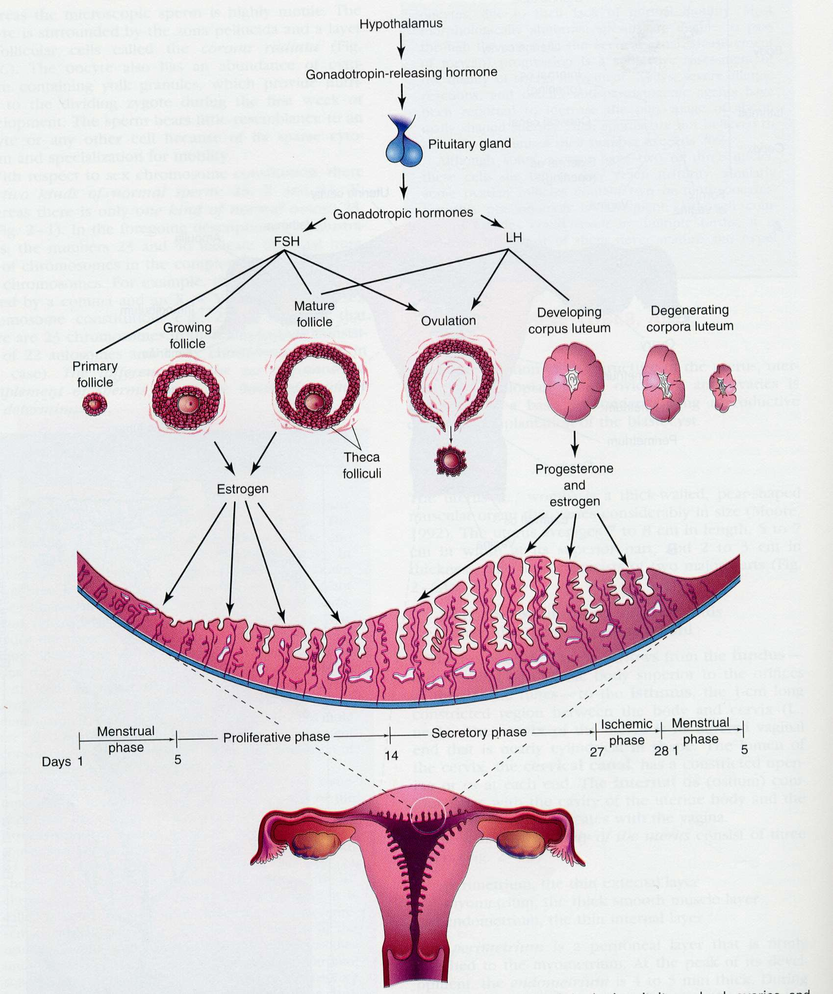

Slide 37
FERTILIZATION
Menstrual cycles continue throughout a woman’s reproductive life
UNLESS fertilization of a released ovum by a mature spermatozoon occurs
PREGNANCY

Slide 38
FERTILISATION
Requires sperm and egg
USUALLY, this occurs following copulation (coitus) between man and woman
BUT In vitro fertilization a reality
Requires male and female (?)

Slide 39
AFFERENT PATHWAY
FROM PENIS
TACTILE STIMULUS
AFFERENT FIBRES IN PUDENDAL NERVE
TO SPINAL CORD

Slide 40
CONTROL OVER PENILE ERECTION
SEXY
THOUGHTS
BRAIN
(LIMBIC SYSTEM)
SPINAL CORD
efferent
PENIS
afferent

Slide 41
EFFERENT PATHWAYS INVOLVED IN PENILE ERECTION
Parasympathetic
via
pelvic nerve
Somatic
via
pudendal nerve
Sympathetic
via
Hypogastric nerve
promotes
erection
promotes
erection
Depresses
erection
(stimulates ejaculation)

Slide 42
THE PENILE ERECTION PROCESS
INVOLVES CHANGE FROM:
FLACCIDITY
TUMESCENCE
ERECTION

Slide 43
PENILE ERECTION:
BLOOD FLOW TO PENIS

Slide 44
PENILE ERECTION
IS INITIATED BY
  INCREASED PARASYMPATHETIC ACTIVITY TO SMOOTH MUSCLE OF PUDENDAL ARTERY
INDUCES DILATATION
COUNTERACTS SYMPATHETIC-MAINTAINED MYOGENIC TONE
INCREASED BLOOD FLOW INTO CORPUS CAVERNOSUM

Slide 45
PENILE ERECTION
The outflow of blood reduced by compression of dorsal vein following increase in corpus cavernosum pressure
Urethra protected from increased pressure by surrounding corpus spongiosum (less turgid)

Slide 46
MECHANISM OF SMOOTH MUSCLE DILATATION
Dilatation of arterial smooth muscle
Parasympathetic post-ganglionic fibres
cGMP
Acetylcholine/VIP
_
PDE
L-arginine
NO
5’GMP
+
NO SYNTHASE
citrulline
VIAGRA

Slide 47
ERECTILE TISSUE IN WOMEN
The female equivalent of the penis is the clitoris
The clitoris, like the penis, increases in size as a result of an increased blood flow into the tissue
The mechanism is the same (i.e. release of NO)

Slide 48
FERTILIZATION
Sexual intercourse
In-vitro fertilization
So, is sex necessary?

