Slide 1
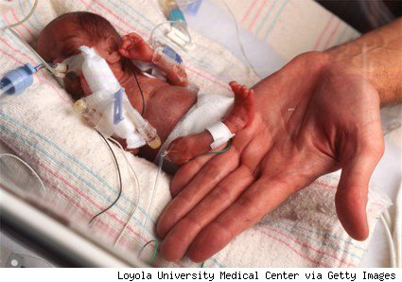
Human labour (birth)
Mark Sullivan
http://www.politicsdaily.com/2010/01/02/preemies-health-care-reform-and-the-cost-benefit-conundrum/

Slide 2
Learning objectives
Identify when labour happens
List the key tissues involved
Define the main biochemical pathways
Identify the main causes of labour
Explain our knowledge of progesterone and human labour

Slide 3
Labour - numbers
Miscarriage (<23 weeks of gestation)
~350,000 p.a., within 13 weeks, ~7,000 late miscarriages
Preterm labour (23-37 weeks of gestation)
~45,000 infants p.a.
Very preterm labour (23-30 weeks of gestation)
~4,500 infants p.a
Term: 37-41 weeks of gestation
~700,000 infants p.a.
NB: Preterm deliveries ~90,000 infants p.a. (?)

Slide 4
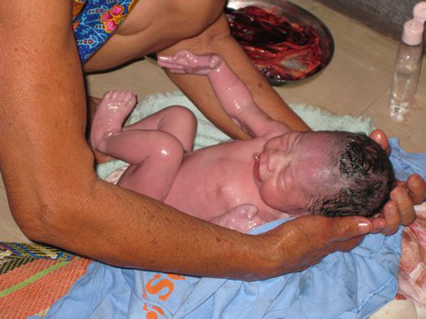
http://article.wn.com/view/2009/05/16/Natural_childbirth_tip_have_a_birth_plan/

Slide 5
http://www.politicsdaily.com/2010/01/02/preemies-health-care-reform-and-the-cost-benefit-conundrum/

Slide 6
Initiation of labour
Term
Not really sure!!!
Estrogens; low progesterone?; CRH?; oxytocin?
Preterm
Intrauterine infection
Intrauterine bleeding
Multiple pregnancy
Stress (maternal)
Others

Slide 7
The process of labour
Independent of the time that labour starts
Cervical ripening and effacement
Co-ordinated myometrial contractions
Rupture of fetal membranes
Delivery of infant
Delivery of placenta
Contraction of uterus

Slide 8
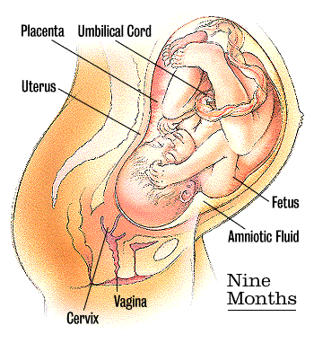
Fundally dominant contractions
Fetal membrane remodelling
Lower segment relaxation
Cervical ripening
http://www.babycentre.co.uk/i/devel/diagram9.gif

Slide 9
Labour stages
Not in labour (~39 weeks)
Latent stage (~8 weeks)
Labour (12-48 hours)
13w 26w 39w
First trimester Second trimester Third trimester
Phase 1 (many hours)
Contractions, cervical changes
Phase 2 (hours)
Baby delivered
Phase 3 (30 min)
Placenta delivered

Slide 10
The process
Cervical ripening and effacement
Co-ordinated myometrial contractions
Rupture of fetal membranes
Delivery of infant
Delivery of placenta
Contraction of uterus

Slide 11
The process
Cervical ripening and effacement
Change from rigid to flexible structure
Remodelling (loss) of extracellular matrix
Recruitment of leukocytes (neutrophils)
Inflammatory process
Prostaglandin E2, interleukin-8
Local (paracrine) change in IL-8

Slide 12
The process
Cervical ripening and effacement
Co-ordinated myometrial contractions
Rupture of fetal membranes
Delivery of infant
Delivery of placenta
Contraction of uterus

Slide 13
The process
Co-ordinated myometrial contractions
Fundal dominance
Increased co-ordination of contractions
Increased power of contractions
Key mediators
Prostaglandin F2α (E2) levels increased from fetal membranes
Oxytocin receptor increased
Contraction associated proteins

Slide 14
The process
Cervical ripening and effacement
Co-ordinated myometrial contractions
Rupture of fetal membranes
Delivery of infant
Delivery of placenta
Contraction of uterus

Slide 15
The process
Rupture of fetal membranes
Loss of strength due to changes in amnion basement component
Inflammatory changes, leukocyte recruitment
Modest in normal labour, exacerbated in preterm labour
Increased levels and activity of MMPs
Inflammatory process in fetal membranes

Slide 16
Summary
Cervix
Prostaglandin E2, interleukin-8, MMPs
Myometrium
Prostaglandin F2α (E2) levels increased from fetal membranes
Oxytocin receptor increased
Contraction associated proteins
Fetal membranes
Inflammatory process in fetal membranes
PGs, interleukins, MMPs

Slide 17
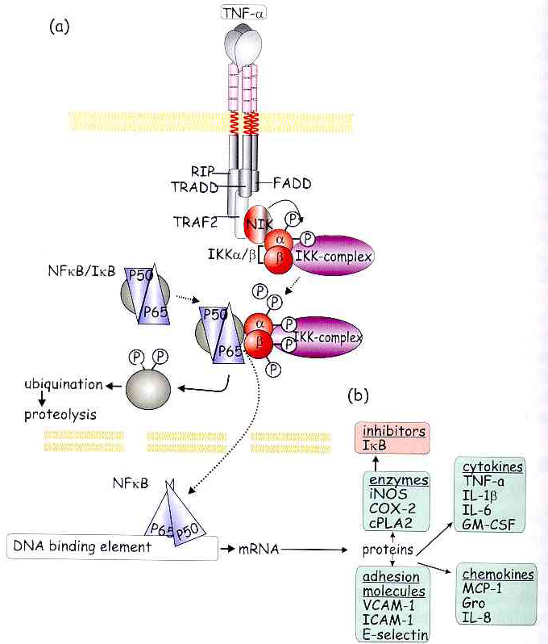
NF-κB: a pro-inflammatory transcription factor
http://bioweb.wku.edu/courses/biol566/Images/ad026.jpg

Slide 18
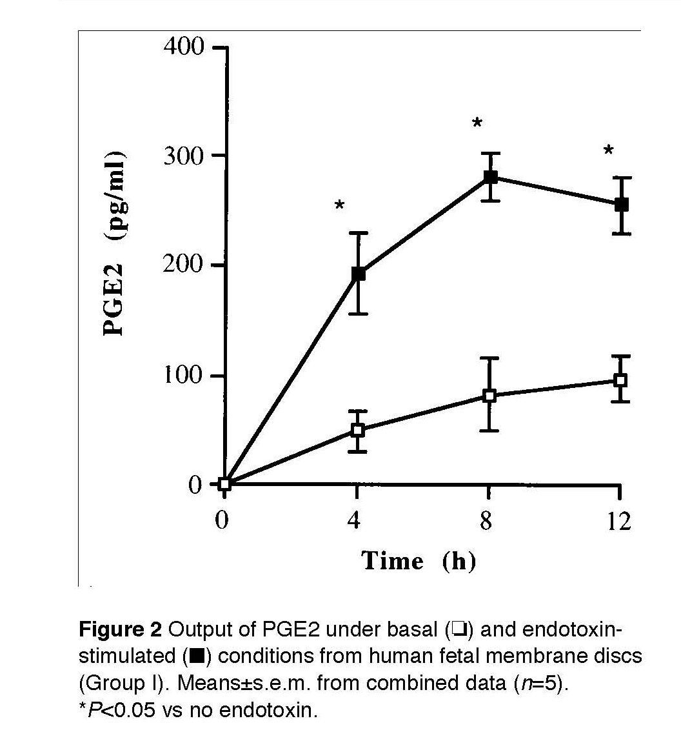
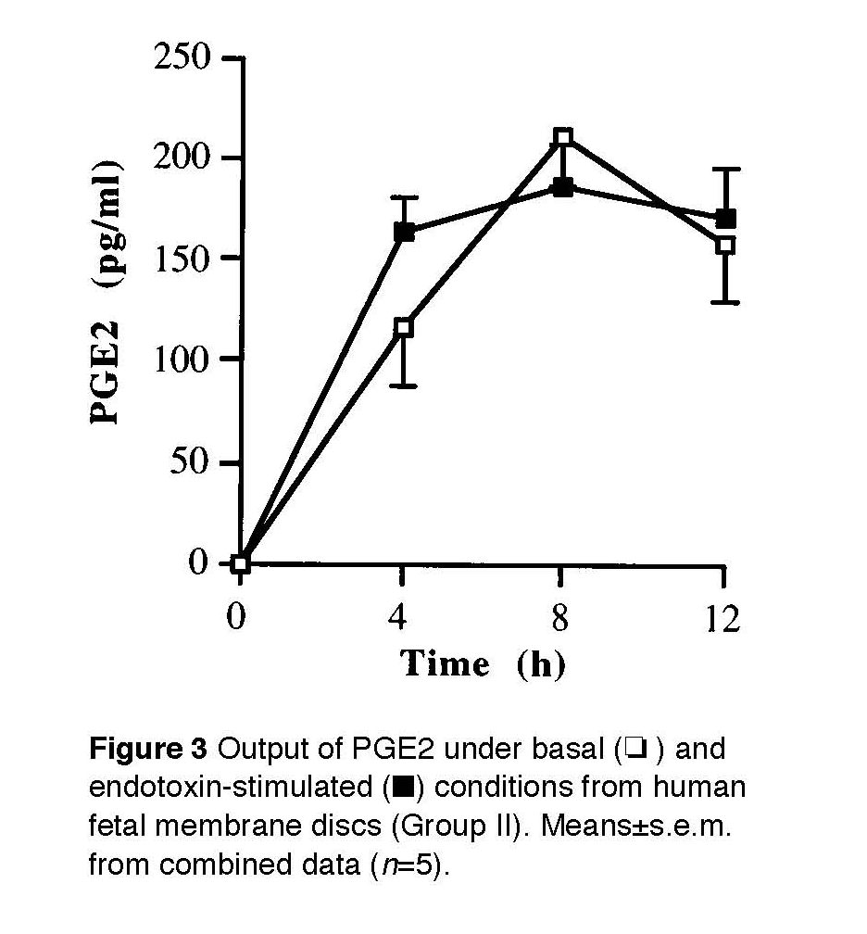
PGE2 output
Brown et al, 1998

Slide 19
Supporting evidence
Almost all pro-labour genes have NFκB binding domains in their promoters
Modification of NFκB sites in promoter sequences leads to loss of expression in cells or in expression vectors

Slide 20
Possible causes
Inflammatory changes are strongly linked with labour
Activators of inflammation are readily linked with preterm labour (eg intrauterine infection)
What about term labour?

Slide 21
Control of term labour?

Slide 22
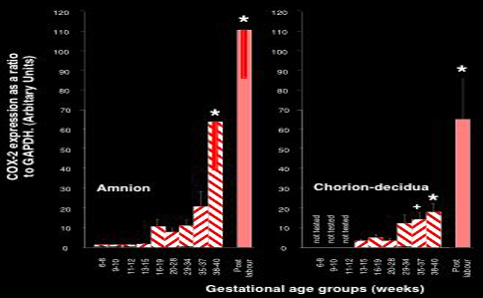
CRH
McLean et al, 1995
Allport & Bennett

Slide 23
Platelet-activating factor
Part of lung surfactant
Surfactant proteins and complexes
Produced by maturing lung, before birth
Levels in AF increase near term
Fetal signal of maturity

Slide 24
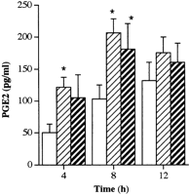
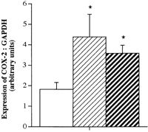
Prostaglandin E2 & COX-2
PAF
CRH
PAF
CRH
Brown et al

Slide 25
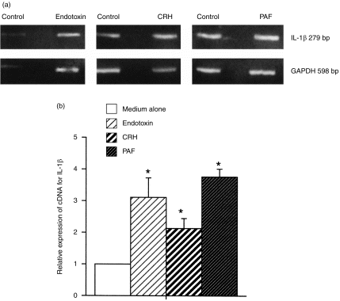
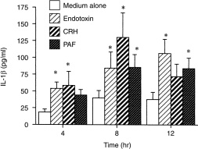
Interleukin-1beta

Slide 26
Summary
CRH and PAF can up-regulate inflammatory pathways in fetal membranes
Candidate initiators of term human labour

Slide 27
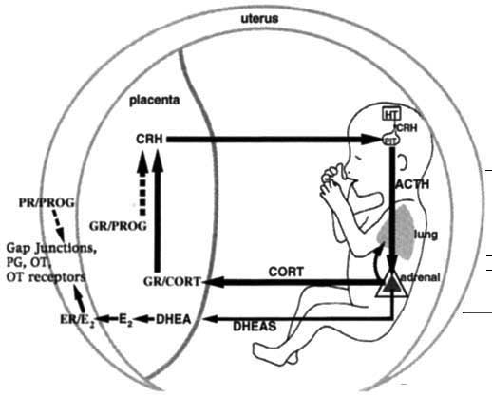
Hypothesis for parturition
IL
PG
PAF
IL
Karalis et al, 1996

Slide 28
Corollaries of the above
Anything that increases CRH may predispose to labour (stress, multiple infants)
Anything that increases muscle contraction may predispose to labour (excess stretch of uterus)
Anything that activates inflammatory cascades may predispose to labour
The above apply to preterm labour (intrauterine infection, bleeding, twins)

Slide 29
Progesterone &
human pregnancy
Progesterone is NEEDED to sustain pregnancy
Progesterone receptor blockade
Progesterone levels remain very high until after delivery of the placenta (unlike sheep)
Effect of progesterone lost in normal term labour

Slide 30
Mutually negative interaction between NFκB and PR

Slide 31
Over-expression of PR inhibits NFκB activity

Slide 32
Progesterone receptor
PR-B mediates the main effects of progesterone via gene expression
PR-A is less able to mediate these effects
Ratio of PR-A : PR-B increases at term
Loss or change in PR may lead to ‘functional progesterone withdrawal’

Slide 33
Labour biochemistry
*
Metabolites
*
*
*
*
*
*
*
*: Affected by progesterone

Slide 34
Labour overview
Many initiators: CRH?, PAF?, infection, bleeding, stress
NFκB
Many genes, mostly ‘inflammatory’: COX-2 (prostaglandins - PGs), IL-8, IL-1β, MMPs, Oxytocin receptor, PG receptors; contraction-associated proteins

Slide 35
Summary
Labour strongly resembles an inflammatory response in fetal membranes and cervix
The main active tissues are myometrium and cervix
The key regulator seems to be NFκB
Term and preterm labour differ mainly in the initiating factors
Maternal progesterone levels remain high during labour – ‘functional progesterone withdrawal

