Slide 1
Introduction to Ageing
“We are all amateurs; we don’t live long enough to become anything else.”
(Charlie Chaplin)
Will you still need me, will you still feed me, when I'm sixty four?
(John Lennon/ Paul McCartney)
Dr Nigel Beckett (Hon Senior Lecturer ICL)

Slide 2
OBJECTIVES
Gain an understanding of…….
What is ageing?
What causes ageing?
Life Expectancy, Health and Disability
Changing nature of the older population
Challenges affecting society.
In HLC2: Gain an understanding of general age-associated physiological changes.

Slide 3
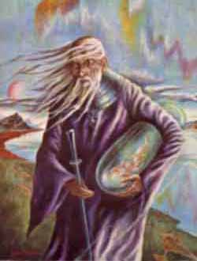
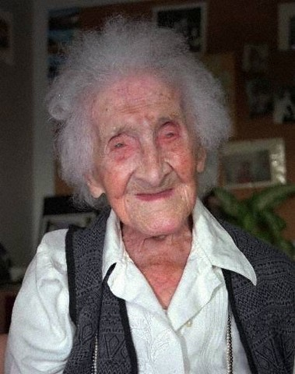

WHO/ WHAT IS OLD
Methuselah 969 years old
Jeanne Calment
122 years 164 days
Sophia Loren
78 years

Slide 4
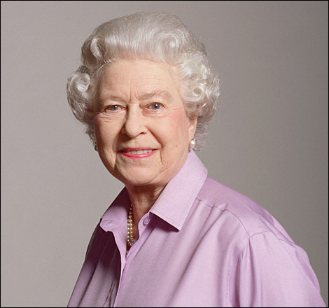
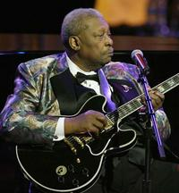
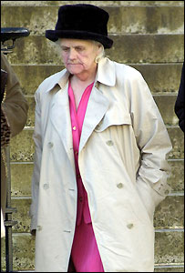
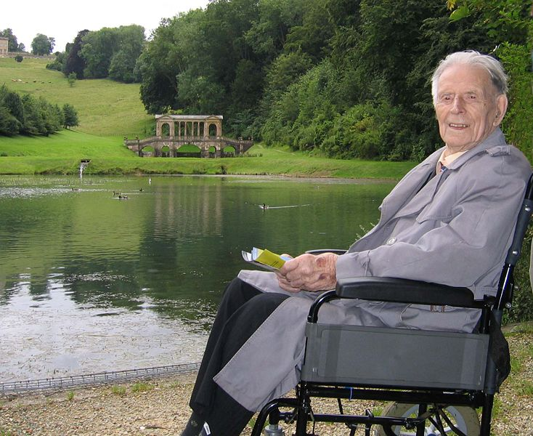
Successful Ageing

Slide 5
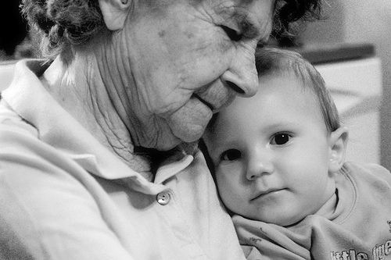
What is Aging?
is not a disease
occurs at different rates
  among individuals
  within individuals
does not generally cause symptoms

Slide 6
Ageing – a challenge of our time
Biomedical science: why is the aged cell (or organ) more vulnerable to pathology?
Clinical: age is the single largest risk factor for a very wide range of diseases of current public health importance.
Public Health: delivery of high quality and appropriate health care to the population

Slide 7
Life Expectancy and Life Span
Life Span: the maximum number of years an individual can live; has remained between 120–125 years
Life Expectancy: the number of years that the average person born in a particular year will probably live
  Has increased an average of 30 years since 1900
Cross-Cultural Differences:
  Japan has highest life expectancy (81 years)
  Differences in health conditions and medical care
Ethnic Differences:
  Life expectancy for African Americans is 7 years lower than that of non-Latino Whites
Gender Differences: Females’ ability to outlive males widens beginning in the mid-thirties
  Social factors (health, attitudes, habits, lifestyles, occupation)
  Biological factors

Slide 8
DEFINITION OF AGING
Old and aging depends on the age and experience of the speaker!
Chronological age - number of years lived
Physiologic age - age by body function
Functional age - ability to contribute to society

Slide 9
When does Ageing become “Old”
Retirement Age
Men Women
65 yrs 60 yrs
65 65 (not if born before 1950)
2024- 2046 to increase to 68 yrs for both sexes
Average life expectancy (man 78, woman 82)

Slide 10
Ageing
Characterised by increasing age-specific mortality
Progressive, generalized impairment of function resulting in a loss of adaptative response to a stress and in a growing risk of age-associated disease (Kirkwood, 1996).
General characteristic of mammals, birds, reptiles and many invertebrates –i.e. seems to predate humans

Slide 11
Characteristics of Mammalian Ageing
cellular and physiologic deterioration
increased mortality with age following maturation
increased vulnerability to disease
decreased ability to adapt to stress
  impaired homeostasis

Slide 12
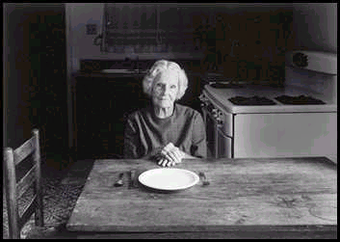
Frailty
Frail Older Adult:
Poor mental and physical health
Low socioeconomic status
Predominantly female
Possibly isolated living conditions
More and longer hospital stays
More money spent on health care and drugs

Slide 13
Theories of ageing traditionally been split into:
  Programmed theories – ageing is caused by genes switching on and off, in the same way that development is regulated.
  Random damage / stochastic damage theories – ageing is caused by wear & tear and accumulation of damage

Slide 14
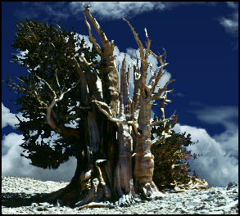

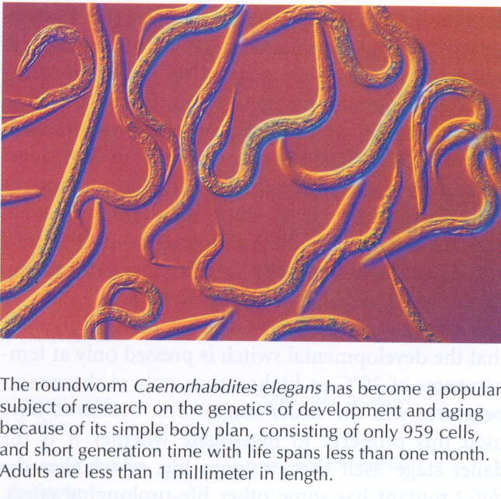
THEORIES OF AGEING:
‘Programmed’ ageing - evidence
1. Species specific max lifespan
120 years
150 years
5,000 years
2. Disease associated genes
e.g. ApoE 4 and AD
ApoE 2 and longevity
ACE and cardiovascular disease
3. Animal longevity ‘gerontogenes’
e.g. c.elegans and d.melanogaster
Several mutations increase longevity

Slide 15
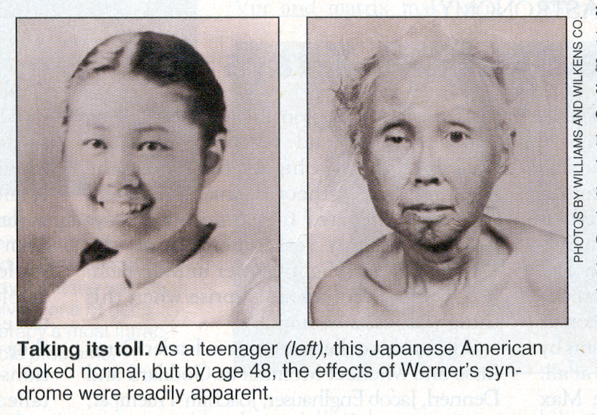
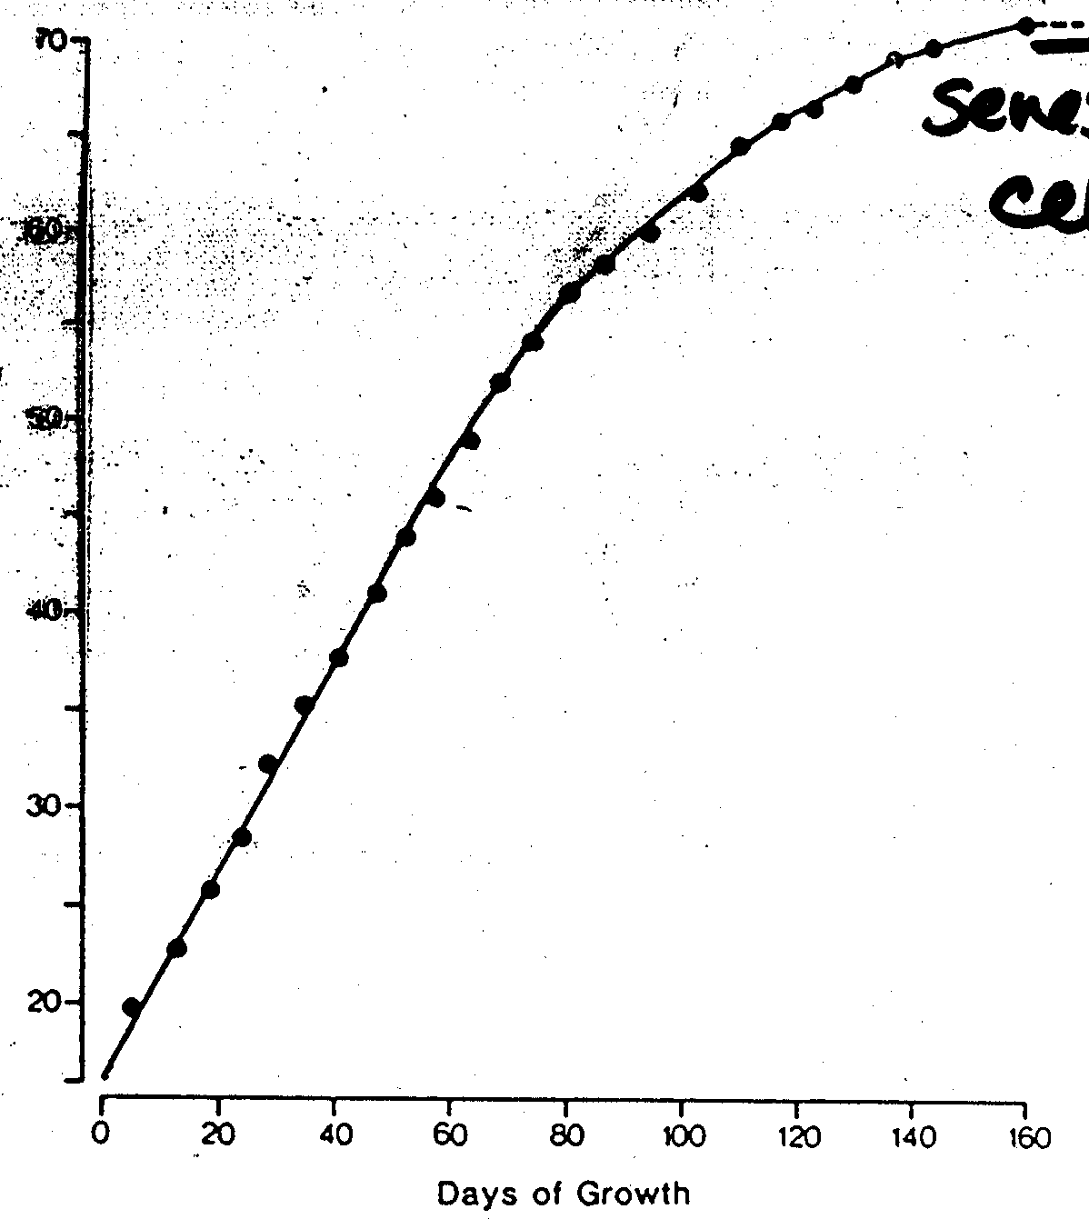
4. Genetic mutations producing
fast ageing syndromes: progeria
17 years 42 years
Hayflick limit
5. Cells in culture can divide only a set
number of times
- ‘cellular clock’ or Hayflick limit

Slide 16
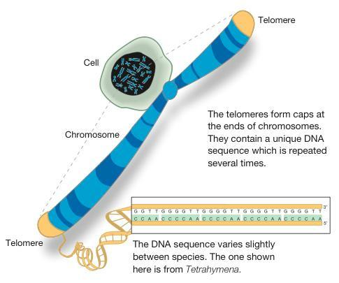
Cellular clock
End regions of chromosomes (telomeres) are lost with each cell division – (DNA polymerase cannot make new DNA at the very end of chromosomes)

Slide 17
Despite these studies no ‘programme’ for ageing has been found
The genes identified with a role in ageing are involved in
Cell maintenance and repair
  e.g.
  ApoE cell membrane repair
  Gerontogenes: antioxidant and metabolic enzymes
  Progeria: helicase, involved in DNA maintenance, repair
  and protein synthesis
  Hayflick limit: DNA protection

Slide 18
THEORIES OF AGEING: Random, stochastic damage - evidence
Two major sources of damage to molecules and cells are:
OXYGEN - Oxidative stress – oxygen free radicals
GLUCOSE - Protein damage by reducing sugars- glycosylation

Slide 19
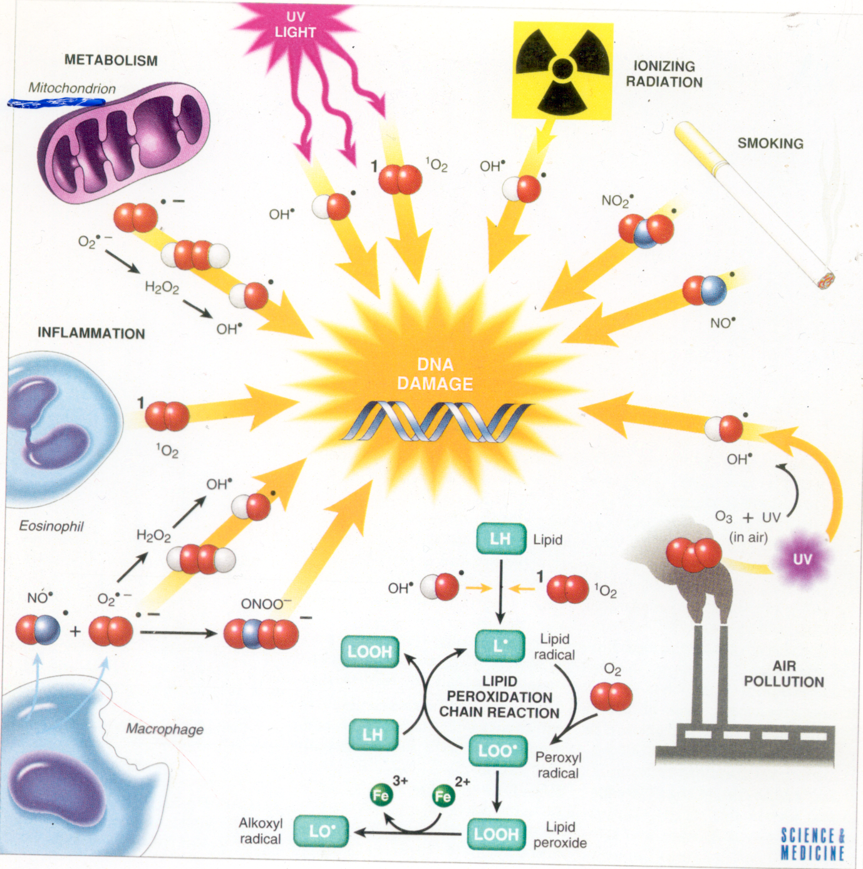
OXYGEN - free radicals (FR) and reactive oxygen species (ROS)
Cell metabolism
environment
lifestyle
DNA damage
Infection
pollution
diet

Slide 20
Links between theories of ageing and many common age-related disorders have been made, e.g:
CVD
Dementia
Osteoporosis
Sarcopenia
Hearing loss…
Conclusion:
Understanding cellular and molecular bases of ageing may impact on treatments for multiple aspects of ageing physiology and associated disease.

Slide 21
Human Ageing is Malleable
By decreasing exposure to damage
  Improved nutrition
  Improved lifestyle
  Improved environment
By enhancing natural mechanisms for protection and repair
  Improved nutrition
  Novel drugs, etc

Slide 22
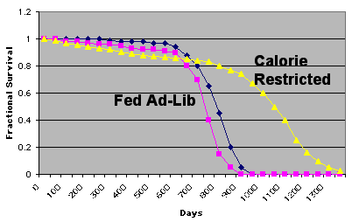
Survival of Calorie Restricted Rats
Eakin F & Witten M. McCay CM et al. Experimental Gerontology 1995, 30: 33-64

Slide 23
Living Longer
We live, on average, about twice as long as we did 200 years ago.
Life expectancy has increased by about 10 years in the last 50 years.
85% children born today can expect to reach their 65th birthday

Slide 24
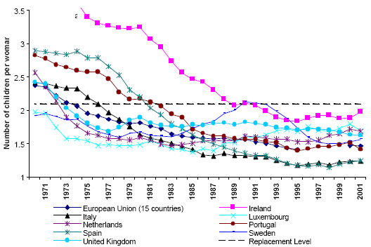
Total fertility rate
EU Member States, 1970-2001
Source: Grant J et al (2004) Low Fertility and Population Ageing. Causes, Consequences and Policy Options. RAND Europe
Notes:
24

Slide 25
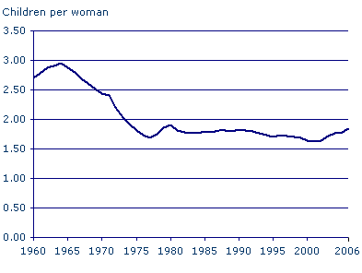
Recent rise in total fertility rate, UK
Total fertility rate, UK
Source: Office for National Statistics, General Register Office for Scotland and Northern Ireland Statistics & Research Agency.
Notes:
25

Slide 26
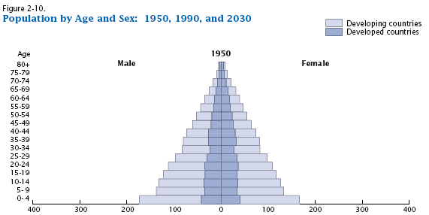
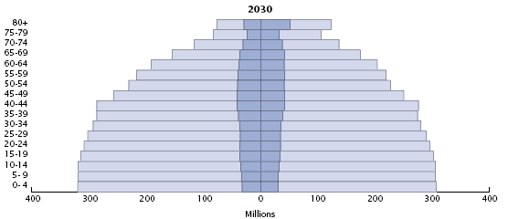
Losing
shape
Notes:
26

Slide 27
The UK demography and changing life expectations
Life expectancy is projected to continue to rise substantially¹
The age composition of the UK population is shifting as the over 50s cohort expands¹
Projected that by 2020, the number of people aged over 65 will increase by over 30% and the 50+ population will account for 40% of UK population by 2029¹…
..but it is not simply the size of the 50+ population that is significant but the longevity of later life – whilst an average 65 year old man could expect to live till 76 in 1950, he can now expect to live ‘till 85²
Latest ONS/ GAD projections;
DWP, Security in Retirement: Towards a New Pension System (2006)

Slide 28
Trends in Population Ageing
Source: 1901-1961 Table in House Magazine, June 24, 1991, p. 19; 1971-1991 Table 1.5 in Population Trends 100, 2000, p.53; 2001-2031 GAD. 2003-based national population projections (http://www.gad.gov.uk/).
Notes:
28

Slide 29
Ageing of the Population

Slide 30
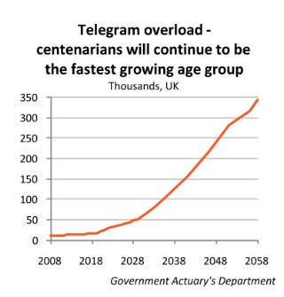

Slide 31
Consequences of Ageing Population
Health care costs
Personal social services
Pensions
Affordability of the welfare state
Notes:
31

Slide 32
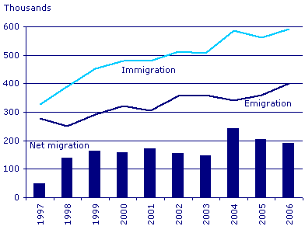
International migration: in and outflow, UK
Notes:
32

Slide 33
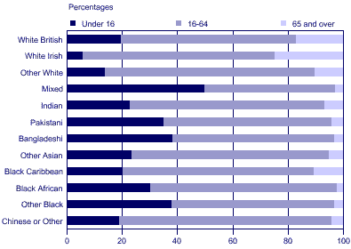
Ethnicity and Ageing
UK Age distribution by ethnic group (2001)
Notes:
33

Slide 34
Ethnicity and Ageing
But, the ethnic minority population is also about to undergo rapid ageing
This is partly due to the timing of migration
The problems:
  Rates of illness are higher in some ethnic groups
  Social disadvantage in some ethnic groups
    “Double Jeopardy”
Notes:
34

Slide 35
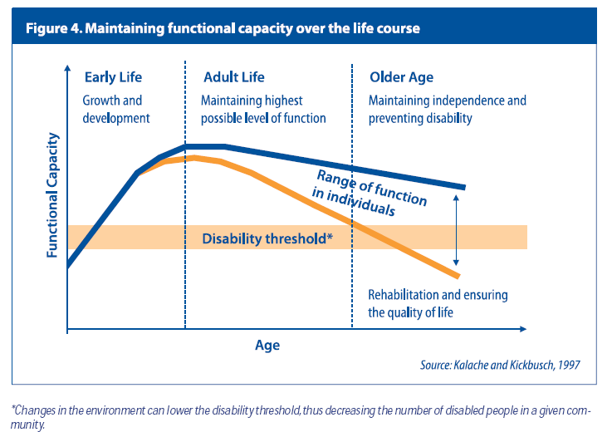

Slide 36
Longer lives, healthier lives?
Death
Disability
Onset of morbidity
Age of cohort
55
80
90
Oh dear – it just gets worse

Slide 37
Longer lives, healthier lives?
Death
Onset of morbidity
Disability
Age of cohort
55
80 90
Excellent - everything is delayed

Slide 38
Ageing, Disability and Lifespan compression of morbidity
Onset of morbidity
Death
Disability
Age of cohort
55
80 90
Even better, it all happens later

Slide 39
The truth is variable and probably changing
Cross national evidence suggests
decreases in severe levels of disability
but increases in mild-moderate disability.
  UK, US, Japan, France and Canada life free of severe disability has been increasing over time.
  BUT overall amount of disability free life has been stable or declining.
  overall burden of disability being reduced but that more moderate disabilities may be increasing.
Implications are that we will need strategies to deal with more prevalent moderate disabilities.

Slide 40
Life Expectancy/ Healthy Life Expectancy

Slide 41
Compression of mortality: Rectangularization of the survival curve (France, Robine 2002)
Notes:
41

Slide 42
Mortality
Notes:
42

Slide 43
Long Term Conditions
Defined as….Non curable but managed.
15.4M people at least 1 Long Term Condition.
77% inpatient bed days due to LTC
68% of outpatient + A&E attendances due to LTC
amounts to £7.00 out of every £10.00 of the healthcare spend!

Slide 44
English Longitudinal Study of Ageing (ELSA).
Participants
About 4000 representative sample aged 65+
followed up for 5 years
Measurement:
Analyses compared the risks of impaired physical function, depression, confusion and mortality associated with various baseline variables
Selected results (associations):
living in deprived neighbourhoods 1.7 x new mobility difficulties
living in deprived neighbourhoods incident cognitive decline
Low social contacts and poor health is more disabling over time
Habitual physical activity age 50-60 with ↓ physical disability

Slide 45

Living Arrangements
Proportion of women aged 65 and over living alone in private households: 1970-2000
Source: Tomassini et al. (2004), Population Trends, 115, Figure 1, pp.24-34.

Slide 46
Number of children
Source: Evandrou and Falkingham (2000) Population Trends

Slide 47
Volunteering
Source: Baines et.al (2006)

Slide 48
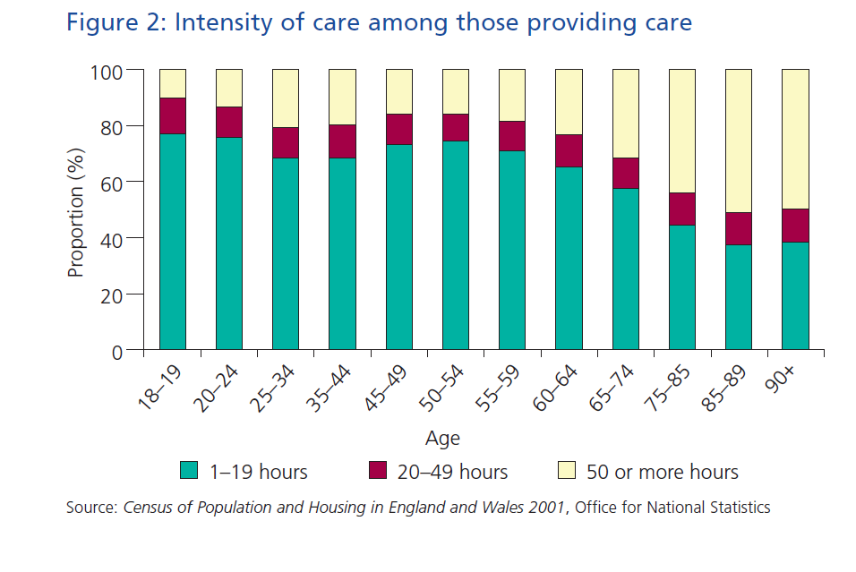

Slide 49
Demographic change represents a huge opportunity – but failure to adjust may present difficult challenges
Opportunity
Increased longevity with healthier, wealthier, active and fulfilling later lives will have profound implications for individuals, economic productivity and social progress
Risk
Longer years lived in ill health, financial insecurity or poverty and a failure to build on the human and social capital of older people will have significant costs for the individual, society and the economy
Cross government approach is to set out how society can make the most of the opportunities and minimise the risks
AGEING
STRATEGY

Slide 50
Society is currently not set up to exploit the opportunities and mitigate the risks that an ageing society presents
Increase participation
Adjustments by society is needed for
individual well-being service provision economic prosperity and social progress
What needs
to be done
Material well-being
Active healthy ageing
Social care provision
Age inclusive services
Change culture and attitudes

Slide 51
There are four broad challenges to ensuring later life is active and spent in the best possibly health
Maintaining good health
Restoring
good health
Managing ill health
Maintain good health and well-being by activity prior to later life
Maintain good health and well-being by activity in later life
Restore good health and well-being through self-care and services
Manage long term conditions and improving quality of care

Slide 52

THE NHS TODAY!
failure to meet the challenge of the care of the elderly through provision of an adequate professional resource. …. treatment of elderly patients could properly be characterised as abuse of vulnerable persons
‘Older people’s care in hospital is delivered through appropriate specialist services and by hospital staff who have the right set of skills to meet their needs.’ (Standard 4)
Notes:
52

