Slide 2
What is the point of Society and Health course?
Understand the role of social factors in health and health care
To make you a more thinking, caring and effective doctor
And this session…?
To help you pass your exams

Slide 3
Society and Health Assessments
Formative (for you to see how you are getting on):
Year 1 Students | Monday 7 January 2013 | 2 pm – 4 pm | Formative examination – written paper (Term 1 Themes)
Graduate Entry Students | Tuesday 29 January 2013 | 2 pm – 4 pm | Written formative exam (Soc & Health, CMS, Reg Sys, Supp Sys)
Summative- your mark for Society & Health is determined by a written Society & Health/Epidemiology in class test
Year 1 Entry students | Tuesday 19 March 2013 | To Be Confirmed | Society & Health/Epidemiology in class test
Graduate Entry Students | Friday 26 April 2013 | 9.15 am – 10.15 am | Epidemiology and Society & Health
These dates are currently provisional and may be subject to change.
Students must check both the intranet and their email regularly for up-to-date information about forthcoming exams.
Notes:
Students will be advised by email of the detailed arrangements for each set of examinations, including candidate numbers and venues,
about 2 weeks before the examinations begin.

Slide 4
Society and Health Assessments:
FCA and Society & Health Essay
2000 word essay
Topic:
  a discussion of the experience of healthcare, First Clinical Attachment
  AND
  a discussion of a core sociological concept (EITHER health inequalities OR deviance)
Submission deadline: Friday 22nd March 2013
These details are currently provisional and may be subject to change.
Students must check both the intranet and their email regularly for up-to-date information about forthcoming assessments.
Details on the FCA/S&H Essay will be posted on the FCA Intranet page.
Notes:
FCA and Society & Health Essay
Instructions for writing
Discuss experiences of health care and the factors that may influence patient satisfaction. Use your own experience, the experience of patients you have met on your placement and patient visits and the experiences of people you have spoken to in your satisfaction survey. You should relate this to relevant topics from FCA and Society & Health courses and to some of the relevant literature.
Your essay should include:
An account of an actual experience of health care described by patients
A consideration of the patient’s satisfaction:
The factors that influenced satisfaction or dissatisfaction with health care in your chosen example
Satisfaction survey:
A brief summary of your findings (supporting tables and graphs can also be included in the Appendix)
Similarities and differences between findings from different settings
How your findings compare with the literature on patient satisfaction
A consideration of how your account of a patient’s experience relates to ONE of the following TWO sociological concepts:
EITHER health inequalities
OR deviance
The sociological topic
You will be asked to relate the account of patient experience to one of two sociological topics: heath inequalities or deviance. Below are some suggestions on these.
Deviance: Using your chosen example, you should discuss how the patient’s past or present behaviour could be classified as deviant. For instance, you could illustrate how the perception of risk by the patient may differ from that of their doctor, of society and/or from your own.
OR
Health inequalities: the largest gap in life expectancy between the most and least deprived deciles of the male population in England is found in the Borough of Chelsea & Westminster. Using your account of a patient’s experience, you should demonstrate how social inequalities in health are produced (see Bartley M and Blane D. Chapter 8: Inequality and Social Class. In: 'Scambler G (ed) (2008) Sociology as Applied to Medicine, 6th edition. London: Saunders.)
Maximum word count
2000 words, this does not include references or diagrams which should be put in an appendix. Penalties apply for excess words beyond 10% of the maximum.
Marks
The mark awarded for this essay will count 13% of the total FCA marks (which is 6.5% of the FOCP mark).
Plagiarism
Please read the section about plagiarism on page 3 carefully before you start your essay.

Slide 5
Information session on Year 1 Assessments
Tuesday 11th December, 10:00 - 12:00
Year 1 Exams: An overview, strategies for dealing with exams, Jan formative Exam, PBL ICA
Dr P Kemp & Dr M Barrett & Dr K Gould & Dr R Herbert
Notes:
In the autumn electronic timetable

Slide 6
Revision cards - pyramid style
Really must know - higher up
Probably should know - in the middle
Interesting to know – lower/ reading

Slide 7
The local population*
Densely populated, rapidly growing, young, unequal, diverse, mobile
Higher proportion of working age people (45% of population aged 20 – 39)
Rich and very poor: 48% of children living in poverty (<60% median income)
>50% born outside UK (Westminster)
High proportion live alone (42% of households single adults)
Probably need to know most of this….

Slide 8
Impact of social factors
Impact on diseases
Impact on access to care
Less registration with GP
Poor knowledge of systems
Challenges for language and communication
Rights to care vary by migration and employment status
Impact on informal care
Linked to poverty, migration, age, for example
People isolated/ living alone
Less access to informal care
Weaker lay referral networks
Greater use of A&E
Addiction & mental health problems
HIV and TB
Liver disease

Slide 9
Measuring socioeconomic status
Indicators for poverty, social class, deprivation, education
Social class
Areas classified by Index of multiple deprivation (seven domains)
Income, Employment, Health, Education, Housing and services, Living environment, Crime
Poverty
Based on occupation (used to be Registrar General’s classification I to VI)
Now use 2001 National Statistics Socioeconomic Classification (8 classes)
absolute or relative measures
Education
Proportion completed different levels of schooling

Slide 10
A bit more on measuring socioeconomic status
Absolute poverty
  people lack the basic necessities for survival (food, sanitation, proper housing, clothing or medicines)
Relative poverty
  people's way of life and income is much worse than the general standard of living in their country
  they struggle to live a normal life and to participate in ordinary economic, social and cultural activities
National Statistics Socio-economic Classification (2001)
1. Higher managerial and professional
2. Lower managerial and professional
3. Intermediate (clerical, sales, service)
4. Small employers and own account workers
5. Lower supervisory and technical
6. Semi-routine occupations
7. Routine occupations
8. Never worked and long-term unemployed
Often collapsed into 5 categories again…

Slide 11
Concepts of health and illness
There are different ways of thinking about health
  absence of disease
  positive state of well being
  Functional – ability to do things
Disease = “biological” (the medical model)
Illness = “psychological” (the experience of symptoms)
Sickness = “social” (a social performance or role)
These states/ concepts do not necessarily overlap
  You may have a disease but not be ill
  You may feel ill but not have a disease
  You may have a disease, feel ill but not be sick

Slide 12
The sick role
the sick role identifies two rights…
  the exemption from normal social roles
  removed from responsibility for their own state
… and two obligations
  to want to get well speedily
  to consult expert medical opinion
Regards illness as deviance
(as described by Talcott Parsons 1951)

Slide 13
“Illness behaviour”
What determines how people act when they have symptoms
  Severity and frequency of symptoms (Elliott)
  Social factors (see Zola’s triggers below)
  Lay referral systems
Zola’s triggers: social factors which influence people’s decision to consult a health professional
  The occurrence of an interpersonal crisis.
  Perceived interference with social or personal relations.
  Perceived interference with vocational or physical activity.
  "Temporalising" - setting a personal deadline.
  "Sanctioning" - pressure from other people to consult

Slide 14
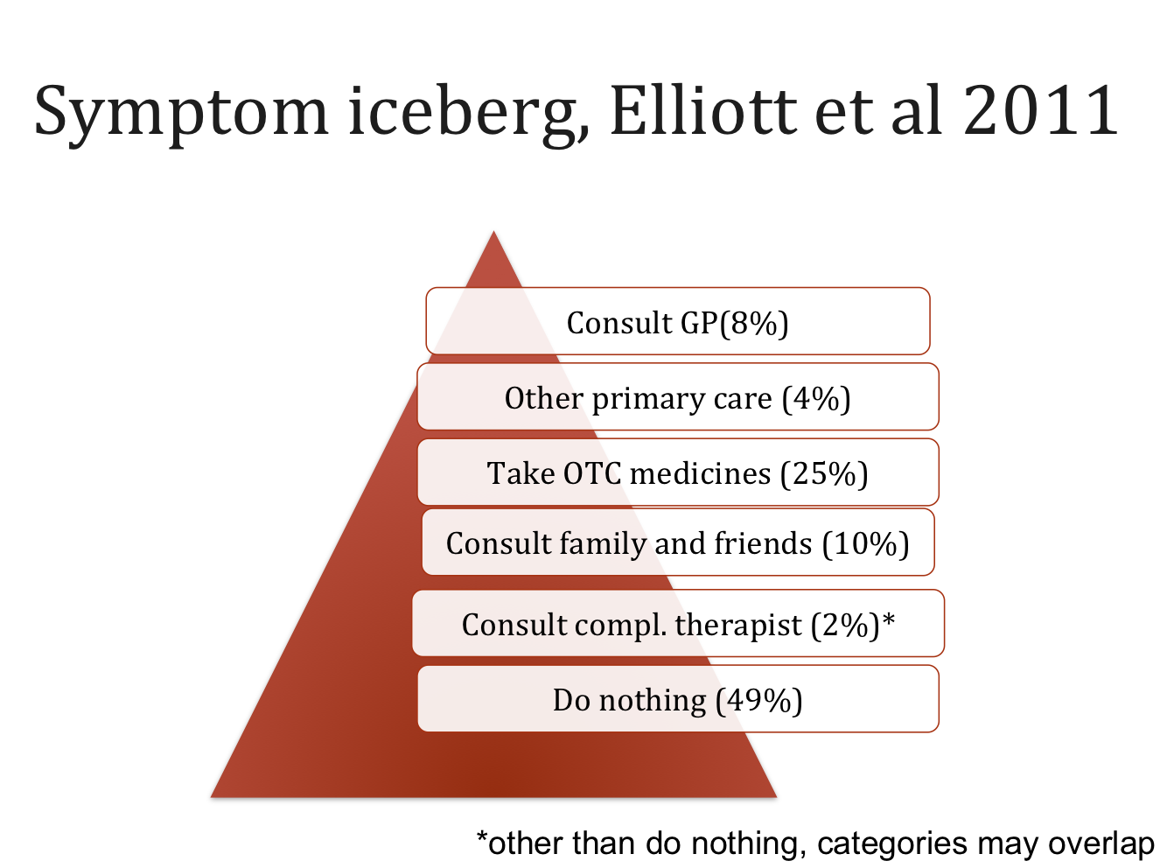
What do people do when they have symptoms?
Many do nothing
If they act they
  seek information
  talk to friends and family
  consult range of lay and professional people
  Self-medicate
8% consult GP

Slide 15
Medical pluralism
there is more than one way of explaining and treating illness
Some medical traditions are more highly regarded than others
Biomedicine is dominant, yet
  most people make use of some form of folk sector medicine
  most care occurs outside of the formal sector
Popular sector
Folk sector
Professional sector
Arthur Kleinman (1981): Types of Health Care Systems

Slide 16
Concepts of normal and abnormal
Biological normality places individual in context of population distribution
  Defined statistically (e.g. >2 standard deviations from the mean), or
  Functionally (e.g. inability to do something), or
  Based on risk (e.g. predict prognosis)
Social normality
  Expectations of behaviours
  If not normal ->“deviant” (some defined in law)
  What is “normal” varies (by group, over time)
  Social “abnormality” sometimes labeled “disease”

Slide 17
Stigma
Norms and deviance in society are also the basis for stigma
Stigma refers to a condition, attribute or behaviour which is viewed negatively and makes the bearer “deviant” in a particular society
What is stigmatising is socially, historically and culturally relative
Goffman defines stigma as (see Gabe et al 2010):
  Discredited: one’s stigma is visible to others and one is forced to manage tension engendered by it
  Discreditable: one’s stigma is hidden, one has to manage information about oneself carefully to prevent from letting this out
Notes:
Gabe et al. Key concepts in medical sociology. Freely available online (link in the course handbook).

Slide 18
Surveillance and stigma
Surveillance shows some health risks vary by social groups (e.g. HIV, obesity)
Focus on those groups can enhance stigma
For many patients the stigma attached to their disease is as incapacitating as the disease itself
Clinicians can reinforce stigma (more on this in FCA)

Slide 19
Mental health
Mental health problems affect 1 in 3 people over their lives
Physical illness a major risk factor for mental illness
Psychiatric patients have poor physical health
MH problems often seen as extreme of distribution
Stigma and fear of stigma obstructs presentation, diagnosis and care

Slide 20
Medicalisation
Medicalisation: a process by which (previously) non-medical problems become defined and treated as medical conditions
Can help validate symptoms (by labeling and proposing treatments)
But increases the power and reach of medicine and pharmaceutical companies
For Ivan Illich (1975), medicine can cause harm not only by stigmatising certain individuals but also through clinical, social, and cultural “iatrogenesis”

Slide 21
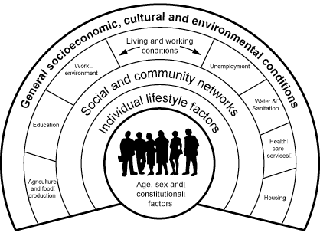
Social determinants of health
Health determined by
  age, sex, genetic factors,
  Lifestyle
  Social factors
WHO social determinants:
  The social gradient
  Stress
  Early life
  Social exclusion
  Work
  Unemployment
  Social support
  Addiction
  Food
  Transport

Slide 22
Social gradient
Health and life expectancy vary by where people are in the social hierarchy
Examples
  Life expectancy varies by social position: boys born in 2005, social class I have 7 year longer life expectancy than those in social class V (more variation in some areas)
  Whitehall study - men in the lowest grades 4 x higher mortality rate than men in the highest grade. The gradient occurs across all grades

Slide 23
Mechanisms for social gradient
Social gradient is not just about poverty
Includes lack of control in work (and life)
  Long term, chronic stress
  Alters physiological responses
    Sympatho-adrenal pathway (fight or flight)
    Hypothalamic-pituitary-adrenal axis (cortisol)
    Blood clotting systems
    Inflammation and immunity
See Brunner and Marmott, 2006

Slide 24
Social disruption and health
Direct impact
  Conflict
  Disruption to basic needs
  Disruption to health care
  Unemployment
  Alcohol
  Violence and accidents

Slide 25
Relative contribution of medicine to health: McKeown hypothesis
Demographic transition shift from short life, high fertility to longer life and lower fertility
In UK, longer life associated with reduced infectious disease: (eg TB, diarrhoea, dysentry and cholera etc. )
Thomas McKeown (1976) argued this mainly due to social improvements (rather than medical treatment or vaccines)
Recent analysis of improved life expectancy in heart disease suggests
  50% - 60% due to lifestyle change
  40% - 50% due to specific medical care

Slide 26
Quality of healthcare
Lord Darzi, 2008, described three elements of quality
  Clinical effectiveness
  Patient safety
  Patient experience - the compassion, dignity and respect with which patients are treated
Focus on patient experience a response to
  Movements for rights and democracy more widely (e.g. disability rights, women’s rights)
  Interest in person-centred care
  Expectation of better service (consumer rights)
  Commercialisation of the NHS (a way of comparing services)
Patient experience (and other parts of quality) used to rate care
Funding increasingly linked to these ratings (e.g. CQUIN - Commissioning for Quality and Innovation payments)

Slide 27
Measuring patient experience
Questionnaires widely used
  Standard questions (but may be difficult to interpret/compare)
  Family and friends test
    From April 2013 patients will be asked if they would recommend the hospital
    F&F test used in business to measure customer loyalty
Impact of drive to improve satisfaction? (conflicting evidence)
  Better patient outcome?
  Increased costs due to more repeat attendances?
For patients, often not possible to separate “experience” from clinical outcome and safety

Slide 28
    Professions
Characteristics of a profession include
  Specialised training, shared knowledge, degree of autonomy, state recognition and regulation, exclusion of others
Doctor remain one of the most trusted professions (although declining)
History of medicine as a profession
  18thC caring (few diagnostics or treatments)
  19thC classification, diagnosis, measurements (shared knowledge, excludes lay knowledge)
  19thC creation of GMC, regulation, exclusion of “quacks”, protection from competition
Nursing and others in healthcare increasingly seeking and gaining professional status

Slide 29
Health system and society
A health system reflects (and reinforces) values and structure of society
  Hierarchies by gender, social class, ethnic background
  Technology (& biomedicine) higher status than caring (& nursing)

Slide 30
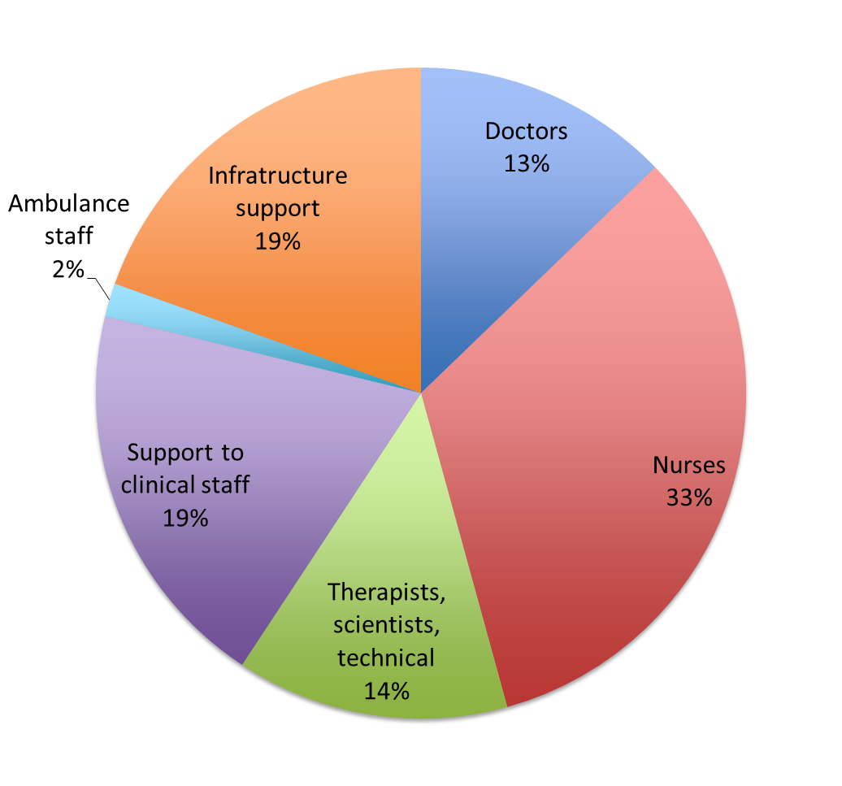
The NHS workforce
1.4 million in England in NHS
  Doctors: 13%
  Nurses: 33%
  Therapists, scientists, technical: 14%
  Support to clinical staff: 19%
  Ambulance staff: 2%
  Infrastructure support: 19%
30% growth over last 10 years
Huge shift in structure of the workforce
Changes in job roles and functions
Probably need to know most of this….

Slide 31
The NHS: challenges
Challenges
  Do no harm: avoid errors through clear
    Procedures
    Physical barriers
    Training
    Supervision
  Reduce health inequalities
  Provide uniformly good service
Principles
  Meet the needs of everyone
  Free at the point of delivery
  Healthcare based on need not ability to pay

Slide 32
The NHS: history
Founded in 1948
Early therapeutic optimism (1950s and 60s)
Cost containment and reform (1970s and 80s)
1990s – 2010: investment and reform
  Investment
  Targets
  Evidence-based and cost-effective care (NICE)
  Quality
2010 – now
  Cost containment and ongoing reform

Slide 33
NHS: recent reforms
NHS management shifting from Dept of Health and PCTs to NHS Commissioning Board (national) and Clinical Commissioning Groups (local, GP-led)
Increased competition
Any willing provider can bid for contracts

Slide 34
NHS in context
The NHS operates in global system
  Subject to international governance and regulation
  Powerful forces including pharmaceutical companies
  Provision of services subject to trade agreements
  Patients may seek care overseas
  Healthcare workers migrate

Slide 35
Patient care in context
Changes in health care (markets, rationing, targets, quality) affect patients directly
Activism and social movements also affect patients
  Example of Klawiter (2004) the effect of breast cancer activism on a single patient
  improvements in patient experience and care
  more support and care inside hospital
  more support and care outside hospital
  less tabloo and stigma
Activism (e.g. breast cancer) includes
  Patients and carers
  Health professionals
  Pharma and industries that manufacture equipment

Slide 36
Medics making a difference
As a doctor and student
  Be aware of the social situation of your patients, be non-judgemental, learn from them
  Understand the impact of social factors on disease, access to care and personal priorities
  Speak out – you can use your privilege and power
    Challenge inequalities, stigma and bigotry
    Campaign for equality and access to care
And to do that you have to pass your exams….

Slide 37
How the questions are asked:
Single BEST answer
We are not trying to trick you
No negative marking
Pass mark set to a benchmark (not ensure appropriate knowledge level

Slide 38
Society & Health/EIP in-class test format:
Single Best Answer
Which of the following fruits is red?
Kiwi
Banana
Strawberry
Blackcurrant
Orange
No negative marking

Slide 39
Society & Health/EIP in-class test format:
Single Best Answer
Which of the following fruits is red?
Kiwi 0 marks
Banana 0 marks
Strawberry 1 mark
Blackcurrant 0 marks
Orange 0 marks
No negative marking
Yes, I know a blood orange can be a bit red, but it is the single BEST answer….

Slide 40
Sample SBA 1
Which one of the following is not included in Parsons’ definition of the sick role :
The sick person has the obligation to consult expert medical opinion
The sick role mainly applies to a person suffering from a chronic illness
The sick person has a right to be regarded as needing care and being unable to get better through her own decisions and will
The sick person has the right to be exempt from normal social roles such as work
The sick person has to want to get well speedily for instance by taking the advised medical treatment

Slide 41
Sample SBA 1
Which one of the following is not included in Parsons’ definition of the sick role :
The sick person has the obligation to consult expert medical opinion
The sick role mainly applies to a person suffering from a chronic illness
The sick person has a right to be regarded as needing care and being unable to get better through her own decisions and will
The sick person has the right to be exempt from normal social roles such as work
The sick person has to want to get well speedily for instance by taking the advised medical treatment

Slide 42
Sample SBA 2
Regarding Mental Health Conditions in the UK please select the correct statement:
  People suffering from mental health conditions have the same life expectancy as the rest of the population
  Mental health conditions affect one in three people at some point in their lives
  Mental health conditions cause low levels of disability
  People suffering from mental health conditions suffer similar levels of physical illness as the rest of the population

Slide 43
Sample SBA 2
Regarding Mental Health Conditions in the UK please select the correct statement:
  People suffering from mental health conditions have the same life expectancy as the rest of the population
  Mental health conditions affect one in three people at some point in their lives
  Mental health conditions cause low levels of disability
  People suffering from mental health conditions suffer similar levels of physical illness as the rest of the population

Slide 44
Sample SBA 3
In the Whitehall study amongst a sample of civil servants, which of the following was not true:
Men in the lowest grades of employment had a four times higher mortality rate than men in the highest grade
A difference in mortality is only observed between the highest and lowest employment grades
Lack of social support may contribute to the gradient in mortality
The gradient in mortality occurs across all employment grades
Socioeconomic position and occupational grade were stronger determinants of the risk of developing cardiovascular disease, compared to any other life circumstances

Slide 45
Sample SBA 3
In the Whitehall study amongst a sample of civil servants, which of the following was not true:
Men in the lowest grades of employment had a four times higher mortality rate than men in the highest grade
A difference in mortality is only observed between the highest and lowest employment grades
Lack of social support may contribute to the gradient in mortality
The gradient in mortality occurs across all employment grades
Socioeconomic position and occupational grade were stronger determinants of the risk of developing cardiovascular disease, compared to any other life circumstances

Slide 46
Sample SBA 4
Regarding the NHS workforce, the largest employment group within the NHS is:
Doctors
Nurses
Therapists, scientists, technical
Support to clinical staff
ambulance staff

Slide 47
Sample SBA 4
Regarding the NHS workforce, the largest employment group within the NHS is:
Doctors
Nurses
Therapists, scientists, technical
Support to clinical staff
Ambulance staff

Slide 48


Good luck!
Further info on assessments on the intranet
Contact us with questions about content
  m.sbaiti@imperial.ac.uk
  h.ward@imperial.ac.uk
  s.day@imperial.ac.uk
Or discuss on twitter…?
  @profhelenward #imperialsandh
Don’t forget SOLE

