Slide 1
Healthcare workers: professions and power
Helen Ward
Professor of Public Health
13 Nov 2012
Thanks to Jane Bruton and Lara Marks for slides

Slide 2
Learning objectives
Recognise the concept of professions as one form of social stratification, and understand the changing role of the medical profession
Recognise different forms of knowledge and their changing contribution to evidence-based medicine, clinical skills, professional monopoly and asymmetries of power in healthcare
Outline the recent changes in the structure and administration of UK health services and the implications for power structures within the NHS.

Slide 3
Objective 1 Recognise the concept of professions as one form of social stratification, and understand the changing role of the medical profession:
Characteristics of a profession
Brief history of the medical profession
Professionalisation of nursing
De-professionalisation of medicine?

Slide 4
Objective 2 Recognise different forms of knowledge and their changing contribution to evidence-based medicine, clinical skills, professional monopoly and asymmetries of power in healthcare:
Relationship of knowledge to professional power
Changing nature of that knowledge
Basic knowledge and clinical skills supplemented technological advances
Evidence based medicine
Power of different professional groups
Implication of patient-centred care

Slide 5
Objective 3 Outline the recent changes in the structure and administration of UK health services and the implications for power structures within the NHS:
Nature of the NHS workforce
Recent changes in workforce
Link to next lecture

Slide 6
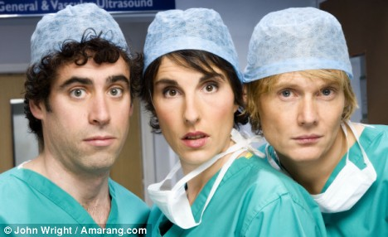
Is a profession different from an occupation?
Discuss….

Slide 7
Definitions of a profession
“Based on, or organised around, a body of specialised knowledge not easily acquired and that, in the hands of qualified practitioners, meets the needs of, or serves, clients”
“a paid occupation, especially one that involves prolonged training and a formal qualification” (OED)

Slide 8
Characteristics of a profession
Specialised training
Shared knowledge
Degree of autonomy
State recognition
Regulation
Self
State
Excludes others

Slide 9
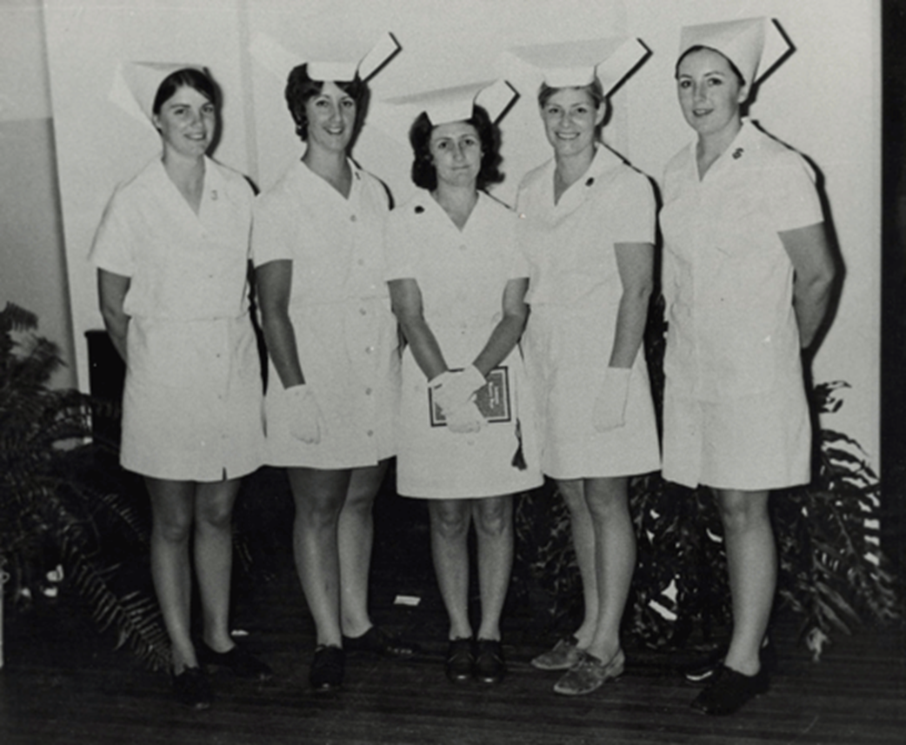
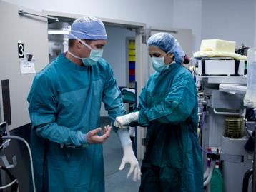
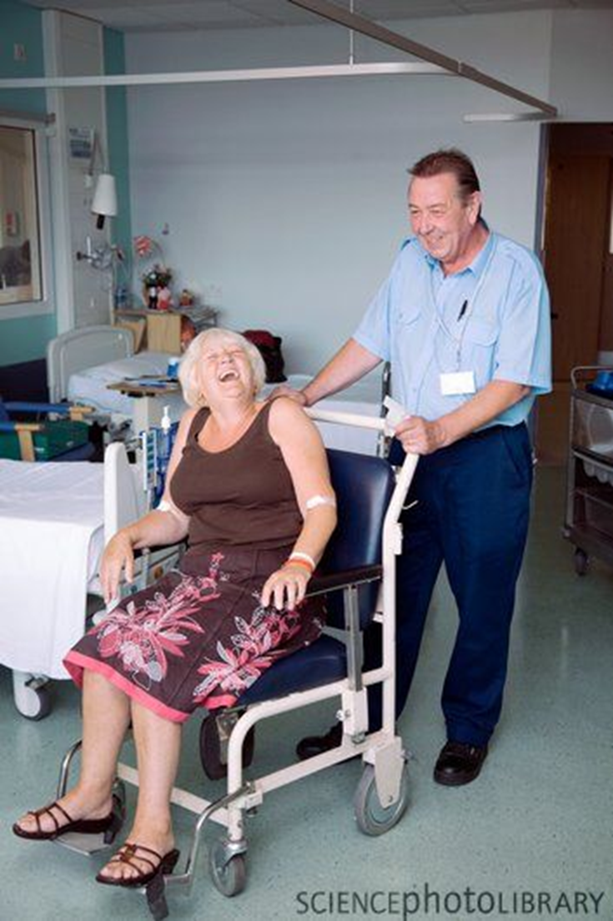
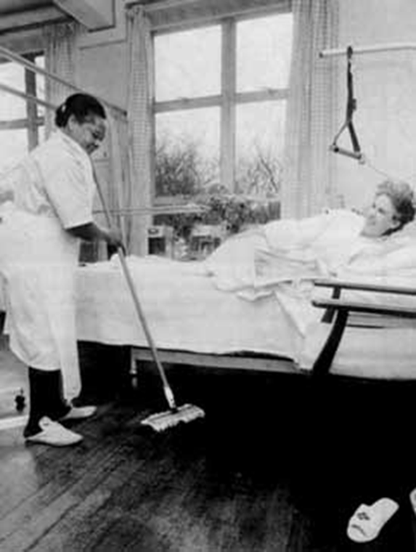
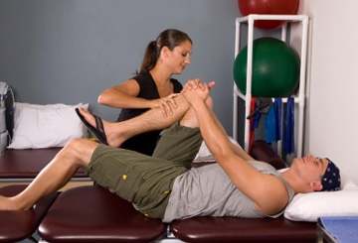
Professions in healthcare

Slide 10
Health and care professions council covers:
arts therapists
biomedical scientists
chiropodists / podiatrists
clinical scientists
dietitians
hearing aid dispensers
occupational therapists
operating department practitioners
orthoptists
paramedics
physiotherapists
practitioner psychologists
prosthetists / orthotists
Radiographers
social workers in England
speech and language therapists

Slide 11
Lots of professional groups
45 regulated professions in medicine in the UK (recognised by the EU)
1276 in all EU countries
(historically three “learned professions”
Divinity
Medicine
Law)

Slide 12
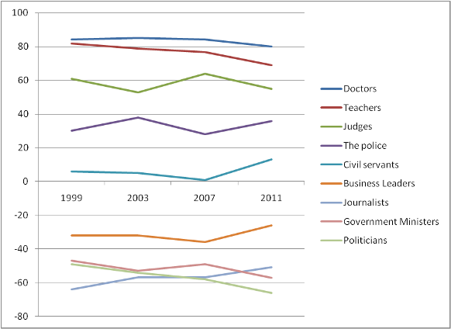
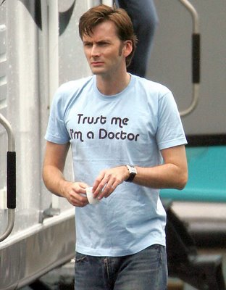
Public trust in professions, 1999 - 2011
Net index = tell the truth - not tell the truth
Source: Ipsos Mori’s veracity index, June 2011

Slide 13
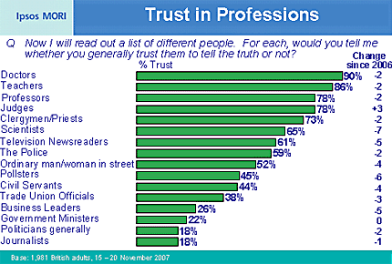
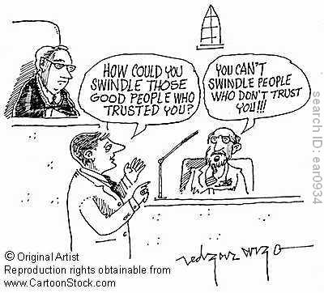
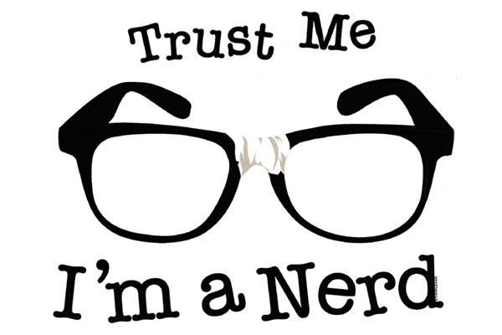
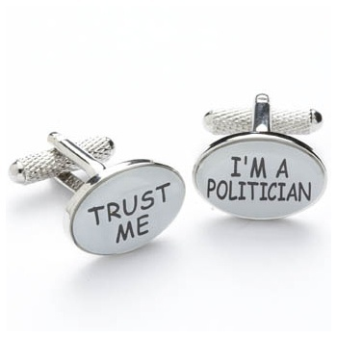

Slide 14
From occupation to profession?
A full-time occupation
School/ university course established
Associations at local and national level
Common standards and ethics agreed
Self-regulation introduced
State recognition and licensing
Sanctions again amateurs

Slide 15
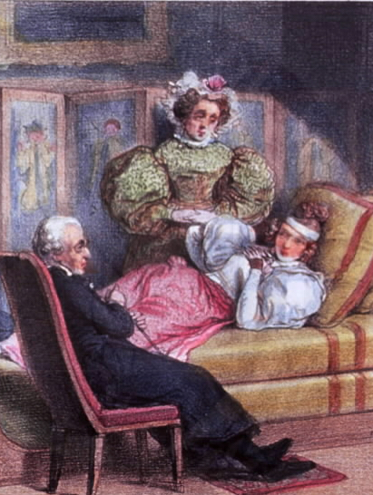
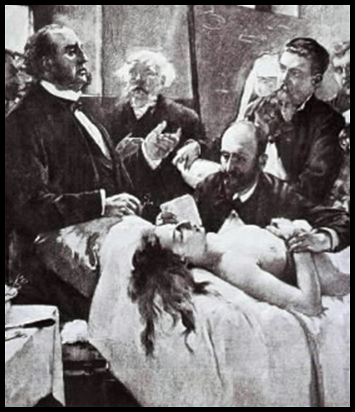
Medical profession
Up to 18th century
Doctors attended the sick
no diagnostic tools - therefore dependent on patient’s testimony
Early 19th century hospital medicine
Increased classification
Based on anatomy, dissection, structures
Diagnostic tools
Medical technology
Quantification and statistics
Later 19th century laboratory medicine
Application of natural sciences to medical problems
Histology and physiology
Clinical diagnosis & chemical tests
Home consultation c.18th century
Surgeon operating in 19th century

Slide 16
Concentration of knowledge
Medicine and knowledge of health confined to a an elite medical profession
Ideas about health and disease no longer understood by the layperson
Therapeutics and diagnosis removed from patient’s own understanding

Slide 17
Shift in focus
Before 19th century - body and health as dependent on:
individual circumstances: lifestyle, work, diet
climate and environment
developmental transitions, eg teething
19th century onwards
Shift away from person oriented medicine
Health and disease understood as specific lesions and malfunctions which had to be analysed and treated
Doctors acquired power over medical knowledge and treatment

Slide 18
Creation of medical profession*
Medical Act of 1858
established the General Medical Council
Led to the Medical Register, a public list of all recognised medical practitioners
distinguished 'qualified' practitioner from the 'quack‘
Protects physicians from competition
Enhances power and influence
see e.g. Porter 2003, and www.chstm.manchester.ac.uk/research/areas/medicalprofession/

Slide 19
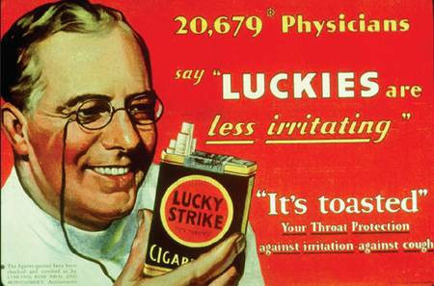

Slide 20
Nurses and doctors
Are nurses a profession?
In what way are they different from doctors?
Will they still be distinct in 25 years?

Slide 21
Challenges of Professionalism
Regulation
Nurses seeking more recognition
Doctors seeking more self regulation
The unregulated
Hierarchies of knowledge and power
Within and between the professions/workforce
Protectionism

Slide 22
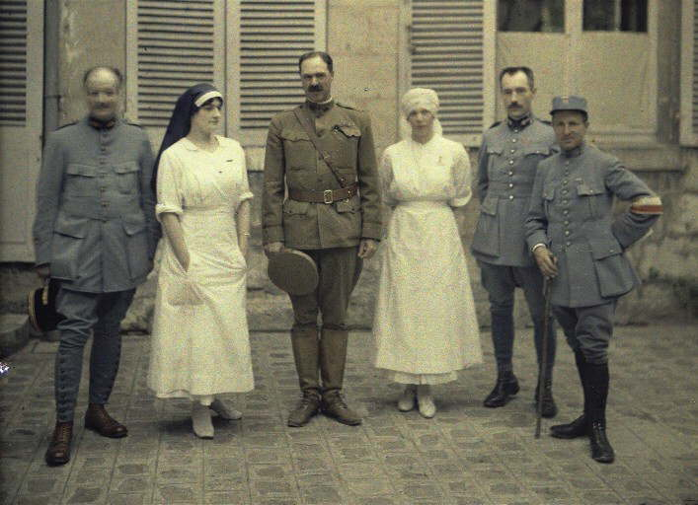
The NHS

Slide 23
The medical system is…..
“An expression of, and to some extent a miniature model of, the values and social structure of the society from which it arises”
Cecil Helman 2007

Slide 24
This results in
Inequalities gender, social class, ethnic background
Hierarchies as reflected in wider society
Prejudices and cultural assumptions about behaviour
Less value put on caring

Slide 25
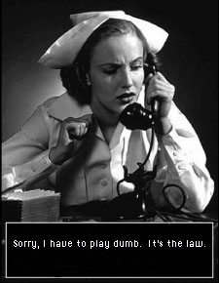

Slide 26
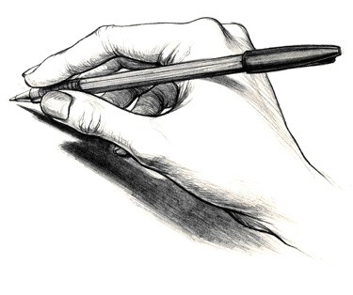
Exercise
How big is NHS (England) workforce in 2011?
854,000
1,040,000
1,350,000
1,520,000
Draw a pie chart showing relative size of 6 groups
Doctors
Nurses
Therapists, scientists, technical (AHP)
Support to clinical staff (e.g. health care assistant)
Ambulance staff
Infrastructure support (e.g. managers, estates)

Slide 27
Answers
Size of NHS workforce: _________________
Proportions
Doctors: ____%
Nurses: ____%
Therapists, scientists, technical: ____%
Support to clinical staff: ____%
Ambulance staff: ____%
Infrastructure support: ____%

Slide 28
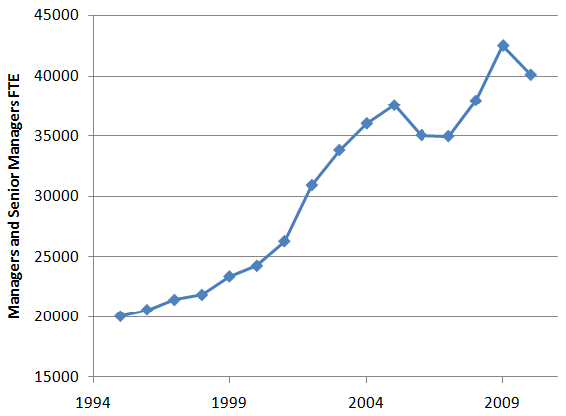
Growth in management

Slide 29
The workforce itself is changing
Contracting out of support services
Role changes
Advanced practice
Support workers
Gender
Greater % of female doctors
BME

Slide 30
Current impacts on the workforce
Changing patterns of health and illness
Internal market
Finance function
Doctors as managers
Policy changes
EWTD
Move to primary care
GPs commissioning
Patient involvement

Slide 31
Conclusion
Constant change is a given
Workforce structure
Skill set
Nature of health and illness
Social
Multidisciplinary team
Flatten hierarchies
Patient-centred care

Slide 32
References
Cecil G Helman Culture, Health and Illness 2007
OHE Guide to UK Health and Health Care Statistics, Office of Health Economics 2010
M Elston, Women and Medicine the Future June 2009 RCP
Roy Porter. Blood And Guts: A Short History Of Medicine W.W. Norton, 2003

