Slide 1
http://medicinex.stanford.edu/portfolio/medicine-x-roni-zeiger

Slide 2

Patient experience and action
Society and Health, Foundations of Clinical Practice
Professor Sophie Day
30th October 2012
Professor of Anthropology
Imperial College & Goldsmiths
s.day@imperial.ac.uk
Notes:
2

Slide 3
Learning outcome 1.
To explore the relationships between patient experience and social movements for health
  What, if any, is the relationship between an individual’s experience of health care and broader health movements?
  - citizen rights vs professional power (session 2 on the medicalisation of social life)
  - See also session 5, 27th November on patient and professional activism

Slide 4
Learning outcome 2.
To explore the relationships between patient experience, patient choice and consumerism
  Patient experience as one of three planks of Service Quality
  Measurement of patient experience, league tables & the market

Slide 5

Learning outcome 3.
To understand the impact of healthcare on patient experience using specific examples
  - preparing your PtEx survey (Module 2 FCA course)
  - Imperial NHS Trust cancer services
  - patient journeys: an example

Slide 6
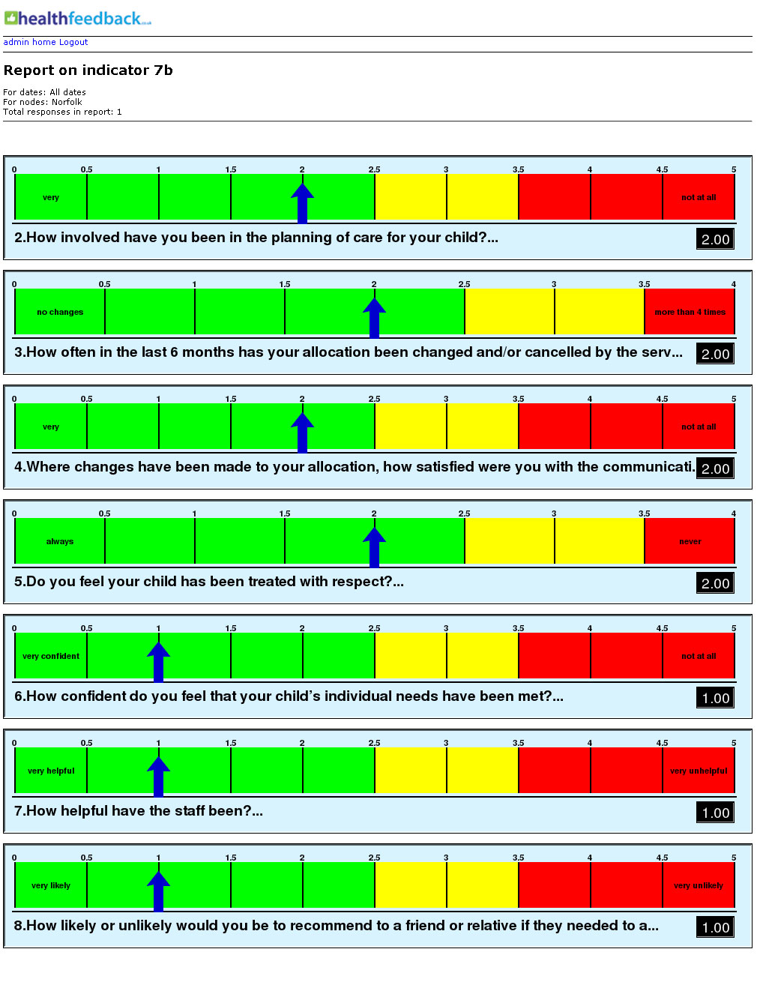
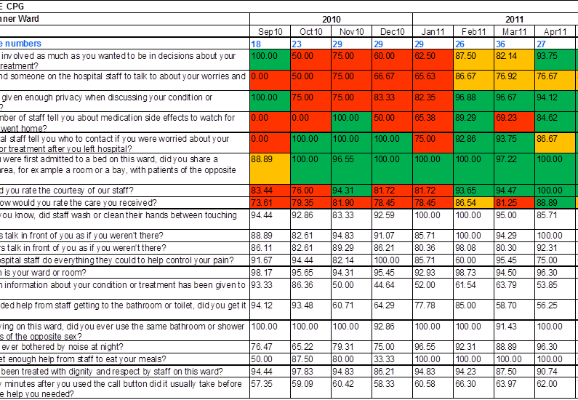
What is patient experience?
Notes:
6

Slide 7
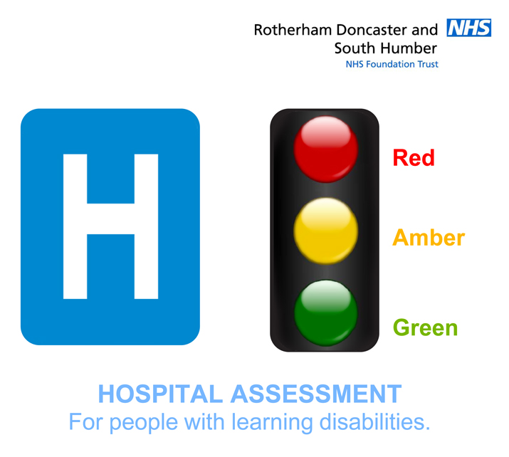

Slide 8
Lord Darzi’s definition of quality in NHS (2008)
Patient safety – means no harm is done to patients.
Patient experience - the compassion, dignity and respect with which patients are treated.
Effectiveness of care - understanding success rates from different treatments for different conditions (Also understanding effectiveness of care from the patient’s own perspective which will be measured through patient-reported outcomes measures - PROMs)
http://www.dh.gov.uk/en/publicationsandstatistics/publications/publicationspolicyandguidance/DH_085825

Slide 9
As usual lots of terms…
Quiz. What is the difference between:-
Patient experience
Patient reported outcomes
Patient satisfaction
Patient involvement
Patient engagement
And - who is at the centre of care/treatment?

Slide 10
Another definition of PtEx
Patient experience - the direct experience of treatment or care, closely related to and in turn influencing clinical effectiveness and safety
Goose M. Definining patient experience. The Kings Fund, www.kinsfund.org.uk/document.rm?id=9374

Slide 11
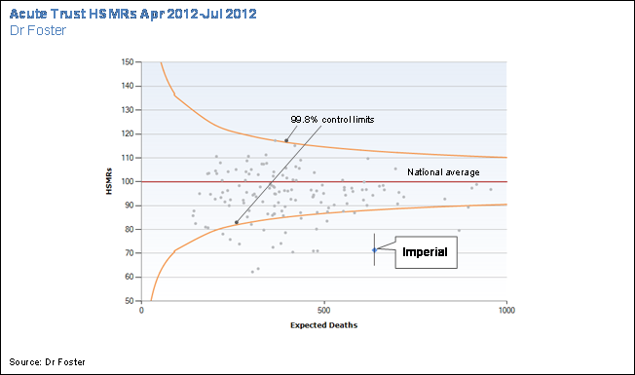

Slide 12
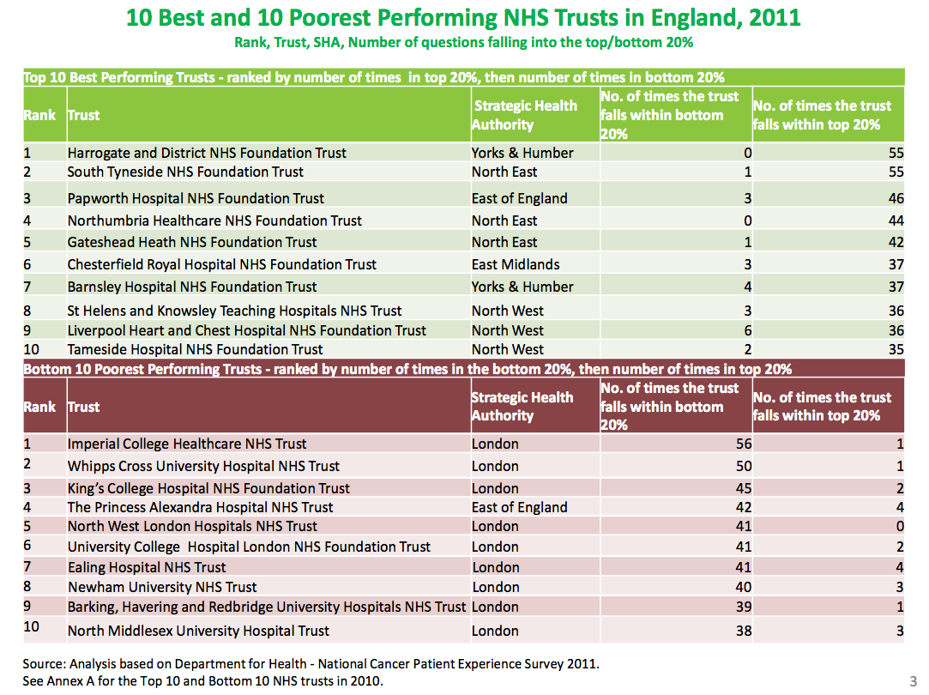
Notes:
Macmillans
http://www.macmillan.org.uk/Documents/AboutUs/Commissioners/Patientexperiencesurvey2012.pdf

Slide 13
Current emphasis on PtEx (1)
1. The impact of patient or health movements
  Citizenship and civil rights; democracy; participatory medicine associated with growing distrust science, medicine, government; dehumanising aspects of biomedicine & bureaucracies (1960s-)
  Turn to ‘person centred’ alternative and complementary treatments and to self care (especially since 1980s)

Slide 14
General, Municipal, Boilermakers and Allied Trades Union (today’s GMB)
‘Hundreds of GMBATU members employed in making or handling town gas, dyestuffs, rubber goods, asbestos … have been killed by the [substances] they worked with. They suffered, then died, from cancer. In many cases, important clues to the cancer risks were ignored, sometimes for decades, by their employers and government departments responsible for their health…”
Cancer and Work: Guidelines for Workers Taking Collective Action over Health Hazards p.348
Notes:
GMB is a general trade union in the United Kingdom, and has more than 617,000 members.
Many mergers
Gmbatu = 1982 merger

Slide 15

1920s gas workers complain of early deaths
  1950s excess lung and bladder cancer shown conclusively by epidemiologists
1930s dyestuffs & rubber workers complain of early deaths
  1950s excess bladder cancer (earlier in Germany and Switz)

Slide 16
GMBATU action towards health provision and disease prevention
Including otherwise patchy or absent
Use of substitute chemicals
Handling in closed systems with monitoring
Risk information and training
Labelling (‘cancer hazard’) & protection
Medical and epidemiological checks
No fault compensation

Slide 17
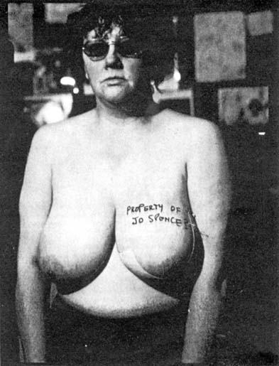
Jo Spence
(1934, London -1992)
© Jo Spence Memorial Archive

Slide 18
Current emphasis on PtEx (2)
2. Customer service (‘patient satisfaction’)
  Consumer society (related to civil rights movements above)
  The growth of markets in NHS
  Patient experience as a management tool for audit (2000s-) associated with de-professionalisation, ratings, constant change

Slide 19

Tesco 5 item score
Clear aisles
No queues
Stocked
Helpful staff
Clean

Slide 20
A sample CQUIN style report using linear meters
http://www.healthfeedback.co.uk/wp/?page_id=23
Notes:
Omit?

Slide 21
CQUIN Framework
CQUIN framework links a proportion of English healthcare providers' income to local quality improvement
ICHT’s local CQUIN goal of improving staff courtesy and three of the national CQUIN questions:-

Slide 22
What do the questions mean?
Local ICHT patient experience CQUIN and ICHT core question:
Q1 How would you rate the courtesy of the staff?
National patient experience CQUIN and ICHT core questions:
Q2 Were you involved as much as you wanted to be in decisions about your care and treatment?*
Q3 Did you find someone on the hospital staff to talk to about your worries and fears?
Q4 Were you given enough privacy when discussing your condition or treatment?
(3 or 4 categories of response from excellent to poor, yes to no / na.)

Slide 23
Maternity & GUM
Some women drew a distinction between care and treatment. Some women did not think that they should or could be involved in decisions about certain aspects of medical treatment:
“your treatment has to be given; it's a set treatment really, isn't it” (Maternity - 2nd baby, birth centre)
“I don't know what it means by were you involved as much. I mean it's basically their decision that I should do the test, so you know there's nothing to be involved with really” (GUM – male, over 29 years)

Slide 24
Pancreatic cancer
Another example from Founder of Healthtalkonline.org – it can be inappropriate to involve a patient any further
http://www.healthtalkonline.org/Improving_health_care/shared_decision_making/People/Interview/2577/Category/503

Slide 25
Difficulties of interpretation
Commonly more than one care or treatment interaction in journey
The best or worst may be most salient and overshadow the others
It may be difficult to calculate an average across your journey
PtEx response can also refer to clinical outcome and safety

Slide 26
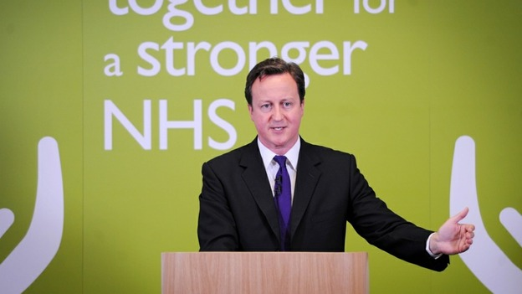
The family and friends test
From April 2013, every NHS hospital will be required to ask patients in A&E & on wards whether they would want a friend or relative to be treated there. The Prime Minister says the results will be made public so ‘everyone will have a really clear idea of where to get the best care’ which will ‘drive other hospitals to raise their game’.

Slide 27


‘what gets measured gets managed’
Net Promoter Score (NPS) – a customer loyalty metric that businesses including Apple, Philips and American Express used to test customer views
The King’s Fund Blog (Jocelyn Cornwell)

Slide 28
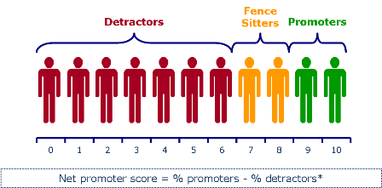
The 7DS Net Promoter Score (NPS) is a client survey system used to measure customer loyalty for companies in and around the real estate and mortgage industries.http://www.renps.com/
Satisfaction-profit chain aims to improve customer retention, loyalty & repeat business often using proxy of quality of personal interactions

Slide 29
So: what might you be measuring?
Difficulties of designing questions and interpreting answers
Timing, e.g. 2-6m after discharge
Relationship to safety and outcome. Not the same as Tesco satisfaction?
Ratings and pay, making markets

Slide 30
For healthcare workers – ‘cost’?
Reported poor experiences of doctor-patient interactions in a London NHS Trust Hospital
  Poorly designed questionnaire
  Badly analysed (statistics)
  Aren’t the others (e.g. nurses) as bad as us?
This ‘3-stage denial’ shifts to ‘patient experience is everyone’s business!’

Slide 31
For healthcare workers – or ‘opportunity’?
A focus on PtEx allows you to think about
What is the doctor’s role and influence when -
  A disease is also an illness and a sick role?
  A health problem is embedded in a person’s everyday life and social networks?
Your assumptions about people
The time it takes to listen and respond eg to take a social history
The issue of social distance, stereotypes, the active patient, Joint investment in ‘therapeutic optimism’
  See the ‘terminology’ clip at http://www.healthtalkonline.org/heart_disease/Congenital_Heart_Disease/Topic/2198/
  Different diagnostic procedures /ethnicity (cancer, USA): Krupat E, Irish JT, Kasten LE, et al. Patient assertiveness and physician decision-making among older breast cancer patients. Soc Sci Med. 1999;49:449-457.
Notes:
Eg - In one study using hypothetical patients,researchers found that physicians recommended more intensive cancer diagnostic procedures for a white woman regardless of her communication behavior but recommended the same procedures for a black woman only when she was assertive in asking about the tests in the scenario.

Slide 32
Impact of PtEx
The relationship between experience, safety and clinical outcome is complex
A study in USA* showed better patient satisfaction scores associated with fewer readmissions. The effect was higher than for clinical performance measures
Goals to improve PtEx ratings may also promote tests and therapies which affect safety or equity negatively
*Boulding et al, Am J Manag Care. 2011;17(1):41-48

Slide 33
The cost of satisfaction*
Prospective US study of 51,946 adults (2000 – 2007)
Patients with highest satisfaction were
  Less likely to have an emergency dept visit
  More likely to have an inpatient admission
  Greater total expenditures including drug costs
  Higher mortality (adjusted hazard ratio, 1.26)
Difficult to interpret - ?overtreatment of satisfied people
*Fenton JJ et al. Arch Intern Med 2012;172:405–11.

Slide 34
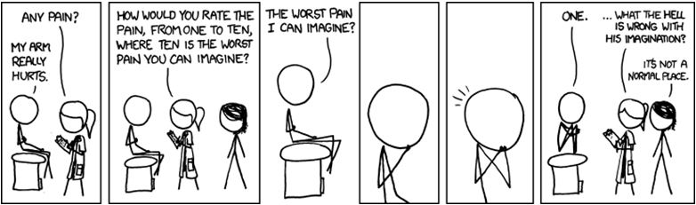
Patient reported outcomes
© Wes Chapman blog

Slide 35
Notes:
Macmillans
http://www.macmillan.org.uk/Documents/AboutUs/Commissioners/Patientexperiencesurvey2012.pdf

Slide 36
Chemotherapy examples
The staff are great BUT
- missing notes and muddles in e.g. referral, diagnosis, treatment
-transport: cost, parking, infirmity
-waits, waits and waits along with lack of information and communication
-poor integration of different services and hospitals
The staff are great BUT
- if they weren’t so busy and if it weren’t that they had to deal with this ‘system’, I might complain
- Varying boundaries between them and us
- High PtEx scores, why?
Notes:
- A patient’s wife wonders if he will eat again and how to get to hospital every day over the fortnight. He can’t travel by public transport.
- A nurse explains that now a transport division deals with this issue; nurses are not allowed
- An intervention leads to assessment for assistance
The wife brings her sister and daughter to live with her from another country
Clinical interface vs managerial backroom. It’s the system. Vs. it’s the staff. Them and us. Us now includes patients and frontline health care staff. Them now - not seen (managers, government, financiers etc)
eg correlation with political views (regardless of health care use) SD to find ref**
Urdu

Slide 37
Free text comments from patients in NCPES
Point one - listen to patients
Breast cancer patient: "Just one thing. I know my body better than anyone, if I say to the doctor something is not normal or wrong, then it`s not normal. Doctors should realise our concerns about something and try to rectify it to our satisfaction, not say leave it, it`ll go in time...it doesn`t and all the time there is discomfort and pain."

Slide 38
Point two - patients can help you improve the services
  Gynae cancer patient: "Fast track to a cancer specialist when temperature goes up whilst in the chemo cycle. Going to A and E and spending 6 hours waiting for doctors/test results/bed in ward is a nightmare.”
  Lung cancer patient: "It would be good to have much more information given about - financial support etc available. Wigs on NHS. Support groups and services. Exercise we should do after specific operations - that would also speed up recovery. Leaflets re: the above would be very, very useful."

Slide 39
Point three - many patients are "grateful" and may have low expectations
Lung cancer patient: "I did not die, anything else would be a little picky."

Slide 40
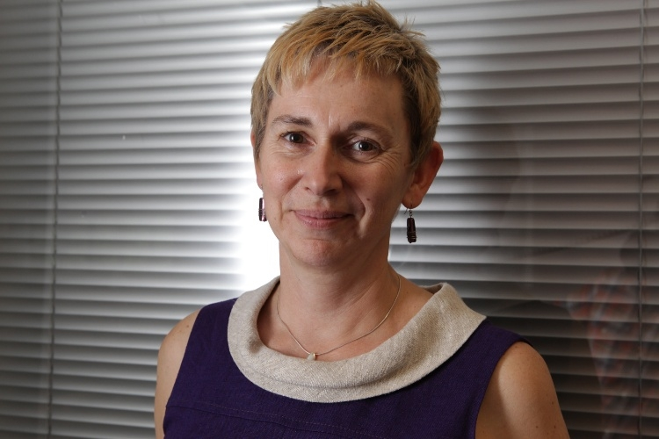
A patient journey
Introducing an experience and its relationship to safety and clinical outcome
What can be measured and said?
Notes:
The importance of narrative
Patient experience is a social experience and social factors mediate care, treatment, safety & outcome

Slide 41
An experienced patient
Atrial-septal defect
Arrhy-thmia
Renal failure
Neuro-pathy
Post-op bleed
ITU Delirium

Slide 42
An experienced patient – “and a cast of thousands”
Atrial-septal defect
Arrhy-thmia
Renal failure
Neuro-pathy
Post-op bleed
ITU Delirium
Haematologist
GP
Vascular surgeon
No-one?
Renal physician
ITU consultant
Cardiologist
Neurologist
Cardiac electrophysiologist

Slide 43
Summing up my experience (1)?
I’m alive
Serious complication
Inadequate explanations
Difficult decisions
  Where to go if…
Additional difficulties as a doctor/colleague
  Self-management
  Informal network of other doctors

Slide 44
Summing up my experience (2)?
One of the most interesting experiences of my life
Ongoing care remains difficult
  The system often forgets
  it is up to me to make things happen
The huge contribution to healthcare made by
  Other patients
  Family and friends

Slide 45
Domains of Patient Experience
Respect for patient-centred values, preferences and expressed needs
Co-ordination & integration of care
Information, communication & education
Physical comfort
Emotional support
Welcoming the involvement of family & friends
Transition and continuity
Access to care
(Adapted from NHS PtEx Framework in Matthews & Cornwell 2012)

