Slide 1
The NHS: what matters most?
Professor Sir Liam Donaldson
13 November 2012

Slide 2
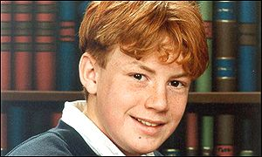
Notes:
Wayne jowett – same age as students? (killed in 2001)

Slide 3
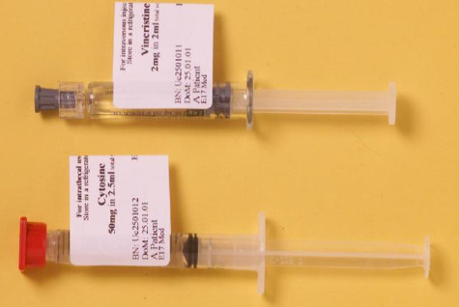
Notes:
Two drugs – similarities:
Colourless fluid
Similar size
Similar amounts
* Both could be connected to a spinal needle *

Slide 4
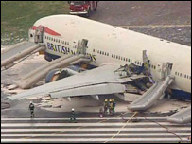

Slide 5
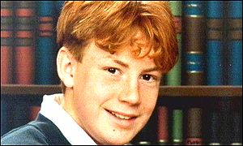
The Swiss Cheese model
Procedures
DEFENCES
Physical barriers
Training
THE GAPS
Supervision
Lack of clear
protocols
Drugs: problems with design, packaging and delivery
Lack of knowledge and experience
Tragic death
Seemingly unavailable
Adapted from Professor James Reason
Notes:
Returning to the case of Wayne Jowett……

Slide 6
Challenges for the NHS?
Primum non nocere (First, do no harm)

Slide 7
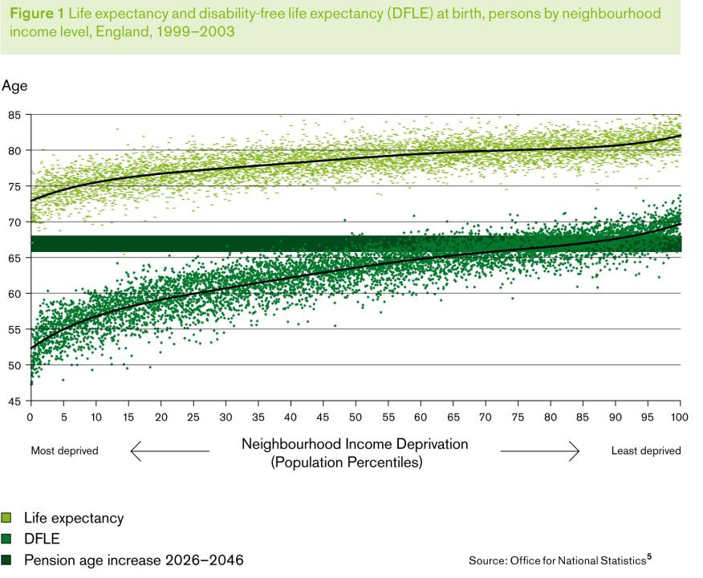

Slide 8
Differences in Life Expectancy within a small area in London
Travelling east from Westminster, each tube stop represents nearly
one year of male life expectancy lost
Canning Town
Westminster
Canary
Wharf
London Bridge
North
Greenwich
River Thames
Bermondsey
Canada
Water
Waterloo
Southwark
London Underground
Jubilee Line
¹ Source: London Health Observatory based on Office for National Statistics data
Notes:
Health inequalities are sometimes incorrectly viewed as a feature of years gone by
Today they still exist and can be stark
As one moves east on the Jubilee line from Westminster, life expectancy falls by a year at every stop

Slide 9
Challenges for the NHS?
Primum non nocere (First, do no harm)
Reduce health inequalities

Slide 10

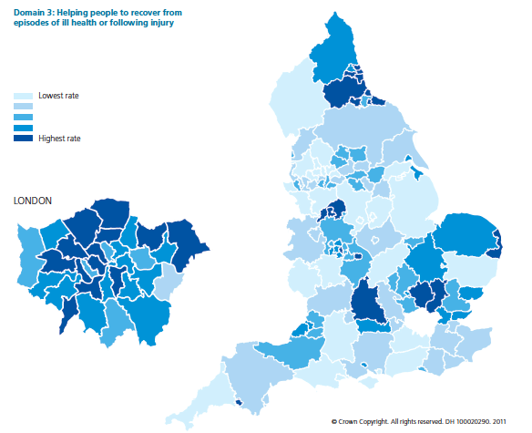

Slide 11
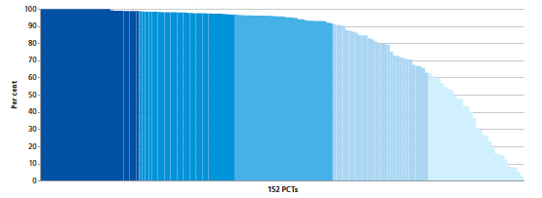
10-fold variation

Slide 12
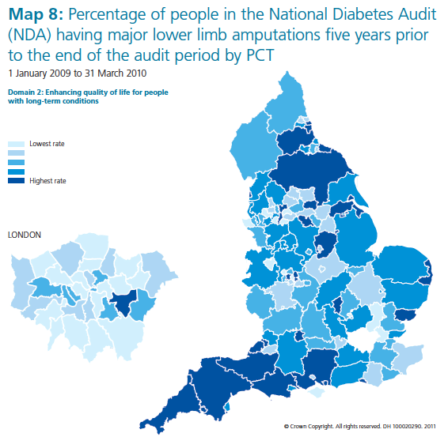

Slide 13
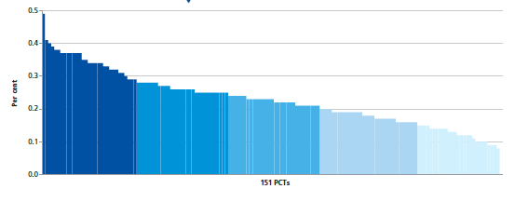
5-fold variation

Slide 14
Challenges for the NHS?
Primum non nocere (First, do no harm)
Reduce health inequalities
Provide a uniformly good service

Slide 15
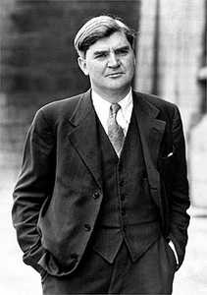
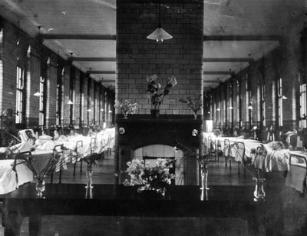
Birth of the NHS: 1948

Slide 16
NHS: Founding principles
Healthcare that meets the needs of everybody
Healthcare that is be free at the point of delivery
Healthcare that is based on clinical need, not ability to pay

Slide 17
E H Shepherd. Those who are about to die salute you. 1946. Ink on paper.
Punch Magazine
Notes:
In modern times, cartoons, too, make their statements about public health. This wry observation by the Winnie the Pooh illustrator, E. H. Shepherd, reflects on the conflicts which attended the introduction of the National Health Service.

Slide 18
Birth of the NHS: The deal in 1948
GOVERNMENT - guaranteed access
- determined budget
PUBLIC - health care entitlement
- paid taxes
PROFESSION - safeguarded standards
- delivered care
Notes:
“Access is mediated by a tradition of "surreptitious rationing" based on the "5 D's" of
delay,
defer,
deter,
dissuade, and
decline.”

Slide 19


The first 50 years of the NHS
1948: the birth of an ideal of universal coverage
1950s, 1960s: the era of therapeutic optimism
1970s, 1980s: the dawn of cost containment
and structural reform

Slide 20
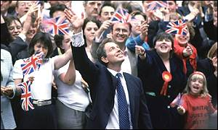
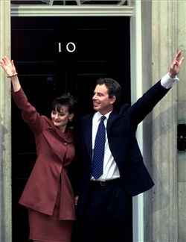
1997

Slide 21
Challenges: Expenditure
Source: WHO statistical information system
Notes:
UK at 7% and US at 13%
Blair pledge to meet EU average
UK spending on healthcare has consistently lagged behind other developed countries.
Since 1960 Organisation for Economic Co-operation and Development (OECD) countries
have on average increased health spending per capita by 5.5% in real terms compared
with only 3.6% in the UK.
Between 1979-1997 the average annual increase in Government spending on health
was even less – just 2.9%. And real terms funding in England has veered between
under 0% and over 6% a year. This erratic pattern of spending has impeded planning
for the shorter, medium and long-term.
(from NHS Plan 2000)

Slide 22
Challenges: Mortality
Source: OECD, 2007
Notes:
Aim to “reduce substantially the mortality rates from major killers by 2010; from heart
disease by at least 40% in people under 75; from cancer by at least 20% in people
under 75; and from suicide and undetermined injury by at least 20%. Key to the
delivery of this target will be implementing the National Service Frameworks for
Coronary Heart Disease, and Mental Health and the National Cancer Plan”
(from NHS Plan 2000)

Slide 23
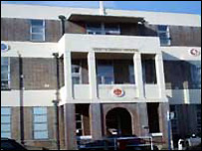
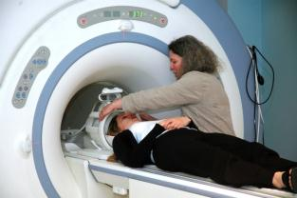
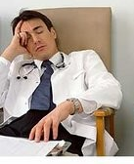
Challenges: Infrastructure 1998
1.8 doctors per 1,000 pop^{n} (EU average 3.2)
1/3 buildings pre-1948
Only 110 MRI scanners
Notes:
1997 - MRI: fewer than 500 000 scans performed annually
2007/8 - MRI 1,471,818 scans done
In 1997 – 110 scanners
By 2008 – 287 scanners

Slide 24
Challenges: Access 1998
Quarter of a million people
waiting more than 6 months!
Patients waiting average of
4 months for hospital admission!
Over 1 million patients
waiting for operations!
6 weeks
average delay
to be seen in
outpatients!
Source: Department of Health
Notes:
IN 1998:
Patients waiting average of 4 months for hospital admission
Over 1 000 000 patients waiting for admission
Quarter of a million people waiting more than 6 months for admission
6 weeks average delay to be seen in outpatients

Slide 25
Phase 1: 1997-2000
Reforms under Labour
“We are near to the bottom of the European League Table”

Slide 26
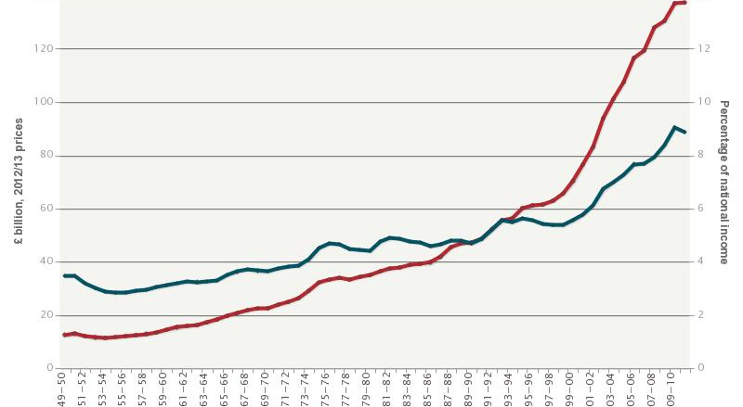
Sustained funding increases
NHS spend (% of GNI)
NHS spend (£bn)
Source: OECD
Notes:
UK spending has significantly increased to level of previous EU average,
But others have increased at similar rate

Slide 27
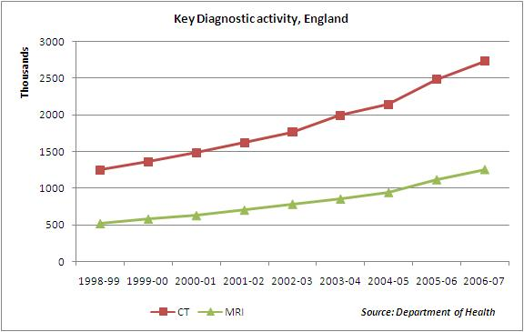
Use of key diagnostic facilities
Increasing diagnostic capacity
Notes:
1997 - MRI: fewer than 500 000 scans performed annually
2007/8 - MRI 1,471,818 scans done
In 1997 – 110 scanners
By 2008 – 287 scanners

Slide 28
More clinicians

Slide 29
Phase 1: 1997-2000
Reforms under Labour
“We are near to the bottom of the European League Table”
Phase 2: 2000-2007
“We have public service values but traditional public service attitudes”

Slide 30
National targets for access
4 hours Emergency Department treatment
2 weeks Specialist Chest Pain clinic
Specialist cancer diagnosis
18 weeks From referral to acute elective treatment
Notes:
30

Slide 31
Improving access times
1999 2000 2001 2002 2003 2004 2005 2006 2007 2008
Notes:
Average wait for admission in 2007/8 - 4 weeks (was 13 weeks in 1997)
Inpatient waiting > 6 months – 60 (was 284 000 in 1997)
556 000 patients waiting for admission (was >1,000,000 in 1997)
Outpatient average wait: <3 weeks (was >13 weeks in 1997)

Slide 32


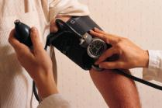
NICE guidance
  Cost-effectiveness assessment of medications and healthcare technologies
NHS Evidence
  Internet-based search engine for
  evidence of effectiveness and
  examples of best practice
Quality & Outcomes Framework
  Primary care incentive scheme based
  on key clinical indicators

Slide 33


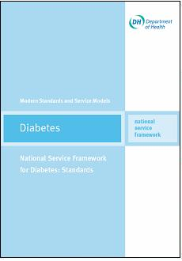

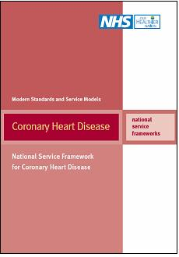


National Service Frameworks
1999
Mental Health
2000
Heart Disease
2001
Diabetes
2004
Children
2005
Long Term Conditions
2005
Older People
2004
Renal

Slide 34
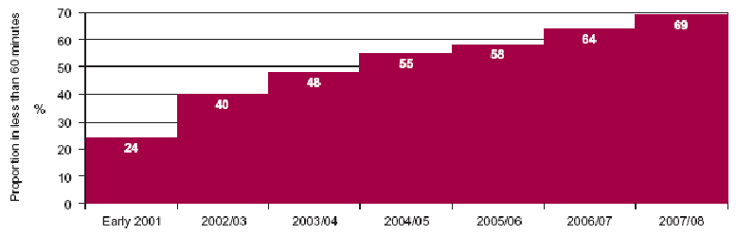
Process targets
Percentage receiving thrombolysis within an hour of calling an ambulance

Slide 35
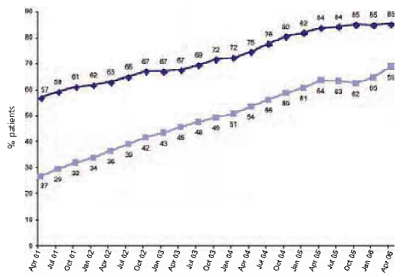
Percentage of Coronary Heart Disease patients achieving blood pressure and cholesterol targets
Outcome targets
Blood pressure <150/90
Cholesterol <5mmol/l

Slide 36
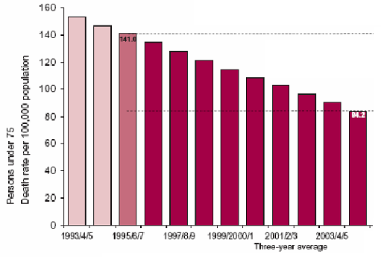
Outcome targets
Coronary Heart Disease mortality
40% reduction
Achieved four years
ahead of target

Slide 37
Clinical governance
“A framework through which NHS organisations are accountable for continuously improving the quality of their services and safeguarding high standards of care by creating an environment in which excellence in clinical care will flourish.”
Source: A First Class Service: quality in the new NHS, London: Stationery Office, 1998

Slide 38
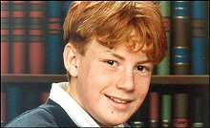


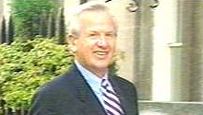
Preventing harm
from poor practice
from the system
from badly managed
organisations

Slide 39
Phase 1: 1997-2000
Reforms under Labour
“We are near to the bottom of the European League Table”
Phase 2: 2000-2007
“We have public service values but traditional public service attitudes”
Phase 3: 2008-2010
“We need to make quality the organising principle of the NHS”

Slide 40


Slide 41
What is a Good Doctor?
Clinical skills
Notes:
In order that the clinicians can function and avoid the dangers of isolation they need a supportive and committed organisations supporting them that is visibly and vocally committed to the use of the checklist.

Slide 42
What is a Good Doctor?
Clinical skills
Quality skills
Notes:
In order that the clinicians can function and avoid the dangers of isolation they need a supportive and committed organisations supporting them that is visibly and vocally committed to the use of the checklist.

Slide 43
What is a Good Doctor?
Clinical skills
Quality skills
Leadership skills
Notes:
In order that the clinicians can function and avoid the dangers of isolation they need a supportive and committed organisations supporting them that is visibly and vocally committed to the use of the checklist.

Slide 44
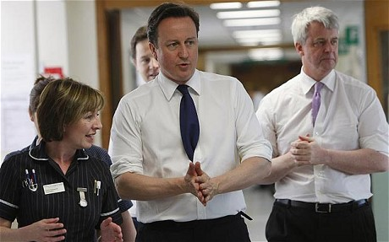
2010

Slide 45


Slide 46
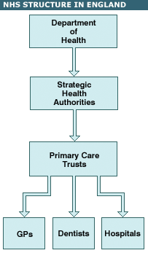

Slide 47
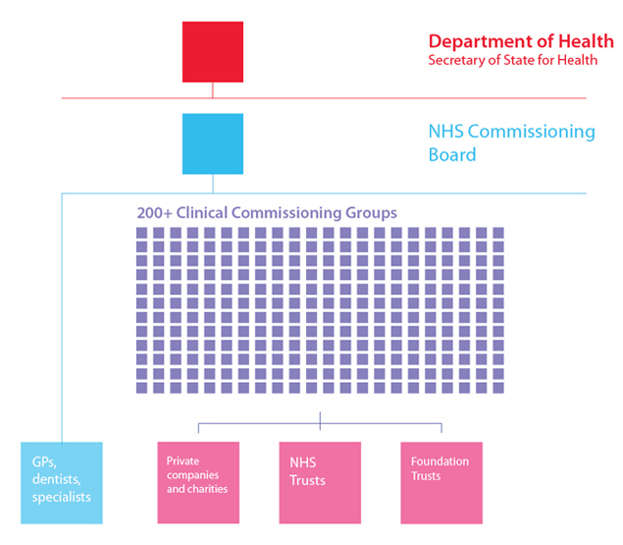

Slide 48
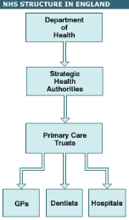

What changes?
NHS management separate from Department of Health (NHS Commissioning Board)
More competition
Commissioning more clinically-led
Focus on outcomes

Slide 49
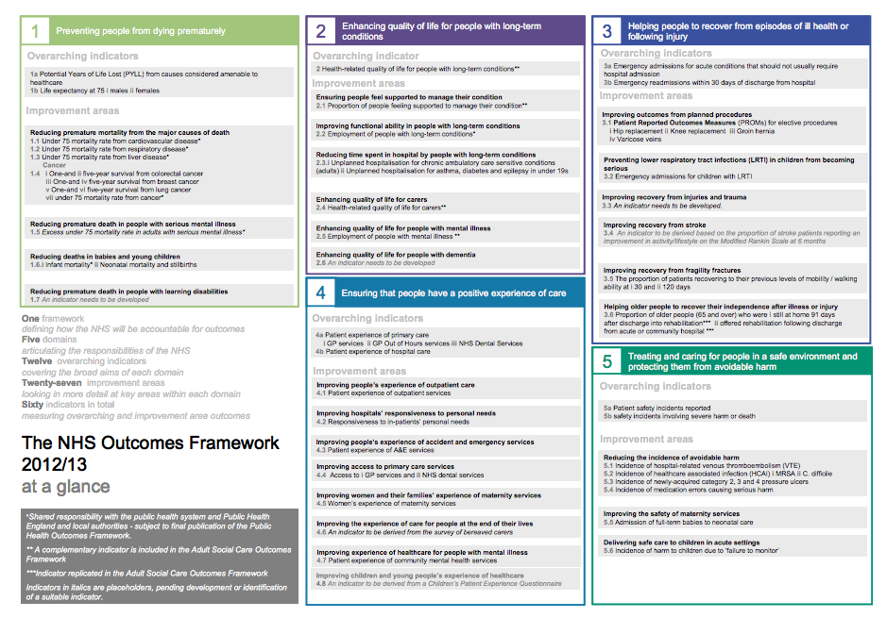

Slide 50
The challenge for healthcare
Increasing healthcare costs
Ageing population
Growth of medical technology
Rising expectations
Epidemic of chronic disease
Achieving excellence consistently

Slide 51
Big questions for the future
Can the NHS stay true to its founding principles?
Can we increase quality while decreasing cost?
When can we promise parents that their children are safe in our hands?
Can prevention really work?
What will you do to make the NHS better?

