Slide 1
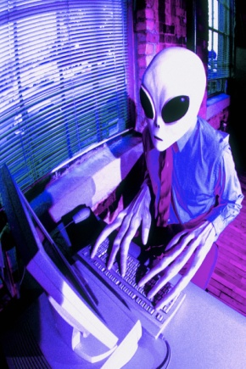
Introduction to your Information Technology Facilities - Foundations of Clinical Practice Dr Mike Barrett Head of Learning Resources Faculty of Medicine
School of Medicine
Photos.com
October 2012

Slide 2
Content
Course Summary
PC Lab Sessions
Where to find things online
Printing
Security
Pitfalls

Slide 3
Duties of a Doctor include
… keep your professional knowledge and skills up to date
… respect patients’ dignity and privacy
… respect and protect confidential information
GMC

Slide 4
Learning objectives of the Course
Appreciate need for an professional approach to use of IT
Use the time to gain an understanding of the IT facilities, the correct way in which they are to be used, and where to obtain further information
Opportunities to revisit some basic IT skills or new ones to be learnt
Develop information literacy skills … to become an independent learner with the confidence and ability to retrieve, evaluate, exploit and manage information

Slide 5
Study Guide
Advice – including ergonomics
Skills and Objectives
Coping in the IT Sessions
It includes…
What you get
What you can/can’t do
Where
When
Managing:
Computer account
Data & Information
...Safely
...Legally
...Ethically

Slide 6
The IT/Information Literacy Course
Lectures
IT : introduction to facilities
Library : introduction
Practical timetabled sessions
Awareness of IT systems (next week)
Information Literacy – on-line modules (see timetables)

Slide 7
Not activated your IC computer account yet?

Slide 8
Please…
Read the Course Guide
Identify your strengths and weaknesses in IT competencies
Initiate your Computer Account
Attend in the PC lab at the allotted time next and following weeks for
Intro to IT (check day and time)
Information Literacy Workshops (check day and time)
Bring ID card - it’s required to access PC suite

Slide 9
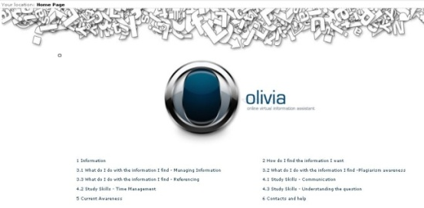
Library - Information Literacy
Lecture
Workshop 1 - check group timetables
Stick to allotted time
On-Line modules - OLIVIA
Finding the right stuff
Using information correctly (including not plagiarising)
Essential for
PBL Years 1 & 2 and BSc
Essays/Reports/Reflections
your career

Slide 10
Gaining awareness session (Monday/Tuesday)
Stick to allotted time and bring the IT and Blackboard Guides
Pre-read the Guides
Use College email and web access
Explore Teaching intranet and locate timetables
Try Discussion Boards in Blackboard
Locate My e-Portfolio
Locate and explore Imperial Mobile, My Imperial, ICT & Library websites
PrintService – try the devices and change settings in the Printer Driver. Try Scan-to-Email
Consider if any IT skills need refinement

Slide 11
Locations of PC clusters
SAFB – Ground Floor - 2 PC labs
CX Reynolds Building (i) Library (Level 2), and (ii) ICT Offices (Basement)
St Mary’s Hynds Lab. 1st Floor Medical School Building
Chelsea & Westminster Library LG Floor
Hammersmith - Cyclotron Building 7th Floor - Commonwealth Building Library and 6th floor - Wolfson Education Centre Student Common Room
Associated University Teaching Hospitals

Slide 12
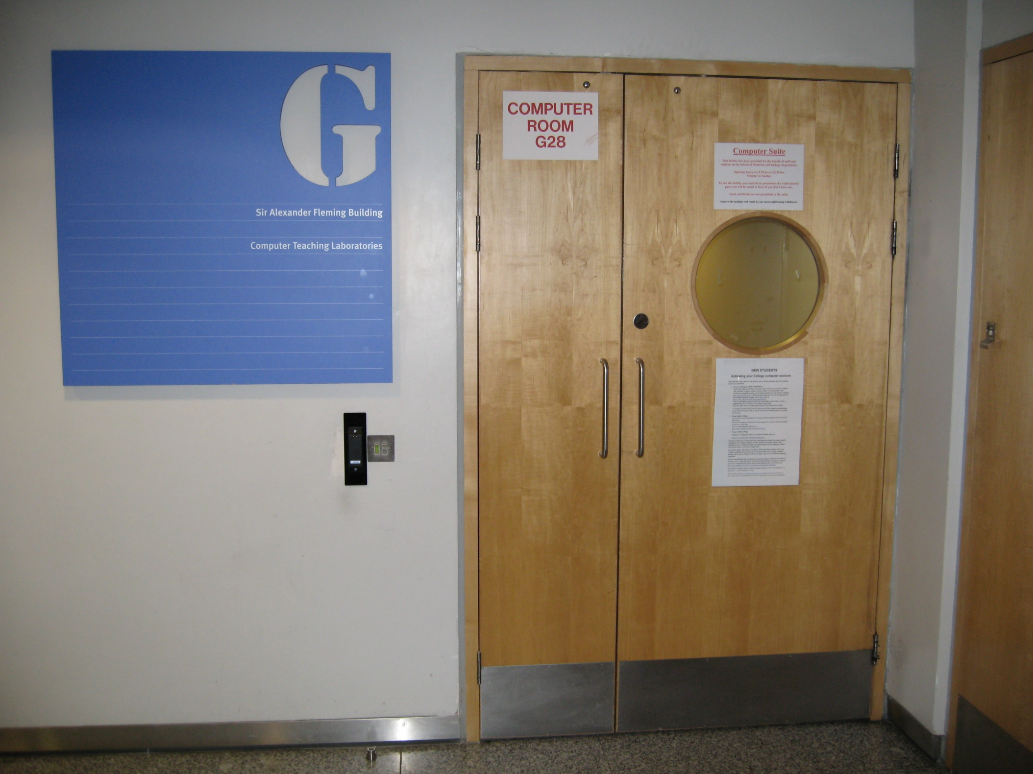

Slide 13
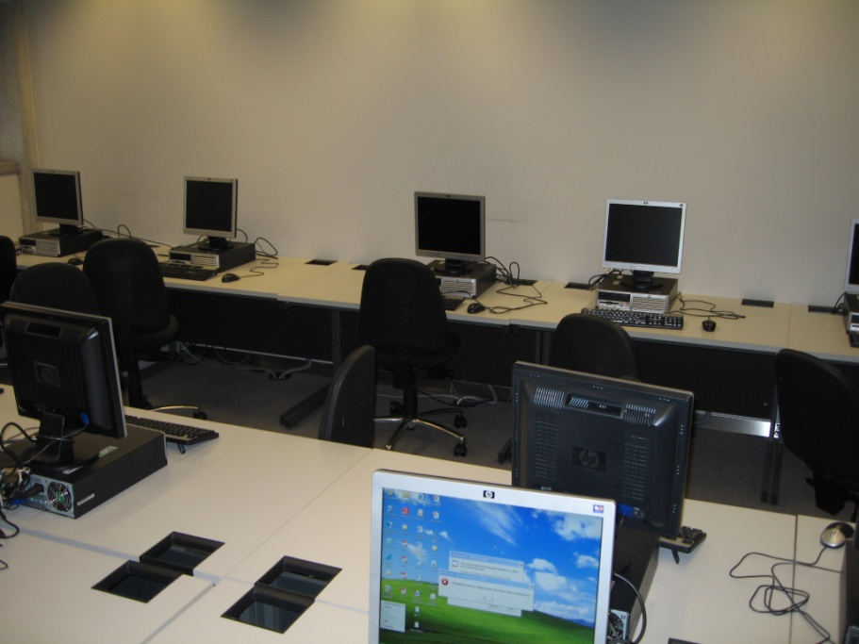
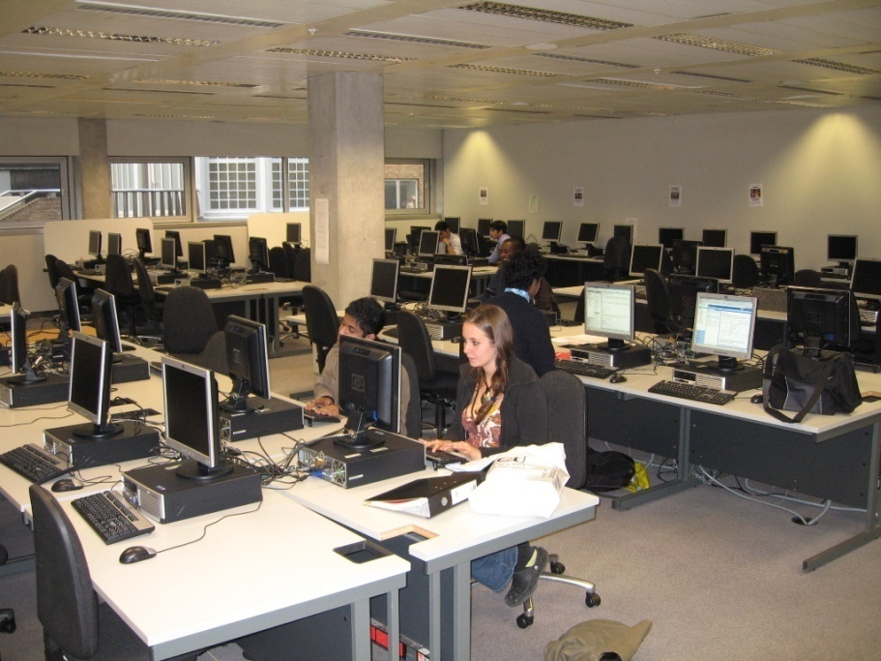
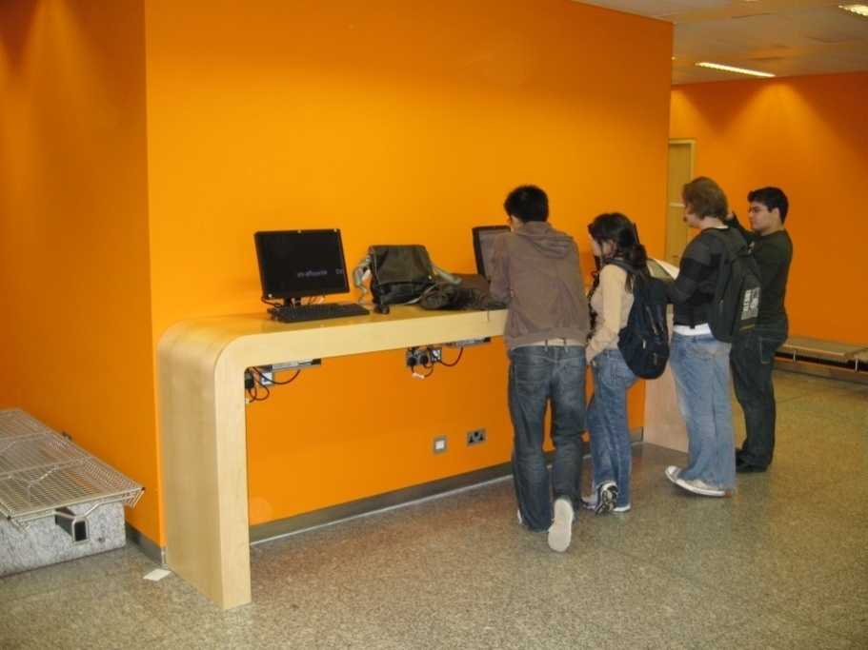
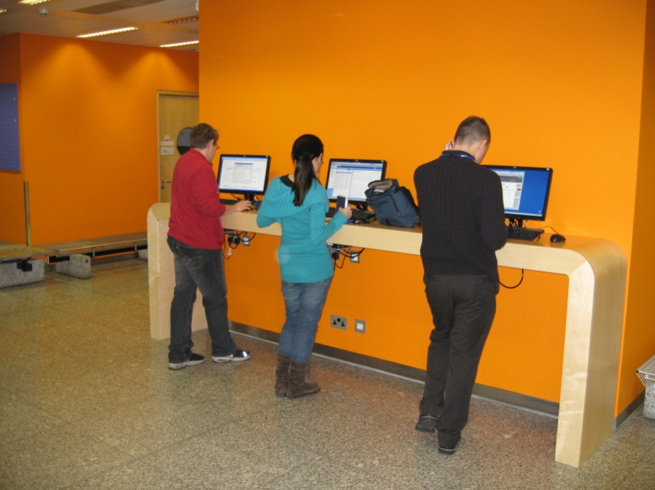
SAFB

Slide 14
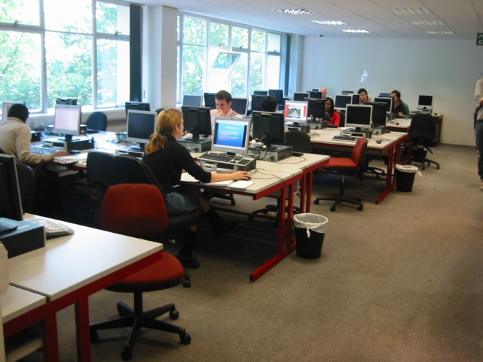
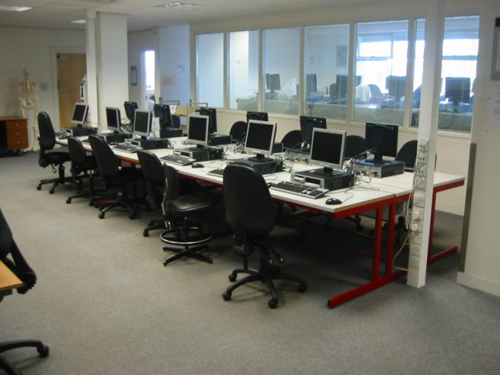
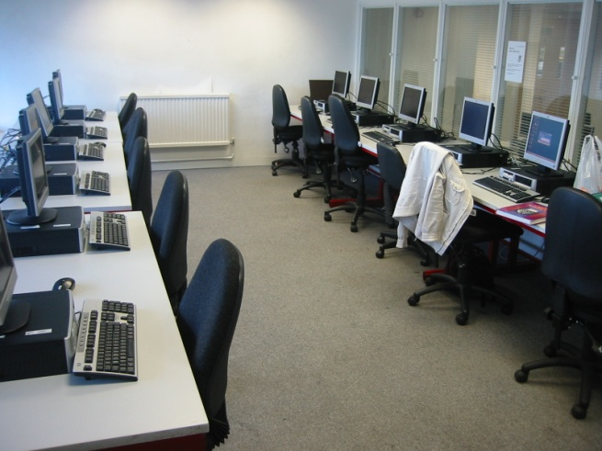
Charing Cross

Slide 15
Food and Drink Policy – PC Clusters
No Food to be consumed in the PC Labs
Keep food items in bags, not on the desk
Drinks – only those from resealable, spill-proof containers, are permitted
1st Offence – Fine = £10
2nd Offence – Fine = £100
3rd Offence – Disciplinary Action!
Fines ⇒ Student Hardship Fund

Slide 16
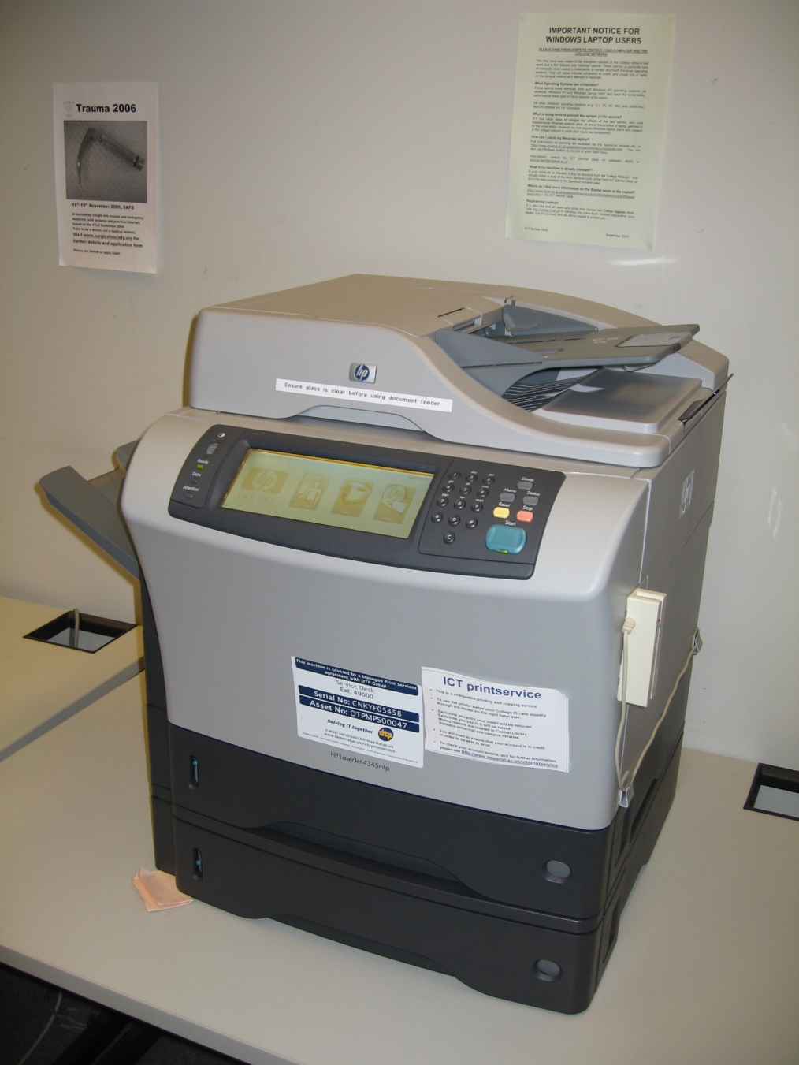
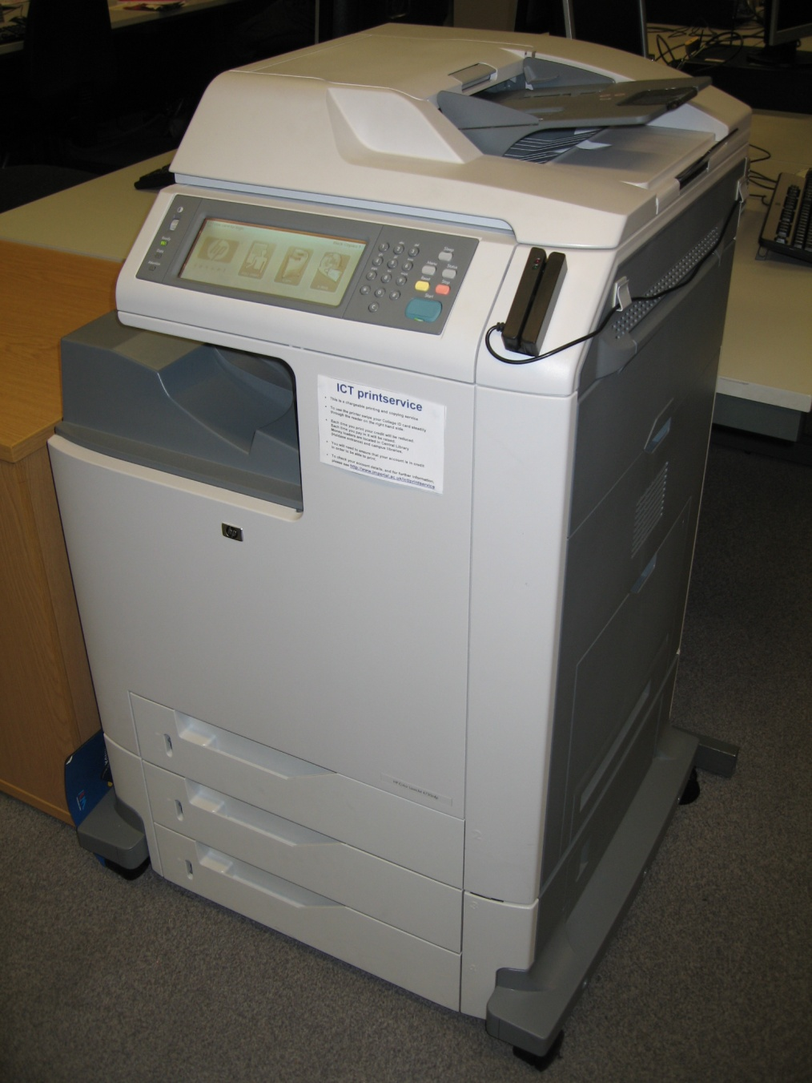
Printers
Mono
Colour

Slide 17
PrintService
PC, Photocopying & Scan to email
Print and Photocopy A4 per side 3p (B&W), 12p (colour)
On-Line credit account using ID Card
Scan to email - Free
How to Print - see IT Course Guide

Slide 18
PrintService Account Credit
You have a starter credit of £5
Maintaining a credit balance will permit you to continue to use the printer/scanner/photocopiers
NO overdraft facility will be provided
Use Value Loader to credit account using cash, (SK Central Library Level 2 & CX Library), or go online
Details may be viewed at any time online http://www.imperial.ac.uk/ict/printservice

Slide 19
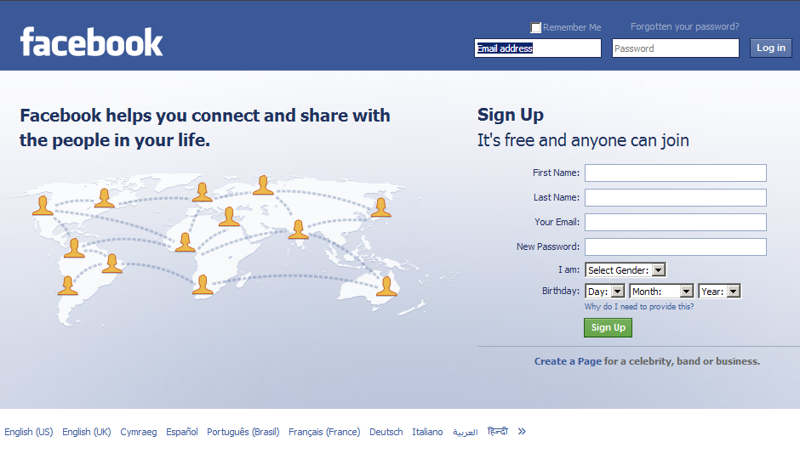
Protect your credibility
future

Slide 20
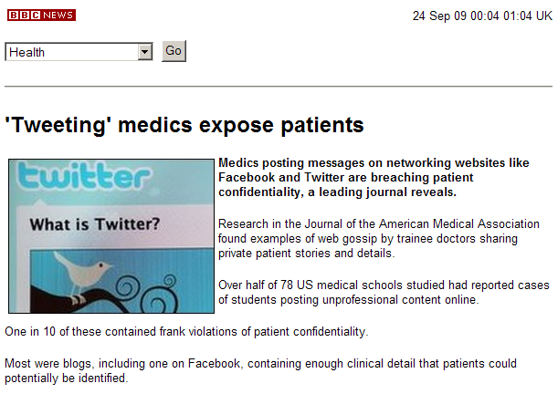
Using social networks

Slide 21
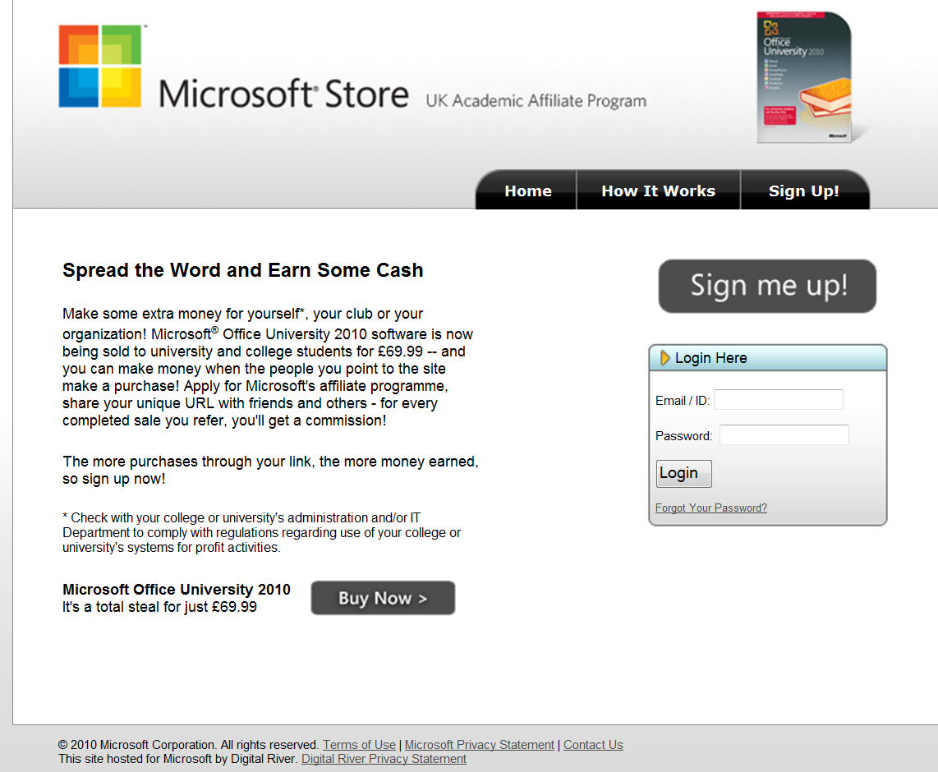
Microsoft Deals for students
https://student.theultimatesteal.co.uk/

Slide 22
Microsoft Deals for students
http://store.digitalriver.com/store/msshgb/en_GB/ContentTheme/pbPage.SHHomePbPage

Slide 23
Quotas
Email: 1Gb
Home Directory 4GB (H: drive)
Backed up nightly
Lost Data can be retrieved up to 3 months later
Previous version of a document can be recovered (right click)
Profile
stored independently of other quotas
Prevent your profile becoming too large
Do NOT save files onto the desktop, use shortcuts
Do NOT save files in “My Documents”
Do NOT use auto-archiving in email without changing the location of the archive files
Warning messages - Act promptly on receipt of any warning, seek help if unsure what to do

Slide 24
Images, Videos & other learning resources
Patients have given permission to be photographed to appear in medical training
Purpose is only for medical education provided by the institution
Rules of Confidentiality still apply
Respect the Copyright of all teaching material you use. Do not pass material on without explicit prior permission.

Slide 25
Mobile Devices
“There’s An App For That”
Imperial College now has a mobile application
Available on
Apple App Store
Android Market
Web Version (e.g. Blackberry etc)
http://www.imperial.ac.uk/imperialmobile
“imperial mobile”

Slide 26
ICT website
Information to new users http://www3.imperial.ac.uk/ict/services/servicesforstudents
FAQ’s http://www.imperial.ac.uk/blog/ictfaq/

Slide 27
What can go wrong?

Slide 28
Protect your reputation
Please use social media systems wisely, and think to your future
Don’t “torrent” copyrighted materials
Follow the College’s rules for use of IT Facilities

Slide 29
Protect your Storage media and Computer
Virus infection (of the digital kind) - Use the College Anti-Viral software and a malware detection and removal programme
Delete only copy of your report - should have made backups
Theft or loss of, PC or storage device - backups in a different place to the PC
Personal Computer is stolen, breaks down and is repaired and data is lost to others - encrypt files with personal identifiers

Slide 30
Careless use of emails
Attempt to bulk email the College’s Global Address Book - harassment
Wrong name@address
Wrong name@address PLUS anti-social message
Defamatory statements about Fred sent to Joe but inadvertently also copied to Fred
Inappropriate/illegal attachments!
Be careful with “Blind copies”
BEWARE of Phishing emails

Slide 31
A few Do’s…
Protect your identity: Choose a strong password and NEVER divulge it. Remember to logoff
Keep your PC secure: OS updates, antivirus software
Keep your data secure: Store files on the H:\ drive, not on Desktop. Use encrypted USB sticks (but some software will not work with corporate PCs). Back up regularly
Protect College’s (and your) reputation: No ‘bad’ Websites (Porn, Extremist, Terrorist, etc.) No ‘bad’ comments about anyone on websites, social networking sites, email, SOLE, discussion boards.
Respect copyright: Do not share or put copyright material on the Web
Avoid bulk Email: so as not to harass recipients

Slide 32
Finally…
Develop a professional approach to the use of IT throughout your studies Foundations of Clinical Practice Course
Stay on the ball in IT patients, and the NHS, expect you to be highly competent
Help is available from your teachers and from ICT staff at the College and main hospital sites

Slide 33
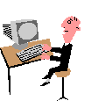
Too Much!
It Works!

Slide 34
Do make best use of the facilities provided
Help us to keep it all working for you
Thanks!

