Slide 1

How can the library help me?
Andrew Regan
Emma Shaw
5 October 2011

Slide 2
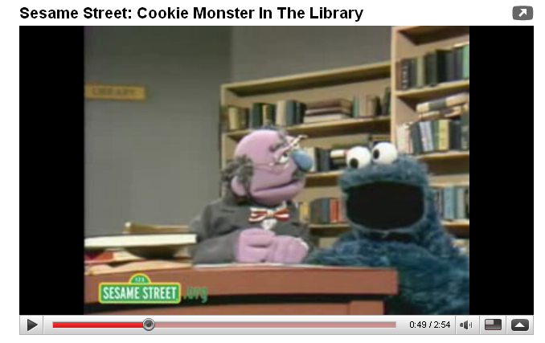
Some library preconceptions, misconceptions, and nostalgia…

Slide 3



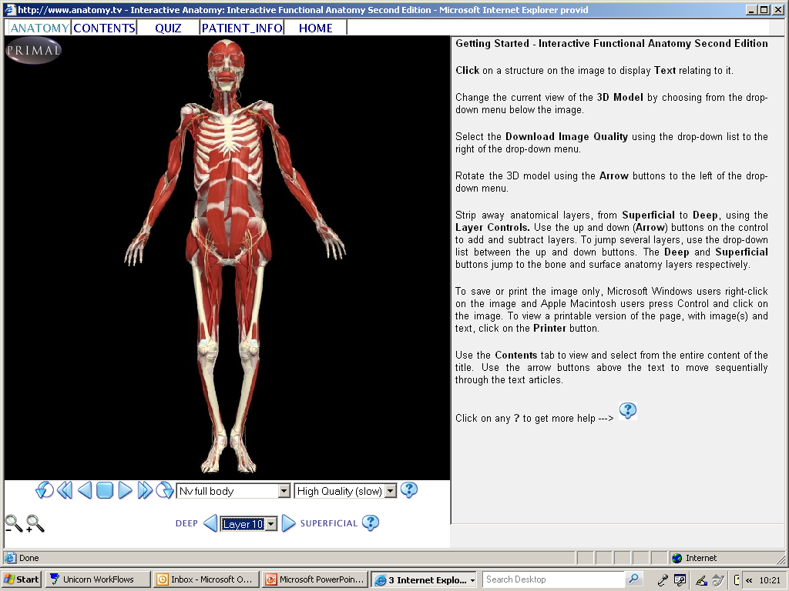
Not Just Books!, Pt. 1
Books! (obviously), journals, and databases
Interactive learning tools like Anatomy TV
Podcasts, RSS feeds, and
The Haldane Collection for DVDS, CDs, and more
…AND…

Slide 4
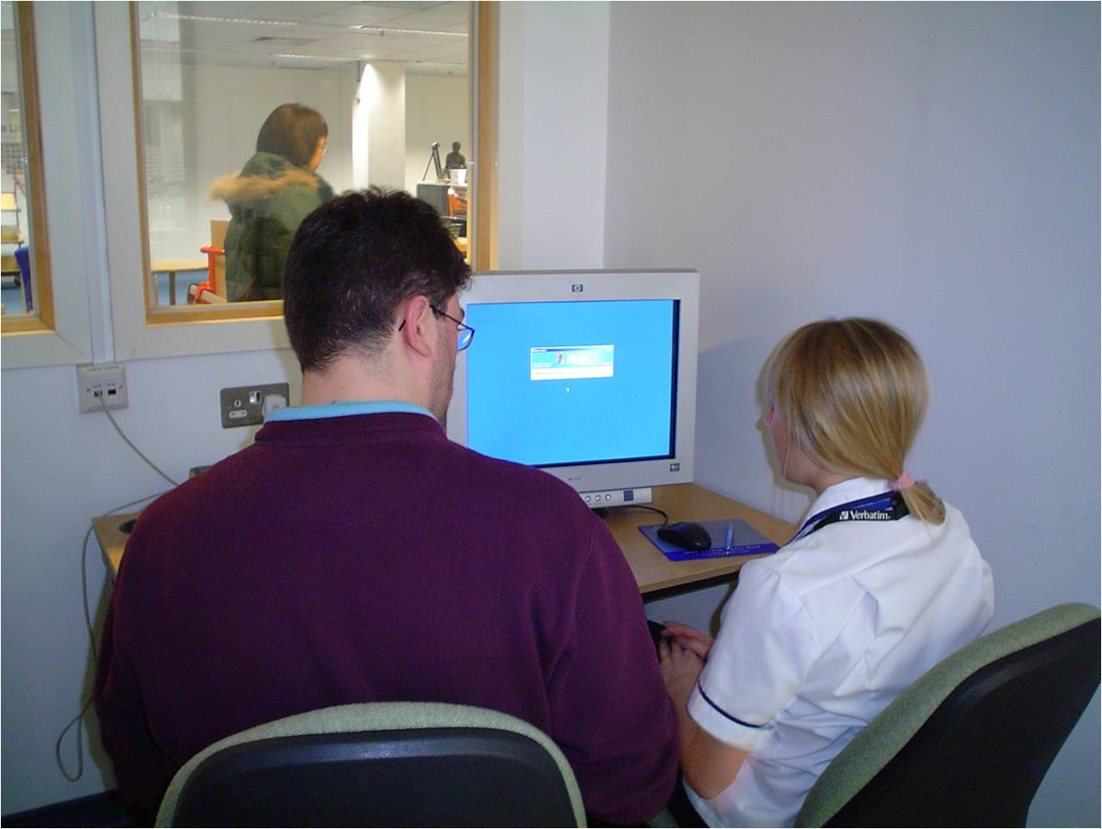
Not Just Books!, Pt. 2
Guidance on plagiarism and academic best practice
Training and advice on all aspects of info retrieval
Critical appraisal skills
Reference management expertise
Bespoke training as and when required
Notes:
4
The library can provide a wide variety of training as needed as well as guidance on referencing and reference management software

Slide 5
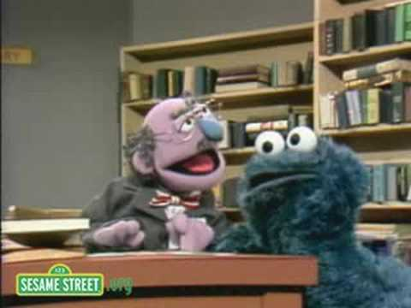

…And all in a friendly manner!

Slide 6
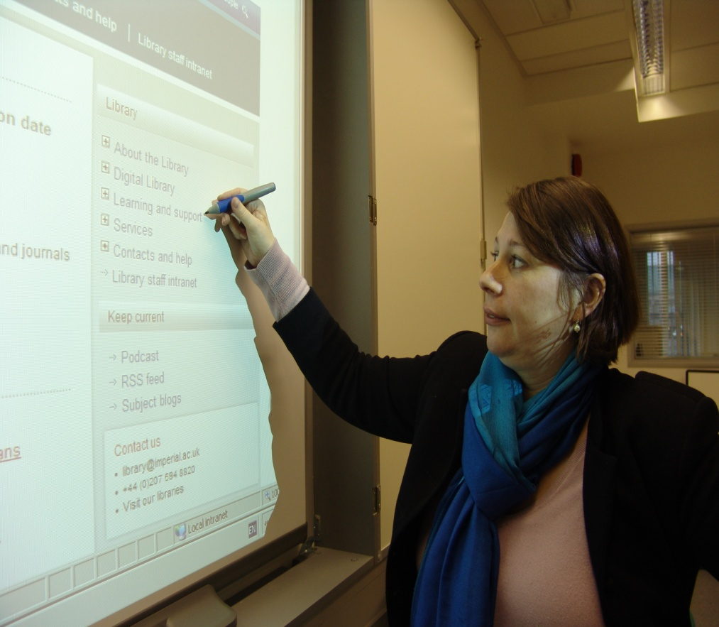
The next 3 weeks…….
Year 1 Workshop 1: Database Searching and Critical Appraisal
Year 1 Workshop 2: Plagiarism and Referencing
Throughout your course: Visit, telephone or email the library. See the library website for contact details: http://www3.imperial.ac.uk/library/getintouch
Notes:
6

Slide 7
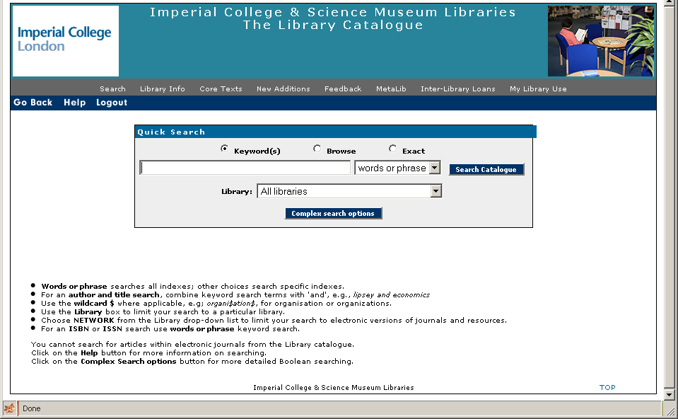
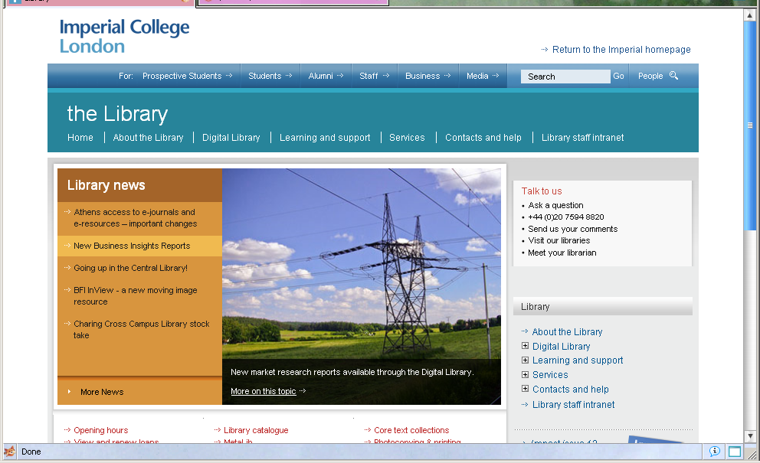
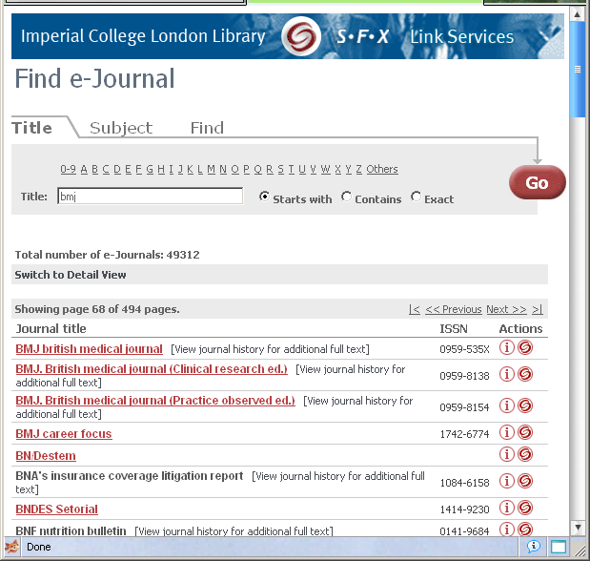
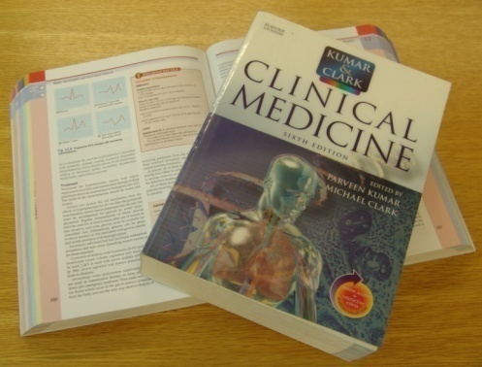
Where can I get started?
http://www3.imperial.ac.uk/library

Slide 8
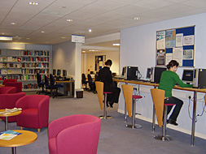
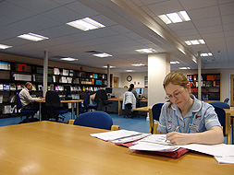
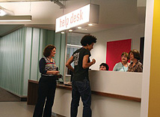
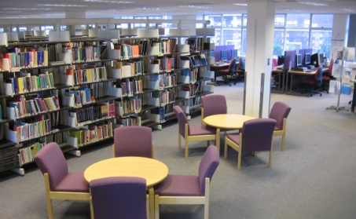
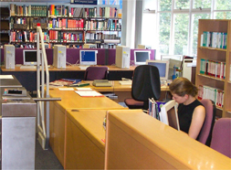
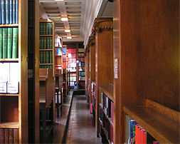
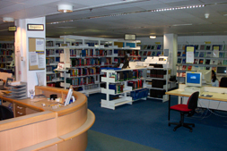
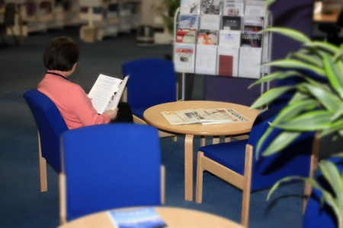
Where is the library?
Royal Brompton Library (NHLI)
Hammersmith Library
Imperial College Libraries
Central library
St. Mary’s
Hammersmith
Charing Cross
Chelsea & Westminster
Royal Brompton (NHLI)
See the library website for details of locations, facilities
and opening hours
http://www3.imperial.ac.uk/library/aboutthelibrary
Central Library, South Kensington
Charing Cross Library
St Mary’s Library
Chelsea and Westminster Library
Notes:
A few practical questions to start with…
As students at IC
Central library at SK
Maps and directions available on Library homepage & leaflets in library
Opening hours do vary so do check the website, but here it’s 9-9 weekdays

Slide 9
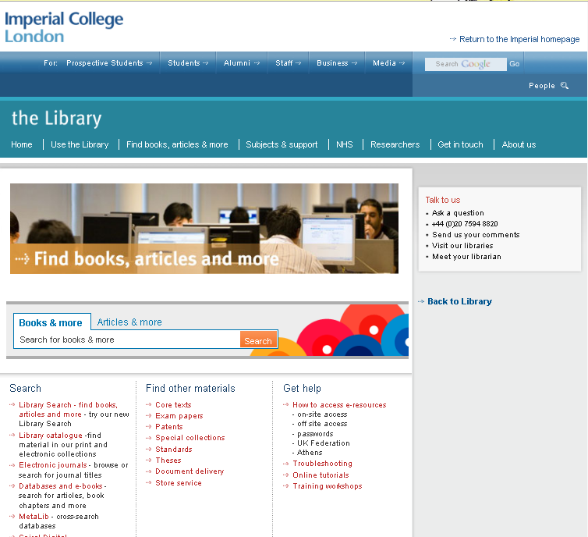

How do I find the book I need?
Notes:
9
You’re in the library and you’re ready to get the book you need and go read it at home. You already have a library card because you can borrow books with your College ID so you can take it out. To find it on the shelf you need to look it up on the catalogue which is on terminals on each floor of the library. You can also use the library search

Slide 10
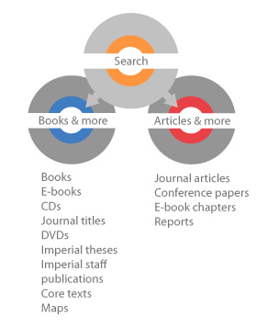
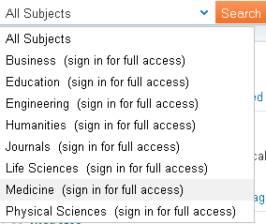
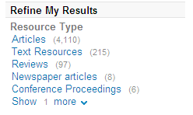
‘Books & More’ vs. ‘Articles & More’
Notes:
You may have noticed that there are two tabs, Books and more and Articles and more. Books and more covers books, ebooks and journal titles e.g. BMJ. Articles and more searches journals at the article level (not just the title of the journal), conference papers, ebook chapters. So you will get a lot more results with articles and more if you are looking for more depth in your search. You can search just medicine resources, and sign in to get access to even more full text. You can also save searches and tag or review items you like.
The Books & more tab finds books, journal titles, e-books, theses, DVDs, maps, CDs and Imperial staff publications from the
College’s digital repository (Spiral). A search using Books and more will take you to both online access and print location information. Click on the library name to show availability information. Books are arranged by a numerical or alphabetical classmark. You will need to make a note of this classmark to find the item on the shelves.
The Articles & more tab searches for journal articles, conference papers, reports and more, many of which are available in
full-text. You can select a subject area from the drop-down menu if you want to focus your search. Our powerful Articles & more
search gives you direct access to thousands of full-text articles. Use Refine My Results to select data by resource type, collection,
publication date and more. To access the full text click on the Online access tab or the SFX tab. SFX shows you the options of how to access your journal titles. Sometimes you can access titles more than one way: First check the year range for each option – if you are looking for a specific issue this is very important.
Whatever you’re looking for just enter a title, keywords, author, etc. in the search box. Filters on the left-hand side of the search
screen help you refine your search. To see different versions of the same title, for example older editions, then click on the view
versions link.

Slide 11
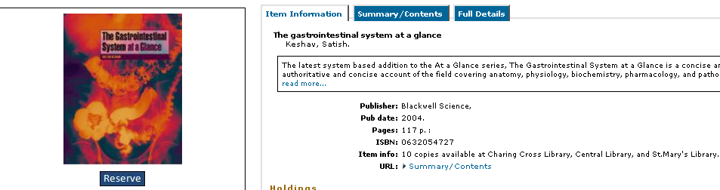
What if there’s no copy on the shelf?
Notes:
11
If all copies at your location were on loan you could place a hold to reserve a copy when it comes back or to obtain the book from another campus. When the book becomes available, the library will email you.
We also have a core text copy of all the books on your reading lists so if all the normal lending copies are on loan the core text copy is available from the issue desk for overnight loan.

Slide 12
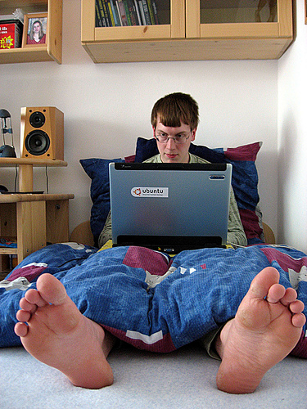
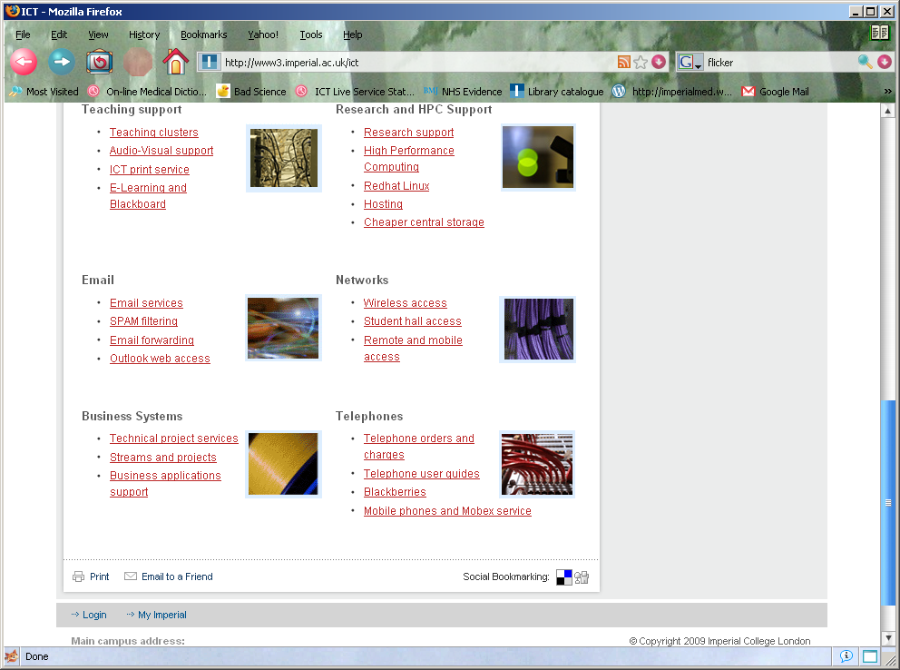
Accessing Library Resources at home
Virtual Private Network (VPN)
http://www3.imperial.ac.uk/ict
Notes:
Library resources can also be accessed from home by either logging into the website, or by connecting to the virtual private network which allows you to connect to you Imperial account from home and thus means you don’t have to keep logging in each time. You can find details on how to set this up by going to the ICT website.

Slide 13
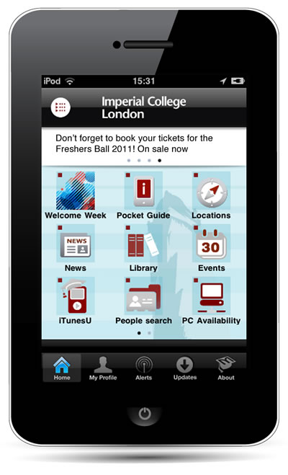
The new Imperial Mobile app
Notes:
On Thursday 22nd September, Imperial Mobile, a new app for smartphones will be available to download onto your iPhone from the app store. It includes content from a number of departments in College including the Library. From the main menu, clicking on Library will take the user to the mobile version of Library Search but we also have a section in the Pocket Guide which includes opening hours, contacts, PC availability, etc. Further information, including details about other phones supported, is available at http://www3.imperial.ac.uk/ict/services/personalcomputersupportandmobileservices/imperialmobile

Slide 14
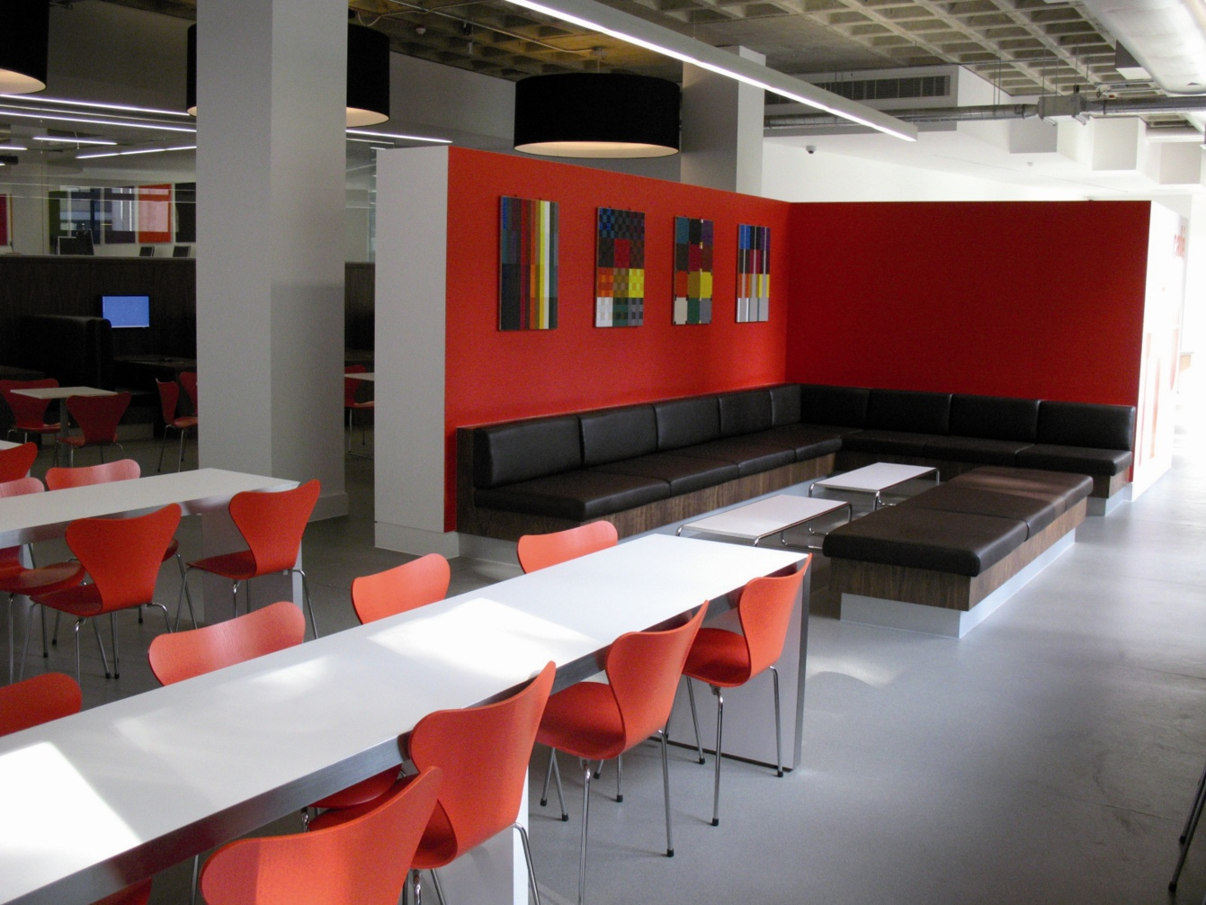
Where can I study?
Notes:
Last year’s students put up with months of building works so that you, this year’s students, could benefit from a new and improved ground floor. There’s now a learning café (seen in this picture) where you can talk and use your laptop and think tanks for group work with big screens. There are group study rooms which can be used to practice presentations. The fourth floor where the medical books are located is a quiet study area.

Slide 15
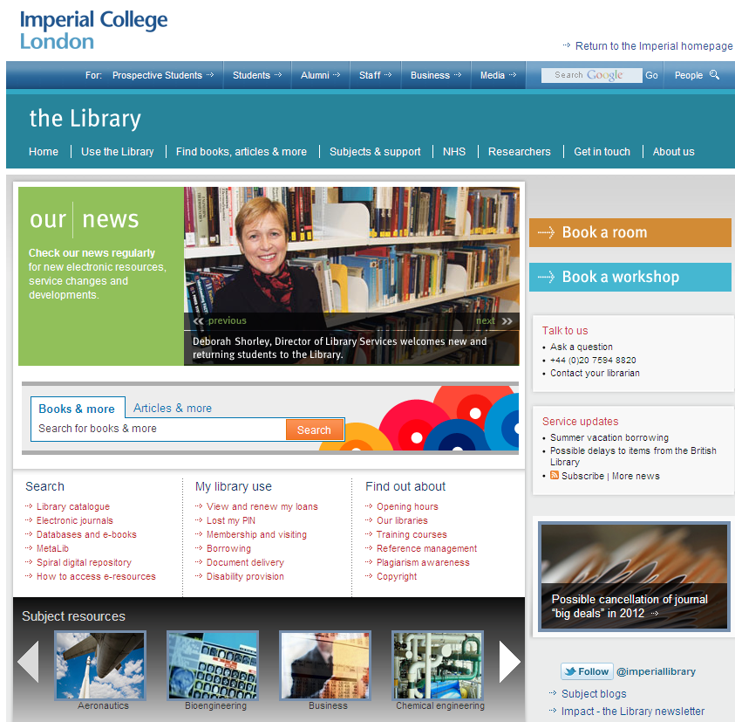
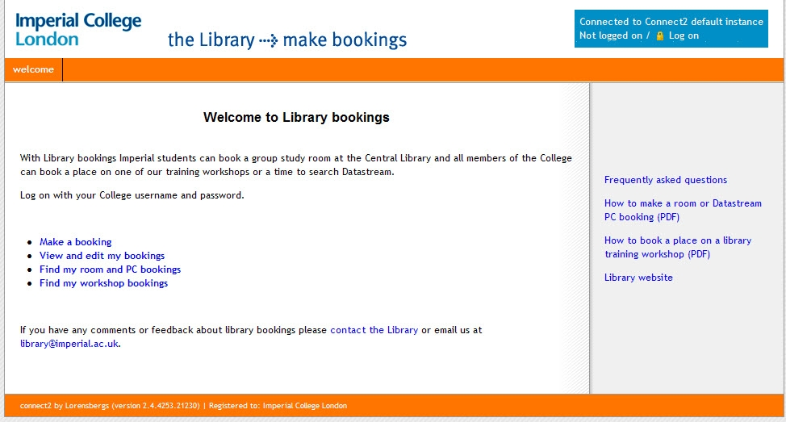
New room booking service
Notes:
The book a room and workshop buttons are now live on the Library website enabling students to book a lunchtime workshop or group study room at the Central Library

Slide 16
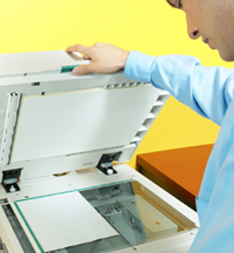
Photocopying, Printing and Scanning
Notes:
Once you’ve found your journal article you’ll need to print it (or photocopy it if it’s on paper). The library provides a photocopying, printing and scanning service, which you can access at any of our libraries. To use this service you’ll need your College ID card, we charge 3p per B&W A4 page for photocopying and printing and scanning is free. The ICT department will automatically provide you with a printing account which you can top-up by adding credit to your ID card at any of our libraries or online.

Slide 17
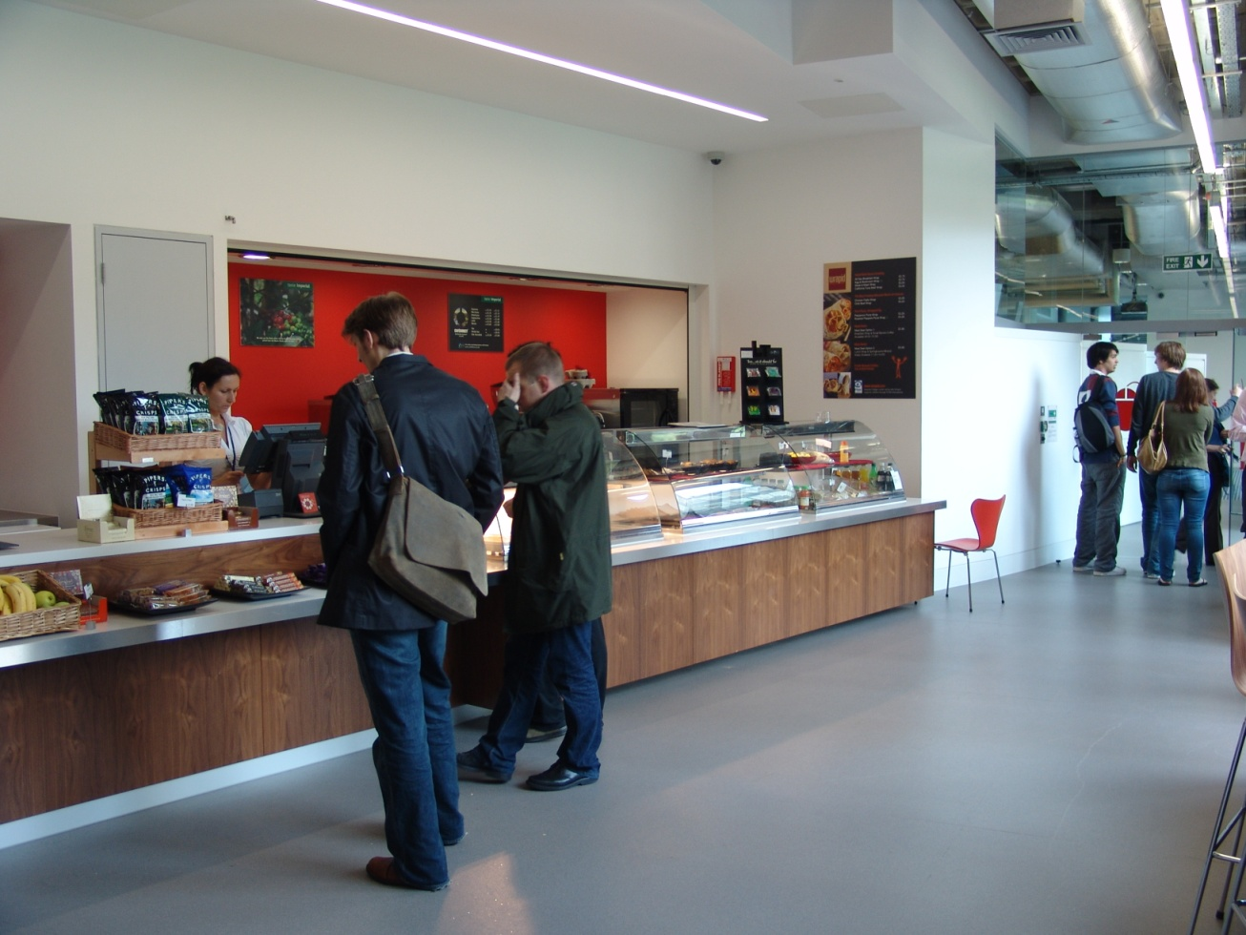


…Even cookies!
Notes:
17

Slide 18
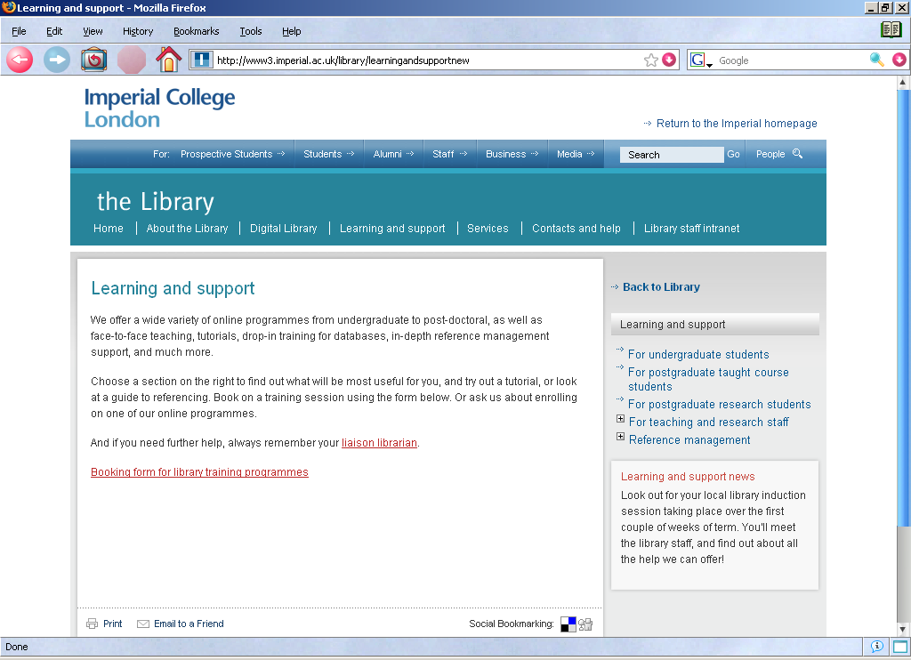
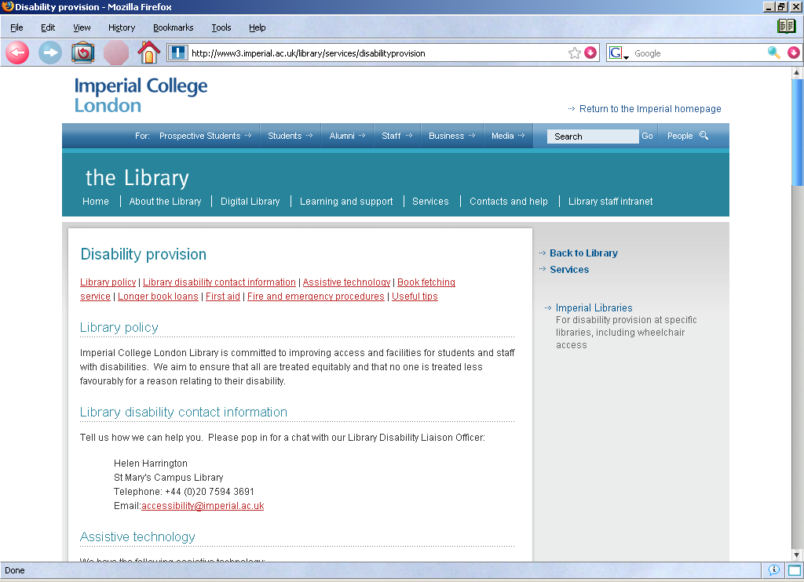
Where to find more information, Pt. 1

Slide 19
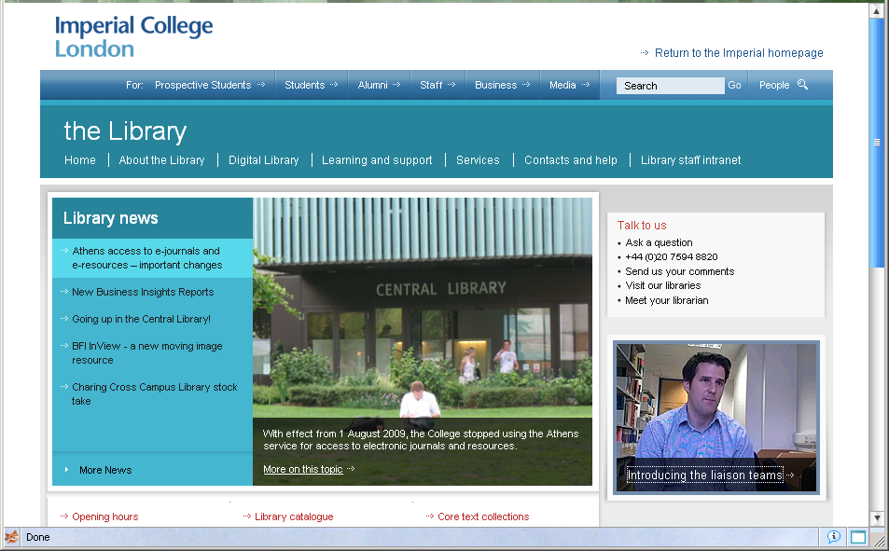
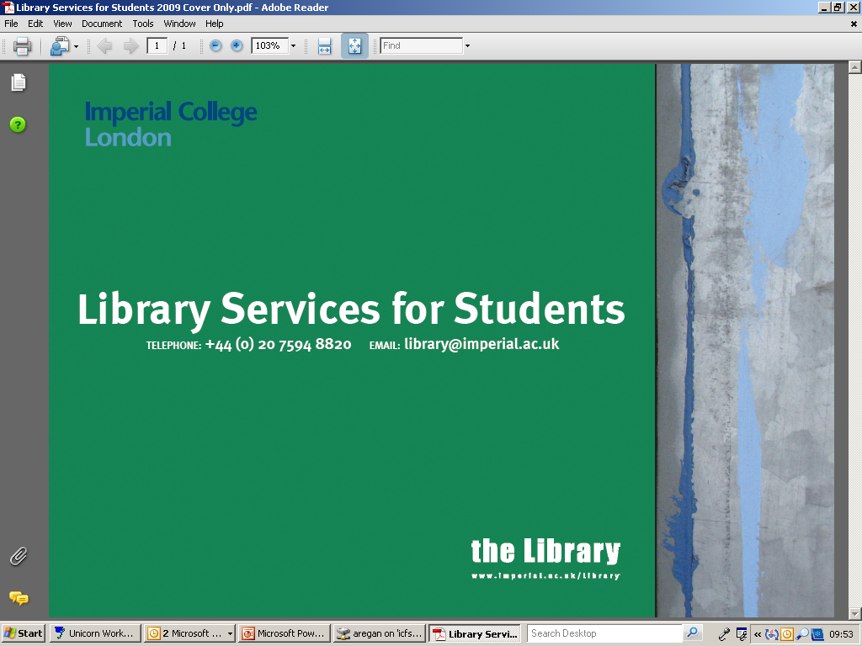
Where to find more information, Pt. 2
Notes:
19

Slide 20

Any Questions?

Slide 21
Credits
Children’s Television Workshop, Sesame Street : Cookie Monster in the Library, accessed via http://www.youtube.com/watch?v=W3ZHPJT2Kp4
Student in bed with laptop, by Pitel, Flickr, 2007 http://www.flickr.com/photos/pitel/507791613/
Imperial College website and images © Imperial College
Cookie Monster, the Metro online, June 25, 2008, http://www.metro.co.uk/news/article.html?in_article_id=191093&in_page_id=34
All other images © clipart.com

