Slide 1
Preparing for your elective - travel health
Claire O’Brien
Occupational Health

Slide 2
Contents
Planning
Screening
Blood Borne Viruses
Vaccines
Malaria
General Travel Health Advice
Screening on return

Slide 3
Planning
USA/ Canada/Australia/NZ Currently the OHS completes forms for individual institutions and we will meet the following requirements: Demonstrate immunity to Measles, Mumps, Rubella Chicken Pox Hep. B Demonstrate you are not infected with TB –Quantiferon (£38) MRSA swabs if required Toxicology tests ( £56.50) | Developing World Info required by OHS: Supply up to date Vaccination hx Country information Travel medicine Databases Vaccinations for elective/ Malaria prophylaxis advice Split Electives The FEO only covers the cost of preparation to 1 elective destination

Slide 4
Blood Borne Virus protection
Primary
- Awareness risk assessment information
Universal precautions
Avoid high risk situations
Safe sharps practice
Safe sex
Secondary
Cleanse
Assess risk
Attend HIV- Post Exposure Prophylaxis (PEP) Talk

Slide 5
HIV Post Exposure Prophylaxis (PEP)
Significant exposure:
Blood/ internal body fluid and
Skin penetration/ mucosal splash/ wound contamination
Treat if significant exposure and source is:
Known HIV positive or
evidence of high risk behaviour or
local sero-prevalence >10%

Slide 6
HIV PEP
Monotherapy- 80% effective
Triple combination therapy more effective
Best if started promptly
28 day course
Rare toxic effects
medical supervision
Common nuisance effects
Drug Interactions are very common

Slide 7
Vaccines
Tropical Africa
BCG
Hep B 5 year Booster
MMR X2
Tetanus Polio & Diphtheria
Hepatitis A
Typhoid
Meningitis ACWY
Yellow Fever
Asia
BCG
Hep B 5 year Booster
MMR X2
Tetanus Polio & Diphtheria
Hepatitis A
Typhoid
Some vaccines are only recommended
for stays of more than 3 months

Slide 8
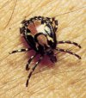
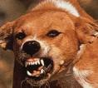
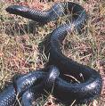
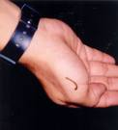
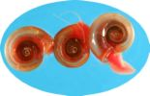
Critters
What’s your bite avoidance strategy?
Notes:
Wear footwear
Don’t encourage /befriend animals
Insect repellent
Mossie nets

Slide 9
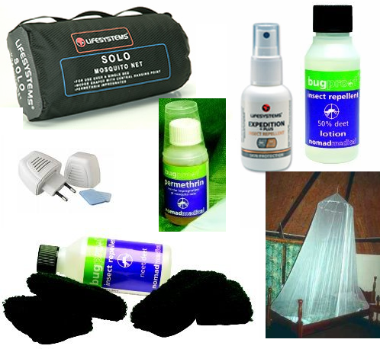
Insect Bite Avoidance
Air-conditioned accommodation
Long-sleeved tops and long trousers
Cover feet
50% DEET most effective
Treat nets & clothing with Prermethrin
Coils are effective for nuisance biting

Slide 10
ABCD of Malaria
Awareness
Bite Avoidance
Chemoprophylaxis
Diagnosis

Slide 11
Malaria Prophylaxis
WHO Malaria map
5 strains of Malaria which we are concerned about but most especially Plasmodium Falciparum
Establish a routine for taking prophylaxis (phone alarm)
Complete course upon return
Observe any fevers/night sweats for 12 months after return
Students cover cost of malaria prophylaxis
Please research and be ready to make a decision about which anti malarial when you attend your OH appointment

Slide 12
Health Protection
Ensure existing medical conditions are well managed
Personal medicines
First aid Kit
Take care to prevent Sun Burn
Consider non vaccine preventable diseases Vector borne diseases
Travellers Diarrhoea
Parasites- Skin /Intestinal

Slide 13
What
Sterile Travel Pack £10
Needles & Syringes
Suture needle & steristrips
Dental needle
IV Giving Set
Gloves
Non adhesive dressings
Assorted Plasters
Paracetamol
Imodium
1% Hydrocortisone
Antihistamine
Dioralyte
Prescription medicines

Slide 14
Screening on return
All students
complete Blackboard health assessment on return
TB exposure
Blood-borne viruses
If concerned re Schistosomiasis contact OHS
Report any significant illness whilst abroad - as a priority
Malaria
Parasite infestation
hospitalisation
Symptoms
fever
Persisting cough
Continuing weight loss

Slide 15
Blood Donation
Before you go
Give serious consideration to how you might respond if asked to donate blood
Recommend not if you have even the smallest doubt about equipment used
Notes:
We have an Ethical Question for you before you go
2 students on returning from elective concerned about BBV exposure having donated blood
unsure about equipment used

